Slide 1
Verifying Applications for Meal Benefits
September 30, 2026

Slide 2
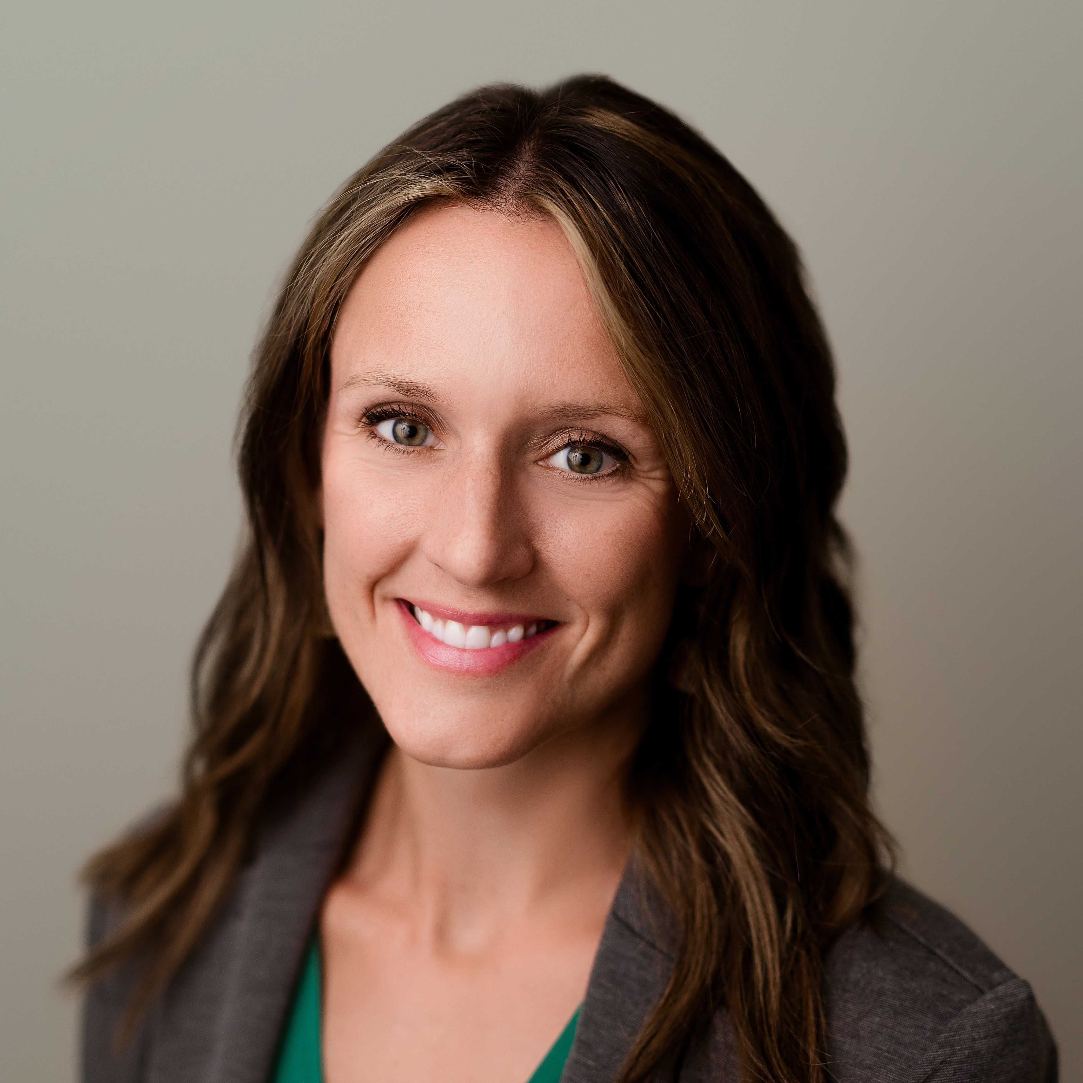

Your Trainers
Kayte Partch
Director, Child Nutrition Programs
Megan Piehl
Nutrition System & Summer EBT Program Specialist

Slide 3
Housekeeping
Please record your first and last names, school name, and email address in the Zoom chat.
We will issue training certificate by email.
Recording will be shared by email and on Nutrition Services website.
Please ask questions! We LOVE questions. Type them in chat or unmute at end of slides.

Slide 4
Objectives
Explain what verification is and does
Identify how to properly select applications for verification
Identify the timeline of required verification activities

Slide 5
Verification of Meal Applications
NSLA and 7 CFR 245.6a(c)(1) schools required to conduct verification for children’s applications that are approved for free or reduced price meals
Applications approved for free or reduced price meals
  SNAP, TANF, FDPIR master case number for household member
  Household income
  Other source categorical eligibility (i.e., migrant, homeless, runaway, Head Start, foster)

Slide 6
Resources
USDA School Meals Eligibility Manual
Nutrition Services Verifying Income Eligibility – training and letter templates

Slide 7
Important Dates
October 1: verification selection pool based on total number of applications approved for free or reduced price meals
November 16: must complete the verification activities and submit annual Verification Report in CNP system
  *Training on completion of the annual Verification Report will be provided on November 5

Slide 8
Key Terms
Direct Verification: Use of records from public agencies to verify children’s eligibility for free and reduced price benefits
Error Prone: Applications within $100 per month ($1,200 per year) of the applicable IEGs
Random Sampling: A sampling process where each application has an equal chance of being selected (determine a selection interval by dividing the number of applications by the required sample size)
Sampling Pool: The total number of applications approved as of October 1

Slide 9
Verification: What and Why
Verify that information submitted on applications approved for free or reduced price meals is true and accurate
Supports program integrity and honesty of information reported by households

Slide 10
Community Eligibility Provision
Do not conduct verification if all schools in district participate in CEP
  Should not distribute applications for meal benefits!
  No requirement to conduct verification on alternate income forms used for non-meal benefits
Do conduct verification if some but not all schools in district participate in CEP
  Verification required for only application approved for free or reduced price meals for students in non-CEP buildings

Slide 11
Community Eligibility Provision
Mixed CEP and non-CEP buildings
  Receive application with student from CEP school and other student at non-CEP school
  This is part of verification pool because student receives meal benefits based on information on application

Slide 12
Establishing Verification Sample
The sample pool uses the total number of applications approved for free or reduced price meals as of October 1
3% of number of approved applications, including paper and electronic applications
Do include: applications with master case number (SNAP, TANF, FDPIR), household income, foster child

Slide 13
Establishing Verification Pool
Example: meal application submitted and approved for reduced price meals
Child appears in direct certification list for SNAP (free meals)
Higher benefit (free meals) issued to student based on direct certification
Not included in verification pool because student benefit from direct certification (not from application)

Slide 14
Establishing Verification Pool
Example: meal application submitted and approved for free meals based on income
Child also appears in direct certification matched for MRED (reduced price meals)
Higher benefit (free meals) issued to student based on application with income
This application IS INCLUDED in verification pool because student benefit was derived from meal application

Slide 15
Summary
If a meal application provides a higher benefit than direct certification, then the meal application becomes part of the verification pool

Slide 16
Categorical Eligibility: SNAP, TANF, FDPIR master case number
Example: application includes SNAP, TANF, FDPIR master case number
  Should be approved upon submission to school
  No proof documentation needed for approval
Application is part of the verification pool if no child on the application is directly certified for SNAP or MFREE
  If any child on the application is also directly certified for SNAP or MFREE, this application is not part of the pool

Slide 17
Other source categorical eligibility applications
Homeless, migrant, or runaway require proof of program participation upon receipt of application in order to receive free meals
Meal benefits for only student with this designation
Child enrolled in the Migrant Education Program as determined by State or local Migrant Education Program coordinator or homeless liaison
  Direct certification

Slide 18
Other source categorical eligibility: Homeless, Migrant, Runaway
Include in verification pool only if did not request/receive proof documentation when application was received
Correctly requesting and receiving proof documentation upon receipt of application = do not include in verification pool
Notes:
Ask Erica

Slide 19
Other source categorical eligibility: Foster
Foster child indicated on application for meal benefits can be processed without supporting proof at time of approval
Example: foster student on application and no other children; application approve for free meals
Application with child receiving free meals based on foster status should be included in verification pool and if selected must provide proof of foster status

Slide 20
Mixed Household Applications
Example: foster child living with three students who qualify for reduced price meals based on household income
Because three students receive reduced price meals based on household income, must be in verification pool
Proof of foster status must be requested if application is selected for verification
*in this case, you must request two different types of proof

Slide 21
Included in verification pool | Not included in verification pool
Application with master case number for SNAP, TANF, FDPIR and no child on application directly certified for SNAP, MFREE | Student submitted application and is directly certified for the same or higher meal benefit through SNAP, MFREE, MRED, migrant, homeless, runaway, foster
Application submitted with income and approved for free or reduced price meals | Student submitted application and lives with student directly certified for the same or higher meal benefit through SNAP, MFREE, MRED, migrant, homeless, runaway, foster
Application with migrant, homeless, runaway marked and did not request/receive proof documentation when processed | Application with migrant, homeless, runaway + school received proof documentation used to process/approve application upon receipt
Application with foster student indicated and not directly certified; foster application reported income, too | Application with foster student that is directly certified for same or higher meal benefit

Slide 22
Verification For Cause
Separate from the required verification random sample of application
Schools must verify all questionable applications on a case-by-case basis
Not included in the random required sample of approved meal applications
Cannot delay the approval of applications; begin verification process only after the determination has been made

Slide 23
Verification: Standard vs Alternate
Standard Sample Size
Standard | 3% of all application approved by the school as of October 1 of current school year, selected from error-prone applications
Alternate Sample Sizes for Qualified Schools
Alternate One | 3% of all application approved by the school as of October 1 of current school year, selected at random

Slide 24
Establishing Verification Type
Question: Did your school have a >20% non-response rate to requests for verification in preceding school year?
Answer: YES – must conduct standard verification method
Answer: NO – your school may conduct alternate 1 verification method

Slide 25
Establishing Verification Type
Question: Was your school’s non-response rate in preceding school year <20%?
Answer: YES – may conduct alternate 1 verification method
Answer: NO – your school must conduct standard verification method

Slide 26
Verification Type
NDE will provide communication to every school identifying the required type of verification based on results from preceding school year

Slide 27
What is Non-Response Rate?
In preceding school year…
Approved 50 applications for F/R meals
3% of 50 = 1.5 round up to 2 applications must be verified
2 requests for verification were sent and only 1 was returned
Determine non-response rate: 1 (no response) ÷ 2 (requests for verification = 50% non-response
This school MUST conduct standard verification process in current school year

Slide 28
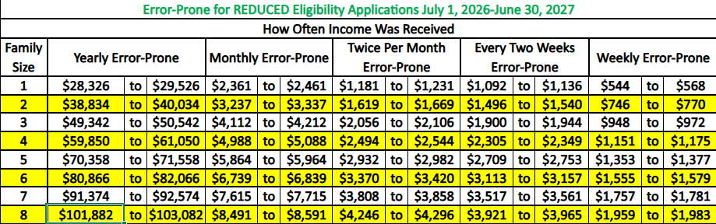
Standard Verification Method
3% sample of error-prone meal applications
  Error-prone: income reported within $100 of the monthly income limit (or $1,200 of the annual income limit) for their household size

Slide 29
Standard Verification Sample Size & Type
Approved 50 applications for F/R meals
  20 applications had income within $1,200 of the annual income limit for their household size (aka “error prone”)
Step 1: 3% of 50 = 1.5 round up to 2 applications
Step 2: randomly select 2 applications from the 20 that are “error-prone”

Slide 30
Standard Verification Sample Size & Type
Approved 15 applications for F/R meals
  1 application had income with $1,200 of the annual income limit for their household size (aka “error prone”)
Step 1: 3% of 15 = .45 round up to 1 application
Step 2: select the 1 “error-prone” application
  - If no “error-prone,” randomly select from pool of approved applications

Slide 31
What if not enough error-prone applications for 3% sample?
If fewer “error-prone” applications were approved than are required for the 3% verification sample:
  Select all error-prone applications, and
  Randomly select from remaining approved applications to verify minimum requirement

Slide 32
Alternate Verification Method
Sample size equals the lesser of:
  Three percent of all applications approved by district for the school year, as of October 1, selected at random; or
  3,000 applications approved by the LEA for the school year, as of October 1 of the school year, selected at random.

Slide 33
Alternate Verification Example
0% non-response rate in preceding school year
Approved 15 applications for F/R meals
Step 1: 3% of 15 = .45 round up to 1 application
Step 2: randomly select 1 application approved for F/R meals (does not have to include any “error-prone” applications)

Slide 34


Before Notification to Households
Ensure your school’s confirming official has reviewed, signed, and dated all selected applications to certify the meal benefit on each application was determined correctly
Jamie Morales
10/1/XX
Notes:
3. Complete the verification process by randomly selecting your 3% sample from all applications you've received as of October 1
**Select from Error Prone applications if completing Standard Verification-These are meal applications with annual income reported within $100 per month of the applicable Income Eligibility Guidelines.
4. Ensure your school’s confirming official has reviewed, signed, and dated all selected applications to certify the meal benefit on each was determined correctly....Confirming Official Should be someone different than Determining Official

Slide 35
Verification Notification & Reminders
1. Send verification selection letter – Attachment F
  Must inform in writing and identify documents household should submit to the school
  Understandable and uniform format and must provide written verification notices in the parent’s/guardian’s primary language
  Detailed requirements page 106 Eligibility Manual
2. Must make at least one follow-up attempt before submission deadline

Slide 36
Income Verification
Proof of income including name of the household member, amount and frequency of income received, and date the income was received
  A pay stub with no dates is not sufficient
Income proof should be from time period immediately preceding submission of application, the month application was submitted, or any month after submission of application

Slide 37
Income Verification
If a weekly pay stub is representative of what the household normally receives each week, one pay stub is sufficient.
If paystub includes overtime, determining official should work with the household to determine whether the overtime for the month being verified is representative of overtime received in other months.
  If overtime is a one-time or sporadic source of income, income should be calculated based on the regular monthly income without overtime.

Slide 38
Verifying Zero Income
If selected application with zero income, the school must request an explanation of how living expenses are met
  May request additional written documentation or collateral contact

Slide 39
Collateral Contact
If written evidence is no sufficient, may require use of collateral contact(s)
A person outside of the household knowledgeable about the household’s circumstances and can confirm income level, participation in Assistance Programs, Other Source Categorical Eligibility Programs
All information provided by collateral contacts (written or oral) must be documented, dated, and initialed

Slide 40
Post-Notification Procedures
Must provide least one reminder for verification before deadline
Phone call, email, letter reminder

Slide 41
Verification is Complete
Household responds with requested information
  Benefit change or no change
Phone call indicating will not provide requested information counts as a response
Did not respond with required information by deadline
Verification Results Letter – Attachment G to all selected

Slide 42

Document Verified Applications
Sign Verified Applications
Jamie Morales
10/1/XX
10/15/XX

Slide 43
Reduction in Benefits
Must notify household of any reduction in benefits
Must inform of their right to reapply for benefits at any time
If benefits are decreased, a notice of adverse action/change of benefits must be sent
  Provide 10 days advance notice to households prior to the actual reduction or termination
Attachment G

Slide 44
Record Retention
Keep all approved applications
All documents submitted by the household, any notes or correspondence, date of submission
Use NDE’s Verification Tracker form Attachment H-2 for each application verified
Civil Rights Summary – Attachment H-1

Slide 45
What’s Next
Complete verification report in CNP
Training for report completion coming on November 4 and November 13
Report is due November 15
  Can request one-month deadline extension
  More info will be provided via email & in training

Slide 46
Questions

