Slide 1
School Stability for Children in Foster Care
Fostering Connections Act • ESSA • Best Interest Determinations
A practical overview for school leaders and child welfare partners

Slide 2
School Stability
Children in foster care often experience much higher levels of residential and school instability than their peers. When children in foster care change schools, they can lose:
Academic progress
Class credits
Educational services
Close and meaningful relationships with friends
Natural supports (trusted adults like teachers, counselors, or coaches)
Extracurricular activity involvement

Slide 3
Fostering Connections Act: the starting point
The Fostering Connections to Success and Increasing Adoptions Act of 2008 strengthened federal child-welfare requirements around safety, permanency, and well-being.
It made educational stability part of foster-care case planning and placement decision-making.
At placement, the goal is to keep the child in the school in which the child was enrolled unless remaining there is not in the child’s best interest.
When a school change is necessary, the child should be enrolled promptly and educational records transferred.
The Act also established a federal framework for supporting transportation to the school of origin.

Slide 4
How ESSA strengthened the framework
Every Student Succeeds Act (2015) placed specific educational-stability duties on State Educational Agencies (SEAs) and Local Educational Agencies (LEAs).
SEAs and LEAs must work with child welfare agencies to minimize school changes for students in foster care.
Students in foster care should remain in their school of origin unless a BID determines another school is in their best interest.
When a school change is appropriate, the new school must immediately enroll the student—even when customary enrollment documents are not immediately available.
LEAs receiving Title I, Part A funds must develop transportation procedures with child welfare partners for students who remain in their school of origin.
These requirements apply to students in foster care statewide, not only to students attending Title I schools.

Slide 5
From federal law to school practice
Fostering Connections: educational stability is part of child-welfare case planning and placement decisions.
ESSA: LEAs (Local Education Agencies) have explicit responsibilities for school of origin, BID, immediate enrollment, collaboration, and transportation procedures.
School of origin: a new foster placement does not automatically mean a new school.
Core principle: placement changes should not automatically become school changes.

Slide 6
What is a Best Interest Determination (BID)?
A BID is a structured, student-centered decision process used to determine whether a child should remain in the school of origin or attend another appropriate school.
A BID is conducted for youth entering foster care and youth who are state wards when circumstances may affect their educational placement
The purpose of a BID is to promote educational stability, continuity, and positive outcomes for the youth
Decisions are made by a multidisciplinary team that includes representatives from DHHS, the school district, the youth and family (when appropriate), and other key partners.
The BID process evaluates whether remaining in the school of origin or changing schools will best support the youth's overall well-being and long-term success.
Educational stability is presumed to be beneficial unless there are factors indicating that a different school placement better serves the youth's needs.
The youth's voice, family connections, cultural considerations, and community supports should be considered during the decision-making process.
*Transportation cost should not be the deciding factor in whether the school of origin is in the child’s best interest.
** BIDs are only for students in foster care, not probation unless the student is in foster care and on probation.

Slide 7
Who is on the BID team?
For a Best Interest Determination (BID) Team, particularly for systems-involved youth, consider including representatives who can provide information about the youth's safety, permanency, well-being, educational needs, and family supports:
Youth (when developmentally appropriate and able to participate)
Parent(s), guardian(s), or legal custodian
Case manager/service coordinator (facilitates the BID process and documents recommendations)
Child welfare representative (if involved)
Probation officer or juvenile justice representative (if involved)
School representative (administrator, counselor, social worker, McKinney-Vento liaison, or special education representative, as applicable)
Behavioral health provider (mental health therapist, psychiatrist, substance use provider, etc.)
Medical provider (when health needs are a significant factor)
GAL/CASA or youth's attorney (if appointed)
Tribal representative (when applicable, including ICWA considerations)
Foster parent, kinship caregiver, or current placement provider
Community-based service providers involved with the youth or family
Independent living or transition specialist (for older youth)
Cultural, linguistic, or natural supports identified by the youth and family
Other subject matter experts as needed based on the youth's unique circumstances

Slide 8
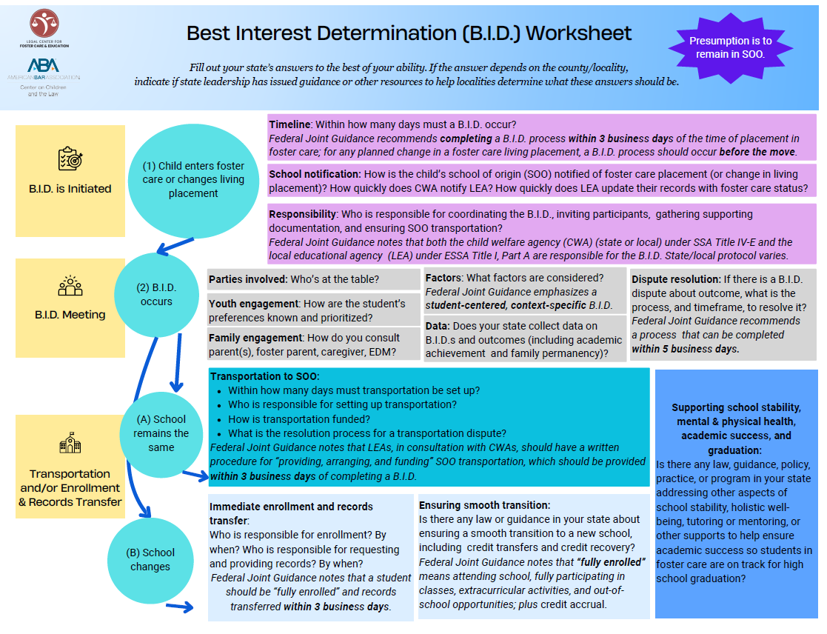
Best Interest Determination Worksheet

Slide 9
BID Form

Slide 10
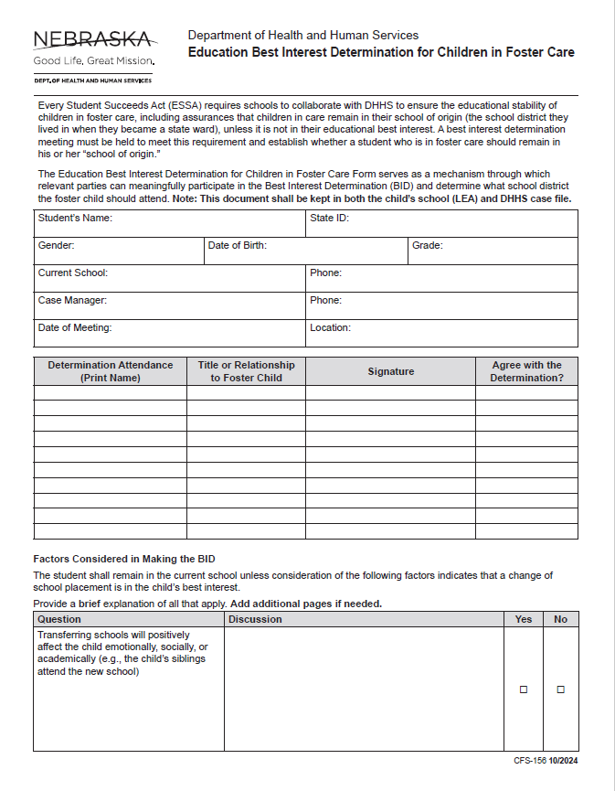
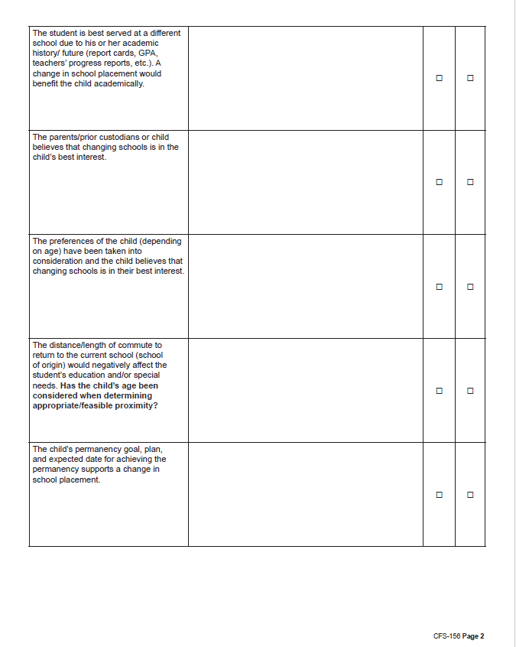

Slide 11
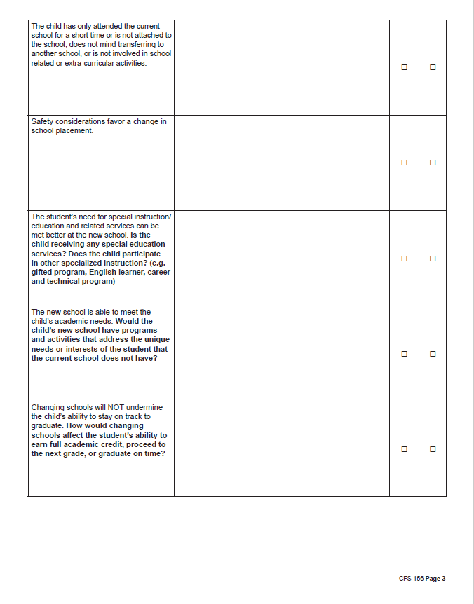
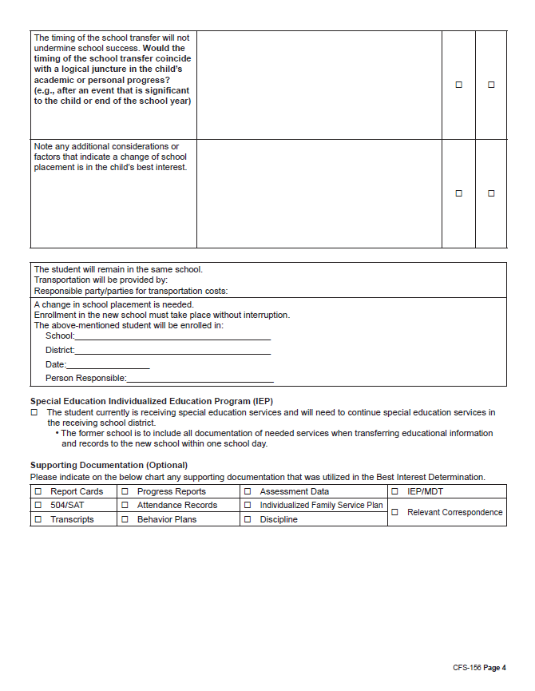

Slide 12
School + DHHS collaboration: what good coordination looks like
DHHS: communicate placement changes promptly, identify the caseworker and relevant decision-making authority, and bring child-welfare information to the BID. This can be done by alerting schools immediately with a Superintendent letter.
School: provide timely information about educational appropriateness, progress, services, relationships, credits, attendance, activities, and the impact of a potential move.
Together: establish a predictable process for BID meetings, transportation, immediate enrollment, records transfer, and dispute resolution.
If a school change is appropriate, enroll promptly and obtain records from the school of origin; if the child remains, implement the transportation plan.
Use secure, appropriate channels for student information and follow FERPA, child-welfare confidentiality, and applicable state requirements.
BID meetings should be a shared responsibility between DHHS and school districts, with the agency identifying the concern taking the lead in convening the team while both parties actively participate in the decision-making process.

Slide 13
Best Practices for Conducting a Best Interest Determination (BID) meeting
Clearly define the purpose and decision to be made.
Include the youth, family, and key stakeholders.
Ensure all participants have relevant information before the meeting.
Center the youth's voice, strengths, and preferences.
Review safety, well-being, permanency, and educational factors.
Consider all viable options and their potential impacts.
Focus on the youth's best interests over system or agency preferences.
Seek consensus while documenting differing viewpoints.
Consider cultural, linguistic, and family connections.
Document the decision, rationale, action steps, and follow-up plan

Slide 14
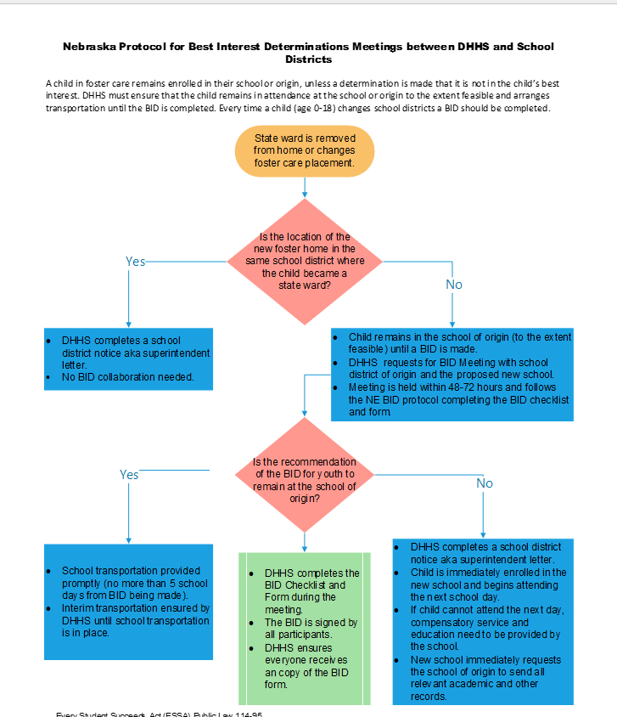
Nebraska BID Protocol

Slide 15
Transportation Requirements
LEAs must provide assurances that they will collaborate with DHHS to:
  Develop and implement clear written procedures for how transportation will be provided, arranged and funded for the duration of time in foster care
  Procedures must ensure that children will promptly receive transportation in a cost-effective manner in accordance with the Fostering Connections Act
  Transportation is an allowable use of federal funds, both under Title IV-E of the Social Security Act and Title I of the ESEA.
  All funding sources should be maximized to ensure costs are not unduly burdensome on one agency
  LEAs and Child Welfare Agencies (CWAs) should work together to agree on costs
    Transportation procedures should include a dispute resolution process if parties can’t come to agreement
  A child must remain in his or her school of origin while any disputes regarding transportation costs are being resolved

Slide 16
Immediate Enrollment
If it’s not in the child’s best interest to stay in his or her school of origin, the student must be immediately enrolled in the new school, even if the child is unable to produce records normally required for enrollment
The enrolling school shall immediately contact the school last attended to obtain relevant academic and other records
A child can’t be denied enrollment because they don’t have proper documentation
Child should also be attending classes and receiving appropriate academic services

Slide 17
Superintendent letters
A DHHS Superintendent Letter is an electronic notification to the school district about a child’s status or a change affecting the child’s involvement with the child-welfare system.
  Provides information to school districts about youth who have been removed from the home and placed in foster care.
  Serves as an important document for school enrollment.
  Often includes foster parent information, biological parent information and DHHS case manager contact information.
  When appropriate, indicates a change in case worker name and contact information.
  Helps facilitate communication between the school district, DHHS, placement provider, foster parent, biological parent and educational decision maker.
  This letter provides important status information. It should not automatically be treated as a substitute for a BID, a court order, or a separate residency determination.

Slide 18
Not all Superintendent Letters are the same
Status / placement: entry into DHHS-CFS legal custody; change of school district because of placement; change of placement within the same district; no longer a State ward; new school year status update.
Other notifications: YRTC admission/release; change in parental education decision-making rights / surrogate-parent status; parent rights relinquished or terminated by court; change in assigned DHHS case manager.
Example: a placement-change letter should trigger an educational-stability review/BID, not an automatic school change.
Example: a decision-making letter should prompt the school to confirm who has authority to participate in educational decisions.
Key point: the letter tells the district what changed. The school still needs to determine what educational action is required.

Slide 19
How BIDs intersect with Residency Determinations

Slide 20
Why Determining Residency matters with Systems involved youth
Systems involved youth: any youth under the jurisdiction of juvenile court (foster care and probation)
There are funding implications and this impacts highly mobile youth
Special Education considerations: the resident district is ultimately responsible for the youth’s IEP.
Disputes cause delays in enrollment.
Education is disrupted if the student is not enrolled immediately.

Slide 21
Nebraska Legal Framework for Residency: §79-215
A student’s residency is generally based on the residence of their parent or legal guardian when they become a ward
Residency may change when a student under jurisdiction of juvenile court or DHHS is placed outside the home through court action, state agency involvement or other qualifying circumstances
The student’s living arrangement, legal custody status and educational placement must all be considered
The goal is to ensure students receive uninterrupted access to education while complying with state law

Slide 22
State Ward/Court Ward Placed in a District Other than where they live
If a student becomes a ward of the state or the court and is placed in a school district different from where they lived when they became a ward and they do not live in a licensed/approved foster family home, then:
    The state pays the education and transportation costs to the receiving district (where they were placed, but not in advance) and
    The student remains a resident of the district where they lived at the time they first became a ward

Slide 23
Wards living in a Foster Family or Approved Home
If the student does live in a licensed/approved foster home
  They are generally considered a resident of the district where they lived when they became a foster child, unless court proceedings (under §43-1311 or § 43-1312) determines they will not attend that district. CFS holds the right to place children safely outside the district where they lived.
  If such a determination is made, then the student is deemed a resident of the district where the foster home is located.

Slide 24
Simplified Residency for Wards
Resident Determination handout

Slide 25
NDE support around residency
For any questions related to determining residency, contact NDE at:
NDE.SIY@Nebraska.gov
Include student’s name, DOB and Student ID
Provide a summary of the student situation
Add as much detail as possible that is aware to school to assist in determining residency.
This is for youth in foster care and probation.

Slide 26
Key takeaways
School stability matters for children in foster care
  Educational stability should be considered as part of every placement decision.
Start with the school of origin
  Consider whether remaining in the school of origin is in the student’s best interest before making a school change.
Center the student
  The student’s voice, relationships, educational progress, services, activities should inform the decision.
Schools and DHHS must collaborate
  Timely communication and shared and shared information are essential to making educational-stability decisions and supporting the student.
Residency disputes should not become barriers to educational access.
  When questions arise, schools can seek support at NDE.SIY@nebraska.gov
The goal is continuity. Every transition should protect the student’s education, relationships, services, credits and sense of connection to school whenever possible

Slide 27
Helpful Resources
NDE’s Website for support around Systems Involved Youth
www.education.ne.gov/siy/
Centralized email for Residency support: NDE.SIY@Nebraska.gov
Find helpful links to federal guidance
  Fostering Connections Act
  NDE ESSA Brief
Find all forms related to Best Interest Determinations
  Worksheet
  Check list
  Workflow

Slide 28
Agency contacts
Department of Health and Human Services (DHHS)
  Angela Miles, DHHS Administrator, Children and Family Services: Angela.D.Miles@nebraska.gov; 402-432-8022
  Kerrin Packard, DHHS Children and Family Services Program Specialist; Kerrin.Packard@nebraksa.gov; 402-619-3367
Nebraska Department of Education (NDE)
  Wendy Schardt, Director of Systems Involved Youth: Wendy.Schardt@nebraska.gov; 531-363-4734
  Alyssa Moore, Registrar: Alyssa.Moore@nebraska.gov: 402-326-3084
  Angela Miller, Registrar: Angela.Miller@nebraska.gov:

Slide 29
Primary sources & Nebraska resources
U.S. Department of Education, Non-Regulatory Guidance: Ensuring Educational Stability and Success for Students in Foster Care (Nov. 15, 2024).
U.S. Department of Education, Foster Care Education Stability FAQs (reviewed Jan. 10, 2025).
U.S. Department of Education, Students in Foster Care: Legislation & Guidance.
Nebraska Department of Education, ESSA School Stability for Students in Foster Care.
Nebraska Department of Education, DHHS Superintendent Letter FAQ (Dec. 1, 2016; updated Mar. 1, 2021).
U.S. Department of Education / HHS, Non-Regulatory Guidance: Ensuring Educational Stability for Children in Foster Care (2016).
Fostering Connections to Success and Increasing Adoptions Act of 2008 (P.L. 110-351).

