Slide 1
Building a Path to Finish Strong
Wendy Schardt
Director of Systems Involved Youth
Alyssa Moore
Registrar, Systems Involved Youth
Malinda Jean Baptiste
School Counseling Specialist - CTE

Slide 2
Agenda
Overview of the Nebraska Department of Education’s approach in supporting systems involved youth
NDE’s statutory responsibilities under LB 296 (2025); Finish Strong Nebraska
Key components of implementation
Overview of the centralized database, a requirement of Finish Strong
Your role in promoting educational continuity and improved outcomes for systems involved youth
Notes:
Wendy

Slide 3




Meet the Team
Wendy Schardt Director
Alyssa Moore
Registrar
Angela Miller
Registrar
NDE Systems-Involved Youth Department
Notes:
Wendy

Slide 4
How we Support Schools and Systems
Lead statewide strategies to improve educational outcomes for SIY
Provide guidance and technical assistance to districts on residency, credit evaluation and school stability
Implement and operationalize NDE responsibilities under LB 296 (2025)
Partner with interim schools (in detention centers, group homes) to strengthen curriculum alignment and expand CTE (Career & Technical Education) access
Convene cross-system partners to promote shared accountability
Notes:
Wendy

Slide 5
Shared Language
System involved youth: youth under the jurisdiction of juvenile court
Rule 10: Nebraska Regulations for Accreditation: Establishes the requirements Nebraska school systems must meet to be accredited, including standards related to instruction, curriculum, staffing, student services, and educational programs.
Rule 18 schools/Interim/Special Purpose schools: state-approved interim schools that provide educational services to youth in juvenile justice and other temporary residential placements, ensuring continuity of learning and transferable academic credit.
LB 296 (2025) also known as “Finish Strong Nebraska”: amended Neb. Rev. Stat. § 79-303.01, which expands educational support for eligible systems-involved youth.
ADVISER: Nebraska Department of Education’s statewide student data system used to collect and maintain student information reported by Nebraska schools and districts.
Resident District: The school district legally responsible for a systems-involved youth’s education based on residency or placement under § 79-215
Career and Technical Education (CTE): these are classes that prepare students for the workforce.
Notes:
Wendy

Slide 6
Progress toward Systems Alignment
LB 705 (2023); led to the creation of a statutory section of Neb. Rev. Stat. § 79-303.01, establishing the framework for cross-agency sharing of education data for students under juvenile court jurisdiction.
Then LB 296 (2025) amended § 79-303.01 to expand that framework, including the centralized education records system, immediate record transfer, registrar/credit-review functions, and a state diploma.
Law required NDE to hire a consultant (Bellwether)
The “Bellwether Report” (2024) highlighted opportunities to strengthen/streamline information flow across agencies
Notes:
Wendy

Slide 7
Bellwether report
Key Findings:
  System involved student experience
    The students are highly mobile
    Inconsistent school attendance and disrupted learning make it difficult to accumulate credits and maintain progress toward graduation
  Student are repeating course work unnecessarily
  Students are placed in inappropriate classes, they have lost or incomplete records, and/or there are delays in services which reduces the likelihood of on time graduation
  Cross agency data sharing is fragmented and inefficient
  As a result, students are dropping out and feeling frustrated
Notes:
Wendy

Slide 8
“I’ve been to five different high school programs…I’ve done everything and all my credits have been lost, so I’ve just given up.”
Anonymous
Student Interview
Notes:
Malinda

Slide 9
User story
Aaliyah is a high school student who has experienced more transitions than most students her age. After spending time in foster care, she became involved with the juvenile justice system, resulting in placements at two different detention centers and eventually a group home.
With each placement came another school transition. Aaliyah often left school in the middle of a semester, sometimes with only a portion of the coursework completed. When she transferred, the work she had completed did not always transfer with her or was not accepted for credit. As a result, Aaliyah has accumulated a transcript filled with partial credits, missing credits, and semesters that don't tell the full story of what she actually accomplished.
Now, Aaliyah wants to graduate and build a future for herself. But instead of simply asking, “What does Aaliyah need to do to graduate?”, her school team needs to ask a different question:
“How do we recognize what Aaliyah has already accomplished, remove the barriers created by her many transitions, and create a path forward that she can actually see herself completing?”
Aaliyah doesn't need another fresh start. She needs someone to help connect the pieces of the journey she's already been on.
Notes:
Malinda

Slide 10
LB 296 (2025):
Finish Strong Nebraska
What it Requires
Centralized Education Records System (RISE-SI)
  Immediate transfer of records
  Credit hours awarded promptly
Hiring of Registrars
  Manage and analyze records across placements
  Credit evaluation
  Award credit hours for academic work
New Graduation Pathway
  Rule 10 minimum of 200 credits/State Defined Plan
  Collaborate with districts
Notes:
Wendy

Slide 11
Determining Eligibility for Finish Strong
Student has been under the jurisdiction of juvenile court at any time during high school
Students has had at least one out of home placement any time during high school
Purpose: Identify students with disrupted credit and credit deficiencies to provide a flexible pathway to graduation.
Notes:
Wendy

Slide 12
RISE-SI: Records Integration Supporting Education for Systems-Involved Youth
DHHS, juvenile courts, and probation upload case files daily to the RISE-SI database.
RISE-SI matches case files to students' educational profile in ADVISER.
RISE-SI uses information from the educational profile and the case file to determine eligibility.
RISE-SI creates lists of eligible students for SIY registrars to communicate with districts.
Notes:
Alyssa

Slide 13
Is my student eligible?
School-Initiated Request:
*Transcript review indicators
*Transferring from an out-of-home placement
*Case manager, guardian, or student asks about the program
What do you do? Fill out a form on the Finish Strong website
*REQUIRED STEP
NDE-Initiated List:
Finish Strong proactive outreach
*Eligibility reports
*School reviews credits and follows up with students and guardians
Notes:
Alyssa

Slide 14
Finish Strong Graduation plan
A more flexible pathway based on state graduation requirements (Rule 10)
  Minimum 200 credits
  A more individualized graduation plan
    Local requirements
    Postsecondary planning
  NDE Graduation Plan
Notes:
Malinda

Slide 15
Quality School Counseling
High quality advisement is vital to help students navigate school transitions, graduation requirements, and postsecondary planning.
  Partnership between school counselors and educational supports
Determining best fit
  Local graduation plans vs Finish Strong plan
  Creating opportunities to individual plans based on postsecondary plans
Not “easier”, but flexible
GOAL: Increase educational opportunities for youth
Notes:
Malinda

Slide 16
NDE Credit Evaluation Support
Assist counselors/registrars with a comprehensive credit review of all placements
  Identify gaps, duplicates and partially completed credits
Ensure credit transfer between districts and award credit as needed
Confirm that awarded credits support the Finish Strong graduation plan and maintain on-track progress
Notes:
Alyssa

Slide 17
“I’ve been to five different high school programs…
I’ve done everything and all my credits have been lost, so I’ve just given up.”
Anonymous
Student Interview
Notes:
Alyssa

Slide 18
Partial Credit – Opportunity for growth
Encouraging superintendents to consider developing local policy around granting partial credits for classes that can not be continued.
  Partnering between schools
NDE Registrars also have the authority to grant partial credit if no policy exists
  Schools can utilize the Finish Strong website form to request this service.
  How does NDE determine amount of credit?
Notes:
Alyssa

Slide 19
Issuing Diplomas
Collaborate with schools to issue a high school diploma
  NDE has authority to issue a diploma in certain circumstances
  Goal is for schools to partner with students
NDE issued Diploma
  Issue transcripts
  Verification of graduation
Notes:
Under authority of issue, if schools refused is “unsettled law” at this point.
Alyssa

Slide 20
Accessing NDE for support services
NDE website for Systems Involved Youth: www.education.ne.gov/siy
Districts will click on a link that takes you to a form outlining a request for assistance with:
  Eligibility check
  Credit Evaluation
  Support around graduation/issuing a diploma
  Placement history
NDE Ticketing system will open and close ticket inquiries
Notes:
ALYSSA

Slide 21
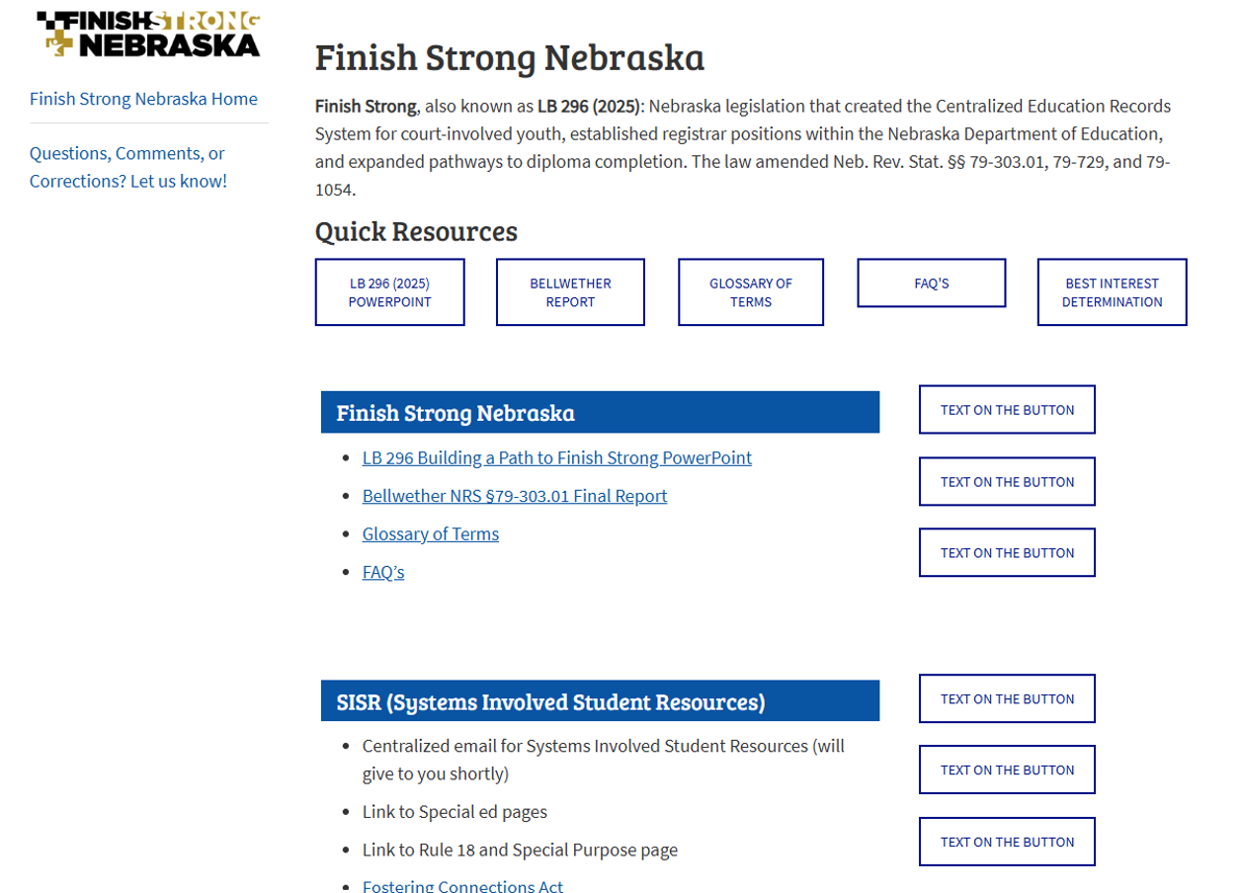
New Website
www.education.ne.gov/siy
Notes:
Alyssa

Slide 22
Summary of Support Services
Determine eligibility for Finish Strong
Technical assistance for transcript review
Issuance of credit
Proactive outreach for eligible students
Professional development: Office hours, webinars
Graduation assistance: collaborate with schools to issue a district HS diploma.
Notes:
Alyssa

Slide 23
How can you support Finish Strong?
Know the student’s education story. Ask about credits, graduation requirements, current school, and educational goals.
Help connect the dots. Share relevant information with Case Managers, Probation Officers, guardians and students
Support timely transitions. Help ensure education records, credits, and services follow the student when placements change. *LB 962: Youth Reentry and Transitional Support program
Keep graduation in sight. Help youth understand that their past educational progress matters and that there may be flexible pathways to graduation.
Notes:
Wendy or Malinda

Slide 24
Why does Finish Strong matter?
Timely transfer for involved youth
Increase academic and postsecondary outcomes
Increase on-time graduation rates
Decrease drop-out and recidivism rates
Flexible pathways that provide greater opportunities
HOPE MATTERS
Notes:
Wendy

Slide 25
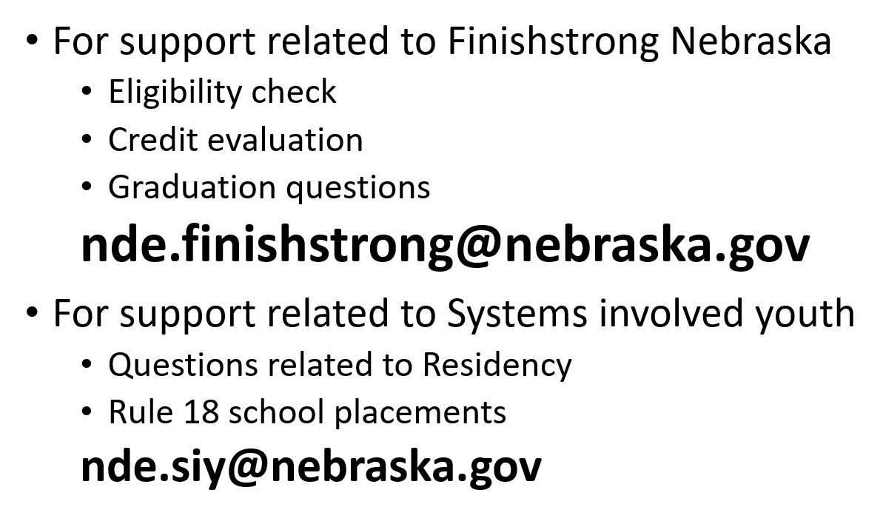
How to contact NDE

Slide 26
Presenter contact information
Wendy Schardt, Director of Systems Involved Youth, NDE
Wendy.Schardt@nebraska.gov (531) 363-4734
Alyssa Moore, Registrar, NDE
Alyssa.Moore@nebraska.gov (402) 326-3084
Malinda Jean Baptiste, School Counseling Specialist, NDE
Malinda.Jean-Baptiste@nebraska.gov (402) 560-6877
Finish Strong application/inquiries:
Nde.finishstrong@nebraska.gov

Slide 27
Questions

