Slide 1
Welcome to
New Superintendent Orientation
July 2026

Slide 2
School District Funds
Bryce Wilson

Slide 3
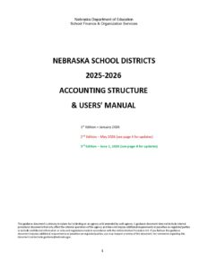
CLASSIFICATION OF FUNDS
This information may be found on the Nebraska Department of Education’s website:
  Rule 2:
  https://www.education.ne.gov/nderule/uniform-system-of-accounting/
  Accounting Structure & Users’ Manual:
  School District
    https://www.education.ne.gov/wp-content/uploads/2026/06/2526DistrictUsersManual_06-01-26.pdf
    ESU’s
    https://www.education.ne.gov/wp-content/uploads/2026/04/2526ESUUsersManual_April-2026.pdf

Slide 4
School District Budgeting
Taxing Funds
General
Special Building
Qualified Capital Purpose
Bond
NET OPTION FUNDING
ALLOCATED INCOME TAX
COMMNITY ACHIEVEMENT PLAN AID
EQUALIZATION AID
Notes:
Taxes collected must be spent for the purpose for which they were originally taxed.
Loans / Borrowing – Only between taxing Funds
Close Out a Fund – Proceeds go to the General Fund
Cannot make transfers to the Special Building Fund or Qualified Capital Undertaking Fund
Questions on Use of Funds – Call Us

Slide 5

General Fund
Operation of District
No Building Projects
Main Revenue Source: Taxes
Levy is Restricted -
Part of the $1.05
Purpose
Notes:
Operation of District:
Salaries/benefits – 65-70% of total budget
Facilities costs – utilities and
Curriculum Costs
State and Federal Program
Pupil transportation
No building projects
Repairs & Maintenance costs
Replace windows
Main Revenue is Property Taxes
Funding for federal and state programs
State funding – apportionment received by all district

Slide 6
Bond Fund
Collect Property Taxes
Bond Principal & Interest for Project
Revenue Source: Taxes
Not Part of $1.05
Levy is Restricted to Bond Principal & Interest
Purpose
Notes:
Purpose:
Collect property taxes to pay for Bond Principal, Bond Interest, related costs
Revenue Source:
Property Taxes
Levy is restricted to amount needed to pay Bond Principal and Interest
Many times the county treasurer retains the property tax revenue in a special fund and makes the payments for the district.
The Bond Fund shall be used to record tax receipts, investment interest, and the payment of bond principal, interest, and other related costs (i.e. trustee fees).
If the fund balance is not sufficient to meet interest or bond retirement payments from the Bond Fund, the General Fund shall be used for these payments.
Revenue from a levy to retire bonds in any school district is retained in a separate fund by the county treasurer, the financial institution serving as a fiscal agent, or the school district.
Proceeds from a bond issue shall be deposited into the Special Building Fund to be expended on the actual building project.
The tax levy for this fund is restricted to expenditures for principal and interest on bonds.

Slide 7
Qualified Capital Purpose
Undertaking Fund
Accessibility Barriers
Life Safety Codes
Asbestos Removal
Mold Abatement & Removal
Safety and Security Infrastructure
Revenue Source: Taxes
Local Board Approval to Issue Bonds
Not Part of $1.05
3¢ / 5.2¢
Purpose
Notes:
Purpose:
Collect property taxes to pay for Bond Principal, Bond Interest, related costs
Revenue Source:
Property Taxes
Levy is restricted to amount needed to pay Bond Principal and Interest
Main advantage in using the QCPUF is that your levy could be outside the $1.05 levy limit. Not as much as an issue in recent years with the higher property valuations
Many times the county treasurer retains the property tax revenue in a special fund and makes the payments for the district.
A Qualified Capital Purpose Undertaking Fund may be established for:
the removal of environmental hazards,
the reduction or elimination of accessibility barriers in school district buildings,
the repayment of a qualified zone academy bond issued for a qualified capital purpose,
A Qualified Capital Purpose Undertaking Fund may be established for (con’t):
modifications for life safety code violations, and
mold abatement and prevention projects
Bonds for this purpose would include, but not be limited to:
Qualified School Construction Bonds
Build America Bonds
Any other bonds authorized by ARRA
The School Board may issue bonds for any Qualified Capital Purpose Undertaking Fund project.
General Fund expenditures for the purpose of this fund are not allowable.
The tax levy and duration of this fund is restricted.

Slide 8
Special Building Fund
Revenue Source: Taxes
Levy is Restricted
14¢ (*17.5¢)
Part of the $1.05
New Building Projects, Purchase Sites & Buildings
Purchase Furnishings for New Facilities
Improvement of Site
Purpose
Notes:
Purpose: - Improvement to the Site
Purchase or Improve Sites
Build, Alter or Improve Facilities
Furnish New Facilities
Revenue Sources:
Bond proceeds
Sale of Property
Tax receipts
Levy is restricted
LB 788 in Legislature to lower the maximum levy to 5¢. With vote of people, the levy can be 14¢
Bill has a provision for districts with a higher levy in place prior to passage for a specific project, they can continue with that higher levy through the 2024-25 school year - 7 years from 2017/18
A Special Building Fund is established to:
Acquire or improve sites
Erect, alter or improve buildings
Cost to furnish new buildings
Provides a way to identify cost associated with construction activities
The primary sources of revenue for the Special Building Fund are:
sale of bonds
the sale of property
tax receipts
General Fund expenditures for the purpose of this fund are not allowable.
The tax levy for this fund is restricted.

Slide 9
Taxing Funds
Tax proceeds must be spent for the purposes for which they were originally collected.
Building projects cannot be paid out of the General Fund.
Interfund Loans can be made between Taxing Funds
*One Exception – General can be used for Bond payment in a shortfall situation.

Slide 10
Depreciation Fund
Examples:
School Buses
Computers
Textbooks
Roof repair or replacement
Spread out Capital Outlay Costs
Use when you are out of Budget Authority
Revenue Source: General Fund Transfers
Restricted by Allowable Reserves Limit
Replacement
Purpose
Notes:
Purpose:
Spread out costly capital outlay costs over a period of years.
Revenue Source:
Transfers from the General Fund that are expensed to appropriate category
Set up Accounts by Expenditure Type
Instructional, Transportation, Building
Restricted by Allowable Reserve Limit
A Depreciation Fund is established to facilitate the eventual purchase of costly capital outlay
Spreads replacement costs over a period of years
Funds are shown as an expense from the General Fund and the Depreciation Fund will show the revenue as a transfer from the General Fund.
Special Building vs Depreciation Fund
Special Building – IMPROVEMENT TO THE SITE – NEW
Depreciation - REPLACEMENT OF EXISITING
Important in how the board motion is worded
Track –
If have a track – could be a depreciation project, but you know a new one track would always be an improvement to the site
Roof-
Replacement – depreciation fund
Improved roof – Special Building Fund
Find mold in the roof – could use QCPUF – a good contractor can always find some mold in a roof
This fund is considered to be a component of the General Fund.
The Depreciation Fund is restricted by statute as part of the allowable reserve limitation.

Slide 11
Employee Benefit Fund
Reserve General Fund Money for Benefit of District Employees
Early Retirements
Unemployment Compensation
Deductibles
Revenue Source: General Fund Transfers
Restricted by Allowable Reserves Limit
Purpose
Notes:
Purpose
Reserve General Fund for District Employee Benefits
Revenue Source:
Transfers from the General Fund that are expensed to appropriate category
Set up Accounts by Expenditure Type
Unemployment, Early Retirement, Deductibles
Cash Reserve is Restricted by Allowable Reserve Limit
Is established to reserve General Fund money for the benefit of school district employees.
Funds are shown as an expense from the General Fund and the Employee Benefit Fund will show the revenue as a transfer from the General Fund.
A school district may divide this fund into more than one account to allocate a portion of this fund for different valid purposes:
Unemployment compensation
Early retirement
Health insurance deductibles
The cash reserve of this fund is restricted by statute as part of the allowable reserve limitation
The Employee Benefit Fund is considered to be a component of the General Fund

Slide 12
Contingency Fund
Uninsured Losses by District
Legal Fees for Defense against Public Losses
Revenue Source: General Fund Transfers
Budgeted Expenditures Limited to 5% of Total General Fund Budget
Purpose
Notes:
Purpose:
Fund District Uninsured Losses and Legal Fees
Revenue Source:
Transfers from the General Fund that are expensed to appropriate category
Budgeted Expenditures from this Fund cannot exceed 5% of General Fund Total Budget
Usually used by larger districts
Authorized by statute to fund uninsured losses and legal fees.
Expenditures from this fund shall not exceed five percent of the total budgeted General Fund expenditures of the school district.
Funds are shown as an expense from the General Fund and the Contingency Fund will show the revenue as a transfer from the General Fund.

Slide 13
Activities Fund
District Extra-Curricular Activities & Student Organizations
Oversight of Financial Transactions for Student Activities
Revenue Source: Organization & Activity Fundraisers. General Fund Transfers
Purpose
Notes:
Purpose:
Account for Financial Transactions for District Extra-Curricular Activities and District Student Organizations
Revenue Source:
Activity/Organization Fund Raising
General Fund Transfers if deficits occur
Activities Fund cannot be used to record General Fund Operational Costs or to be used as a Clearinghouse for the General Fund
The Activities Fund is required to account extra-curricular activities
If included in the General Fund the school district’s operational costs would be distorted
The Activities Fund is not to be used to record general operation revenues or expenditures, nor shall this fund be used as a clearinghouse for the General Fund.
The school district may divide this fund into more than one account to allocate a portion of this fund for different purposes
If deficits in such activities are incurred, they shall be covered by funds transferred from the General Fund

Slide 14

School Nutrition Fund
Financial Activities of all Nutrition Programs
Staff Salaries, Food/Supplies,
Kitchen Equipment,
Contractors
Revenue Source: Lunch Sales, Federal & State Reimbursement,
General Fund Transfers.
Purpose
Notes:
Purpose:
Operation of all Nutrition Programs for the District
Food and Supplies
Salaries/Benefits of Nutrition Staff
Kitchen and Related Equipment
Contracted Food Services
Important to show kitchen equipment purchases in School Nutrition Fund
Cannot carry over more than 3 months expenses into following school year.
NDE will ask for valid rationale and how district will lower it.
Federal Reimbursement rate could be decreased if not resolved
Revenue Source:
Sales of Lunches
Federal Reimbursement
State Reimbursement
General Fund Transfers
The School Nutrition Fund shall reflect a record of all revenues and expenditures for the operation of all Nutrition Programs
If a deficit is incurred in the operation, the deficiency shall be covered by funds transferred from the General Fund.

Slide 15
Cooperative Fund
Shared Teacher or Administrator
Program Between Two or More Districts
ONLY used by District Serving as Fiscal Agent to Pay Shared Expense
Revenue Source:
Payments from other participating political subdivisions
General Fund Transfers by District serving as Fiscal Agent.
Purpose
Notes:
Purpose:
Used by a District serving as fiscal agent between the district and one or more other districts or other agency
Examples: Shared Teacher or Administrator, Shared Instructional Programs between Districts
Revenue Source:
District serving as Fiscal Agent – General Fund transfer expensed to appropriate category
Member Districts: Tuition paid – Instructional Program; Salary/Benefits – Shared Teacher or Administrator
Can be an agreement between district and another public agency – like a city.
The Cooperative Fund may be used by the school district acting as the fiscal agent for any cooperative activity between one or more public agencies.
All school districts, including the school district acting as the fiscal agent, shall show the payment for services to the cooperative in their General Fund.

Slide 16
Student Fee Fund
Record Transactions Fee-Based Programs
Extra-Curricular Activities,
Post-Secondary Education,
Summer/Night School
(No Other Allowable Uses)
Revenue Source:
Fees Collected by Each Category.
Not Funded by Tax Revenue
Purpose
Notes:
Purpose:
Record Transactions for Fee-Based Programs
Extracurricular Activities
Postsecondary Education
Summer or Night School
Revenue Source:
Only from Fees Collected for Programs/Activities Listed Above
Expenditures must be for the purposes for which the fees were collected.
The Student Fee Fund is a separate fund not supported by tax revenue.
Includes money collected from students pursuant to the Public Elementary and Secondary Student Fee Authorization Act (§79-2,125 through §79-2,135).
Included are fees for:
Extracurricular Activities
Postsecondary Education
Summer or Night School.
Expenditures from this fund must be for the purposes for which the fees were collected.

Slide 17

School District Budget
Stephanie DeGroot

Slide 18
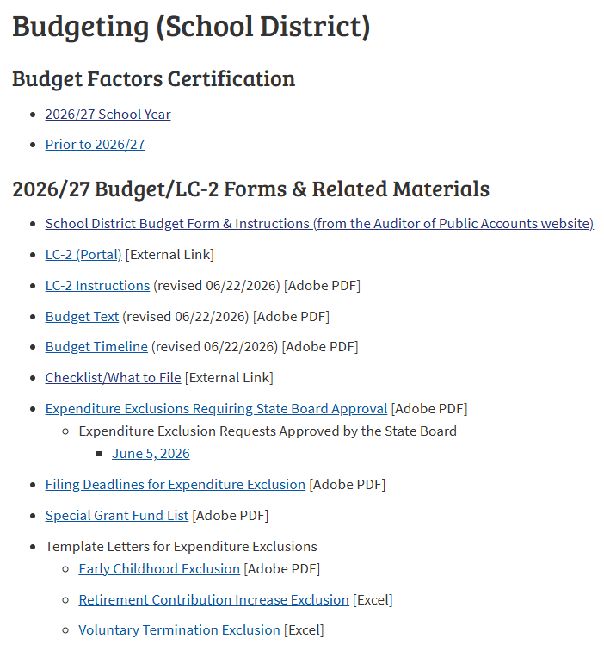
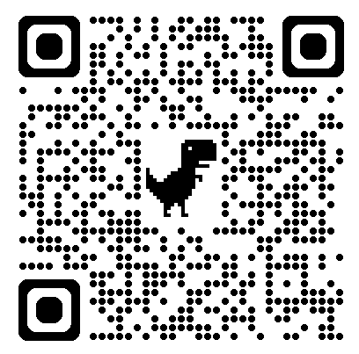
Budgeting School District
https://www.education.ne.gov/fos/budgeting-school-district/

Slide 19
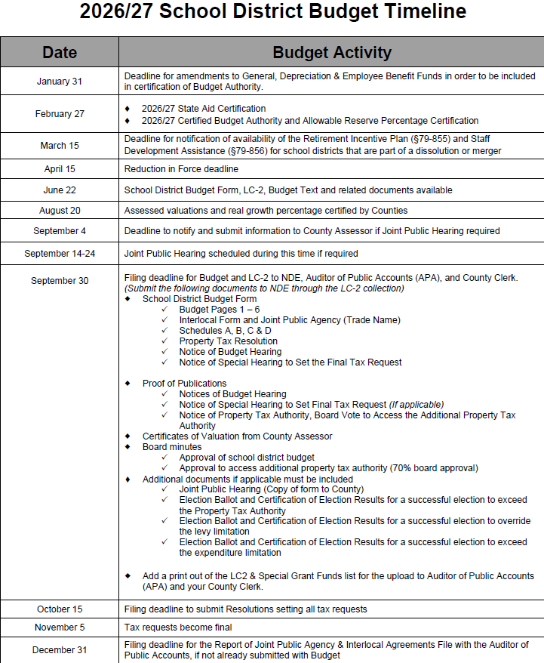

Slide 20
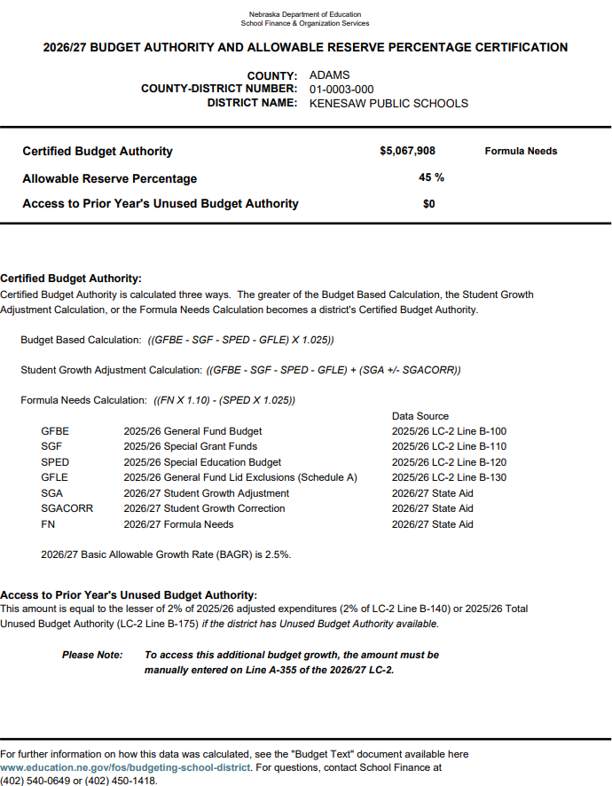
2026/27 Budget Authority Certification https://www.education.ne.gov/fos/budget-factors/
Certified on or before March 1st
each year
*See Budget Text for full calculation explanation
*Budget Base, Student Growth, or Formula Needs
*Pre-populates into LC-2

Slide 21

Allowable Reserves
Budgeting tool – not cash in the bank
General, Employee Benefit & Depreciation Funds
Enter on Necessary Cash Reserve line in budget worksheets
Auto populates into LC2
Reference: See Budget Text – Allowable Reserve Limitation for more info

Slide 22
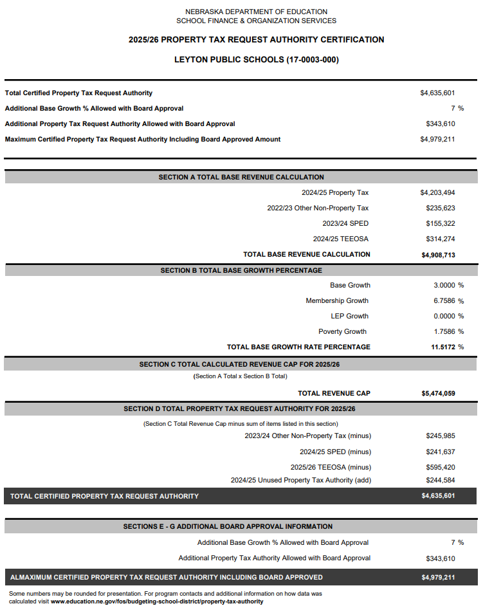
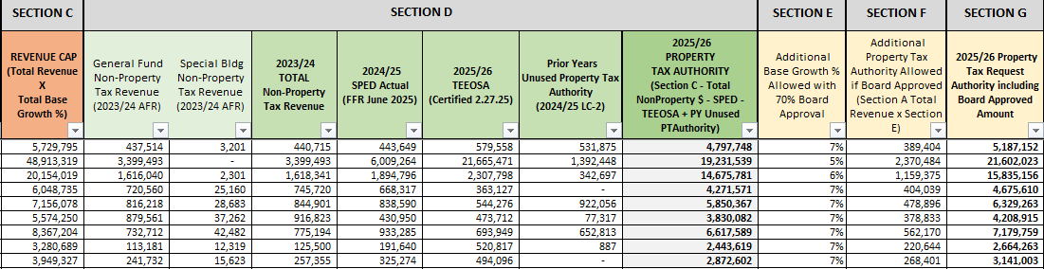
2026/27 Property Tax Authority Certification https://www.education.ne.gov/fos/budgeting-school-district/property-tax-authority/
*Certified in May/ June based on Legislature
*Applies to General & Special Building Fund
*Additional authority must be approved by 70% of board
*New Certification Document

Slide 23
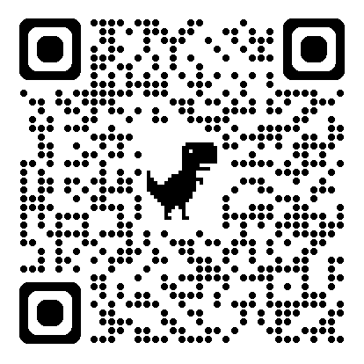
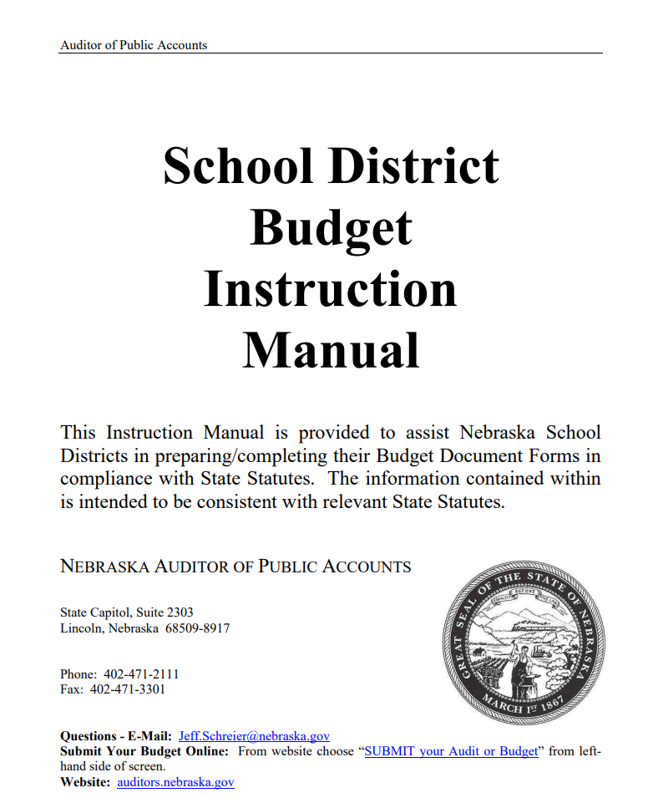
Budget Instruction Manual
Detailed budget form & instructions
In-depth statute reference
Updates each year to incorporate Legislative changes
https://auditors.nebraska.gov/Budget_Info.html

Slide 24
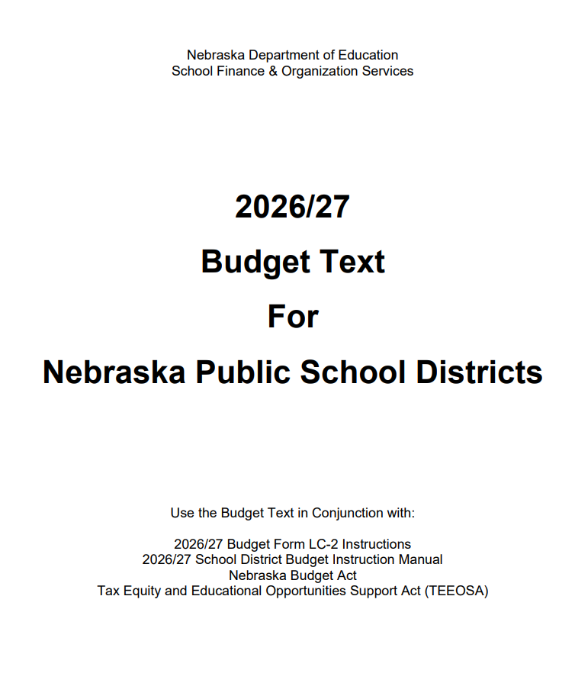
Budget Text Document
How budget authority is calculated
Expenditure Exclusions
Access to additional budget authority
Budget prep details
Budget, Special & JPH hearings
Budget amendments & corrections
Levy limits & overrides
Ballot language
https://www.education.ne.gov/fos/budgeting-school-district/

Slide 25
General Fund Revenue Sources
Local/County 39%
Property Taxes
Motor Vehicle Taxes
State
50%
State Aid
State Grants
Federal
9%
Loans
Non-Revenue less than 2%
Title Grants
IDEA Grants
ESSER
Medicaid
Sale of property
Insurance proceeds
Interest
Fines & Licenses
Apportionment
SPED Reimbursement
Transfers from other funds

Slide 26
School District Budget Cycle
Review Current Budget
Will Any Funds Need To Be Amended?
Amendments Due By August 31st
Monitor Spending throughout School Year
Prepare Budget & Schedule Hearing(s)
Adopt Budget
Gather Board Input on Levy Limit & Tax Request

Slide 27

No Standard Method
  Evaluate district needs & limitations
  What are your board’s goals?
  Review prior year budget and audit trends
  Necessary Cash Reserve
  Certified Budget Authority
  Property Tax Authority
  What is your levy goal?
    Board may determine maximum levy amount
    Do you have bond or building projects?
  Seek guidance from out-going Supt., NCSA mentor, and NDE team
  Review Budget Text and APA Instruction Manual
Preparing
District
Budget
Notes:
Completing the Budget provides a school district with the authority to levy and to spend district funds

Slide 28
General Fund Disbursements
Things to consider when planning:
Build in percentage increase for salary & benefits
Consider the unexpected situations (SPED)
  What if you had to hire another teacher?
  What if you had to buy another vehicle?
Instructional materials
New computers or tablets
Building & grounds maintenance
  New mower
  Sprinkler repairs
Pupil Transportation:
  Repair & maintenance
  New tires
  New Van

Slide 29
Depreciation Fund
Things to consider when planning:
Replacement Capital Expenditures
  Are you replacing a van or a bus?
  Are you replacing an A/C unit?
  Are you replacing carpet?
Consider the unexpected situations
  Do you need to save for a bus
  Do you need to set money aside to plan for an upcoming capital expense?

Slide 30
Bond, Special Building & QCPUF Considerations:
Do you have a bond & interest payment due?
  Remember what you are planning for now, won’t be avail. until next year, so plan ahead
QCPUF outside PTA, great way to set funds aside for qualifying projects:
  ADA Compliance
  Mold
  Security
  Fire Code
Special Building – New or improved
Depreciation - Replacement

Slide 31
Activity Fund vs. Student Fee Fund:
Activity Fund – more flexibility
  Shift funds around as needed
  Build fund for new uniforms or equipment
  Collect fees
Student Fee Fund – Must be in/out for same reason
  Meant for secondary education or night school

Slide 32
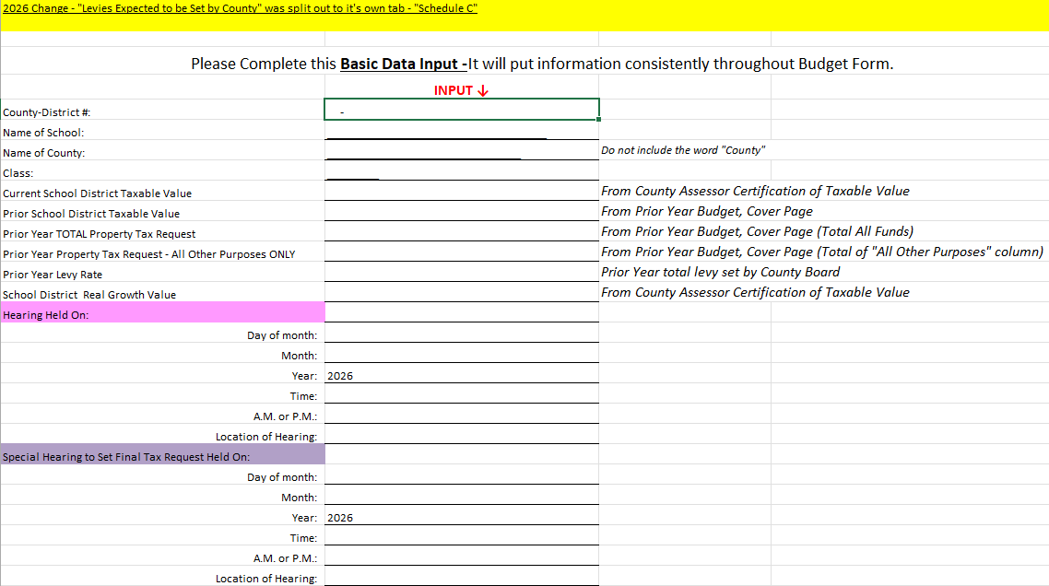
Basic Data Input
Enter school district information at the top
Enter estimated district taxable value
  Certificate of Valuations released by county Aug. 20
  Create multiple scenarios 5%, 10% increase
  Update figures as needed
Enter prior year information
  Use last year’s Cover Page for data
School District Real Growth Value
  Listed on Certificates of Valuation
  Enter estimate to calculate JPH Page 6
  Update in August
Hearing dates & times
  Flow through to Budget & Special Hearing pages

Slide 33
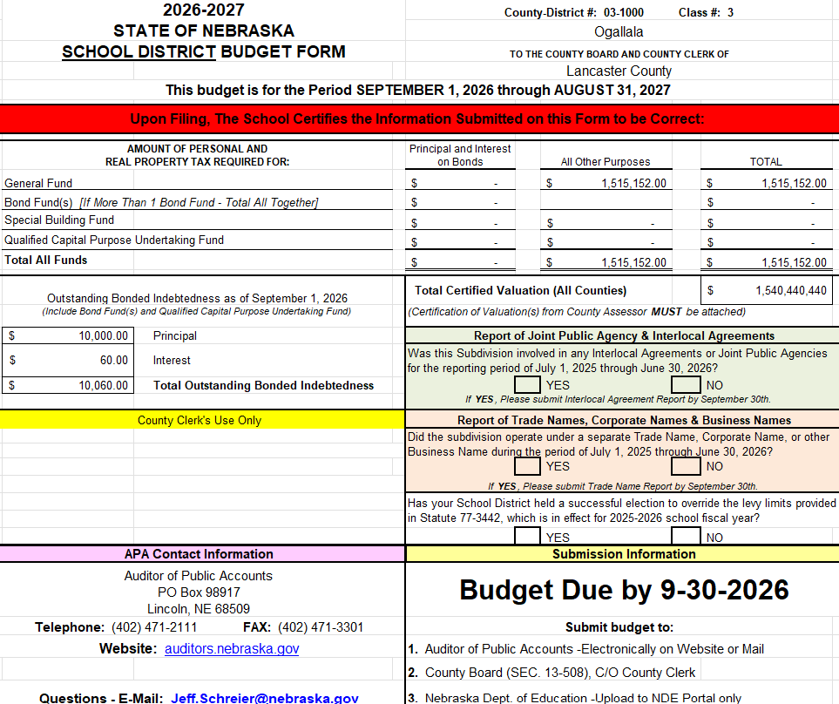
Cover Page
The only manual entry on this page are Yes/No questions
Total Certified Valuation flows through from Basic Data Input page
The Principal and Interest on Bonds, All Other Purposes & Total flow through from “Fund” worksheet pages
Outstanding Bonded Indebtedness flows through from Debt Outstanding worksheet

Slide 34
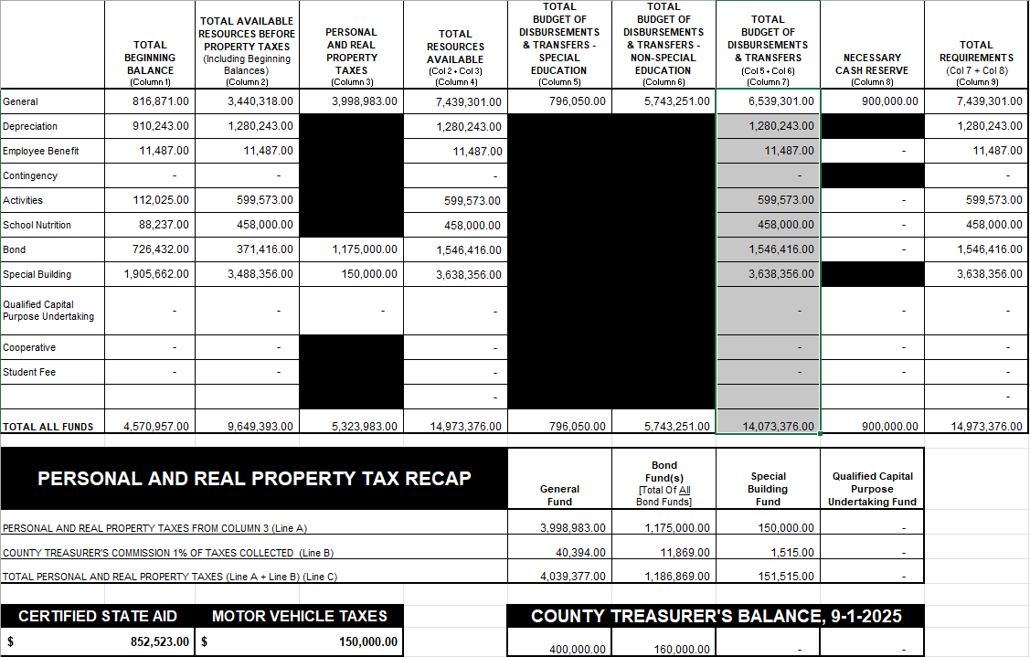
Pages 2, 3 & 4
Page 2 = Column F Current Budget
Page 3 = Column E Actual/Estimated
Page 4 = Column D 24/25 Audit Data
Page 2 is check point for auditors
Make sure this page is correct
Verify State Aid number is correct
Verify MVT has an entry
Verify CT Balance has entry
If something is out of balance or a correction is needed – Go back to “Fund” worksheet page & correct, then check page again to verify corrections flowed through
No manual entries on these pages
***Data flows through from ”Fund” worksheet pages
Ending balance of Page 4 is beginning balance of Page 3. Then Page 3 ending balance is Page 2 beginning balance

Slide 35
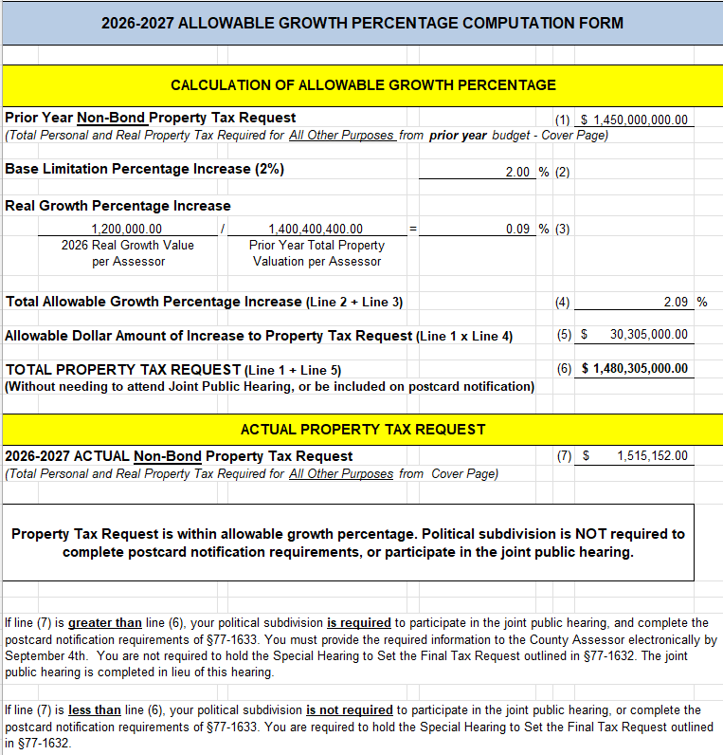
PT Request Act Page 6 - Allowable Growth Percentage
No manual entries here
Required if tax asking exceeds 2% plus real growth
Joint Public Hearing – Hold with other political subdivisions in the county
  Schedule between Sept. 14 – Sept. 24
  After 6:00 PM
Must notify County Assessor by Sept. 4th
  Postcards will be sent to property taxpayers/owners
  Ask to proof postcards/ check for errors before mailing
“Voting Member” required to attend
County Assessor required to attend
Excludes bond principal & interest
Budget Hearing can be held prior to JPH, but not adopted

Slide 36
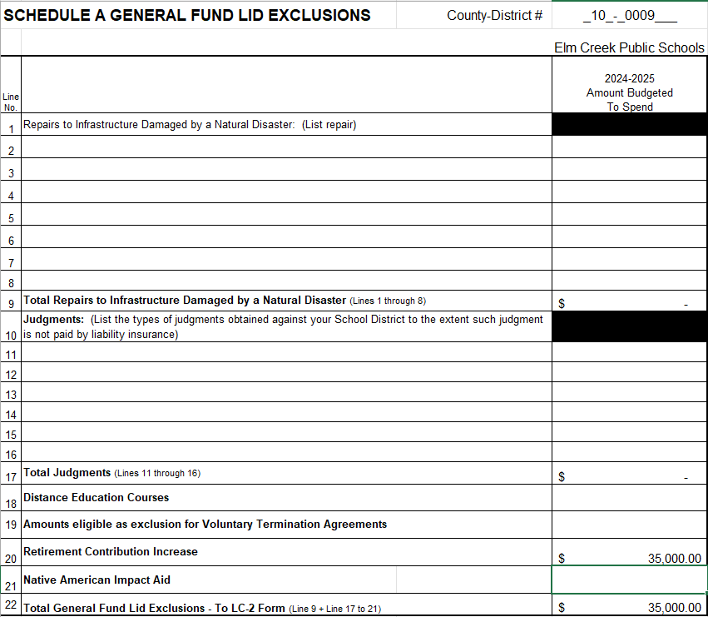

General Fund Lid Exclusions
Schedule A
Notes:
Items located at the bottom of the Special Grant fund list Do require state board approval since they are specific to your district. A couple of things to consider…
Insurance Settlements:
Consider depositing settlements into your Special Building Fund, so you don’t have to request state board approval when you need to spend those funds.
In recorded in the Special Building Fund, then it wouldn’t impact per pupil costs
Inter-fund loans:
The General Fund may loan to another taxing funds
You have two years to repay an inter-fund loan
Short Term borrowing
Need a load from the bank to help get through a shortfall in revenue during the year.
Must repay this in a year

Slide 37
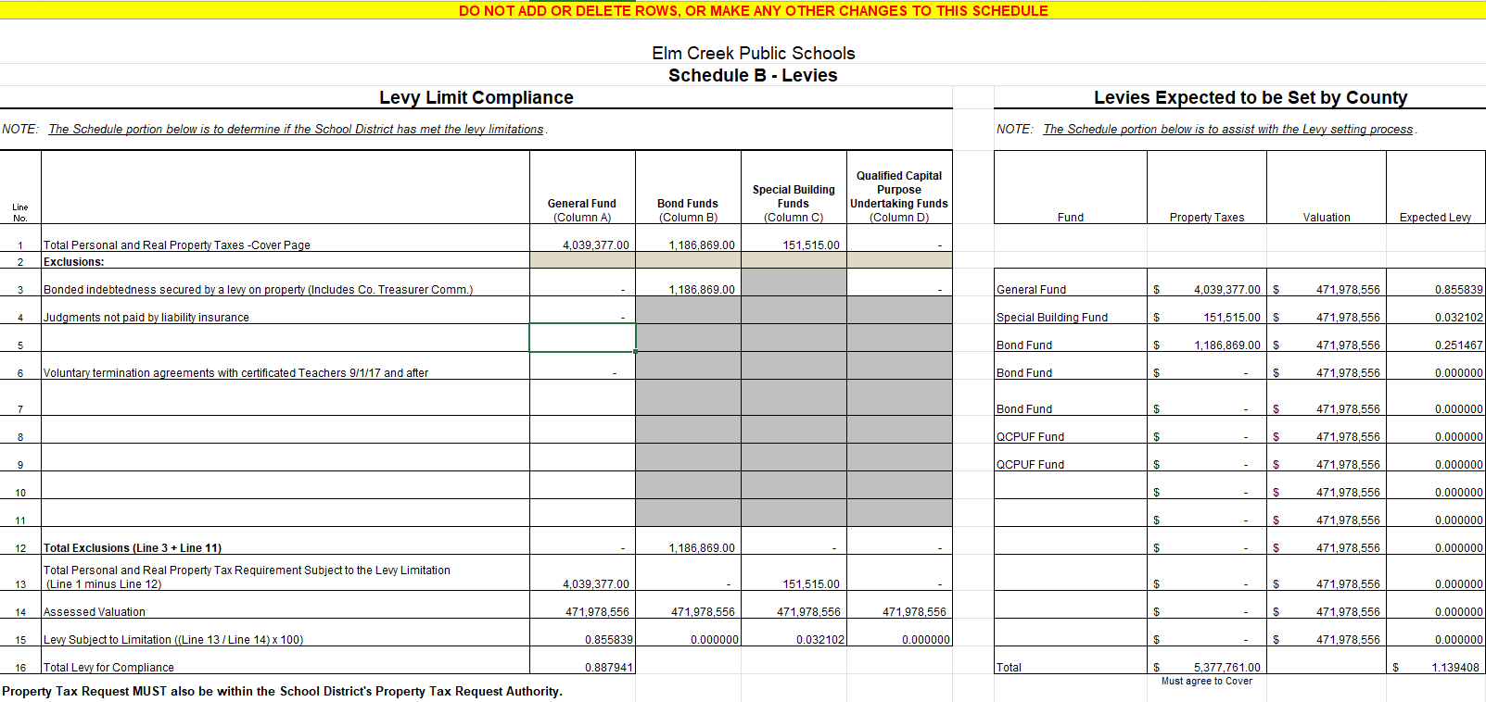
Schedule B
***No Manual Entries***
Moved to Schedule C

Slide 38
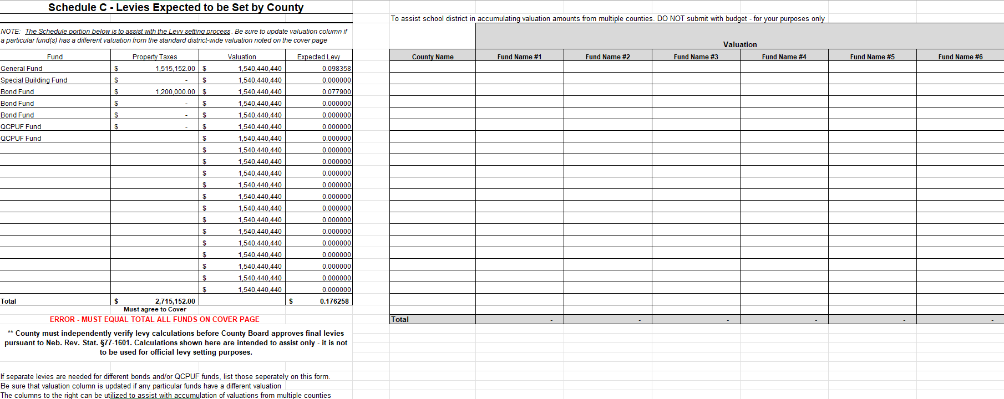
Schedule C – New Page
Intended to assist in separating Bond Valuations
The left-side table will auto populate from data throughout the budget document
The only manual entry to the left table is, if you receive separate Certificates of Valuation for a Bond
The right-side table is for your information only

Slide 39
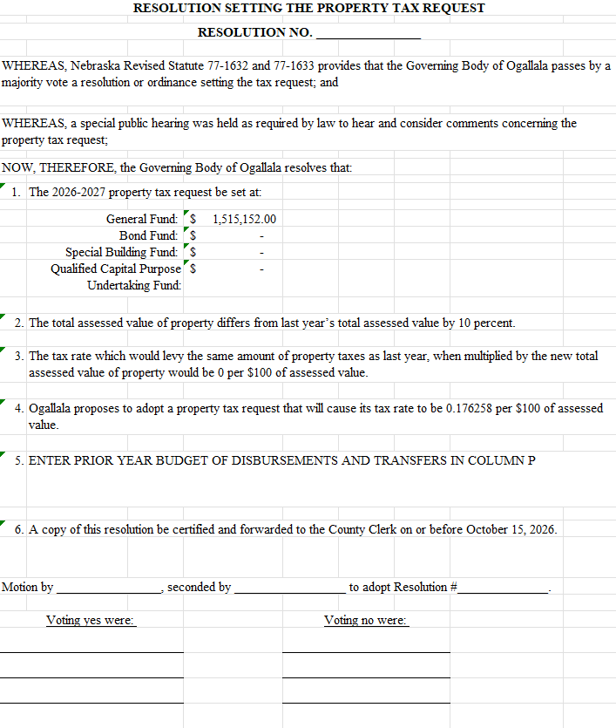
Resolution Setting The Property Tax Request
Remember to fill out & turn in with budget forms
Answers to questions you may receive
  How much per $100 of assessed value
Can be signed or typed
  Note the results in the meeting minutes

Slide 40
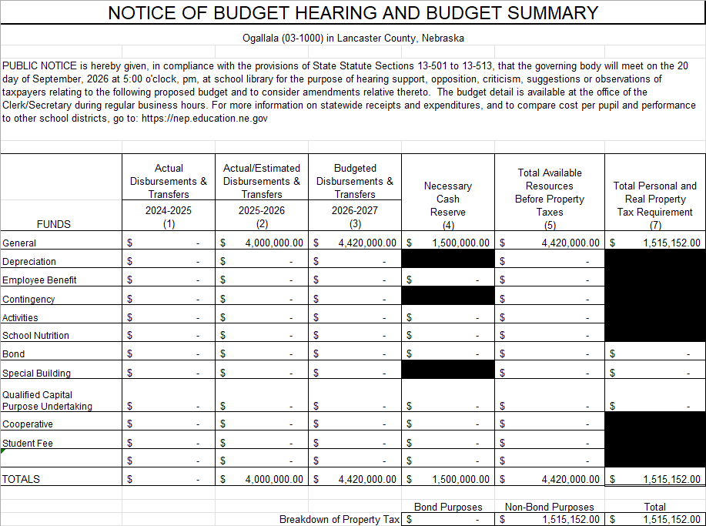
Notice of Budget Hearing
Hearing dates flow through from Basic Data Input page
***No manual entries here

Slide 41
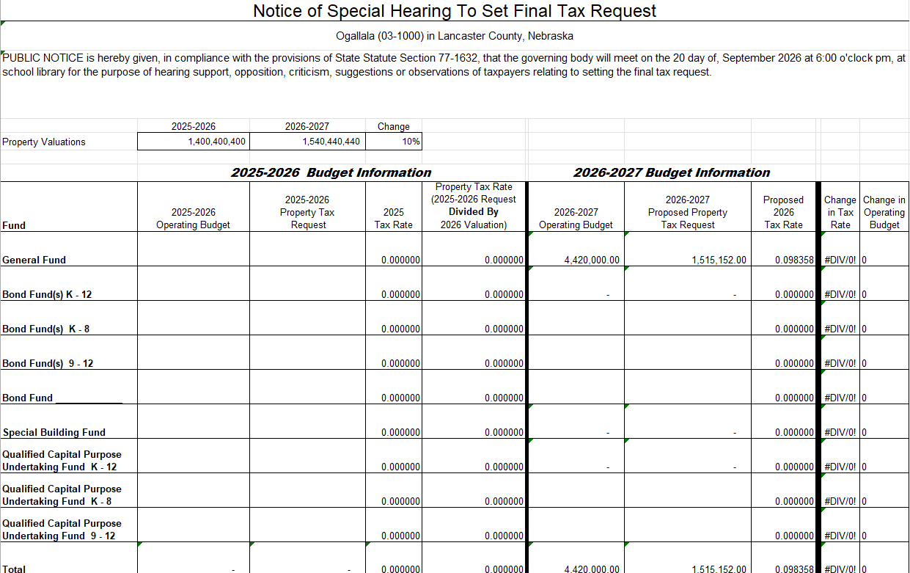
Here is where you can see how the estimated valuations can change things – Update from Basic Data Input page
Look at last year’s Special Hearing page & manually enter the prior year information
here:
This section will pre-populate from the “Fund” worksheet pages

Slide 42
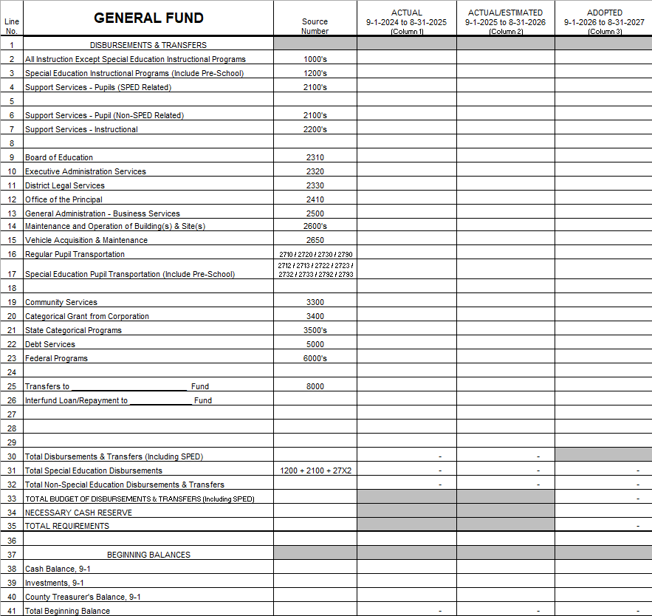
Budget Fund Worksheets
Start by entering Column D – 24/25 Audit
  Use supplemental audit pages
  Don’t estimate – must use actuals
Beginning & ending balances auto populate Pages 2, 3, 4 of budget
  Auditor check point is page 2 – Make sure it aligns with 24/25 audit
Column D ending balance is Column E beginning balance
Enter Column E
  Enter YTD + estimates through August 31st
  Ending balance should represent where you expect to be on Aug 31st – know what you have to apply towards the new budget
  If there is room in the current budget (under budget) consider transferring excess funds:
    Depreciation Fund - future capital expenditures
    Nutrition Fund – appliance purchase
    Activities Fund – new equipment, uniforms
24/25 Audit
Current YTD
New Budget

Slide 43
Budget Fund Worksheets - Cont.
Enter Column F
  Start by entering salaries, include projected salary increases
  Consider if you had to hire another teacher mid-year
Enter SPED salaries, services, transportation
  Remember SPED is an exclusion of the budget
  See SPED totals line 31
Remember to budget for items like
  New mower
  Bus tires
  Sprinkler repairs
  Building maintenance
  Board expenses
  Training
  Curriculum
Include planned transfers to other funds
Include projected State & Federal program expenses
Don’t forget to add Necessary Cash Reserve
24/25 Audit
Current YTD
New Budget

Slide 44
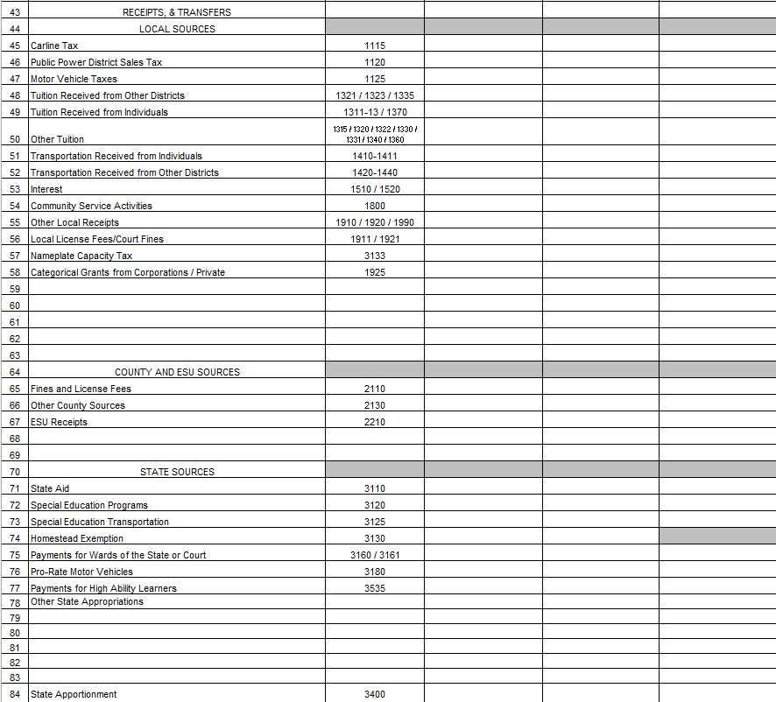
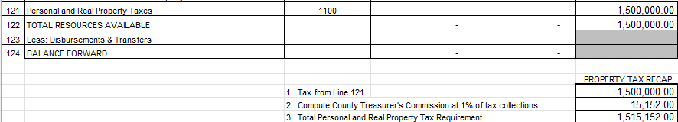
Budget Fund Worksheets - Cont.
Enter receipts (lower half of budget) to match total expenses
  State Aid must be exact amount from certification page
Enter Property tax request at bottom of page
  Remember to account for County Treasurer’s balance 1%
Receipts can be estimated
Expenses need to be accurate
Top half of budget must match bottom half of budget
Enter “To balance budget line” if needed
Save & upload to LC2 to check if within limits
Adjust as needed
Start next fund, same process
Keep an eye on Pages 2, 3, 4
  Make sure they are in balance
24/25 Audit
Current YTD
New Budget

Slide 45
Data Entry Reminders
Don’t forget to fill out the other pages in the budget:
Interlocal agreement, Trade Name, Correspondence, Schedule D, Debt Outstanding
Don’t type over formulas
It could cause errors to important pages like JPH, cover page or hearing pages
Don’t struggle – Call us, we will be glad to help!
Save, Save, Save
Upload to LC2 often – Check Budget Authority, Levy & Property Tax Limits
Return to Budget for corrections & then re-upload to LC2

Slide 46


Slide 47
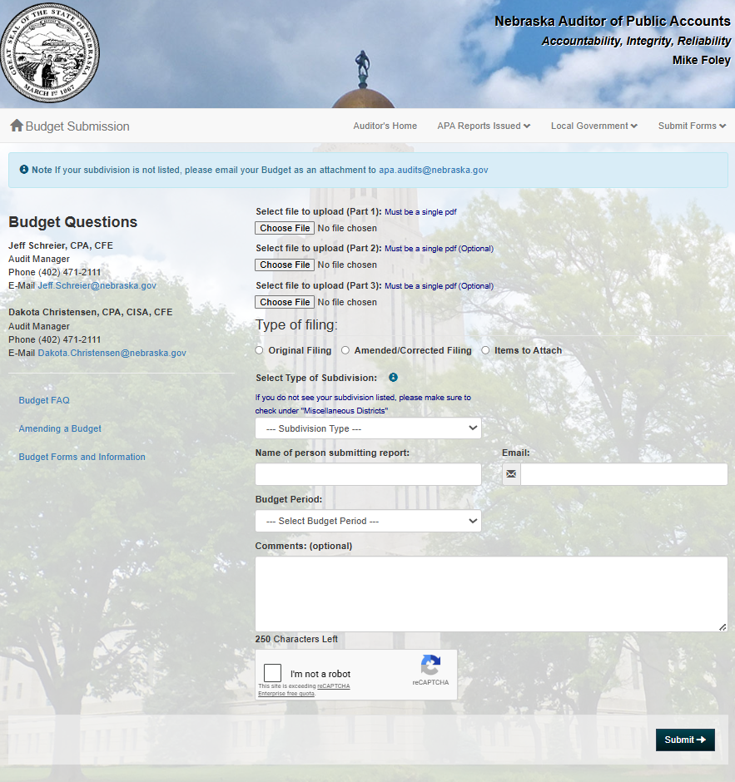
Submit the Budget
NDE
  Save budget in PDF format
  Upload to LC2
Auditor of Public Accounts
  Upload checklist in PDF format
County Clerk
  Upload checklist in PDF format

Slide 48

How to Calculate
How to Calculate Levy?
(Total Tax Request ÷ Assessed Valuation) x 100 = Levy
($4,389,899 ÷ $443,000,000) x 100 = .990948
How Much Will My Levy Generate in Property Taxes?
(Levy x Valuation) ÷ 100 = Property Tax Request
(.990948 x $443,000,000) = $4,389,899
Additional 1¢ in Levy Generates Additional Property Tax
Move decimal 4 spaces to the left on district valuation
$443,00.0,000. valuation = $44,300 additional pennies!

Slide 49

Current Year Budget Reminders
*Review current budget to avoid overspending and to see if an amendment is required
*If spending authority remains in General Fund, consider a transfer to other funds:
    Depreciation Fund
    Employee Benefit Fund
    School Nutrition Fund
    Activity Fund
*Unspent General Funds will increase next year’s available beginning balance. Put towards cash reserve.

Slide 50
Need to Amend the Current Year’s Budget?
*Per Statute must amend before overspending occurs
*Required if ANY fund will exceed total budget of disbursements & transfers out
*Hold hearing and approve by August 31
*Total Requirements must equal Total Resources available
*Property tax request cannot change if tax levy has been set
Required Action
*Hearing notice to amend
  Budget as originally adopted
  Proposed amended budget
  Rationale for amending
  Include statement “No impact to district tax levy”
*Documents to submit:
  Proof of Publication
  Board Minutes
  Page 2 of Budget Document
Submit documentation to:
  State Auditor
  County Clerks
  NDE

Slide 51

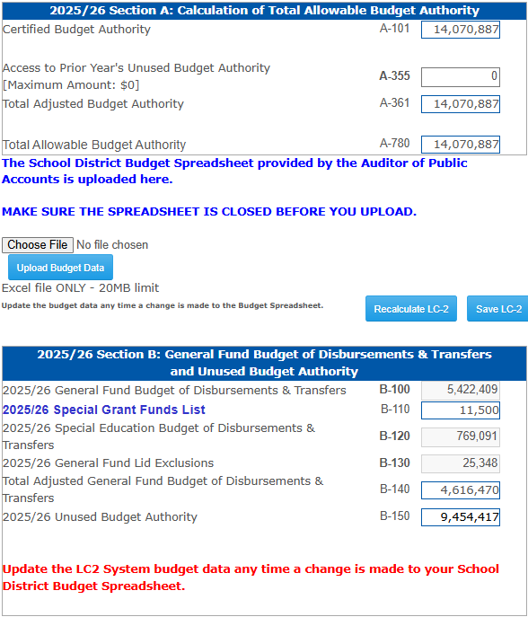
Amending the LC2
*LC-2 must be revised if these funds are amended:
  General Fund
  Depreciation Fund
  Employee Benefit Fund Cash Reserve
*Make sure Allowable Reserves has not been exceeded
*Upload to LC-2 before Board approves
*Must contact NDE to unlock LC-2
https://www.education.ne.gov/fos/process-for-amending-a-budget/
Notes:
Items located at the bottom of the Special Grant fund list Do require state board approval since they are specific to your district. A couple of things to consider…
Insurance Settlements:
Consider depositing settlements into your Special Building Fund, so you don’t have to request state board approval when you need to spend those funds.
In recorded in the Special Building Fund, then it wouldn’t impact per pupil costs
Inter-fund loans:
The General Fund may loan to another taxing funds
You have two years to repay an inter-fund loan
Short Term borrowing
Need a load from the bank to help get through a shortfall in revenue during the year.
Must repay this in a year

Slide 52
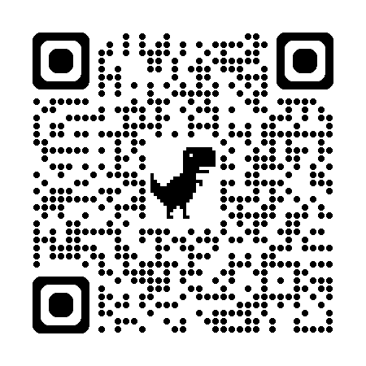
Pupil Transportation Website https://www.education.ne.gov/fos/pupil-transportation/
QR Code to Pupil Transportation Website

Slide 53

Announcements
Check Announcements Page Updates
Join Our Zoom Meetings
  Next one Sept. 21st
Rule Revision – In Progress
Admin Days Class – Wed. July 29th
  Younes Conf. Center, Kearney
  Students First, Safety Always
  Playbook for Administrator’s
Pupil Transportation Director’s Class Wed. Sept. 23rd
  Neb. Safety Center, Kearney
  Only 75 Seats Available
  For PT Directors Only

Slide 54

New Documents Available
*2026 Back to School Checklist
*Pupil Transportation Guide
**Will be updated once Rule 91 & 92 revisions drafts are ready
**Continue to use Dec. 2024 Version on website for now
*Driver Requirement Charts
*10 Passenger Van – Quick Reference Guide
*Medical Exam

Slide 55

Contact Info:
402-540-0649 stephanie.degroot@nebraska.gov

Slide 56


Slide 57

2026-2027
Nebraska Department of Education
Superintendent Orientation
The mission of the Nebraska Council of School Administrators is to be a leader for quality education that results in learning for all children/youth and to enhance the professionalism of its members.

Slide 58
2026-2027
Thank you
Finance and Organizational Services Staff
The mission of the Nebraska Council of School Administrators is to be a leader for quality education that results in learning for all children/youth and to enhance the professionalism of its members.

Slide 59

2026-2027
Email: troy@ncsa.org
Phone #: 402-910-8763
X: @NCSAtroy
The mission of the Nebraska Council of School Administrators is to be a leader for quality education that results in learning for all children/youth and to enhance the professionalism of its members.

Slide 60
2026-2027
Upcoming Events
Administrator Days – July 29-31, 2026
Business Manager Training – August 6, 2026
School Finance & Final Budget Preparation - August 6, 2026
Student Legal Issues Workshop - August 13, 2026
School Law Update – September 16, 2026
Ed Academy for Leg Advocacy - September 23-24, 2026
NCSA Tailgate - September 19, 2026 (North Dakota)
NCSA Free Webinar Series throughout school year
The mission of the Nebraska Council of School Administrators is to be a leader for quality education that results in learning for all children/youth and to enhance the professionalism of its members.

Slide 61

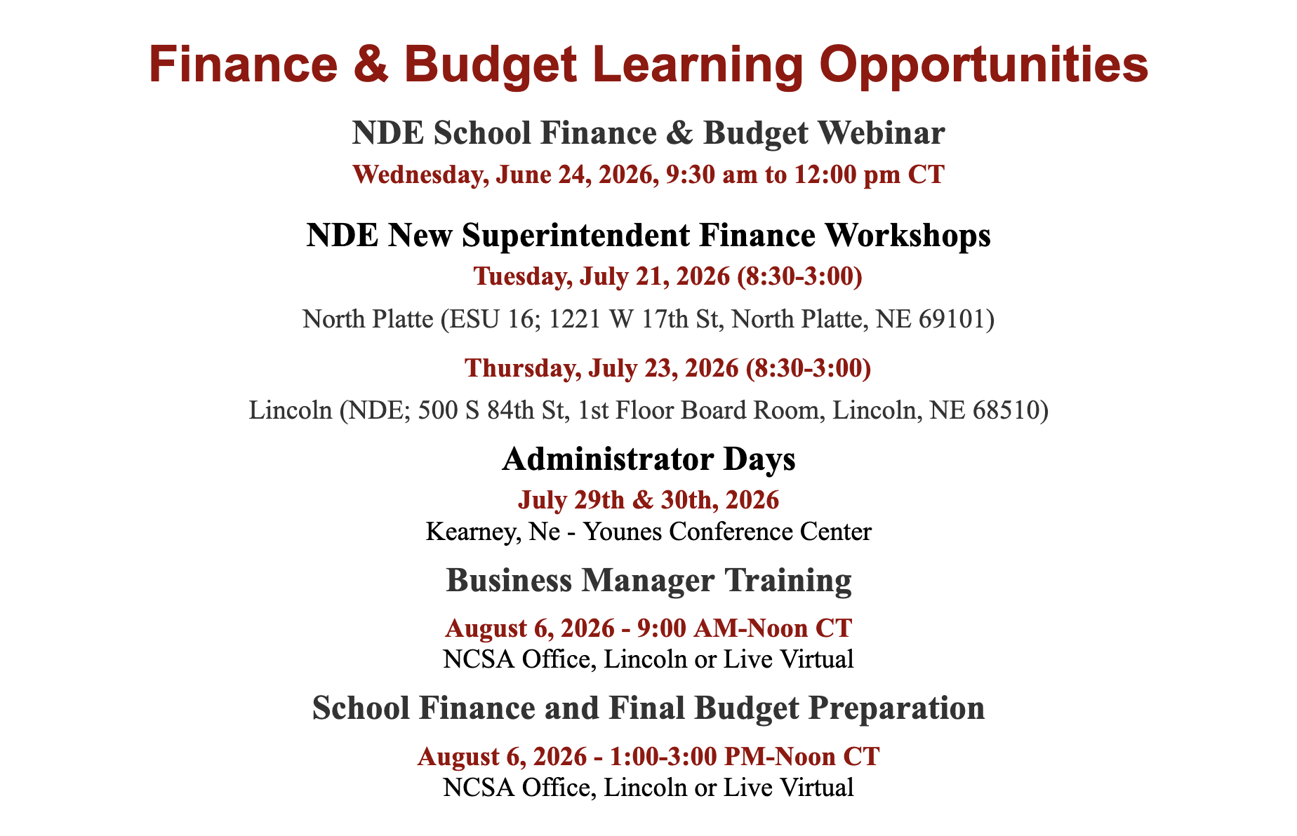

Budget/Finance Mentorship

Slide 62
“NEW” Budget Academy
NCSA Budget and Finance Academy
October 22, 2026
NCSA is proud to host school administrators and district staff from across the state to help school districts to develop and maintain a budget process that will work for each district. Not all budgets are alike and there is diversity in values and state funding across the state. This academy will focus on budget development, practical timelines, financial planning, and state/federal requirements.
One full day in Lincoln with follow up ZOOM meetings quarterly throughout the 2026-2027 school year.

Slide 63
Academy
Step 1. Plan and Prepare.
Mobilizing key stakeholders, gathering information on academic performance and cost structure, and establishing principles and policies to guide the budget process.
Step 2. Set Instructional Priorities.
The budget needs to be rooted in the priorities of the district. Priorities provide a strong basis for developing a district’s budget and strategic financial plan.
Step 3. Pay for Priorities.
Current resources and expenditures must be thoroughly analyzed in order to find capacity to pay for top instructional priorities.
Step 4. Implement Plan.
The “strategic financial plan” or “plan of action is the long-term road map for implementing the district’s instructional priorities.
Step 5. Ensure Sustainability.
The planning and budgeting process should be one that can be replicated in the future to ensure the district remains focused and plans accordingly for reaching its student achievement goals.

Slide 64
2026-2027
Questions?

Slide 65
Exclusions, LC-2, &
Enrollment Option
Kelsey Larsen

Slide 66
General Fund Exclusions
Levy Exclusions
Allows districts to levy more than the $1.05 levy limit
Found on Budget Schedule B
No State Board approval needed
Expenditure Exclusions
Allows districts to spend more than their Certified Budget Authority
Most need State Board approval

Slide 67
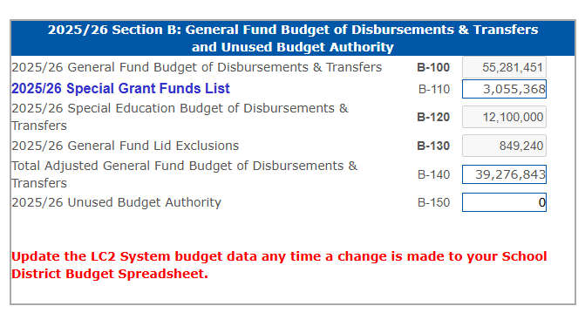
General Fund Expenditure Exclusions
State Board Approval is NOT
Required For:
Special Education Expenses
  - Includes SPED Transportation & any other SPED related student services (21XXs, excludes 219X’s)
Special Grant Funds List
  - List found in LC-2
  - Commonly used programs are pre-approved by the State Board each year
2026/27 Section B: General Fund Budget of Disbursements & Transfers and Unused Budget Authority
2026/27 General Fund Budget of Disbursements & Transfers
2026/27 Special Grants Fund List
2026/27 Special Education Budget of Disbursements &
Transfers
2026/27 General Fund Lid Exclusions
Total Adjusted General Fund Budget of Disbursements &
Transfers
2026/27 Unused Budget Authority

Slide 68
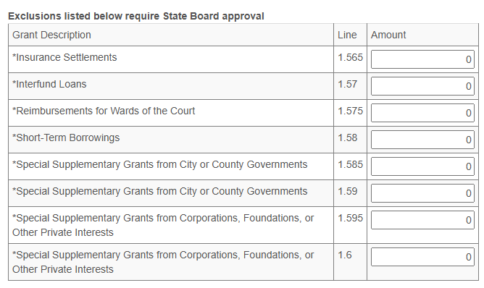
Exclusions & Supplemental Grants Needing Approval
Exclusions & Supplemental Grants needing State Board Approval can be found at the bottom of the Special Grants List.
Email exclusion requests to Kelsey at kelsey.larsen@nebraska.gov
NOTE: Requests must include district name, district number, amount, & purpose

Slide 69
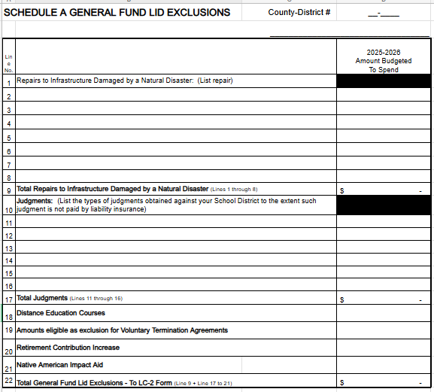
Schedule A
Need Board Approval For:
Repairs to Infrastructure
Judgements
Distance Education
Voluntary Terminations
Retirement Contributions
Native American Impact Aid

Slide 70
Early Childhood Education Grant
If 2026/27 is the first-year that Early Childhood Membership is being included in the district’s formula students…
- Districts can request a General Fund Expenditure Exclusion for the amount equal
to their 2025/26 Early Childhood Education Grant increased by the Basic
Allowable Growth Rate of 2.5%
State Board approval is needed
Qualifying districts have been sent an exclusion letter template to be completed & returned to Kelsey if wanting to utilize the exclusion
Kelsey will enter the amount into the LC-2
Amount remains in the base for calculation of future Budget Authority
NOTE: If a district receives other “Early Childhood” grants, the district will need to entered those grants into the Special Grants Fund List within the LC-2

Slide 71

New Elementary Site Allowance
Must have already qualified for Elementary Site Allowance
- Requested in the TEEOSA collection
Exclusion is for the costs related to the first year of operation
- Salaries, Utilities, Building Maintenance, etc.

Slide 72

Repairs to Infrastructure
Exclusion is for the cost of repairs
due to damage from a natural disaster
Natural Disasters include:
- Tornadoes
- Floods
- Wildfires
Governor or FEMA must declare a disaster
State Board approval is needed

Slide 73

Distance Education Courses
To qualify, a district must provide distance education course through an ESU Coordinating Council to another district
Exclusion Amount equals the amount received as payment from another district
State Board approval is needed

Slide 74
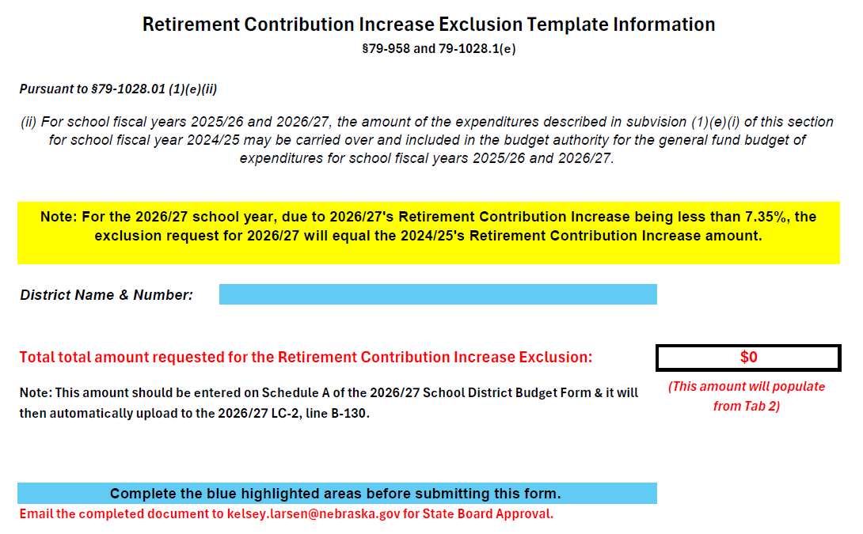
Retirement Contribution Increase
This exclusion allows districts to exceed their expenditure limitation by a specific dollar amount, not to exceed the difference between the employer’s contribution rate and the budgeted amount of employee salaries.
***New for 2026/27***
The total contribution rate will be coded to 230-236. Nothing will be coded to 237 starting July 1st
**Note**
- 2024/25 Contribution Rate: 9.88%
- 2026/27 Contribution Rate: 7.3225%

Slide 75
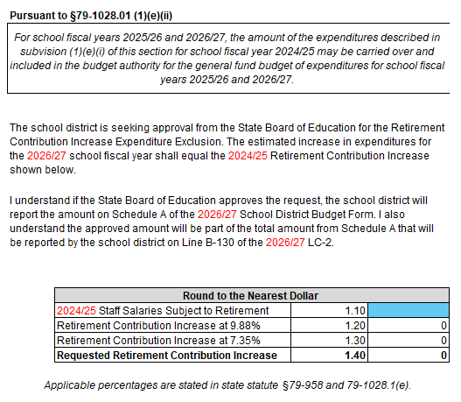
Retirement Contribution Increase Continued
Tab 2: 2026/27 Exclusion Worksheet
***New for 2026-27***
The 2026/27 Retirement Contribution Increase Exclusion request amount will equal the 2024/25 Retirement Contribution Increase amount.
State Board approval is needed

Slide 76
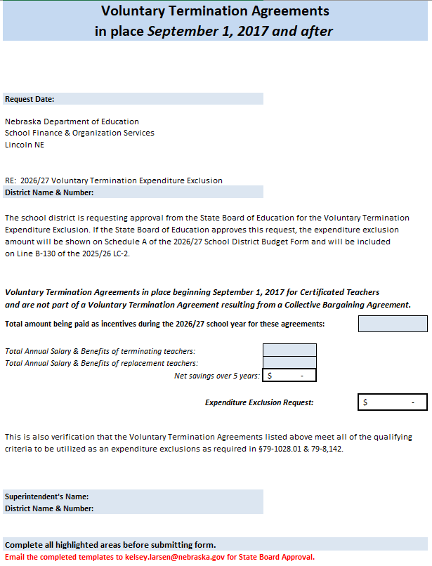
Voluntary Termination Agreements
The voluntary termination agreement was not part of any collective bargaining agreement.
The value of the current and future incentives shall not exceed $35,000 in total per employee.
All incentives must be paid withing five (5) years of agreement or until the certificated teacher becomes eligible for Medicare, whichever comes first.
The payment of incentives must result in a net savings in salary and benefits to the district over the five-year period.
State Board approval is needed

Slide 77
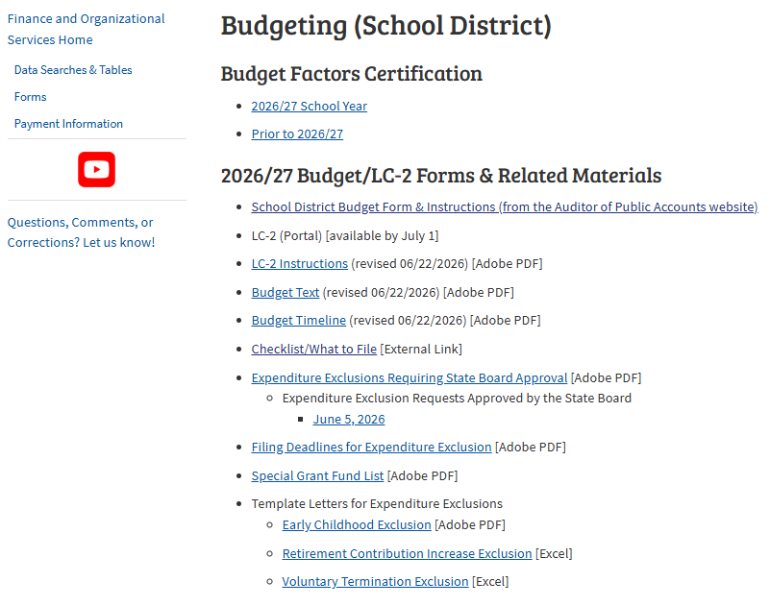
Template Letters for Expenditure Exclusions
https://www.education.ne.gov/fos/budgeting-school-district/

Slide 78
Exclusion templates are available in the Budget section of NDE’s Finance & Organizational Services website
https://www.education.ne.gov/FOS/
Complete the appropriate template or type a letter on official district letterhead for the exclusion
Summary: Requesting State Board Approval
for an
Exclusion
Send requests to NDE via email to kelsey.larsen@nebraska.gov before the filing deadline
Exclusion requests can be included in budget planning before State Board approval has been posted online

Slide 79
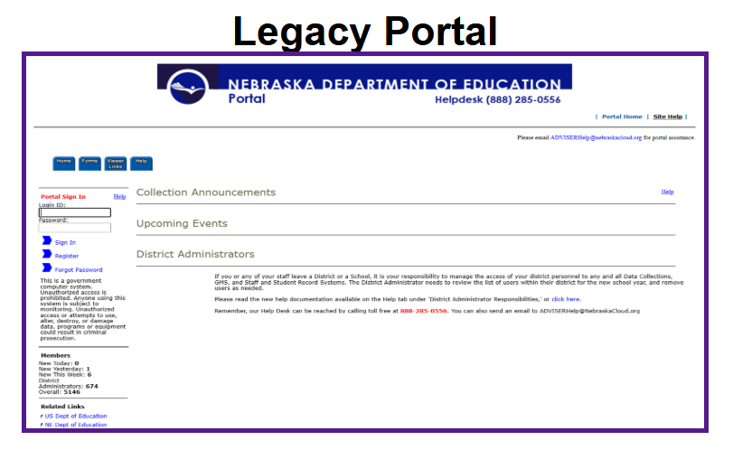
LC-2
Located in the Legacy Portal
Instructions can be found on NDE’s Financial & Organizational Services website: https://www.education.ne.gov/FOS/ (Budget Documents)
Will receive a new activation code each year
Are you a new Superintendent or at a new district this year?
  Need to register in the Legacy Portal
Note: For questions about the NDE Portal or submitting data online, contact the ADIVSER Service Desk

Slide 80
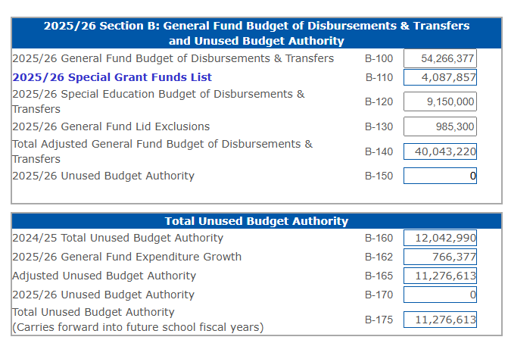
Functions of the LC-2
Amounts entered on the budget worksheet will pre-populate once the worksheet has been uploaded
Confirms that the budget is in compliance & does not exceed limitations
- If limitations have been exceeded, you will receive an error message
Calculates any Unused Budget Authority
Any Special Grants will need to be entered into the Special Grants Funds List (B-110)
2026/27 Section B: General Fund Budget of Disbursements & Transfers and Unused Budget Authority
2026/27 General Fund Budget of Disbursements & Transfers
2026/27 Special Grants Fund List
2026/27 Special Education Budget of Disbursements &
Transfers
2026/27 General Fund Lid Exclusions
Total Adjusted General Fund Budget of Disbursements &
Transfers
2026/27 Unused Budget Authority
2025/26 Total Unused Budget Authority
2025/26 General Fund Expenditure Growth
Adjusted Unused Budget Authority
2026/27 Unused Budget Authority
Total Unused Budget Authority
(Carries forward into future school fiscal years)

Slide 81
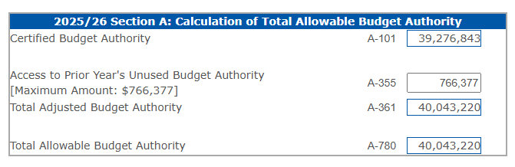
Unused Budget Authority
2026/27 Section A: Calculation of Total Allowable Budget Authority
If additional Budget Authority is needed, can enter the Prior Year’s Unused Budget Authority into A-355
The amount listed is the lesser of 2% of the prior year’s adjusted General Fund expenditures or the prior year’s total Unused Budget Authority

Slide 82
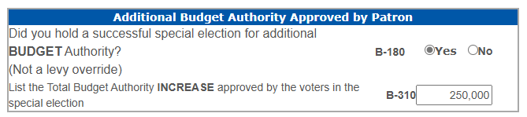
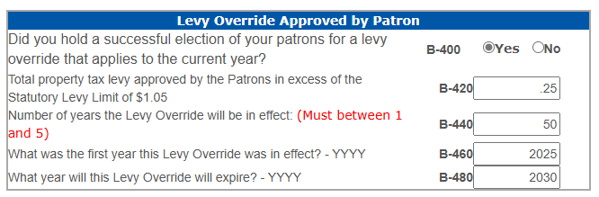
Election for Additional Budget Authority & Levy Override
If the answer is “YES”
5
2026
2031
NOTE: Must include supporting documentation for the election with your budget documents

Slide 83
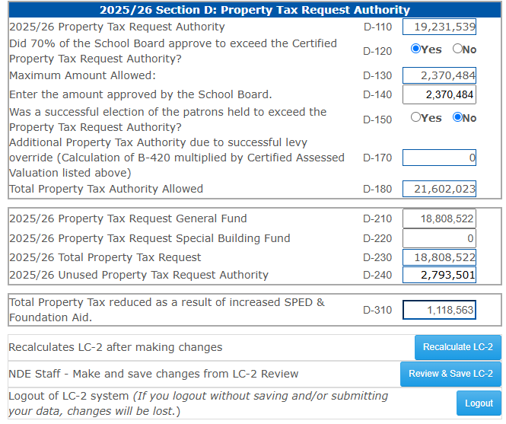
Section D – Property Tax Authority
Certified Assessed Valuation & Property Tax Request will pre-populate when the budget document is uploaded
If the board approves additional Property Tax Authority:
- Click “Yes”
- The maximum amount allowed will populate (D-130)
- Enter the amount approved by the Board (D-140)
D-180 calculates the Total Property Tax Authority Amount Allowed
- Note: D-230 cannot exceed D-180
Any Unused Property Tax Authority listed will roll forward to next year (D-240)
D-310 is the Total Property Tax amount that is reduced due to an increased in SPED & Foundation Aid
- Total can be $0. However, NDE will reach out to
confirm
Always Rember to “Recalculate” & “Save”
2026/27 Section D: Property Tax Request Authority
2026/27 Property Tax Request Authority
2026/27 Property Tax Request General Fund
2026/27 Property Tax Request Special Building Fund
2026/27 Total Property Tax Request
2026/27 Unused Property Tax Request Authority

Slide 84

LC-2 Error Messages
Budget Authority Exceeded
Allowable Reserves Exceeded
Levy Information/Dates Do Not Match
Property Tax Authority Exceeded
**LC-2 cannot be submitted with error messages**

Slide 85
LC-2 Tips & Tricks
There is no limit on the number of times you can upload into the LC-2.
Remember to “Recalculate” & “Save” often
Remember to click “Save” the Special Grant Funds List after making changes & before returning to the LC-2
Make sure to upload the budget documents as a single PDF after District Approval

Slide 86
Budget Checklist
  Have you sent Kelsey your Expenditure Exclusion requests?
  Did you Utilize the LC-2 while working on budget?
  Is the Budget within spending, levy & property tax limits?
  Does the LC-2 & Budget match?
  Is a Joint Public Hearing required?
  Does Hearing Notice match the budget document?

Slide 87
Budget Check List Continued
  Did you publish your Hearing Notices?
  Did you confirm that your Hearing Notices were published in newspaper?
  Did you reserve adequate time for public comment at the Budget Hearing?
  Submit the budget documents to NDE, APA, County Clerks by September 30th
  Submit the Property Tax Resolution to the County by October 15th

Slide 88
After clicking “District Approval” the “Load Budget Document” button will appear at the top of the LC-2
Review the Budget Checklist
Convert listed items into a single PDF
Upload documents into the LC-2
How to Submit Budget Documents to NDE
Confirmation emails sent when:
District Admin approves the budget
PDF documents are uploaded
NDE approves LC-2 & budget documents
Mailed copies of the budget documents will not be accepted by NDE

Slide 89
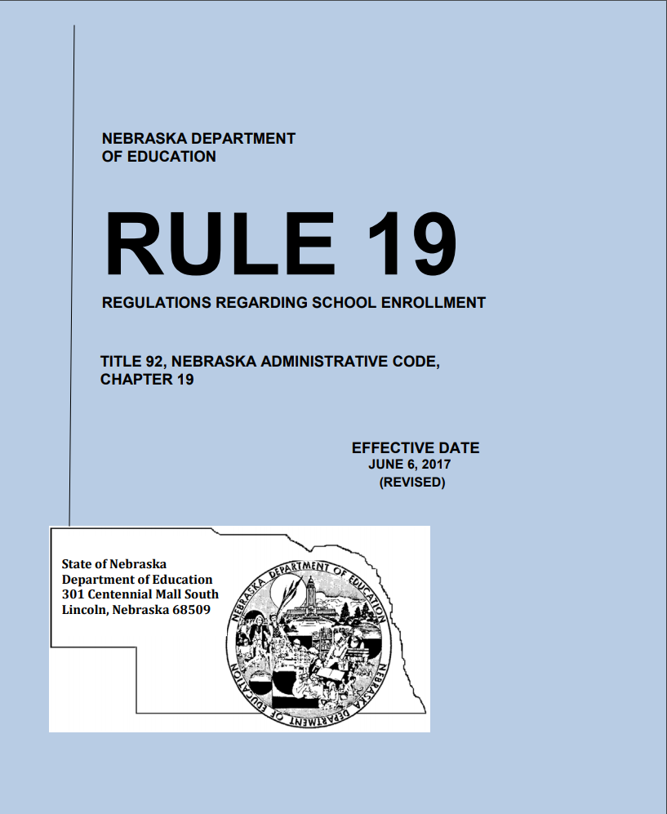
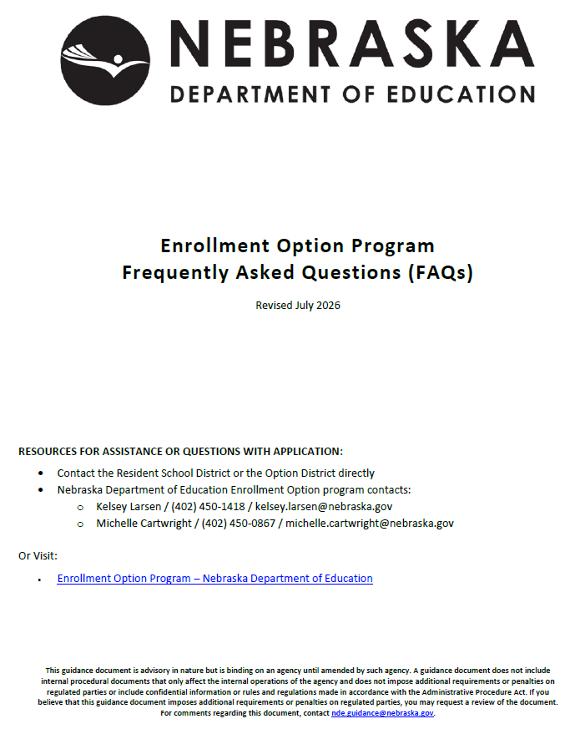

Enrollment Option Program
https://www.education.ne.gov/fos/enrollment-option-application-instructions-faqs/

Slide 90
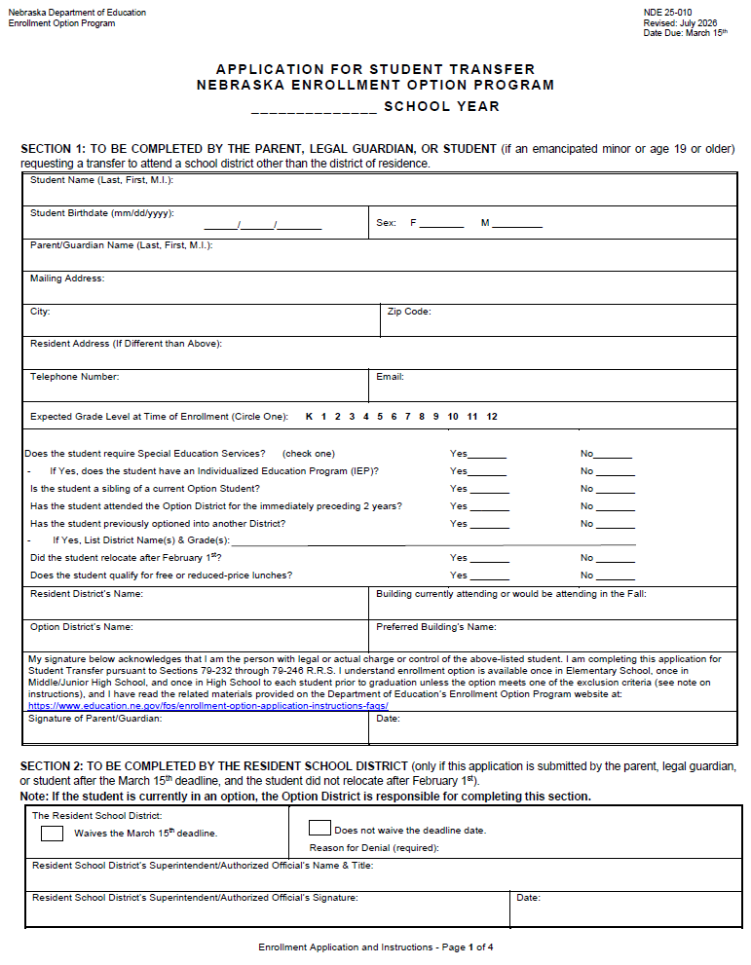
Enrollment Option Application
Application & FAQs are located on NDE’s Financial & Organizational Services website
Applicants must use the most current version, posted 7/17
Now available online:
- Application & FAQs in Spanish
- Both English & Spanish applications are a fillable PDF
Program Contacts:
  - Kelsey Larsen at kelsey.larsen@nebraska.gov
  or 402.450.1418
  Michelle Cartwright at michelle.cartwright@nebraska.gov
  or 402.450.0867

Slide 91

Enrollment Option Reminders
Effective July 19, 2024
A student may option once during elementary school, once during middle/junior high school, and once during high school for a total of three times.
If option started in elementary student may seek a new option in middle/junior high or high school
Exceptions still available

Slide 92
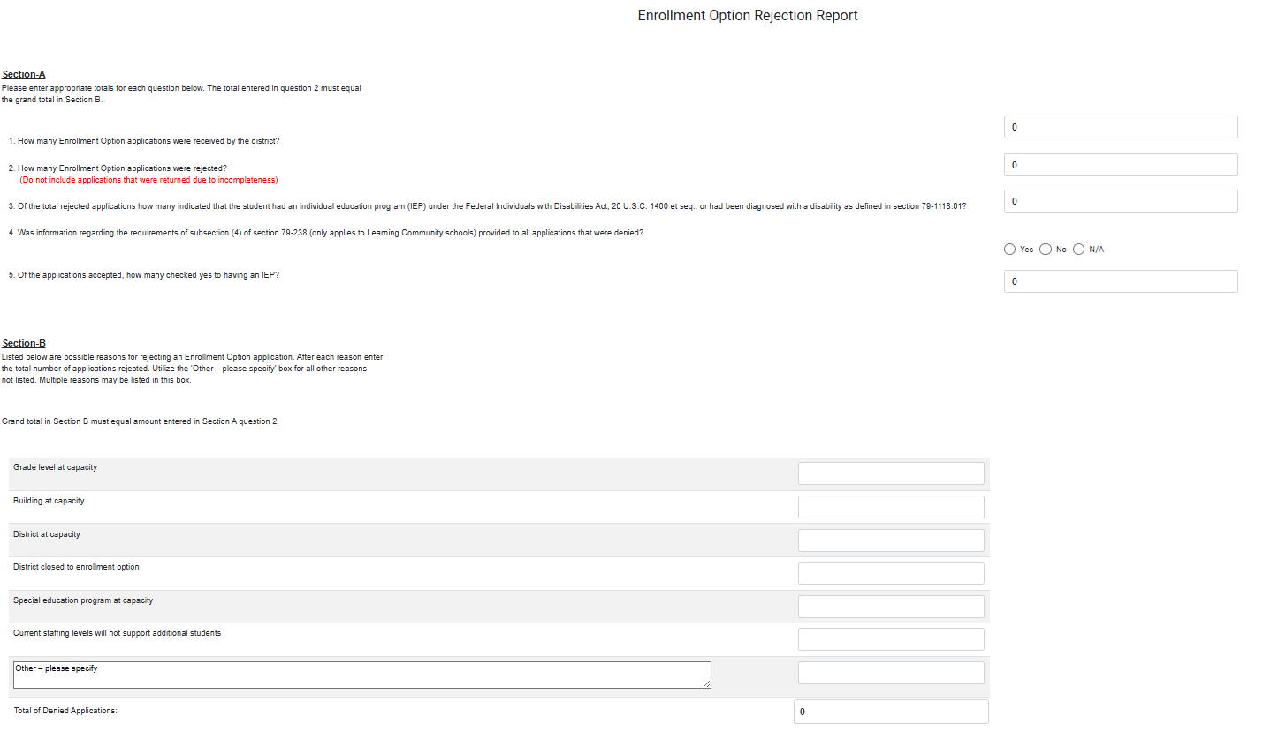
Enrollment Option Rejection Collection
The collection is now open in the New Portal
Report all option in applications received between June 1st & May 31st regardless of the school year
Collection must be submitted & approved by July 31st
- Legislative Requirement

Slide 93
TEEOSA 101
STATE AID CALCULATION
Michelle Cartwright

Slide 94
What is TEEOSA?
Tax
Equity and Educational Opportunities
Support
Act
Statute that defines State Aid
Creates the basic concept for the present state aid formula
Equalization Aid and Foundation Aid – largest components of State Aid
Complex matrix of formulas

Slide 95
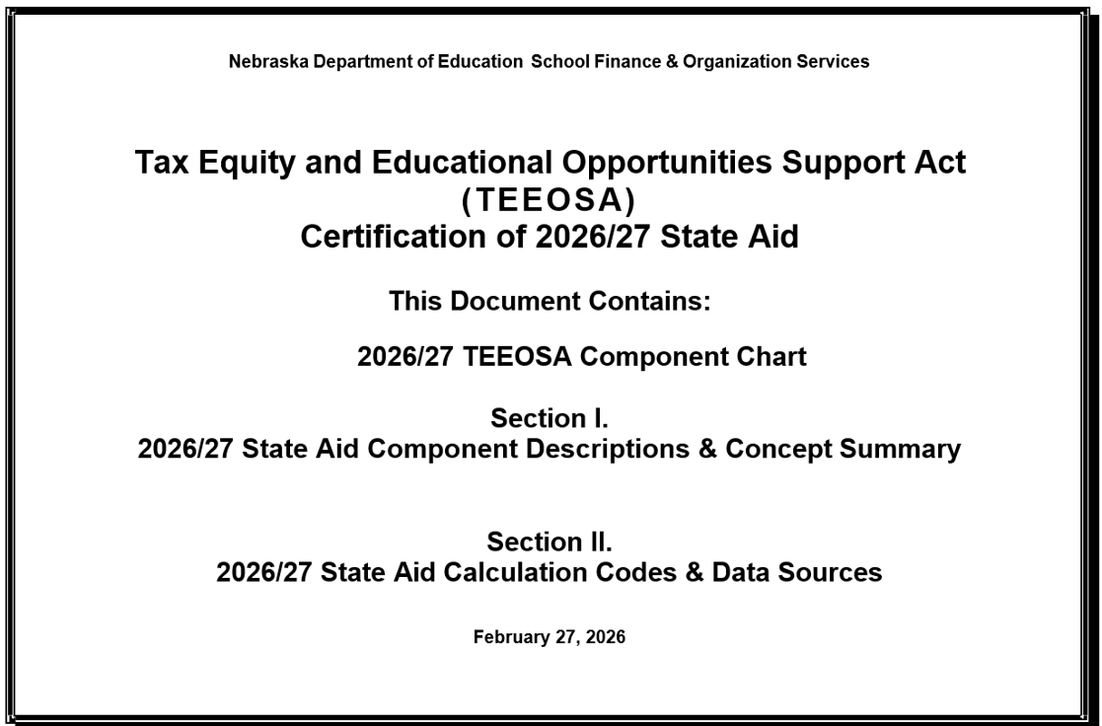
TEEOSA Document
Decodes
the components of Equalization Aid
Resource
for more detailed information
Available
on NDE’s website
https://www.education.ne.gov/fos/state-aid/

Slide 96
TEEOSA FAQ Document
For those
NOT so really ‘dumb’ questions….
What are Formula Students?
How are Needs determined?
How is Poverty Allowance determined?
What is Foundation Aid?
What is Equalization Aid?
How is Total State Aid determined?
https://www.education.ne.gov/fos/state-aid/

Slide 97
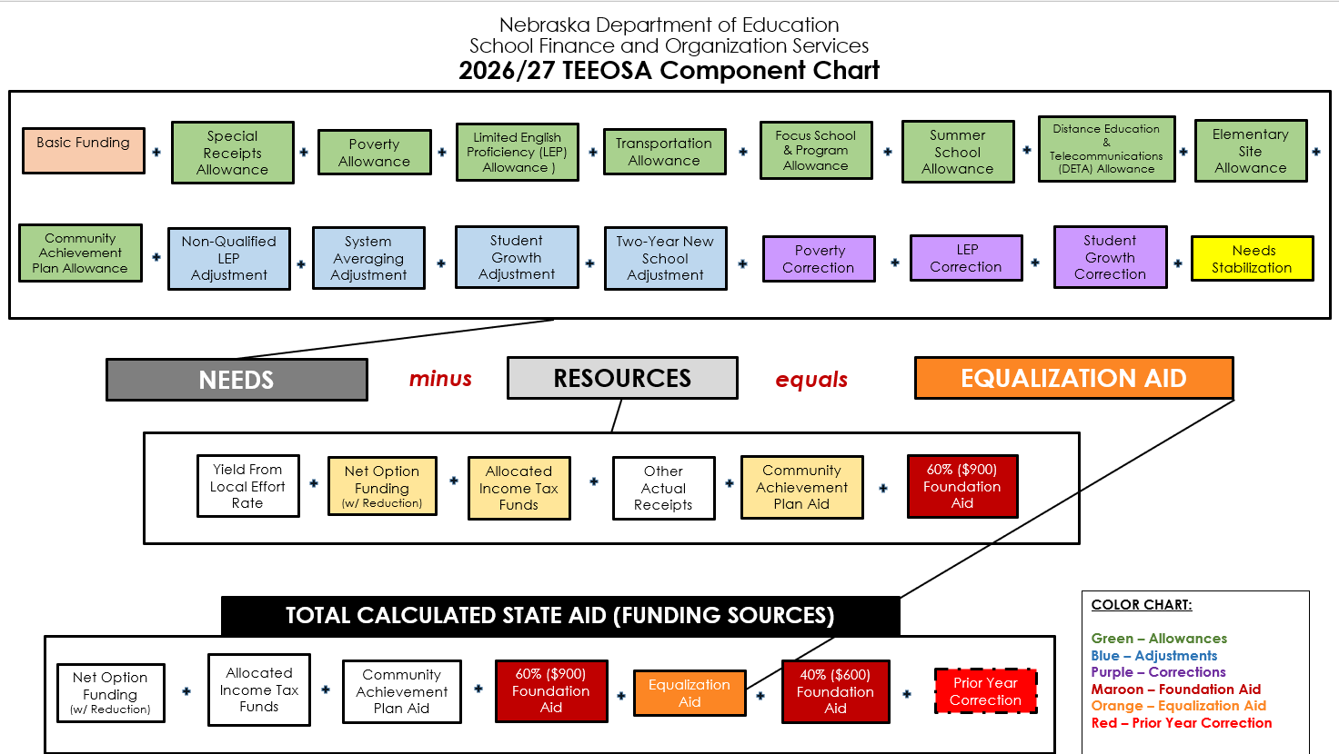

Slide 98


TEEOSA AID PROCESS
CERTIFICATION
  Calculated in the spring for the upcoming school year
  Certified on or before March 1st
  Most Data Components collected in late fall
  Fall membership counts used
RECALCULATION
  Recalculated in the fall to create prior year correction shown on next cert year
  Average Daily Membership (ADM) used
  AFR Amendments (mid July deadline)
  Updates the formulas
CALCULATED TWICE PER YEAR

Slide 99



IMPACTING FACTORS
FORMULA STUDENTS
  Grades K - 12
  Qualified 4 & 5-year-olds (60% Rate)
  Contracted to another district
GENERAL FUND OPERATING EXPENDITURES
  Revenues & expenses from Annual Financial Report
PROPERTY VALUE
  Tax Base
  District's ability to pay
COST SHARING FORMULA

Slide 100
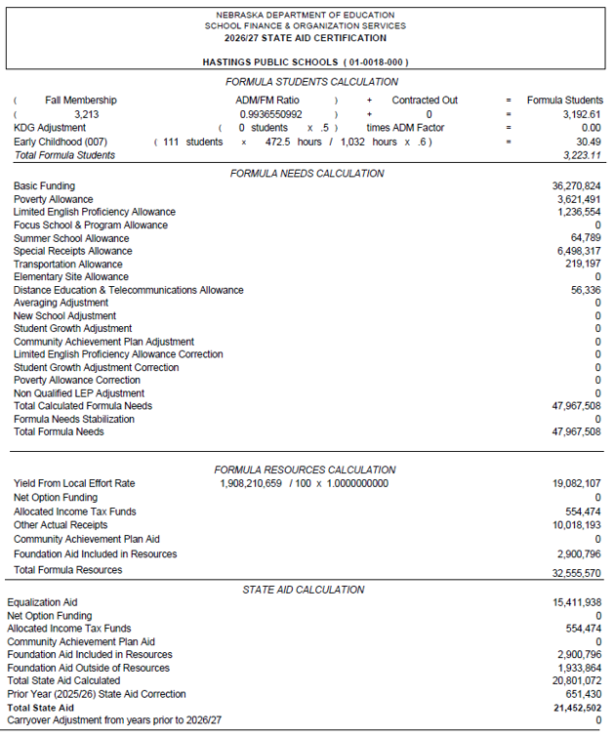
STATE AID CERTIFICATION FORM
Released by March 1 https://sfos.education.ne.gov

Slide 101





CATEGORIES OF NEEDS
BASIC FUNDING
  Estimated amount required to generally operate a school district with a specified number of students
  Calculated by a comparison group
  Average general fund operating expenditures
ALLOWANCES
  Based on estimated or actual expense
  District specific
  Addresses a specified situation by reducing basic funding
ADJUSTMENTS
  Increases the needs
  Adds money to formula
  Addresses a specified situation without reducing basic funding
CORRECTIONS
  Added or subtracted
  Corrects for an allowance or an adjustment
  Occurs 2 years later
NEEDS STABILIZATION
  An amount added or subtracted
  Keeps the needs from growing or declining by more than a specific rate
COSTS TO EDUCATE THE STUDENTS

Slide 102
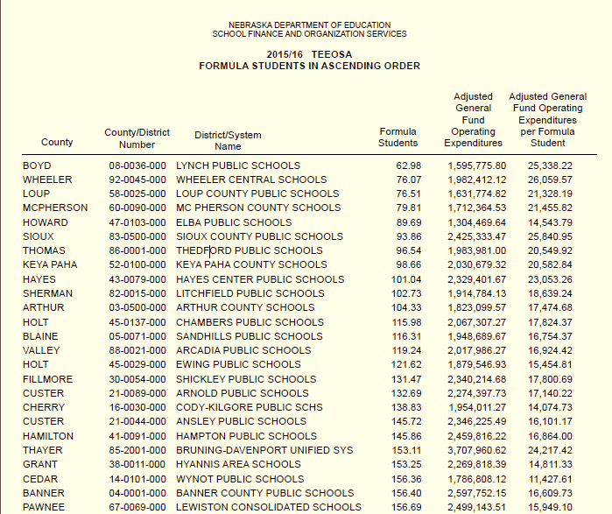
BASIC FUNDING
ESTIMATED AMOUNT
required to generally operate a school district with a specified number of students
CALCULATED BY COMPARISON GROUP
Using the 10 larger and 10 smaller districts closest in size and measured by formula students
ADJUSTED GFOE
is averaged when calculating basic funding

Slide 103
NEEDS & ALLOWANCES
Transportation
Distance Education & Telecommunication
Elementary Site
Summer School
Focus School & Programs
Special Receipts
Poverty/Limited English Proficiency (LEP)
Community Achievement
2026/27
Allowances
Recognizes Funding
For……

Slide 104
NEED & ADJUSTMENTS
2025/26
Adjustments
Adds Money to the Formula For…....
Student Growth
Two-Year New School
System Averaging

Slide 105
NEED & CORRECTIONS
OCCURS…Two years after the district receives the allowance.
Compares the estimated to what occurred.
WHY…….Aligns the funding with when the expenditure or
student growth is expected.
Poverty & Limited English Proficiency Corrections
  Subtract any excess allowance received
  Penalized if plan requirement not met
  LEP – Disqualified for current year if minimum spending requirement is not met
Student Growth Correction
  An amount added or subtracted
  Aligns with actual student growth

Slide 106






COMPONENTS OF RESOURCES
YIELD FROM LOCAL EFFORT RATE
  Property tax capacity
  Local Effort rate – hypothetical tax rate
  Applies a tax rate to adjusted valuations
NET OPTION FUNDING
  Provides funding for the additional non-resident students being educated
  Enrollment Option Program
ALLOCATED INCOME TAX
  Distributes a percentage of individual income taxes back to the school district
OTHER ACTUAL RECEIPTS
  Special Education
  Motor vehicles
  Apportionment
  Power district sales tax
  Interest
  Fines/license fees
  Tuition
  State Wards
  PILT Funds
COMMUNITY ACHIEVEMENT PLAN AID
  Aid for cooperative programs in the Learning Community
  Sharing of administrative and instructional staff for approval and accreditation requirements
FOUNDATION AID
  $1500 per Formula Student.
  Only 60% is included in Resources
REVENUE SOURCES

Slide 107
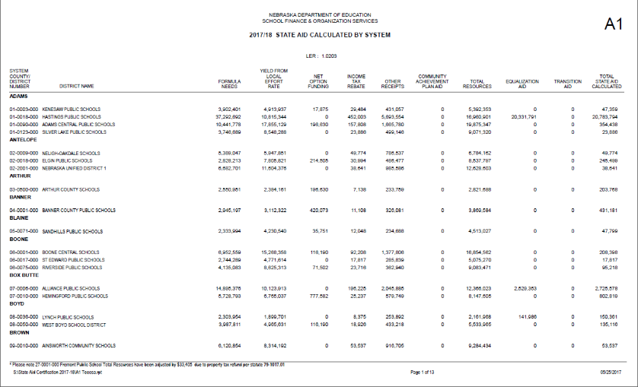
PRIOR YEAR CORRECTION
2025/26
Prior Year
Correction
2026/27
TEEOSA Aid
2025/26 Certification
DIFFERENCE
2025/26 Recalculation

Slide 108
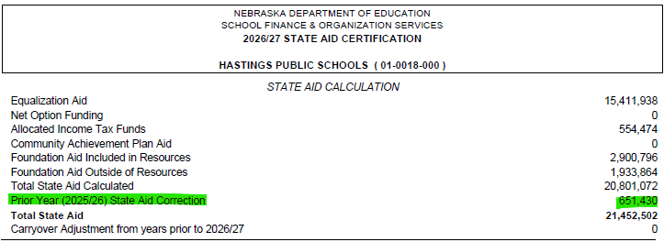

PRIOR YEAR CORRECTION
Included on State Aid Certification Form
Positive Correction
Lump-Sum Payment
  On or before July 15 NDE will notify districts
  Over $1000 can be paid in September if requested
  Under $1000 is automatically paid without requesting
  If a district does not request, it will be included in the 10 monthly installments
Negative Correction

Slide 109
COMMON State Aid QUESTIONS
Why does our school district receive very little state aid?
    Does not receive equalization aid
      Equalization Aid is the largest component of TEEOSA Aid
    Not utilizing allowances and adjustments
    Had a correction for a prior year allowance/adjustment
    Resources are greater than your needs
    Property-rich = less support from the state

Slide 110

COMMON QUESTIONS
I’m a non-equalized district
….does TEEOSA aid matter?
ALLOCATED INCOME TAX
COMMUNITY ACHIEVEMENT PLAN AID
FOUNDATION AID
EQUALIZATION AID
NET OPTION FUNDING
2026/27 TEEOSA Aid Certification
44 Equalized Districts
200 Non-Equalized Districts

Slide 111
COMMON QUESTIONS
Does my general fund levy rate
have any effect on TEEOSA aid?
    No, general fund levy rate does not affect TEEOSA aid.

Slide 112
COMMON QUESTIONS
Can districts maximize
their financial situation?
Understand the components of formula need
Code revenues and expenses correctly
Look at the whole picture when determining where to code expenses
Submit verified data by the due dates

Slide 113

NDE Legacy Portal - ADVISER

Slide 114
ADVISER- School Finance Review
Information is received nightly from districts’ Student Information System (SIS).
Reports from SIS and ADVISOR should be compared for discrepancies.
If assistance is needed, contact the Service Desk.
ADVISER Reports used for TEEOSA
  Average Daily Membership (ADM)
  Fall Membership (October 1st)
  Option In/Out
  Contracted Students
  Qualified Early Childhood
  Limited English Proficient (LEP)

Slide 115
TEEOSA
DATA
SYSTEMS
TEEOSA State Aid Collection (New Portal)
  Assessed Valuation and Levies
  Elementary Site Allowance
  Estimated Expenditures for Poverty and LEP
  Student Growth Adjustment
  Summer School Student Unit
  Two-Year New School Adjustment Application
PK Instructional Program Hours/K Program (Legacy Portal – CDC)
  Data entered here is used for Early Childhood Formula Student counts
**Open September, due by October 15 each year

Slide 116

TEEOSA
State Aid
Collection

Slide 117
LEP & Poverty Expenditure Requirement
*RIGHT NOW*
2025/26
Expenditures
117.65% level of Expenditures
Reports posted identifying required level
Coding for 25/26 AFR
*UPCOMING*
2027/28
Expenditures
Report this fall
  Sept 1 – Oct 15
TEEOSA Collection - Estimated Expenditures for LEP and Poverty
Reports have been posted here:
https://www.education.ne.gov/fos/poverty-allowance-expenditure-requirement/
https://www.education.ne.gov/fos/lep-allowance-expenditure-requirement/

Slide 118
Superintendency Pay Transparency Act
T
Submission deadlines required by statute
On or before August 1:
Submit entire approved contract (pdf) in Portal Collection
September 30:
Complete Schedule D in the District Budget, submit in LC-2
October 1:
Withholding state & local funds started for schools not submitting superintendent contract through NDE Portal (CDC)

Slide 119
Federal Program
Updates

Slide 120
ESSA Consolidated Grants
Name | Purpose | Disbursement Code
Title I-A | Support for Educationally Disadvantaged Students | 6200
Title I-D | Neglected and Delinquent Student Support | 6230
Title II-A | Professional Development or Class Size Reduction | 6310
Title III-EL | Support for English Language Learners | 6925
Title III-IE | Support for Immigrant Education Students | 6926
Title IV-A | Student Support and Academic Enrichment in the areas of Well-Rounded, Safe and Healthy, and Effective Use of Technology | 6969

Slide 121
Additional Federal Grants
Name | Purpose | Disbursement Code
CSI Grant | Buildings identified as Continuous School Improvement New Schools will be identified in November 2026 | 6212
RLIS | Rural and Low Income School | 6330
SRSA (REAP) | Small Rural School Achievement Program--Schools with an ADA of 600 or less are eligible. (All information from this grant is sent directly from the federal government.) | 6310
McKinney-Vento | Districts that have identified at least 20 students experiencing homeless can apply for this grant. 3-year cycle. Year 2 starts this year. | 6991

Slide 122

Good News: We have the allocations!
Notes:
Last year at this time, we had not received any of the allocations for Title I-C, II-A, III-A, IV-A, and IV-B, but this year we have the amounts
122

Slide 123

2026-2027 Application is Open in GMS
No delays this year!
Closing Date is 9-30-2026
Allocations have been uploaded into the grant
Time and Effort Calculator

Slide 124
What should I do now?
Create your grant in the 2027 year
Complete the ESSA GEPA Tab
Review the Allocations Tab to determine your funding per program and transfer money if desired
  Allowable Transfers
    Title II to Title I or IV
    Title IV to Title I or II
Stay with us this afternoon and we’ll help you complete your application.
Notes:
If you don’t have your salary and benefits info for your Title I teacher, call your bookkeeper at lunch and we’ll help you with the T & E calculator.

Slide 125
Monitoring Schedule-ESEA Programmatic and Fiscal
ESEA Programmatic is on a 5-year rotation unless any issues are noted
  Ask one of us today if you are on the list to be reviewed this year
  If so, your reviewer will be in touch by the beginning of second semester
Fiscal is on a 3-year rotation unless any issues are noted, or the fiscal review hasn’t been conducted in more than three years, or the district is a high-risk district
  Fiscal Team under the direction of Victoria Katzberg will be in touch sometime during the 2026-2027 SY

Slide 126
Opportunities For Additional Support
NDE Days
ESU Sessions (look for info from your local ESU)
Office Hours for Grant Support
  September 3 @ 2:00 p.m. CT
  September 9 @ 10:00 a.m. CT
  September 23 @ 10:00 a.m. CT
One-on-One Support from your reviewer

Slide 127

Reviewers by ESU

Slide 128
District Administrator
Portal ​Responsibilities​
NDE Service Desk
NDE.ServiceDesk@Nebraska.gov

Slide 129
A Portal District Administrator, typically the Superintendent, manages electronic access to District data within the NDE Portal.​

Slide 130

NDE Portal https://portal.education.ne.gov/

Slide 131

Legacy

Slide 132

Portal District Admin
Once a District Administrator has been approved, they will see and utilize 5 main tabs in their portal account:​
  Data Collections
  Student & Staff (NSSRS)​
  District Admin​
    Only District Administrators have this tab​
  My Profile
  Help

Slide 133
Data Collections Tab​
Supports the collection of many different types of data. ​Examples:
Financial​: Annual Financial Report, Census Report, LC-2​, Pupil Transportation
SPED: ICLD, Special Education Financial Report System (SPEDFRS)
Other​: Consolidated Data Collections (CDC)

Slide 134
Student & Staff (NSSRS) Tab​
Supports the collection of student and staff specific data.
Student Data
  ADVISER Validation
Staff Data
  NSSRS Validation
  NDE Staff ID

Slide 135
District Admin Tab​
Where District data access is managed.
Activation Codes
  Lists activation codes for every collection in the portal
    Some collections only have 1 activation code, others have many
    Some collections require a District Admin role, some can be assigned to whomever
    Some collections require a new activation code every year, some are one time only
  Remove access from staff no longer at your District
Administrator Reports
  Lists access for District by User ​or by Collection
    REVIEW these and remove access for folks no longer at your District

Slide 136
My Profile & Help Tabs​
My Profile
  Update email address
  Add/remove Portal District Admin code (likely already completed)
Help
  Activation Code instructions
  How to create a new portal account
  District Admin responsibilities

Slide 137


New

Slide 138
New
SSO Login (ESUCC NebraskaCloud)
  Blue ‘Click Here’ button
Access assigned and requested within Portal (Admin Portal)
  No activation codes
  Instead: Roles
    Single-Application, or
    ‘Job Based’ Multi-Application
      All Public Supts: District Admin - Public
Proxy
  One person per District, select date range
  Can approve/assign access and approve some applications

Slide 139
Applications
Slowly being transitioned from Legacy
Financial: TEEOSA State Aid, Enrollment Option Rejection Report
Student: ADVISER Person ID
Staff: ESSA Ineffective Teachers (for Supts only), Staff Reporting 26-27
Other: DHHS Supt Letters, HAL

Slide 140

Admin Portal ​
Where District access is managed
Proxy Admin and Request Approvals

Slide 141
Resources
NDE Service Desk: NDE.ServiceDesk@Nebraska.gov
Help Site: https://help.education.ne.gov/
Bulletin: https://www.education.ne.gov/bulletin/
Portal: https://www.education.ne.gov/portal/

Slide 142
Data Specific Resources
ADVISER: https://www.education.ne.gov/dataservices/adviser-resources/
Consolidated Data Collections (CDC): https://www.education.ne.gov/dataservices/consolidated-data-collection-cdc/
Staff Reporting: https://www.education.ne.gov/dataservices/staff/

Slide 143
New Superintendent
Wrap up
Bryce Wilson

Slide 144
School Tax Credit
Instead of receiving half of the 2025 tax request in September of 2026 the State paid the credit portion in two payments
  On or before Jan 1st
  On or before April 1st
Counties are paying out these credits on different time schedules.
Impacts
  A portion of the tax request is received earlier now
  Lower tax draws in May and September than before the school tax credit.

Slide 145

Audit Requirement
State Statute §79-1089 requires that a public accountant or a certified public accountant annually examine all financial records maintained by school districts.
Important part of Nebraska’s Transparency and Accountability Program.

Slide 146
Audit Requirements
Average Daily Membership must be audited by your independent auditors.
Template available for auditors.
School District must have individual capable of overseeing financial statement preparation otherwise:
Must hire acct firm to prepare f/s that is different from the firm that audits the f/s.

Slide 147
Superintendent Pay Transparency Act -- Budget Schedule D
Timeline required by statute:
At least 3 days before meeting, publish/post for returning Supt:
  Meeting notice detailing current costs and estimated future costs
  Proposed contract or amendments to contract (pdf)
Within 2 days after board approval, publish/post for new Supt:
  Entire approved contract (pdf)
  Meeting Notice

Slide 148

Mileage Reimbursement Rates
$.725 per mile Effective January 1, 2026
Regular Resident District Students:
$2.0663 per mile
Qualify if living 4 miles from school
Reimburse from 3 miles
One way travel once a day
Enrollment Option Students
$1.0331 per mile
Qualify if on free lunch
Reimburse from 3 miles
One way travel once a day

Slide 149
Notification of State Payments
Department of Education Payment Information
https://www.education.ne.gov/fos/payment-information/
Grants Management System (GMS)
Payment Information
Audit Confirmation
All District Payments from State of Nebraska
Liz.hernandez@nebraska.gov
Request to receive email notification of all payments to district from State of Nebraska
Email must be sent from Superintendent
Only one email per district

Slide 150

Grants Compliance Division
We strengthen accountability, reduce risk, and help ensure education funds are used effectively and in compliance with federal and state requirements through proactive guidance, monitoring, and support.
How We Do It:
Risk Assessments
Fiscal Monitoring
Single Audit Review
Corrective Action Management
Technical Assistance
Compliance Oversight
Director of Grants Compliance
Victoria Katzberg

Slide 151

Resources and Contact Information
Fiscal Monitoring Page
  Fiscal Monitoring
  GMS Links
  Risk Assessment Guide
Fact Sheets & Templates
Training Hub
2 CFR 200

Slide 152
Website Addresses
Nebraska Department of Education
http://www.education.ne.gov
Finance & Organizational Services
http://www.education.ne.gov/FOS
Nebraska Department of Education Portal
https://portal.education.ne.gov
NDE Payment Information
https://www.education.ne.gov/fos/payment-information/

Slide 153

Budget Assistance
Administrators’ Days – Crowne Conference Center
  Second Floor
  July 29th & July 30th
    8 a.m. – Noon
    1 p.m. – 3 p.m.
Dedicated Rooms
  One on One Help
  Bring Laptop
  Budget Form started
  Audit
If the budget has you feeling this way come find us!

Slide 154
NDE School Finance Team
Bryce Wilson
bryce.wilson@nebraska.gov 402-471-4320
Michelle Cartwright
michelle.cartwright@nebraska.gov 402-450-0867
Stephanie DeGroot
stephanie.degroot@nebraska.gov 402-540-0649
Kelsey Larsen
kelsey.larsen@nebraska.gov 402-450-1418
Notes:
RUSS END

Slide 155

You Made It!!!

Slide 156
Thank You!

