Slide 1


Direct Certification
Nebraska department of Education
Nutrition services
July 2023

Slide 2
Training Agenda
Direct Certification Basics
Enrollment
Match List and Possible Match List
Student Lookup
Direct Verification
Resources

Slide 3
Direct Certification Basics

Slide 4
Direct Certification
Electronic data-matching process
Federally mandated; facilitated by the Nebraska Department of Education (NDE)
Students are directly certified based on their participation in a qualifying program administered by the Nebraska Department of Health and Human (DHHS)
Increases participation in school meals
Reduces administrative burden
Notes:
Direct Certification is an electronic data-matching process that is federally mandated and facilitated by the Nebraska Department of Education (NDE). Students are directly certified, or “matched”, based on data from NDE and the Nebraska Department of Health and Human Services (DHHS). Data between these two agencies is matched on a daily basis using student name, date of birth and gender. Students that appear in both the NDE student database and DHHS student databases receive free or reduced priced meals without being required to submit a household income application. School Food Authorities (SFAs) who participate in the National School Lunch Program (NSLP) are notified of qualifying students, which increases participation in school meals programs and reduces administrative burden.
These training modules are meant to provide information and guidance for SFAs in navigating and maximizing the use the Direct Certification system. The Direct Certification is accessed through the CNP online system. Guidance for accessing Direct Certification can be found here {include link to access doc}.

Slide 5
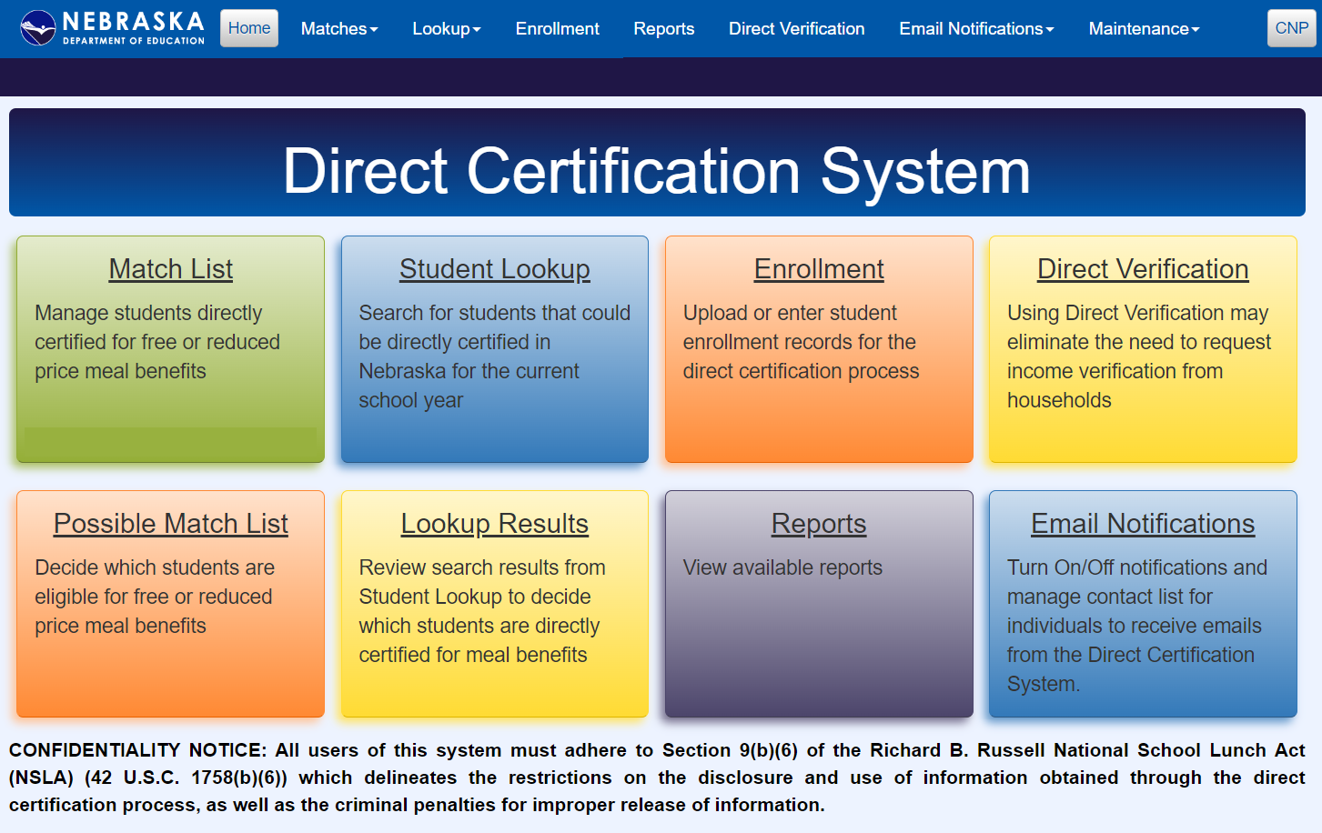
Direct Certification Modules
Notes:
There are eight modules contained within the Direct Certification system that school personnel can access. They can be accessed by the colored tiles on the Direct Certification Homescreen or on the top toolbar.

Slide 6
Qualifying Programs
Qualifying Program | Direct Certification System Acronym | Benefit Level | Household Extension | Priority
Supplemental Nutrition Assistance Program* | SNAP | Free Meals | Yes | 1
Temporary Assistance to Needy Families* | TANF | Free Meals | Yes | 2
Food Distribution on Indian Reservations* | FDPIR | Free Meals | Yes | 3
Foster Children | FSTR | Free Meals | No | 4
Medicaid Free* | MFREE | Free Meals | Yes | 7
Medicaid Reduced* | MRED | Reduced Meals | Yes | 8
*Income-based categorical eligibility
Notes:
Students are matched into one of eight qualifying programs in the Direct Certification system.
Six programs match students who appear in the DHHS database as qualifying and currently receiving benefits for need-based assistance programs. These programs include: Supplemental Nutrition Assistance Program (SNAP), Temporary Assistance to Needy Families program (TANF), Medicaid Free (MFREE), Medicaid Reduced, (MRED), Food Distribution on Indian Reservations (FDPIR) and Foster children (FSTR).
Three programs match students based on internal NDE student databases and include Migrant Students, and Homeless Students.
All qualifying programs, with the exception of Foster Children, extend eligibility to other students residing in that same household. This means that if one student within a household is matched as qualifying for SNAP benefits, all other students within that household can have the same benefits extended.
Medicaid Reduced is the only qualifying program where reduced benefits are extended; all other qualifying programs result in matched students being eligible for free meals.
Students are always matched at the highest priority. For example, a student might qualify for both FDPIR and SNAP; the student will match with SNAP benefits as it’s the highest priority program.

Slide 7
Important Direct Certification Dates: July
July 1
Start of program year
Old data tables cleared; data as of July 1 pulled from DHHS used for matching
Update student enrollment data
Public schools: upload student information into the CNP Direct Certification Enrollment
Non-public schools: begin adding student enrollment information into PersonID beginning in June
Remainder of July
Matches will start to populate in the Match List and Possible Match List
Distribute notification letters to households with matched students

Slide 8
Updating Student Enrollment: August, October and February
Federal regulations require updating student enrollment data at least three times annually.
Public Schools
ADVISER system communicates with school's student information system daily
Non-public Schools
Regularly update student enrollment in PersonID/ADVISER to ensure match list is current

Slide 9
Important Direct Certification Dates: July 1 – June 30
Program year runs from July 1 – June 30
Tasks to complete on a regular basis throughout the program year;
Accept, transfer or remove students added to Match List
Review and take action on students added to Possible Match List
Send notification letters to households as students are directly certified
Utilize direct certification reports for data reporting
Set up direct certification system notifications
Modify notifications based on staff changes
Keep PersonID/ADVISER updated
ADVISER will start to pull student data automatically after validation (typically mid-September)

Slide 10
Benefit Category FAQ
Can a student qualify for two programs?
Students are matched into the highest priority program for which they participate/qualify.
A student re-appeared on my match list as qualifying for a higher-priority program. What should I do?
Students should be receiving the highest priority benefit level from the date of matching through the remainder of the program year. Update your SIS to indicate the new benefit level and note any changes (i.e. change from reduced meals to free).
A household wants to decline benefits. How do I proceed?
The student(s) will still appear in your Direct Certification system. Ensure your SIS shows this student as not receiving benefits. Do not include this student when reporting Direct Certification data.

Slide 11
Direct Certification and Medicaid
Medicaid programs vary in their qualifying method
Not all students who receive Medicaid benefits qualify for free or reduced priced meals
Utilize student lookup to match students
Notes:
Nebraska offers a wide variety of medicaid programs to school-aged children. These programs include traditional medicaid and Child Health Insurance Program. Unlike programs like SNAP and TANF, where qualification for the program results in automatically being directly certified for school meal benefits, qualifying for medicaid does not mean a student is guaranteed free or reduced priced meals.
There are some medicaid programs that do not require income documentation for the child to qualify, while other programs do require income documentation.

Slide 12
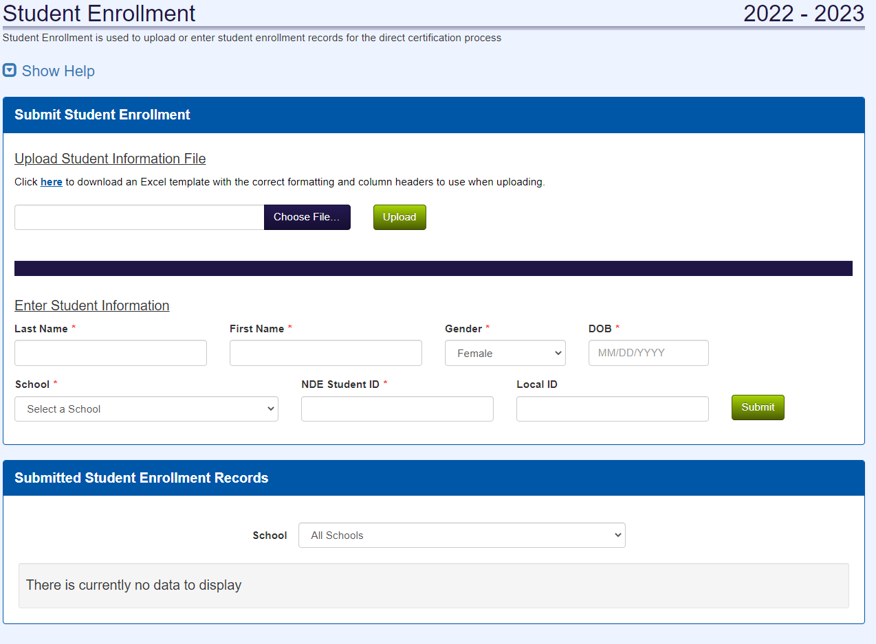
Student Enrollment Data

Slide 13
Starting a New School Year
Non-public schools
Upload student data into PersonID beginning in June and ongoing as needed
Periodic updates throughout the school year
Public schools
Upload a complete student information file into the CNP DC Enrollment tab
After SIS approved to interface with ADVISER, uploading to CNP DC Enrollment not needed

Slide 14
Direct Certification Enrollment Module
Two Submission Options:
Student Enrollment File Upload
Individual Student Data
Notes:
Your school is required by the NDE Data and Research Evaluation team to provide regular enrollment updates to the ADVISER and PersonID systems. If your school decides to also upload sudent enrollment student data into the Direct Certification system, know that this data is only accessible to school personnel with DC access and the Nutrition Services team. Data uploaded into DC will not also be added to the Adviser or PersonID systems.
Please ensure that these files contain all enrolled students, not just those who might qualify for free or reduced priced meals. The direct certification system will compare the uploaded student into the DC against DHHS databases and internal NDE databases in an attempt to provide direct benefits to students.
The DC system provides two different options for uploading student data, either through a student enrollment file upload that contains all enrolled students or the submission of individual student data. Both of these options are accessed by the enrollment box in the DC system or Enrollment link on the top tool bar.

Slide 15
Enrollment Submission: File Upload
Must utilize and complete the provided template file
Data Element | Required For Upload | Data Format | Notes
School Building Number | Yes | Numeric (3 digits)
Local Student ID | No |  | District-specific student ID
NDE Student ID | Yes | Numeric (10 digits) | NDE’s unique state student ID
Student Last Name | Yes | Alphanumeric
Student First Name | Yes | Alphanumeric
Student Gender | Yes | M or F
Student Birthdate | Yes | Alphanumeric (m/d/yyyy)
Notes:
The most time effective option for uploading student enrollment data in the DC system is by using the Student Information File upload option. Schools will compile data for all enrolled students into a single file and upload that file into the Enrollment tab in the DC system.
Nutrition Services has developed a template file that schools must use to have a successful upload. This file contains the required columns and has been formatted to ensure successful upload. A copy of the template can be accessed using the link on this slide, and is also linked in the Student Enrollment tab in the DC system.
When uploading the Student Information File, each data line must contain the 6 required data elements listed on this slide. The only data element that is optional is the Local Student ID. Your school may or may not have local student IDs in addition to the required NDE student ID. All other data elements are required for your upload to be successful. The required data elements include the three digit school building number, 10 digit NDE student ID, the student’s first and last name, their gender and birthdate. See formatting requirements and additional notes for each of these data elements on the current slide.

Slide 16
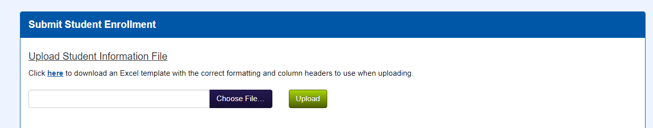
Enrollment Submission: File Upload
Choose file and upload
Must be in .csv or .xls format
Data will be matched in the overnight process and matches appearing in the match list export the next business day (except for holidays: Christmas, Thanksgiving, and New Year’s Day)
Notes:
Once you have completed the template file and have all required data elements included for all enrolled students, please save your file as a BLANK file type. You will navigate to the Submit Student Enrollment section, choose the file and then upload. A successful upload will be indicated by student data populating the Submitted Student Enrollment Records section after you refresh your screen.
The data submitted by this file upload will go through the matching process the night after being uploaded, and any additional matches that can be made based on this data will populate in the match list on the next business day. It is possible that uploading your student data into the Enrollment tab will not result in any matches, especially if the data you upload matches what is currently found in the Adviser or PersonID systems.
Uploading students in a single file is the most time effective option to add student enrollment data to the DC system. All schools, regardless of size, are encouraged to use the upload option to reduce staff time spend on uploading into the enrollment tab.

Slide 17
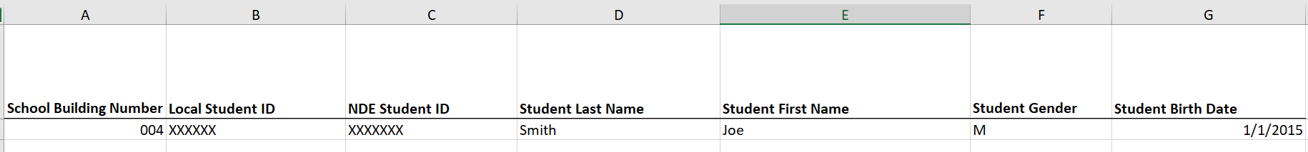
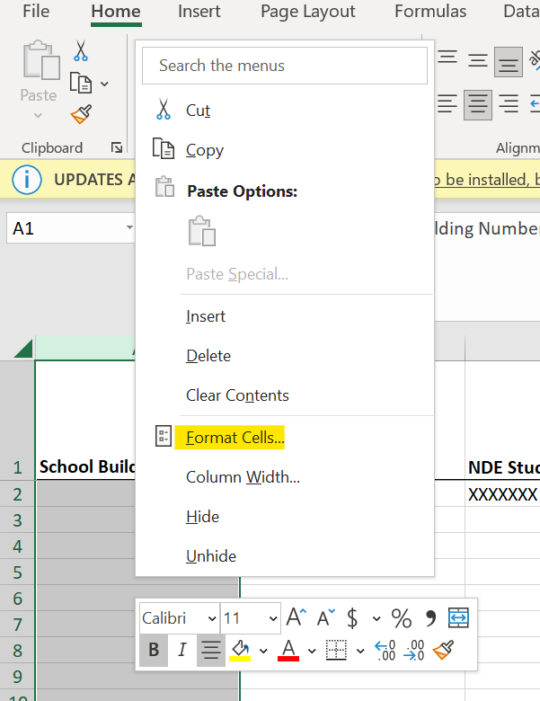
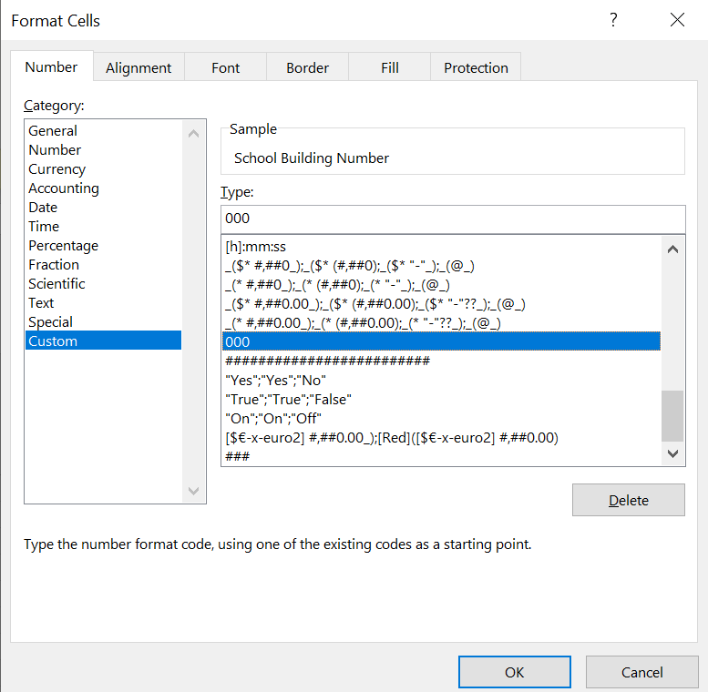

Slide 18
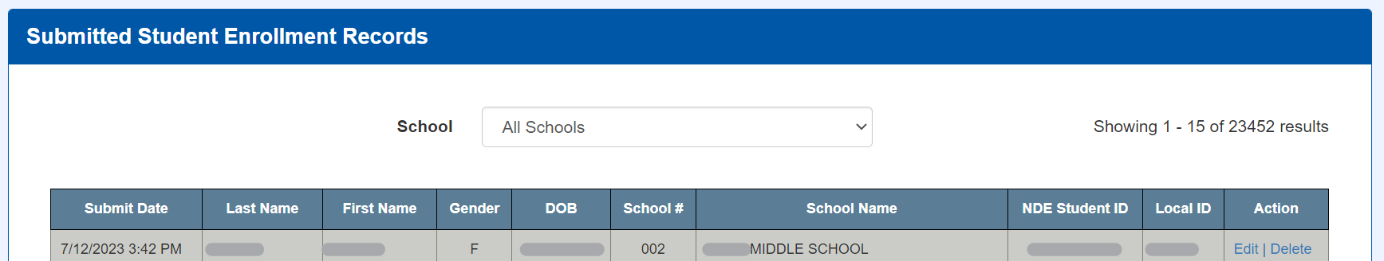

Enrollment Submission: File Upload Success
Notes:
Once you have completed the template file and have all required data elements included for all enrolled students, please save your file as a BLANK file type. You will navigate to the Submit Student Enrollment section, choose the file and then upload. A successful upload will be indicated by student data populating the Submitted Student Enrollment Records section after you refresh your screen.
The data submitted by this file upload will go through the matching process the night after being uploaded, and any additional matches that can be made based on this data will populate in the match list on the next business day. It is possible that uploading your student data into the Enrollment tab will not result in any matches, especially if the data you upload matches what is currently found in the Adviser or PersonID systems.
Uploading students in a single file is the most time effective option to add student enrollment data to the DC system. All schools, regardless of size, are encouraged to use the upload option to reduce staff time spend on uploading into the enrollment tab.

Slide 19
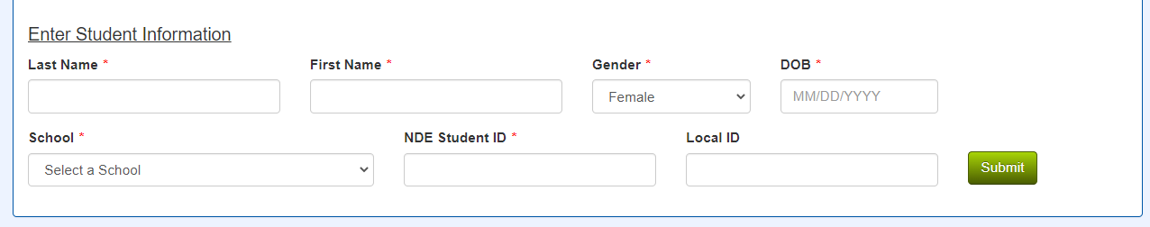
Enrollment Submission for Individual Students
Newly added students not in the batch upload
Must enter data for all fields marked with *
Data will be matched in the overnight process and matches appearing in the match list export the day (except for holidays: Christmas, Thanksgiving, and New Year’s Day)
Notes:
Schools have a secondary option to individually submit students to be considered for direct certification. This option is more time consuming than completing a file upload, but can be a good option if you are wanting to add newly transferred students to your enrollment records in DC or have a very small enrollment. Each student will need to be entered into the Enrollment tab, and each of the fields marked with an * MUST be filled out for the student enrollment data to be submitted. Please note that a local ID can be entered, but is not required to submit the student for direct certification consideration.
Successful submission of individual students will be indicated by student data populating the Submitted Student Enrollment Records section after you refresh your screen.
The individual data submitted will go through the matching process the night after being uploaded, and any additional matches that can be made based on this data will populate in the match list on the next business day. It is possible that submitting individual student data into the Enrollment tab will not result in any matches, especially if the student data you submitted matches what is currently found in the Adviser or PersonID systems.

Slide 20
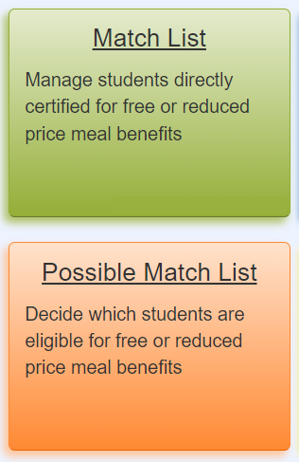
Match List and Possible Match List
Notes:
The next modules we will focus on will be the match list and possible match list. These modules can be accessed either by clicking on the green or orange tiles, or navigating to the tool bar and selecting the match list or possible match list from the drop down menu.

Slide 21
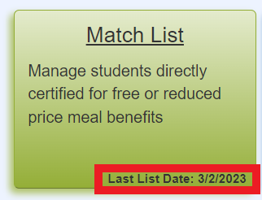
Match List
Match List contains all students who have been directly certified
Refer to the green tile on the Direct Certification home screen for the most recent match list date
Notes:
The Match List displays all students who have been directly certified. Students that appear on the match list qualify for benefits starting on the list date and are not required to submit any additional documentation or paperwork to receive benefits at either a free or reduced level. New additions can be made to the match list daily, as DHHS and NDE student databases are updated nightly and can result in new matches any time student data is added or changed.
Refer to the green tile on the Direct Certification home screen for the most recent date that your school’s match list has been updated. An email notification is also sent to BLANK when new students have been added to the match list or possible match list. We will discuss the possible match list next, and a resource is found in the Canvas resource section and on the NDE website related to Direct Certification notifications.

Slide 22
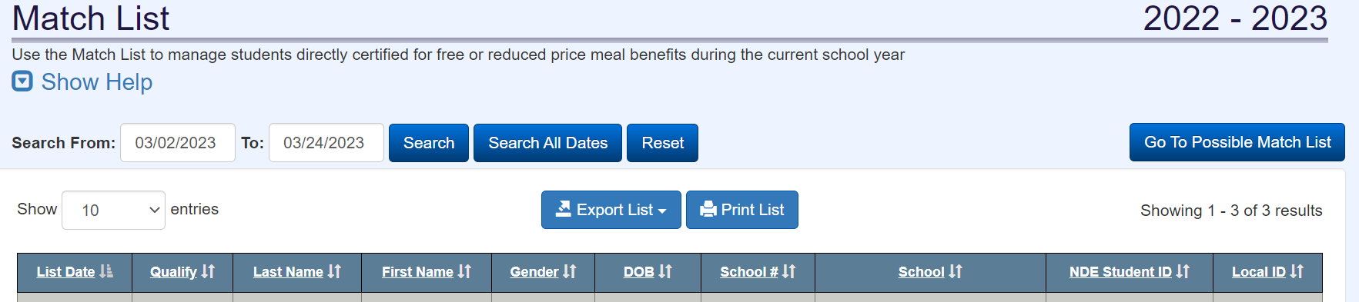
Match List Functions
Filter, Sort, View and Export List
Notes:
Users have the option to filter, sort, view and print match list data from the Direct Certification system.

Slide 23
Filtering the Match List
Filter by Search From dates
Notes:
Match List data can be filtered by the Search From and To dates. Student matches with list dates that fall between the Search From and To parameters will be displayed. The earliest search from date will always be July 1 of the current program year, and the latest search to date will always be the current date.
To search from July 1 to the current date, click on the Search All Dates button.
This feature is especially helpful when completing reports including the annual Verification Report, as data can be filtered down to identify matches made within a certain time frame.
Clicking the Reset button will change the Search from date to 22 days prior to the current date, the automatically set time frame.
Please note that this is the only data filtering function for the match list, and the sorting columns noted below including List Date and Qualifying program will only include students matched within the currently set search from and to dates.

Slide 24
Sorting the Match List
Sort by Data Columns
Notes:
Match List data can also be sorted by any of the Data Columns. This includes list date, which is the date the student populated on the match list and is the first date of benefit issuance for that student. Data can be sorted by the qualify column or the qualifying program the student was matched under. You can also view the full qualifying program name by hovering over the qualify acronym. Refer back to the Benefit Categories section for a list of qualifying program acronyms.
Identifying student data including first and last name, gender and date of birth can also be used to sort match list data. Data can be sorted by the three digit school ID of the school the student attends along with the school name. You can sort students by NDE ID, and might be able to also sort by local ID if that data is included in Adviser, Person ID or in an upload or student entry made into the Direct Certification Enrollment module.
Do note that data can only be sorted by the data columns; it cannot be filtered. To filter out student match data, you will need to modify the Search From and To dates.

Slide 25

Viewing the Match List
Select the number of students on the screen
Notes:
There are multiple ways to view match list data. Users can adjust the number of entries that display by changing the entry number. This allows users to remain in the Direct Certification system and view more student data.

Slide 26
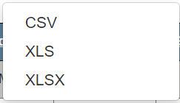
View & Print the Match List
Export list to CSV – file will save to your computer
Print the match list from the downloaded file
Notes:
Match list data can also be exported to Excel in one of three formats: a CSV file, an XLS file or an XLSX file.
Do note that the export will only include data based on filtering from the Search From and To dates. To export all match list data for the current program year, first click on Search All Dates, then select the type of file to export.

Slide 27
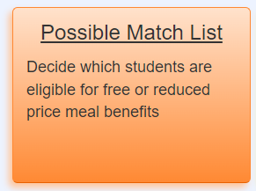
Possible Match List Basics
Possible Match List contains students who have NDE and DHHS data, but a 100% match cannot be made by the DC system
Users need to review Possible Match List matches for approval/denial
Notification email is sent when a possible match has been added to the Possible Match List
Common reasons for student to appear on the Possible Match List
Different names (i.e. spelling errors or hyphenated names)
Different DOBs (different month, date or year)
Incorrect gender

Slide 28
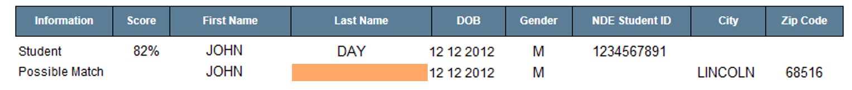
Possible Match List Guide: Score
Because files don’t match exactly, a score (PURPLE) of less than 100% will be displayed
Scores closer to 100% indicate a greater likelihood of a match
Scoring is based on the number and type of difference(s) between the top and bottom data lines

Slide 29
Possible Match List Guide: Determination
Confirming a possible match
Select MATCH
Student will be added to your match list
Denying a possible match
Select NO MATCH
Student will not be added to your match list
Unsure about a possible match
Make no selection and utilize Student Lookup option

Slide 30
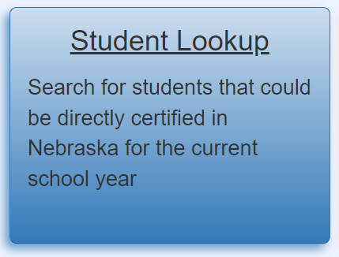
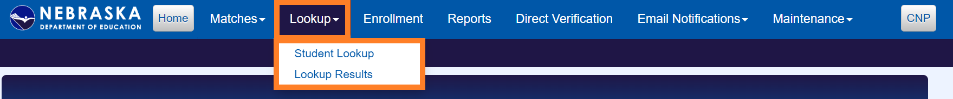
Student Lookup

Slide 31
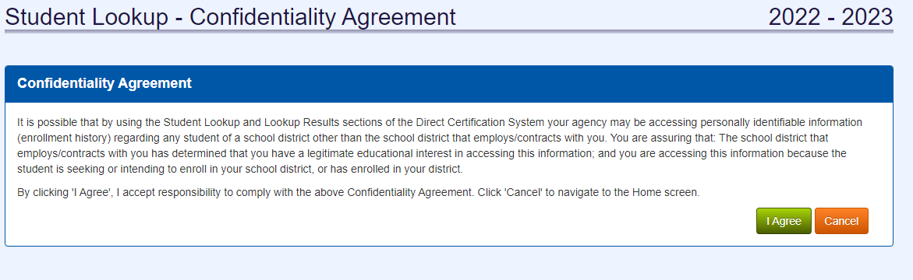
Student Lookup Confidentiality Agreement
Notes:
Before entering the student lookup module, all users must agree to the confidentiality agreement. Student lookup should only be used when you believe a student enrolled or soon to be enrolled at your school might qualify for benefits, and the student is not populating on the match list. Student lookup cannot and should not be used for any other reason, and the data from a resulting student lookup match should be kept confidential. You must click agree to use the student lookup module.

Slide 32
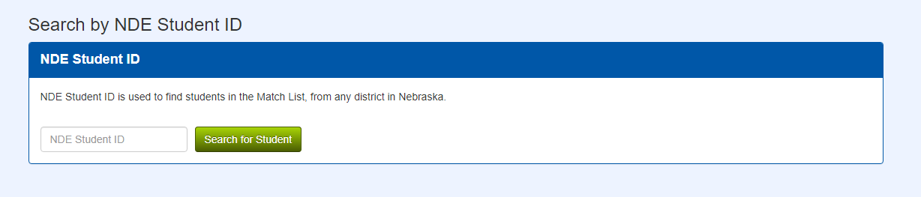
Student Lookup: NDE ID
Search Option 1: NDE Student ID
Enter the student’s unique 10 digit ID
Search for student
Notes:
Once you’ve accepted the confidentiality agreement, you can continue to the search function to locate a student in the student lookup. There are two ways to lookup a student; using their NDE Student ID or Student information.
To search for a student using their NDE ID, enter the 10 digit unique ID and click the Search for Student number.
A students NDE ID remains the same while they are enrolled at Nebraska schools, public and non-public and is not impacted by transfers throughout the state.
If a resulting match is found, you will need to navigate to the Lookup Results page to see the match. If a match is not made, a message will appear on this screen

Slide 33
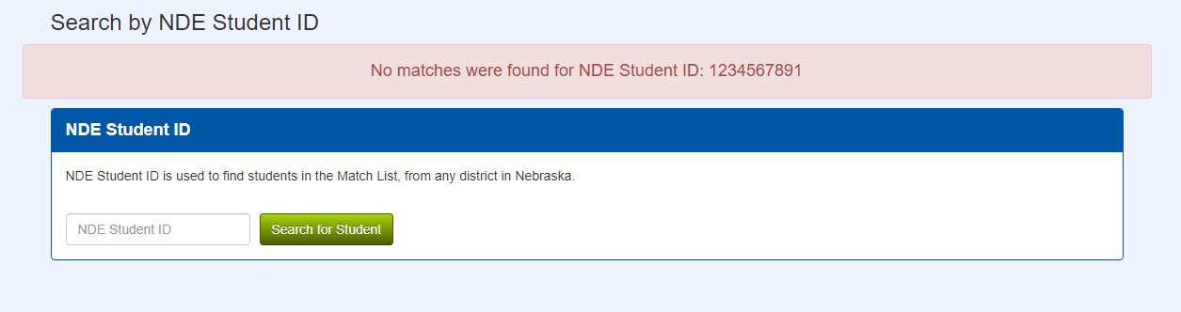
Student Lookup: NDE ID
Search Option 1: NDE Student ID
Enter the student’s unique 10 digit ID
Search for student
Notes:
If a match is not found using the student NDE ID, a message will appear at the top of the Student Lookup screen. Ensure you correctly entered the NDE Student ID. You can also attempt to search for the student using Student Information, but will likely not find a match for this student.

Slide 34
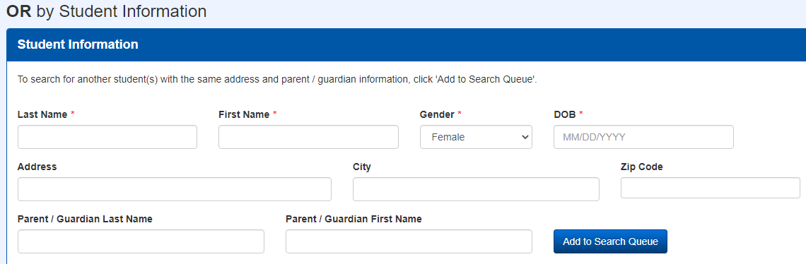
Student Lookup: Student Information
Search Option 2: Student Information
Notes:
You can also use student information to make a match in the student lookup module. Fields marked by an asterisk are required for searching for a student. You must enter the last name, first name, gender and date of birthday of the student. In order for a match to be made, these fields will need to match what is found in the DHHS or NDE databases. You can search for a student using different last names, DOBs or any other varying data you might have on file for them.
The additional fields are optional, but can help narrow down the list of possible students for lookup success.
Once you have entered data into at least the required fields, and possibly additional fields, click the add to search queue.

Slide 35
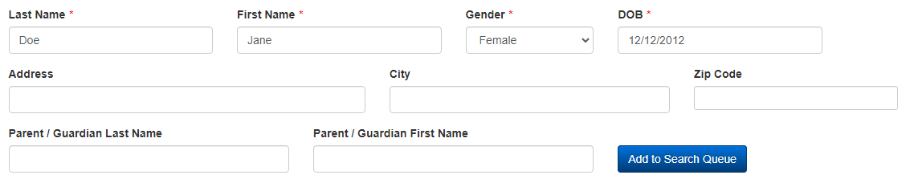
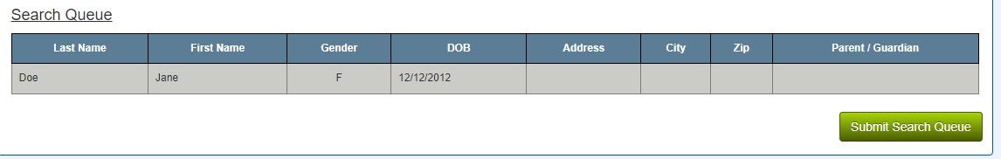
Student Lookup: Student Information
Search Option 2: Student Information
Notes:
You will know you have successfully added a student to the search queue when they data populates in the table as seen here. You must click the Add to Search Queue to see the data populate.
You can add multiple students from different households to the search queue before submitting it for lookup results.

Slide 36
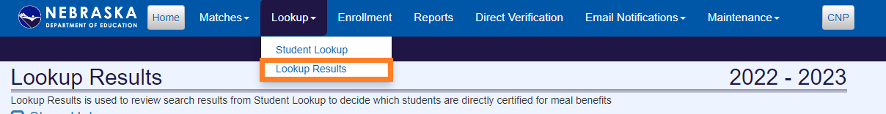
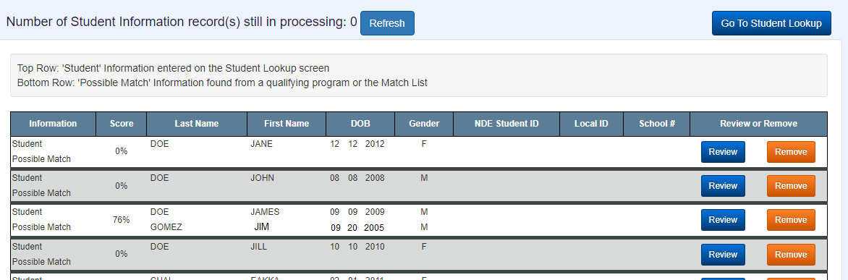
Lookup Results
Notes:
Once you have submitted your search queue in the Student Lookup section, navigate to the Lookup Results module. This is where you can see the status of your search using student information and see results for students you have looked up both by NDE ID and student information.
Seeing the green message indicates that your search was successful, and the student lookup module is reviewing data for the students entered.

Slide 37
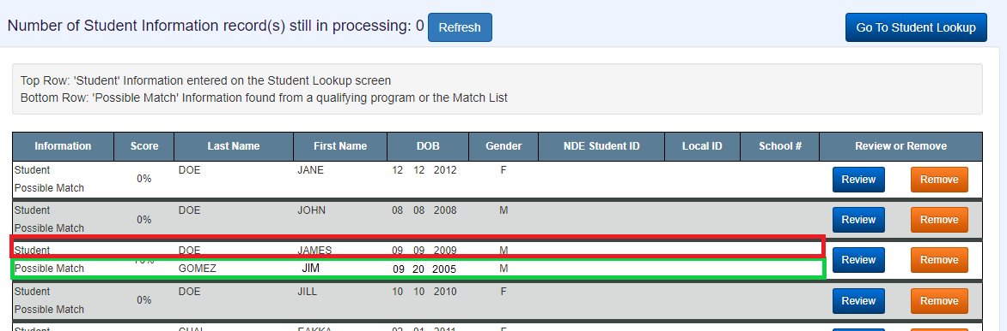
Lookup Results
Student vs. Possible Match rows
Notes:
Look for two signs that your search results have been processed: 0 records indicated as still being processed and the student’s you searched for being included in the data table.
Each searched student will have the data entered into student lookup located on the top line under “student” and the data pulled from DHHS or NDE databases on the bottom line under “possible match”. Just like with the possible match process, a percentage score is given. The closer this score is to 100%, the more confident the matching system is that the student and possible match are the same person. Carefully review each lookup result to see if the student and possible match are the same person.

Slide 38
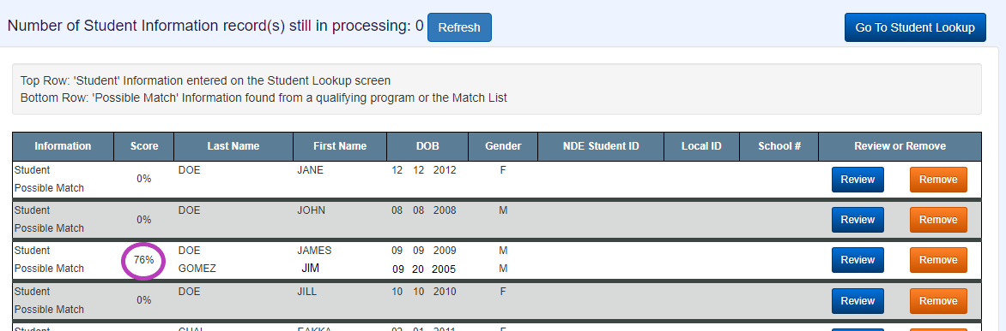
Lookup Results
Score
Notes:
Just like with the possible match process, a percentage score is given. The closer this score is to 100%, the more confident the matching system is that the student and possible match are the same person. Each lookup result should be carefully reviewed to see if the student and possible match are the same person. It’s important to review scores that are high (90’s and above) to ensure the student is being correctly match.

Slide 39
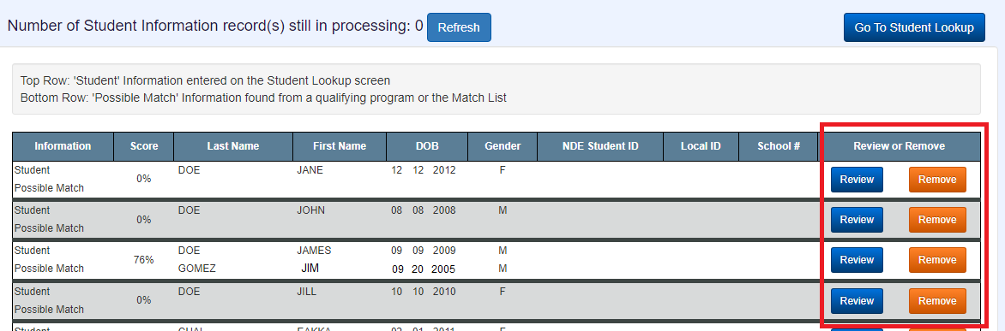
Lookup Results
Review or Remove
Notes:
When you feel confident on making a decision about each student that was searched, click on either the review or remove buttons.
For students that you are confident the student and possible match data indicate the same person, click on Review.
For students who are not a matched based on the student and possible match data lines, or when the possible match data line is blank indicating no possible match was found, click on Remove.

Slide 40
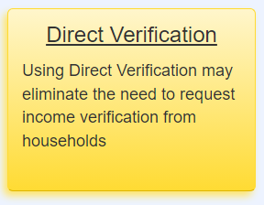
Direct Verification

Slide 41
Direct Verification of Categorical Eligibility
Meal application with case number provided for SNAP, TANF, FDPIR should be accepted at face value for issuing meal benefits
These categorically eligible meal benefits are part of your verification pool
Exception: students in the DC match list who also submitted a meal app
Benefits of Direct Verification
Verify categorical eligibility prior to sending out Verification request letters
Reduces administrative and household burden
Notes:
Direct Verification is related to the annual, verification process as school food authorities who participate in the National School Lunch Program must complete. Each fall, all SFAs are required to verify 3% or 1 application, whichever is greater, of the household income applications they have received as of October 1. This process typically includes sending a formal request to the household(s) selected to provide income documentation that verifies the data that household indicated on their income eligibility form. The results of verification are documented in the Verifiation Report, which must be submitted through CNP by all SFAs by November 15, annually.
Direct Verification allows SFAs to see if income verification exists in the DHHS or NDE databases before sending the formal request to the household. Households that are identified and have their income verified through the Direct Verification process are not required to submit income documentation to the school. This reduces the burden on the school staff to communicate, receive and review income documentation, and does not require any additional work from the household.
Students searched through the Direct Verification module have their data checked against more databases than students that are idneifitied and searched through Direct Certification. Additional Medicaid databases are reviewed in Direct Verification, which can provide the required income documentation but do not meet the requirements for qualifying for reduced or free meals.
Another benefit of direct verification is that the selected households can be searched in the direct verification module without disrupting the Verificaiton Process. If a student is not found through direct verification, the school can simply proceed through the typical verification process and request the necessary documentation from the household.

Slide 42
Direct Certification vs. Direct Verification
Direct Certification
Includes students who qualify for free or reduced priced meals
Used year round
Direct Verification
Includes students who reside in households with verified income data
Used prior to Verification Process
All enrolled students considered
Students selected in Verification Process sample considered
Available to all participating SFAs; public and non-public
Available to all participating SFAs; public and non-public
Notes:
It is important to remember that direct verification is not the same as direct certification. A student being directly certified indicates that they qualify for benefits; a student who is directly verified just means that the required income documentation is available for them rather than having to make a request to the household. We strongly advise schools to pull out any household income applications they receive from households who have been directly certified. As a result, none of the students who show up on your match list would also go through direct verification.
Directly verifying a student is rare, as our match list is efficient and catches most students who qualify for benefits. As we noted though, there is no harm in trying to directly verify a student to see if they

Slide 43
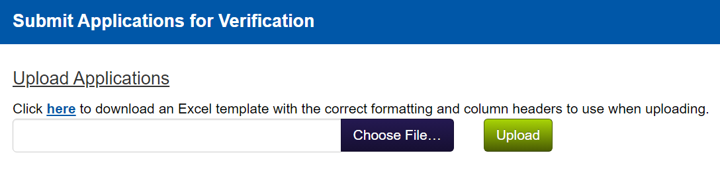
Direct Verification: Application Upload
Application Upload
Best option if….
Number of sample applications for Verification Process is large
Want to upload single file instead of entering individual student data
Want immediate results

Slide 44
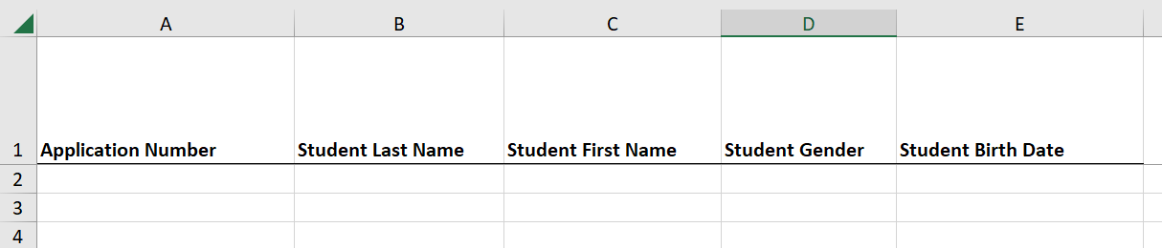
Direct Verification: Application Upload
{Template} is linked in the Direct Verification system
Five pre-formatted columns; all fields required for successful upload
Application Number: Assigned by SFA
Student Last Name
Student First Name
Student Gender
Student Date of Birth
Save completed template as .csv, .txt .xls or .xlsx file
Notes:
The completed file can be saved in one of four file types to be successfully uploaded into the Direct Verification system: comma separated, text, or excel file

Slide 45
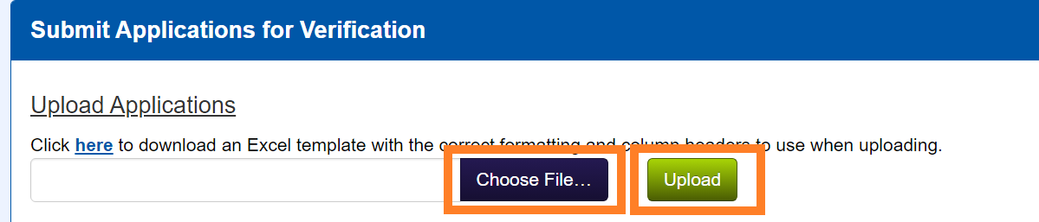
Direct Verification: Application Upload
Choose completed file; upload
Successful upload: student(s) populating in Verification Results table
Immediate results for students included in template
Notes:
The completed file can be saved in one of four file types to be successfully uploaded into the Direct Verification system: comma separated, text, or excel file

Slide 46
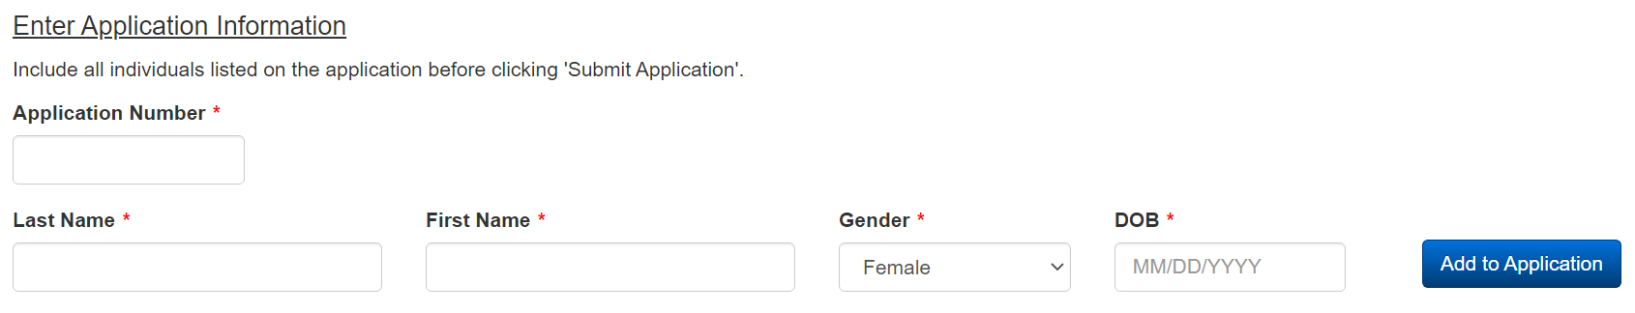
Direct Verification: Enter Information
Enter data for all students included on sample income application(s)
Successfully entered student data will appear in the student table and the application is then submitted for results
Good option if a very small number of students are being considered for Direct Verification
Notes:
Many Nebraska schools have a single application selected for the Verification sample. As a reminder, 3% of approved applications, or 1 approved applications whichever number is greater, needs to be verified. There is a chance this might be a single application with a single student listed for your SFA, which might lead you to choose the

Slide 47


Direct Verification: Enter Information
Enter each student who is included on sample income application(s) individually
Must enter data for each required field and click Add to Application after each student
Application Number: Assigned by SFA
Student Last Name
Student First Name
Student Gender
Student Date of Birth
When all students appear in the Application table, click Submit Application
Results will appear in Verification Results table
Notes:
Many Nebraska schools have a single application selected for the Verification sample. As a reminder, 3% of approved applications, or 1 approved applications whichever number is greater, needs to be verified. There is a chance this might be a single application with a single student listed for your SFA, which might lead you to choose the

Slide 48
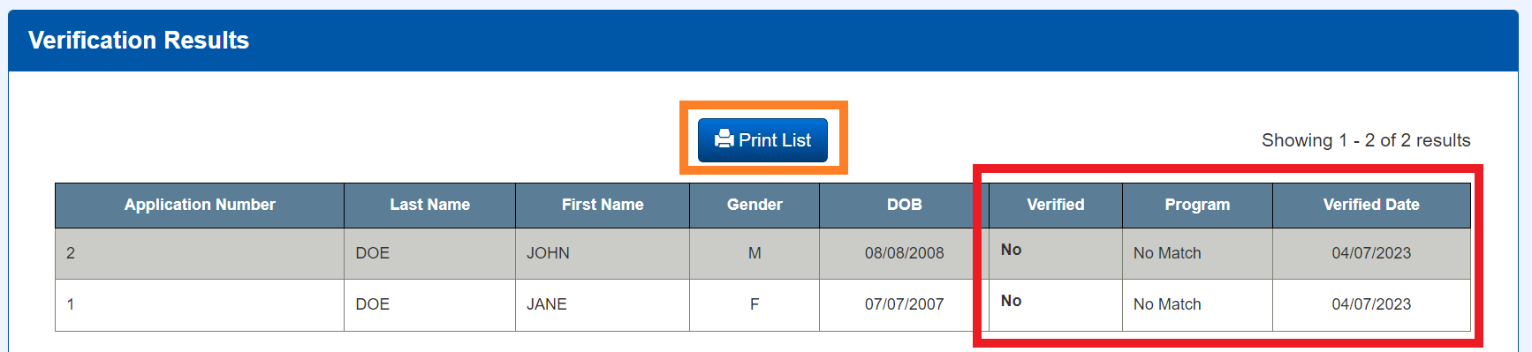
Direct Verification: Results
Results will appear in Verification Results table regardless of student entry type
Can print Verification results using Print List button
Focus on three columns: Verified, Program and Verified Date

Slide 49
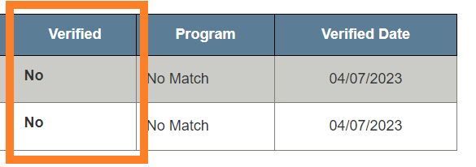
Direct Verification: Results
Verified column
Verified Column Result | Description | Next Steps
Yes | The student submitted appears in the DHHS database and qualifies for assistance. | Review the Program column for the qualifying program. Income documents will not need to be requested for this student/household.
No | The student submitted does not appear in the DHHS database. | Income documents will need to be requested and verified for the student/household.
Rejected | The student already appears on the Match List for the current school year. | This student cannot be selected for verification. File the application and select another for the verification sample that does not appear on the Match List.

Slide 50
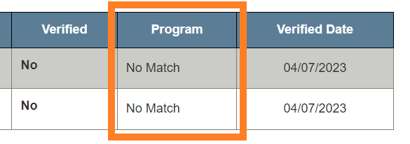
Direct Verification: Results
Program column
CONTINUED ON NEXT SLIDE
Program Result | Description | Next Steps
DirCrt | Direct Certification | The student appears on the match list. Select another application for the Verification sample.
SNAP TANF FDPIR MFREE | Supplemental Nutrition Assistance Program Temporary Assistance for Needy Families Food Distribution Program on Indian Reservations Medicaid Free | The student’s income has been verified as meeting the Free threshold. A request for income verification does not need to be sent to the household. Free benefits can be extended to other students within the household.
MRED | Medicaid Reduced | The student’s income has been verified as meeting the Reduced threshold. A request for income verification does not need to be sent to the household. Reduced benefits can be extended to other students within the household.

Slide 51
Direct Verification: Results
Program column
CONTINUED ON NEXT SLIDE
Program Result | Description | Next Steps
DirCrt | Direct Certification | The student appears on the match list. Select another application for the Verification sample.
SNAP TANF FDPIR | Supplemental Nutrition Assistance Program Temporary Assistance for Needy Families Food Distribution Program on Indian Reservations | The student’s income has been verified as meeting the Free threshold. A request for income verification does not need to be sent to the household. Free benefits can be extended to other students within the household.
FSTR | Foster | The student's benefit eligibility has been confirmed, but not their income for verification. Utilize the student lookup function to add the student(s) to the Match List, then select a replacement application for your verification sample. Free benefits cannot be extended to other students within the household.

Slide 52
Direct Verification: Results
Program column
Program Result | Description | Next Steps
MGRNT HOMLS | Migrant Homeless | The student's benefit eligibility has been confirmed, but not their income for verification. Utilize the student lookup function to add these students to the Match List, then select a replacement application for your verification sample. Free benefits cannot be extended to other students within the household.
MFREE or MRED would not appear in Direct Verification??? | Foster | The student's benefit eligibility has been confirmed, but not their income for verification. Utilize the student lookup function to add the student(s) to the Match List, then select a replacement application for your verification sample. Free benefits cannot be extended to other students within the household.
No Match | No matching qualifying program | The student does not qualify for DHHS programs. A request for income verification needs to be sent to the household.

Slide 53
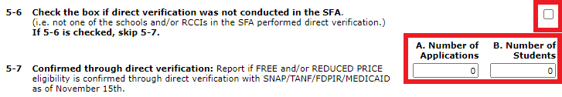
Direct Verification: Verification Report
Use Direct Verification to reduce administrative workload for Verification Report
Include verified student(s) in the Verification Report prior to November 15th
ONLY report students who were verified as SNAP, TANF, FDPIR, MFREE or MRED
Leave box in question 5-6 UNCHECKED
Enter number of applications confirmed through direct verification in question 5-7A
Enter number of students confirmed through direct verification in question 5-7B

Slide 54
Direct Verification FAQs
Search for all students included on application
If student(s) are Directly Verified in SNAP, TANF, FDPIR, you do NOT need to request/receive income documentation from the household
If student(s) are Directly Verified in MGRNT, FOSTR or HOMLS, use student lookup to add those students to the match list. You will need to select a new application for income verification (because these qualifiers are not income-based)
Student(s) must be directly verified during the current school year- cannot use direct verification from previous school year(s)
Encouraged to add directly verified students to the Match List
Use student lookup function
Directly verified students are not automatically added to the Match List

Slide 55
Student Lookup FAQ
Does Direct Verification replace the Verification Process?
Direct Verification does not replace the Verification Process. Only students who meet a need-based qualifying program will appear in Direct Verification. Many households also qualify for free or reduced meals by income and will need to have that income verified.
Do I have to use the Direct Verification process?
School districts are not required to use Direct Verification but are encouraged to review all students within their verification sample. If a student is Directly Verified for a categorically eligible program, income verification does not have to be completed.
Why would a student appear in Direct Verification but not on the match list?
Student lives with someone who participates in a program that provides categorical eligibility to the student

Slide 56
Student Enrollment Data FAQ
No matches are appearing for my school district. What do I do?
Ensure updated enrollment data has been added to the ADVISER PersonID or Direct Certification system. Allow one business day for matches to appear.
Can I upload data for early matching (matching prior to July 1)?
NO. To ensure accuracy of matching, data from the previous program year is cleared. Only data from ADVISER, PersonID or DC starting on July 1 will be used to match students for the current program year.
A new student transferred into our school district. How do I add them to our enrollment data?
School district with ADVISER: Enter the new student data into your SIS. The Adviser system will run overnight, collecting the new data and attempt to make a match.
School district using PersonID; Update the student record as enrolled at your district in PersonID. The PersonID system will run overnight, collecting the new data and attempting to make a match.
School district using DC data: Either upload a file containing the new student or enter their individual data in the Enrollment module. The DC system will run overnight, review the new data and attempt to make a match.
Notes:
In order for students to appear on the Direct Certification match list, NDE must have up-to-date student data on all enrolled students. The direct certification system pulls data on a nightly basis from ADVISER and PersonID to be matched against DHHS and NDE Internal data. Some school districts have student information systems that communicate directly with ADVISER. This results in immediate student changes including new student enrollment or student transfers that are noted in the nightly direct certification matching process. School districts without student information systems that communicate directly with ADVISER are required to upload data into the ADVISER or PersonID systems on a regular basis to ensure student enrollment data is accurate.
A third option exists for schools to provide NDE with the most up to date student enrollment data; uploading files into the Direct Certification Enrollment Module. This option will be discussed in greater length on the next slide.
All school districts, regardless of how their student data is shared with NDE, are encouraged to upload a complete student enrollment file into the PersonID system. There is a delay in the Direct Certification system matching with ADVISER due to the required verification NDE must complete on the ADVISER database. The DC system though can immediately begin matching students who have an updated enrollment record in the PersonID system for the upcoming school year. Schools are encouraged to upload a complete enrollment file into PersonID starting on July 1 annually. This helps maximize the number of accurate matches being made for the new school year. This also reduces the administrative work required for collecting and reviewing household income applications. If a household is matched during July or August, the school has the opportunity to notify the household of those benefits, and they would not be required to submit a household income application.
NDE recommends regular updates to the PersonID in general. Students have an NDE ID in order to be matched in the direct certification system. This means that all students need to have, at some point, been added to the PersonID student database to qualify for matching. Schools that do not have a student information system that communicates directly with Adviser are asked to upload enrollment files on a regular basis into PersonID.

Slide 57
Match List and Possible Match List FAQs
How will I know when new matches or possible matches have been made?
Direct Certification system users are notified of matches and possible matches based on their notification preferences. Refer to the <DC Notification Guide> for guidance on adding users and modifying notifications.
How often should I check the Possible Match List?
School districts are encouraged to check the Possible Match List two to three times per week, and upon notification of a new possible match.
A student on my match list has transferred from our school district. What should I do?
DC users are encouraged to Transfer Out any student who is no longer enrolled at their school. This allows the student to be added to the match list at their new district.
A student is not on the match list, but their sibling is. Who receives benefits?
If the matched student qualifies for SNAP, TANF, FDPIR, MGRNT, HOMLS, MFREE or MRED, benefits can be extended to other students in the household. FOSTR benefits cannot be extended to other students in the household.

Slide 58
Match List and Possible Match List FAQs
What should be done if a student appears on the match list twice?
Review the student data lines on the match list. Duplicate student entries are often related to school codes or a student qualifying for two programs. Remove the incorrect/out-dated student data line.
No matches are being reported, what should I do?
Ensure you have provided NDE with updated data through PersonID updates, ADVISER communication or direct certification enrollment uploads.
Can a student be removed from the Match List?
Students, once matched, qualify for benefits for the remainder of the program year. They are not removed from the Match List, but can be transferred as necessary. Utilize your SIS for households that decline benefits.

Slide 59
Student Lookup FAQ
A household believes their student fits into one of the qualifying programs, but has not been matched and can't be found using student lookup. What is the next step?
Contact Nutrition Services regarding the student. It's possible the student qualifies for DHHS benefits but not free or reduced priced meals.
What is a good score in the Student Lookup module?
The higher the score, the greater certainty the DC system has that the student and possible match are the same person. Each record should be thoroughly reviewed regardless of score.
A student on my match list has transferred from our school district. What should I do?
DC users are encouraged to Transfer Out any student who is no longer enrolled at their school. This allows the student to be added to the match list at their new district.
A student is not on the match list, but their sibling is. Who receives benefits?
If the matched student qualifies for SNAP, TANF, FDPIR, MGRNT, HOMLS, MFREE or MRED, benefits can be extended to other students in the household. FOSTR benefits cannot be extended to other students in the household.

Slide 60
Important Direct Certification Dates: November
Utilize Direct Verification system
Search for students selected as sample for Verification
Complete Verification Report by November 15th
Report results of Direct Verification

Slide 61
Resources
Direct Certification: Accessing the System
Direct Certification: Email Notifications
Direct Certification: Reports
Enrollment Roster File Upload Instructions
DC Medicaid FAQs

