Slide 1
Rule 59 Training for School Staff
Emergency Response to
Life Threatening Asthma & Anaphylaxis
August 2025

Slide 2
First, let’s start with updates to Rule 59
Notes:
These are the objectives for this session. Please note, the last few slides of the presentation are directed at the Emergency Response Team, but anyone can participate in that part of the discussion.

Slide 3
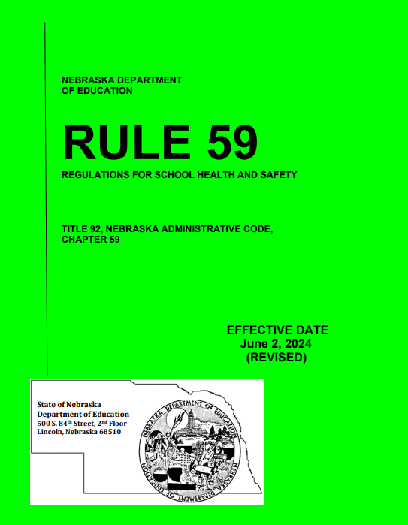
What’s New?
Revision took effect in June 2024
Seizure Safe Schools Act was added to Rule 59
We will go over other important changes in the following slides
Rule 59 updates

Slide 4

What’s New?
School Day is defined:
  “School is in session means any period of time during which students are under the direction of school staff during the regular school day as defined by the school or school district
  …and does not include any period of time during which an extracurricular activity is occurring outside of the regular school day.”
Rule 59 updates

Slide 5
What’s New?
Minimum competency areas and standards (new):
Part of Title 172 Ch. 95: Administration of Medications by Medication Aides and Medication Staff
Very similar to the old 14 competencies
School nurses training Unlicensed Assistive Personnel will need to use these competencies for Medication Administration training now. See Competencies-for-Medication-Administration-Final.pdf
14 Competencies (old)
Had previously been a part of the text of Rule 59
  Were used to train Unlicensed Assistive Personnel in medication training
Were removed from text of Rule 59 (Medication Aide Act) in 2024 updates.
Rule 59 updates

Slide 6

What’s New?
“Other Routes” do not include IV medication
  Although this has always been true, it is now part of Rule 59 (Medication Aide Act) that unlicensed people may not give students IV medications or fluids.
Rule 59 updates

Slide 7
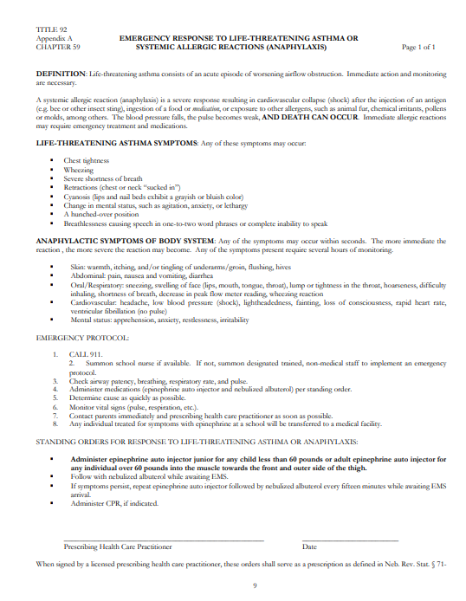

What’s New?
Physician has been changed to “Prescribing Health Care Practitioner”
  Now, Physician Assistants (PAs) or
  Nurse Practitioners can sign the bottom
  of the Rule 59 protocol.
Rule 59 updates

Slide 8
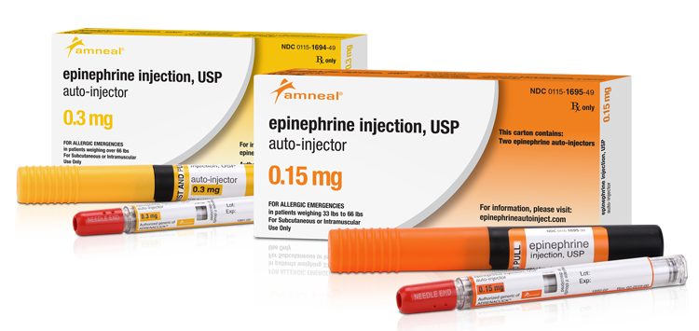
What’s New?
Epi-pen changed to epinephrine auto injector:
  Schools are not required to use brand-name Epi-pens.
  They may choose to stock any kind of epinephrine pen, name brand (such as Auvi-Q) or generic.
  Remember to re-train staff if changing to a new type of epinephrine autoinjector
Rule 59 updates

Slide 9
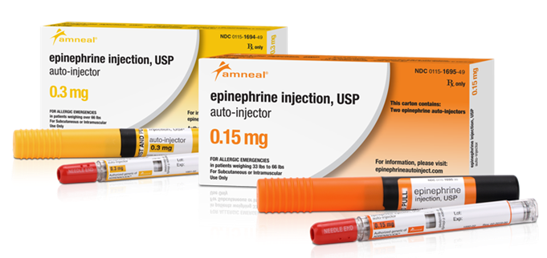



What’s New?
Weight change!
Weight for epinephrine junior version changed from 50 to 60 pounds.
New text under Standing Orders
  “Administer epinephrine auto injector junior for any child less than 60 pounds or
  epinephrine auto injector for any individual over 60 pounds"
Rule 59 updates

Slide 10


What’s New?
You can repeat epinephrine + albuterol after 15 minutes!
The new text states “If symptoms persist, repeat epinephrine auto injector followed by nebulized albuterol every 15 minutes while awaiting EMS arrival”.
Rule 59 updates

Slide 11
What’s New?
Find a summary document of the 2024 Rule 59 changes here:
Rule-59-Changes-Summary-for-School-Nurses-dated.pdf
Find a summary of the updated competencies here:
Competencies-for-Medication-Administration-Final.pdf
Rule 59 updates

Slide 12
Now, on to the Emergency Response training!
Notes:
These are the objectives for this session. Please note, the last few slides of the presentation are directed at the Emergency Response Team, but anyone can participate in that part of the discussion.

Slide 13
Learning Objectives
Understand Rule 59 regulations and protocol
Identify asthma triggers, symptoms and medications
Understand how to use an inhaler
Identify allergy triggers, symptoms and medications
Identify anaphylaxis triggers and symptoms
Understand how to activate the Emergency Response Team (ERT)
FOR ERT ONLY:
  List the protocol to be followed in an emergency, as outlined in the Nebraska Department of Education – Rule 59
  Demonstrate how to administer epinephrine (EpiPen) and a nebulized albuterol treatment
Notes:
These are the objectives for this session. Please note, the last few slides of the presentation are directed at the Emergency Response Team, but anyone can participate in that part of the discussion.

Slide 14


On any given day at school…
Marcus, a high school junior, tells the PE teacher he took his inhaler, but his chest feels very tight.
Ella tells her 3rd grade teacher her mouth feels itchy, and she is having a hard time breathing.
Are you prepared
To handle situations like these?

Slide 15
Rule 59: Regulations for School Health & Safety
TITLE 92, NEBRASKA ADMINISTRATIVE CODE,
CHAPTER 59, SECTION 06
006.01 Emergency Protocol. All Accredited Schools, Approved Schools, and Early Childhood Education Programs shall adopt and implement the Emergency Response to Life Threatening Asthma or Systemic Allergic Reactions (Anaphylaxis) Protocol contained in Appendix A of this Chapter. In addition to adopting the protocol, Accredited Schools, Approved Schools and Early Childhood Education Programs shall procure and maintain the equipment and medication necessary to implement the protocol in each school building while school is in session in the case of any student and/or school staff emergency.
Notes:
Rule 59 is a state regulation – very similar to a law – except that regulations are created in the executive branch of governments, not the judiciary branch where it goes through state senators. One thing to note – while some schools choose to create and take bags and have trained people on field trips, before and after school programs, etc., the law requires the protocol be enacted on grounds bell to bell. It is important to know what your school's policy is for medical emergencies when outside of the school building.

Slide 16
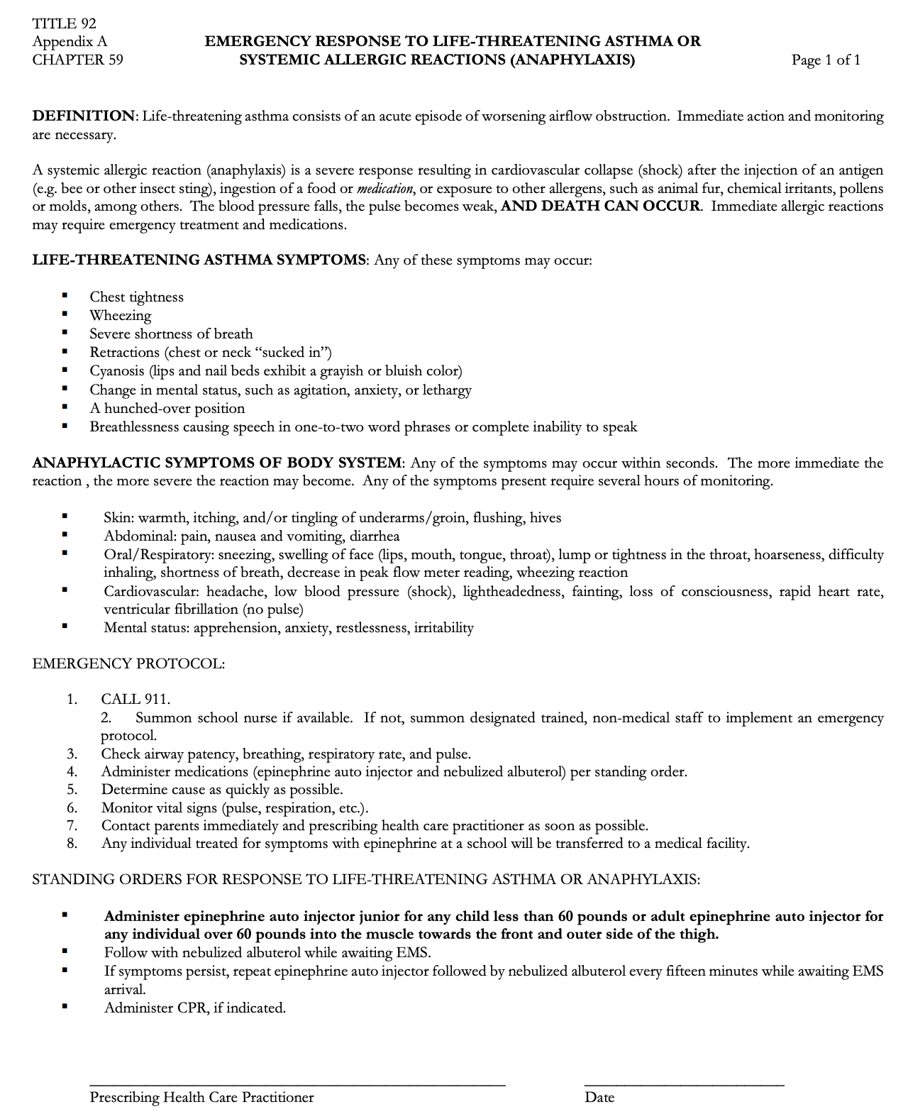
This is the protocol in the regulations. It is suggested you have it signed by a provider on a YEARLY basis.
Notes:
The regulation says to have the protocol signed by a provider, but it does not mandate that it is re-signed on a yearly basis. It is suggested you have it signed each year because it is best practice and standard of practice to have prescriptions renewed and signed on a yearly basis.

Slide 17
Understand the Difference
Severe, life- threatening asthma
Allergic response leading to anaphylaxis
Rule 59 protocol
Notes:
Life threatening asthma and anaphylaxis from an allergen are two separate events. Both can lead to someone needing the Rule 59 protocol. Asthma and allergies are not necessarily related, but they both can be life threatening and lead to death.

Slide 18
Rule 59 Highlights
Rule 59 includes both medication administration and this emergency response to life threatening asthma and anaphylaxis
It is NOT optional to follow the regulation…ALL schools and early childhood education programs must do it!
Both epinephrine AND nebulized albuterol must be given if the protocol is initiated.
It is YOUR responsibility to make sure you know and understand the regulation.
Let’s start with a basic understanding
of what leads to life-threatening
asthma & anaphylaxis…..
Notes:
This is a lot of information, but make sure you remember these highlights. This is a regulation meaning it is like a law; the difference is that laws are created by the judicial branch of state government while regulations are created by the legislative branch – our state senators in the unicameral. Either way, it must be adhered to. The regulation has seven parts to it – we are only talking about part 6 today which is the emergency response protocol, so we are not training you to give medications outside of the emergency protocol.

Slide 19
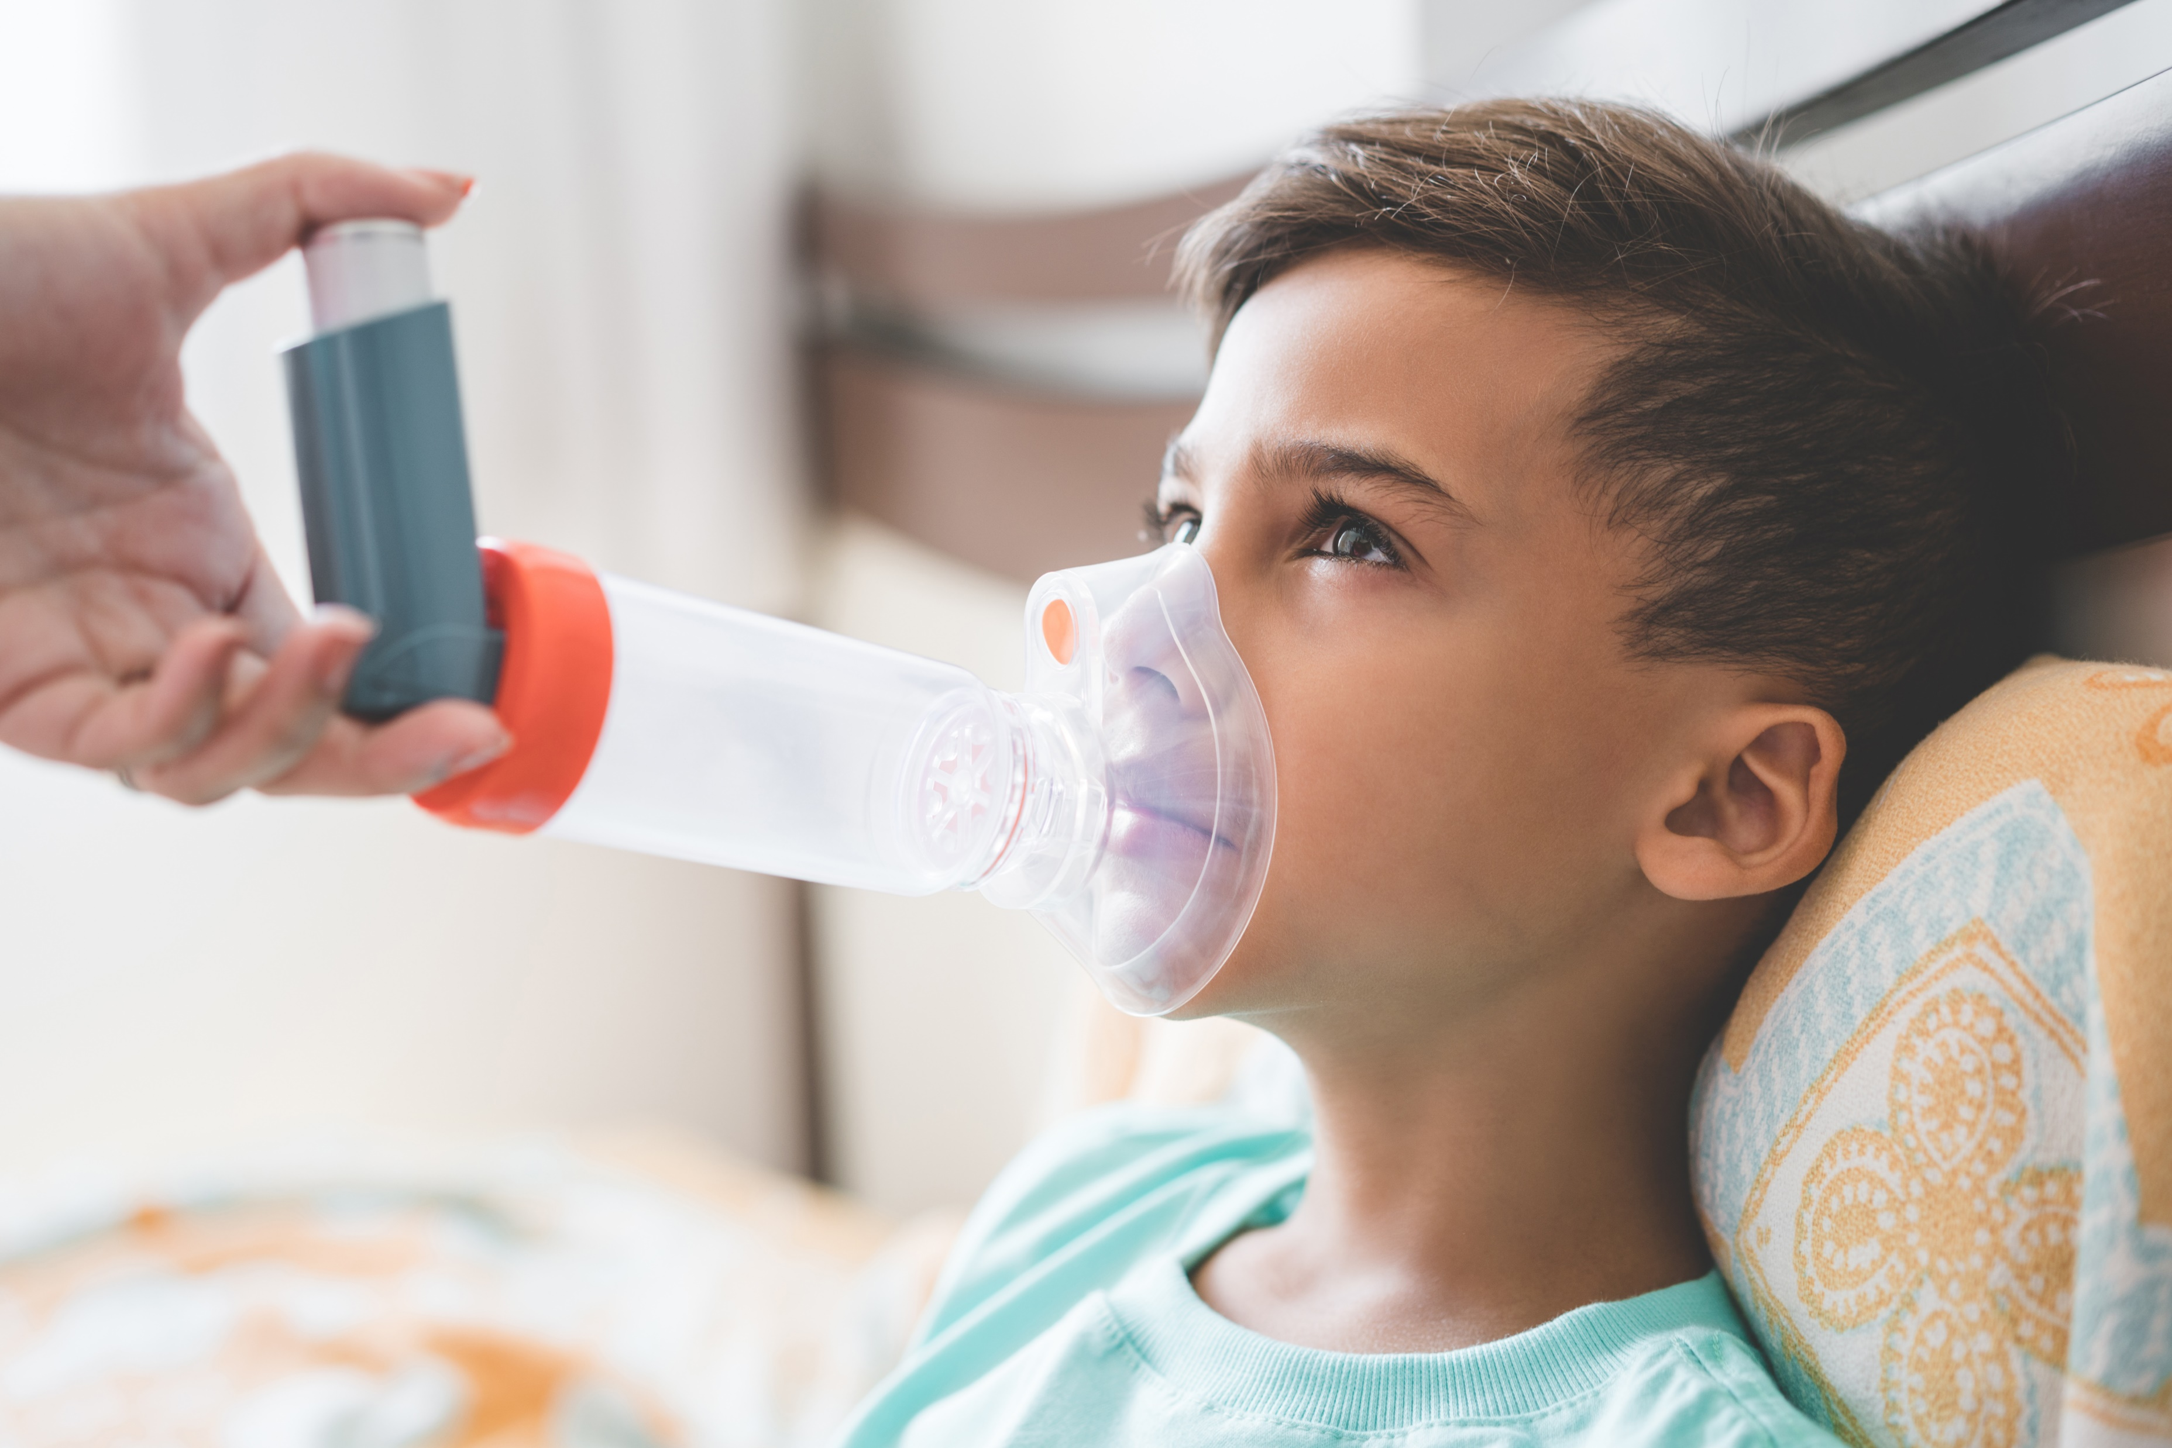
Asthma

Slide 20
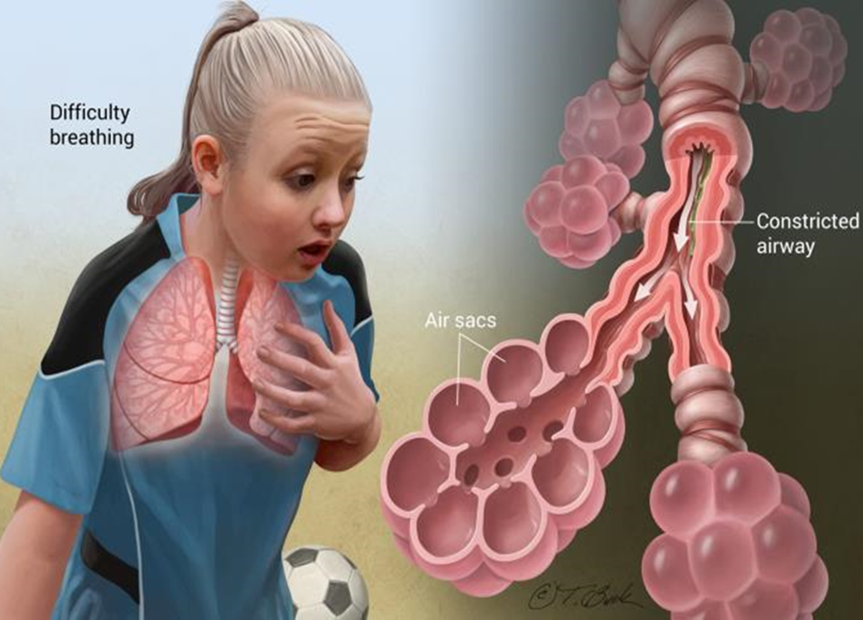
What is Asthma?
Asthma is a chronic inflammatory disorder of the airways characterized by episodes of reversible breathing problems due to airway narrowing and obstruction. These episodes can range in severity from mild to life threatening.
Daily preventive treatment can prevent symptoms and attacks and enable individuals who have asthma to lead active lives.
Source: HealthyPeople.gov
Notes:
Most people know what asthma is in general terms. This picture shows what the lungs look like. Three things happen – swelling, clogging and squeezing – all the way down to those air sacs (alveoli). Some people hardly struggle at all with their asthma while others need their inhalers daily and have asthma attacks.

Slide 21
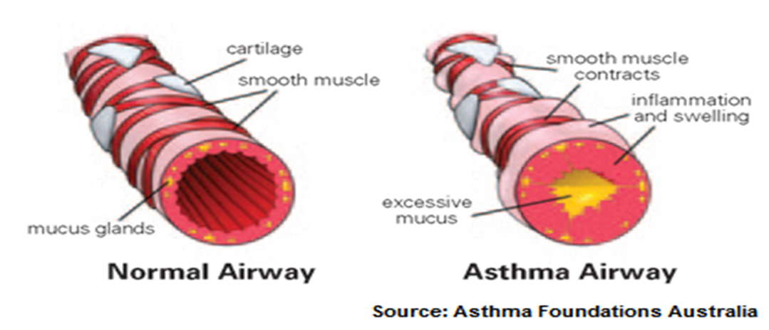
What is an Asthma Attack?
Airways can become swollen
The muscles around the airways tighten
Air passages get smaller and irritated
Mucus fills the air sacs
It can become SEVERE and LIFE THREATENING
Notes:
This infographic is a great visual of what asthma does to the lungs. If you have ever watched someone have an asthma attack, this is what the inside of their lung is doing – swelling, spasming and filling with mucus. From looking at the airway on the right, you can see why asthmatics have difficulty breathing – and why it is important for them to have immediate access to an inhaler.

Slide 22

Asthma Triggers
Exercise
Stress
Breathing cold air
Diffusers & essential oils
Vehicle (& bus) exhaust
Cockroach & mouse droppings
Illness
Extreme weather
Perfume
Cleaning chemicals
Burning wood or grass
Tobacco smoke
Notes:
Not all students are affected by the same triggers plus their sensitivities can change over time. Some of these triggers might surprise you like weather changes and stress. The most common cause of asthma episodes is colds or other upper airway infections, which is just one more reason to emphasize the importance of good handwashing. Some children only experience asthma symptoms during or after physical activity. This is referred to as exercise induced asthma (EIA).

Slide 23
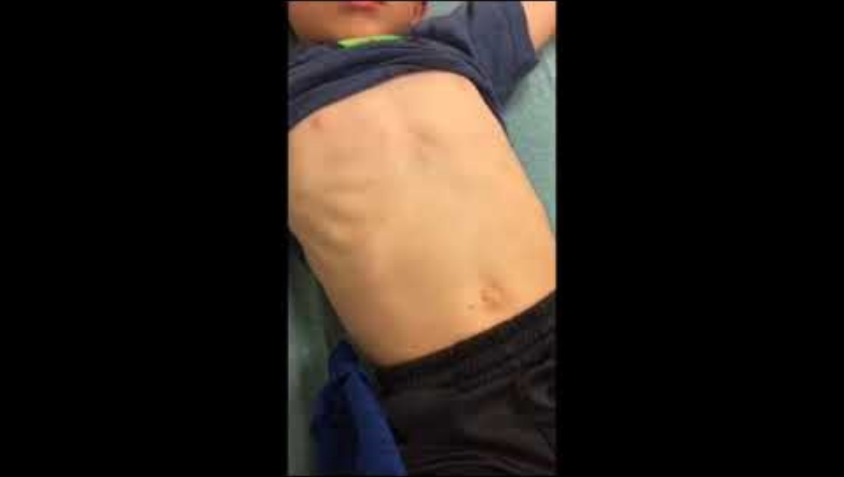
Asthma Signs & Symptoms
Wheezing
Shortness of breath
Breathlessness – speaking 1-to-2-word phrases or unable to speak
Complaints of chest tightness
Hunched over position
Retractions (sucking in of chest or neck)
Cyanosis (turning blue)
Change in mental status – agitation, anxiety, lethargic
Short video of pediatric retractions (sign of respiratory distress)
Notes:
Like I said before, asthma affects everyone differently, and symptoms can vary greatly from one asthmatic to the next. Most people can use their rescue or short-acting inhaler and get relief from their symptoms.

Slide 24
Asthma Medications
Short-acting relievers (quick relief – should be brought to school) | Long-acting controllers (usually used at home in morning and at night)
Immediate relief of bronchospasms | No immediate relief
Use when needed | Taken regularly every day even if no symptoms
Short term effects | Controls inflammation and improves asthma overall
Does not help long term problem of inflammation in the lungs | Does not help during an asthma attack
Also called a rescue inhaler | Includes corticosteroids and bronchodilators
Notes:
When we talk about controlling asthma with medication, it is important to know the difference between the two types of inhalers – especially for students who self carry and have it in their backpack. Some school nurses have reported that their students bring the wrong inhaler to school. And if that student is having an asthma attack, their long-acting inhaler is not going to help. Both types are important, but they do not do the same thing.

Slide 25
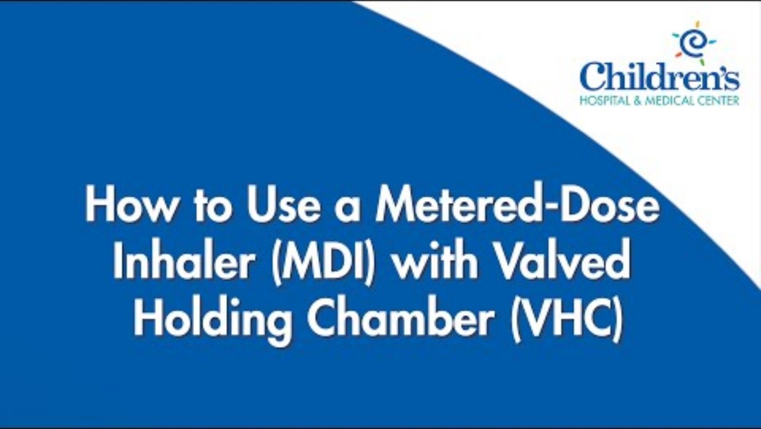
Inhaler & Spacer Education
Notes:
These are good videos to show you how to use an inhaler. Some people use a spacer and others do not. The Children’s pulmonology and allergy experts say everyone should use a spacer with their inhaler regardless of how old they are. The spacer is efficient and helps get all the medication into the lungs increasing the chance of the medication relieving symptoms.

Slide 26
When is Asthma an Emergency?
Prescribed medication does not relieve symptoms
Chest tightness, wheezing, severe shortness of breath, retractions (chest or neck “sucked in”)
Cyanosis (lips/nail beds are grayish or bluish in color
Change in mental status – agitation, anxiety, lethargy
Breathlessness causing speech in 1–2-word phrases or not being able to speak at all
A hunched over position
When 1 or more of these symptoms occur, activate the Rule 59 protocol.
NOTE: Death may occur if a severe asthma event
is not treated!
Notes:
There is a lot on this slide, but it is all very important information. If someone is not getting relief from their inhaler, you need to active the Rule 59 protocol right away. People can die during an asthma attack, so it is imperative you take the symptoms seriously and get help right away. Remember, it is never the wrong decision to call 911!

Slide 27

Allergies
Notes:
Let’s switch gears and talk about allergies for a few minutes…

Slide 28


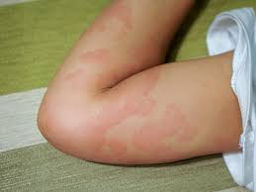
Allergic Reactions
An allergic reaction occurs when a person is exposed to an allergen by inhaling it, swallowing it, or getting it on their skin.
After a person is exposed, there is a sequence of events in the body that creates an allergic reaction.
Notes:
Allergic reactions can occur from just about anything.

Slide 29




Allergy Triggers
Common allergens include:
• Pollen • Dust • Pet dander
• Wheat • Smoke • Cleaning chemicals
• Latex • Weeds • Weather changes
• Cats • Perfumes • Insect stings
• Eggs • Nuts • Cockroaches
And many more……
Notes:
These are just a few of the triggers that can cause allergies. There are simply far too many to list, but these are some of the most common ones you will see.

Slide 30

Allergy Symptoms
Sneezing
Stuffy nose
Throat tightness
Itchy nose and throat
Itchy, watery eyes
Skin rash
Coughing
Wheezing
Vomiting
Shortness of breath
Upset stomach
Notes:
These are the eleven most common symptoms of allergies in kids and teens. Again, symptoms can also vary greatly, and most can be relieved with over the counter or prescription medications.

Slide 31

When are Allergies an Emergency?
When someone’s immune system overreacts to an allergen, it releases chemicals that cause allergy symptoms.
Typically, these bothersome symptoms occur in one location of the body (e.g., sneezing, watery eyes, rash).
When more than one body system reacts at once, it can become severe requiring immediate attention and action.
Notes:
When someone starts to have multiple symptoms to more than one body system, it becomes an emergency very quickly. If someone starts to have multiple symptoms from an allergy – and sometimes you may not even know what they were exposed to – then it is time to get serious and think about needing the Rule 59 protocol.

Slide 32

Anaphylaxis
Notes:
Let’s transition to anaphylaxis and talk about what a severe allergic reaction looks like.

Slide 33

What is Anaphylaxis?
Anaphylaxis is a sudden onset of severe and potentially life-threatening symptoms that occur within minutes to hours of exposure to an allergen.
The blood pressure falls, the pulse becomes weak, AND DEATH CAN OCCUR.
While it is not common in school, you must be prepared to respond immediately to this type of emergency!
Notes:
The biggest take away from this slide is that people die from anaphylaxis. There is really no other way to say it but to be blunt. It is a serious, life-threatening event, and without treatment, most people will die.

Slide 34

Timing of an Anaphylactic Event
BE AWARE…..
Symptoms generally start 5-30 minutes after exposure to an allergen but can start within seconds or may be delayed even up to a couple hours.
Notes:
When anaphylaxis occurs, it usually comes on quickly, but understand someone can be exposed to an allergen at lunch but not show symptoms until they are back in the classroom taking a test two hours later.

Slide 35
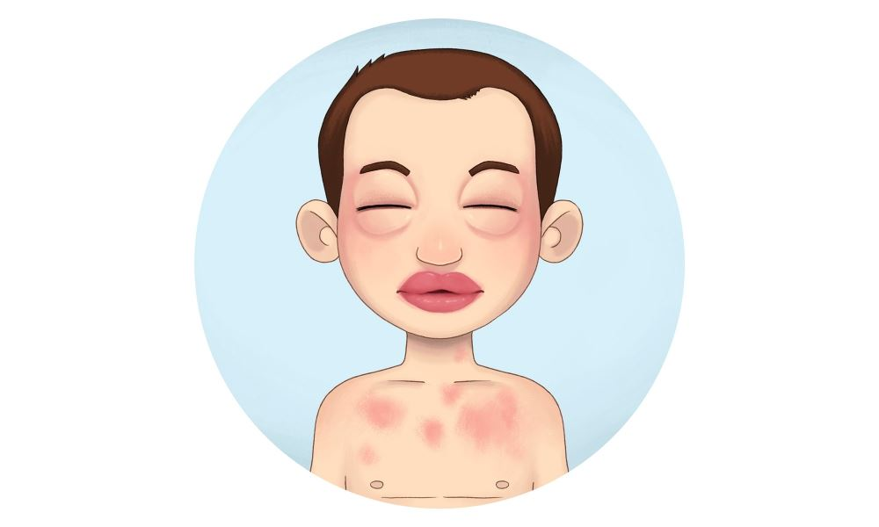
Anaphylaxis Triggers
Most common triggers:
  Foods (31%)
  Medication (34%)
  Insect sting (20%)
While it is important to understand what caused the anaphylaxis, your #1 goal is to treat the person and keep them safe.
Source: Allergy & Asthma Network
Notes:
These are interesting facts on what triggers most anaphylactic events. Do not get caught up in figuring out what caused the allergic reaction if the person has worsening symptoms. You can always go back later and figure out what the trigger was.

Slide 36
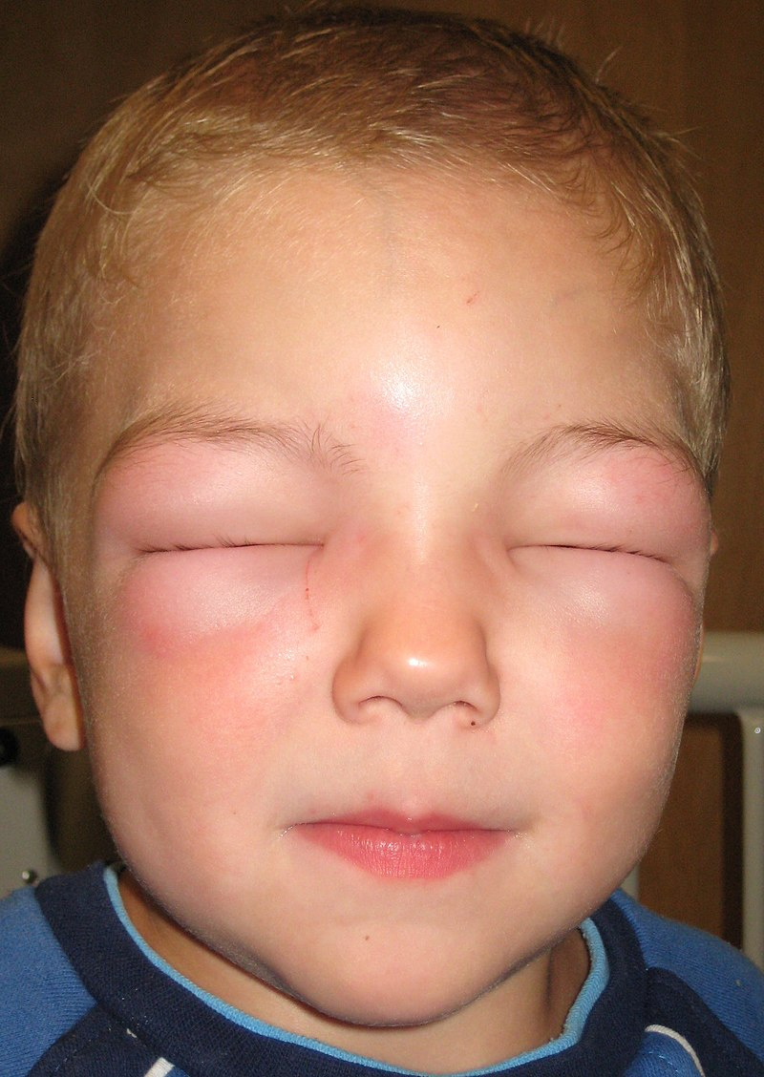
Symptoms of Anaphylaxis
Any of these symptoms may occur within seconds. The more immediate the reaction, the more severe the reaction may become.
Skin:
Warmth
Itching and/or tingling of underarms/groin
Flushing
Hives
Abdominal:
Pain
Nausea and vomiting
Diarrhea
By James Heilman, MD - Own work, CC BY-SA 3.0, https://commons.wikimedia.org/w/index.php?curid=9445432
Notes:
There are a lot of symptoms on this slide. Know this….People often get that feeling of impending doom. Time is of the essence and people die very quickly with anaphylaxis. If a student or staff tells you something is wrong, believe them! And never, ever send someone with these symptoms to the nurse’s office alone!

Slide 37
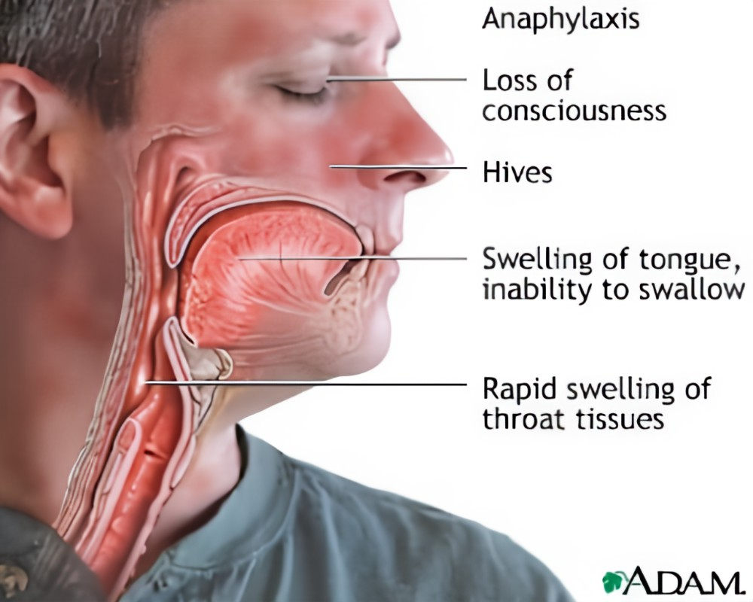
Symptoms of Anaphylaxis
Any of these symptoms may occur within seconds. The more immediate the reaction, the more severe the reaction may become.
Oral/Respiratory:
Sneezing
Swelling of face (lips, mouth, tongue, throat)
Lump or tightness in the throat
Hoarseness
Difficulty inhaling
Shortness of breath
Decrease in peak flow meter reading
Wheezing reaction
Notes:
There are a lot of symptoms on this slide. Know this….People often get that feeling of impending doom. Time is of the essence and people die very quickly with anaphylaxis. If a student or staff tells you something is wrong, believe them! And never, ever send someone with these symptoms to the nurse’s office alone!

Slide 38
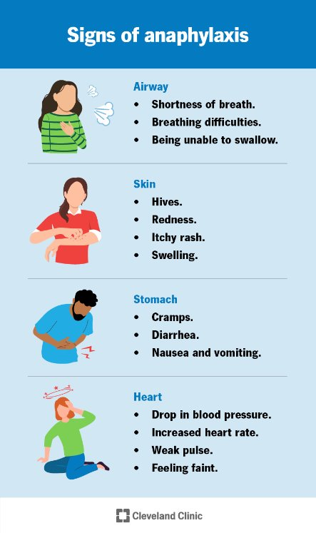
Symptoms of Anaphylaxis
Any of these symptoms may occur within seconds. The more immediate the reaction, the more severe the reaction may become.
Cardiovascular:
Headache
Low blood pressure (shock)
Lightheadedness
Fainting
Loss of consciousness
Rapid heart rate
Ventricular fibrillation (no pulse)
Mental status:
Apprehension
Anxiety
Restlessness
Irritability
Notes:
There are a lot of symptoms on this slide. Know this….People often get that feeling of impending doom. Time is of the essence and people die very quickly with anaphylaxis. If a student or staff tells you something is wrong, believe them! And never, ever send someone with these symptoms to the nurse’s office alone!

Slide 39
Putting It All Together
Marcus, a high school junior, tells the PE teacher he took his inhaler, but his chest feels very tight.
Ella tells her 3rd grade teacher her mouth feels itchy, and she is having a hard time breathing.​
Marcus is now having a severe asthma event
& Ella is experiencing anaphylaxis….
What do you do?
Notes:
Remember Marcus and Ella from earlier? They are both in a serious medical emergency and need attention NOW. Marcus has an action plan, but his inhaler is not giving him any relief. He is getting worse, and his breathing is becoming more labored plus he can barely talk now. And Ella – her lips are swelling, and he is getting short of breath plus she is really itching all over now. So, what comes next? What do you do?

Slide 40
When should Rule 59 be implemented?
Treatment should be given when an individual is showing signs of distress and one or more of these symptoms are present:
Difficulty breathing
Throat tightness (feeling throat is closing)
Only speaking 1-2 words
Wheezing
Fast heartbeat / pulse
Trouble swallowing
Cyanosis (turning blue)
Hives / skin rash / swelling
Nausea / vomiting / diarrhea
Passing out
Severe, life- threatening asthma
Allergic response leading to anaphylaxis
Rule 59 protocol
Remember….
Rule 59 is used for both events!
Notes:
Let’s revisit this slide. We talked about asthma and allergies, and both can lead to someone needing the Rule 59 protocol. Asthma and allergies are not necessarily related, but they both can be life threatening and lead to death. It is imperative you take these situations seriously and get the person immediate help.

Slide 41


Who can you use Rule 59 for?
Students without an emergency action plan
Students whose emergency plan was followed but need further treatment
Rule 59 protocol
006.01 Emergency Protocol In addition to adopting the protocol, accredited schools, approved schools, and approved early childhood education programs must procure and maintain the equipment and medication necessary to implement the protocol in each school building while school is in session in the case of any student and/or school staff emergency.
School staff, including substitute teachers and temporary employees
Notes:
Let’s revisit this slide. We talked about asthma and allergies, and both can lead to someone needing the Rule 59 protocol. Asthma and allergies are not necessarily related, but they both can be life threatening and lead to death. It is imperative you take these situations seriously and get the person immediate help.

Slide 42
Activate the Rule 59 Protocol
Does the student have an emergency action plan?
YES
Start there - move on to the Rule 59 protocol if symptoms are not resolved and further treatment is needed
Initiate the Rule 59 protocol
NO
Note: The Rule 59 protocol does not replace a student’s action plan for asthma, food allergies and anaphylaxis.
Notes:
This is where the Rule 59 protocol comes into play. If the student has an action plan, start there then move on to the Rule 59 protocol if the medication in their plan does not work. For example, Jason is a 4th grader with a known strawberry allergy. He comes to you with mild shortness of breath and thinks he was exposed at lunch. His action plan says to give him 25 mg of Benadryl and two puffs of his rescue inhaler. You follow the plan, but he is getting worse, not better. Now Jason can hardly talk, is very short of breath, is hunched over in his chair and his lips and eyes are swelling. Jason is experiencing anaphylaxis and now you need to initiate the Rule 59 protocol.

Slide 43
Important Reminders
Severe asthma attacks and anaphylaxis need immediate attention
Call 911 as soon as possible
When in doubt, administer the protocol – if you think something is wrong, you are probably right
If the student has an action plan, start there then move to the Rule 59 protocol as needed
If the student does not have an action plan, activate the Rule 59 protocol immediately
Notes:
Calling 911 is so important! Paramedics and hospitals can do far more for someone who is in a life-threatening emergency than you can do in a school. The sooner you get the person in crisis some help, the better their chance of survival. And like the slide says, if you are in doubt, follow the protocol. Usually, you know in your gut that something is wrong, and help is needed. Follow your school’s policy for getting the nurse to the person and/or activate the Emergency Response Team.

Slide 44
Protocol Steps
Call 911
Summon school nurse if available. If not, summon designated ERT to implement emergency protocol
Check airway patency, breathing, respiratory rate, and pulse
Administer medications (epinephrine and nebulized albuterol) per standing order
Determine cause as quickly as possible
Monitor vital signs (pulse, respiration, etc.)
Contact parents/guardians immediately and physician as soon as possible
Any individual treated for symptoms with epinephrine at school will be transferred to a medical facility
Next, let's look at each step in detail...
Notes:
Let’s go through the steps of the Rule 59 protocol. These are straight out of the regulation.

Slide 45

Step 1
CALL 911
  Ensure a call is being made to 911 while remaining with the individual experiencing the emergency
  Direct a staff member to watch for the ambulance and escort the emergency medical services (EMS) team to the individual
  Notify the building administrator
Notes:
Calling 911 from a cell phone or the location of the "patient" is good to be able to provide updated information to the dispatcher. They can assist you in what to think about or do while waiting.

Slide 46

Step 2
Summon the School Nurse and/or Emergency Response Team (ERT)
  Each building needs a plan in place for how to alert the school nurse and ERT
  Each staff member in the building needs to know this plan
  Each member of the ERT needs to know their role when responding
Notes:
Each building needs a plan, is it the same across the district? Do you need to let traveling staff know? Do substitutes know how to respond? Is a hold type event enacted and the team knows to break that hold? While planned assignments are great, have a back up plan in case someone is not there that day. What if it is a member of your team you are treating? Make sure you and your coworkers know how to answer these questions and have a plan before something happens in your district.

Slide 47
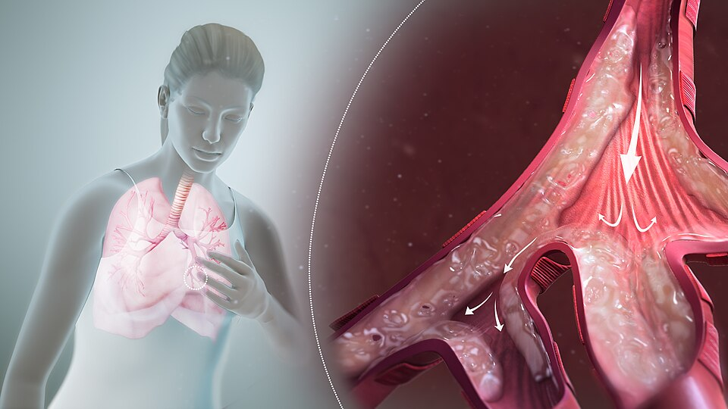
Step 3
CHECK ABCs
  Airway - Is the airway open or obstructed?
  Breathing - Is the individual still breathing (look, listen and feel)? How fast are they breathing?
  Circulation - Is there a pulse or body movement? Is the individual conscious?
Notes:
Are you ready to start CPR if you find they are not breathing and have no circulation? Who is CPR certified in your building?

Slide 48
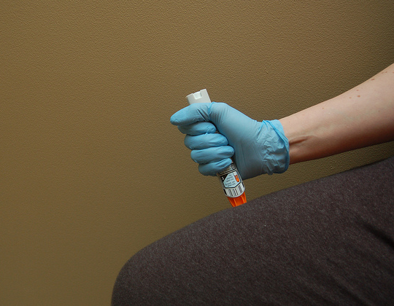
Step 4
ADMINISTER MEDICATIONS
  Give epinephrine first!
    Dosing:
      Epinephrine Auto Injector (adult): for people >60 pounds
      Epinephrine Auto Injector Jr: for people <60 pounds (usually students up to first grade)
      If you do not know the person’s weight, use the adult Epinephrine Auto Injector
      When administering, press and hold the pen in place for the count of three
      This medicine can be given through clothing

Slide 49

How to Use an Epinephrine Autoinjector
(STEP 4: ADMINISTER MEDICATIONS)
Staff must be trained on how to use an epinephrine autoinjector. This video trains on the brand “Epi-pen”, but any epinephrine autoinjector (brand name or generic) may be used.

Slide 50
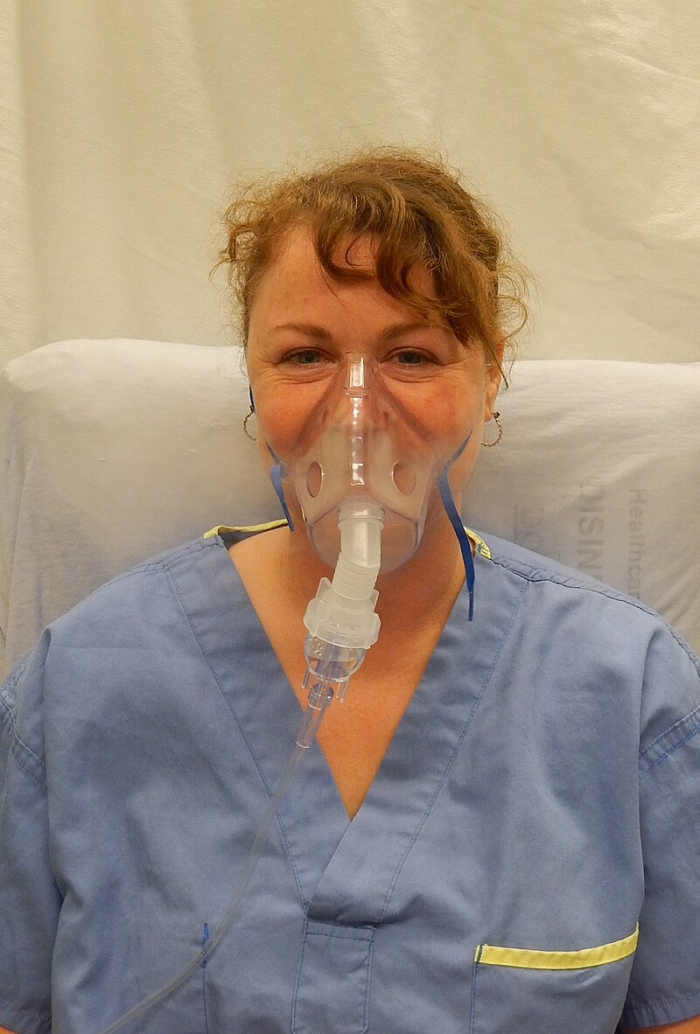
Step 4, continued
ADMINISTER MEDICATIONS
Epinephrine must be followed by nebulized albuterol while awaiting EMS to help relieve breathing symptoms.
If symptoms persist, repeat epinephrine auto injector followed by nebulized albuterol every 15 minutes while awaiting EMS arrival.
Benadryl (diphenhydramine) should not be given to someone in a severe asthma/anaphylactic event
because it works too slowly-
follow the protocol!
By James Heilman, MD - Own work, CC BY-SA 4.0,https://commons.wikimedia.org/w/index.php?curid=34056920

Slide 51

How to Administer Nebulized Albuterol
(STEP 4: ADMINISTER MEDICATIONS)
Give albuterol through a nebulizer after epinephrine has been given

Slide 52

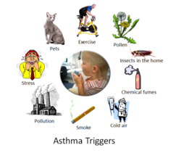
Step 5
DETERMINE THE CAUSE ASAP
  If possible, determine contributing factors that may have 'triggered' this event
  Remove the offending trigger if applicable
  Share this information with EMS
  Make sure you know what hospital the person is being sent to if there is more than one in your area

Slide 53
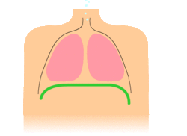
Step 6
MONITOR VITAL SIGNS
  Continue to monitor breathing
    Is person still breathing?
    Look, listen, and feel
    How fast are they breathing?
  Continue to monitor for signs of circulation (e.g., pulse, movement, skin color, and level of consciousness)
  If indicated, administer CPR
Notes:
All ERT members should be CPR certified but if someone needs to do CPR, but know that 911 can lead someone through the steps of CPR if needed.

Slide 54

Step 7
CONTACT PARENT/GUARDIAN & PROVIDER
  Notify parent/guardian of the situation ASAP
  Direct parent/guardian where to report (either to the school building OR the emergency department)
  Also notify the provider (if student has one)
Notes:
The protocol says to notify the physician but in many areas of the state, mid level practitioners are the primary care providers.

Slide 55

Step 8
TRANSPORT TO A MEDICAL FACILITY
  Every time epinephrine is administered in a school setting, 911 must be called, and the individual transferred to a medical facility
  A medical clearance should be required before the student can return to the building
  A student who did not previously have a current emergency plan and medication at school should return to school with a plan and ordered medication
Notes:
Each school will have their own policy about whether students can return to school if they do not have an emergency plan and medication at school. Know what your school's policy is.

Slide 56
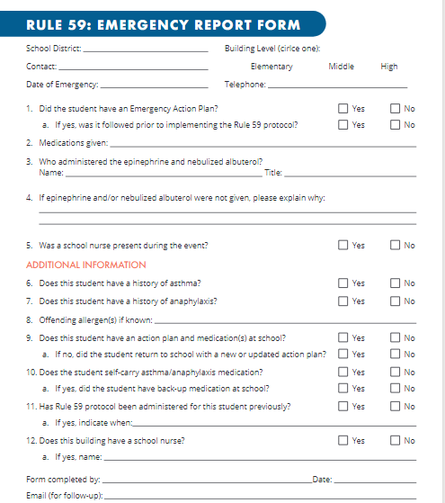
Reporting the Event
The Rule 59: Emergency Report Form is on the NDE Health Services website.
Please send completed forms to:
NDE.healthservices@nebraska.gov
Notes:
It is suggested that you report events so NDE can collect data (de-identified) in order to analyze the protocol in the future and make sure it meets the needs of schools. It is not mandated in the regulation that these events are reported to the Department of Education.

Slide 57
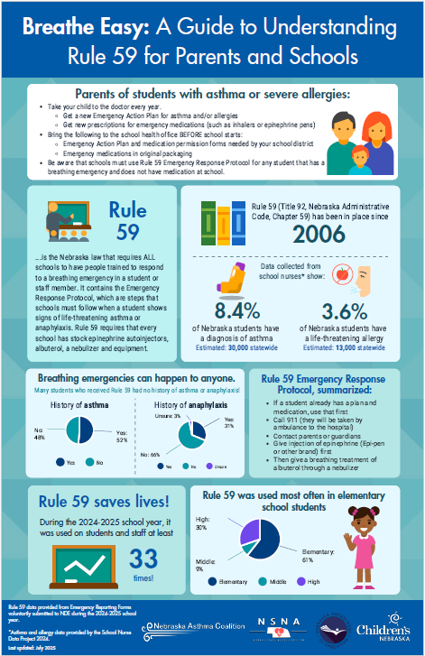
Resources
Rule 59 Infographic
To educate parents or schools on Rule 59
Includes new data from the Emergency Reporting Forms submitted to NDE during the 2024-2025 school year.
Rule 59 Infographic
Notes:
These are links to the regulation and also to the NDE website where a variety of resources can be found. These were all updated in 2022 and are available for use.

Slide 58
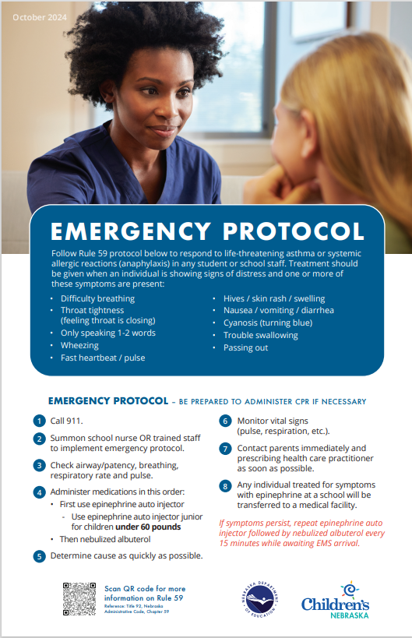
Resources
Rule 59 poster
Keep this in your health office to remind you of how to respond!
If you don’t have one, you can request a copy for free (see contact information, last slide).
Notes:
These are links to the regulation and also to the NDE website where a variety of resources can be found. These were all updated in 2022 and are available for use.

Slide 59
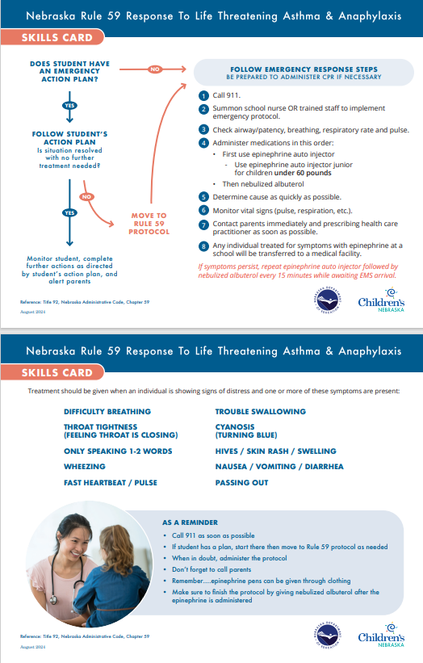
Resources
Rule 59 Skills Card
Give this to each member of your school’s Emergency Response Team!
Download and print here:
Revised-Skills-Card-dated-rule-59.pdf
Notes:
These are links to the regulation and also to the NDE website where a variety of resources can be found. These were all updated in 2022 and are available for use.

Slide 60
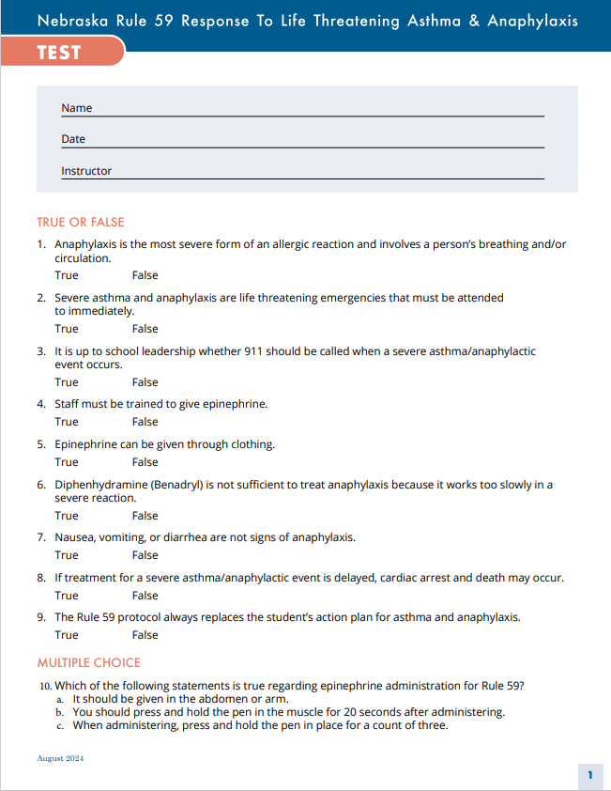
Resources
Competency Test
To assess competency for members of your school’s Emergency Response Team
Answer key is also available online
Test-dated-rule-59.pdf
Notes:
These are links to the regulation and also to the NDE website where a variety of resources can be found. These were all updated in 2022 and are available for use.

Slide 61
Resources
Rule 59 legislation can be found here:
  https://cdn.education.ne.gov/wp-content/uploads/2017/10/Rule59_2006.pdf
NDE website:
  https://www.education.ne.gov/csss/school-health-education-and-services/
  You will find a copy of this presentation, the reporting form, poster, skills card, and more.
Notes:
These are links to the regulation and also to the NDE website where a variety of resources can be found. These were all updated in 2022 and are available for use.

Slide 62

If you have questions or comments, please contact your school nurse
Or
Andrea Riley, BSN, RN
State School Nurse Consultant
School Health Liaison
Children’s Nebraska
402-955-6957
anriley@childrensnebraska.org
Notes:
If you have any questions or comments on this presentation or the Rule 59 protocol in general, please contact Kim. She works in partnership with NDE to manage the Rule 59 protocol and would love to help.

