Slide 1
Welcome to New Superintendent Orientation July 2025

Slide 2
School District Funds Bryce Wilson

Slide 3
CLASSIFICATION OF FUNDS
This information may be found on the Nebraska Department of Education’s website:
Rule 2:
https://www.education.ne.gov/wp-content/uploads/2017/10/Clean_Rule2_2021.pdf
Accounting Structure & Users’ Manual:
School District
https://www.education.ne.gov/wp-content/uploads/2025/04/2425DistrictUsersManual_May2025.pdf
ESU’s
https://www.education.ne.gov/wp-content/uploads/2025/02/2425ESUUsersManual_Febr2025.pdf

Slide 4
School District Budgeting
Taxing Funds
General
Special Building
Qualified Capital Purpose
Bond
NET OPTION FUNDING
ALLOCATED INCOME TAX
COMMNITY ACHIEVEMENT PLAN AID
EQUALIZATION AID
Notes:
Taxes collected must be spent for the purpose for which they were originally taxed.
Loans / Borrowing – Only between taxing Funds
Close Out a Fund – Proceeds go to the General Fund
Cannot make transfers to the Special Building Fund or Qualified Capital Undertaking Fund
Questions on Use of Funds – Call Us

Slide 5

General Fund
Operation of District
No Building Projects
Main Revenue Source: Taxes
Levy is Restricted -
Part of the $1.05
Purpose
Notes:
Operation of District:
Salaries/benefits – 65-70% of total budget
Facilities costs – utilities and
Curriculum Costs
State and Federal Program
Pupil transportation
No building projects
Repairs & Maintenance costs
Replace windows
Main Revenue is Property Taxes
Funding for federal and state programs
State funding – apportionment received by all district

Slide 6
Bond Fund
Collect Property Taxes
Bond Principal & Interest for Project
Revenue Source: Taxes
Not Part of $1.05
Levy is Restricted to Bond Principal & Interest
Purpose
Notes:
Purpose:
Collect property taxes to pay for Bond Principal, Bond Interest, related costs
Revenue Source:
Property Taxes
Levy is restricted to amount needed to pay Bond Principal and Interest
Many times the county treasurer retains the property tax revenue in a special fund and makes the payments for the district.
The Bond Fund shall be used to record tax receipts, investment interest, and the payment of bond principal, interest, and other related costs (i.e. trustee fees).
If the fund balance is not sufficient to meet interest or bond retirement payments from the Bond Fund, the General Fund shall be used for these payments.
Revenue from a levy to retire bonds in any school district is retained in a separate fund by the county treasurer, the financial institution serving as a fiscal agent, or the school district.
Proceeds from a bond issue shall be deposited into the Special Building Fund to be expended on the actual building project.
The tax levy for this fund is restricted to expenditures for principal and interest on bonds.

Slide 7
Qualified Capital Purpose Undertaking Fund
Accessibility Barriers
Life Safety Codes
Asbestos Removal
Mold Abatement & Removal
NEW – Safety and Security Infrastructure
Revenue Source: Taxes
Local Board Approval to Issue Bonds
Not Part of $1.05
3¢ / 5.2¢
Purpose
Notes:
Purpose:
Collect property taxes to pay for Bond Principal, Bond Interest, related costs
Revenue Source:
Property Taxes
Levy is restricted to amount needed to pay Bond Principal and Interest
Main advantage in using the QCPUF is that your levy could be outside the $1.05 levy limit. Not as much as an issue in recent years with the higher property valuations
Many times the county treasurer retains the property tax revenue in a special fund and makes the payments for the district.
A Qualified Capital Purpose Undertaking Fund may be established for:
the removal of environmental hazards,
the reduction or elimination of accessibility barriers in school district buildings,
the repayment of a qualified zone academy bond issued for a qualified capital purpose,
A Qualified Capital Purpose Undertaking Fund may be established for (con’t):
modifications for life safety code violations, and
mold abatement and prevention projects
Bonds for this purpose would include, but not be limited to:
Qualified School Construction Bonds
Build America Bonds
Any other bonds authorized by ARRA
The School Board may issue bonds for any Qualified Capital Purpose Undertaking Fund project.
General Fund expenditures for the purpose of this fund are not allowable.
The tax levy and duration of this fund is restricted.

Slide 8
Special Building Fund
Revenue Source: Taxes
Levy is Restricted
14¢ (*17.5¢)
Part of the $1.05
New Building Projects, Purchase Sites & Buildings
Purchase Furnishings for New Facilities
Improvement of Site
Purpose
Notes:
Purpose: - Improvement to the Site
Purchase or Improve Sites
Build, Alter or Improve Facilities
Furnish New Facilities
Revenue Sources:
Bond proceeds
Sale of Property
Tax receipts
Levy is restricted
LB 788 in Legislature to lower the maximum levy to 5¢. With vote of people, the levy can be 14¢
Bill has a provision for districts with a higher levy in place prior to passage for a specific project, they can continue with that higher levy through the 2024-25 school year - 7 years from 2017/18
A Special Building Fund is established to:
Acquire or improve sites
Erect, alter or improve buildings
Cost to furnish new buildings
Provides a way to identify cost associated with construction activities
The primary sources of revenue for the Special Building Fund are:
sale of bonds
the sale of property
tax receipts
General Fund expenditures for the purpose of this fund are not allowable.
The tax levy for this fund is restricted.

Slide 9
Taxing Funds
Tax proceeds must be spent for the purposes for which they were originally collected.
Building projects cannot be paid out of the General Fund.
Interfund Loans can be made between Taxing Funds
*One Exception – General can be used for Bond payment in a shortfall situation.

Slide 10
Depreciation Fund
Examples:
School Buses
Computers
Textbooks
Roof repair or replacement
Spread out Capital Outlay Costs
Use when you are out of Budget Authority
Revenue Source: General Fund Transfers
Restricted by Allowable Reserves Limit
Replacement
Purpose
Notes:
Purpose:
Spread out costly capital outlay costs over a period of years.
Revenue Source:
Transfers from the General Fund that are expensed to appropriate category
Set up Accounts by Expenditure Type
Instructional, Transportation, Building
Restricted by Allowable Reserve Limit
A Depreciation Fund is established to facilitate the eventual purchase of costly capital outlay
Spreads replacement costs over a period of years
Funds are shown as an expense from the General Fund and the Depreciation Fund will show the revenue as a transfer from the General Fund.
Special Building vs Depreciation Fund
Special Building – IMPROVEMENT TO THE SITE – NEW
Depreciation - REPLACEMENT OF EXISITING
Important in how the board motion is worded
Track –
If have a track – could be a depreciation project, but you know a new one track would always be an improvement to the site
Roof-
Replacement – depreciation fund
Improved roof – Special Building Fund
Find mold in the roof – could use QCPUF – a good contractor can always find some mold in a roof
This fund is considered to be a component of the General Fund.
The Depreciation Fund is restricted by statute as part of the allowable reserve limitation.

Slide 11
Employee Benefit fund
Reserve General Fund Money for Benefit of District Employees
Early Retirements
Unemployment Compensation
Deductibles
Revenue Source: General Fund Transfers
Restricted by Allowable Reserves Limit
Purpose
Notes:
Purpose
Reserve General Fund for District Employee Benefits
Revenue Source:
Transfers from the General Fund that are expensed to appropriate category
Set up Accounts by Expenditure Type
Unemployment, Early Retirement, Deductibles
Cash Reserve is Restricted by Allowable Reserve Limit
Is established to reserve General Fund money for the benefit of school district employees.
Funds are shown as an expense from the General Fund and the Employee Benefit Fund will show the revenue as a transfer from the General Fund.
A school district may divide this fund into more than one account to allocate a portion of this fund for different valid purposes:
Unemployment compensation
Early retirement
Health insurance deductibles
The cash reserve of this fund is restricted by statute as part of the allowable reserve limitation
The Employee Benefit Fund is considered to be a component of the General Fund

Slide 12
Contingency Fund
Uninsured Losses by District
Legal Fees for Defense against Public Losses
Revenue Source: General Fund Transfers
Budgeted Expenditures limited to 5% of Total General Fund Budget
Purpose
Notes:
Purpose:
Fund District Uninsured Losses and Legal Fees
Revenue Source:
Transfers from the General Fund that are expensed to appropriate category
Budgeted Expenditures from this Fund cannot exceed 5% of General Fund Total Budget
Usually used by larger districts
Authorized by statute to fund uninsured losses and legal fees.
Expenditures from this fund shall not exceed five percent of the total budgeted General Fund expenditures of the school district.
Funds are shown as an expense from the General Fund and the Contingency Fund will show the revenue as a transfer from the General Fund.

Slide 13
Activities Fund
District Extra-Curricular Activities & Student Organizations
Oversight of Financial Transactions for Student Activities
Revenue Source: Organization & Activity Fundraisers. General Fund Transfers
Purpose
Notes:
Purpose:
Account for Financial Transactions for District Extra-Curricular Activities and District Student Organizations
Revenue Source:
Activity/Organization Fund Raising
General Fund Transfers if deficits occur
Activities Fund cannot be used to record General Fund Operational Costs or to be used as a Clearinghouse for the General Fund
The Activities Fund is required to account extra-curricular activities
If included in the General Fund the school district’s operational costs would be distorted
The Activities Fund is not to be used to record general operation revenues or expenditures, nor shall this fund be used as a clearinghouse for the General Fund.
The school district may divide this fund into more than one account to allocate a portion of this fund for different purposes
If deficits in such activities are incurred, they shall be covered by funds transferred from the General Fund

Slide 14

School Nutrition Fund
Financial Activities of all Nutrition Programs
Staff Salaries, Food/Supplies,
Kitchen Equipment,
Contractors
Revenue Source: Lunch Sales, Federal & State Reimbursement,
General Fund Transfers.
Purpose
Notes:
Purpose:
Operation of all Nutrition Programs for the District
Food and Supplies
Salaries/Benefits of Nutrition Staff
Kitchen and Related Equipment
Contracted Food Services
Important to show kitchen equipment purchases in School Nutrition Fund
Cannot carry over more than 3 months expenses into following school year.
NDE will ask for valid rationale and how district will lower it.
Federal Reimbursement rate could be decreased if not resolved
Revenue Source:
Sales of Lunches
Federal Reimbursement
State Reimbursement
General Fund Transfers
The School Nutrition Fund shall reflect a record of all revenues and expenditures for the operation of all Nutrition Programs
If a deficit is incurred in the operation, the deficiency shall be covered by funds transferred from the General Fund.

Slide 15
Cooperative Fund
Shared Teacher or Administrator
Program Between Two or More Districts
ONLY used by District Serving as Fiscal Agent to Pay Shared Expense
Revenue Source:
Payments from other participating political subdivisions
General Fund Transfers by District serving as Fiscal Agent.
Purpose
Notes:
Purpose:
Used by a District serving as fiscal agent between the district and one or more other districts or other agency
Examples: Shared Teacher or Administrator, Shared Instructional Programs between Districts
Revenue Source:
District serving as Fiscal Agent – General Fund transfer expensed to appropriate category
Member Districts: Tuition paid – Instructional Program; Salary/Benefits – Shared Teacher or Administrator
Can be an agreement between district and another public agency – like a city.
The Cooperative Fund may be used by the school district acting as the fiscal agent for any cooperative activity between one or more public agencies.
All school districts, including the school district acting as the fiscal agent, shall show the payment for services to the cooperative in their General Fund.

Slide 16
Student Fee Fund
Record Transactions Fee-Based Programs
Extra-Curricular Activities,
Post-Secondary Education,
Summer/Night School
(No Other Allowable Uses)
Revenue Source:
Fees Collected by Each Category.
Not Funded by Tax Revenue
Purpose
Notes:
Purpose:
Record Transactions for Fee-Based Programs
Extracurricular Activities
Postsecondary Education
Summer or Night School
Revenue Source:
Only from Fees Collected for Programs/Activities Listed Above
Expenditures must be for the purposes for which the fees were collected.
The Student Fee Fund is a separate fund not supported by tax revenue.
Includes money collected from students pursuant to the Public Elementary and Secondary Student Fee Authorization Act (§79-2,125 through §79-2,135).
Included are fees for:
Extracurricular Activities
Postsecondary Education
Summer or Night School.
Expenditures from this fund must be for the purposes for which the fees were collected.

Slide 17

School District Budget Stephanie DeGroot

Slide 18
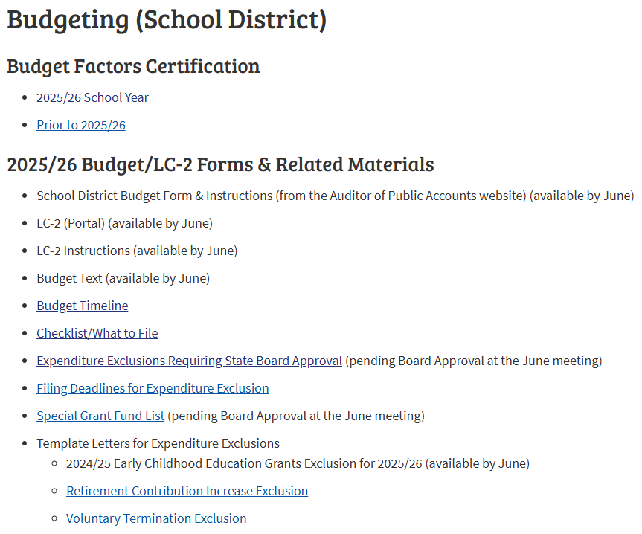
Budgeting Information & Tools Available on FOS Website
https://www.education.ne.gov/fos/budgeting-school-district/

Slide 19
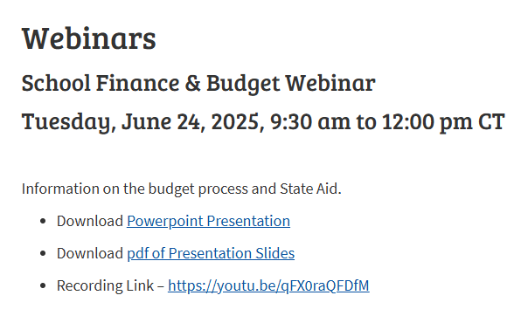
Budget Webinar Available on FOS Website
https://www.education.ne.gov/fos/webinars/

Slide 20
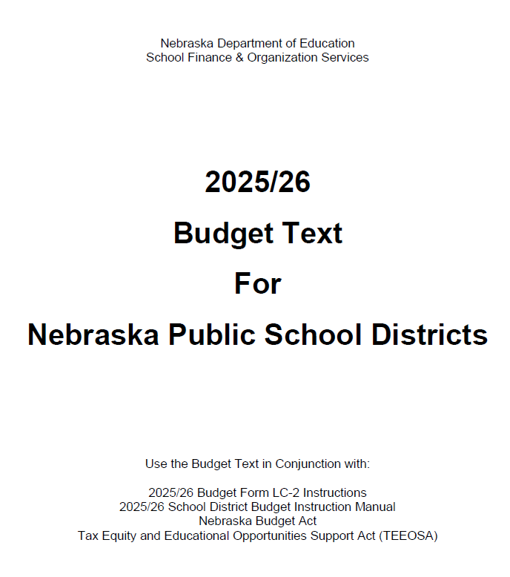
Budget Text Document
Explanation of budget terms
Taxing fund description
Levy detail
Access to unused budget authority
Levy and expenditure exclusions
Procedures for a holding special election
Levy override
Exceed budget authority
https://www.education.ne.gov/fos/budgeting-school-district/

Slide 21
Budget Instruction Manual
Instruction manual for Budget Documents
In-depth statute reference
Updates each year to incorporate Legislative changes
https://auditors.nebraska.gov/Budget_Info.html

Slide 22
School District Budget Cycle
Review Current Budget
Budget Workshop
Board Input on Levy & Tax Request
Hold Hearing(s)
Adopt Budget
Monitor Spending throughout School Year
Amendment Needed?

Slide 23

No Standard Method
Evaluate district needs & limitations
What are your board’s goals?
Review prior year budget and audit trends
Necessary Cash Reserve
Certified Budget Authority
Property Tax Authority
Budget to a specific levy amount
Board may determine maximum levy amount
Do you have bond or building projects?
Seek guidance from out-going Supt., NCSA mentor, and NDE team
Review Budget Text and APA Instruction Manual
Preparing
District
Budget
Notes:
Completing the Budget provides a school district with the authority to levy and to spend district funds

Slide 24
General Fund Disbursements
Things to consider when planning:
Build in percentage increase for salary & benefits
Consider the unexpected situations (SPED)
What if you had to hire another teacher?
What if you had to buy another vehicle?
Instructional materials
New computers or tablets
Building & grounds maintenance
New mower
Sprinkler repairs
Pupil Transportation:
Repair & maintenance
New tires
New Van

Slide 25
General Fund Revenue Sources
Local/County 52%
Property Taxes
Motor Vehicle Taxes
State
39%
State Aid
State Grants
Federal
8%
Loans
Non-Revenue less than 1%
Title Grants
IDEA Grants
ESSER
Medicaid
Sale of property
Insurance proceeds
Interest
Fines & Licenses
Apportionment
SPED Reimbursement
Transfers from other funds
*Data source for percentages from 2023/24 State AFR

Slide 26
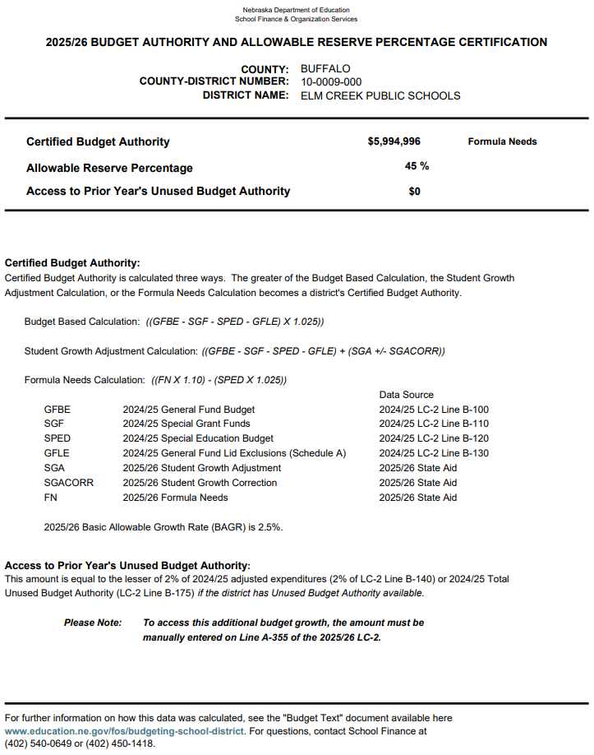
Certified on or before March 1st each year *See Budget Text for full calculation explanation *Budget Base, Student Growth, or Formula Needs *Populated into LC-2
Certified Budget Authority
https://sfos.education.ne.gov/Default

Slide 27
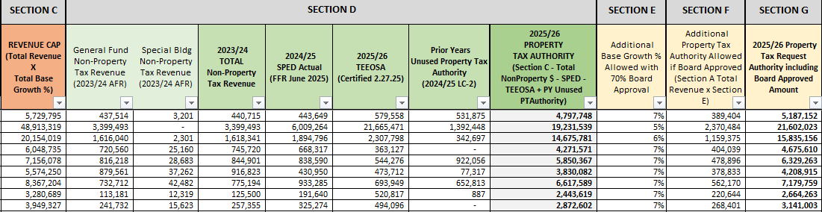
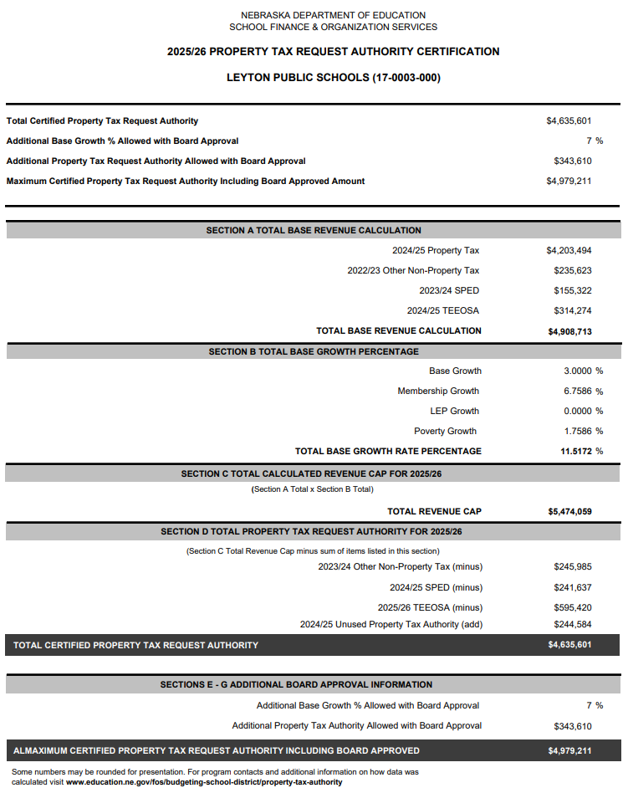
2025/26 Property Tax Authority Certification https://www.education.ne.gov/fos/budgeting-school-district/property-tax-authority/
*Certified in May/ June based on Legislature
*Applies to General & Special Building Fund
*Additional authority must be approved by 70% of board
*New Certification Document

Slide 28

Employee Benefit Fund Necessary Cash Reserve
Depreciation Fund Necessary Cash Reserve
General Fund Necessary Cash Reserve
Total Allowable Reserves *Budgeting tool to help with cash flow *Not cash in the bank *Data entered in budget worksheets *Auto populates into LC-2 *Total cannot exceed allowable amount
(Budget Authority Certification)

Slide 29
Calculation of Total Allowable Reserves
General Fund Budget $5,000,000
Allowable Reserve Percentage 45%
Total Allowable Reserves $2,250,000
Allowable Reserve Percentage is based on District’s ADM
Reference: See Budget Text – Allowable Reserve Limitation for more info

Slide 30
Provisions in statute allow specific items to be outside of the General Fund expenditure limitation.
Up Against Budget Authority?
Utilize Exclusions:
Special Grant Funds List
Early Childhood
Short Term Borrowing, etc.
SPED
General Fund Lid Exclusions
Retirement Contribution
Voluntary Termination
If you have still exceeded certified budget authority:
Hold a public hearing
Include ballot language stating access to expenditure exclusions
Amount is approved for one fiscal year
Must budget the total amount approved to carry over for future years.
Becomes part of the base
Notes:
Items located at the bottom of the Special Grant fund list Do require state board approval since they are specific to your district. A couple of things to consider…
Insurance Settlements:
Consider depositing settlements into your Special Building Fund, so you don’t have to request state board approval when you need to spend those funds.
In recorded in the Special Building Fund, then it wouldn’t impact per pupil costs
Inter-fund loans:
The General Fund may loan to another taxing funds
You have two years to repay an inter-fund loan
Short Term borrowing
Need a load from the bank to help get through a shortfall in revenue during the year.
Must repay this in a year

Slide 31
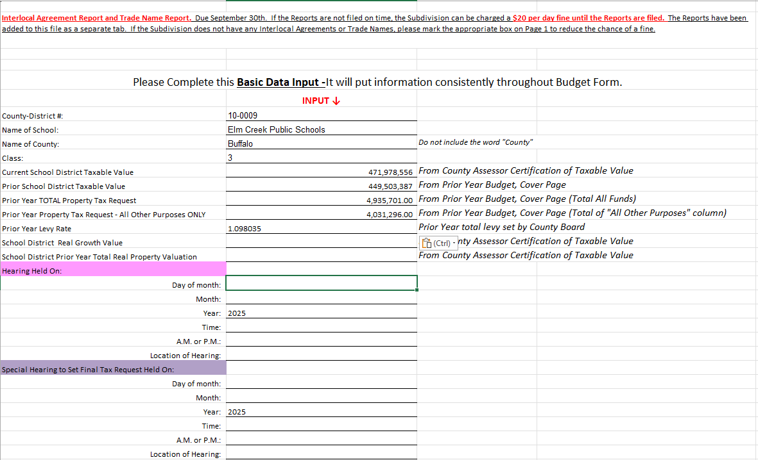
*Enter estimated valuations (Update in August) *Enter prior year valuations & levy *Bond principal & interest Excluded in “Total of All Other Purposes” *Information will flow through to other budget pages
Basic Data Input
*https://auditors.nebraska.gov/Budget_Info.html

Slide 32
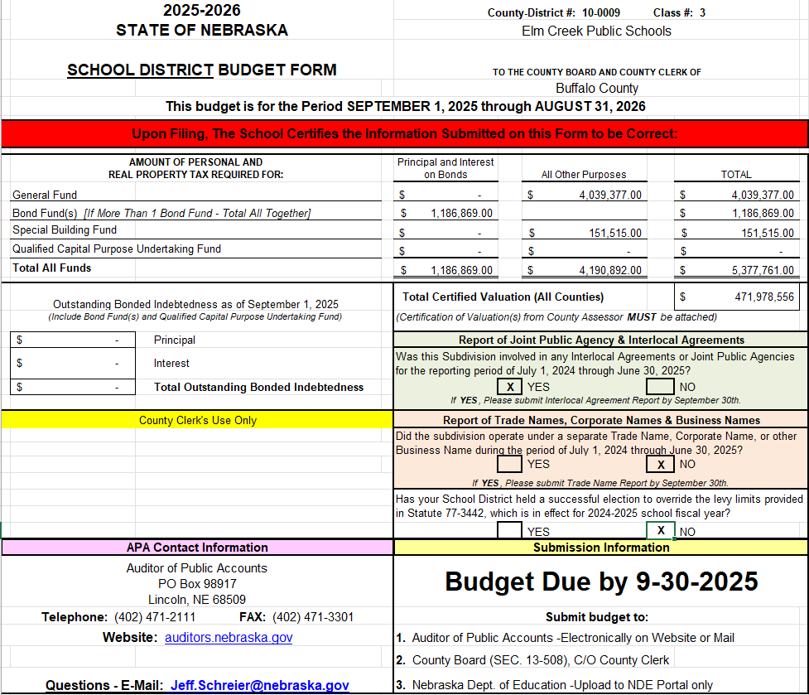
Cover Page
Data flows through from other budget pages
No manual entries here except Yes/No questions
Principle & interest on bonds
Will assist with entry on Basic Data Page

Slide 33
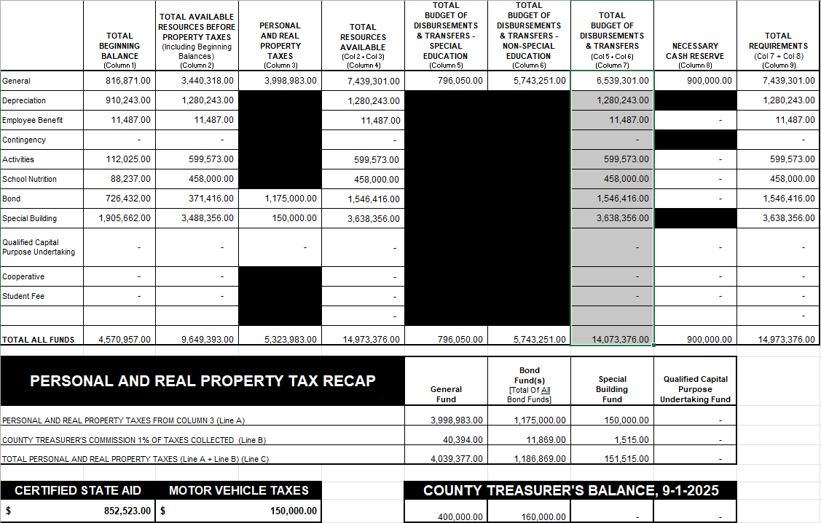
Pages 2, 3 & 4
Data flows through from budget worksheet pages
No manual entries here
Snapshot of budget
Verify State Aid number is correct
Verify taxing funds have a County Treasurer’s balance

Slide 34
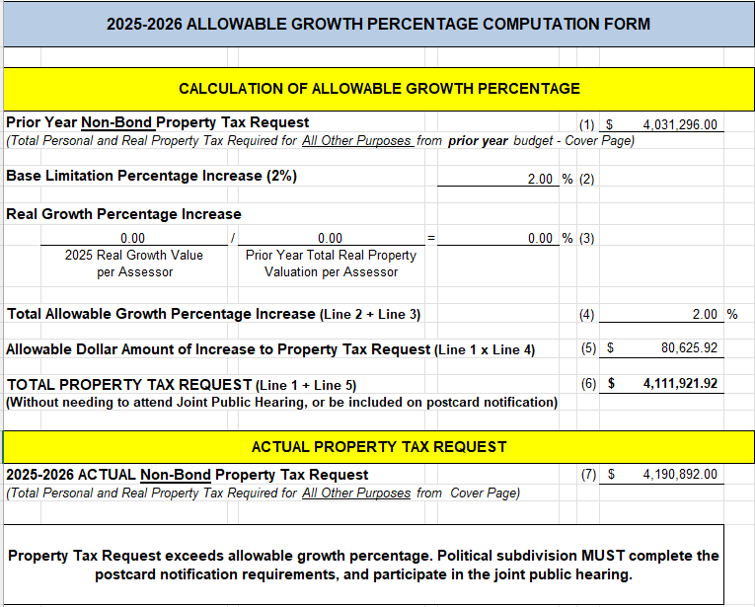
PT Request Act Page 6 - Allowable Growth Percentage
Required if tax asking exceeds 2% plus real growth
Joint Public Hearing – Hold with other political subdivisions in the county
Schedule between Sept. 14 – Sept. 24
After 6:00 PM
Must notify County Assessor by Sept. 4th
Postcards will be sent to property taxpayers/owners
Ask to proof postcards/ check for errors before mailing
Elected official must be present
Excludes bond principal & interest
Budget Hearing can be held prior to JPH, but not adopted
No manual entries here

Slide 35
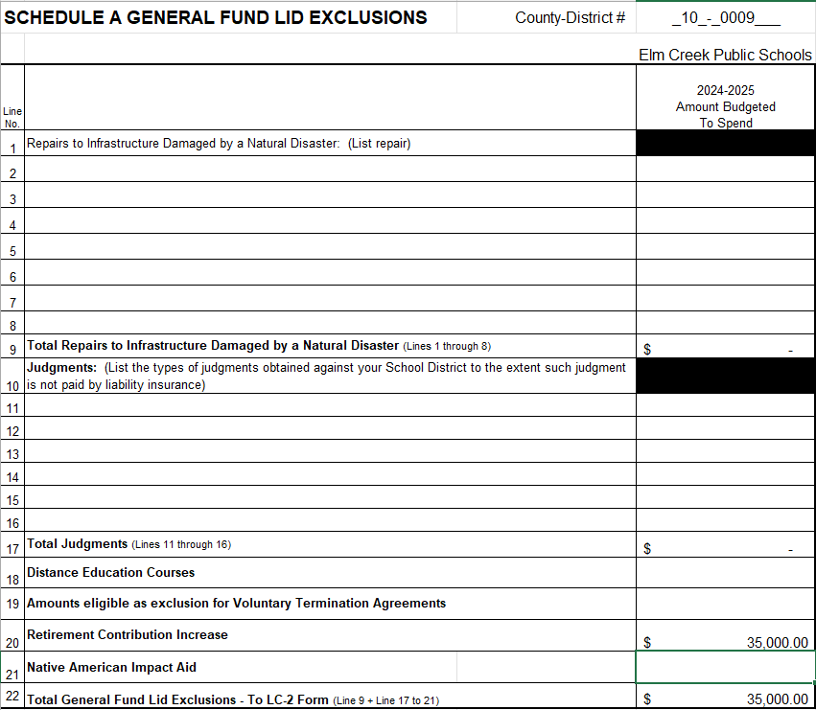
General Fund Lid Exclusions Schedule A
Notes:
Items located at the bottom of the Special Grant fund list Do require state board approval since they are specific to your district. A couple of things to consider…
Insurance Settlements:
Consider depositing settlements into your Special Building Fund, so you don’t have to request state board approval when you need to spend those funds.
In recorded in the Special Building Fund, then it wouldn’t impact per pupil costs
Inter-fund loans:
The General Fund may loan to another taxing funds
You have two years to repay an inter-fund loan
Short Term borrowing
Need a load from the bank to help get through a shortfall in revenue during the year.
Must repay this in a year

Slide 36
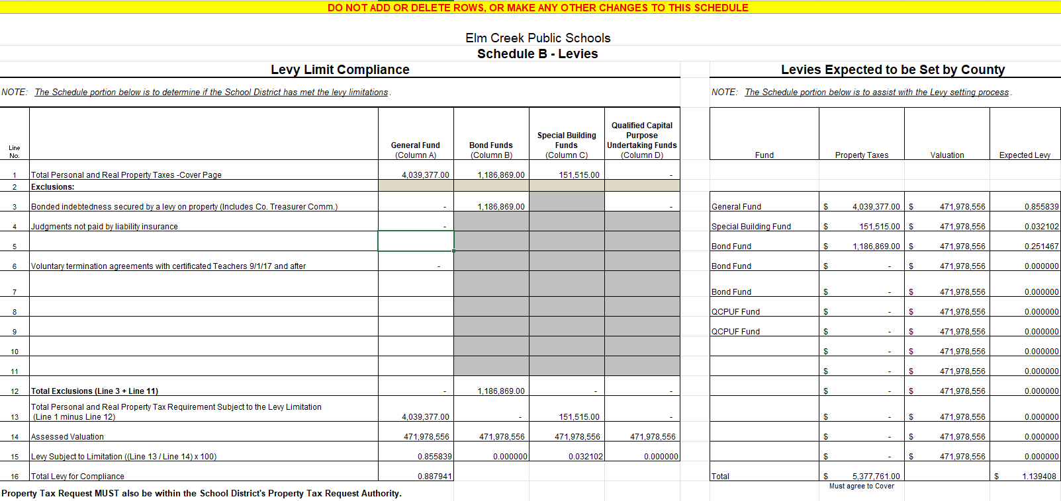
Schedule B
***No Manual Entries***

Slide 37
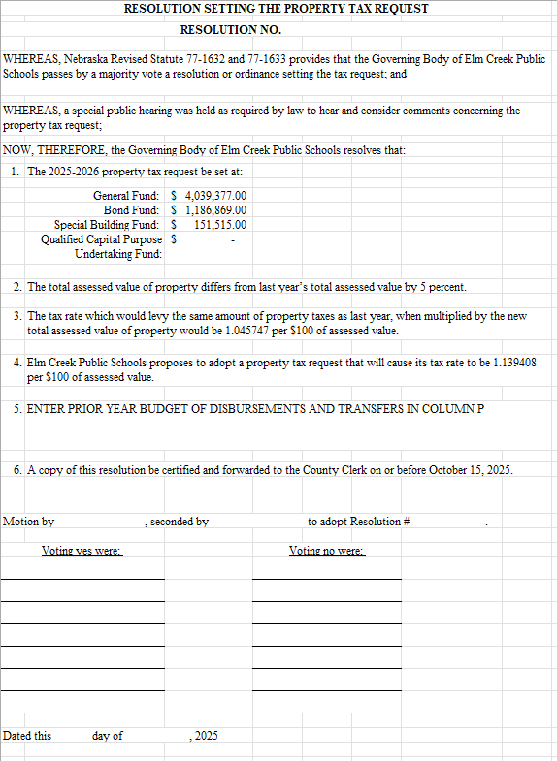
Resolution Setting The Property Tax Request
Remember to fill out & turn in with budget forms
Answers to questions you may receive
How much per $100 of assessed value
Can be signed or typed
Note in meeting minutes

Slide 38
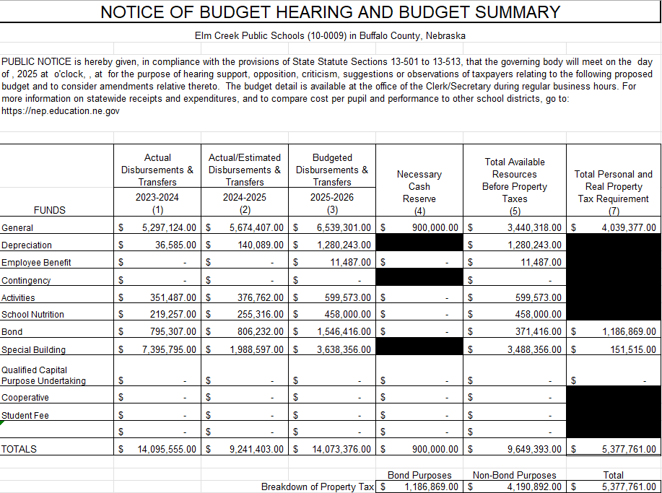
Notice of Budget Hearing

Slide 39
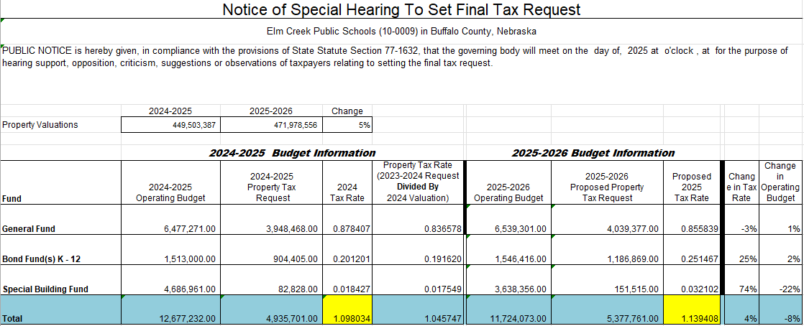

Slide 40
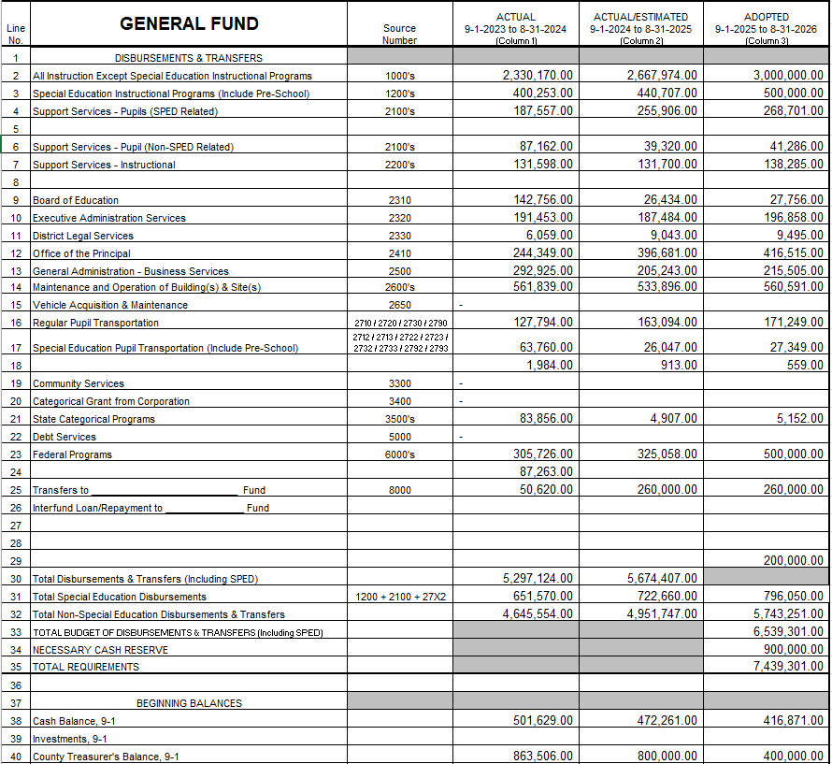
Budget Fund Worksheets
Column D - Start by entering the Audit Information
Column F – 2025/26 Budget
Note – This is the data that will auto populate the first half of budget
Column E - Current YTD
Enter Necessary Cash Reserve Here
Ending cash balance, must match beginning cash balance in next column
23/24 Audit
Current YTD Actual
Plan 25/26 Budget

Slide 41
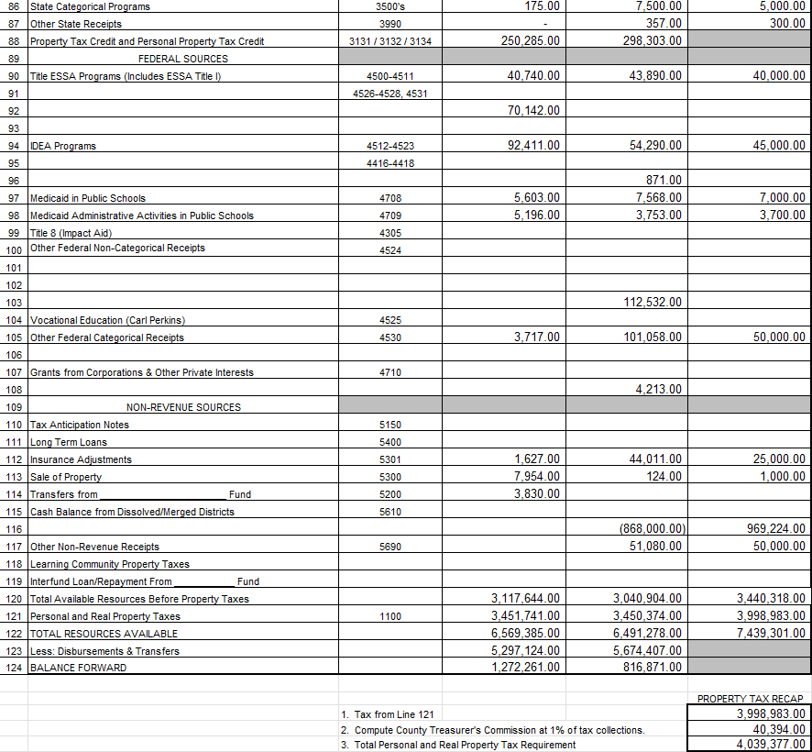
Budget Fund Worksheets – Cont.
Enter Property Tax Request
Bottom of Page
Remember County Treasurer 1%
Revenue can be estimated Expenses need to be more accurate

Slide 42
Upload budget to the LC-2
Make sure to save budget & upload to LC-2 often
Verify budget is within
Budget Authority
Allowable Reserve Limits
Levy Limits
Property Tax Request
Unlimited uploads
***Save, Save, Save
You must click save or the data will erase

Slide 43
Budget Data Entry Reminders
Enter the correct State Aid Amount from State Aid Certification Document
Motor Vehicle Taxes Enter similar $ to previous year
County Treasurer’s Balance Estimate from prior years
Beginning and Ending Balances Use actual balances from audit
Second column of worksheet can be used to reach the desired levy

Slide 44

Calculations – For Fun…
How to Calculate Levy?
(Total Tax Request ÷ Assessed Valuation) x 100 = Levy
($4,389,899 ÷ $443,000,000) x 100 = .990948
How Much Will My Levy Generate in Property Taxes?
(Levy x Valuation) ÷ 100 = Property Tax Request
(.990948 x $443,000,000) = $4,389,899
Additional 1¢ in Levy Generates Additional Property Tax
Move decimal 4 spaces to the left on district valuation
$443,00.0,000. valuation = $44,300 additional pennies!

Slide 45

Current Year 2023/24 Budget Reminders
*Review current budget to avoid overspending and to see if an amendment is required
*If spending authority remains in General Fund, consider a transfer to other funds:
Depreciation Fund
Employee Benefit Fund
School Nutrition Fund
Activity Fund
*Unspent General Funds will increase next year’s available beginning balance. Put towards cash reserve.

Slide 46
Need to Amend the Current Year’s Budget?
*Per Statute must amend before overspending occurs
*Required if ANY fund will exceed total budget of disbursements & transfers out
*Hold Hearing and Approve by August 31
*Total Requirements must equal Total Resources available
*Property Tax request cannot change if Tax Levy has been set
Required Action
*Hearing Notice To Amend
Budget as originally adopted
Proposed amended budget
Rationale for amending
Include statement “No impact to district tax levy”
*Documents to submit:
Proof of Publication
Board Minutes
Page 2 of Budget Document
Submit documentation to:
State Auditor
County Clerks
NDE

Slide 47

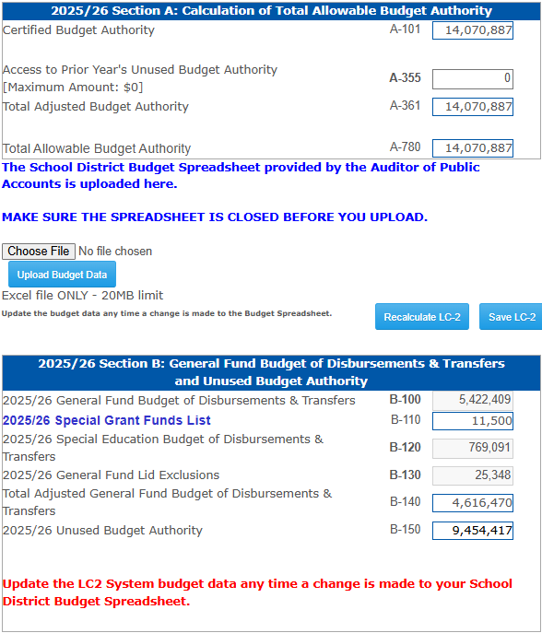
Amending the LC2
*LC-2 must be revised if these funds are amended:
General Fund
Depreciation Fund
Employee Benefit Fund Cash Reserve
*Make sure Allowable Reserves has not been exceeded
*Upload to LC-2 before Board approves
*Must contact NDE to unlock LC-2
https://www.education.ne.gov/fos/process-for-amending-a-budget/
Notes:
Items located at the bottom of the Special Grant fund list Do require state board approval since they are specific to your district. A couple of things to consider…
Insurance Settlements:
Consider depositing settlements into your Special Building Fund, so you don’t have to request state board approval when you need to spend those funds.
In recorded in the Special Building Fund, then it wouldn’t impact per pupil costs
Inter-fund loans:
The General Fund may loan to another taxing funds
You have two years to repay an inter-fund loan
Short Term borrowing
Need a load from the bank to help get through a shortfall in revenue during the year.
Must repay this in a year

Slide 48
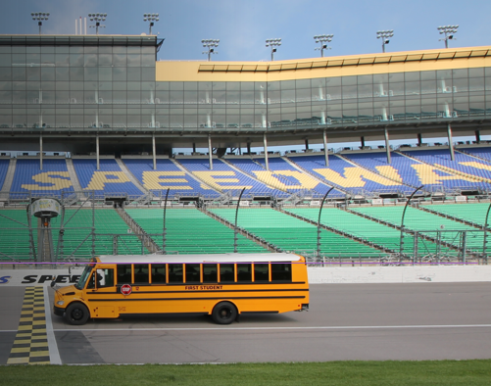
Pupil Transportation Website https://www.education.ne.gov/fos/pupil-transportation/
New Pre-Trip Inspection Packet
Includes Instructions
New Annual/80 Day Inspection Packet
Includes Mechanic Qualifications
Includes Instructions
2025-26 School Year
Keep Track of Mileage
Spreadsheet Example on Website
Beginning of School Year
Checklist & Reminders on Website
Join Quarterly Zoom Meeting

Slide 49
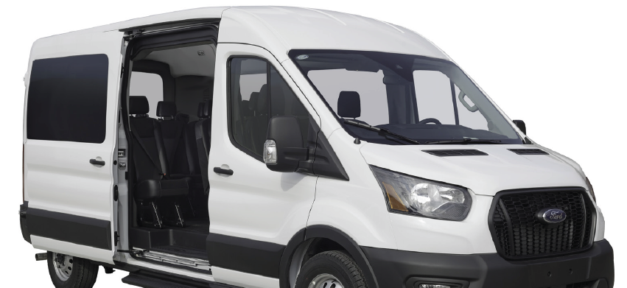
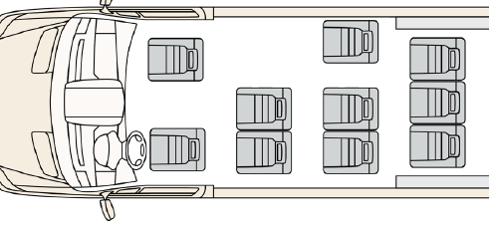
Van Update – 10 Passenger Total (Including the Driver)
New National Standards Late July/Early August
Eliminates Grey Areas On Used Vans
Rule Revision Begins September
Approximate Finalized May/June 2026
Grace Period (Unknown Yet)
No One Is Grandfathered In
Chevy Express Vans – Most sit on a 15-Passenger Chassis which has been outlawed since 2005 - These cannot be modified
Dealers – Cannot remove seats, it is illegal
To Meet Federal Requirements
Tire Load Sticker MUST SAY:
10 Total Passengers
Vehicle Type MUST SAY:
MPV MultiPurpose Vehicle

Slide 50
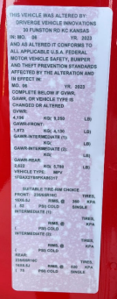
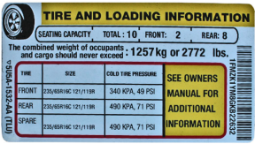
What You Need To Look For On The Van:

Slide 51

Contact Info: 402-540-0649 stephanie.degroot@nebraska.gov

Slide 52

New Superintendents Orientation
Drs. Keith Rohwer & Mike Sieh
July 27, 2023
10:30 a.m.

Slide 53

Associate Executive Director
Dr. Troy Loeffelholz
Dr. Troy Loeffelholz
Email: troy@ncsa.org
Phone #: 402-910-8763
X: @NCSAtroy

Slide 54
Thank You
NDE Staff – Bryce for allowing us to be part of this orientation
Upcoming Events
Administrator Days – July 23-25
Business Manager Workshop - July 31
Student Legal Issues Workshop - Aug 7
School Law Update - Sept. 17
Ed Academy for Leg Advocacy - September 24-25
NCSA Tailgate - Sept. 20
NCSA Free Webinar Series throughout school year

Slide 55
Superintendent Leadership
Professional Development
Connections
Hearings
Student discipline
Legal issues
Legislative process
Decision making processes,
Strategic planning.
Programs
New Superintendents – Monthly ZOOM
Networking with New Principals
Emerging Superintendents
Region & ESU Meetings

Slide 56

Small Group Networking
Huddles

Slide 57


Questions?

Slide 58
Exclusions & LC-2 Kelsey Larsen

Slide 59
General Fund Exclusions
Levy Exclusions
Allows districts to levy more than the $1.05 levy limit
Found on Budget Schedule B
No State Board approval needed
Expenditure Exclusions
Allows districts to spend more than their Certified Budget Authority
Most need State Board approval

Slide 60
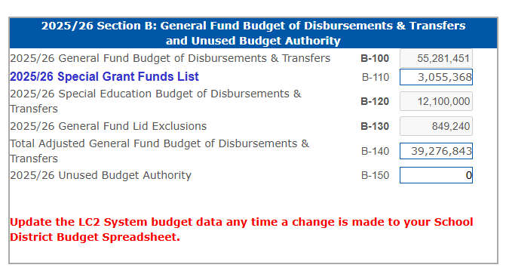
General Fund Expenditure Exclusions
State Board aapproval is not required for:
Special Education Expenses
Includes SPED Transportation and any SPED related student services (21XXs, excludes 219X’s)
Special Grant Funds List
List found in LC-2
Programs pre-approved each year by State Board, commonly used programs:

Slide 61
Supplemental Grants on the Special Grant List
Exclusions that need State Board approval:
Insurance Settlements
Inter-fund Loans
Reimbursements for Wards of the Court
Repayments to County Governments for Previous Overpayments
Short Term Borrowing
Grants from City or County Government
Grants from Corporations, Foundations, or Other Private Interests
Email exclusion requests to kelsey.larsen@nebraska.gov
*Include district name & number, amount, & purpose*

Slide 62
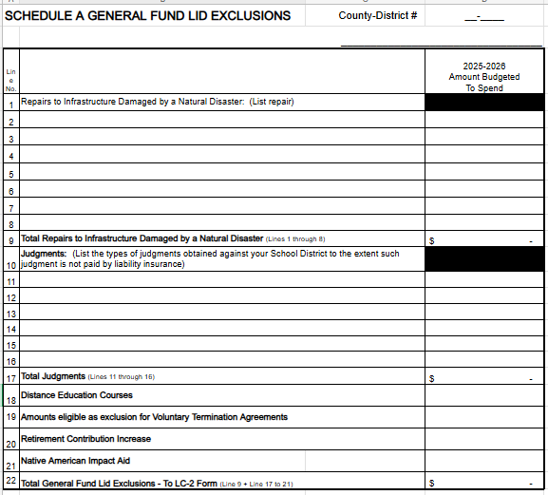
Schedule A
Need Board Approval For:
Repairs to Infrastructure
Judgements
Distance Education
Voluntary Terminations
Retirement Contributions
Native American Impact Aid
Email Requests to: kelsey.larsen@nebraska.gov

Slide 63

Early Childhood Education Grant & New Elementary Site
Early Childhood Education Grant & New Elementary Site
Early Childhood Education Grant
An email was sent to those districts who qualify
If 2025/26 is the first-year early childhood membership is included in the district’s formula students, districts can request a General Fund expenditure exclusion for the amount equal to the 2024/25 Early Childhood Education Grant increased by the Basic Allowable Growth Rate (2.5%)
State Board approval is needed
Amount remains in the base for calculation of future budget authority
New Elementary Attendance Site(s)
Must have already qualified for Elementary Site Allowance
Exclusion is for costs related to first year of operation
Salaries, Utilities, Building Maintenance

Slide 64

Repairs to Infrastructure
Damage is due to a Natural Disaster
Governor or FEMA must Declare a Disaster
Natural Disasters include:
Tornadoes
Floods
Wildfires
State Board approval is needed

Slide 65

Distance Education Courses
To qualify, a district must provide distance education course through an ESU Coordinating Council to another district
Exclusion: The amount received as payment from another district
State Board approval is needed

Slide 66
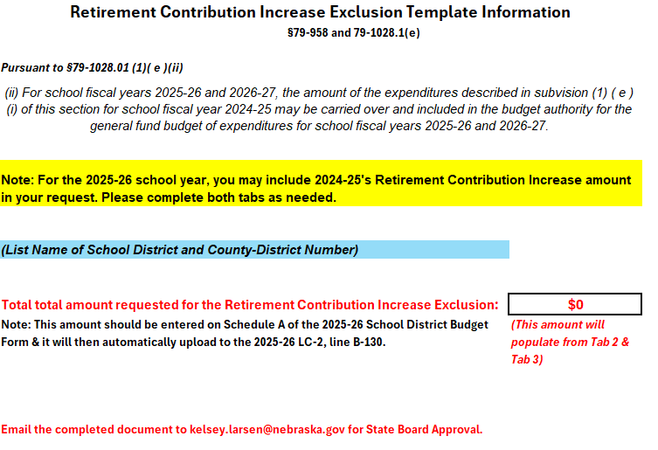
Retirement Contribution Increase
This exclusion allows districts to exceed their expenditure limitation by a specific dollar amount, not to exceed the difference between the employer’s contribution rate and the budgeted amount of employee salaries.
State Board approval is needed
**New** 2024-25 can be included in your exclusion request for 2025-26 & 2026-27.
**Note** - 2024-25 Contribution Increase: 9.88% - 2025-26 Contribution Increase: 8.08%

Slide 67
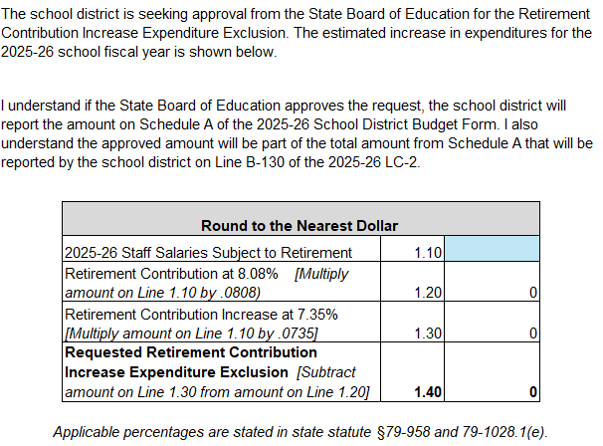
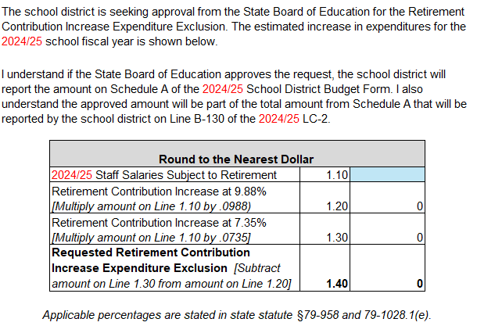
Retirement Contribution Increase Continued
Tab 2: 2025-26
Tab 3: 2024-25

Slide 68
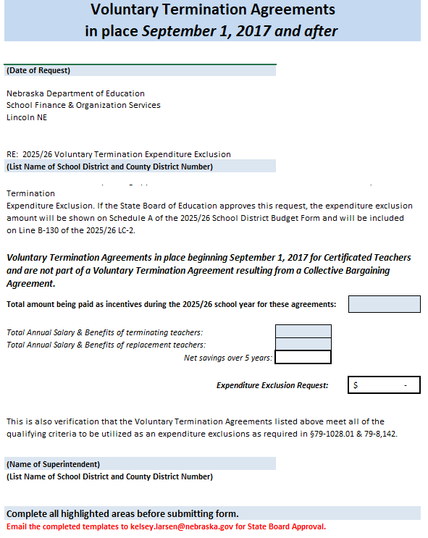
Voluntary Termination Agreements
The voluntary termination agreement was not part of any collective bargaining agreement.
The value of the current and future incentives shall not exceed $35,000 in total per employee.
All incentives must be paid withing five (5) years of agreement or until the certificated teacher becomes eligible for Medicare, whichever comes first.
The payment of incentives must result in a net savings in salary and benefits to the district over the five-year period.
State Board approval is needed

Slide 69
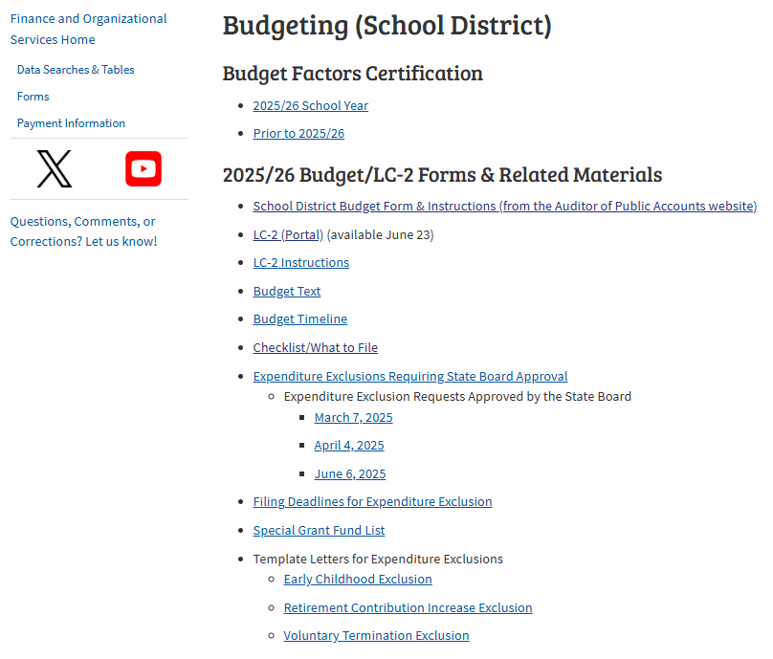
Template Letters for Expenditure Exclusions
https://www.education.ne.gov/fos/budgeting-school-district/

Slide 70



Requesting State Board Approval
Exclusion templates are available in the budget section of NDE’s Finance and Organizational Services website https://www.education.ne.gov/FOS/
Can include exclusion requests in budget planning before State Board approval has been posted
Send requests to NDE via email kelsey.larsen@nebraska.gov

Slide 71
LC-2
Located in the NDE Portal
Will receive a new activation code each year
New Superintendent this year?
Contact ADVISER HelpDesk to Register in NDE Portal
Instructions can be found on NDE’s Financial and Organizational Services website: https://www.education.ne.gov/FOS/ (Budget Documents)
Budget Form (Excel format)
- Upload into the LC-2, it will auto populate
For questions about the NDE Portal or submitting data online, contact the NDE Service Desk at NDE.ServiceDesk@Nebraska.gov

Slide 72
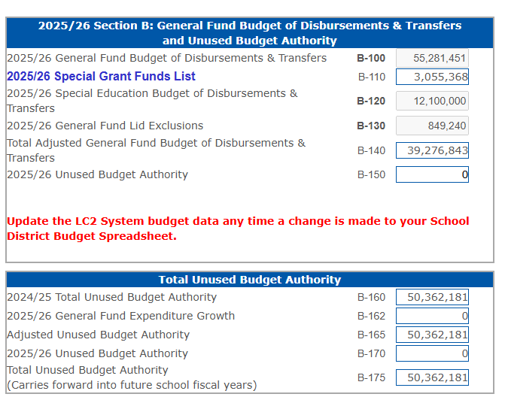
Purpose of the LC-2
Confirms that the budget is in compliance, and it does not exceed limitations
Error messages appear if limitations are exceeded
Special Grant Funds
Calculates Unused Budget Authority, the goal is $0

Slide 73
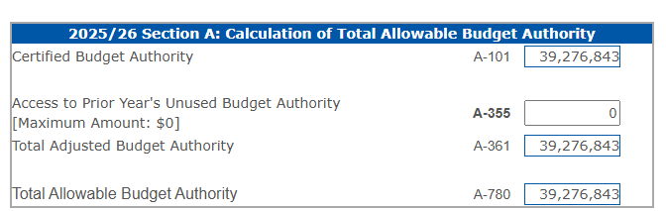
LC-2 Access & Unused Budget Authority
Amount listed is lesser of 2% of the prior year’s adjusted General Fund expenditures or the prior year’s total Unused Budget Authority
Provides additional Budget Authority for 2025/26

Slide 74
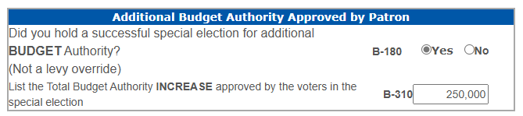
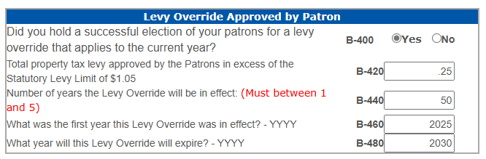
Election for Additional Budget Authority & Levy Override
If the answer is “YES”

Slide 75
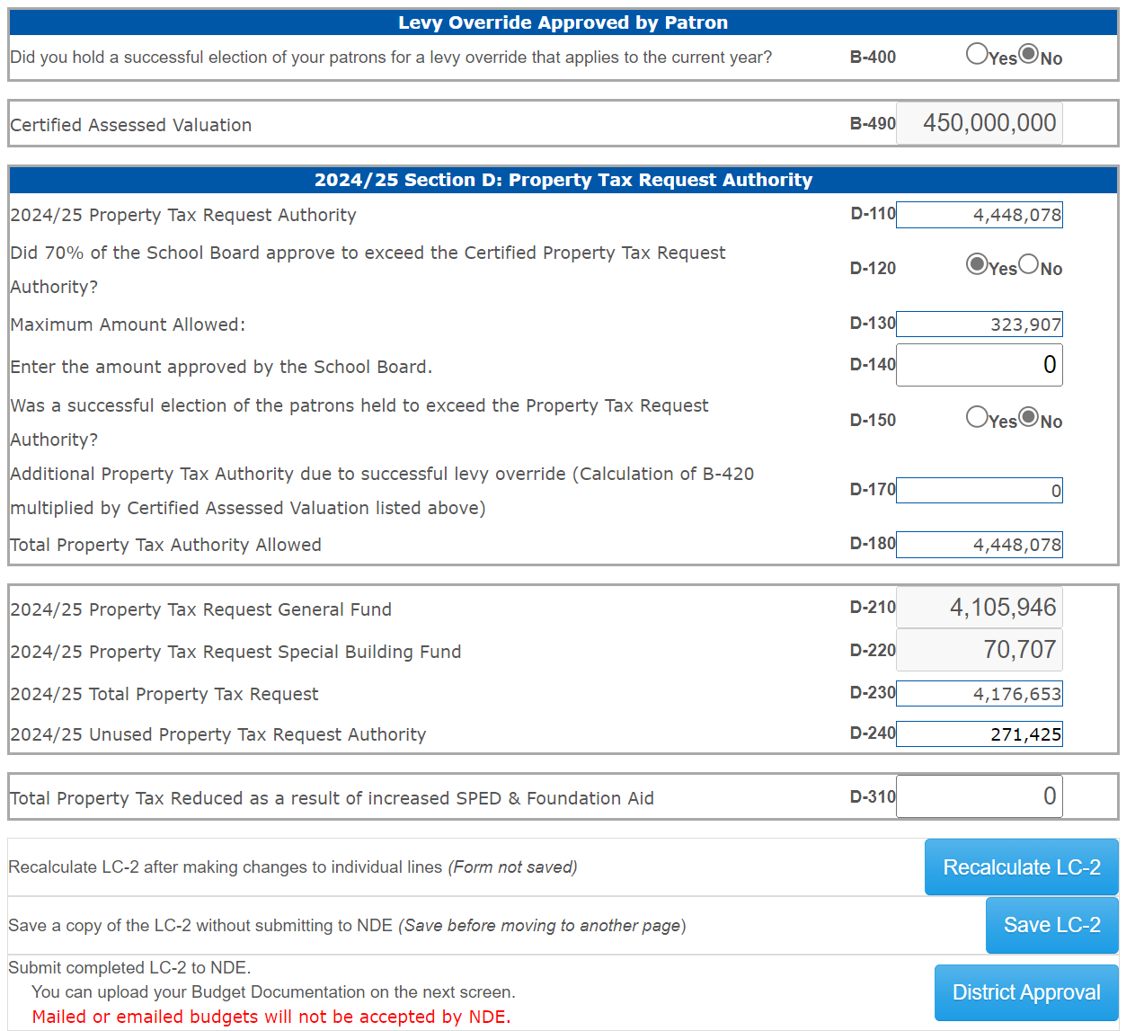
Section D – Property Tax Authority
Certified Assessed Valuation & Property Tax Request will pre-populate when the budget document is uploaded
If YES on additional authority the maximum amount allowed will be displayed.
The actual value approved will need to be entered in D-140
D-180 will calculate Total Property Tax Authority Amount Allowed
Total Property Tax Reduced as a result of increased SPED & Foundation Aid in D-310
Always “Recalculate” and “Save”
2025/26 Section D: Property Tax Request Authority

Slide 76
LC-2 Error Messages
Budget Authority Exceeded
Allowable Reserves Exceeded
Levy Information/Dates Do Not Match
Property Tax Authority Exceeded
**LC-2 cannot be submitted with error messages**

Slide 77
Budget Checklist
Expenditure exclusion requests sent in?
Utilize the LC-2 while working on budget
Is the budget within spending, levy & property tax limits?
Does the LC-2 & budget match?
Is a Joint Public Hearing required?
Does hearing notice match the budget document?

Slide 78
Budget Check List Continued
Publish hearing notices?
Confirm Hearing Notices were published in newspaper
Reserve adequate time for public comment at budget hearing
Submit the budget documents to NDE, APA, County Clerks by September 30
Submit the Property Tax Resolution to the County by October 15

Slide 79




Review Checklist, PDF listed items, and upload through the LC-2 as a single PDF
How to Submit Budget Documents to NDE
Send copies of supporting documentation to APA’s office & County Clerk’s office
Do not mail in budget documents
Confirmation emails sent when:
District admin approves budget
PDF documents are uploaded
NDE approves LC-2 and budget documents
Due: September 30th
Paper & email copies will not be accepted

Slide 80
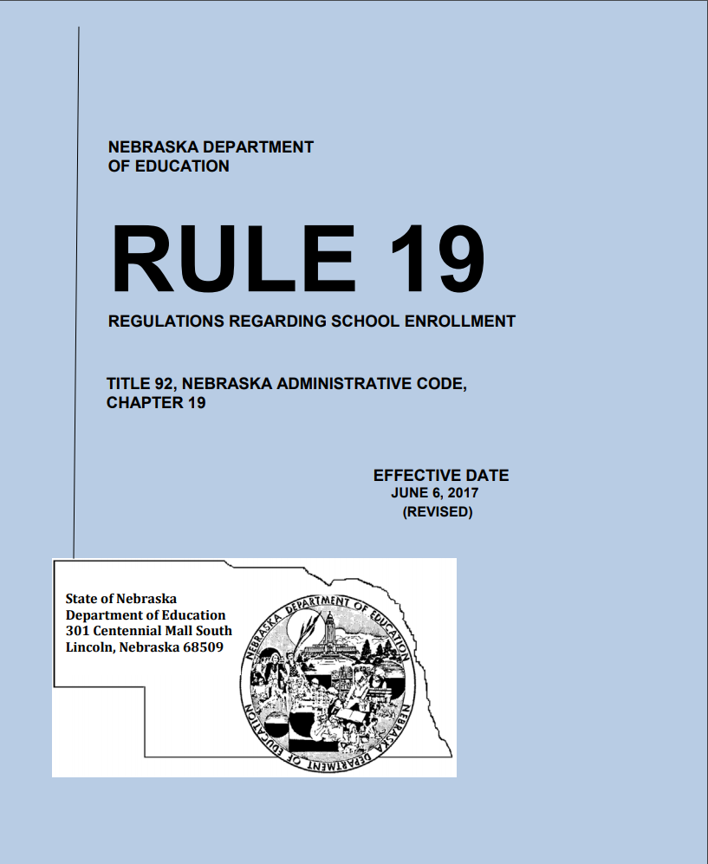
Enrollment Option Program
https://www.education.ne.gov/fos/enrollment-option-application-instructions-faqs/

Slide 81
Enrollment Option Application
Application/FAQ’s now posted
*New fillable document
Use most current version
Spanish version now posted
Districts retain application until student graduates or reaches age 21
Program Contacts:
Michelle Cartwright
michelle.cartwright@nebraska.gov or 402.450.0867
Kelsey Larsen
kelsey.larsen@nebraska.gov or 402.450.1418

Slide 82

Enrollment Option – What’s New?
Effective July 19th, 2024
A student may option once during elementary school, once during middle school or junior high school, and once during high school for a total of three times.
Exceptions still available
Enrollment Option Rejection Report - NDE Portal
Legislature Reporting Requirement
Opens June 1, closes June 30
Reporting data for applications received June 1 through May 31

Slide 83
TEEOSA 101 STATE AID CALCULATION Michelle Cartwright

Slide 84
What is TEEOSA?
Tax Equity and Educational Opportunities Support
Act
Statute that defines State Aid
Creates the basic concept for the present state aid formula
Equalization Aid and Foundation Aid – largest components of State Aid
Complex matrix of formulas

Slide 85
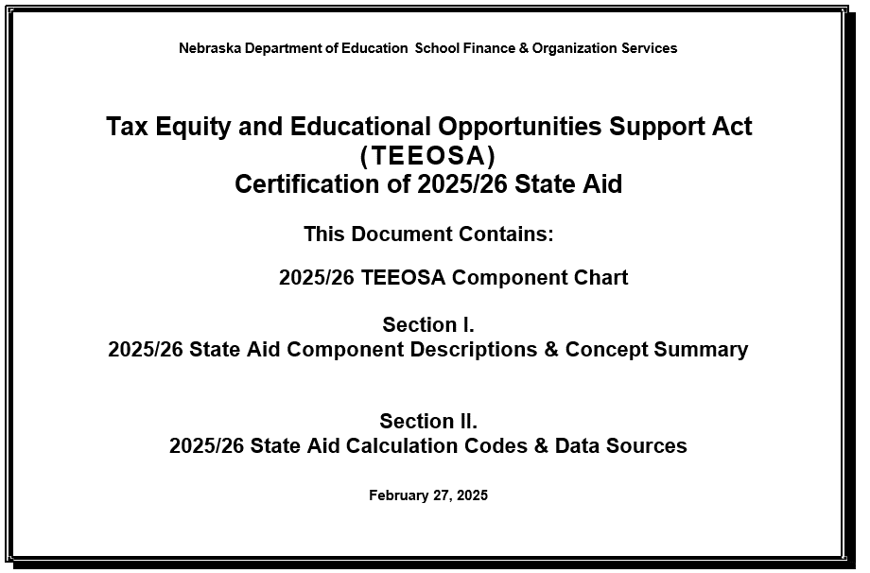
TEEOSA Document
Decodes
the components of Equalization Aid
Resource
for more detailed information
Available
on NDE’s website
https://www.education.ne.gov/fos/state-aid/

Slide 86
TEEOSA FAQ Document
For those
NOT so really ‘dumb’ questions….
What are Formula Students?
How are Needs determined?
How is Poverty Allowance determined?
What is Foundation Aid?
What is Equalization Aid?
How is Total State Aid determined?
https://www.education.ne.gov/fos/state-aid/

Slide 87
Nebraska Department of Education School Finance and Organization Services 2025/26 TEEOSA Component Chart
Basic Funding
Special Receipts Allowance
Poverty Allowance
Limited English Proficiency (LEP)
Allowance )
Transportation Allowance
Focus School & Program Allowance
Summer School Allowance
Distance Education & Telecommunications (DETA) Allowance
Elementary Site Allowance
Community Achievement Plan Allowance
Non-Qualified LEP Adjustment
System Averaging Adjustment
Student Growth Adjustment
Two-Year New School Adjustment
Poverty Correction
LEP Correction
Student Growth Correction
Needs Stabilization
NEEDS
minus
RESOURCES
equals
EQUALIZATION AID
Yield From Local Effort Rate
Net Option Funding
(w/ Reduction)
Allocated Income Tax Funds
Other Actual Receipts
Community Achievement Plan Aid
60% ($900)
Foundation Aid
TOTAL CALCULATED STATE AID (FUNDING SOURCES)
COLOR CHART:
Green – Allowances
Blue – Adjustments
Purple – Corrections
Maroon – Foundation Aid
Orange – Equalization Aid
Red – Prior Year Correction
Net Option Funding
(w/ Reduction)
Allocated Income Tax Funds
Community Achievement Plan Aid
60% ($900)
Foundation Aid
Equalization Aid
40% ($600)
Foundation Aid
Prior Year Correction

Slide 88


TEEOSA AID PROCESS
CERTIFICATION
Calculated in the spring for upcoming school year
Certified on or before March 1st
Most Data Components collected in late fall
Fall membership counts used
RECALCULATION
Recalculated in the fall for the current year
Average Daily Membership used
AFR Amendments
Updates the formula
Creates prior year correction shown on next cert year
CALCULATED TWICE PER YEAR

Slide 89



IMPACTING FACTORS
FORMULA STUDENTS
Grades K - 12
Qualified 4-year-olds (60% Rate)
Contracted to another district
GENERAL FUND OPERATING EXPENDITURES
Revenues & expenses from Annual Financial Report
PROPERTY VALUE
Tax Base
District's ability to pay
COST SHARING FORMULA

Slide 90
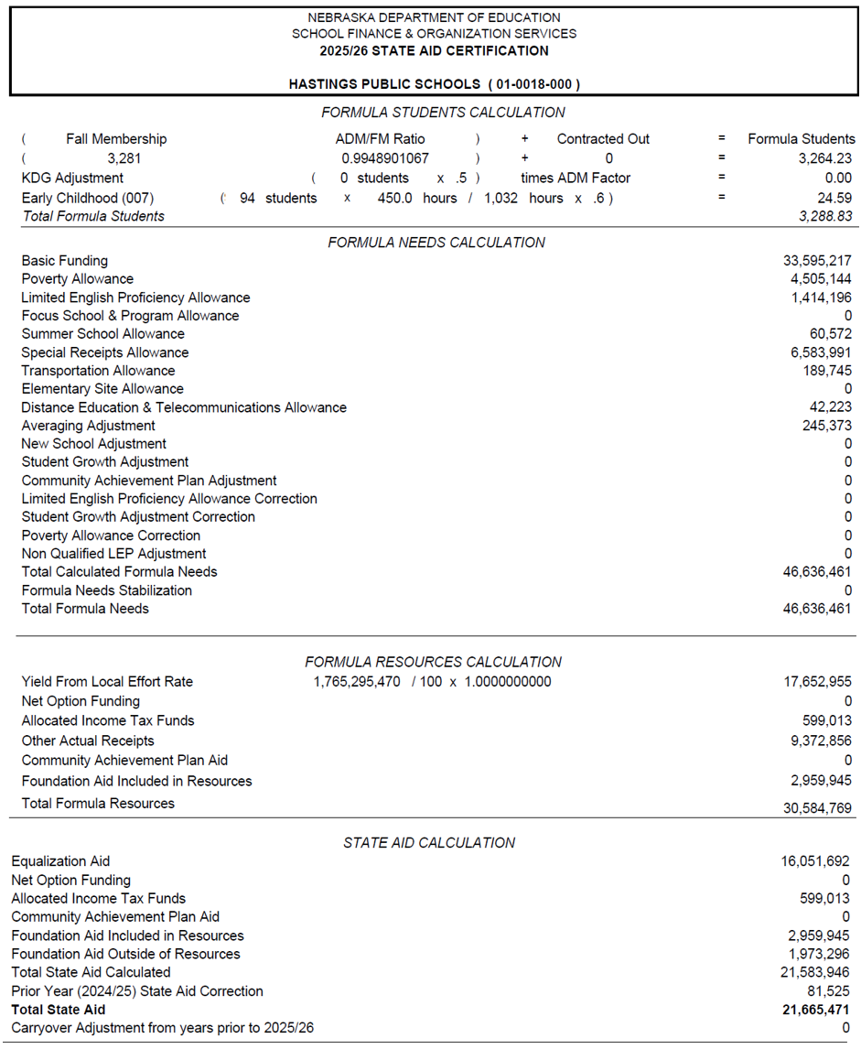
STATE AID CERTIFICATION FORM Released by March 1 https://sfos.education.ne.gov

Slide 91





CATEGORIES OF NEEDS
BASIC FUNDING
Estimated amount required to generally operate a school district with a specified number of students
Calculated by a comparison group
Average general fund operating expenditures
ALLOWANCE
Based on estimated or actual expense
District specific
Addresses a specified situation by reducing basic funding
ADJUSTMENT
Increases the needs
Adds money to formula
Addresses a specified situation without reducing basic funding
CORRECTION
Added or subtracted
Corrects for an allowance or an adjustment
Occurs 2 years later
STABILIZATION
An amount added or subtracted
Keeps the needs from growing or declining by more than a specific rate
COSTS TO EDUCATE THE STUDENTS

Slide 92
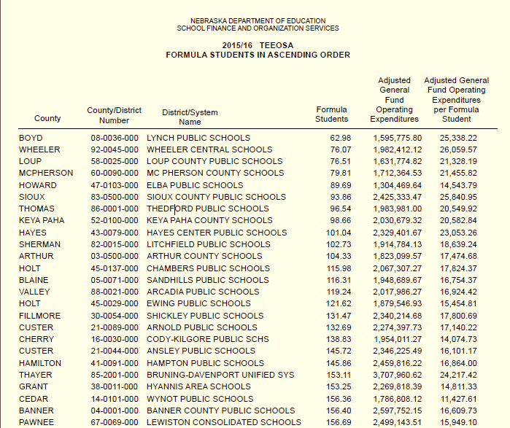
BASIC FUNDING
ESTIMATED AMOUNT
required to generally operate a school district with a specified number of students
CALCULATED BY COMPARISON GROUP
Using the 10 larger and 10 smaller districts closest in size and measured by formula students
ADJUSTED GFOE
is averaged when calculating basic funding

Slide 93
NEEDS & ALLOWANCES
2025/26
Allowances
Recognizes Funding
For……
Transportation
Distance Education & Telecommunication
Elementary Site
Summer School
Focus School & Programs
Special Receipts
Poverty/Limited English Proficiency (LEP)
Community Achievement

Slide 94
NEED & ADJUSTMENTS
2025/26
Adjustments
Adds Money to the Formula For…....
Student Growth
Two-Year New School
System Averaging

Slide 95
NEED & CORRECTIONS
OCCURS…Two years after the district receives the allowance.
Compares the estimated to what occurred.
WHY…….Aligns the funding with when the expenditure or
student growth is expected.
Poverty & Limited English Proficiency Corrections
Subtract any excess allowance received
Penalized if plan requirement are not met
LEP – Disqualified for current Year; minimum spending requirement are not met
Student Growth Correction
An amount added or subtracted
Aligns with actual student growth

Slide 96






COMPONENTS OF RESOURCES
YIELD FROM LOCAL EFFORT RATE
Property tax capacity
Local Effort rate – hypothetical tax rate
Applies a tax rate to valuations
NET OPTION FUNDING
Provides funding for the additional non-resident students being educated
Enrollment Option Program
ALLOCATED INCOME TAX
Distributes a percentage of individual income taxes back to the school district
OTHER ACTUAL RECEIPTS
Power district sales tax
Fines/license fees
Tuition
Interest
Special Education
State Wards
Motor vehicles
Non-Categorical Federal Funds
COMMUNITY ACHIEVEMENT PLAN AID
Aid for cooperative programs in the Learning Community
Sharing of administrative and instructional staff for approval and accreditation requirements
FOUNDATION AID
$1500 per Formula Student.
Starting 2025/26 cert only 60% is included in Resources
REVENUE SOURCES

Slide 97
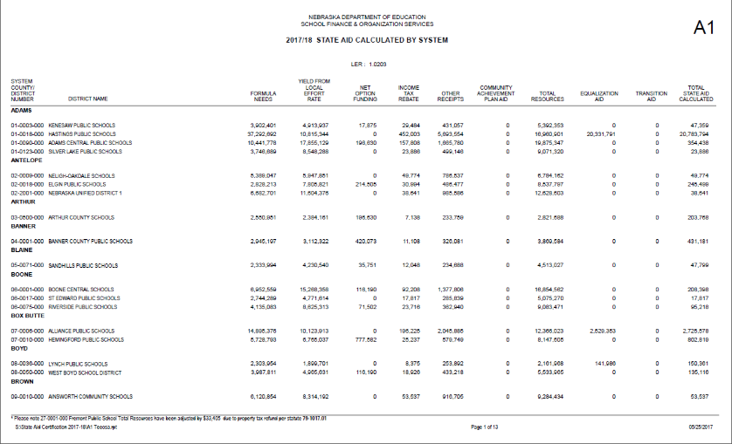
PRIOR YEAR CORRECTION
2024/25
Prior Year
Correction
2025/26
TEEOSA Aid
2024/25 Certification
DIFFERENCE
2024/25 Recalculation

Slide 98
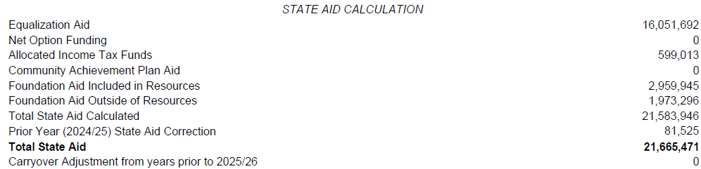
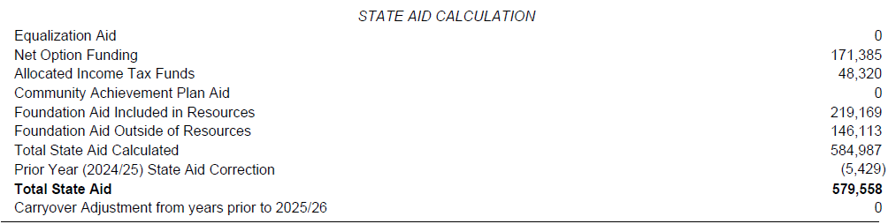
PRIOR YEAR CORRECTION
Included on State Aid Certification Form
Positive Correction
Lump-Sum Payment
On or before July 15 NDE will notify district
Over $1000 can be paid in September if requested
Under $1000 is automatically paid without requesting
If a district does not request, it will be included in the 10 monthly installments
Negative Correction

Slide 99
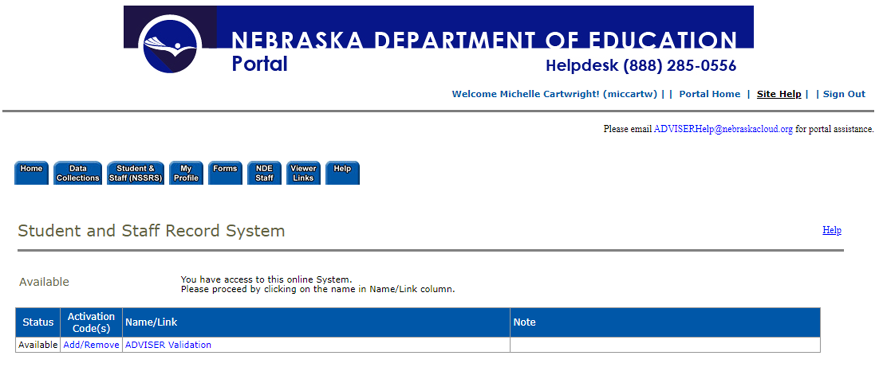
NDE Portal - ADVISER

Slide 100
ADVISER- School Finance Review
Information is received nightly from districts Student Information System (SIS).
Reports from SIS and ADVISOR should be reviewed for discrepancies.
Reach out to Service Desk is issues noted for assistance.
ADVISER Reports used for TEEOSA
Average Daily Membership (ADM)
Fall Membership (October 1st)
Option In/Out
Contracted Students
Qualified Early Childhood
Limited English Proficient (LEP)

Slide 101
TEEOSA DATA SYSTEMS
NEW - TEEOSA State Aid Collection
Assessed Valuation and Levies
Elementary Site Allowance
Estimated Expenditures for Poverty and LEP
Student Growth Adjustment
Summer School Student Unit
Two-Year New School Adjustment Application
Other:
PK Instructional Program Hours/K Program
**All Due by October 15 each year

Slide 102
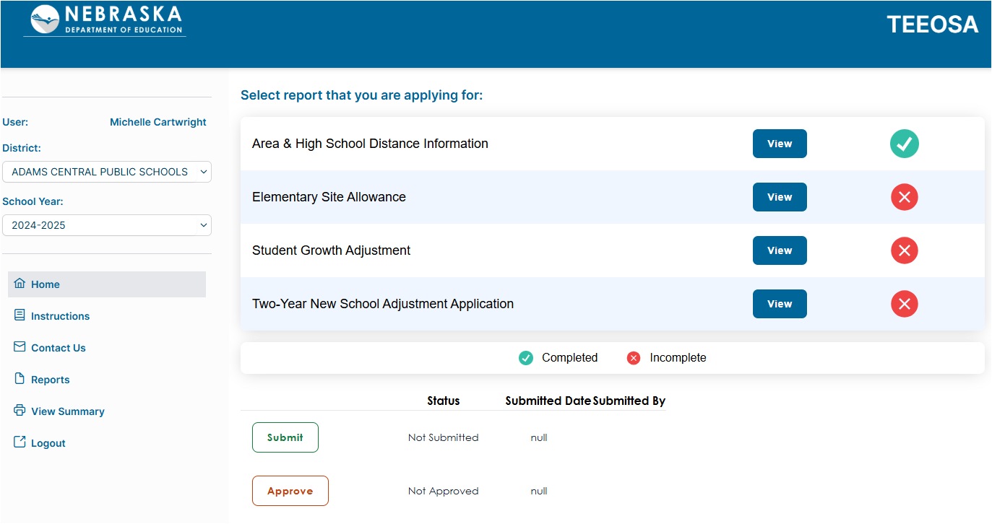
TEEOSA State Aid Collection

Slide 103
LEP & Poverty Expenditure Requirement
2024/25
Expenditures
117.65% level of Expenditures
Reports posted identifying required level
Coding for 24/25 AFR
2026/27
Expenditures
Report this fall
Sept 1 – Oct 15
TEEOSA Collection - Estimated Expenditures for LEP and Poverty
Reports have been posted here:
https://www.education.ne.gov/fos/poverty-allowance-expenditure-requirement/
https://www.education.ne.gov/fos/lep-allowance-expenditure-requirement/

Slide 104
COMMON QUESTIONS
Why does our school district receive very little state aid?
Possibly a non-equalized district
Does not receive equalization aid
Resources are greater than your needs
Equalization Aid is largest component of TEEOSA Aid
Property rich = less support from the state

Slide 105

COMMON QUESTIONS
I’m a non-equalized district
….does TEEOSA aid matter?
ALLOCATED INCOME TAX
COMMUNITY ACHIEVEMENT PLAN AID
FOUNDATION AID
EQUALIZATION AID
NET OPTION FUNDING
2025/26 TEEOSA Aid Certification
50 Equalized Districts
194 Non-Equalized Districts

Slide 106
COMMON QUESTIONS
Does my general fund levy rate
have any effect on TEEOSA aid?
No, general fund levy rate does not affect TEEOSA aid.

Slide 107
COMMON QUESTIONS
Can districts maximize
their financial situation?
Understand the components of formula need
Code revenues and expenses correctly
Look at the whole picture when determining where to code expenses
Submit verified data by the due dates

Slide 108
Superintendency Pay Transparency Act
T
Timeline required by statute
On or before August 1:
Submit entire approved contract (pdf) in Portal Collection
September 30:
Complete Schedule D in the District Budget, submit in LC-2
October 1:
Withholding state & local funds started for schools not submitting superintendent contract through NDE Portal (CDC)

Slide 109
Federal Program Updates

Slide 110
Federal Grants
ESSA Consolidated Grant | Description | Disbursement Code
Title I – A | Provides support for educationally disadvantaged students | 6200
Title I – D | Neglected and Delinquent | 6230
Title II – A | Professional Development or Class Size Reduction | 6310
Title III – EL | English Language Learners | 6925
Title III – IE | Immigrant Education | 6926
Title IV – A | Student Support and Academic Achievement (well-rounded, safe and healthy, & effective use of technology) disbursement | 6969

Slide 111
Additional Federal Grants
Grant | Description | Disbursement Code
CSI Grant | Buildings identified as CSI (Continuous School Improvement) | 6212
RLIS | Rural and low-income school | 6330
SRSA (REAP) | Small Rural School Achievement Program | 6992
Competitive Grants
McKinney-Vento | Districts that have identified at least 20 students experiencing homelessness | 6991
Stronger Connections Grant | Title IV Safe & Healthy Uses ( no construction ) 8/23/2023 – Ends 9/30/2026 | 6424

Slide 112
*Title I - Allocations
Allocations in 2024-2025
$90,471,477
Allocations in 2025-2026
$78,493,470
Decrease to the State of NE $11,978,007
*This includes Title I-A, School Improvement, and Title I-D Subpart 2, N or D (4 districts receive this-Omaha, Lincoln, Papillion-LaVista & Madison

Slide 113
Title I-C, II-A, III-A, IV-A, & IV-B
OMB is reviewing all the amounts to determine how much, if any, funds will be allocated to states.
Message was sent by the Commissioner regarding this on July 2, 2025.
Funding for several key federal formula grant programs—including Title I-C, II-A, III-A, IV-A, IV-B, and Adult Education— is still under review. As a result, USED did not issue Grant Award Notifications (GANs) on July 1, as has been customary in previous years.
Overall, the impact on Nebraska is near $40 million.

Slide 114
ESSA Consolidated Application
Current Plan
Application for 2025-2026 is open
Closing date – Tentatively set at 9-30-2025, but may change due to funding delays
Allocations for Title I are not reflecting in GMS yet
Ann & Dot can give you your amounts
Allocations for Title I will be in the GMS by Tuesday, July 22
Steps to do now:
Create the grant in the 2026 year
Complete the ESSA GEPA Tab
Title I: Complete all pages except for Targeting Step 4 and Budget Page
Do not have the ability to submit the grant at this time.

Slide 115
Things to Consider
Will you have any carryover from 2024-2025 in any of the Title Programs?
Your Title I amounts have decreased and what effects will that have to your Title I program (if any)?
What if all states don’t receive Title II, III, or IV funds? What does that mean for your district?
Nonpublic amounts will be reduced based on the cut. Who will communicate that to your NP’s?

Slide 116
Federal Program Team’s Updates
Looking at cutting our budget
Monitoring will be done via Desk Review or Zoom
Monitoring Schedule
If/When funding for the additional programs comes through, districts will have to update their grant or create an amendment. That will depend on timing of the release of those funds.

Slide 117
Additional Support
NDE Day at Administrator Days-Wednesday, July 23 & Thursday, July 24 – Support in room Platinum 3
Federal Programs Team Office Hours
Monday 8/25 2:00 CDT
Thursday 8/28 10:00 CDT
Wednesday 9/17 10:00 CDT
Thursday 9/18 2:00 CDT
Look for continual updates about funding from the Federal Programs Team via email

Slide 118
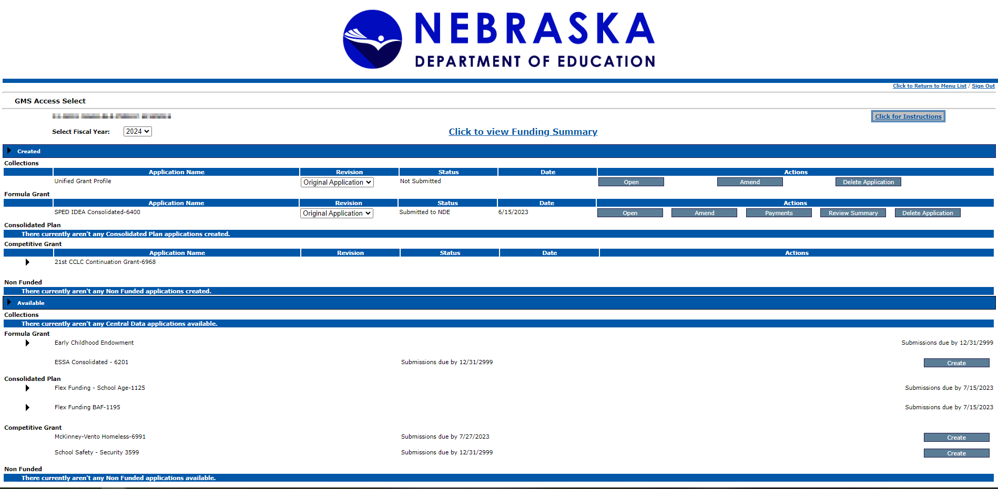
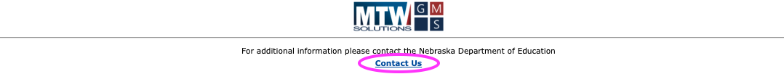
GMS Overview

Slide 119
ESEA Federal Programs Team
Beth Wooster | Senior Administrator | beth.wooster@nebraska.gov | 402-310-1390
Dottie Heusman | Asst. Administrator & Title I-A Director | dottie.heusman@nebraska.gov | 402-219-4802
Michelle Rezek | Title I-A, School Improvement | michelle.rezek@nebraska.gov | 402-405-4616
Tate Toedman | Title I-A, Title II-A, Title IV-A, Non Publics | tate.Toedman@nebraska.gov | 402-405-6456
Ann Carmoney | Title I-A, McKinney-Vento, REAP, Title I-D | ann.carmoney@nebraska.gov | 402-525-7109
Julie Otero | Title III Director | Julie.Otero@nebrakska.gov | 402-219-3303
Anne Hubbell | Title III EL & IE Specialist | anne.hubbell@nebraska.gov | 402-405-7017
Benjamin Zink | Title I-C Migrant Program | benjamin.zink@nebraska.gov | 402-416-9876
Rhonda Wredt | Office Associate - Title I-A, I-D, II-A, IV-A, ESSER | rhonda.wredt@nebraska.gov | 513-510-8773
Janice Paling | Program Specialist | janice.paling@nebraska.gov | 402-890-1096

Slide 120
New Superintendent Wrap up Bryce Wilson

Slide 121
School Tax Credit
Replaces the income tax credit individuals received on taxes paid to school districts
Instead of receiving half of the 2024 tax request in September of 2025 the State paid the credit portion in two payments
On or before Jan 1st
On or before April 1st
Impacts
Higher cash balances now and likely at year end (8/31/25)
Lower September/October tax draws
One year (2024/25) fiscal revenue increase due to the timing of the new payments

Slide 122
School Tax Credit Example
Taxpayer owes $100,000 in property taxes
Prior to 24/25
Made two payments in April and August - $50,000 each
August payment was received in September (following fiscal year)
Beginning in 24/25
Taxpayer owes $60,000 – Makes two payments in April and August - $30,000 each
State owes $40,000 (School tax Credit) - Makes two payments of $20,000 – On or before Jan 31st and on or before April 30th
Impact – One Year Issue
$20,000 will be shown as revenue in 24/25 that would have been received in 25/26 under the system in place prior to 24/25.

Slide 123
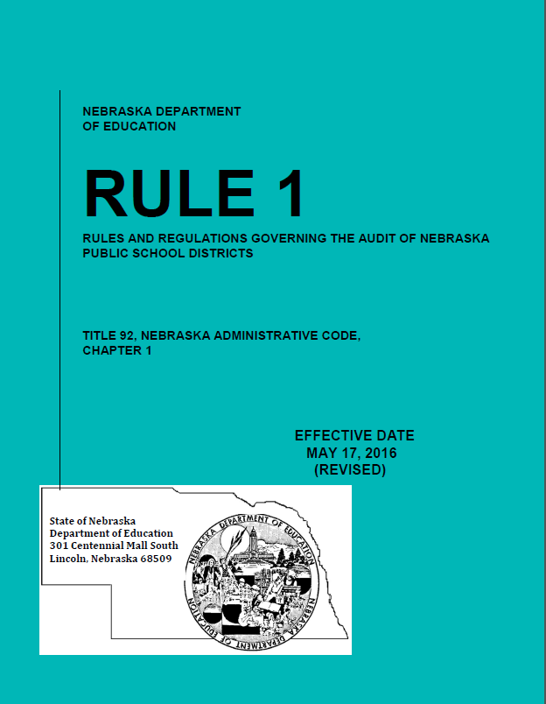
Audit Requirement
State Statute §79-1089 requires that a public accountant or a certified public accountant annually examine all financial records maintained by school districts.
Important part of Nebraska’s Transparency and Accountability Program.

Slide 124
Audit Requirements
Average Daily Membership must be audited by your independent auditors.
Template available for auditors.
School District must have individual capable of overseeing financial statement preparation otherwise:
Must hire acct firm to prepare f/s that is different from the firm that audits the f/s.

Slide 125
Superintendent Pay Transparency Act -- Budget Schedule D
Timeline required by statute:
At least 3 days before meeting, publish/post for returning Supt:
Meeting notice detailing current costs and estimated future costs
Proposed contract or amendments to contract (pdf)
Within 2 days after board approval, publish/post for new Supt:
Entire approved contract (pdf)
Meeting Notice

Slide 126

Mileage Reimbursement Rates
$.70 per mile Effective January 1, 2025
Regular Resident District Students:
$1.995 per mile
Qualify if living 4 miles from school
Reimburse from 3 miles
One way travel once a day
Enrollment Option Students
$.9975 per mile
Qualify if on free lunch
Reimburse from 3 miles
One way travel once a day

Slide 127
District Administrator Portal ​Responsibilities​
Naomi Kohles NDE Service Desk
NDE.ServiceDesk@Nebraska.gov

Slide 128
A Portal District Administrator, typically the Superintendent, manages electronic access to District data within the NDE Portal.​

Slide 129
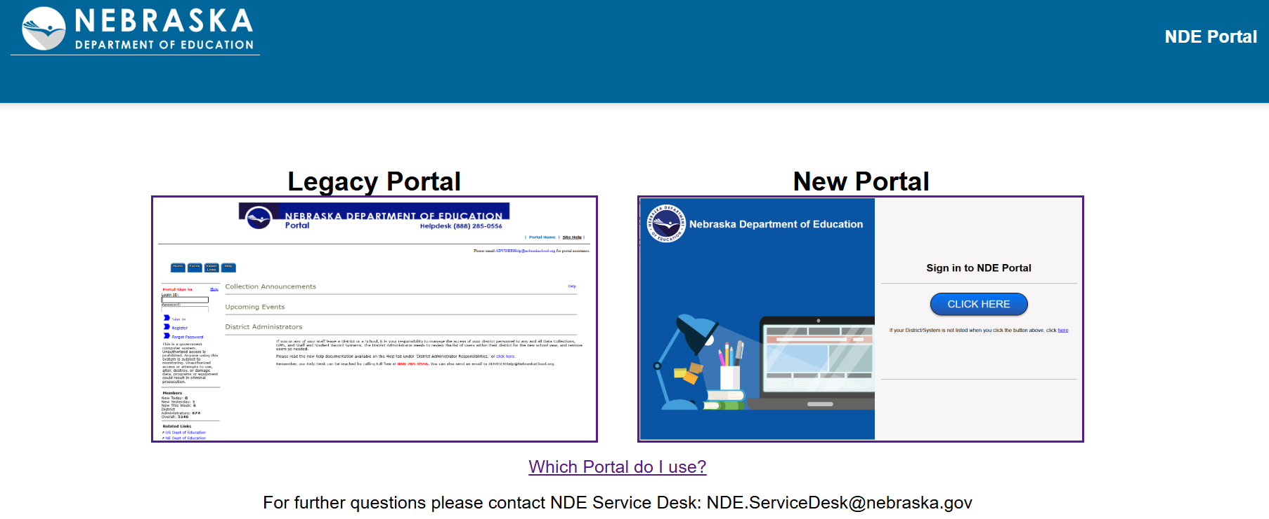
NDE Portal https://portal.education.ne.gov/

Slide 130
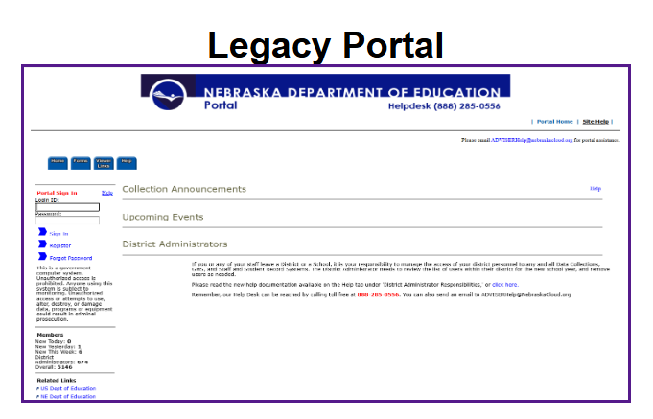
Legacy

Slide 131

Portal District Admin
Once a District Administrator has been approved, they will see and utilize 5 main tabs in their portal account:​
Data Collections
Student & Staff (NSSRS)​
District Admin​
Only District Administrators have this tab​
My Profile
Help

Slide 132
Data Collections Tab​
Supports the collection of many different types of data. ​Examples:
Financial​: Annual Financial Report, Census Report, LC-2​
Accreditation​: Counselor and Library/Media Specialist Not Endorsed, Rule 10 Assurances
Other​: DHHS Superintendent Letter, High Ability Learners, Consolidated Data Collections (CDC)

Slide 133
Student & Staff (NSSRS) Tab​
Supports the collection of student and staff specific data.
Student Data
ADVISER Validation
Staff Data
Staff Reporting 25-26
NSSRS Validation
NDE Staff ID

Slide 134
District Admin Tab​
Where District data access is managed.
Activation Codes
Lists activation codes for every collection in the portal
Some collections only have 1 activation code, others have many
Some collections require a District Admin role, some can be assigned to whomever
Some collections require a new activation code every year, some are one time only
Remove access from staff no longer at your District
Administrator Reports
Lists access for District by User ​or by Collection
REVIEW these and remove access for folks no longer at your District

Slide 135
My Profile & Help Tabs​
My Profile
Update email address
Add/remove Portal District Admin code (likely already completed)
Help
Activation Code instructions
How to create a new portal account
District Admin responsibilities

Slide 136
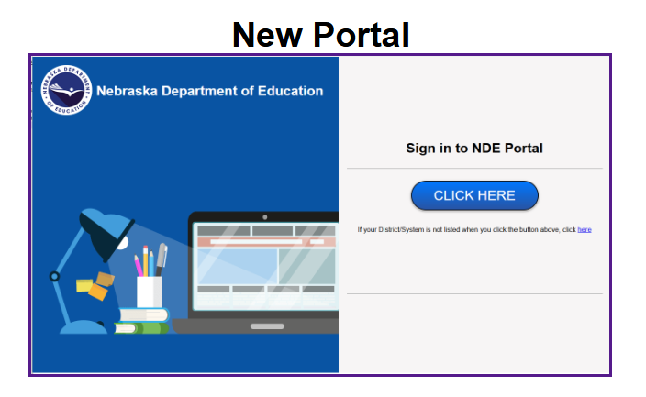

New

Slide 137
New
SSO Login (ESUCC NebraskaCloud)
Blue ‘Click Here’ button
No activation codes
Roles
Single Application or ‘Job Based’
Access assigned and requested within Portal (Portal Admin page)
Proxy
One person per District, select date range
Can approve/assign access

Slide 138

Portal District Admin
Role: District Admin-Public
Assigned by Service Desk
Only one per District
Automatically comes with all portal applications
Displayed as tiles on homepage

Slide 139
Applications
Slowly being transitioned from Legacy
Currently available
District Contact Information (New)
ADVISER Person ID
Coming Soon
ESSA Ineffective Teachers (for Supts only)

Slide 140

Admin Portal ​
Where District access is managed
Proxy Admin and Request Approvals

Slide 141
ESU New Portal Roadshows​
Receive hands‐on help with access requests
Learn how to navigate and use the New Portal effectively
Live Q&A and troubleshooting
Flyer: https://www.education.ne.gov/wp-content/uploads/2025/06/New-Portal-ESU-Road-Shows-Online-Flyer.pdf
Schedule

Slide 142
Resources
NDE Service Desk: NDE.ServiceDesk@Nebraska.gov
Bulletin: https://www.education.ne.gov/bulletin/
Portal: https://www.education.ne.gov/portal/

Slide 143
Collection Specific Resources
ADVISER: https://www.education.ne.gov/dataservices/adviser-resources/
Consolidated Data Collections (CDC): https://www.education.ne.gov/dataservices/consolidated-data-collection-cdc/
Staff Reporting: https://www.education.ne.gov/dataservices/staff/

Slide 144
Enables districts to create, submit, and amend certain grant applications.
Allows districts to create and submit grant reimbursement requests.
Assists districts in tracking the status of applications, allocation, and reimbursements amounts.
Grants Management System (GMS)

Slide 145

Accessing GMS
First Time Use:
Type your email address in “Username/Email test box”
Click “Forgot/Change”
Follow directions in next pop-up window
For Assistance, contact: NDE.GMSData@nebraska.gov

Slide 146
GMS Related Questions
Grant Applications (Title) – Beth Wooster
Phone - (402) 310-1390
E-Mail - beth.wooster@nebraska.gov
Grant Applications (IDEA) – Suzie Pierce
Phone - (531) 530-9096
E-Mail -Suzie.Pierce@nebraska.gov Greg.Prochazka@nebraska.gov
Grant Reimbursement Request – Help desk
Phone – (402) 890-8977
E-Mail - NDE.BGMhelp@nebraska.gov
Activation Codes and Technical Assistance
E-Mail - NDE.GMSData@nebraska.gov

Slide 147
Notification of State Payments
Department of Education Payment Information
https://www.education.ne.gov/fos/payment-information/
Grants Management System (GMS)
Payment Information
Audit Confirmation
All District Payments from State of Nebraska
Liz.hernandez@nebraska.gov
Request to receive email notification of all payments to district from State of Nebraska
Email must be sent from Superintendent
Only one email per district

Slide 148
Website Addresses
Nebraska Department of Education
http://www.education.ne.gov
Finance & Organizational Services
http://www.education.ne.gov/FOS
Nebraska Department of Education Portal
https://portal.education.ne.gov
NDE Payment Information
https://www.education.ne.gov/fos/payment-information/

Slide 149

Budget Assistance
Administrators’ Days – Crowne Conference Center
Second Floor
July 23rd & July 24th
8 a.m. – Noon
1 p.m. – 3 p.m.
Dedicated Rooms
One on One Help
Bring Laptop
Budget Form started
Audit
Don’t Let This Happen to You!! ☺
Don’t let this happen to you! ☺

Slide 150
NDE School Finance Team
Bryce Wilson
bryce.wilson@nebraska.gov 402-471-4320
Michelle Cartwright
michelle.cartwright@nebraska.gov 402-450-0867
Stephanie DeGroot
stephanie.degroot@nebraska.gov 402-540-0649
Kelsey Larsen
kelsey.larsen@nebraska.gov 402-450-1418
Notes:
RUSS END

Slide 151

You Made It!!!

Slide 152

Thank You!

