Slide 1
2025 NSCAS Alternate
Test Administration Training

Slide 2
Topics
Key Dates
DRC INSIGHT Portal
Support Resources
DRC INSIGHT Portal Demonstration
Questions and Answers

Slide 3
2025 NSCAS Alternate Key Dates
Student PreID information provided to DRC
January 17, 2025
February 18 and February 20, 2025
Test Administration Training
Student and Test Management open in the DRC INSIGHT Portal
February 17 –
May 7, 2025
Student Test Booklets and Test Administration Manuals available for printing in the DRC INSIGHT Portal
March 10, 2025
NSCAS Alternate Testing Window (Last day to enter student responses in the DRC INSIGHT Portal)
March 24 – May 2, 2025
Last day to enter student Accommodations and Testing Codes in the DRC INSIGHT Portal
May 7, 2025
3

Slide 4
Eligible Grades for NSCAS Alternate Testing
Grades 3-8 and High School (third-year cohort) English Language Arts and Mathematics
Grades 5, 8, and High School (third-year cohort) Science
Students are required to take all subjects of either the NSCAS General or NSCAS Alternate tests for their eligible grades. Students may not take the NSCAS Alternate for some subjects and the NSCAS General for other subjects.
4

Slide 5
Online Administration
Alternate Assessment is available for online administration via the DRC INSIGHT test engine
NOTE – Please see the NSCAS Alternate Administration Manual (Located in the Teacher Forms A and B have been specifically assigned to districts) or Proctor Training for information on the test login process.
Students capable of using touch-enabled devices or other computer-based input devices are able to respond to items themselves
If a student cannot select responses in the DRC INSIGHT test engine, Proctors will capture the student’s responses and enter them into the online system to be scored
5

Slide 6
Online Administration
On-demand Student Test Booklets and Teacher Test Booklets available for printing (Permissions were granted to the DAC and SAC)
Districts do not receive and return test materials
NOTE: Test Administrators/Proctors are not required to navigate through every item on the test if a student who is being administered the test does not or ceases to respond to items. Tests may be ended on the last item administered.
A Proctor Training video providing detailed direction on administering the NSCAS Alternate tests online is posted to the NDE Assessment webpage (Proctor Training).
6

Slide 7
Special Note for External Programs
Students attending an external program (Rule 18, ESU school or program, or an approved contracted agency) – are required to participate in NSCAS testing.
Districts need to reach out to the school program and make testing arrangements with the external program.
Discuss your options and decide what arrangement is best for the student.
If an external program plans to test the student, Paper/pencil materials will be provided to them from the districts.
If staff at an external program needs access to the DRC INSIGHT Portal please contact DRC Customer Service or Maggie Sis at NDE.
7

Slide 8
External Programs (continued)
DACs for all External Programs should reach out to NDE (Maggie Sis) and provide site information so the site is available on the DRC INSIGHT Portal.
External Programs will provide student information to NDE and DRC will upload the students to each site.
Once testing has completed, NDE will send a file of the reported sites (where students are reported).
DRC will move the tested students to their reported sites.
If External Programs receive new students throughout the testing window they will reach out to NDE to make sure the student has been added to the DRC INSIGHT Portal.
If a student at an External Program is to test online. Please send the Student’s State ID number, resident school, and the external program to Maggie Sis by March 10, 2025.
8

Slide 9
Scheduling the Test
Flexibility throughout the testing window
Make-ups are required
Recommend scheduling early in the window
To allow flexibility in scheduling testing across multiple test sessions and days, the online tickets for the NSCAS Alternative tests do not expire
Be certain proctors understand the key dates and the district’s testing schedule.
9

Slide 10
Test Security
Tests are to be administered on a one-to-one basis
Test content is to be viewed only by those individuals directly responsible for test administration
Test Administrators and Proctors should study the NSCAS Alternate Administration Manual (Located in the Teacher Test Booklets. Forms A and B have been specifically assigned to districts) and become familiar with the test format prior to test administration
Do not discuss, disseminate, or otherwise reveal the contents of the test to anyone
10

Slide 11
Test Security
Do not keep, copy, reproduce, or use any test content
All printed materials (i.e., Teacher Test Booklets/Manual, Student Test Booklets, and online test tickets) must be destroyed locally once the Test Administrator has confirmed the student’s answer have been successfully added to the DRC INSIGHT Test Engine
All digital copies of files must be deleted/removed by the end of the testing window
11

Slide 12
Test Security
Students must not be left alone with test materials
Students cannot take test materials out of the testing site
Do not coach or provide feedback in any way, including prompting or answering questions related to the contents of the test
Do not alter, influence, or interfere with a test response in any way
Refer to the NSCAS Alternate Administration Manual (Located in the Teacher Test Booklets. Forms A and B have been specifically assigned to districts) for complete Test Security procedures
12

Slide 13
Student Information
Students identified in ADVISER as taking the alternate assessment are pre-assigned to online test sessions
Students who weren’t pre-identified must be added to the DRC INSIGHT Portal Student Management application via the Multiple Students Upload (MSU) functionality
Student Details are precoded for pre-identified students but must be entered for new students
Accommodations and Testing Codes must be entered into the DRC INSIGHT Portal Student Management application, when applicable
NOTE: Enter or edit student information and Testing Codes in the DRC INSIGHT Portal by May 7, 2025.
13

Slide 14
DRC INSIGHT Portal→ Student Management→ Student Detail
To enter/edit Student Detail…
Expand the “My Applications” dropdown at the top of the screen
Select the “Student Management” application under “PARTICIPANT PREPARATION”
Select the “Manage Students” tab
Use the filters on the Manage Students tab to find the student or students whose information you want to enter/edit and select the “Find Students” button
14

Slide 15
DRC INSIGHT Portal→ Student Management→ Student Detail
View/Edit Student Detail for Individual Students
In the Manage Students search results, select the “View/Edit” button in the “Action” column
When the “Edit Student” window opens, select the “Student Detail” tab
Editable field include, Gender and Race/Ethnicity, use dropdowns to edit the details when applicable
NOTE: Users cannot edit fields in Student Detail that have an asterisk. If the Student Detail is incorrect, users are required to upload a new MSU
Select the “Save” button to return to your original search results
Make sure to update information in ADVISER. NDE will verify student information before reporting.
15

Slide 16
Accommodations
Accommodations for students with IEP or 504 Plans and English Language Learners must be reported in the DRC INSIGHT Portal Student Management application
Refer to the NSCAS Accessibility Manual on the NDE website for information on how to select, administer, and evaluate use of accessibility supports for instruction and assessment
https://www.education.ne.gov/assessment/nscas-system/#nscas-accessibility
16

Slide 17
Accommodated Testing Materials
No accommodated versions (Braille and Large Print) of the NSCAS Alternate assessment are provided
Districts may provide tests in large print or another format that supports the student’s primary mode of communication
Districts must securely destroy any tests provided in these formats
NDE does not provide manipulatives/objects for the NSCAS Alternate tests, but they are allowed if their use is a normal part of a student’s instruction and in the student’s IEP
17

Slide 18
IEP Accommodations to be Reported
Report the following accommodations in the DRC INSIGHT Portal Student Management application, when applicable
Paper/Pencil—paper/pencil test instead of online format
Mathematical Supports—abacus, calculation device, number line, addition/multiplication charts, etc.
Assistive Technology—alternate response options, word processor or similar keyboarding device used to respond to items
Specialized presentation of test—colored paper, tactile graphics, color overlay, magnification device, background color, etc.
18

Slide 19
DRC INSIGHT Portal→ Student Management→ Accommodations
To enter/edit a student’s accommodations…
Expand the “My Applications” dropdown at the top of the screen
Select the “Student Management” application under “PARTICIPANT PREPARATION”
Select the “Manage Students” tab
Use the filters on the Manage Students tab to find the student or students whose accommodations you want to enter/edit and select the “Find Students” button
There are two options for updating accommodations
19

Slide 20
DRC INSIGHT Portal→ Student Management→ Accommodations
OPTION 1: Enter/Edit for Individual Students
In the Manage Students search results, select the “View/Edit” button in the “Action” column
When the “Edit Student” window opens, select the “Accommodations” tab
Select the checkbox next to each applicable accommodation; Note that you must report the accommodation for each subject tested, as accommodations may vary by subject
Select the “Save” button to return to your original search results
Enter or edit accommodations by the last day of the NSCAS Alternate Testing Window—May 7.
20

Slide 21
DRC INSIGHT Portal→ Student Management→ Accommodations
OPTION 2: Assign the Same Accommodation(s) to Multiple Students
In your search results, check the boxes to the left of the students’ names for all the students whose accommodations you want to update
Select the “Update Accommodations” button
Select the checkbox next to each applicable accommodation shown in the “Update Accommodations for Multiple Students” window
Select the “Save” button to return to your original search results
Enter or edit accommodations by the last day of the NSCAS Alternate Testing Window—May 7.
21

Slide 22
Testing Codes
Testing codes indicate reasons students were not tested or specific conditions that apply to some students who were tested
Testing codes affect how student results are reported in the statewide accountability system
Testing codes are not pre-coded and must be completed individually
Every student in the DRC INSIGHT Portal Student Management application must have a completed test result or a testing code indicated by May 7.
22

Slide 23
Testing Codes
Reasons a student was not tested
Emergency Medical Waiver (EMW)—Student was not tested because of a medical emergency. NDE approved waiver required.
Parent Refusal (PAR)—Student was not tested because of a formal request from the parent/guardian. District should have written documentation on file from the parent at the district.
Student Refusal (STR)—Student was not tested due to student refusal to start or participate in testing.
Left Before Window (LBW)—Student withdrew from district/school BEFORE the test window(s) began.
23

Slide 24
Testing Codes
Reasons a student was not tested continued
Unable to Test (UTT)—District was unable to test the student during the testing windows due to excessive absences or suspensions/expulsion.
Exempt (EXP)—Student exempt from testing due to certain circumstances, such as a student requiring an unprovided accommodation; student attending an out-of-state facility. NDE approval required.
Full-Time Equivalency (FTE)—Full-Time is less than 51% so the student is excluded from testing.
24

Slide 25
Testing Codes
Reasons a student was not tested continued
Invalid (INV)—Student's assessment was invalidated, such as testing irregularity or security breach. NDE approval required.
Not Currently Enrolled (NCE)—Student started/withdrew enrollment in the district/school during the testing window(s).
Other (OTH)—Student was not tested for reasons not covered by other descriptions. For example, occurrence of a natural disaster. NDE approval required.
25

Slide 26
Testing Codes
Conditional codes
Student Not Responsive (NOR)—Student is unable to interact and respond to any item on the test. Credit given for participation. Must be indicated for each subject separately. Scores included in the state accountability system.***
General (GEN)—Student was originally coded as an Alternate student, but district administered the General Assessment or the ACT.
*** Tests may be ended on the last item administered.
Test Administrators/Proctors are not required to navigate through every item on the test if a student is administered the test but does not, or ceases to, respond to items.
26

Slide 27
DRC INSIGHT Portal→ Student Management→ Testing Codes
To enter/edit a student’s testing code(s)…
Expand the “My Applications” dropdown at the top of the screen
Select the “Student Management” application under “PARTICIPANT PREPARATION”
Select the “Manage Students” tab
Use the filters on the Manage Students tab to find the student or students whose testing codes you want to enter/edit and select the “Find Students” button
27

Slide 28
DRC INSIGHT Portal→ Student Management→ Testing Codes
Enter/Edit for Individual Students
In the Manage Students search results, select the “View/Edit” button in the “Action” column
When the “Edit Student” window opens, select the “Testing Codes” tab
Choose all applicable testing codes using the check boxes and dropdowns that appear
Select the “Save” button to return to your original search results
Students must be in a Test Session in order to apply the Testing Codes.
28

Slide 29
Test Materials for Proctoring NSCAS Alternate
NSCAS Alternate Teacher Test Booklets/Administration Manual
Online Test Ticket(s) printed from the DRC INSIGHT Portal Test Management application
Student Test Booklet(s) for students requiring paper/pencil administration
Teacher Test Booklet/Administration Manuals and Student Test Booklets are form specific. Each district was pre-assigned either Form A or Form B.
BE SURE THE FORM ON THE TEACHER TEST BOOKLET/MANUAL AND STUDENT TEST BOOKLET MATCHES THE FORM INDICATED ON THE ONLINE TEST TICKET.
29

Slide 30
DRC INSIGHT Portal→ General Information→ Documents
To print Teacher Test Booklets/Administration Manuals and Student Test Booklets…
Expand the “My Applications” dropdown at the top of the screen
Select the “General Information” application
Select the “Documents” tab
Leave “Document Type” filter set to “(All)” and select the “Show Documents” button
Use the “Open PDF” or “Save PDF” button in the “Action” column next to the document you want to print, then print the documents needed for test administration
Permission to access these documents has been assigned to the District (DAC) and School Assessment Coordinators (SAC).
30

Slide 31
Test Materials for Proctoring NSCAS Alternate
All NSCAS Alternate Teacher Test Booklets/Administration Manuals and Student Test Booklets contain secure test content and must not be downloaded electronically and stored locally
Printed NSCAS Alternate Teacher Test Booklets/Administration Manuals, Student Test Booklets, and online Test Tickets must be stored securely until testing is finished
Do not send any materials to DRC. Districts are responsible for secure destruction of printed NSCAS Alternate materials.
31

Slide 32
DRC INSIGHT Portal Test Management Application
The DRC INSIGHT Portal Test Management application is the point of access for these online test administration activities
Printing Online Test Tickets
Adding New Students to Test Sessions
Monitoring Testing Status
** NOTE - The DRC INSIGHT Test Engine is where student’s login using the Test Tickets.
32

Slide 33
DRC INSIGHT Portal→ Test Management→ Manage Test Sessions
To print Online Test Tickets for a Test Session
Expand the “My Applications” dropdown at the top of the screen
Select the “Test Management” application under “TEST PREPARATION”
Select the “Manage Test Sessions” tab
Select the District and School for which you want to print tickets and select the “Show Sessions” button
Use the “Print All Tickets” button in the “Action” column to print the Student Test Roster and Tickets for all students assigned to that test session
It is best practice to add new students to test sessions before printing Online Test Tickets.
33

Slide 34
DRC INSIGHT Portal→ Test Management→ Adding New Students
Adding students to Test Session
Expand the “My Applications” dropdown at the top of the screen
Select the “Student Management” application under “PARTICIPANT PREPARATION”
Select the “Manage Students” tab
Select the “Upload Multiple Students” tab
Select the District (required) and School (optional) for which you want to add students
Produce a file containing required student information according to the File Layout and Sample File
Select “Browse…” to find the file, then select the “Upload” button to load the file
34

Slide 35
DRC INSIGHT Portal→ Test Management→ Adding New Students
The system will verify student information meets requirements outlined in the File Layout; check back after a few minutes to see if the file was accepted or generated an error report
If an error report was generated, correct the errors shown in the report and repeat the upload process until the file is free of errors
Students uploaded via the MSU are added directly to new test sessions for the form assigned to the district; Student Detail, Accommodations, and Testing Codes must then be updated if needed
35

Slide 36
DRC INSIGHT Portal→ Test Management→ Testing Status
To monitor testing status
Expand the “My Applications” dropdown at the top of the screen
Select the “Test Management” application under “TEST PREPARATION”
Select the “Manage Test Sessions” tab
Select the District and School for which you want to check status and select the “Show Sessions” button
Use the “Edit/Print Ticket Status” button in the “Action” column to view the “Testing Status” window
36

Slide 37
DRC INSIGHT Portal→ Test Management→ Testing Status
Students’ tests will be assigned one of three statuses
Not Started—the online Test Ticket has not been used
In Progress—the online Test Ticket was used to log into the test, but the test has not been ended; only the Started date/time is populated
Completed—the test has been ended; Started and Completed date/times are both populated
NSCAS Alternate Test Tickets do not “lock” after periods of inactivity or overnight to facilitate flexible scheduling
Tests in a Completed status are locked. Contact DRC Nebraska Customer Service at (866)342-6280 if there is a need to unlock a completed test.
37

Slide 38
2025 NSCAS Alternate Reports
July 7, 2025—Districts provided access to preliminary reports and data file in the DRC INSIGHT Portal Report Delivery application
August 4, 2025—Districts provided access to final reports and data file in the DRC INSIGHT Portal Report Delivery application
*NOTE – Dates are subject to change
Results are not released to the districts until public release of reports. NDE will provide information on the public release of 2025 NSCAS results as it becomes available.
38

Slide 39
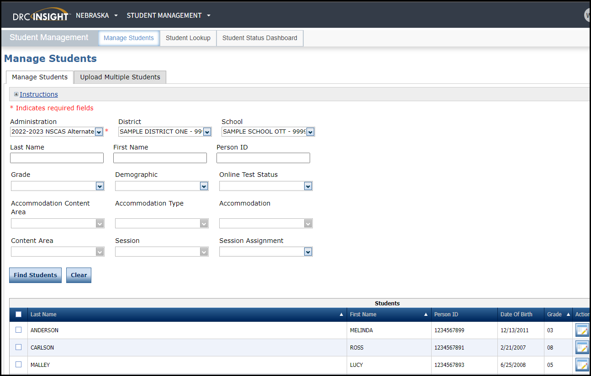
DRC INSIGHT Portal Student Management DEMO
39

Slide 40
Q & A
NSCAS Alternate Customer Service
Call Toll Free - (866) 342-6280
necustomerservice@datarecognitioncorp.com
8:00 A.M. – 5:00 P.M. CST
7:00 A.M. – 5:00 P.M. CST (March 24 – May 7, 2025)
40

