Slide 1
Infant Meal Pattern Requirements FY2024

Slide 2
Agenda
CACFP General Requirements
Breastmilk & Infant Formula
Solid Foods & Developmental Readiness
Infant CACFP Records
FY2024 Infant Meal Pattern

Slide 3
Agenda
CACFP General Requirements
Breastmilk & Infant Formula
Solid Foods & Developmental Readiness
Infant CACFP Records
FY2024 Infant Meal Pattern

Slide 4
CACFP General Requirements
CACFP defines infants as birth through 11 months
Each infant must have a current & complete:
CACFP Enrollment
Income Eligibility Form determined by center official on file to be claimed as “Free” or “Reduced”
FY2024 Infant Meal Pattern

Slide 5
Providing Food Components
CACFP General Requirements
All Centers must offer and provide:
One formula to parents
Meals to infants
This includes centers who do not claim infant meals for reimbursement.
Parents/guardians may provide only one creditable component per meal for a reimbursable meal
Childcare providers must provide remaining components
i.e., provide breastmilk = 1 component
FY2024 Infant Meal Pattern

Slide 6
Meal Eligibility
CACFP General Requirements
Allowed to claim:
2 meals & 1 snack per infant per day
OR
2 snacks & 1 meal per infant per day
FY2024 Infant Meal Pattern

Slide 7
CACFP General Requirements
Remember:
Infants are fed on demand
Not required to follow the mealtimes on the application
FY2024 Infant Meal Pattern

Slide 8
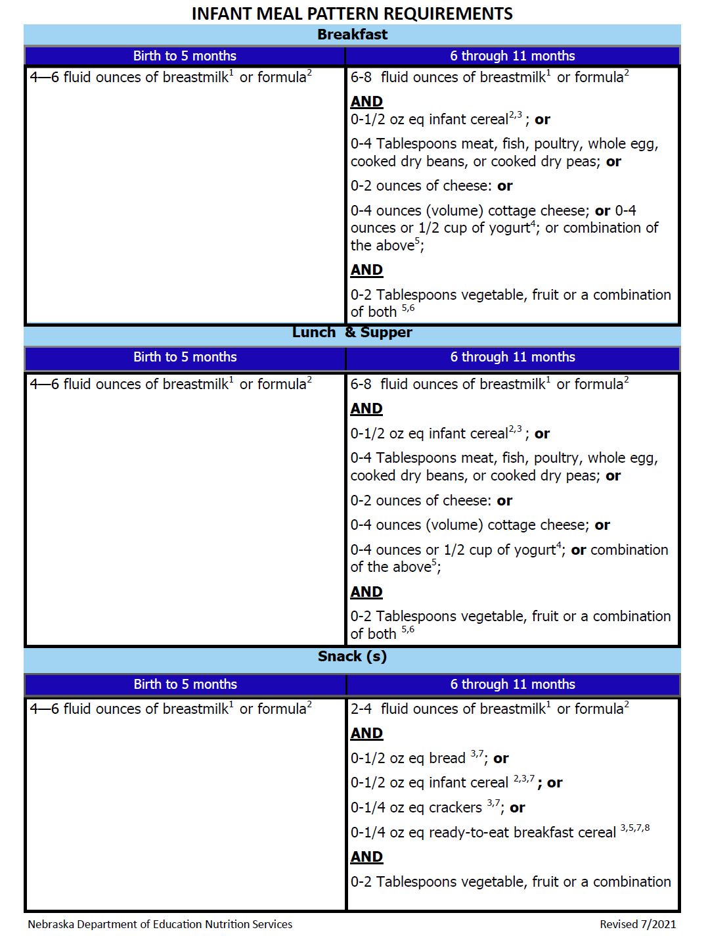
CACFP General Requirements
Infant Meal Pattern
Post prominently
Breastmilk and/or Formula
Solid Foods are added when the infant is developmentally ready
FY2024 Infant Meal Pattern
Handout
Notes:
Keep meal pattern out to refer to as we go through this training

Slide 9
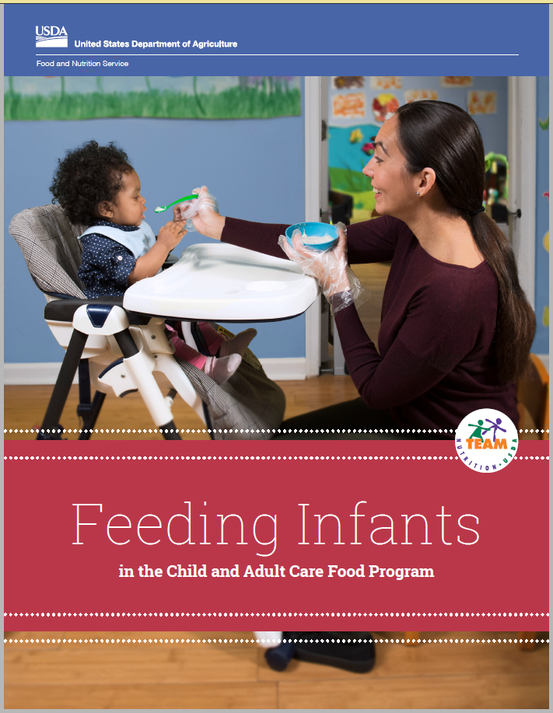
CACFP General Requirements
Feeding Infants Resource
Each Infant Staff Member should review this resource
Includes staff questionnaires and parent resources
https://www.fns.usda.gov/tn/feeding-infants-child-and-adult-care-food-program
FY2024 Infant Meal Pattern

Slide 10
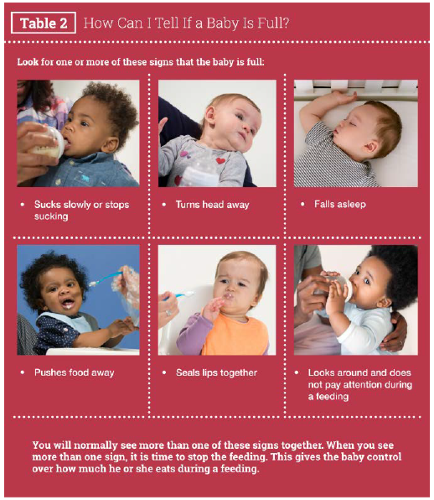
CACFP General Requirements
Feeding Infants Guide Page 8-9
Hunger
Fullness
FY2024 Infant Meal Pattern

Slide 11
Creditable Foods for Infants
CACFP General Requirements
Infant feeding guide page 150
FY2024 Infant Meal Pattern

Slide 12
Agenda
CACFP General Requirements
Breastmilk & Infant Formula
Solid Foods & Developmental Readiness
Infant CACFP Records
FY2024 Infant Meal Pattern

Slide 13
Breastmilk & Infant Formula
Breastmilk or infant formula is the only meal component required until the infant is developmentally ready for solid foods
Birth to 5 Months:
Minimum serving size is 4-6 oz
6 month through 11months:
Minimum serving size is 6-8 oz
FY2024 Infant Meal Pattern

Slide 14
Breastmilk & Infant Formula
Breastmilk is optimal source of nutrients
FY2024 Infant Meal Pattern
Handout

Slide 15
Breastmilk & Infant Formula
USDA promotes breastfeeding by allowing reimbursement when:
A parent/guardian supplies breastmilk
A mother breastfeeds her infant ON-SITE

Slide 16
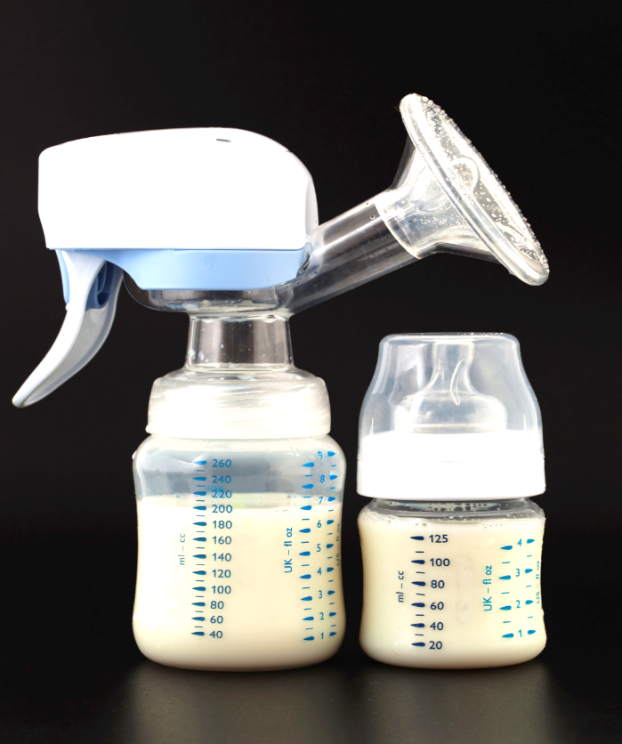
Breastmilk & Infant Formula
Expressed Breastmilk
OK to offer less than the minimum serving size of breastmilk
Offer additional breastmilk later, if infant will consume more
FY2024 Infant Meal Pattern
Notes:
Reminder that Infants are fed on demand

Slide 17
Breastmilk Storage Guidelines
Breastmilk & Infant Formula
FY2024 Infant Meal Pattern
Handout
Notes:
Reminder that Infants are fed on demand

Slide 18
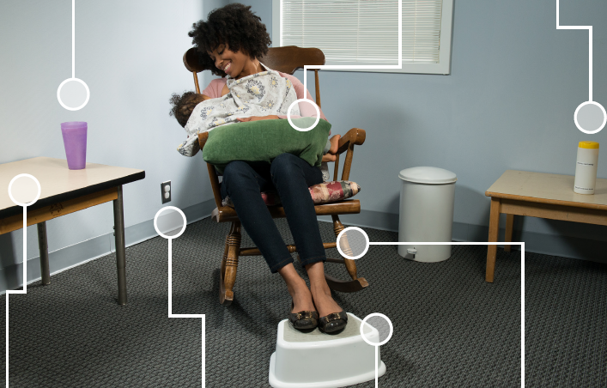
Breastmilk/Formula for Infants
Drinking water for mom
Pillow to support baby
Small table to place items
Electrical outlet for a breast pump
Small table to place items
Disinfecting Wipes
Stepstool to support feet
Creating a Friendly Environment
Feeding Infants Guide Page 27
FY2024 Infant Meal Pattern

Slide 19
USDA Resources
Breastmilk & Infant Formula
https://www.fns.usda.gov/tn/breastfed-babies-welcome-here
FY2024 Infant Meal Pattern
Available in Spanish!
Handout
Notes:
WIC also has

Slide 20
Iron-Fortified Infant Formula
Breastmilk & Infant Formula
Best supplement for breastmilk
Supports healthy brain development & growth
Reimbursable meals may include:
Iron-fortified formula
Breastmilk
Combination of both
FY2024 Infant Meal Pattern

Slide 21
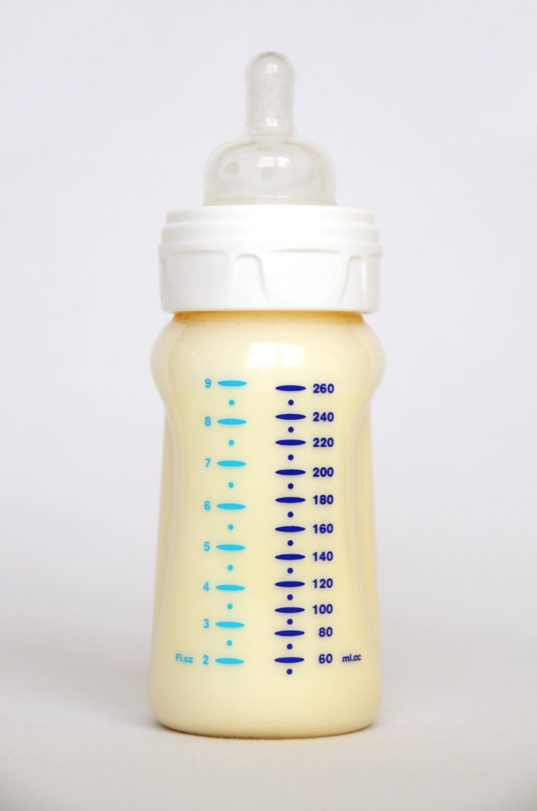
Iron-fortified Infant Formula
Breastmilk & Infant Formula
All Sponsors must offer at least 1 type of iron-fortified infant formula
Identify brand of formula on Sponsor Application
All Infant formula must be regulated by FDA
Does not credit if purchased outside U.S.
FY2024 Infant Meal Pattern
Notes:
Add to instructors manual talking points explaining that formula bought in a store in the US is regulated by FDA. All formula marketed in the US is regulated by FDA; formula purchased outside of the US may not be regulated by FDA.

Slide 22
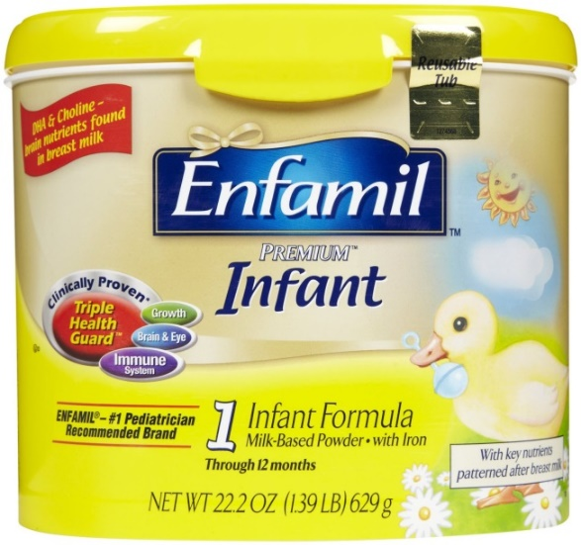
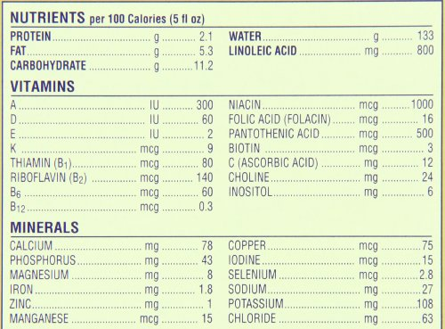
Iron Fortified Infant Formula
Breastmilk & Infant Formula
Must have 1 mg of iron per 100 calories of formula & prepared according to directions.
Must specify “with iron” or “iron-fortified”
FY2024 Infant Meal Pattern
Notes:
Must specify “with iron” or “iron-fortified” on package label; Must have 1 mg of iron per 100 calories of formula when prepared in accordance with label directions

Slide 23
Serving Infant Formula
Breastmilk & Infant Formula
Infants may not drink the entire serving of formula
Must still provide minimum serving size based on the infant's age
Formula used to prepare infant cereal does not count toward the minimum requirement
Do not put infant cereal in a bottle
FY2024 Infant Meal Pattern

Slide 24
Agenda
CACFP General Requirements
Breastmilk & Infant Formula
Solid Foods & Developmental Readiness
Infant CACFP Records
FY2024 Infant Meal Pattern

Slide 25
Solid Foods & Developmental Readiness
Once an infant shows signs of developmental readiness, solid foods must be offered:
Zero (0) ≠ Optional
Gradually introduce solid foods one at a time, over a few days
Observe for allergic reactions
FY2024 Infant Meal Pattern
Notes:
Most common mistake noted during our compliance reviews is the misinterpretation of the infant meal pattern. To claim meals served to infant the infant meal pattern is to be served. The infant, upon parent permission is to be offered solids. Solids are considered either commercially prepared foods specifically designed for infants OR table foods. Either source of infant solids are to be served in the appropriate texture (puree’, diced, chopped, etc) for the infant in your care.

Slide 26
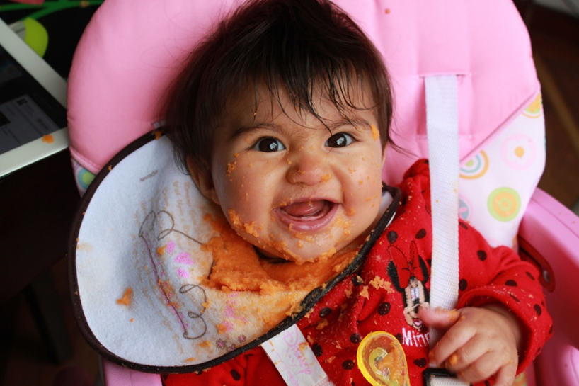
Solid Foods & Developmental Readiness
Final Rule States:
“Solid foods are introduced at 6 months of age …
…with the flexibility to introduce foods …
…before and after 6 months of age when requested by parents.”
Notes:
After introducing purees, babies should progress to new textures,from a puree with some soft lumps up to thicker mashed foods to soft, chopped solid foods. It is important to continue introducing new textures so that babies continually build the chewing and feeding skills that will eventually allow them to eat table foods.

Slide 27
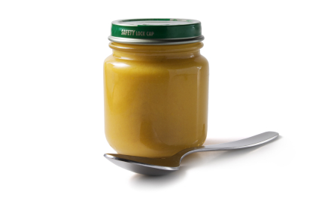
What are Infant Solids?
Solid Foods & Developmental Readiness
Solid Foods are:
Commercially prepared baby foods (Gerber, Happy Baby Food, Gerber Graduates, Beech-nut, etc.)
Center prepared baby foods from table foods (Meats, Fruits, etc.)
Table Foods

Slide 28
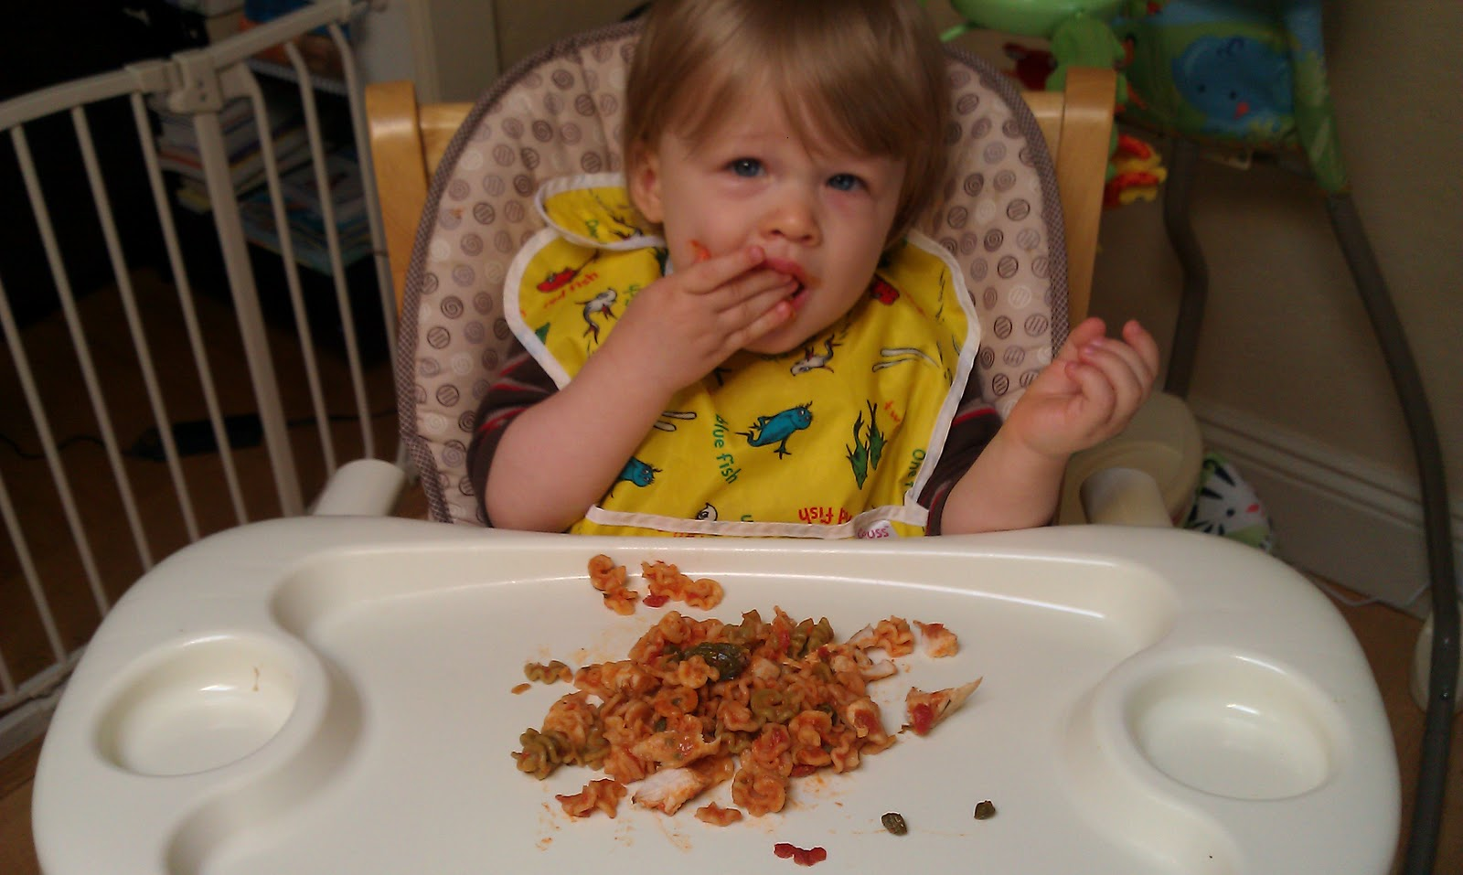
* Puree, Mashed, Ground * Diced, Small bite-size pieces less ½ inch
Solid Foods & Developmental Readiness
Food texture should be appropriate for the infant you are feeding:
Notes:
After introducing purees, babies should progress to new textures,from a puree with some soft lumps up to thicker mashed foods to soft, chopped solid foods. It is important to continue introducing new textures so that babies continually build the chewing and feeding skills that will eventually allow them to eat table foods.

Slide 29
Iron-Fortified Infant Cereals
Solid Foods & Developmental Readiness
Iron-fortified infant cereals are often the first solid foods:
Often easiest to digest
Least likely to cause an allergic reaction
Added source Iron
Serve at meals & snacks when infants are developmentally ready
Minimum serving size: 0 - ½ oz eq
(approximately - 4 Tbsp)
FY2024 Infant Meal Pattern
Notes:
Breastfed infants are commonly served infant cereals because they lack iron in breastmilk

Slide 30
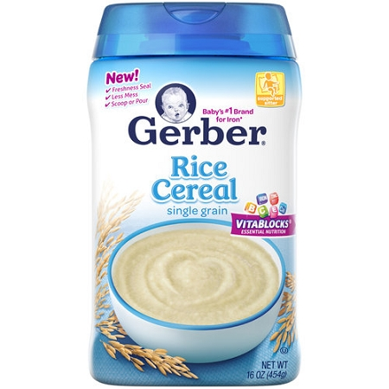
Iron Fortified Infant Cereal
Solid Foods & Developmental Readiness
Note: Commercially prepared infant cereals (in a jar), regular or instant cereal, and cereals containing fruit are not creditable for infants.
Must be labeled
"iron rich"
Nutrition facts label must indicate it is at least 45% daily value
FY2024 Infant Meal Pattern

Slide 31
Vegetables & Fruits
Solid Foods & Developmental Readiness
Required at all meals & snacks
Serve vegetable, fruit, or a combination of both
Increases consumption & promotes better acceptance later in life
Great source of essential nutrients
i.e., fiber & vitamin C
Minimum serving size: 0 - 4 Tablespoons
FY2024 Infant Meal Pattern

Slide 32
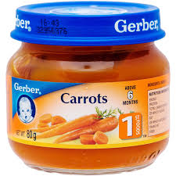
Commercially Prepared Vegetables & Fruits
Solid Foods & Developmental Readiness
Creditable: First ingredient listed must be fruit/vegetable; should not contain added sugar or salt.
Avoid combinations such as peas mixed with peaches until the
infant has been introduced to each food separately.
Not Creditable Hawaiian Delight, Peach Cobbler, pudding, etc.
FY2024 Infant Meal Pattern

Slide 33
Center Prepared Vegetables & Fruits
Solid Foods & Developmental Readiness
Cooked and processed to the appropriate texture
No added fat, salt or sugar
Canned or frozen - no added salt or sugar
Progress from puree to ground to fork mashed, and eventually to diced as baby’s skills develop.
FY2024 Infant Meal Pattern

Slide 34
Vegetables & Fruits
Solid Foods & Developmental Readiness
Warning - Choking hazards:
Raw vegetables
Hard raw fruits i.e., apple, pear…
Whole pieces canned fruit
Cooked or raw whole corn kernels
Whole grapes, cherries, grape tomatoes
(cut into small pieces for older infants)
Uncooked dried fruit
FY2024 Infant Meal Pattern

Slide 35
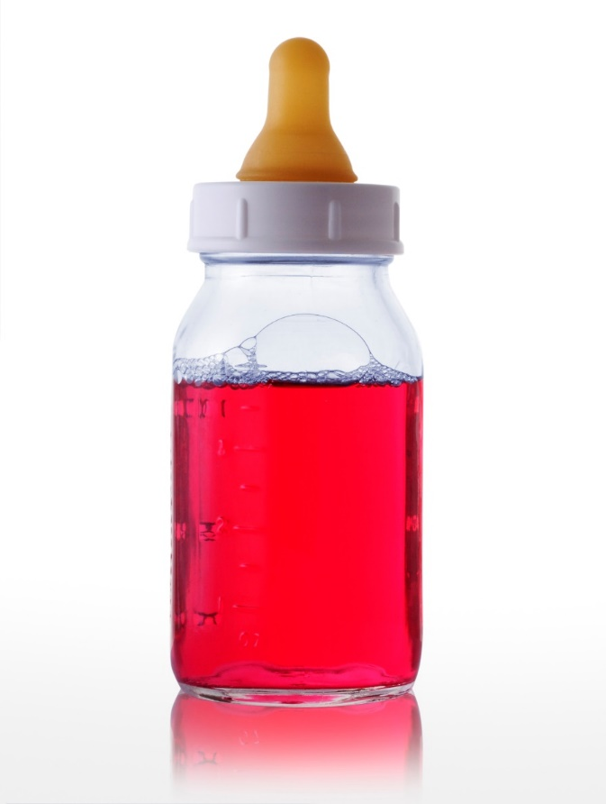
Juice
Solid Foods & Developmental Readiness
Not creditable component toward a reimbursable meal for infants
Lacks dietary fiber found in fruits and vegetables
X
FY2024 Infant Meal Pattern

Slide 36
Meat/Meat Alternates
Solid Foods & Developmental Readiness
Serve at breakfast, lunch, and supper
Minimum serving sizes:
0 - 4 Tbsp. Meat, fish, poultry, whole egg, cooked dry beans or peas
0 - 2 oz. Cheese
0 - 4 oz. Yogurt or cottage cheese (½ cup)
FY2024 Infant Meal Pattern
Notes:
Egg whites are no longer thought to develop allergies – no longer the thought

Slide 37
Meat/Meat Alternates
Solid Foods & Developmental Readiness
Beef, pork, lamb, veal, fish, chicken or turkey
Commercially prepared
Center prepared - well-cooked and pureed, mashed, or finely diced
Single ingredient foods until baby is developmentally ready
FY2024 Infant Meal Pattern
Notes:
The AAP recommends introducing single-ingredient foods to baby before giving combination foods. Once the baby gas eaten all ingredients within a combination food individual without having an allergic reaction, then combination foods can be served.

Slide 38
Solid Foods & Developmental Readiness
Meat/Meat Alternates
Natural Cheese - Cheddar, Swiss, Colby, & Monterey Jack
Cottage cheese
Yogurt
Whole Eggs
Dry beans or peas
FY2024 Infant Meal Pattern

Slide 39
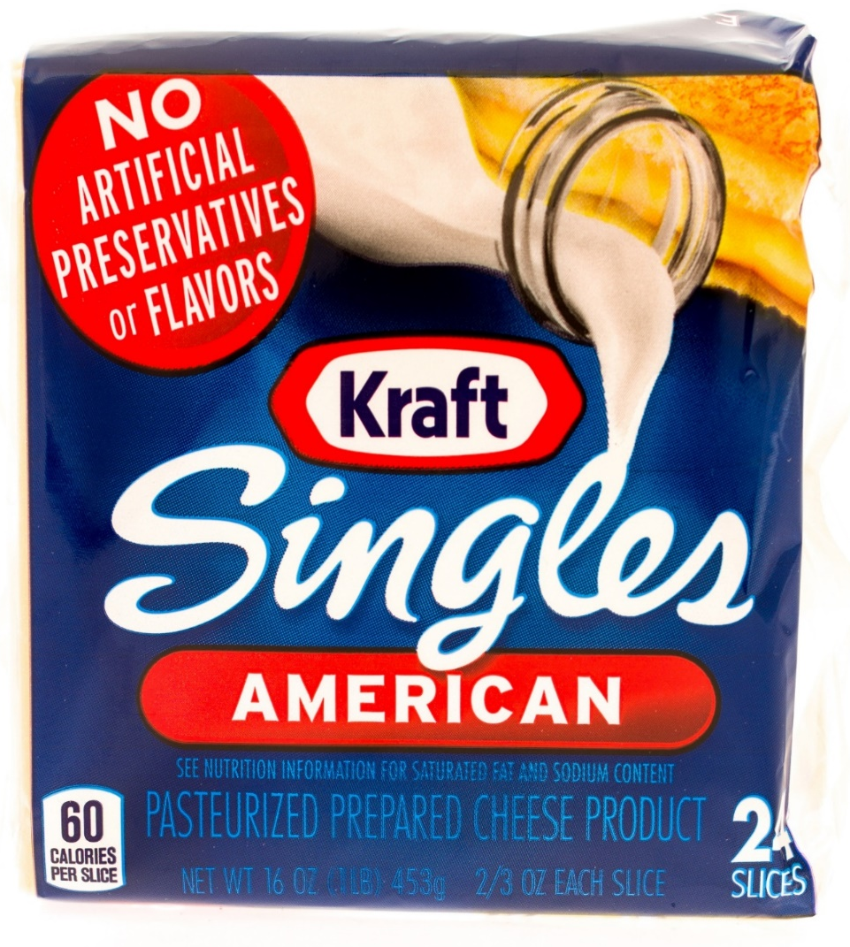
Non-Creditable Cheese Foods
Solid Foods & Developmental Readiness
Product packaging states:
“Imitation cheese”
“Cheese food and spreads”
“Cheese product”
Common items
Cheese whips
Cheese with pimento
Cream cheese
FY2024 Infant Meal Pattern

Slide 40
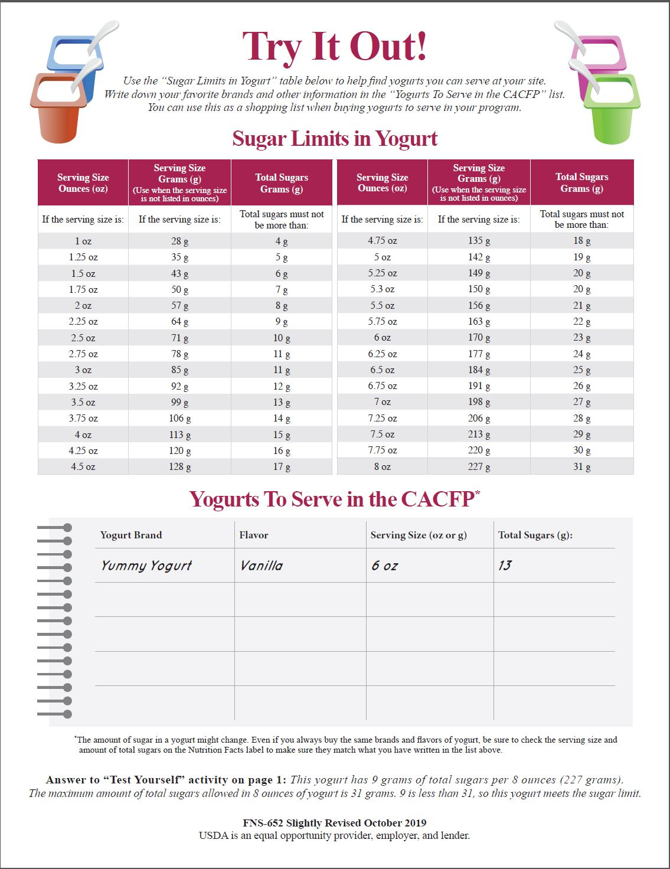
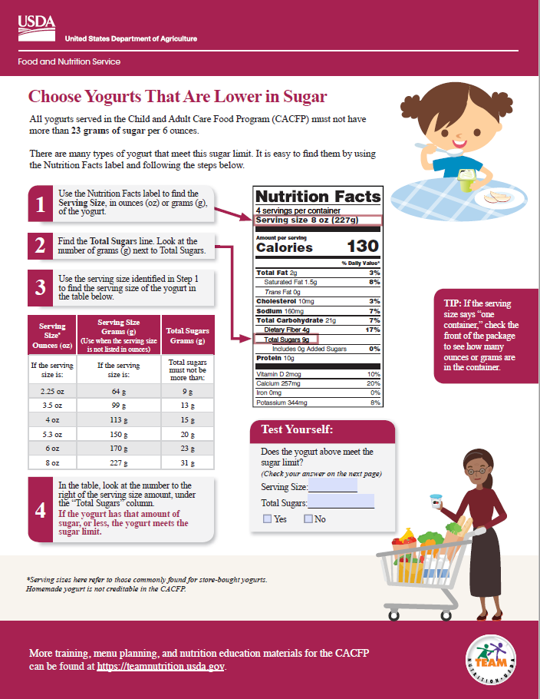
Yogurt - Sugar Limit Must contain no more than 23 grams of total sugars per 6 oz.
Solid Foods & Developmental Readiness
Sugar Limits by container size
Write down selected options
FY2024 Infant Meal Pattern
Notes:
You have two handouts – get them out.
Use yogurt examples at tables.

Slide 41
Snack Meal Pattern – Solid Foods
Solid Foods & Developmental Readiness
0-½ oz eq bread; OR
0-½ oz eq infant cereal; OR
0-¼ oz eq crackers; OR
0-¼ oz eq ready-to-eat breakfast cereal
AND
0-2 Tablespoons vegetable, fruit or a combination of both
FY2024 Infant Meal Pattern

Slide 42
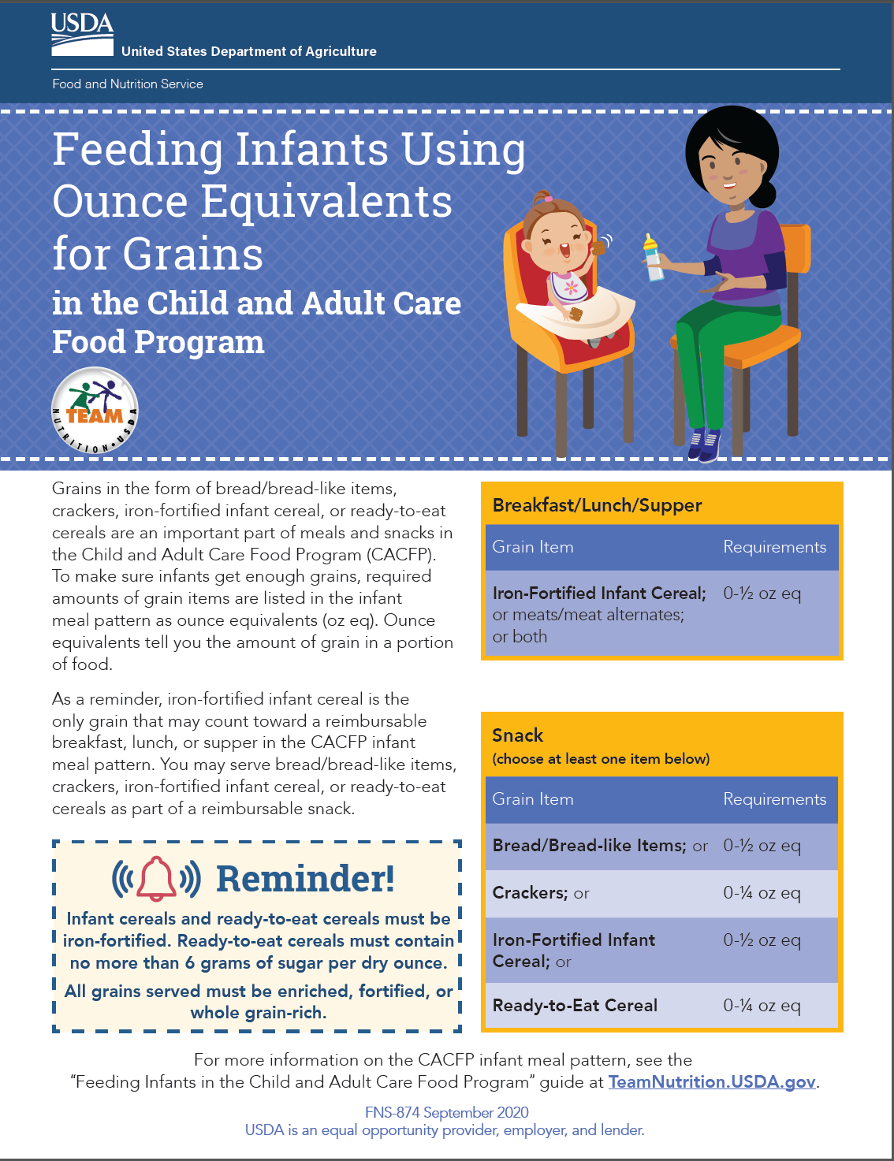
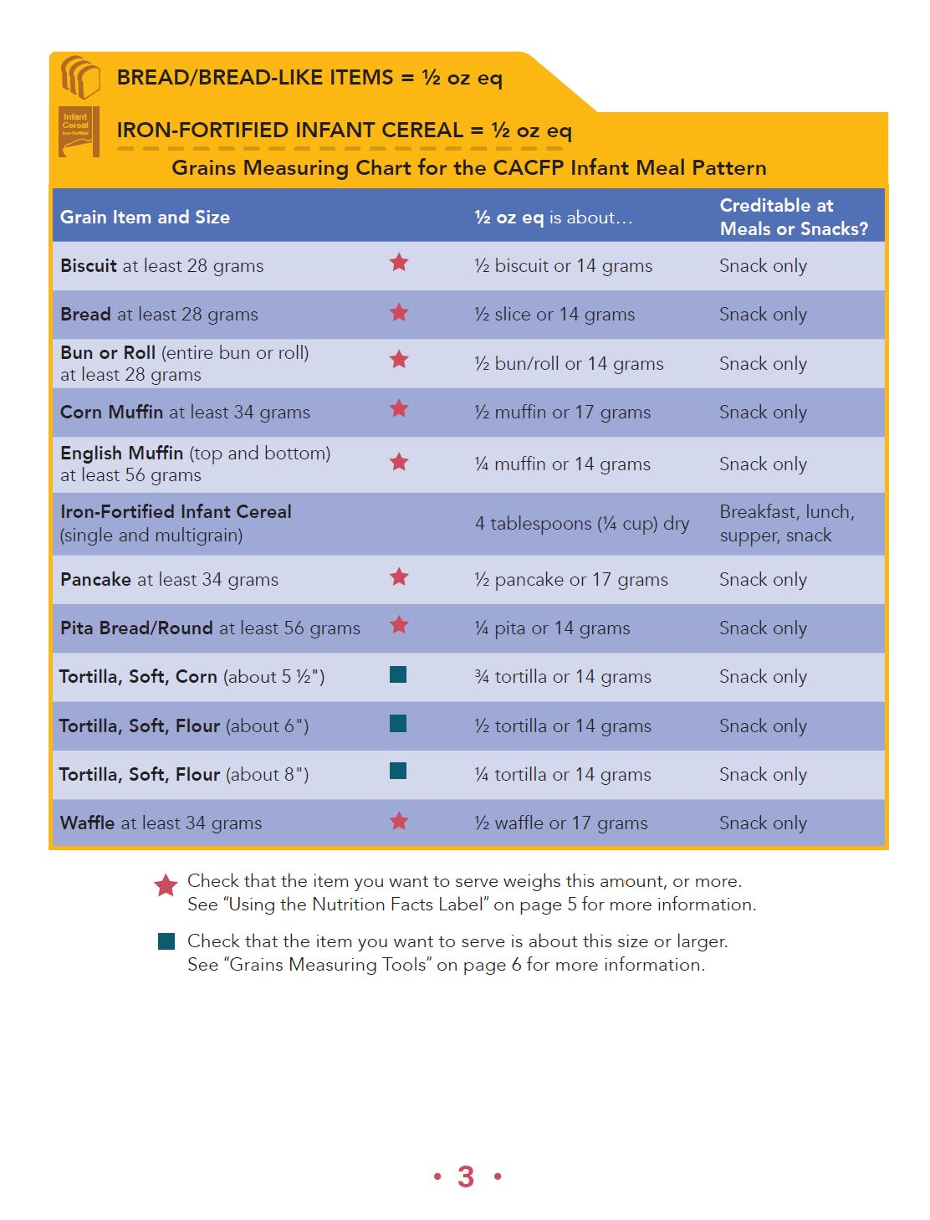
Grain creditable only at Snack
Solid Foods & Developmental Readiness
Creditable grains
First ingredient whole or enriched grain
Quantities to be recorded in Ounce Equivalent measurements
FY2024 Infant Meal Pattern
Handout

Slide 43
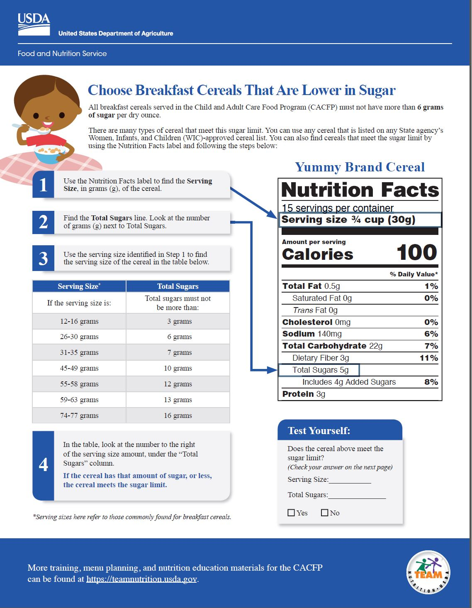
Grain creditable only at Snack
Solid Foods & Developmental Readiness
Ready-to-eat breakfast cereals:
No more than 6 grams of sugar per dry oz.
Try It Out! Chart tool
ONLY AT SNACK
FY2024 Infant Meal Pattern

Slide 44
Developmental Readiness
Solid Foods & Developmental Readiness
Each infant’s eating habits are unique and will change over time as they develop
Introduction of solid foods is determined by the parent/ guardian
FY2024 Infant Meal Pattern
Handout
Notes:
Infant meal pattern allows flexibility to accommodate these differences

Slide 45
Developmental Readiness
Solid Foods & Developmental Readiness
Introducing solid foods too early:
cause choking
consume less breastmilk or formula
increases risk of obesity
FY2024 Infant Meal Pattern
Notes:
(Page 23) Developmentally Ready Cues

Slide 46
Developmental Readiness
Solid Foods & Developmental Readiness
Sits in chair with good head control
Opens mouth for food
Moves food from a spoon into throat
Doubles in birth weight
Generally, around 6 months of age
American Academy of Pediatrics Guidelines
FY2024 Infant Meal Pattern

Slide 47
Parent Communication
Solid Foods & Developmental Readiness
Working with parents helps to:
Ensure individual infants needs are met
Be consistent with eating habits
Support developmental readiness
Always consult with parents/guardians first before serving solid foods
FY2024 Infant Meal Pattern

Slide 48
Agenda
CACFP General Requirements
Breastmilk & Infant Formula
Solid Foods & Developmental Readiness
Infant CACFP Records
FY2024 Infant Meal Pattern

Slide 49
Documenting Developmental Readiness
Infant CACFP Records
Request a written statement from parents or guardians:
Outlining when & which solid foods to serve (NDE Form)
Follows the preferences of parents or guardians and document conversations (e.g., notebook for each child)
Licensing requirement
FY2024 Infant Meal Pattern
Handout
Notes:
Living document which needs to be updated continuously - new Infant parent form

Slide 50
Infant CACFP Records
Infant Formula Selection & Solids Food Form
Instructions to Parents
Infant Formula Selection & Solid Foods
Section A. Formula Selection
Section B. Solids Foods Permission
Staff Instructions (Post for staff in infant room)
FY2024 Infant Meal Pattern
Handout

Slide 51
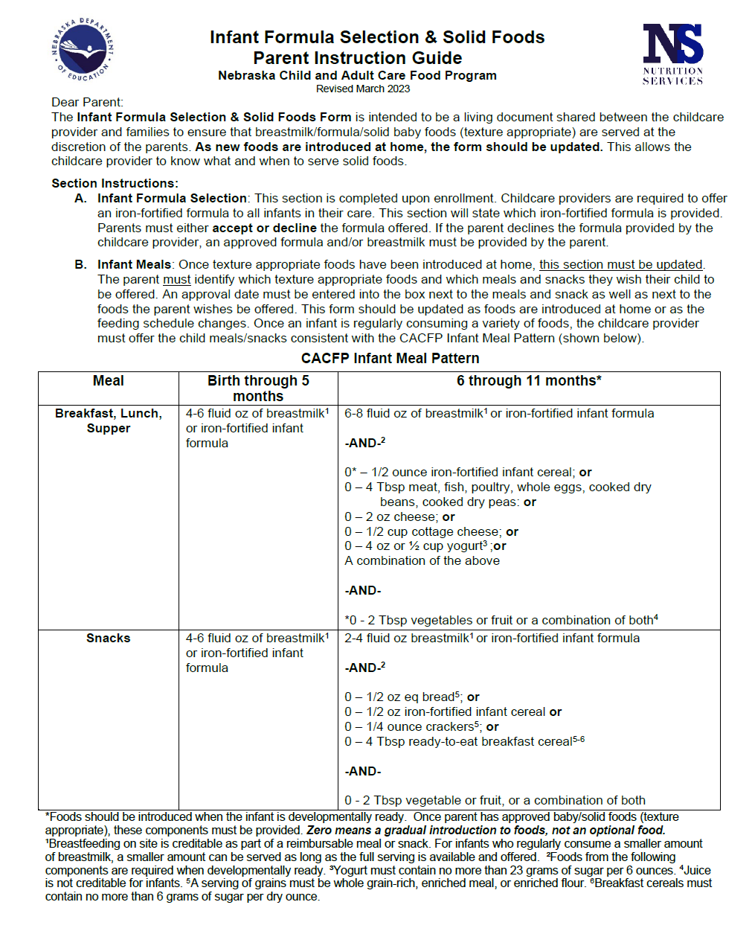
Infant CACFP Records
Instruction to Parents
How to complete form
What are the center’s responsibilities
Infant Meal Pattern
Staff need to be available to answer questions about completing the form
FY2024 Infant Meal Pattern
Available in Spanish

Slide 52
Infant CACFP Records
Section A. Formula Selection Form
Centers are responsible to:
Record Infant Formula offered by sponsor
Ensure first name, last name & date of birth are complete
Ensure parents have accepted/declined formula offered
If declined, ensure a formula or breastmilk has been identified for infant
Obtain parents signature and date
FY2024 Infant Meal Pattern
Notes:
This will need to be updated once form is updated. Ask child care licensing specialist if they will accept this form.

Slide 53
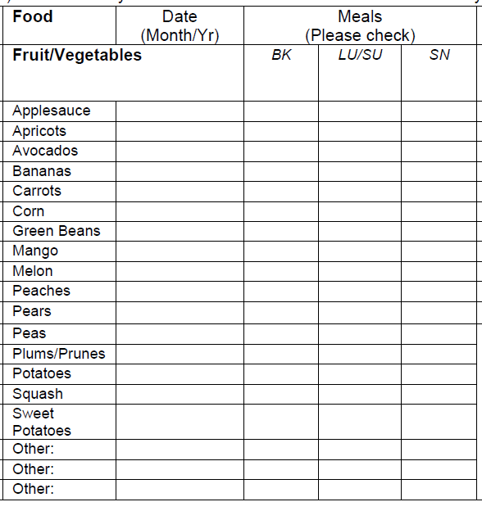
Infant CACFP Records
Section B. Solids Foods
Completed by parent or staff member
Identify date
Mark the meals food is to be offered at the center
Living Document – on-going changes
8/2023
x x x
FY2024 Infant Meal Pattern
Notes:
When provided permission of specific foods staff need to ask a follow up question: what meals each food is to be served

Slide 54
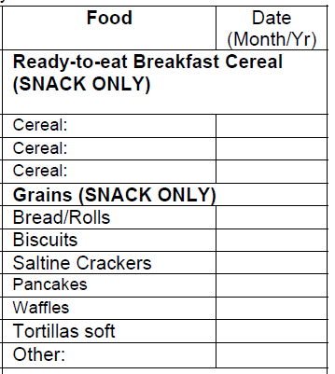
Infant CACFP Records
Section B. Solids Foods
Foods only contribute to meeting meal pattern at snack
Prior to copying enter:
Ready-to-eat breakfast cereals offered by your center to infants
Cheerios
7/2023
FY2024 Infant Meal Pattern
Notes:
This will need to be updated once form is updated.

Slide 55
Infant CACFP Records
8/30/23
Start serving beef or infant cereal @ lunch
Jane Hokey, Director
Infant feeding schedule or food changes can be noted:
Page 2 of Form
OR
Infant Production Records
FY2024 Infant Meal Pattern
Notes:
Page 3 does not go to parents & should be posted in the classrooms for infant staff members to review.

Slide 56
Infant CACFP Records
Instruction to Staff
How to:
Review form for completeness
Complete Infant Menu Production Records
Complete Daily Meal Counts
Post in each infant room for staff
FY2024 Infant Meal Pattern

Slide 57
Infant CACFP Records
Infant Meal Pattern
NDE’s Expectation from Centers:
On-going communication with parents as infant grows
Recorded Dates when solid foods are approved to be served and for which meals
Correlation between the Infant Production Records and approved solid foods documentation
FY2024 Infant Meal Pattern

Slide 58
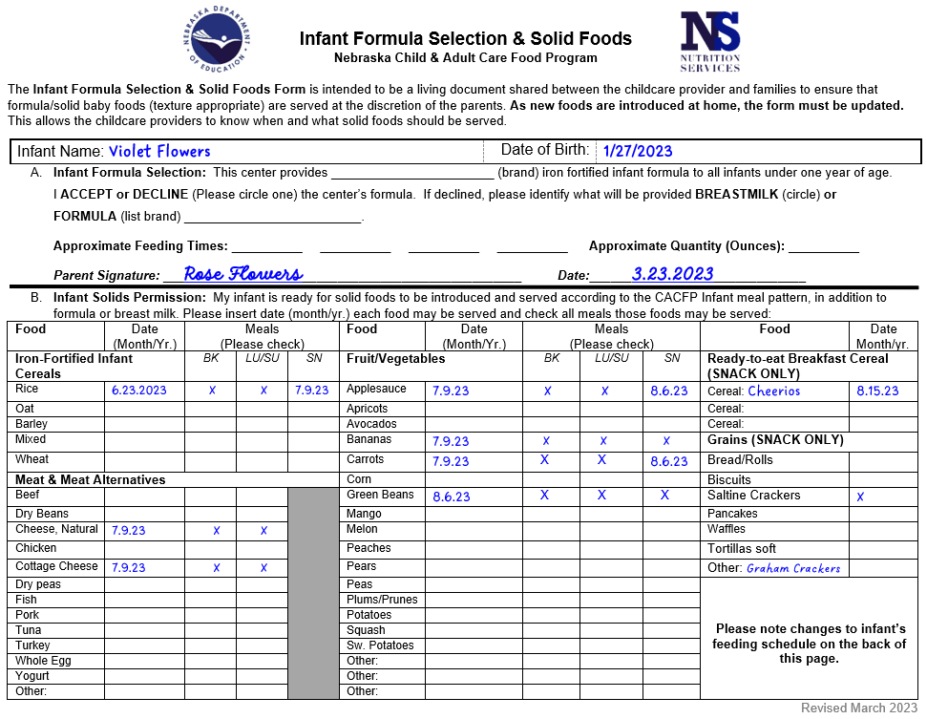
Test Your Knowledge
Is this Form Complete?
Based on this form:
Do you have permission to serve
* Crackers
* Chicken
FY2023 Infant Meal Pattern
Notes:
Does the infant have permission to be served crackers?
Does the infant have permission to be served chicken?

Slide 59
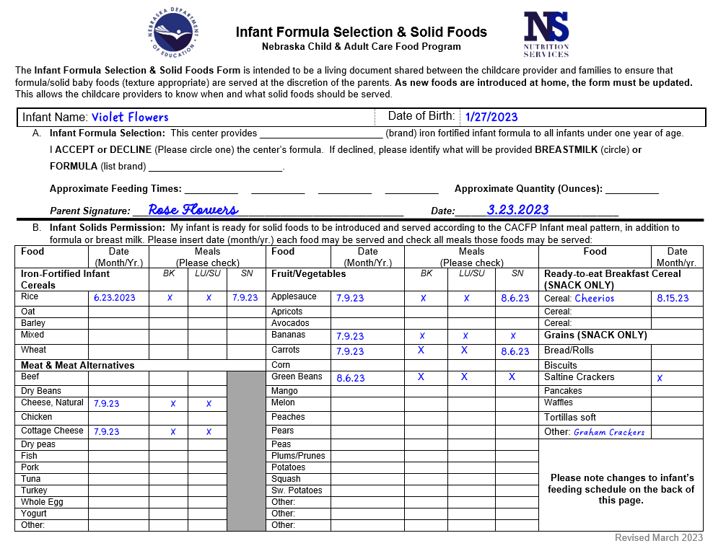
Crackers – Yes, but only saltine crackers
Chicken – No, only meat/meat alternate is beef and cheese, natural
FY2023 Infant Meal Pattern
Notes:
Does the infant have permission to be served crackers?
Does the infant have permission to be served chicken?

Slide 60
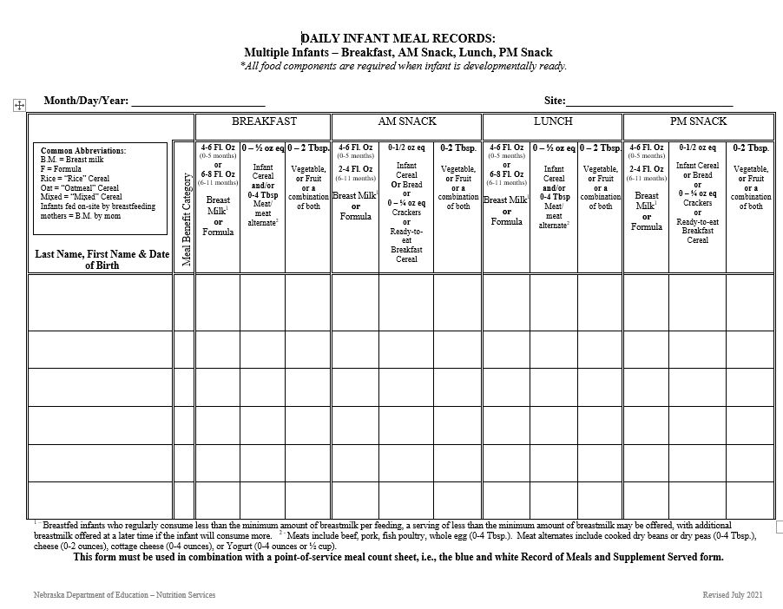
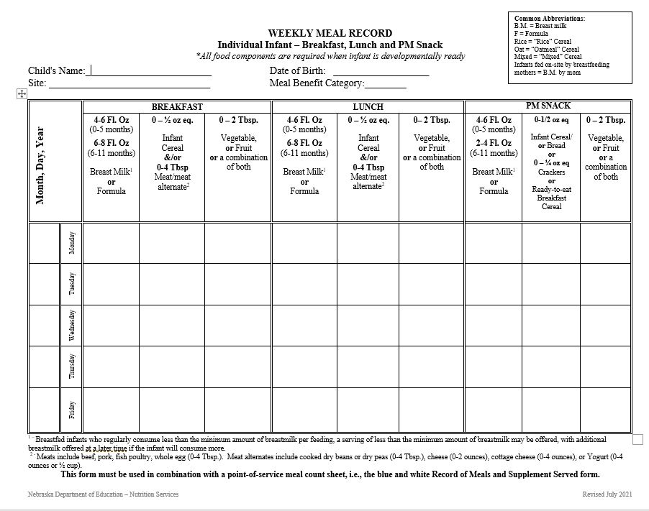
Infant CACFP Records
Infant Production Records
Daily
Weekly
FY2024 Infant Meal Pattern
Handout
Notes:
Daily – one per day for multiple infants Weekly – one per infant per week

Slide 61
Infant Production Records
Infant CACFP Records
Basic information
First & Last Name
Date of Birth
Meal Benefit Category (claim code)
Dates (Month/Day/Year)
Formula/Breastmilk & Solid Food quantities prepared
6 oz Formula or Breastmilk
½ oz Rice Cereal, 2 T Beef etc.
2 T Peaches; 3 T Peas; 1 ½ T Applesauce etc.
¼ oz Goldfish crackers; ½ oz saltine crackers, etc.
FY2024 Infant Meal Pattern

Slide 62
Specify foods and their quantities (Combination foods – identify specific food component) Use abbreviations to save time
Infant CACFP Records
Thayer, John
4/7/23
Hokey Hideaway
A
8/7
6 oz. F
½ oz
Rice
2 T
Pears
BM by mom
2 T
Beef
2 T
Peas
4 oz. BM
½ oz Cheerios
2 T
Pumpkin
6 oz. F
½ oz
Rice
2 T
Squash
6 oz. F
2 T
Carrots
4 oz. BM
½ oz Saltine
Crackers
2 T
Mangos
8/8
3 T Chicken
FY2024 Infant Meal Pattern
Sample – Handout
Notes:
Combination foods such as spaghetti, pizza, chicken noodles – must identify the meat within the food served

Slide 63
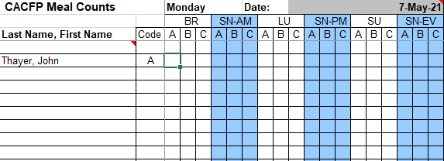
Infant CACFP Records
Infant CACFP Records
Infant meal counts must be supported with a complete infant production record for each infant.
Thayer, John
4/7/2023
Hokey Hideaway
A
6 oz. F
½ oz
Rice
2 T
Pears
BM by mom
2 T
Beef
2 T
Peas
8/7/23
X
X
FY2024 Infant Meal Pattern

Slide 64
Test your Knowledge
Infant Production Record vs Infant Solid Permission Form
Review each meal to determine –
Was the infant meal pattern met – is the meal eligible for reimbursement?
Is the documentation complete?
Are the foods creditable for an infant?
Were the foods and meals served according to the instructions provided by the parent/guardian?
FY2024 Infant Meal Pattern
Activity Handout
Notes:
Left Side of the Room – Review the meals for Monday Tuesday Wednesday
Right Side of the Room – Review the meals for Wednesday, Thursday Friday

Slide 65
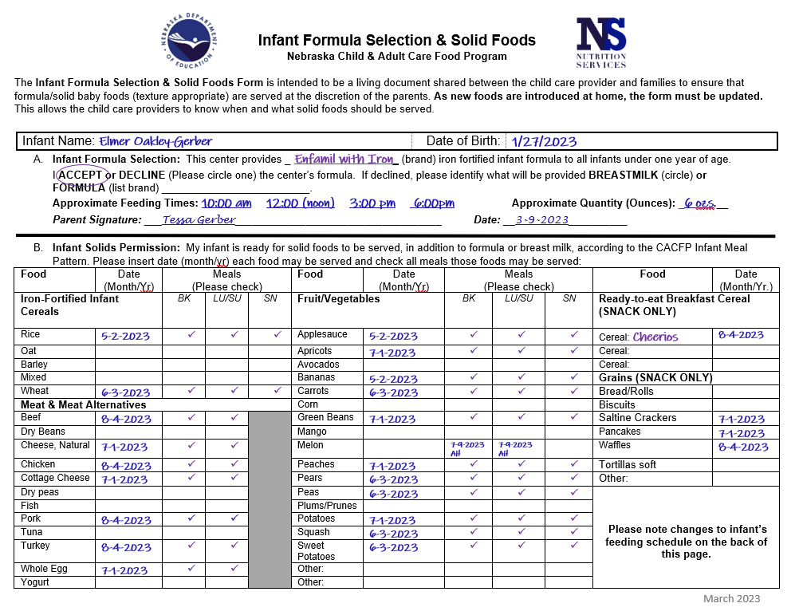
Test your Knowledge
FY2024 Infant Meal Pattern
Activity Handout

Slide 66
Test your Knowledge
FY2024 Infant Meal Pattern
Notes:
Red Circles indicates errors in which deductions would be made; “not allowed” symbol indicates a non-creditable food for an infant and deduction; purple would be a technical assistance as a result of in-proper documentation OR because the infant was not approved for the food served.
ABSENT – child was marked on the meal count records but production records did not record a meal

Slide 67
Wrap Up
Each infant must have a current & complete:
CACFP Enrollment
Income Eligibility Form determined by center official on file to be claimed as “Free” or “Reduced”
Infant Formula Selection and Solid Readiness
Infant meal production record for each meal claimed
Daily Meal Count Records (blue & white)
FY2024 Infant Meal Pattern

Slide 68
Wrap Up
Infant Meal pattern is child-specific and determined by the parent’s/guardian's approval of foods to be served
Creditable food components for infants differ from other age groups
Meal pattern is required to be met for an infant’s meal to be claimed for reimbursement
FY2024 Infant Meal Pattern

Slide 69
Questions?
Contact NDE
800-731-2233
Pick up your training certificate.
FY2024 Infant Meal Pattern

