Slide 1
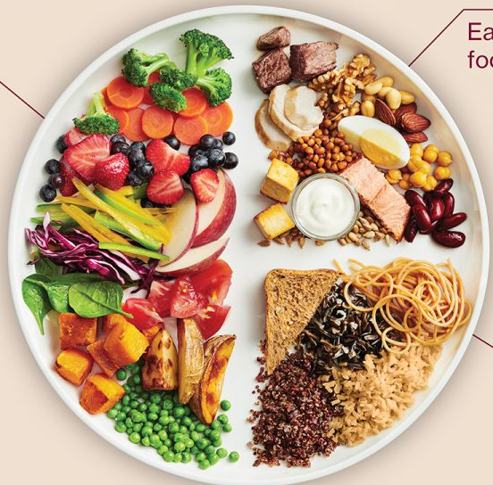

WELCOME!
CACFP
Meal Pattern
&
Menu Production Records

Slide 2
Nutrition Services’ Vision
Nutrition Services provides leadership that inspires service of nutritious meals to children, students and adults.

Slide 3
Workshop Staff
Lisa Smith, CACFP Director
Sandy Edwards
Marla Kurtenbach
Jenna Hilligoss
Laura Lutz
Susanne Schnitzer
Jane Bailey
Aspen Shirley

Slide 4
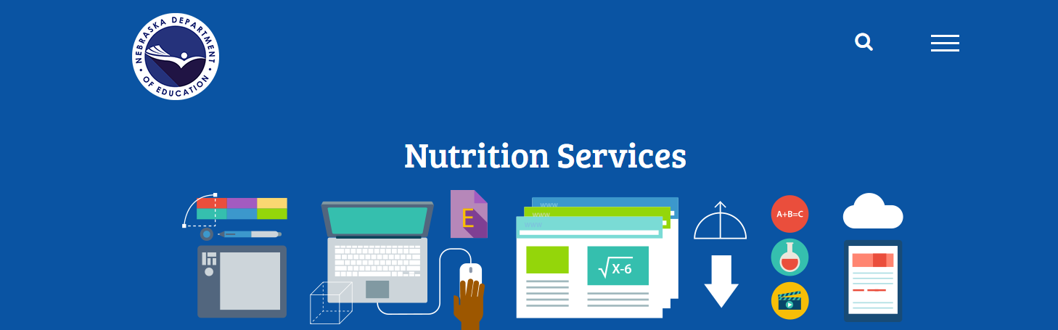
https://www.education.ne.gov/NS
NDE Nutrition Services Website

Slide 5
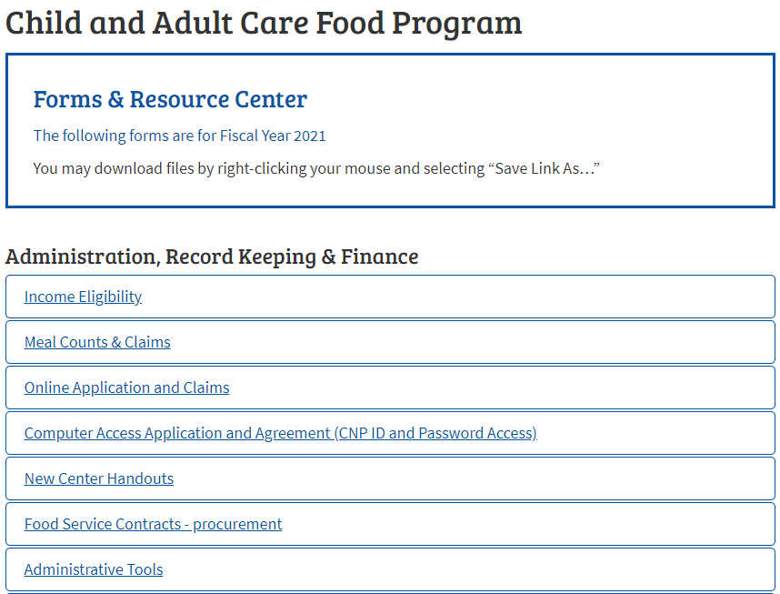
CACFP – Forms & Resource Center
https://www.education.ne.gov/ns/forms-resources/child-and-adult-care-food-program
Forms available on website:
Administration, Record Keeping & Finance
Food & Nutrition
Training Resources
USDA Resources
USDA Regulation & Policy
WIC Resources
Notes:
Double Click on each topic to open up each folder where forms can be downloaded

Slide 6
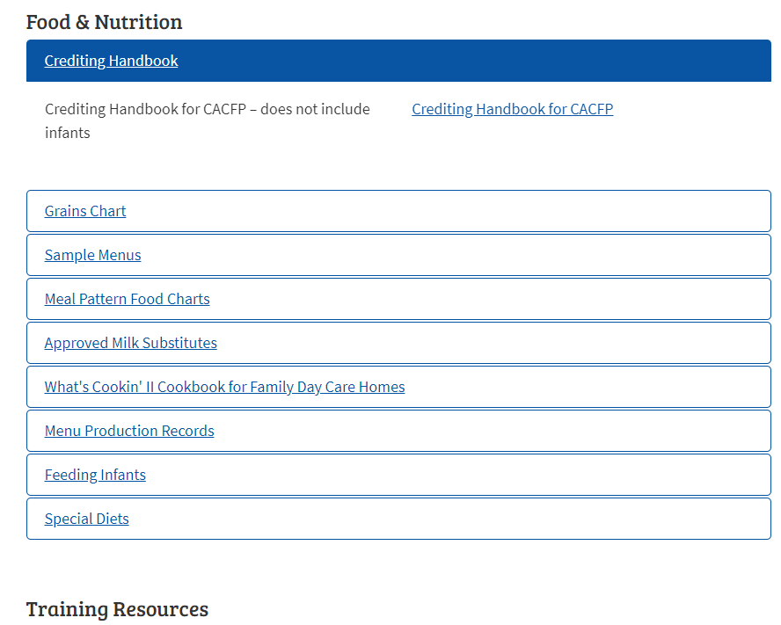
CACFP – Forms & Resource Center
https://www.education.ne.gov/ns/forms-resources/child-and-adult-care-food-program/
Medical Statements
&
Request for Meal Accommodation Forms
located in the
Special Diets Folder

Slide 7
Nebraska CACFP
800 - 731- 2233

Slide 8
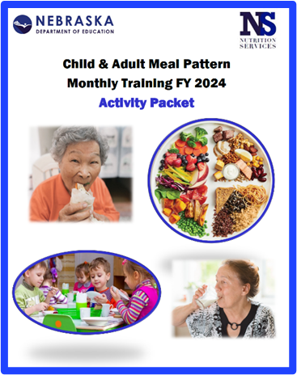
Agenda
Meal Pattern Overview
Component Groups
Menu Production Records
Family Style Meals
Farm to Preschool

Slide 9

Today’s Objective
How to prepare and document a reimbursable meal

Slide 10
Tips for the Day
Ask questions!
Take notes!
Be an active learner!
Share your success!
Have fun!

Slide 11

Tips for the Day
Get to know
the people
around you.

Slide 12
Tips for the Day
Make yourself comfortable
Take care of your needs
USDA

Slide 13

Reminders
Please turn off cell phones or place on vibrate. Return calls during break time.
Please be courteous to others; no sidebar conversations.

Slide 14

Reminders
NO TEXTING DURING MEETING

Slide 15

Reminders
This is a nonsmoking facility and campus.
Please return from breaks on time.

Slide 16

Reminders
Certificates of attendance will be available at the registration table at the end of this session.
Remember to pick up your certificate before you go to leave.

Slide 17
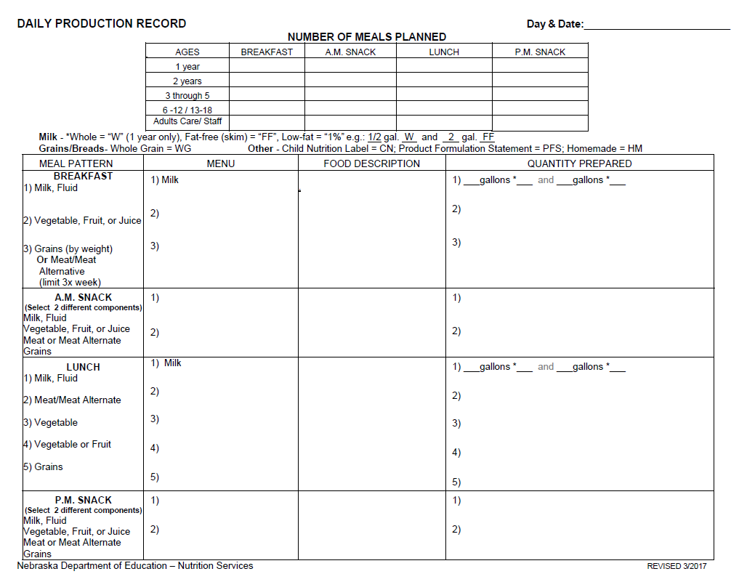
Today, you will learn…
How to complete
menu production
records

Slide 18
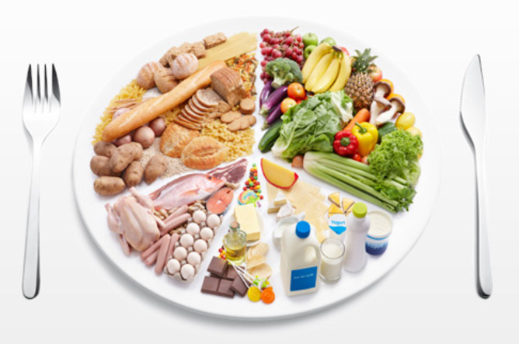
Today, you will learn…
What components are required to be served for a meal to be reimbursable.
Milk
Meat/Meat Alternative
Vegetables
Fruit
Grain

Slide 19

Best Practices
Serve lean meats, nuts, legumes
Provide at least 2 servings of whole grain-rich servings per day
Provide a large variety of fresh or frozen vegetables and fruits.
This Photo by Unknown Author is licensed under CC BY-NC-ND

Slide 20
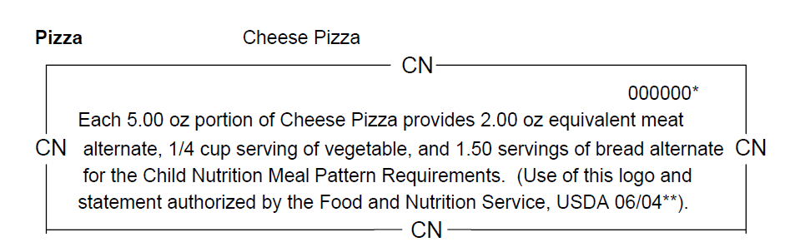
Today you will learn …
How to identify and use the information from:
CN Labels
Product Formulation Statements

Slide 21

Paperwork
We can lick gravity, but sometimes the paperwork is overwhelming.
Wernher von Braun

Slide 22
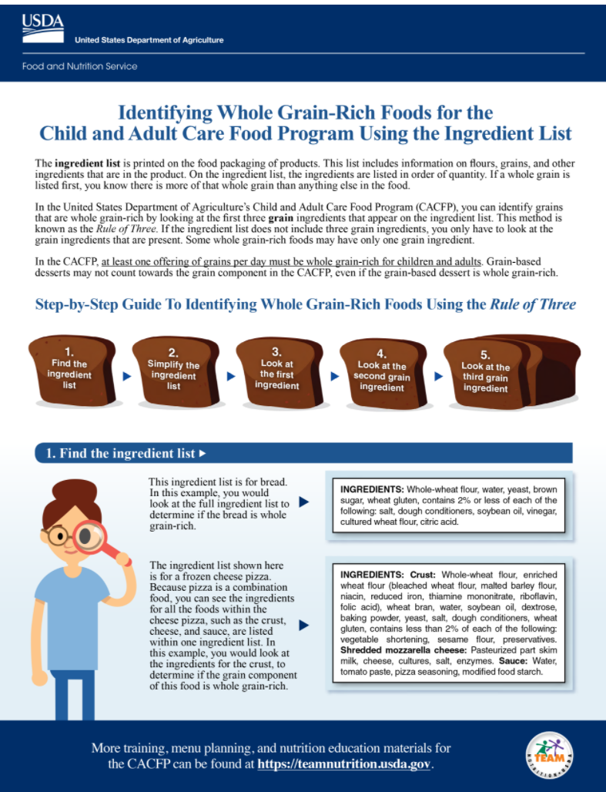
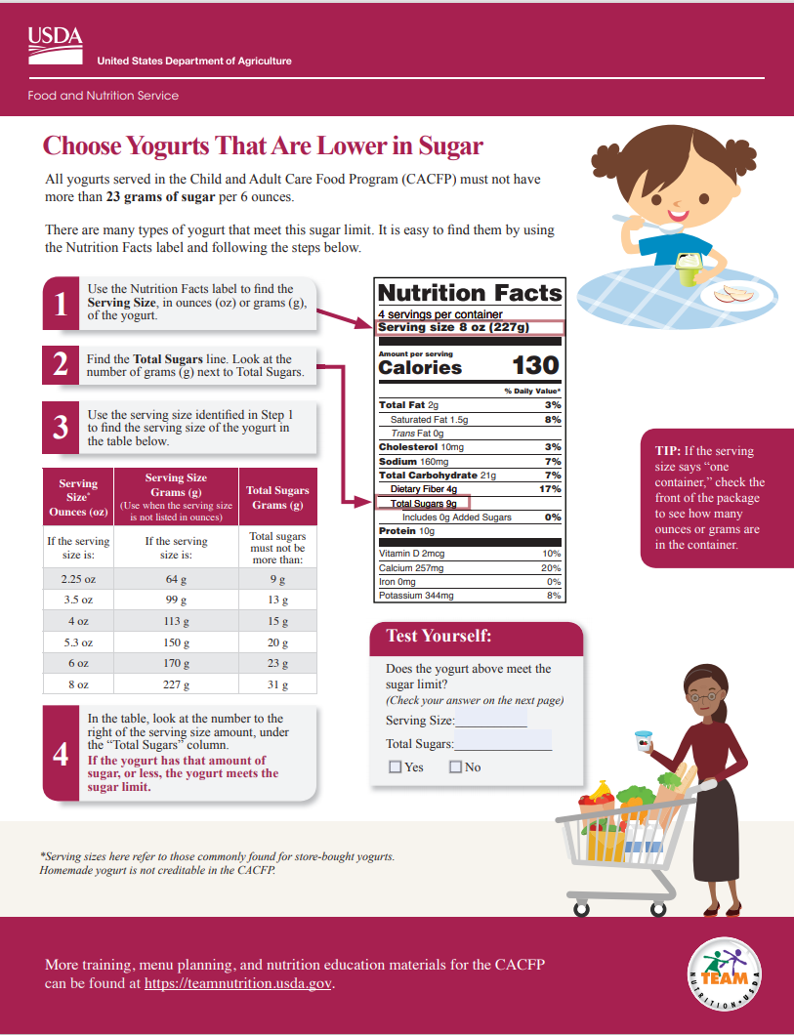
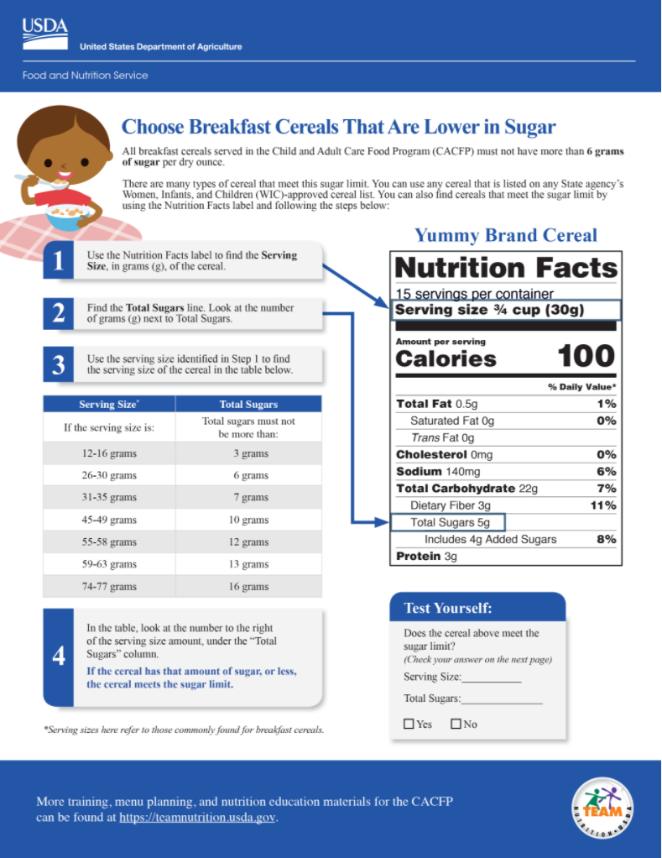


NDE Nutrition Services Website
https://www.education.ne.gov/ns
Forms & Resources Available:
Administration, Record Keeping & Finance
Food & Nutrition
Training Resources
USDA Resources
USDA Regulation & Policy
WIC Resources

Slide 23

Integrity
Integrity without knowledge is weak and useless, and knowledge without integrity is dangerous and dreadful.
Samuel Johnson
(1709–1784)

Slide 24

CACFP Motto
“If it’s not written down, it didn’t happen.”

Slide 25
Agenda
Meal Pattern Overview
Component Groups
Menu Production Records
Family Style Meals
Farm to Preschool

Slide 26

USDA Crediting Handbook
USDA Team Nutrition Website – CACFP
https://www.fns.usda.gov/tn

Slide 27
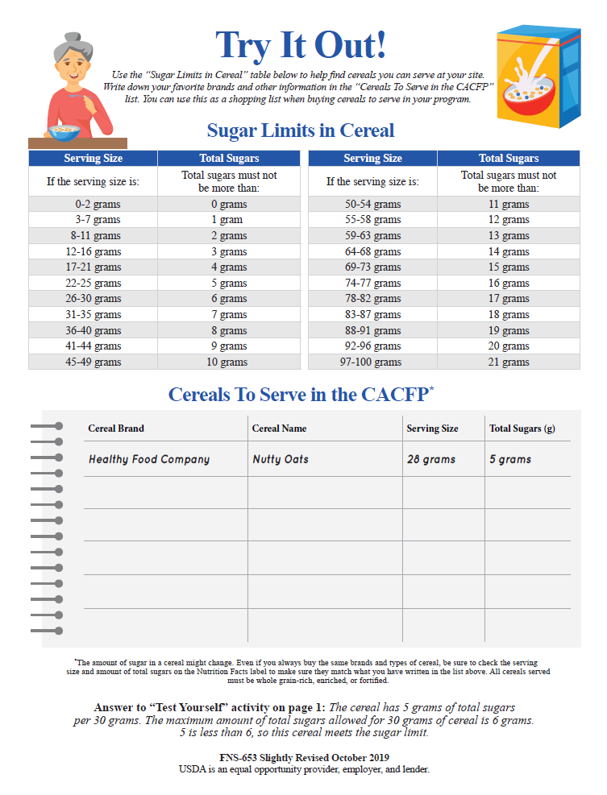
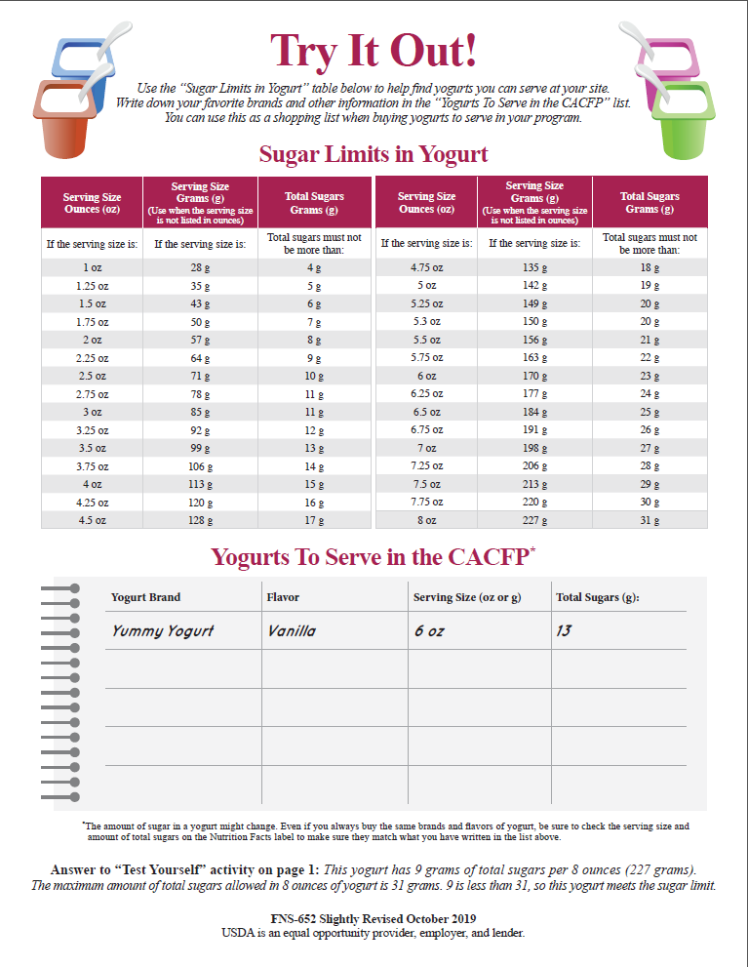
CACFP Tips
Important Resources:
USDA Yogurt Sugar Limit Guide
USDA Cereal Sugar Limit Guide

Slide 28

Learning
Success is no accident..
It is hard work, perseverance, learning, studying, sacrifice and most of all, love of what you are doing or learning to do.
– Pele

Slide 29
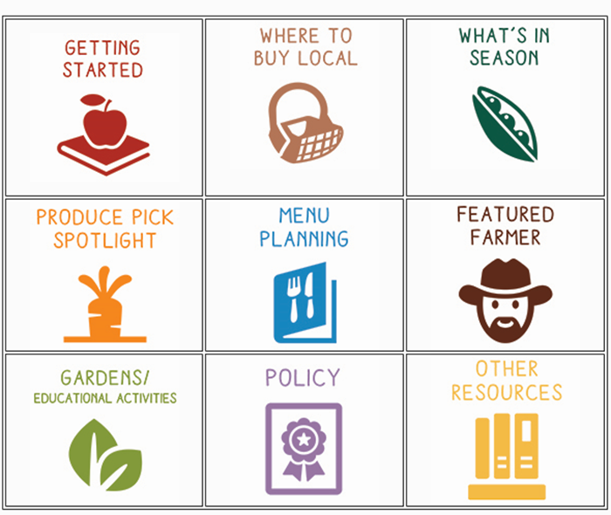

Farm to Preschool Website
https://www.education.ne.gov/ns/CACFP/F2Preschool/index.html

Slide 30

USDA Buying Guide
On-line Version:
https://www.fns.usda.gov/tn/food-buying-guide-for-child-nutrition-programs
Cell Phone Application Available
Apple and Android Devices

Slide 31
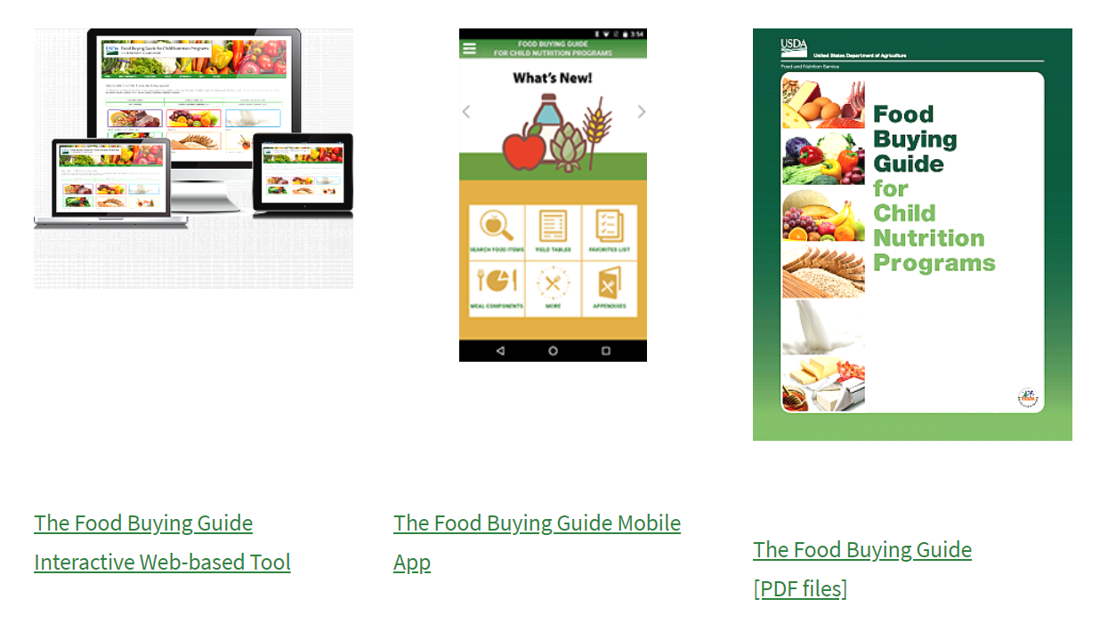
Food Buying Guide
Food Buying Guide for Child Nutrition Programs (usda.gov)
Handout
Notes:
During this demonstration you will want to refer to the power point handouts for the minimal portions required for each age group.

Slide 32

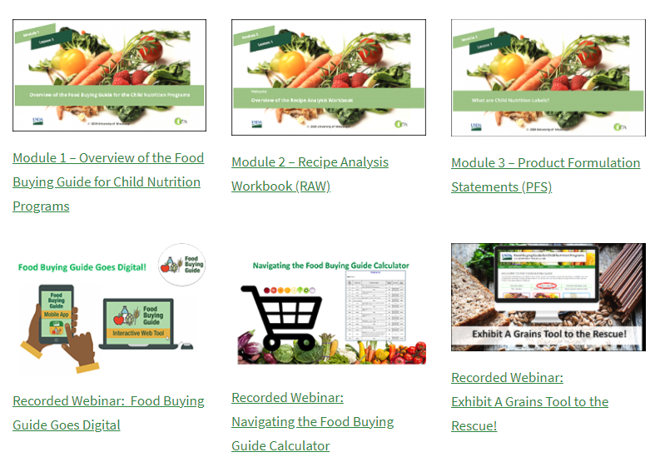



Food Buying Guide – On-line Trainings
https://www.fns.usda.gov/tn/food-buying-guide-training-resources

Slide 33

Learning
We are drowning in information but starved for knowledge.
John Naisbitt

Slide 34
Agenda
Meal Pattern Overview
Component Groups
Menu Production Records
Family Style Meals
Farm to Preschool

Slide 35

Farm to Preschool
Growing Edible School/Center Gardens
Serving local foods
Cooking with kids
Farm field trips
Taste tests
Nutrition education

Slide 36

CACFP Wisdom
“If you always do what you always did, you’ll always get what you always got.”

Slide 37
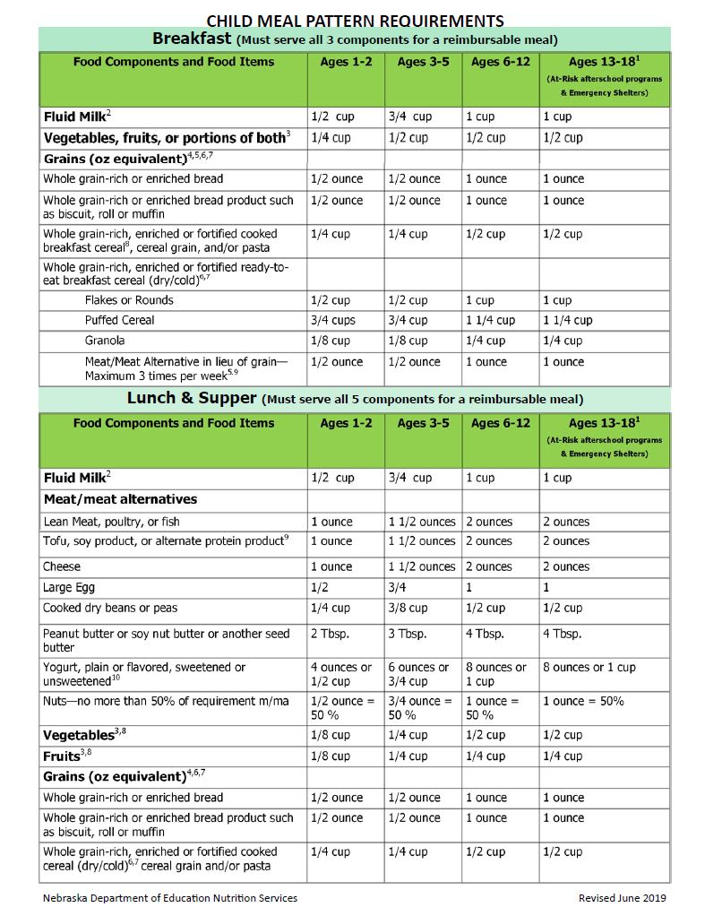
Child Meal Pattern (Ages 1-18)
All staff members should be trained on:
Food components
Minimum portion sizes.

Slide 38

CACFP Tips & Reminders
Must be maintained and kept on file for 4 years:
Menu Production Records
Vendor Tickets
Product/Food Labels

Slide 39

CACFP Tips & Reminders
Meals are to be served according to the meal times identified on your CACFP Application.

Slide 40

CACFP Tips & Reminders
Requirement and responsibility to train your staff on their CACFP responsibilities.

Slide 41

CACFP Tips & Reminders
Meal counts must be made
at the
point of meal service.

Slide 42
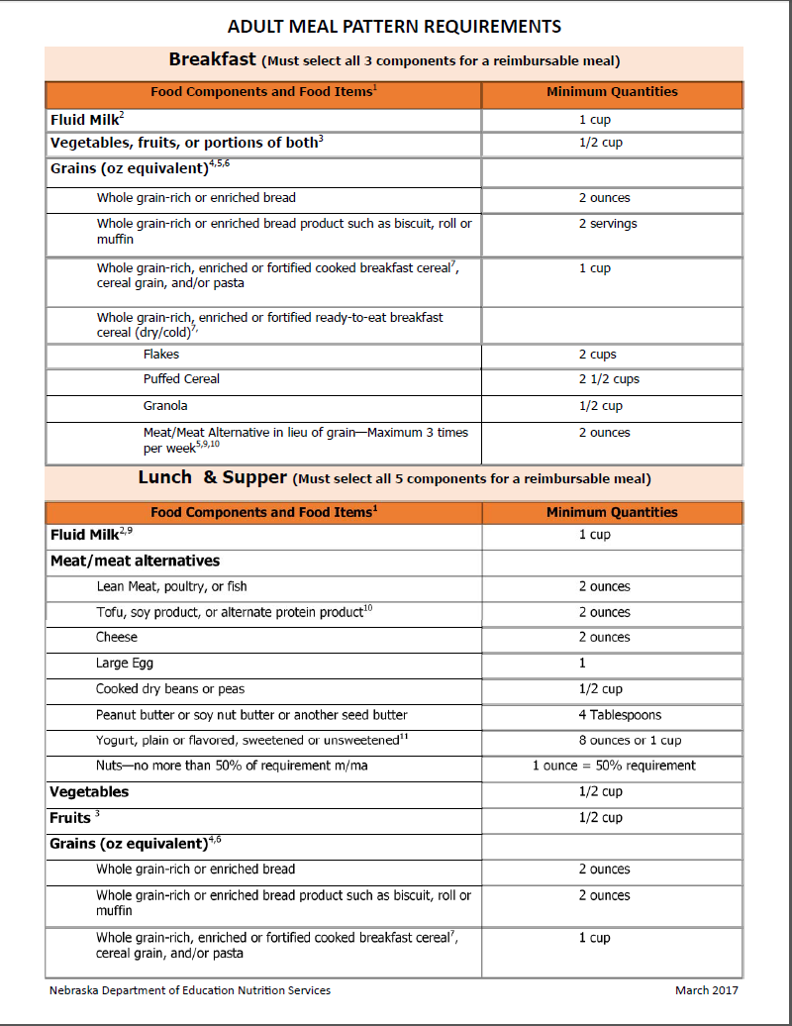
Adult Meal Pattern
All staff members should be trained on:
Food components
Minimum portion sizes.

Slide 43

CACFP Tips & Reminders
Menu Production errors
add up
to large over claims

Slide 44


CACFP Tips & Reminders
The minimum portion size must be served to participants.
Programs which serve family style must provide glasses large enough to hold the minimum portion size.

Slide 45

Integrity
Doing the right thing,
even when no one is looking.
It is called integrity

Slide 46
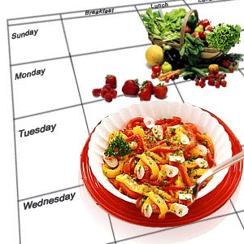
CACFP Tips & Reminders
Menu Production Records
are to be completed
at the time of
meal preparation

Slide 47


CACFP Tips & Reminders
Kitchens should be equipped with measuring tools and scales

Slide 48
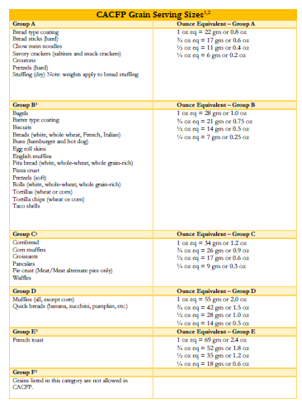
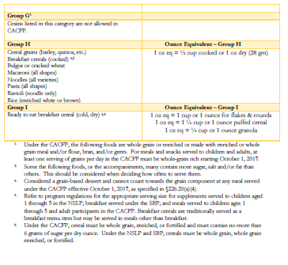
CACFP Grains Chart
Ounce Equivalent Chart

Slide 49

CACFP Resources
Website Resources:
USDA Team Nutrition
https://www.fns.usda.gov/tn

Slide 50



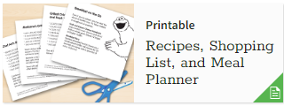

CACFP Resources
Website: www.ssic.org
Articles Activities
Recipes Videos

Slide 51

CACFP On-line Training & Resources
The Institute of Child Nutrition
https://theicn.org/cacfp

Slide 52
CACFP On-Line Training & Resources
The Institute of Child Nutrition
https://theicn.org/cacfp
Food Allergy Fact Sheets
Nutrition 101 Training
Food Safe Training for Child Care & Adult Care Programs
Along with a variety of recorded webinars

Slide 53
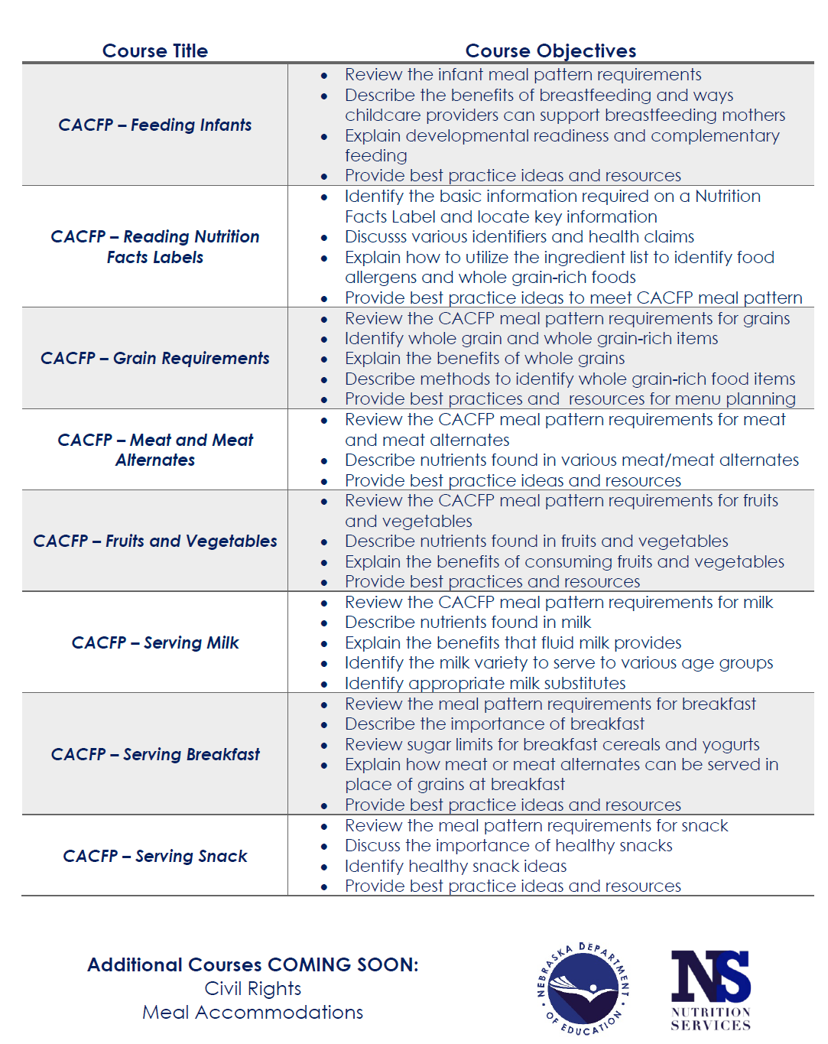
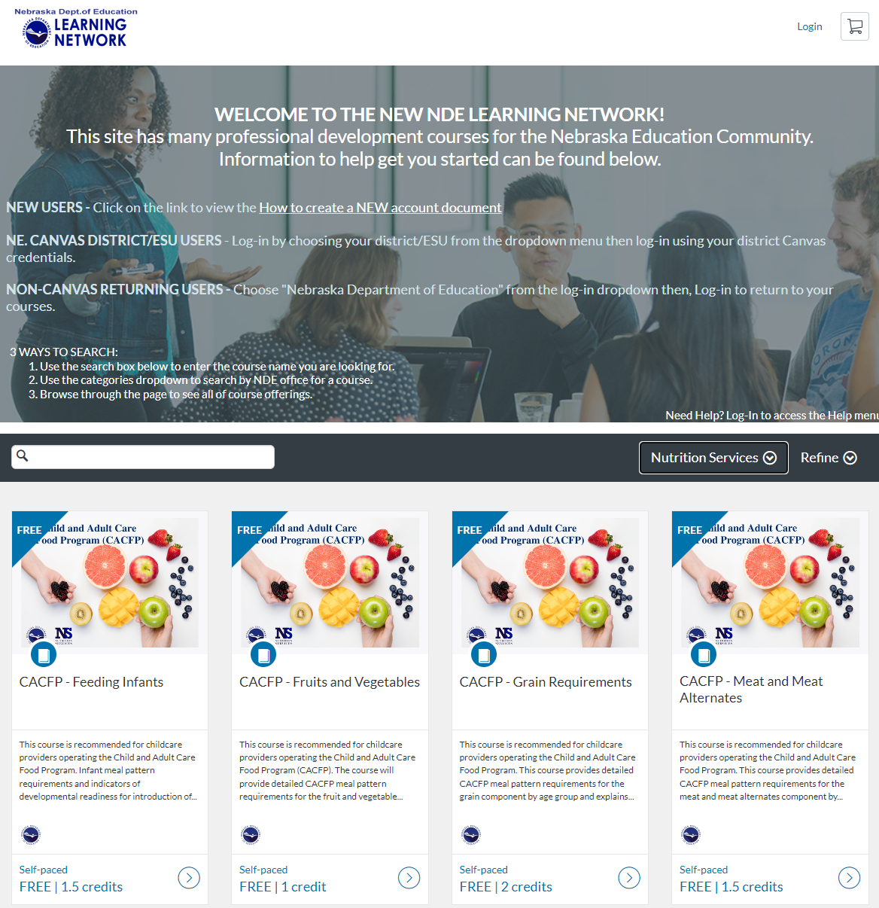

CACFP On-line Training
https://canvas.education.ne.gov/
Notes:
Handout located in folders
Each training is self-paced training, free and credits are provided at the conclusion of the training.
To locate the nutrition trainings a drop down menu is located under “Categories”.

Slide 54
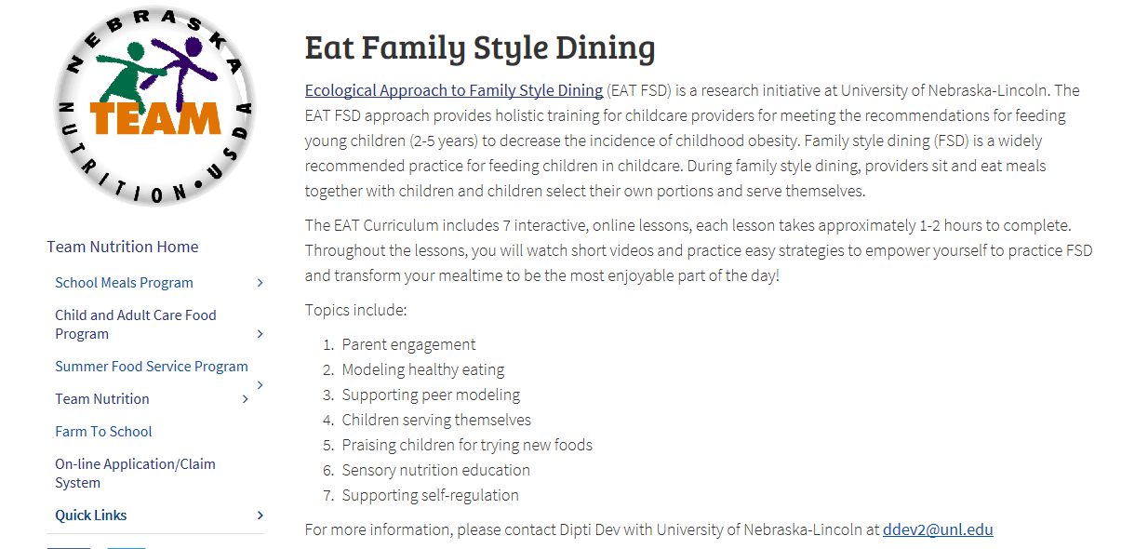

CACFP On-line Training
Training on Family Style Meal Service
https://www.education.ne.gov/ns/team-nutrition/cacfp/eat-family-style-dining/

Slide 55
CACFP On-line Training
SafeGuard Classes: https://sgclassesonline.com/
Safeway Certifications: https://www.responsibletraining.com/
ServeSafe: https://www.servsafe.com/

Slide 56
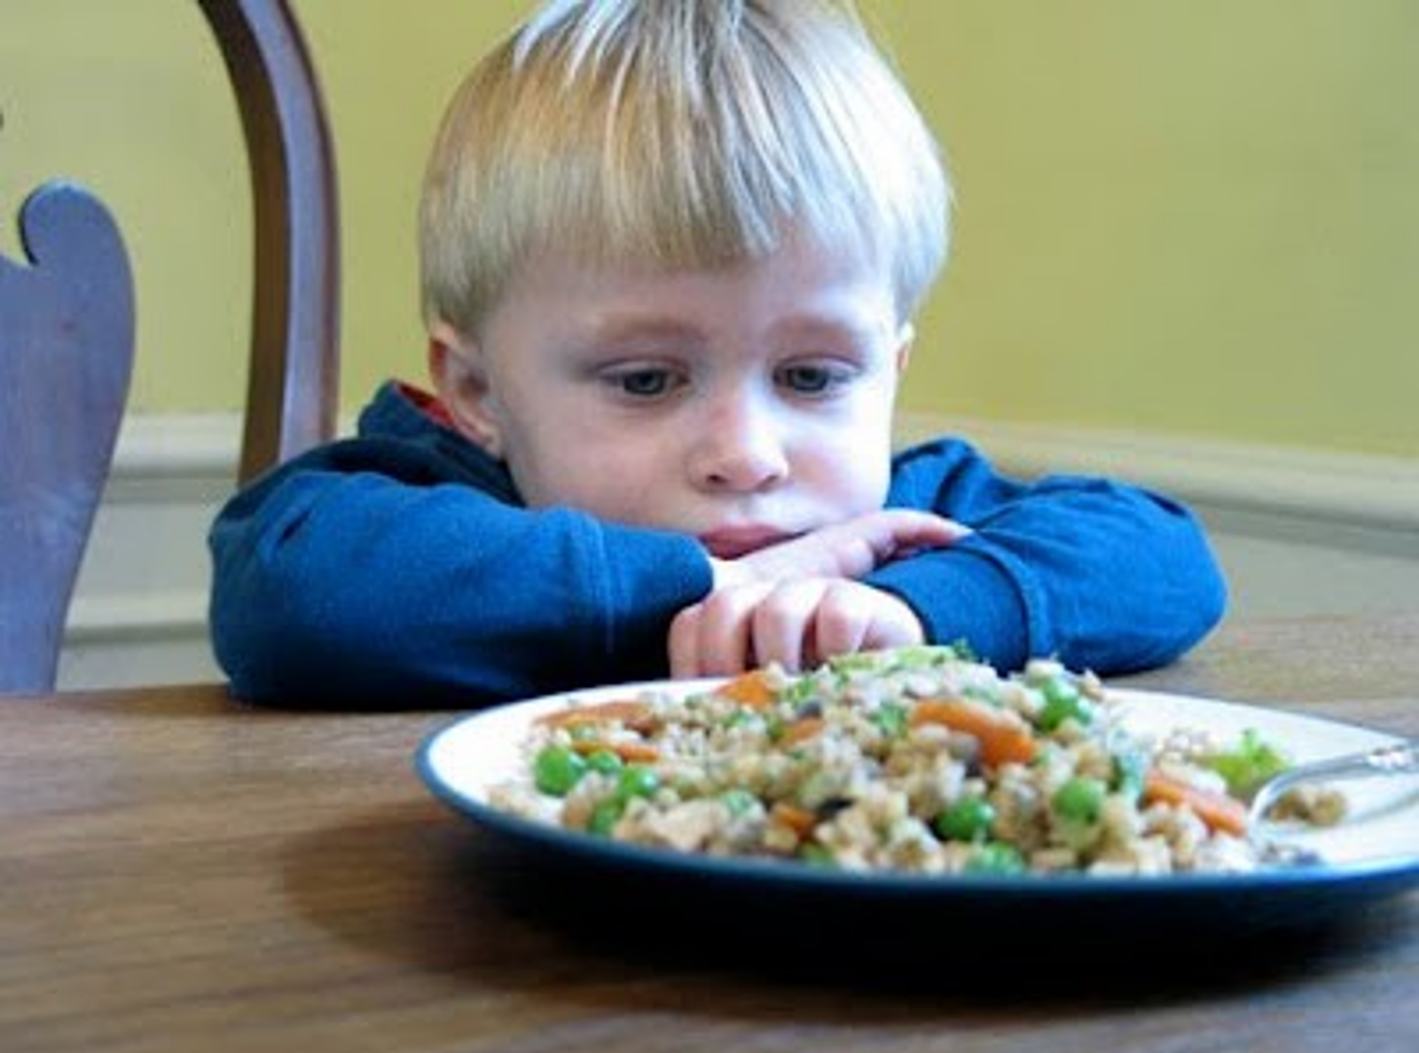
Honesty
Honesty is the best policy
Miguel de Cervantes Saavedra
Don Quixote

