Slide 1
Everyone’s An Asset Builder
Erika Wibbels, Healthy Schools Specialist
Notes:
Erika Welcome!
Erika’s bio: Erika is the Healthy Schools Program Specialist at the Nebraska Department of Education; she works with schools to enhance learning and achievement through supporting social, emotional, behavioral, mental, physical health & safety of students. Erika’s love for youth gives her the drive to continue to engage, connect and make change to provide the best for students!
Cody Talarico is a musician and supporter of arts education. Cody taught music in the Bellevue (NE) Public Schools. He is currently serving Nebraska as the Fine Arts Education Specialist at the Nebraska Department of Education. Cody holds pedagogical certification in Orff-Schulwerk, an elemental approach to music education. He is a professional church musician, too, and all-around fine arts fanatic.

Slide 2
Nebraska
Department of Education
The mission of the Nebraska Department of Education is to lead and support the preparation of all Nebraskans for learning, earning, and living.
Notes:
At the NDE, we have be involved in an effort to bring coherence to our work across divisions and offices. Using Nebraska's Multi-Tiered System of Support, we are working to strengthen coherence across NDE Offices, improving the communication and services in the name of supporting student achievement and enhancing educational outcomes.
Visit nemtss.unl.edu to learn more.

Slide 3
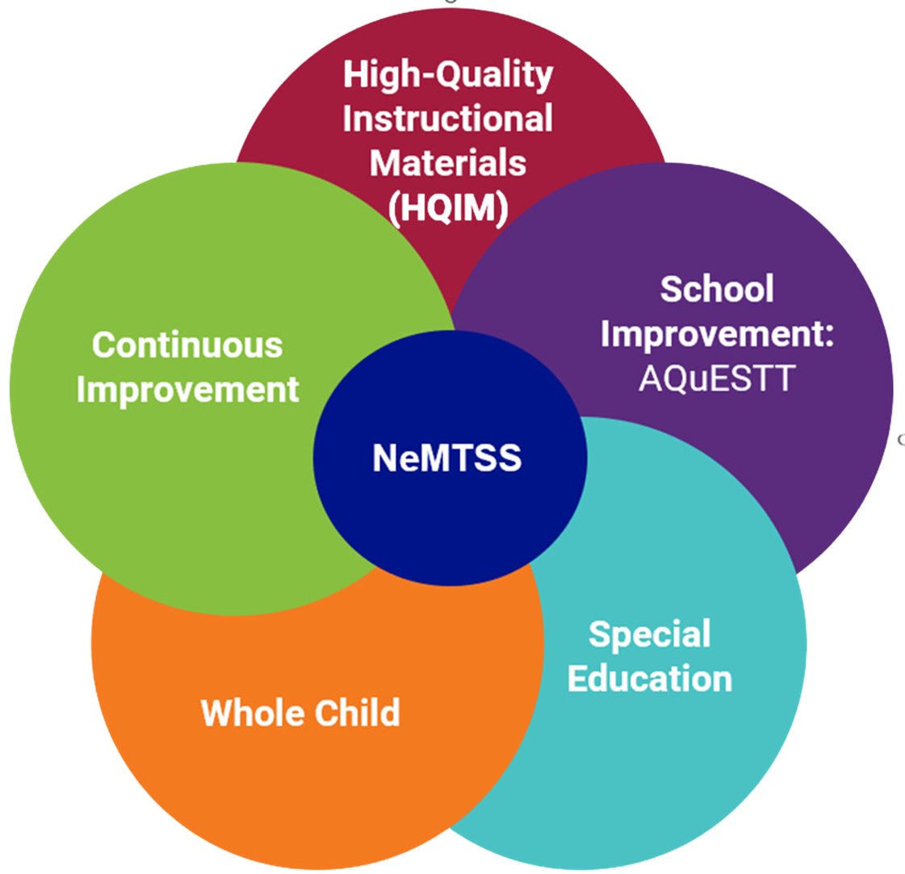
Nebraska’s Multi-Tiered Systems of Support
Strengthen coherence across NDE Offices, improving the communication and services in the name of supporting student achievement and enhancing their educational outcomes.
nemtss.unl.edu
Notes:
At the NDE, we have be involved in an effort to bring coherence to our work across divisions and offices. Using Nebraska's Multi-Tiered System of Support, we are working to strengthen coherence across NDE Offices, improving the communication and services in the name of supporting student achievement and enhancing educational outcomes.
Visit nemtss.unl.edu to learn more.

Slide 4
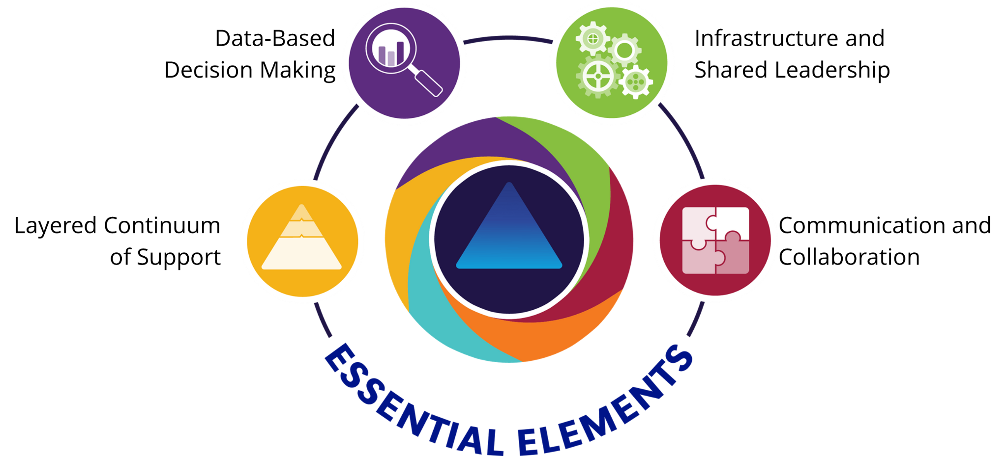
NeMTSS Essential Elements
nemtss.unl.edu/about
Notes:
The four essential elements of the NeMTSS Framework are infrastructure and shared leadership, layered continuum of supports, data-based decision making, and communication and collaboration.
Visit https://nemtss.unl.edu/about/ to learn more about these elements and how they comprise the NeMTSS Framework.

Slide 5
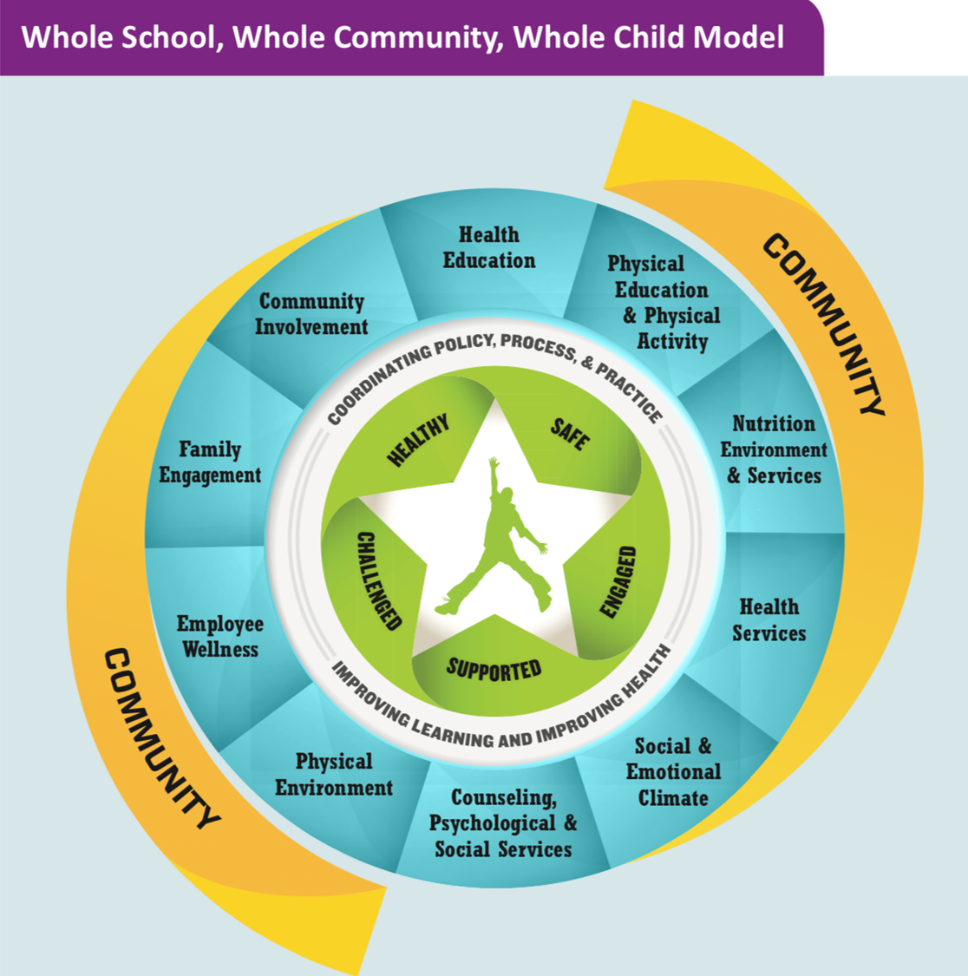
Office of Coordinated Student Support Services
Created based on the Whole School, Whole Community, Whole Child Model.
Developed by ASCD and adopted by CDC in 2014.
Evolution of the Coordinated School Health model
●Coordinate and collaborate among component areas
●Facilitate awareness of student need
●Leverage resources
●Reduce program duplication and fill gaps
Notes:
Erika

Slide 6
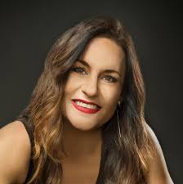
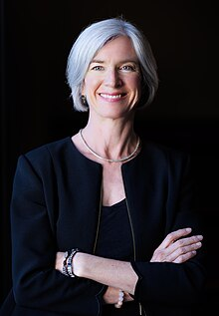
What’s you first impression? What would you guess about each person?
Notes:
Cody -
Look at the following individuals. What is your first impression? What do you think about each person?

Slide 7
How did your first impression compare to reality?
Jennifer Welter
Professional Football Player
Frank Anderson, Ballet Dancer
Ali Sabur, College Professor at age 18
Jennifer Doudna, Nobel Winner in Biochemistry
Levon Helm
Rock Band Drummer
Notes:
Cody
Now, you can see these individuals careers? Were your assumptions correct? How did they differ?
As adults, we tend to focus on positive attributes when making a first impression. Search Institute has found that too often youth feel that the first impression formed is a negative one.
It’s important to realize that while one may identify with their chosen career that as individuals there are many layers to identity.
As an asset builder, our task is to consistently challenge our thinking and view youth as resources, not as problems. Youth have positive attributes and can be celebrated and supported. Through building assets, we contribute to their ability to thrive.

Slide 8
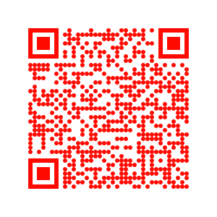
Workshop Overview
Learning Objectives
Understand Search Institute’s framework of Developmental Assets and the role of individual asset builders;
Identify the general characteristics of effective asset builders and their own personal areas of strength and challenge;
Understand the concept of “circles of influence” and identify the circles in which they have the greatest potential for personal asset-building impact;
Explore barriers to being an individual asset builder and strategies for moving toward action; and
Make & share a personal action commitment to asset-building action
Agenda
Characteristics of an Asset Builder
The Developmental Assets Framework
Exploring the Assets
Overcoming Barriers: Moving toward Action
Who We Are, What We Value & What We’ll Do
Handouts
Notes:
Erika (slides 1-6 = 5 minutes)
(Read objectives). As you can see on the agenda, we will work through 6 sections. Let’s begin!

Slide 9
Principles of Asset Building
All young people need assets
Everyone can build assets
Relationships are key…
It’s about people more than programs
Asset building is an ongoing process
Start where you can
Small steps make a big difference
Consistent messages are crucial
Repetition is important
It’s cumulative—little things add up
Start early…and it’s never too late
Notes:
Erika p 19-20 #9
Much of asset building occurs within the context of individual relationships.
All young people need assets
Urie Bronfenbrenner (YURE-ee BRAHN-fen-bren-ner) has looked extensively at- young people who persevere and grow up healthy in spite of significant stress and difficulty. He has noted that such resilient youth have at least 1 adult who cares deeply for them. He describes this caring as “irrational love” and adds that youth who have many such adults in their lives are luckier still.
Everyone can build assets
There is much research on adolescent development that points to the impact of positive peer influence on healthy growth and development. Young people have great potential for asset building through caring friendships with their peers.
Relationships are key. It’s about people more than programs, which is why Search does not promote programs; rather tools & resources
Asset building is an ongoing process.
Consistent messages are crucial.
Repetition is important.
Start Early…
One finishing thought from another study:
Milbrey W. McLaughlin, Merita A. Irby & Juliet Langman have researched the places in urban settings where youth find sustenance and support, and describe such places in their book. They point to the important role of individuals within such places and call them wizards. They can have almost magical powers in kids’ lives due primarily to their capacity to care and communicate that caring to young people whom they meet.

Slide 10
Characteristics of an Asset Builder Activity
Step 1: Think about someone who was or is an asset builder in your life. They have made a positive impact on you!
Step 2: Record on the notecard what it was about that person that allowed/allows them to have that kind of positive impact in your life?
** Note, if you do not want to identify a specific person, it is an option write down what kind of person would make a positive impact on lives.
Step 3: Share in the chat
Notes:
Cody
We will now spend time considering the qualities of individuals who are asset builders. Take a few moments to think about someone who was or is an asset builder in your life. Someone who had a positive impact on your life when you were young.
On the note cards,
Write what it was about that person that allowed them or allows them to have that kind of positive impact in your life? (2 minutes)
Share with neighbor who you choose and what you wrote.

Slide 11
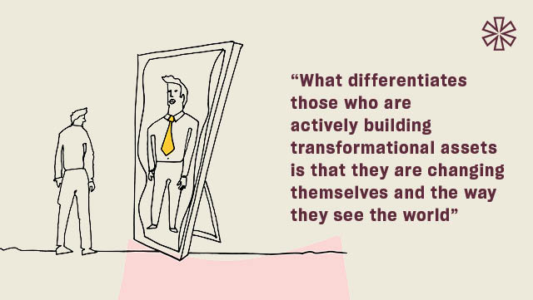
Characteristics of an Asset Builder Activity
Step 4: Place a ➕ sign next to items that are characteristic of who that person is
Step 5: Place a ⭐ next to items that reflect what that person does/did
Notes:
Erika
(bring back together) place a ➕sign next to items that are characteristics of who that person is (allow them a 1 minute to do this) NOW, place a ⭐ next to items that reflect what that person does/did
Do you notice that the ➕sign reflect “Who You Are” (attitudes, character, competencies, etc) and the ⭐ was “What You Do” (actions, relationships, modeling, etc)

Slide 12
Two Types of Assets
External Assets
The supports, opportunities, and relationships young people need across all aspects of their lives.
Internal Assets:
The personal skills, commitments, and values they need to make good choices, take responsibility for their own lives, and be independent and fulfilled.
P. 3 –
40 Developmental Assets
Notes:
Cody
In 1989, Search Institute asked the question, “Why do some kids grow up with relative ease, while others struggle? Another way of putting that would be to ask, “What are the factors that have an impact on healthy growth and development in young people?”
The two types of assets are divided by their function. External factors are those that are in the environment that provide structure and support to young people. Tey are the relationships and opportunities they have.
Internal assets reflect the personal character strengths, social-emotional skills, and attitudes that allow young people to fully engage in what’s around them.
It’s important to remember that the asset approach is one where more assets help young people thrive. No single asset is more important than the other. Rather, the more assets, the better.
You can access and download the 40 Developmental Assets handouts from Search Institute.

Slide 13
External Assets
Notes:
Here’s a list of the four external asset categories. Looking at your handout, the external assets are listed at the top. Take a moment to look over the these assets. On the right, you’ll notice the percentage of young people surveyed from June 2012 to May 2015 of young people who can identify that they have this asset in their life. What do you notice?
Some highlights
Other adult relationships - 52%
Community Values Youth - 25%
Adult Role Models - 32%
Positive Peer Influences - 72%
Creative Activities - 20%

Slide 14
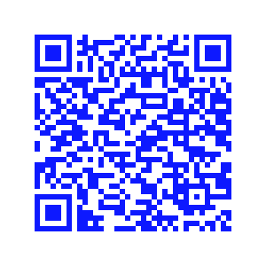
Internal Assets
40 Developmental Assets by Age Category
Notes:
Erika
Those external assets that we just took a look at are built through relationships and sometimes require courageous conversations. Now we are pivoting to look at internal assets that are driven more from internal beliefs.
How can you demonstrate these assets for students:
Commitment to learning: Encourage peer learning, be responsive to multiple learning styles, admit when you don’t have an answer
Positive Values: Demonstrate care and concern for others, do not make or tolerate jokes or comments that are put downs of other people based on differences
Social Competencies: Welcome and affirm the value of diversity within the group, openly address conflict
Positive Identity: Tell your own story & affirm the stories of others, celebrate your own learning & learning of others
Age Categories:
Compare assets (#20) for all different levels to see the difference.

Slide 15
Focus Questions
What is most important to you?
What is most interesting to you?
What is most surprising to you?
Notes:
Cody
(Five minutes)
Take 2 minutes to read through the 40 assets and think through the slide questions. As a group we will discuss thoughts and reactions to the asset list.

Slide 16
Power of Assets to Promote
Notes:
Erika
Looking at these graphs you can see the correlation across all the behaviors between increased number of assets and an increased outcome/behavior. When doing a quick dive into the charts we see a jump anywhere from 36%-62% increase between the 0-10 asset group versus the 31-40 asset group.

Slide 17
Power of Assets to Protect
Notes:
Erika
I think we would all agree that we would love to help students stay clear of poor behavior choices.
These charts are showing the correlation between increased number of assets and a decreased likelihood that a young person will report being involved in these negative behaviors.
Problem with alcohol use decreased 37%. Drug use was not even present with students who possessed 31-40 assets. Sexual activity decreased by 28% and violence decreased by 49%.

Slide 18
Nebraska Results
2021 Youth Risk Behavior Survey
Alcohol Use
Drug Use
Notes:
Let’s take a dive into our Nebraska data on alcohol use, drug use, sexual activity and violence. Our Nebraska Youth Risk Behavior Survey shows the need to help our students build assets! You will also notice that students who have better mental health are less likely to report being a part of negative behaviors.

Slide 19
Nebraska Results
2021 Youth Risk Behavior Survey
Tobacco Use
Violence/Sexual Activity Use

Slide 20
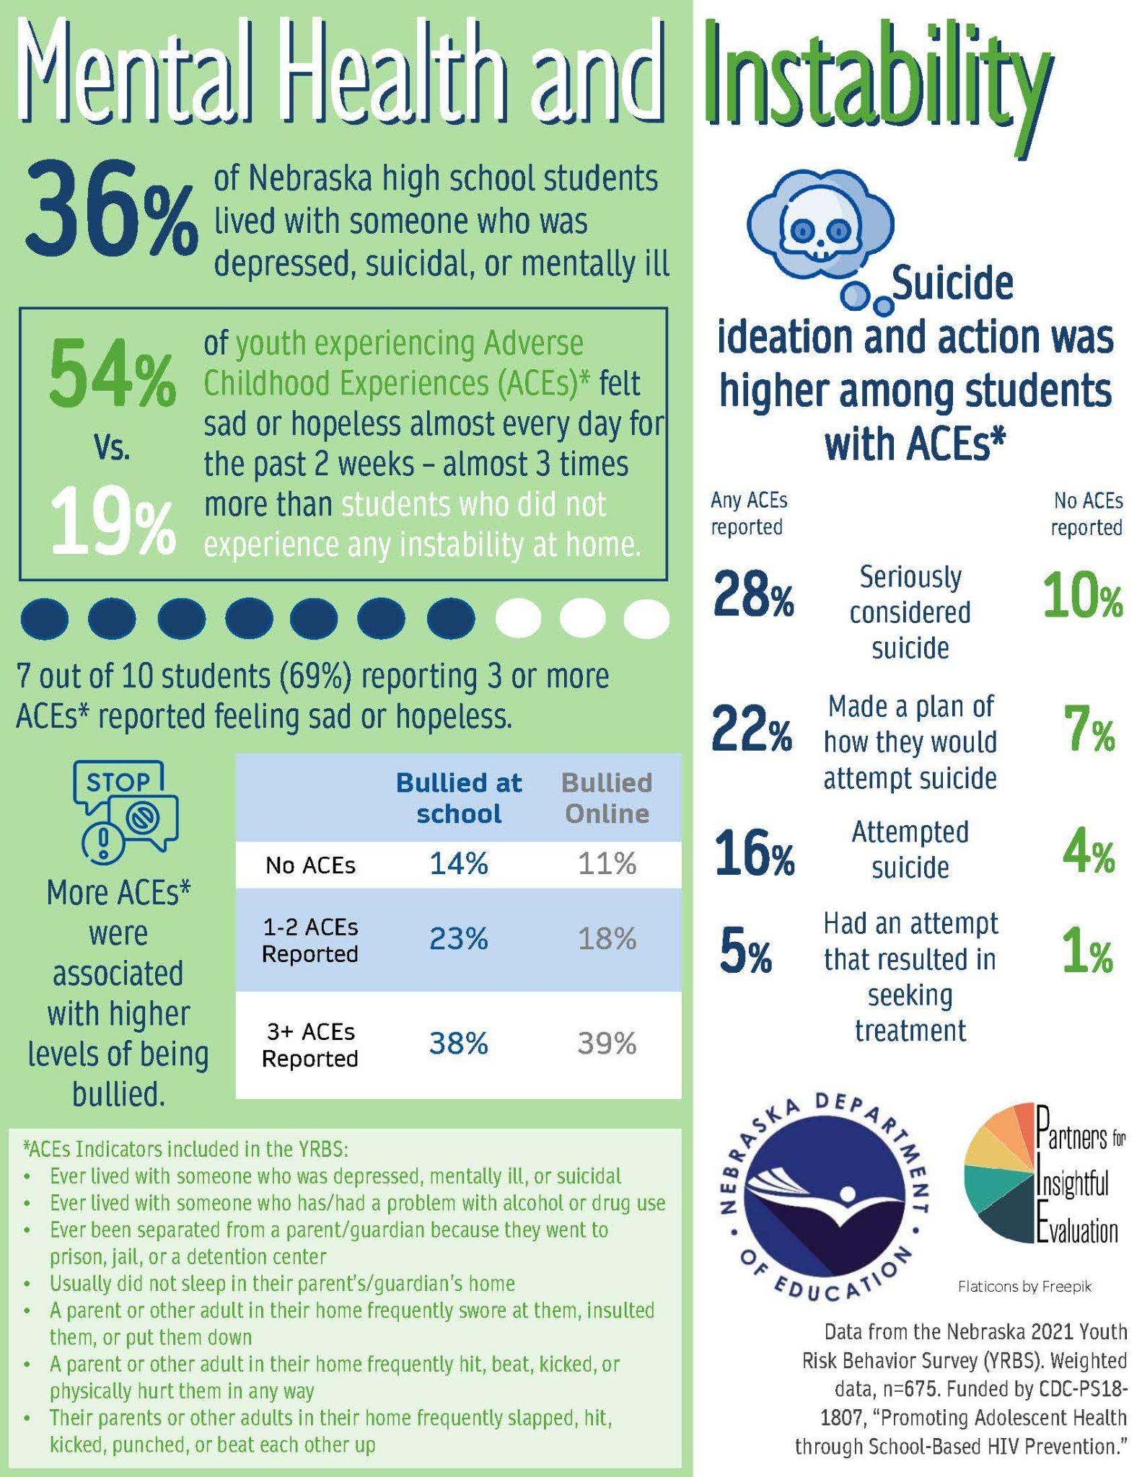
Nebraska Results
2021 Youth Risk Behavior Survey

Slide 21
Youth with
Different Levels of Assets
Notes:
Erika (slides 11-13 = 2 minutes)
50% of youth experience fewer than 21 assets. Search Institute has identified that the optimum is for youth to experience 31 or more assets. The challenge is clearly one of building up the Developmental Assets of youth, so that greater numbers of young people can experience the protective and promotional power of a stronger asset base.

Slide 22
Asset Category Groups
Record all the ways in which this asset category was built for you when you were young or is being built in the lives of youth today
Notes:
Cody -
The power of one! You are an asset builder. Let’s begin to develop your ability to build assets in young people. In small groups
Introduce yourself.
On which asset category are your focusing?
Keep in mind the ideas that were generated. We hope you’ll bring these into the larger group discussions.
A few important takeaways
Asset building is not new. It’s just that now we’re being intentional about it.
We’re choosing to more intentional about asset building and to focus on it.
Assets can be built in many places and in many ways.
The assets are intertwined. You’ll likely build more than asset, even if you are focusing on one in particular.

Slide 23
What are Asset Builders Like?
Notes:
Erika V- #12 ON PG 23
Handout #3
Being: our communities and organizations are full of people who have some of these qualities and characteristics, but if they never translate into action they have no impact. Tragically so many people don’t take action because they believe that they don’t have a role to play unless they are professionals or connected to a youth program or a school. Forty Developmental Assets works. EVERYONE is invited to play a role. The framework provides simple ideas for action.
Doing: Sometimes people are busy doing, but their actions don’t come from positive core qualities like the ones we identified in our asset builders. Their actions may actually have unintended negative effects on youth and can breed resentment because so much of the action is conditionally based on how youth respond.

Slide 24
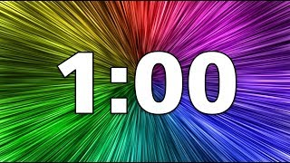
What Do Asset Builders Do?
Notes:
Erika - pg 23
Characteristics discussed reflect pieces of each of us. No one has all the characteristics, but as individuals we each bring to asset building areas of strength and points of challenge in our own being (who we are) and doing (what we do). BOTH BEING AND DOING are essential for individuals who are effective asset builders.
Self-Reflection: Review the items from Handout #3 and circle one area of personal strength listed on the handout and circle an identified area of challenge.

Slide 25
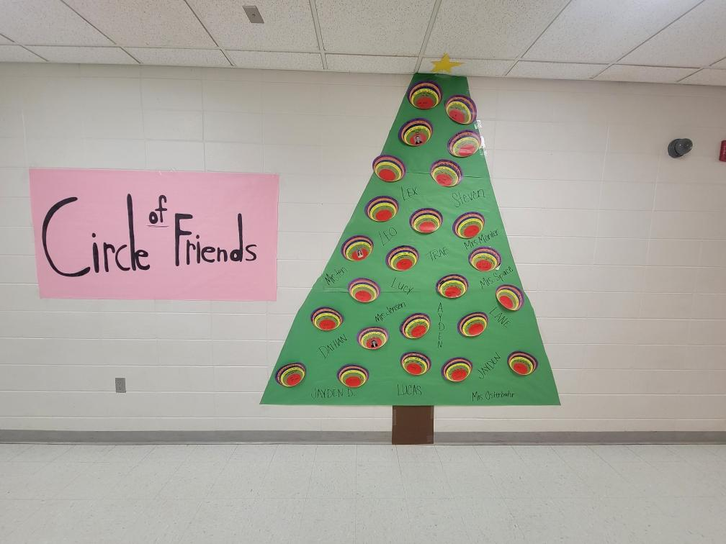
Circles of Influence
Neighborhood
Family
Work
School
Clubs
Faith
community
Friends, peers,
colleagues
Community
organizations
Notes:
Cody -
Link to Jamboard - https://jamboard.google.com/d/1bKCCiYD3VL6br1E-MJ9ay6l9wAcxJZGj6Bm73m9X76U/edit
It’s our hope that asset building becomes just part of who you are and how you look to support young people.
What’s your greatest gift in asset building? Think back to a time to someone in your life that built assets for you? How did it make you fee? What did they do? What context did they have in your life and in the lives on others?
Stephen Covey identifies circles of influence as those places where you naturally can have influence and impact. Are there areas of your life that you have greater influence or impact?
Let’s consider your own circle of influence.
Handout #4
Place your name in the innermost circle.
What areas of your life do you have influence? Write the areas of influence that you have in the circles closest to the center. Here you likely have greater capacity to build assets. You don’t need to list every areas of your life, just the ones of which you feel you can have influence.
Time to work.
Discuss with someone one area of which you’d like to focus and why that is important to you.
Now, look for someone who has a match to an area that you do and share. What strategies, ideas can you gain or give in support?
Record areas that resonate with you.
On the jamboard, list one sphere of influence on the jamboard. Use the specific group or organization.

Slide 26
Strategies for Action
Make It Possible
Make It Simple
Make the Most of Your Available Time
Commit and Don’t Forget
Now What?
How can 40 Developmental Assets be part of what you do?
Notes:
Erika - page 29
HANDOUT #5
Use to create a culture within the school or organization you are with
Where, When, How and With Who (in groups)

Slide 27
Hi! I’m an Asset Builder
Who I Am
What I Value
What I Do
Notes:
Cody
You are an asset builder. On the reverse side of your notecard, share you who are, what you value, and what asset building action you will do. We encourage you to have this handy, tack it up next to your desk or put it somewhere you will see it. Be intentional because you are an asset builder.

Slide 28
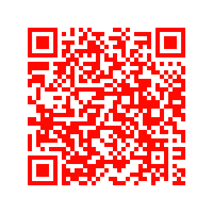
What’s Next?
Bring the training to your club, staff parents
Explore Search Institute
Surveys
Developmental Relationship training & resources
Family Connections
Explore 40 Development Asset Supplies
Future Funding possible!
Notes:
Erika
You can contact us about presenting to your school. You could also inquire about being trained as a trainer.
Preview of the developmental relationships.
Showcase books & supplies
Red QR code is search institute
Blue QR code is 40 Developmental Assets by age category

Slide 29
NDE Highlights
The Nebraska Network of Care.
Mental Health Webinars
Setting Healthy Boundaries Wednesday November 29th 3:30-4:30pm
OBJECTIVE: To empower school staff with the knowledge & skills to establish & maintain healthy boundaries in their professional roles.
School Mental Health Webinar Series
November 14th – Reframing Defiant Behaviors (Alexandra Murtaugh)
School Health Services
School Health Learning Collaborative
XX Date & time
School Safety
Psychological First Aid for Schools (PFA-S) Team Virtual Training
February 20-21, 2024 Register here
Youth Risk Behavior Survey Results
School Health Profiles Survey
Nebraska School, Family, and Community Engagement Framework
This Framework is a tool to help Nebraska educators as they reach out to families and community partners.
Notes:
Erika

Slide 30
NDE Fine Arts
Resources
Upcoming Work
APL for Arts Educators for students working with divergent needs
Supporting students with artistic creation in collaboration with NDE School Based Mental Health Team
NFTA - Supporting Your Arts Education Program
Notes:
Fine Arts Exchange
In its second year, the Fine Arts Exchange is a hybrid event designed to connect arts educators with arts organizations (nonprofits and state agencies) that have opportunities to extend, enhance, and enrich arts learning. This year will includes 39 visual art, music, and theatre organizations from across Nebraska. New this year! You can meet arts org staff members via zoom.
The 2023 Fine Arts Exchange website is coming soon. You can view the first four newsletters of the Exchange: No. 1, No. 2, No. 3, No. 4, No. 5, No. 6
Professional Learning Recordings
NDE Fine Arts, Nebraska Art Teachers Association (NATA) and Smithsonian American Art Museum (SAAM)
Art Museums Can Help Me Teach? - February 2023
Recording
Slide Deck
More Ways Art Museums Can Help Me Teach - March 2023
Recording
Slide Deck
Recordings and Slide Decks are available on the NDE Fine Arts Education Website
Smithsonian American Art Museum, presenter
Nebraska Art Teachers Association, co-sponsor
Arts Education Data Project
In addition, Nebraska is also preparing for entry into the Arts Education Data Project (AEDP) through an opportunity and partnership with the Nebraska Arts Council.
The AEDP is a national project that takes publicly reported arts education enrollment, access, and participation data, standardizes it, and provides the information in interactive, publicly available, data visualization dashboards. The project will allow us, as decision makers, to make better data-informed decisions regarding arts education in Nebraska.
You can look at other state's arts education data at artseddata.org.
The project currently has over 30 states participating and can be accessed at artseddata.org. A national report from 2019 is also available. In 2019, only 19 states were involved in the project. Click on the map of participating states to go into each states data dashboard.
You can learn more about the Arts Ed Data Project at artseddata.org.
Other Resources available from NDE Fine Arts.
Visit education.ne.gov/finearts/ to learn more.

Slide 31
Thank You!
QUESTIONS?
Erika - erika.wibbels@nebraska.gov

