Slide 1
Conservation Education
Program
Conservation Education (CE) at the Nebraska Forest Service connects Nebraskans, especially youth, with our state’s trees and forest resources to inspire the next generation of tree planters and conservation stewards.

Slide 2
Viewpoints on the Line…
On a scale of 1 (Completely Disagree) to 10 (Complete Agree) how do you feel about the following statements? Put them in the chat.
It is important for people to preserve wilderness areas.
Damage to the environment is the biggest problem facing humanity today.
The government is doing a good job of protecting our country’s environment.

Slide 3
What is
Environmental Literacy?
An environmentally literate person as someone who, both individually and together with others, makes informed decisions concerning the environment; is willing to act on these decisions to improve the well being of other individuals, societies, and the global environment; and participates in civic life.
North American Association for Environmental Education (NAAEE) www.naaee.net/framework

Slide 4
KNOWLEDGE
Physical, ecological, social, cultural and political systems
North American Association for Environmental Education (NAAEE) www.naaee.net/framework

Slide 5
KNOWLEDGE
DISPOSITIONS
Physical, ecological, social, cultural and political systems
Feelings towards the environment. sensitivity to environmental issues and the motivation to work for a more positive future
North American Association for Environmental Education (NAAEE) www.naaee.net/framework

Slide 6
KNOWLEDGE
DISPOSITIONS
Physical, ecological, social, cultural and political systems
Feelings towards the environment. sensitivity to environmental issues and the motivation to work for a more positive future
COMPETENCIES
the skills to investigate, analyze, evaluate, and make informed decisions
North American Association for Environmental Education (NAAEE) www.naaee.net/framework

Slide 7
KNOWLEDGE
DISPOSITIONS
Physical, ecological, social, cultural and political systems
Feelings towards the environment. sensitivity to environmental issues and the motivation to work for a more positive future
BEHAVIOR
the ultimate expression of environmental literacy, how we chose to live our lives at home, in community, and in the world
COMPETENCIES
the skills to investigate, analyze, evaluate, and make informed decisions
North American Association for Environmental Education (NAAEE) www.naaee.net/framework

Slide 8
Core Services
We inspire the next generation of conservation stewards through:
Educator Professional Development (Project Learning Tree & WET)
Direct Outreach
Field Trips to the Forest
Conservation Contest Support

Slide 9
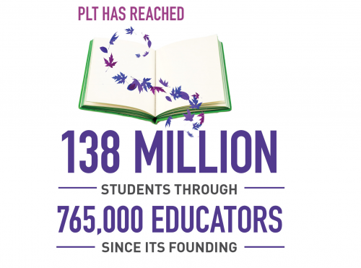
About Project Learning Tree & WET
Comprehensive K-12 Interdisciplinary Environmental Education Programs:
Project Learning Tree started in the 1970’s.
Project WET started in the 1980’s.
The activities help students learn how to think, not what to think about complex environmental issues.
Environmental Education Curricula Works! Most trained educators report that they use it at least monthly.
In Nebraska, Both programs are coordinated by the Nebraska Forest Service; however, Your Nebraska Forest Service in tandem with +50 partner organizations, 35 volunteer facilitators, and 20-member steering committee work tirelessly to empower educators with the training and tools they need to integrate high-quality, non-biased environmental education curricula into the lives Nebraska’s children..

Slide 10
Good for Afterschool
Bloom Box @School
Tree Trunks
Educator training coupled with a Pollenator Garden or Trees for your school!
Partnerships with 7 community-level organizations to host Educator Trunks
Youth Outreach
Educator Trainings
PLT/WET training for your staff
NFS staff or partners visiting your school/program

Slide 11
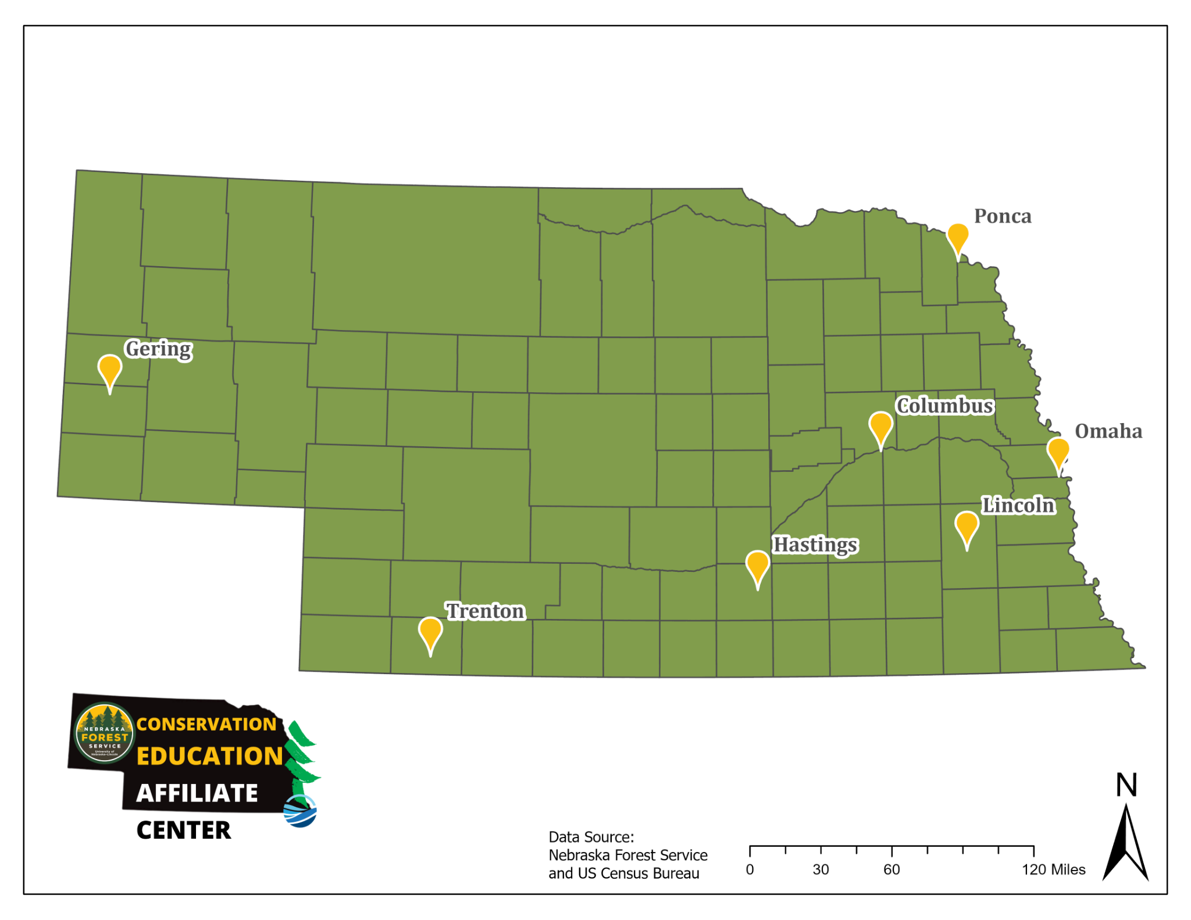
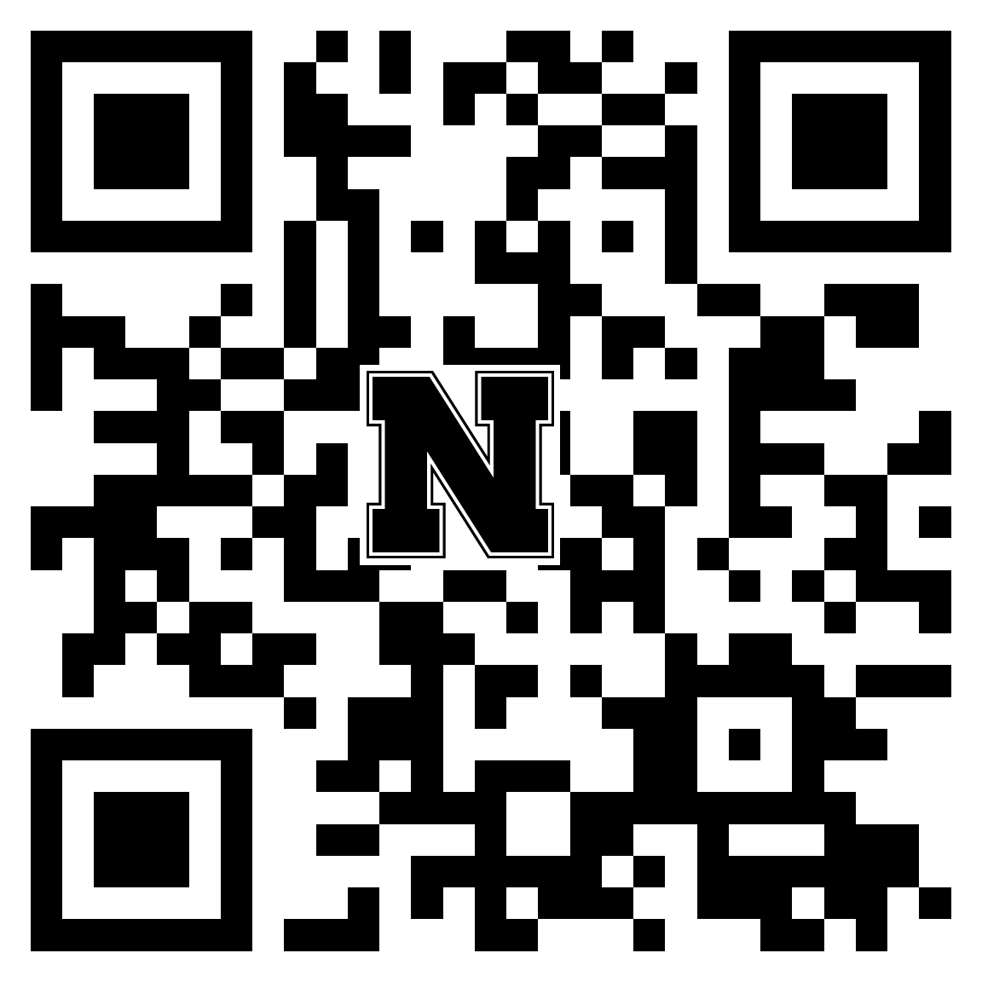
Innovative Practice

Slide 12
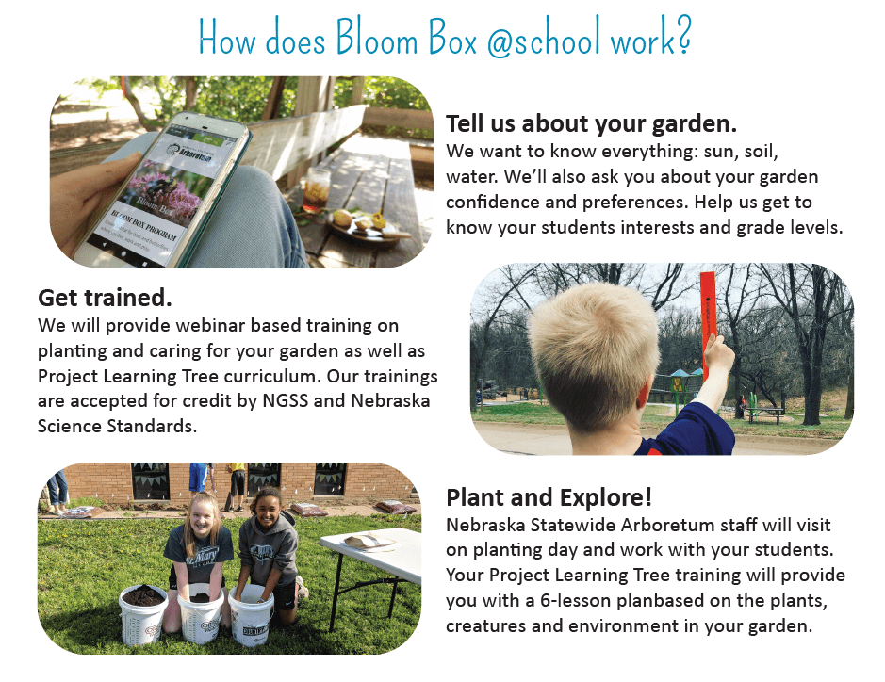
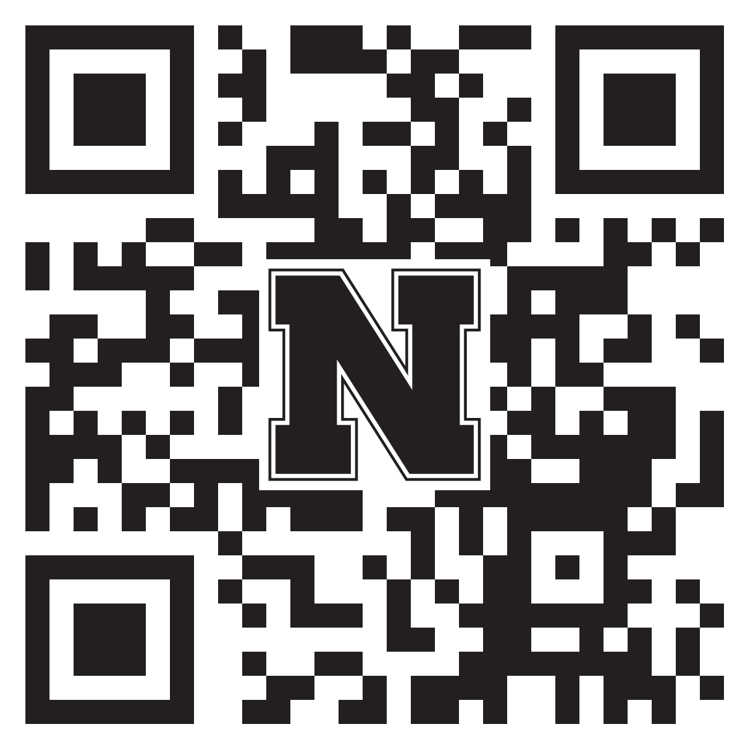
Innovative Practice

Slide 13
Testimonial: Mitchell Public Schools

Slide 14
Testimonial: Mitchell Public Schools

Slide 15
Innovative Practice

Slide 16
Thank You!
“Far and away the best prize that life has to offer is the chance to work hard at work worth doing”
~Theodore Roosevelt
Jack Hilgert
Jack.Hilgert@unl.edu
402-472-9727

