Slide 1
NSCAS 2023-24
and Beyond

Slide 2
Statewide Assessment Staff
Director – Trudy K Clark, Ed.D.
Assistant Director – Cassandra Seiboldt
Assessment Program Coordinator - Margaret Sis
Special Education Assessment Liaison - Sharon Heater
ACT Coordinator, Onsite Liaison for the NDE – Iris Owens
Competitive Grants for State Assessments Specialist - Rhonda True
Senior Professional Learning Consultant - Aly Martinez Wilkinson
NAEP Coordinator – Polly Bowhay

Slide 3
Thank you!!!!
Thank you to all the educators that participated in
Item writing
Alignment studies
English Language Arts Achievement Level Descriptor reviews
English Language Arts instructional supports reviews
Math extended indicator review
Standard setting and policy reviews
that took place this spring and summer!!! You have amazing educators in your buildings! We appreciate them giving us their valuable time!

Slide 4
Agenda
NSCAS 2023 – 2024
What to expect
Reminders
Test Dates
Assessment Roadshow
And beyond
ACT
NAEP
Science
Formative Assessment Supports Network (FASN)

Slide 5
What to expect 2023-2024
NSCAS Growth optional fall & winter, required in spring
MAP Growth K-10 optional fall, winter, spring
Test design – 2 grades above, no floor
Depending on the student, he/she may not access the full blueprint in F/W
Only in spring will student be guaranteed to meet the blueprint – accountability score comes from spring
First 27 items on-grade level items form the basis of the proficiency/accountability score
All 40-45 items form the basis of the RIT score (with the exception of those items measuring writing standards)
NSCAS Growth RIT will report to the hundredth place, like MAP Growth RIT, & will populate MAP Growth Reporting Suite as it did in spring 2023 if it has the smallest SEM

Slide 6
Reminders
“Because you enter the data, you control its accuracy!”
ADVISER data is generated by the district through scheduled bridges between your SIS and ADVISER
Run regular comparisons of your students’ names and DOB between your SIS and ADVISER Person ID
Name and DOB corrections must be made within ADVISER Person ID
If you use Preferred names in your SIS, then populate this information in ADVISER Person ID as well.
When NDE pulls NSCAS rosters the Preferred names are pulled first, if blank then we pull legal names
Ensure all SPED data has been bridged accurately to ADVISER Validation
Disability and the Assessment Student data element are the most common errors on SPED records

Slide 7
Reminders…
Ensure student enrollment and demographics are bridged accurately to ADVISER Validation
Resident districts are still responsible for reporting any students attending an external program (Rule 18 program, ESU program, or approved contracted service)
Resident districts are still responsible for NSCAS testing these students attending an external program
This includes students that a ward of the court or state
Foreign exchange students in the high school 3rd-year cohort are expected to participate in the NSCAS ACT (accommodations are available)
New EL students are expected to participate in the appropriate NSCAS test, including Recent Arrivals (accommodations are available)
ADVISER does have Error Reports that should be checked regularly

Slide 8
Keep in Mind…
Computer adaptive tests select items that are tailored to a student’s performance throughout the assessment.
Items get easier or harder based on a student’s response to any given item
Items can be difficult or easy for students even within grade.
On the diagnostic portion of NSCAS, the algorithm selects items based on the difficulty level of the items, not its grade level.
A student in 7th or 8th grade could see items aligned to 9-12th grade level standards because they are treated as one grade.
A student in 6th grade could see items aligned well below grade level because of the item difficulty.

Slide 9
Keep in mind…
A student’s RIT score is calculated based on a mixture of student responses (i.e., right/wrong) and item difficulty.
Cannot compare number of right or wrong items – more nuanced
Also impacting student score…
Specific set of items & item difficulty
Student results on specific domains (e.g., numbers, algebra)
Total number of points a student receives on an item
The number of diagnostic items

Slide 10
Keep in mind…
Item difficulty is referred to in terms of how likely a student is to correctly answer the question based on their ability level.
NSCAS Growth item difficulty is set with the barely proficient student in mind (i.e., a student’s score is right at the cut score for proficiency).
Easy = the student has a 75% probability or better of answering correctly
Medium = the student has between 40% and 75% probability of answering correctly
Hard = the student has a 40% probability or less of answering correctly

Slide 11
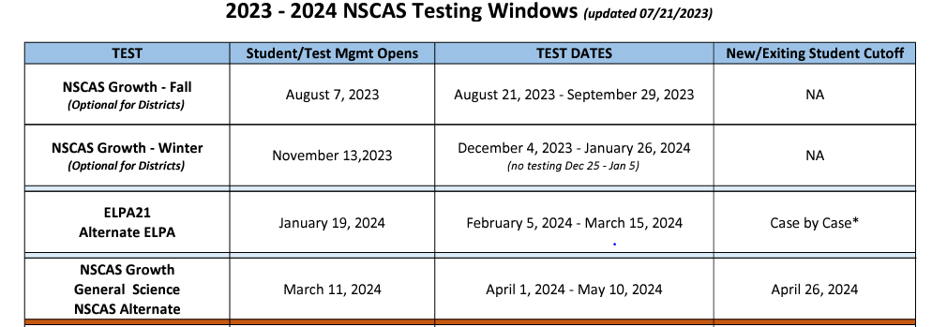
Test Dates

Slide 12
NSCAS Roadshow
The Assessment Team will visit the following locations and provide updates.
Kearney – September 6 (Great Platte River Road Archway)
Norfolk – September 7 (Lifelong Learning Center)
Scottsbluff – September 12 (ESU 13)
Lincoln – September 19th (Courtyard by Marriott)
Omaha – September 26th (TAC Board Room)

Slide 13
and beyond…ACT

Slide 14
NSCAS ACT Iris Owens
Overview of 2022-2023
What is new for 2023-2024
Test Dates and Makeups
Lessons Learned
PreACT and ACT Online Prep
Resources Page

Slide 15
NSCAS ACT REPORTING UPDATE
NDE is currently working on finalizing the data for spring 2023 testing for ACT.
The date for final NSCAS ACT data found in Success as well as reports to download will be available on FRIDAY, AUGUST 11, 2023.
This data, along with all NSCAS data, is embargoed until the NDE Portal is open to the public, that date has yet to be determined.

Slide 16
What’s New for 2023-2024
EBAE has been retired as a Braille Test Option
Prohibited Behavior policy is updated
Calculator Policy will no longer be shipped with test materials
Styli for iPad Approved for Online Testing
Video Monitoring Systems Policy Added to Test Administration Manuals
Pre-recorded Audio
Proctor Caching No Longer Recommended
Extended Online Testing
Notes:
EBAE has been retired as a braille option. ACT will continue to offer UEB Math/Science and UEB with Nemeth forms to support our blind and visually impaired students.
Thanks to Dr. Trudy Clark’s persistence, The ACT Prohibited Behavior policy has been updated. Examinees who have been dismissed for prohibited behaviors will be allowed to retest.
The ACT Calculator Policy will no longer be shipped with test materials. Please see the link in the resources page of this slide deck.
ACT does not allow closed-circuit television (CCTV) in the test center/site. Please disable or cover CCTV cameras in the testing room. If your test center/site must use CCTV cameras in the testing room, and they cannot be removed, you must take steps to ensure the cameras are not positioned to capture test content during testing. The test center's/site's use of video monitoring and storage of recordings must fully comply with the laws of your jurisdiction, and you agree that the recording is not done at ACT's request. As a reminder, no other cameras are allowed in testing rooms.
Pre-recorded audio is no longer distributed on USB drives. Pre-recorded audio will be available via the internet. Information will be provided in the Pre-recorded Audio Supplement, which will be posted on your test administration platform home page closer to test dates. If you are unable to access pre-recorded audio via the internet, contact ACT for options.
ACT no longer recommends proctor caching for online testing, and the proctor caching process has been removed from test administration manuals. Eliminating proctor caching will simplify technical readiness documentation from ACT and reduce setup complexity for sites, while not increasing online testing risks.

Slide 17
Test Dates and Makeup Opportunities
NSCAS ACT 2023-2024 Test Window Dates
NSCAS ACT 2023-2024 Test Window 1 Initial
Standard Administration (Paper): March 26, 2024
Accommodations Administration (Paper): March 26-29 & April 1-5
Standard & ACT-Authorized Accommodations (Online): March 26-29 & April 1-5
NSCAS ACT 2023-2024 Test Window 2 Initial and Makeup
Standard Administration (Paper): April 9, 2024
Accommodations Administration (Paper): April 9-12 & April 15-19
Standard & ACT-Authorized Accommodations (Online): April 9-12 & April 15-19
NSCAS ACT 2023-2024 Test Window 3 Make-up Only
Standard Administration (Paper): April 23, 2024
Accommodations Administration (Paper): April 23-26 & April 29-30, May 1-3
Standard & ACT-Authorized Accommodations (Online): April 23-26 & April 29-30, May 1-3

Slide 18
NSCAS ACT- Lessons Learned
Misadministrations 2023: 16 misadministrations were investigated, a rise of 100% over the 2022 numbers
Missing test times, timing overages and wrong test materials were the issues
Testing with unauthorized or unapproved accommodations
Irregularity reports also mentioned bells and announcements were reported as interruptions to testing
Online issues included firewalls not allowing access to the online platform, lack of internet access and sessions set up incorrectly

Slide 19
NSCAS ACT- Lessons Learned
Prohibited Behaviors 2023: 65 prohibited behaviors ended in voided scores; this is slightly less than with previous years.
Working ahead or behind
Electronic Device going off during testing
Disruptive behavior

Slide 20
NSCAS ACT
External Programs, Foreign Exchange and Alternate Students
If you have a 3rd year cohort student who is enrolled in your district, and is not an alternate student, they are expected to test.
Work with the external program directly or contact Iris or Maggie for assistance. If the student has accommodations, the district/school is expected to request the accommodations for the ACT.
Foreign Exchange students that are part of the 3rd year cohort are expected to test, as are EL students, including New Arrival students.
ACT does not have an Alternate test, either students will use the standard test or accommodations materials with ACT approval.

Slide 21
District Choice PreACT
Fall and Spring Ordering and Test Windows
PreACT Fall- You may order materials from August 21-November 1, 2023. The test window is October 2– November 22, 2023.
PreACT Spring- You may order materials from January 22- March 22, 2024. The test window is March 4 – April 12, 2024.

Slide 22
PreACT Ordering Update-ACT Central
ACT has created a new platform for ordering and access for systems called ACT Central
On July 31, 2023, ACT will have migrated all logins to the new system.
If you or your staff have a login for the CCRIS system for ACT orders such as PreACT or ACT fee waivers, this will be a new platform to login.
Emails will be sent to all users on July 31 with details on how to login.

Slide 23
District Choice- ACT Online Prep (AOP)
ACT Online Prep offered to almost 3,000 students, only 740 participated
This year the opportunity to use AOP will be available on August 1, 2023.
New website with new videos and helps
Webinar on August 8 at 10 am CT, link for registration

Slide 24
NSCAS ACT RESOURCES
ACT-Nebraska Website
NDE NSCAS ACT Page
PearsonAccess next
ACT Success (Online Reporting and Accommodations)
Iris Owens- iris.a.owens@act.org 531-207-9019
ACT Customer Service 800-553-6244 x 2800
ACT Accommodations 800-553-6244 x 1788 ACTStateAccoms@act.org

Slide 25
and beyond…NAEP

Slide 26
NAEP (National Assessment of Educational Progress)
NAEP 2024
Schools are randomly selected for participation by NAEP statisticians
NAEP participation is required by the U. S. Department of Education
Grades 4, 8 and 12 will be assessed in mathematics and reading
Grade 8 grade will be assessed in science

Slide 27
NAEP (National Assessment of Educational Progress)
Assessment Window-January 29 through March 8
Districts/schools will be notified via email in August if they have been selected
100 districts and 200 Nebraska schools will be selected to participate
Every school will continue to designate a building testing coordinator

Slide 28
NAEP (National Assessment of Educational Progress)
*New this year-every school will designate a technology coordinator
NAEP assessment team will continue to bring equipment and coordinate testing in each building
Please contact NAEP Coordinator-Polly Bowhay with any questions.
531-207-4252
polly.bowhay@nebraska.gov

Slide 29
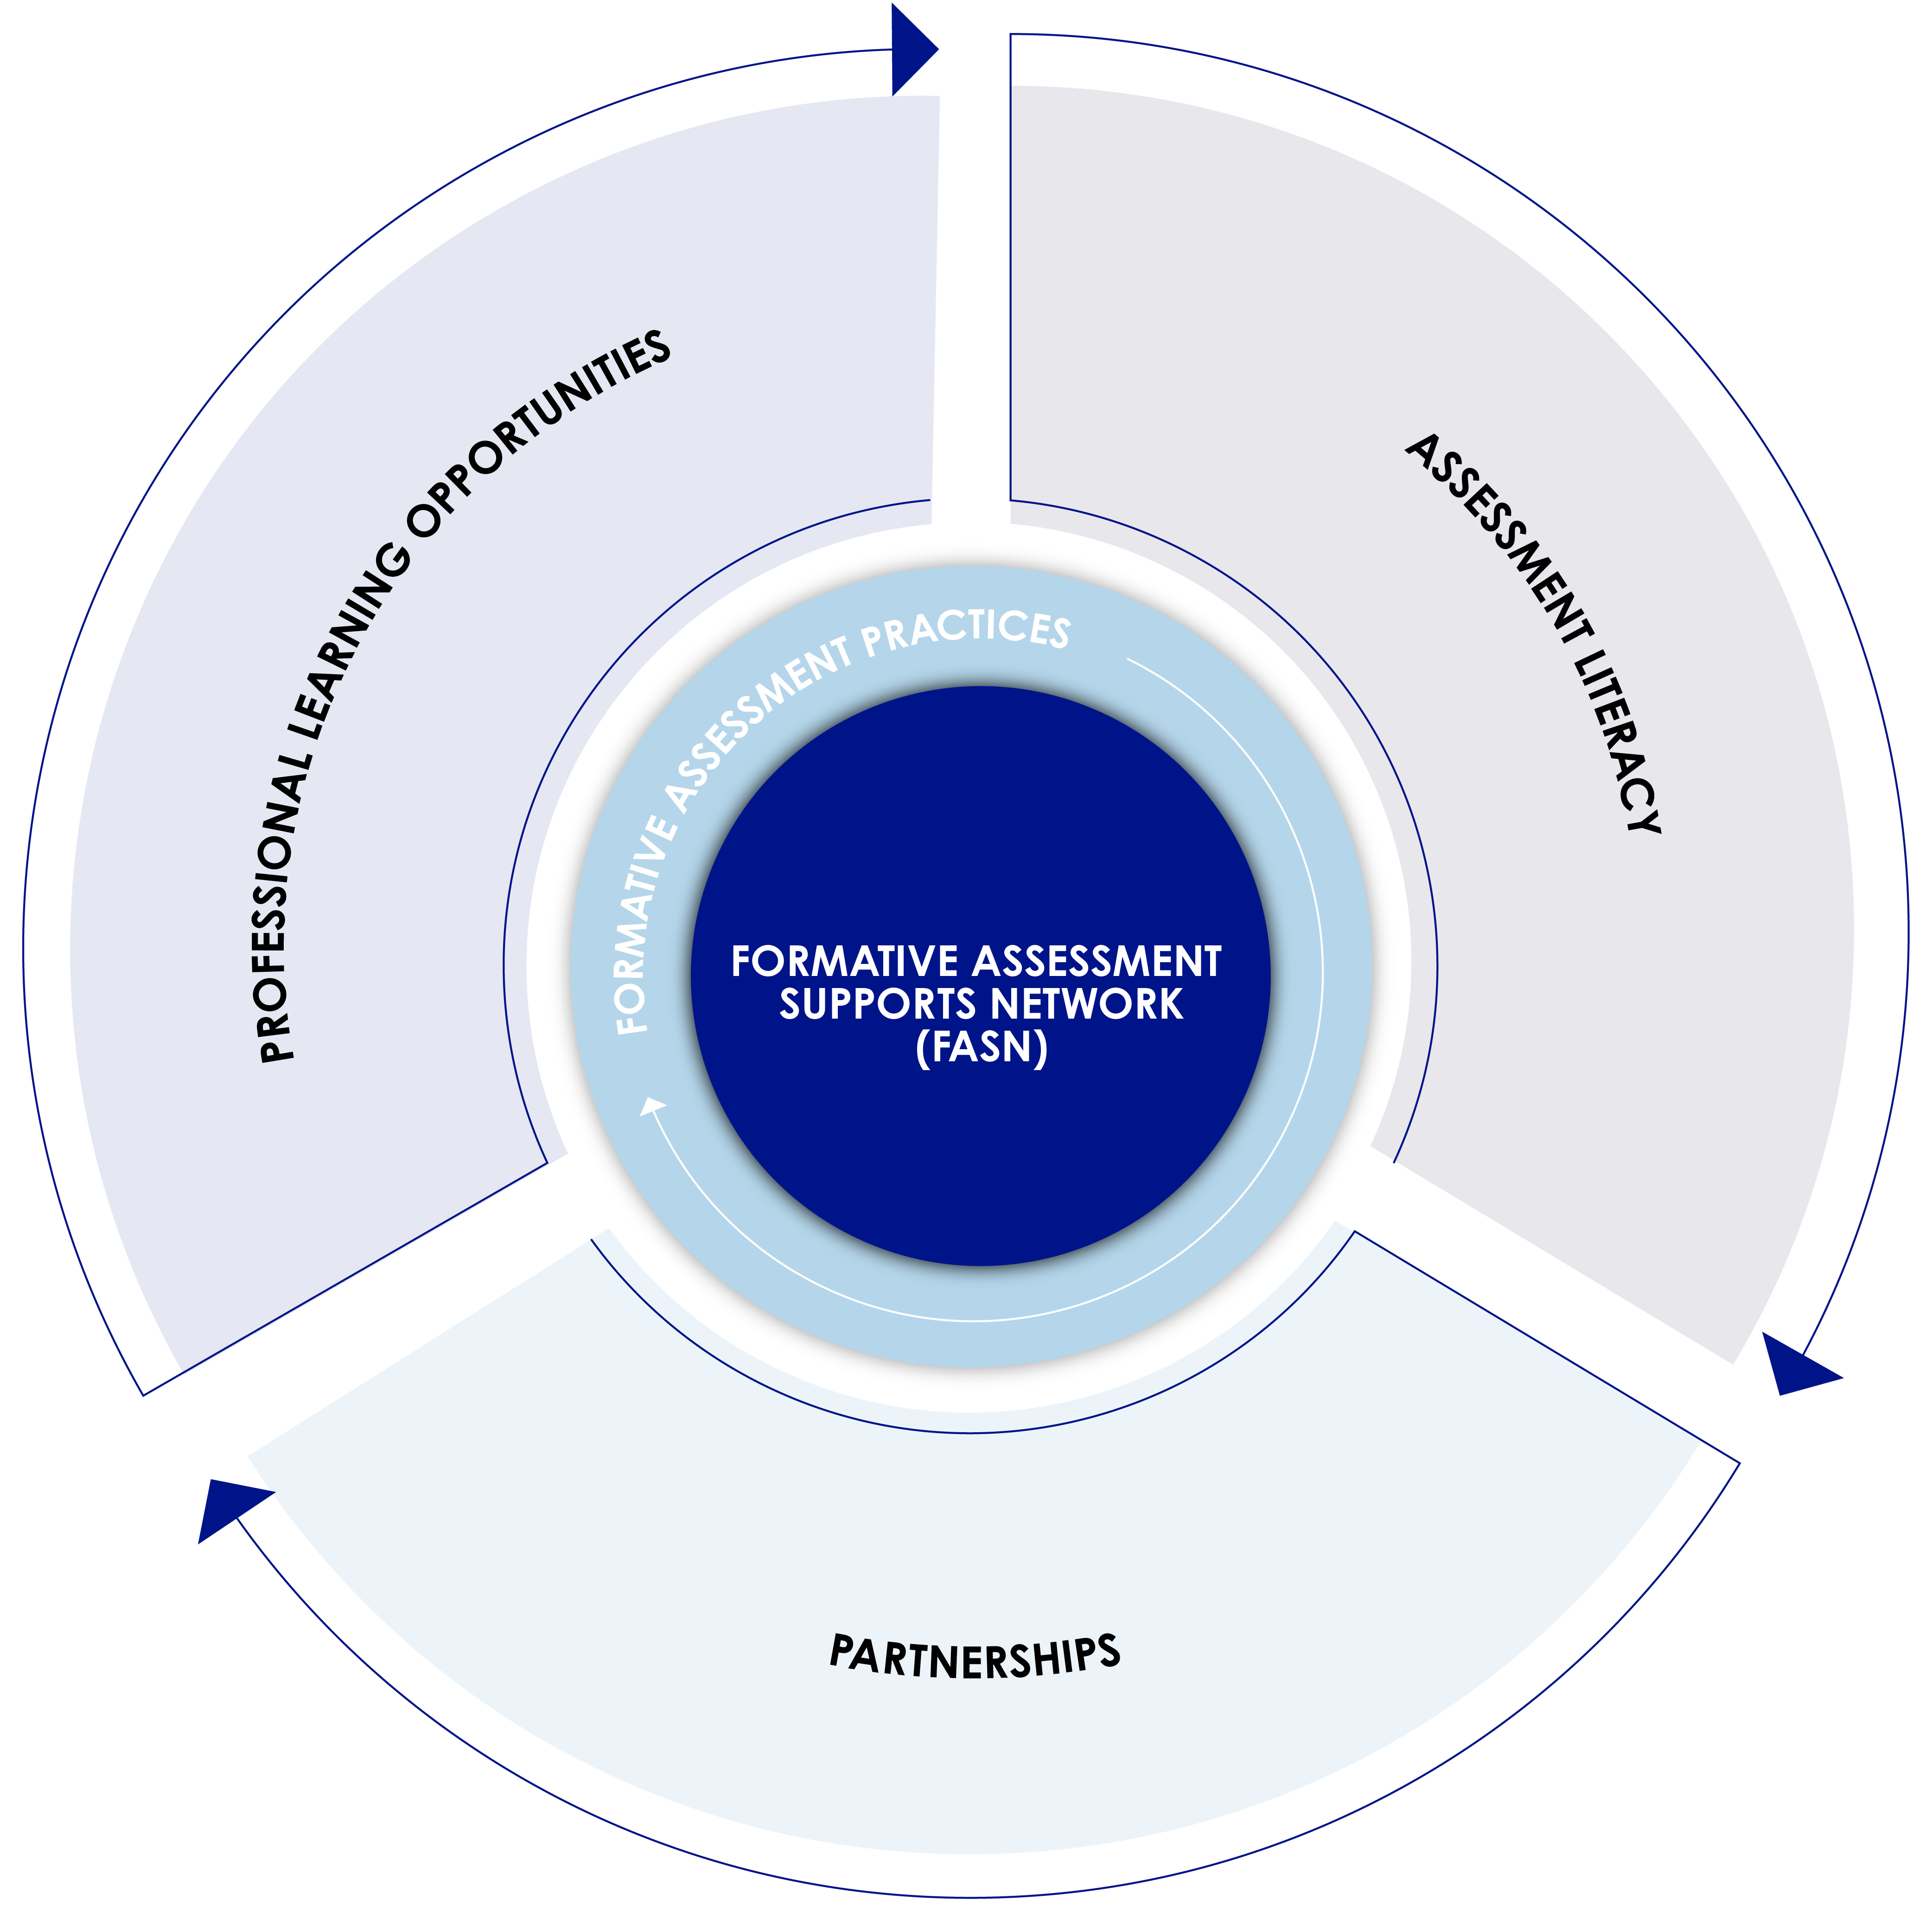
and beyond…Formative Assessment Supports Network

Slide 30
Formative Assessment Supports Network
Formative Assessment Supports Network
A system of supports for Nebraska educators designed to advance assessment literacy and focus on the implementation of formative assessment practices to strengthen effective instruction and propel student learning statewide.

Slide 31
What are the supports?
Professional learning for all program participants
Coaching for teachers
Professional learning communities
Coaches’ network
Customized professional learning for coaches
Professional Learning consultant support for coaches
Asynchronous learning resources

Slide 32
Empowering learning
“The success of formative assessment as an enabler of learning depends on the knowledge and skills of teachers to implement this approach in collaboration with their students . . . .”
—Margaret Heritage
Source: Margaret Heritage, “Formative Assessment: An Enabler of Learning,” Better: Evidence-Based Education (Spring 2011): 19.

Slide 33
Science Classroom Formative Task Repository
Link Password- ScienceFA
K-12 science tasks aligned to the standards at the indicator level and written by Nebraska educators.
Includes:
administration & scoring guidance for teachers
design tools
learning modules
blank templates
5th & 8th grade end of unit tasks (EOUs) aligned to bundled NE standards/indicators and developed by SIPS grant work.
Includes:
4 EOUs per grade level (Interim)
Crosswalk of the EOU bundles to NE standards
Scoring guidance for teachers
Instructional Framework for each unit
Developed with the same processes as NSCAS Science summative

Slide 34
Thank you!
Questions?

