Slide 1
NSCAS Growth 23–24 Test Administration Training
July 2023

Slide 2
Testing Time and Scheduling Recommendations
Grade Level | Content Area | Approximate number of test questions | Estimated test taking time
3–8 | Mathematics | 40 | 90 minutes
3–8 | English Language Arts | 40 | 90 minutes
Districts/Schools have flexibility in scheduling tests
Testing times are M–F, 6:00am to 7:00pm CT.
Recommendation – end testing by 5:00pm CT on Fridays.
Recommendation: One to two sittings each for ELA and Math
Schools may schedule two sessions per subject as a local decision.

Slide 3
NSCAS Overview
NSCAS Growth Subjects and Grades
English Language Arts and Mathematics (College and Career Ready Standards) Grades 3–8
Test Windows
Fall: August 21,2023–September 29, 2023
Winter: December 4, 2023–January 26, 2024
Modes of Delivery: Online and Paper/Pencil
*Paper/Pencil Assessments & Item Type Samplers in English/Spanish available to print on Nebraska Assessment Portal
*Braille available for order

Slide 4
Testing Time and Scheduling - Recommendations and Considerations
Estimated test taking time does not include:
Test ticket distribution.
Launching the secure browser.
Student log in.
Students’ tests can be paused by logging out.
Student will be automatically logged out of the test after 15 min of inactivity.
Note: No Proctor action required for the student to resume testing, students must log back in using the information on the test ticket.

Slide 5
Technology Readiness

Slide 6
Technology Readiness
NWEA State Solutions Secure Browser
System Requirements
New Secure Testing Browser or App is REQUIRED for all devices.
https://securebrowser.state.nwea.org
Different STB than MAP Growth – "NWEA State Solutions Secure Browser“.
Device and Application
Mac Secure Testing Browser
Windows Secure Testing Browser
Chromebook App
iPad App

Slide 7
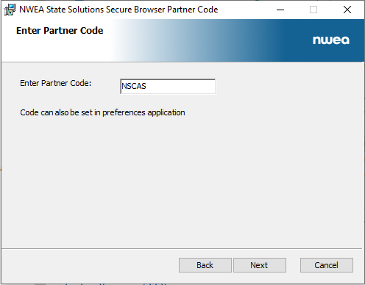
Tips for Installing the Secure Browser
Partner Code: NSCAS
Multiple Device Management installation available
Secure Browser can be downloaded from Acacia Manage or via NWEA provided link.
Note: If a previous version has been installed, it must be uninstalled before installing the new version.
Instructions for network/MDM uninstallation in System & Technology Guide.
Reminder: Turn off auto updates on student devices during the Test Administration Window

Slide 8
Supported Devices
NWEA State Solutions Secure Browser
Device | Supported OS Versions
Windows PC | Windows 10, Windows 11
Mac OS | 12 and 13
Chromebook | Release Channel Only – version 109 or later
iPads | iOS 15 and 16

Slide 9
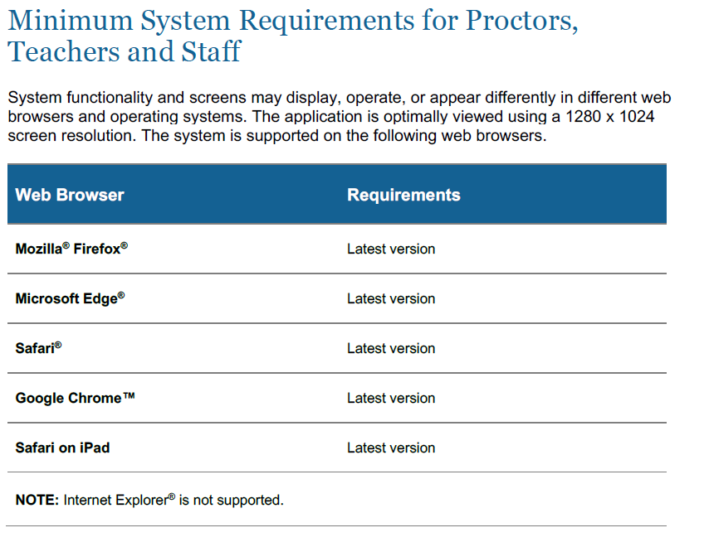
Supported Devices

Slide 10
Technology Readiness
System and Technology Guide
Navigating the NSCAS Growth Platform (Acacia)
IT Readiness
Network and System Requirements
State Solution Secure Browser installations
Allowed lists
Online Readiness Check
Upon launching the secure browser
Additional site available for checks
Notes:
ACTION' Rock will speak to how the tool is enhanced/different.

Slide 11
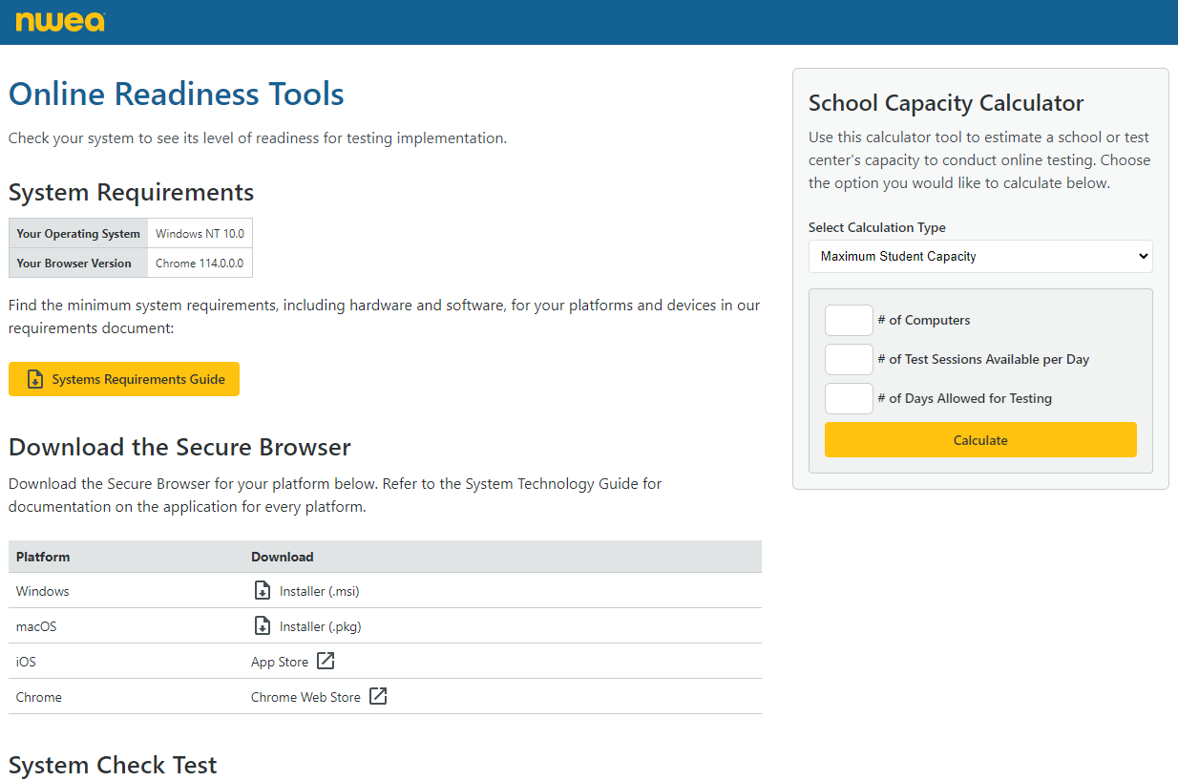
Online Readiness Checker
Resource: Online Readiness Checker
Location: https://securebrowser.state.nwea.org

Slide 12
NSCAS Growth Assessment Management (Acacia Platform)

Slide 13
NSCAS Management (Acacia)
Single-sign on connects your access from the Comprehensive Assessment Platform (MAP Growth) to the NSCAS Growth Platform (Acacia).
Use the same MAP Growth Username / Password
User roles will be managed through CAP
Same role titles in CAP and the NSCAS Platform, different permissions
After logging into CAP, users will see the NSCAS link

Slide 14
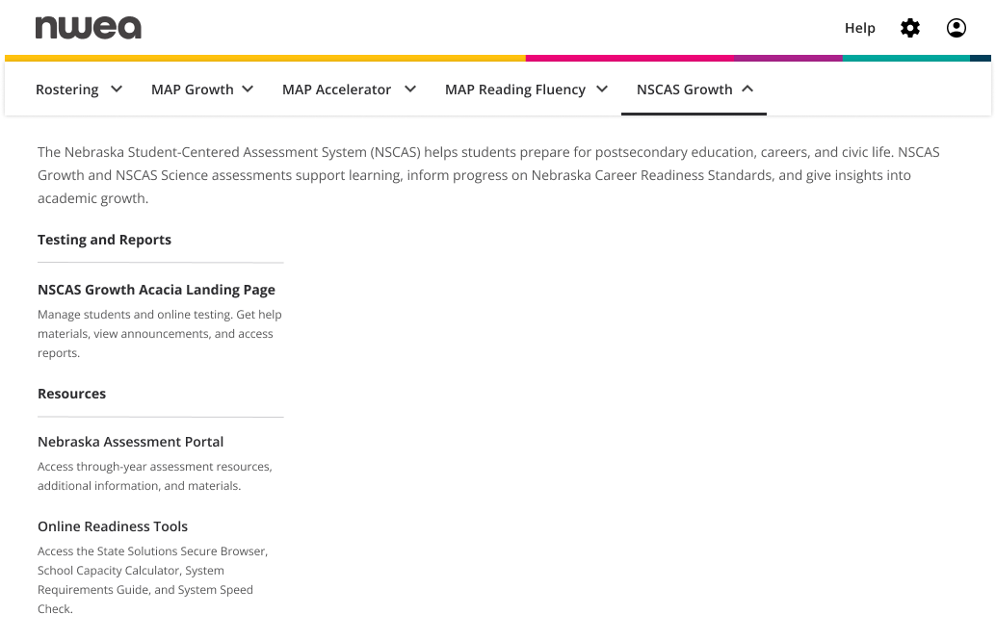
NSCAS Management (Acacia)

Slide 15
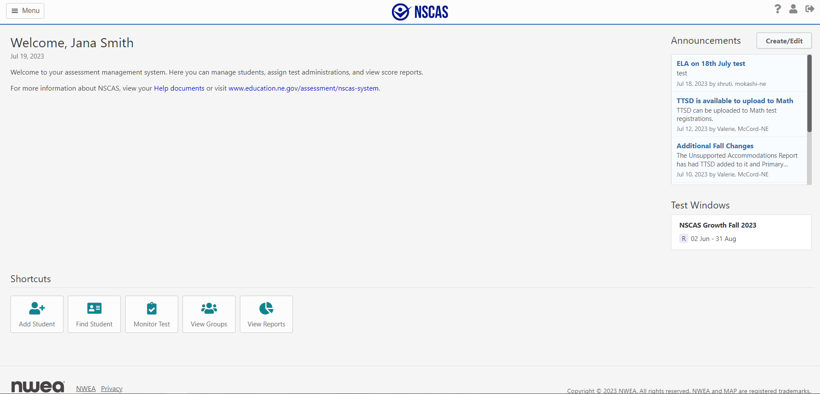
NSCAS Management (Acacia)

Slide 16
NSCAS Growth Tasks
Import Student Rosters via MAP Growth
Update/add additional Student information like accommodations and NTCs in the Registration Report and upload report
Manage online test groups (in MAP Growth)
Print Test Tickets
Monitor Student Progress
Access Reports
Data Clean Up

Slide 17
NSCAS Assessment Management Rostering

Slide 18
NSCAS Growth – Rostering
Districts will upload their student rosters to the current MAP Growth term (Such as Fall 23–24), using existing processes.
Districts using Auto-rostering solutions such as Clever can be used, however only data from the current term will be synced.
Note: If using Clever, please confirm your Term Start Date to ensure student data are synced prior to the Test Window date.
Student updates must be made prior to the sync to get the information into MAP. (e.g., Grade 8 students from 2022/2023 will be rostered/registered again if their grade isn't updated before the sync starts for 2023/2024.
Student information will be synced to the NSCAS Growth State Platform nightly from MAP Growth starting 8/5. Changes to the term start date must be made by EOD 8/4

Slide 19
NSCAS Growth – Rostering
Districts roster their students to MAP Growth
Data syncs between MAP Growth and NSCAS Growth nightly
Student Registrations are automatically created
Updated Student information will display in NSCAS Growth
The source of truth for student data is district data uploaded to the MAP Growth system
Initial sync will:
Create student profiles for the NSCAS Growth Administration
Create Test registrations in NSCAS Growth for required tests
Data will continue to sync from MAP Growth nightly starting 8/5

Slide 20
NSCAS Growth – Rostering
It is the district’s responsibility to ensure student data are up to date in their SIS, ADVISER Systems and imported to MAP Growth.
Districts can generate the Registrations Report within Acacia’s Operational Reports to make updates to accommodations and NTCs to update in bulk.
Overnight processing is required for these changes.
The import can support 10,000 student records at once, for larger imports, please upload separate files.
Note: Student Profile information cannot be updated via the Registration File upload, as these data are coming from MAP Growth.
Please make any changes to student profiles/demographics in MAP Growth and wait for the nightly sync.

Slide 21
NSCAS Growth – Student Groups
Student Groups for Testing and Reporting will be synced from MAP Growth nightly with the other student data.
As MAP Growth is the source of truth, there will not be an ability to update Student Groups in the NSCAS Growth platform. These should instead be updated through MAP Growth and synced.
If a student moves out of the district, the district will need to unenroll the student in MAP Growth.
If the student moves out of state or another district has not enrolled the student, the unenrolled student may still appear on the NSCAS Growth roster and an NTC code will need to be added to their registered test(s).

Slide 22
NSCAS Assessment Management Accessibility

Slide 23
Accommodations
Students with disabilities must be included in NSCAS Growth and NSCAS General in the following ways:
Students may be tested on the NSCAS Growth assessments without accommodations.
Students may be tested on the NSCAS Growth and NSCAS General assessments with approved accommodations specified in the student’s IEP, 504 plan or EL plan. Accommodations provided to students must be specified in the student’s IEP or 504 plan and used during instruction throughout the year.
Districts should still ensure the student’s IEP, 504 Plan and/or EL Status is indicated on their profile in Adviser.

Slide 24
Accessibility
Universal Tools/Features
Scratch paper (lined or blank scratch paper or blank graph paper)
Math Reference Sheets: This will be available in the toolbar. May be printed from the Assessment Portal or the NDE assessment website prior to students testing online.
Embedded resources
Highlighter
Notepad
Magnify
Line Reader
Answer Eliminator
Ruler/protractor
Graph paper
Color (color contrast)
Universal Math reference sheets

Slide 25
Accessibility
Linguistic Supports
Text to Speech in English and Spanish (available for all of Math; ELA – not passages)
Spanish Translations (online and paper)
Additional non-embedded supports
Accommodations
Text to Speech in English and Spanish (available for all of Math; ELA – not passages)
Spanish Translations (online and paper)
Embedded calculator
Additional non-embedded supports
Braille and Large print
Some items on the ELA assessment assess writing skills. The prompts for these items will be read aloud.

Slide 26
Text to Speech (TTS)
TTS is available in both English and Spanish
TTS for Math is now also available as a designated feature
Students that benefit from having generated audio but do not have an IEP, 504 Plan or EL Learners
These students should regularly have access to generated audio during instruction. No student should have access to TTS if they do not use it regularly as part of instruction
Need for this accommodation will be indicated on the student’s test registration profile
Districts should still ensure the student’s IEP, 504 Plan and/or EL Status is indicated on their profile in ADVISER systems.

Slide 27
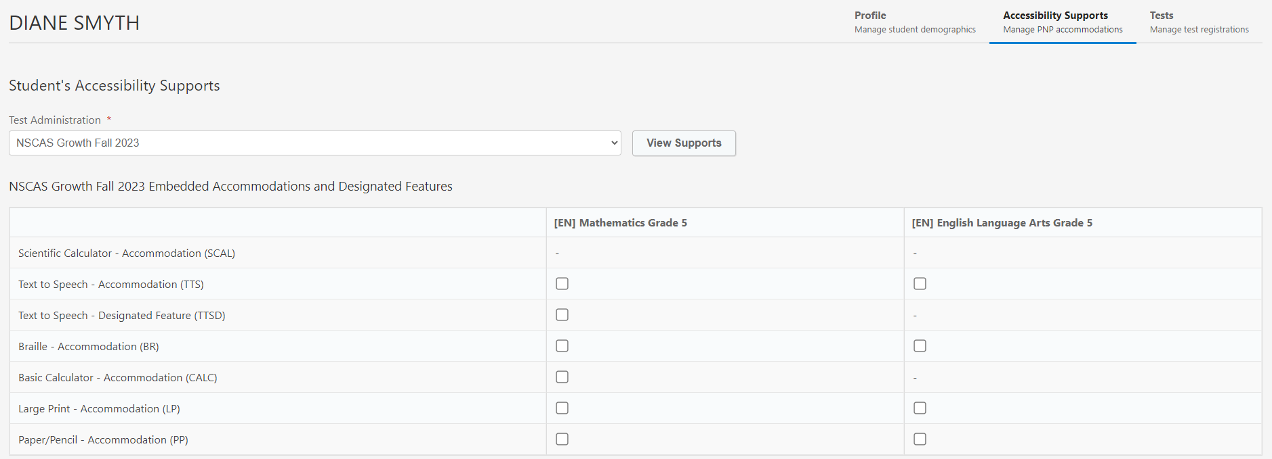
Text to Speech (TTS)
Assigning Text To Speech Accommodation Manually.
Under Student’s profile, select Accessibility Supports and the subject for TTS, then Save changes at the bottom.

Slide 28
Calculator as an Accommodation
A calculator will be available throughout the test.
Grades 3–6: Basic
Grades 7–8: Scientific
Embedded Calculator should only be available to students with IEPs or 504 plans in the NSCAS Growth Platform for Math.
Guidance is in the Accessibility Manual.
Need for this accommodation will be indicated on the student's test registration profile.
The calculator will display in the toolbar when enabled.

Slide 29
Accessibility - Paper
Paper accommodations will be available for students with a documented need.
Need will be indicated on the student profile in the NSCAS Growth Platform.
English and Spanish + Large Print – NWEA will provide a secure SFTP link to where the test materials will be posted for districts to download and print.
Braille – NWEA will ship to DAC contact.
Test materials should be securely destroyed locally.
Scribe
No answer sheets to track! Students will indicate their response by circling their answer.
After paper/pencil tests are complete, the scribe must transcribe the student's responses into the online test delivery system exactly as student has responded.
This will ensure that students' responses are scored and remove shipping and processing time!

Slide 30
Accessibility - Paper
Paper can be assigned like other Accommodations in the Student’s Profile

Slide 31
Accessibility in the NSCAS Platform
Non-embedded Universal Tools
Alternate location
Directions
Flexible scheduling
Noise buffer/Headphones
Redirection
Scratch paper
Read aloud
Non-embedded Linguistic Supports
Bilingual dictionary
Native language translation
Embedded Linguistic Supports/ Accommodations
Text to Speech English (Accommodation)
Text to Speech Spanish (Accommodation)
Text to Speech English (Designated Feature)
Text to Speech Spanish (Designated Feature)
Calculator
Non-embedded Accommodations
Assistive Technology
Mathematical Support
Specialized presentation of test
Scribe
Setting

Slide 32
Testing Location
Off-site Testing
Testing Location = district and school of attendance or enrolled.
Students testing at different buildings can be easily assigned a Testing Location during Registration.
Ex. External Programs
Proctors at these alternate locations can access test tickets to test students.

Slide 33
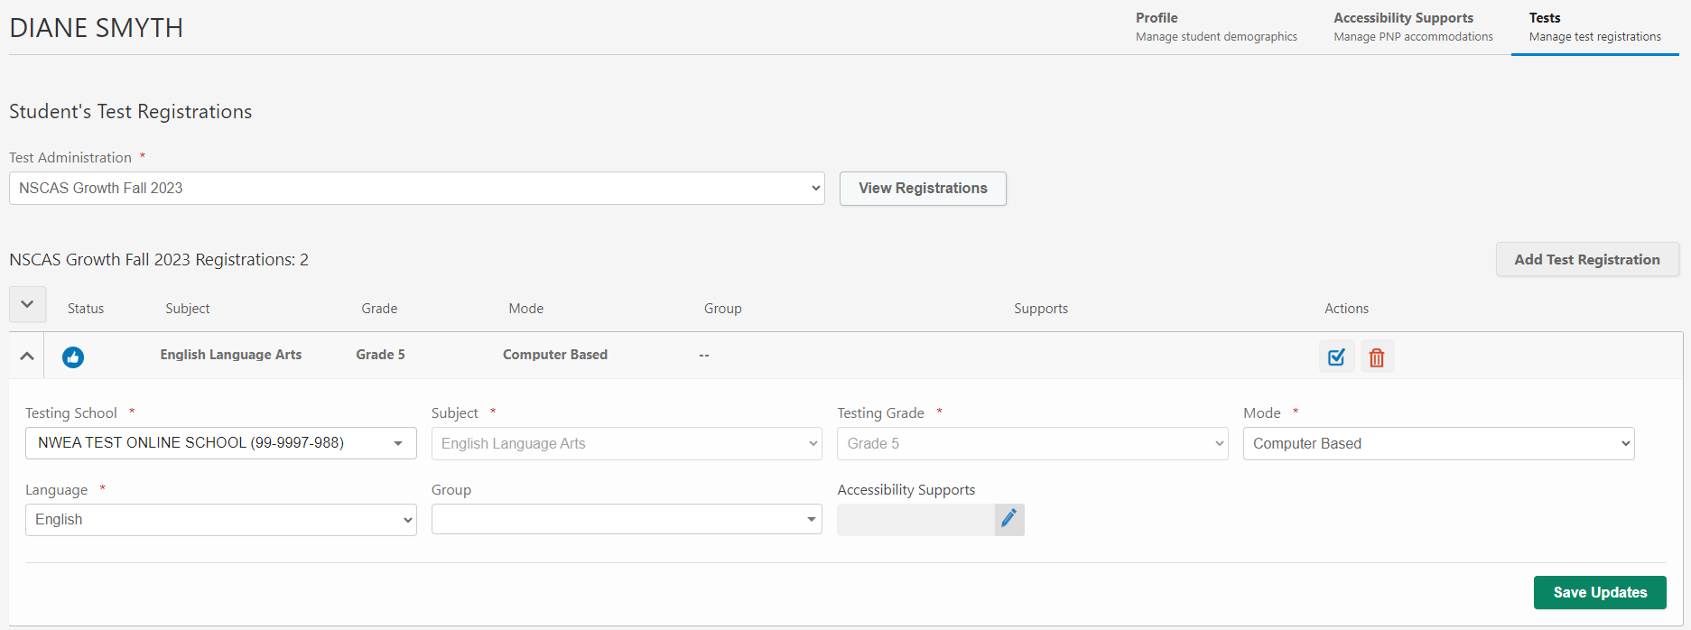
Testing Location

Slide 34
NSCAS Assessment Management Not Tested Codes

Slide 35
Not Tested Codes
Code | Description | Explanation of Use
ALT | NSCAS Alternate Assessment | Student participated in the alternate assessment.
EMW | Emergency Medical Waiver | Student was not tested due to a medical emergency. Requires NDE approval.
EXP | Exception | Student exempt from testing due to circumstances, such as student requiring an unavailable accommodation; student is attending an out-of-state facility; or testing irregularities. Requires NDE approval.
FTE | Not Full Time | Full-Time Equivalency is less than 51% so the student is excluded from testing. NDE will verify.
INV | Invalid | Student's assessment was invalidated; such as security breach or student refuses to finish test. Requires NDE approval.
LBW | Left Before Window | Student withdrew from district/school BEFORE the test window(s) began.
NCE | Not Currently Enrolled | Student was not enrolled in the district/school during testing window.

Slide 36
Not Tested Codes
Code | Description | Explanation of Use
OTH | Other | Student was not tested for reasons not covered by other descriptions. For example, occurrence of a natural disaster. Requires NDE approval.
PAR | Parental Refusal | Student was not tested because of a written request from parent or guardian.
STR | Student Refusal | Student was not tested due to student refusal to participate.
UTT | District Unable to Test Student | District was unable to test the student during the testing window due to excessive absences or suspension/expulsion.
NTCs are updated in the student’s profile under Accessibility Supports.

Slide 37
Adding Accommodations + NTCs

Slide 38
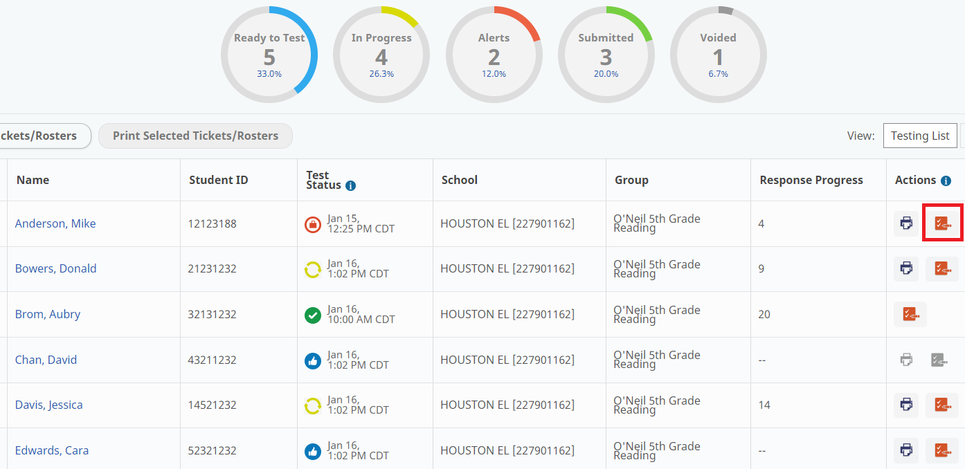
Adding Accommodations + NTCs

Slide 39
NSCAS Assessment Management Preparing for and Monitoring Testing

Slide 40
Roles for Testing Students
 | District Assessment Coordinator | School Assessment Coordinator | Proctor
Assign Accommodations | X | X
Assign Not-Tested Codes | X | X
Create Optional Student Groups (In MAP Growth as Classes) | X | X
View Manage Online Testing Dashboard | X | X | X
Print Test Tickets | X | X | X
Proctor Registered Tests |  |  | X

Slide 41
Print Student Test Tickets
Available in two formats starting 8/7:
PDF Format (one to four per page)
CSV Export (For bulk printing)
In two ways:
Manage Online Testing page
Individual Student Profile, Test Registrations tab
Proctors can print on demand.
There is a roster in a pdf that shows the list of tickets that have been printed.
Students don't have to be in test groups to access a test ticket.
If the student has their ticket, they can log in and test!

Slide 42
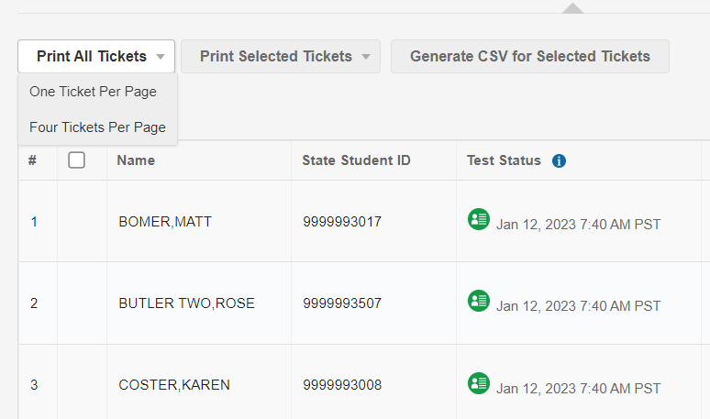
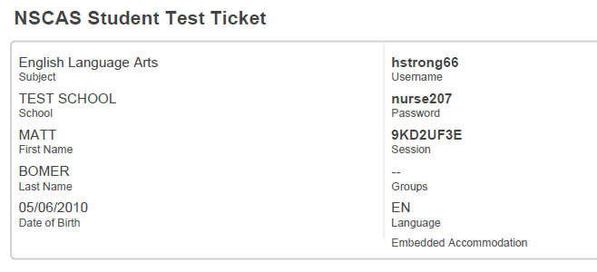
Student Test Tickets
Multiple student tickets can be printed at once or printed individually.
Test tickets print 1 or 4 to a page.
Four Tickets Per Page can be selected in the system.

Slide 43
Resetting Tests
Tests can be reset in certain circumstances by contacting the NWEA Help Desk.
Below are some of the situations in which a student’s test may be reset or moved to another profile.
Student signed in under a different student's name.
Student began test in wrong language / wrong accommodations
Emergency evacuation.
Please refer to guidance from NDE for other scenarios where a reset is applicable.
Note: Retest requests must come from the DAC to NWEA’s Help Desk. NWEA’s Help Desk will automatically grant the retest request and log the request. NDE will regularly review the retest logs and look for instances of overuse and/or abuse by districts.

Slide 44
Operational Reports
Operational Reports: These reports are designed to help DAC and SAC monitor testing status and the status of materials.
To access operational reports:
In the main menu, select Reports > Operational.
Select the Organization and Report Type from the drop-down lists.
Select Find.
Information about the report appears below. Select the icon in the Download column to download the report.
Data file layout for each report is in the Help section to reference format.

Slide 45
Operational Reports
Operational Report | Description
NSCAS Growth Materials Order Report | Report summarizes the quantity of tests by school that were assigned a paper/pencil accommodation.
NSCAS Growth Organization Report | Report details the Organizational Hierarchy data in the system. The source of this data is the state Organization file.
NSCAS Growth Registrations Report | Report details the students that were rostered to the administration.
NSCAS Growth Student Mobility | Report details students that have been transferred from one school and/or district (within a school year) to another.
NSCAS Growth Summary Testing Status Report | Report is a summarization of testing statuses.
NSCAS Growth Testing Status Report | Report details the status of each student’s test.
NSCAS Growth Student Results File | File provide preliminary results data.
District-Level Student Data File | Will contain all information for individual students, including demographics, RIT, reporting categories, achievement levels, and NSCAS scale scores

Slide 46
Student Mobility
District Transfers
As MAP Growth is the source of truth for student data, if a student transfers out of your district, they must be un-rostered from the current term (such as Fall 23–24) so they do not continue coming through the sync.
In MAP Growth, you can locate the student’s profile and remove the current term (Such as Fall 23–24) and save changes.
Transfer the student to the new school within Acacia
To move a student and their testing data to a new district in MAP, submit the following form: MAP District Transfer Form.
If using Clever, choose to stop sharing this student as part of your data set.
Once the student is rostered in the new district, they will be available to test at the new location.
Notes:
For within district transfers do not enter NLE

Slide 47
Test Security
Training is the responsibility of the building principal with assistance from the DAC.
Test administrators, test proctors, and test coordinators must be trained prior to test administration.
Training materials are provided by NDE and NWEA.
School districts may provide supplementary training materials.
Educators and principals will become familiar with specified testing practices and appropriate assessment accessibility supports for testing. See the Nebraska Student-Centered Assessment System Accessibility Manual.
The building principal’s signature on a signed security agreement affirms that they will insure training for all staff.
Annual security agreements will be processed August 14 – 18, 2023.

Slide 48
Proctor/Student Experience

Slide 49
Proctor / Student Experience - Login
Step 1:
Student launches secure browser
Step 2:
From Test Ticket, student enters username, password, and session ID
Step 3: Student verifies text on screen is accurate while Proctor monitors
Step 4: Proctor gives verbal approval to start

Slide 50
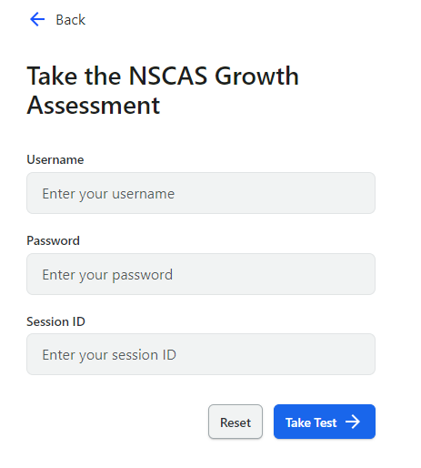
Student Experience: Session Name & Password

Slide 51
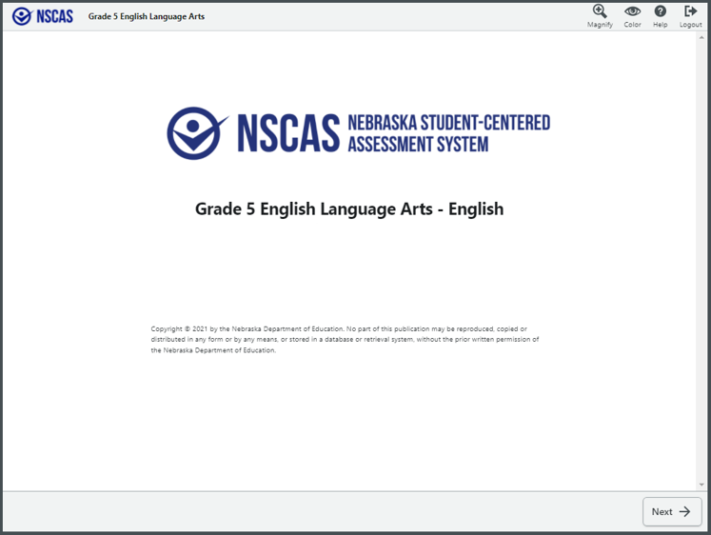
Student Experience

Slide 52
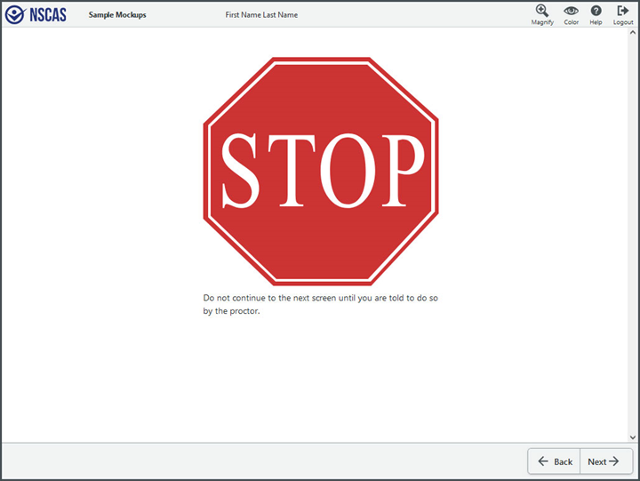
Student Experience

Slide 53
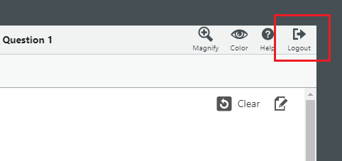
Student Experience Logout

Slide 54
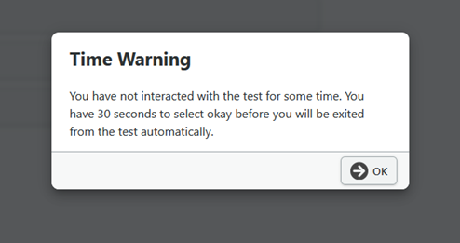
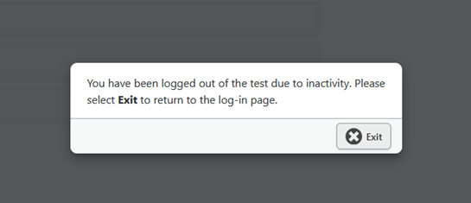
Student Experience Logout
Inactivity
Message appears when student has been idle for 14.5 minutes.
If student doesn’t click within the screen then they will get the time out message.
Once they receive this message then clicking exit is their only option.

Slide 55
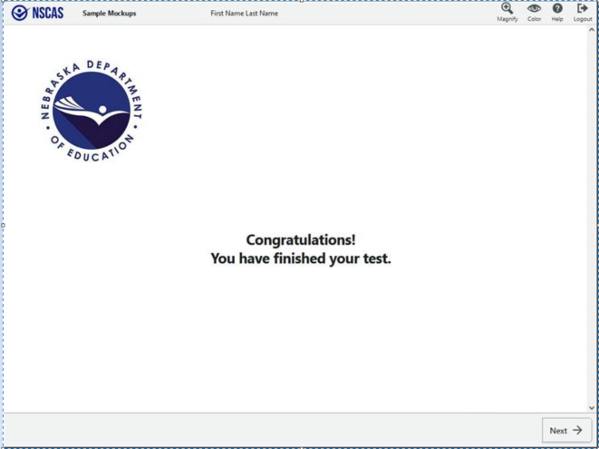
Student Experience – End of Test

Slide 56
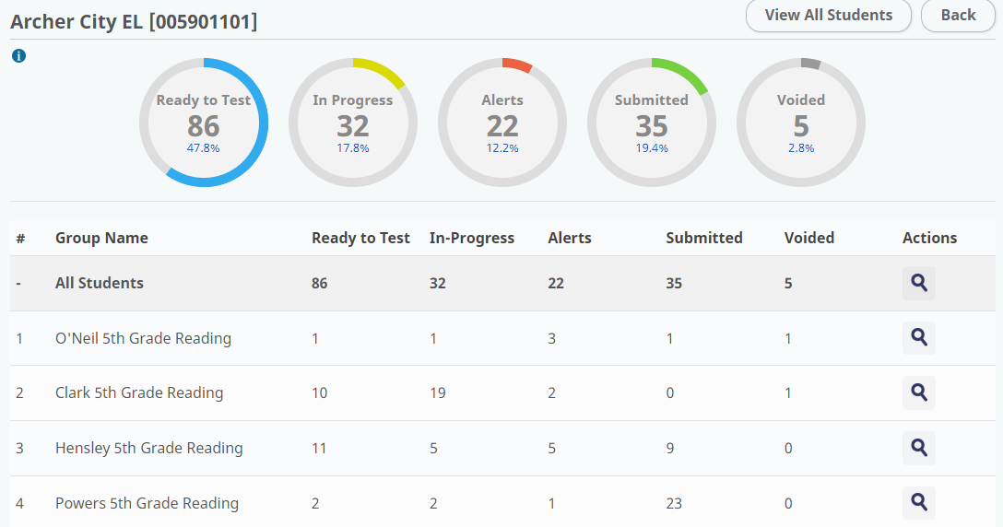
Testing Progress
Ease of use to allow proctors to more efficiently monitor students.
Testing Status Report can help understand where your students are in testing.
Note: Students with NTCs will show as Ready To Test.

Slide 57
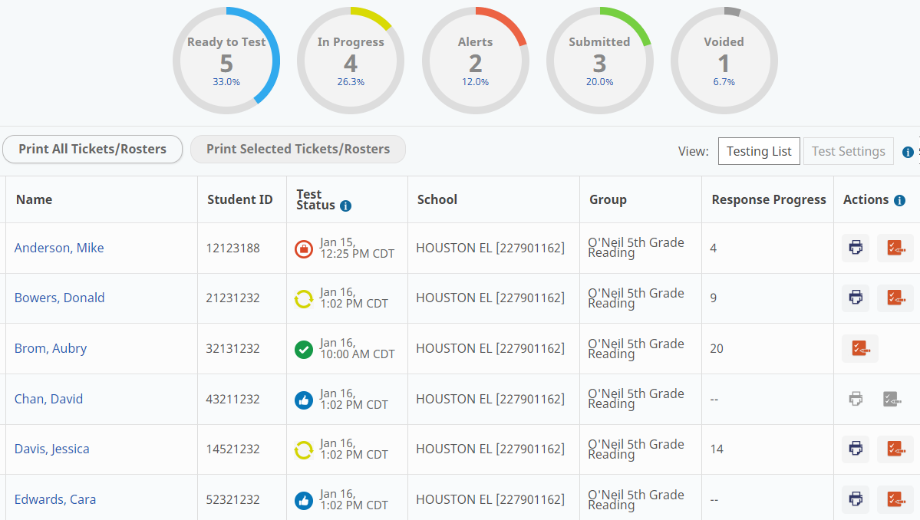
Testing Progress
Proctors will be able to monitor status from the test group, school or can look up students individually

Slide 58
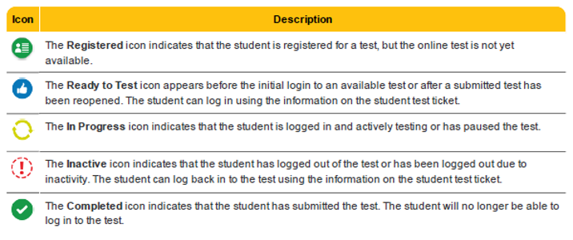
Testing Progress

Slide 59
Reporting Issues
Problem item reports
Should students experience an item that is potentially problematic, a problem item report can be submitted via the NWEA Assessment Portal.
Click Nebraska Dedicated Support
Log into NWEA Connection
Select Contact Customer Support
Enter the following information:
Student State ID
Grade and Subject
Item Sequence Number
Note: Do not take photos or screenshots or provide details about the content of the item.

Slide 60
Test Management
How-to Videos that are available:
How to Assigns Accommodations
How to Assign NTC's
How to Print Test Tickets
Location:
NWEA Nebraska Assessment Portal - Assessment Coordinator Tab

Slide 61
NSCAS – Student Tutorials
Interactive video available for students to learn how to use the online test platform.
How to use the online tools
How to navigate through the test
How to respond to different item types
Test-Taking Tips
Link to NSCAS Growth Student Tutorial

Slide 62
Item Type Samplers
Purpose: Provide students with an opportunity to practice each item type and gain familiarity with the platform/interface.
Includes all item types and item aides for each grade level.
Accessed on the Assessment Portal.
Paper item type samplers are also provided as PDFs for Districts to download and print (including answer documents).
Large Print and Braille item type samplers can be requested.
Resource: Item Type Samplers
Location: https://nscas-assess.state.nwea.org/inbrowser/index.html

Slide 63
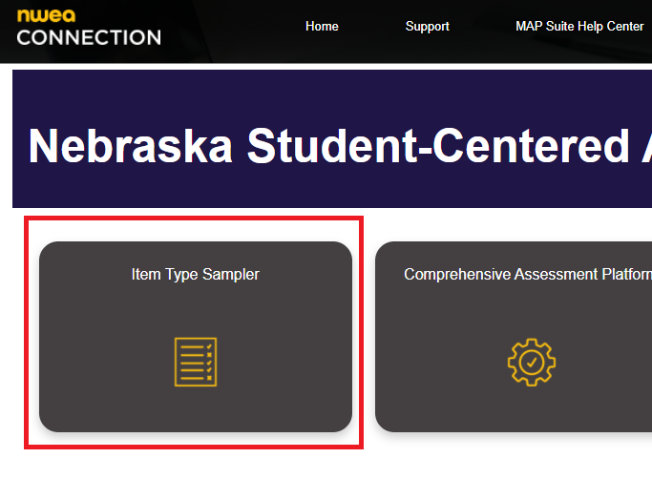
NSCAS – Item Type Samplers

Slide 64
Data and Reporting

Slide 65
Data and Reporting: What is available
Report/File | Access | Description
Student Score Report - By District | District Coordinators and Admins | Available on a rolling basis Demographic filters Averages for the district
Student Score Report - By School | School coordinators, Admins and above | Available on a rolling basis Average for the school Graphic views of student performance
Student Score Report - By Group | Instructors and above | Available on a rolling basis Similar to class level view of MAP Growth reports Will have averages for the group Graphic views of student performance Users will be able to create groups to get
Online Student Report | Instructors and above | Available on a rolling basis Student performance data in an easily printable format focused on each content area separately Item level information by standard, item type, and difficulty

Slide 66
Data and Reporting: MAP Growth Reports
RIT score data from NSCAS Growth is also available in MAP Growth and the various MAP Growth reports.
Popular reports such as Student Profile, Class Profile and Family Report (and more) are all available
Note: Learning Continuum and Learning Statements are not available for NSCAS assessments.
If a student has taken both MAP Growth and NSCAS Growth in a term, the test with the lowest Standard Error of Measure (SEM) will be the one reportable in MAP Growth.
Only NSCAS Growth assessments will appear in Acacia reporting, not MAP Growth assessments.

Slide 67
Reports

Slide 68
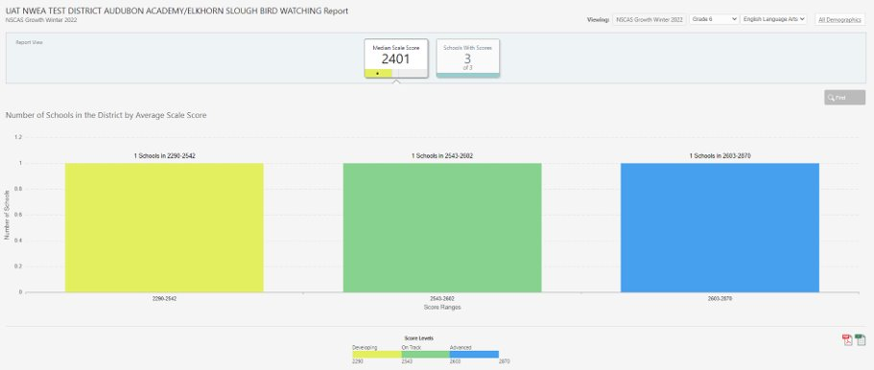
Reports: District Level

Slide 69
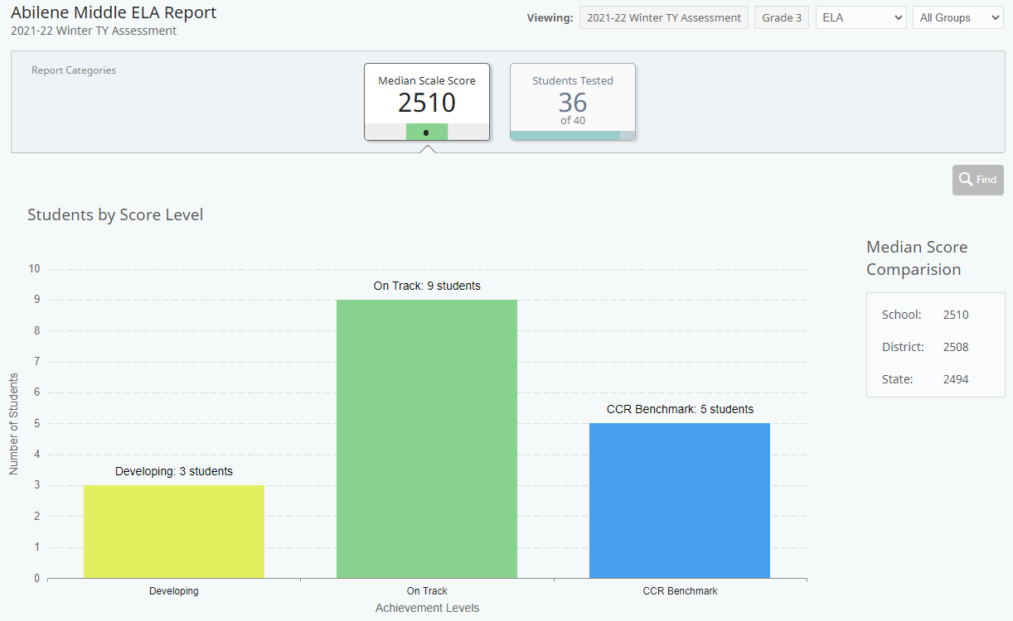
Reports: School Level

Slide 70
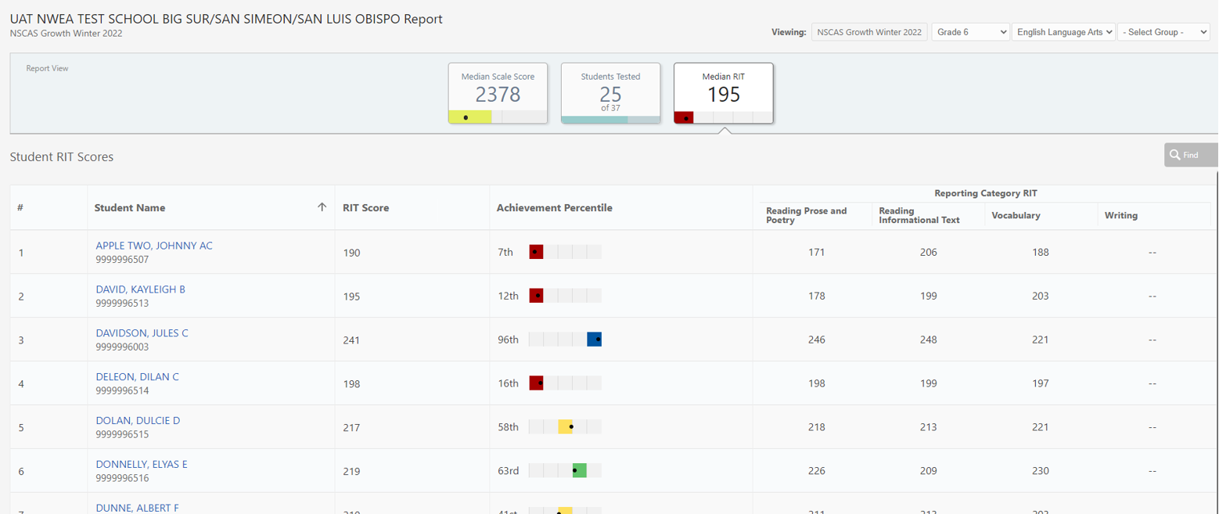
Reports: School/Group Level

Slide 71
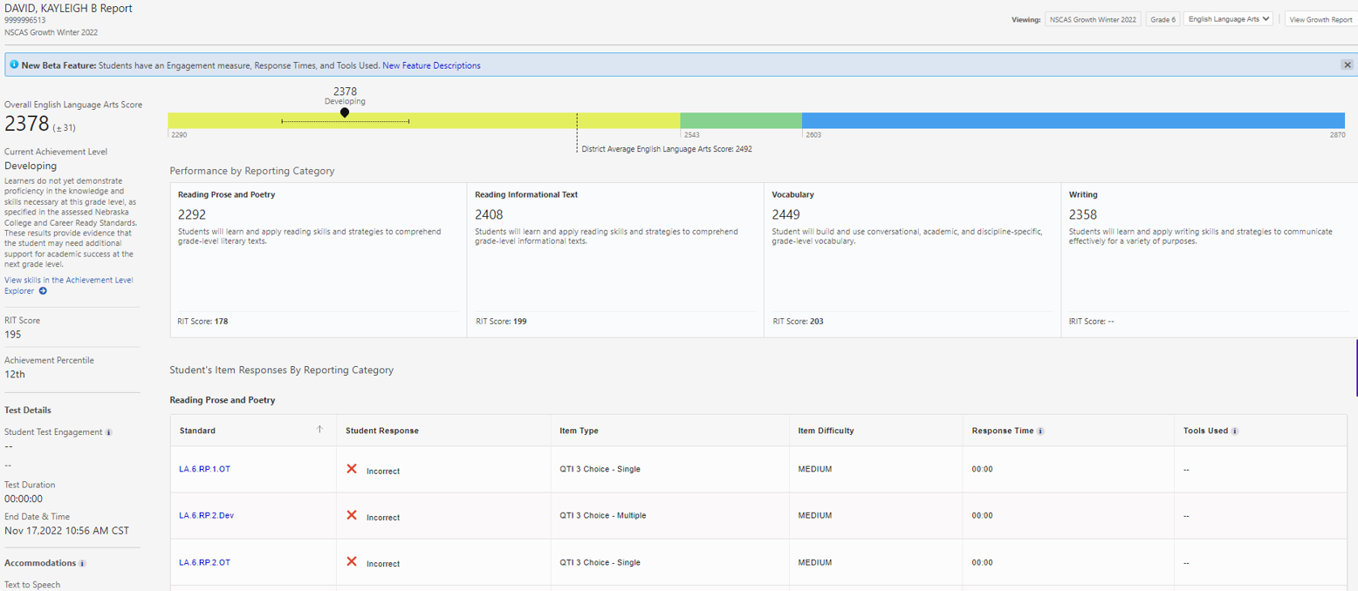
Reports: Student Level

Slide 72
Data Clean Up Activities
Recommended fields to confirm when reviewing your data:
Confirm all students have either a test record or an assigned Not Tested Code prior to the end of the test window.
All scribe entries for paper tests are submitted (testing status is not 'inactive') prior to end of the test window.
Review Reporting School vs Testing Location for accuracy. The operational report Registration Report will help with this.
Testing Status Report is a good tool to determine any gaps!
Fields such as IEP/504/Ethnicity and EL status will be updated from Adviser at the end of the test window.

Slide 73
External Programs

Slide 74
Resident Districts
EXTERNAL PROGRAMS
Accountable District Actions
Resident Districts must Register all students they are accountable to test, including those attending and testing at external programs.
Option 1:
Testing Location (external program) can be identified by changing the Testing Location for each test via the Registration Report import or manually in Acacia. This must be performed by the Resident District. Test Tickets available to print at external program.
Option 2:
Test tickets are sent via a secure manner (Secure email, secure SFTP, or hand delivered) to the external program for student to test.
Responsible for rostering and communicating with the external program coordinators

Slide 75
External Program - School Assessment Coordinators
EXTERNAL PROGRAMS
Assessment Management
Primary Duties:
Develop a scheduling plan for the testing window including proctors.
If Option 1 is used, Verify student rostering – Attending Location.
Print test tickets if Option 1 is used.
Update accommodations if needed, after verifying with the resident district.
Secure handling of test materials.
Coordination of test proctors.
Monitor Student Testing Progress.
Create make-up test sessions.
Serve as single points of contact for resident districts and are responsible for coordinating the testing activities within their external programs.

Slide 76
Proctor Role
EXTERNAL PROGRAMS
Proctor Responsibilities
Prepare the testing environment including providing scratch paper.
Ensure approved accommodations are provided during testing.
Distribute Student Test Tickets.
Monitor the test session to ensure a secure and productive test setting.
Adhere to all security requirements.
Return all test materials when testing is complete.
Start and manage testing as outlined in the Test Administration Manual

Slide 77
Preparing for Testing

Slide 78
Preparing for NSCAS Assessments
Review technical requirements for NSCAS Testing.
Download new NWEA State Solution Secure Browser.
Uninstall previous version before install.
Review NDE guidelines for accessibility and identify individual students in need of specific accommodations.
Review scheduling guidance from NDE.
Review NDE Test Security Manual.

Slide 79
Suggestions for a Smooth Testing Experience
Enable audio on devices used for TTS & provide headphones.
Ensure all students have appropriate accessibility feature assigned, as needed.
Validate school proctor rights have been assigned.
Use the Manage Online Testing Dashboard to monitor testing progress throughout the test window.
Refresh Manage Online Testing Dashboard to see updated information.

Slide 80
NSCAS Assessment – Resources
Assessment Portal
https://nwea.force.com/nweaconnection/s/nebraska
Item Type Samplers (English and Spanish)
Proctor Guide (English and Spanish)
Assessment Coordinator Guide
Online Student Tutorial Video
How to Videos
NSCAS Growth User and Student Management Guide
NSCAS Growth Scheduling Guidance
NSCAS Growth Readiness Checklist

Slide 81
Partner Support

Slide 82
Help Desk
Policy questions: Contact NDE
Phone: 402-314-3013
Email: nde.stateassessment@nebraska.gov
NSCAS or MAP Growth inquires or support: Contact NWEA
Phone: (855) 225-9926
Email: NWEANebraska@nwea.org
7:00 a.m.–5:00 p.m. Central Time (CT), Monday–Friday

