Slide 1
Expanded Learning Opportunities: Sustaining a Statewide Movement
Connie Duncan
Jeff Cole

Slide 2
Expanded Learning Opportunities
ELOs: What they are and why they are important
The ESSER III moment / opportunity
Sustaining / reinforcing growing momentum
Notes:
Welcome and Overview – Jeff
Who is in the room / level of experience
What are ELOs and Why are they important?
The ESSER III moment / Opportunity
Sustaining / reinforcing the growing momentum.

Slide 3
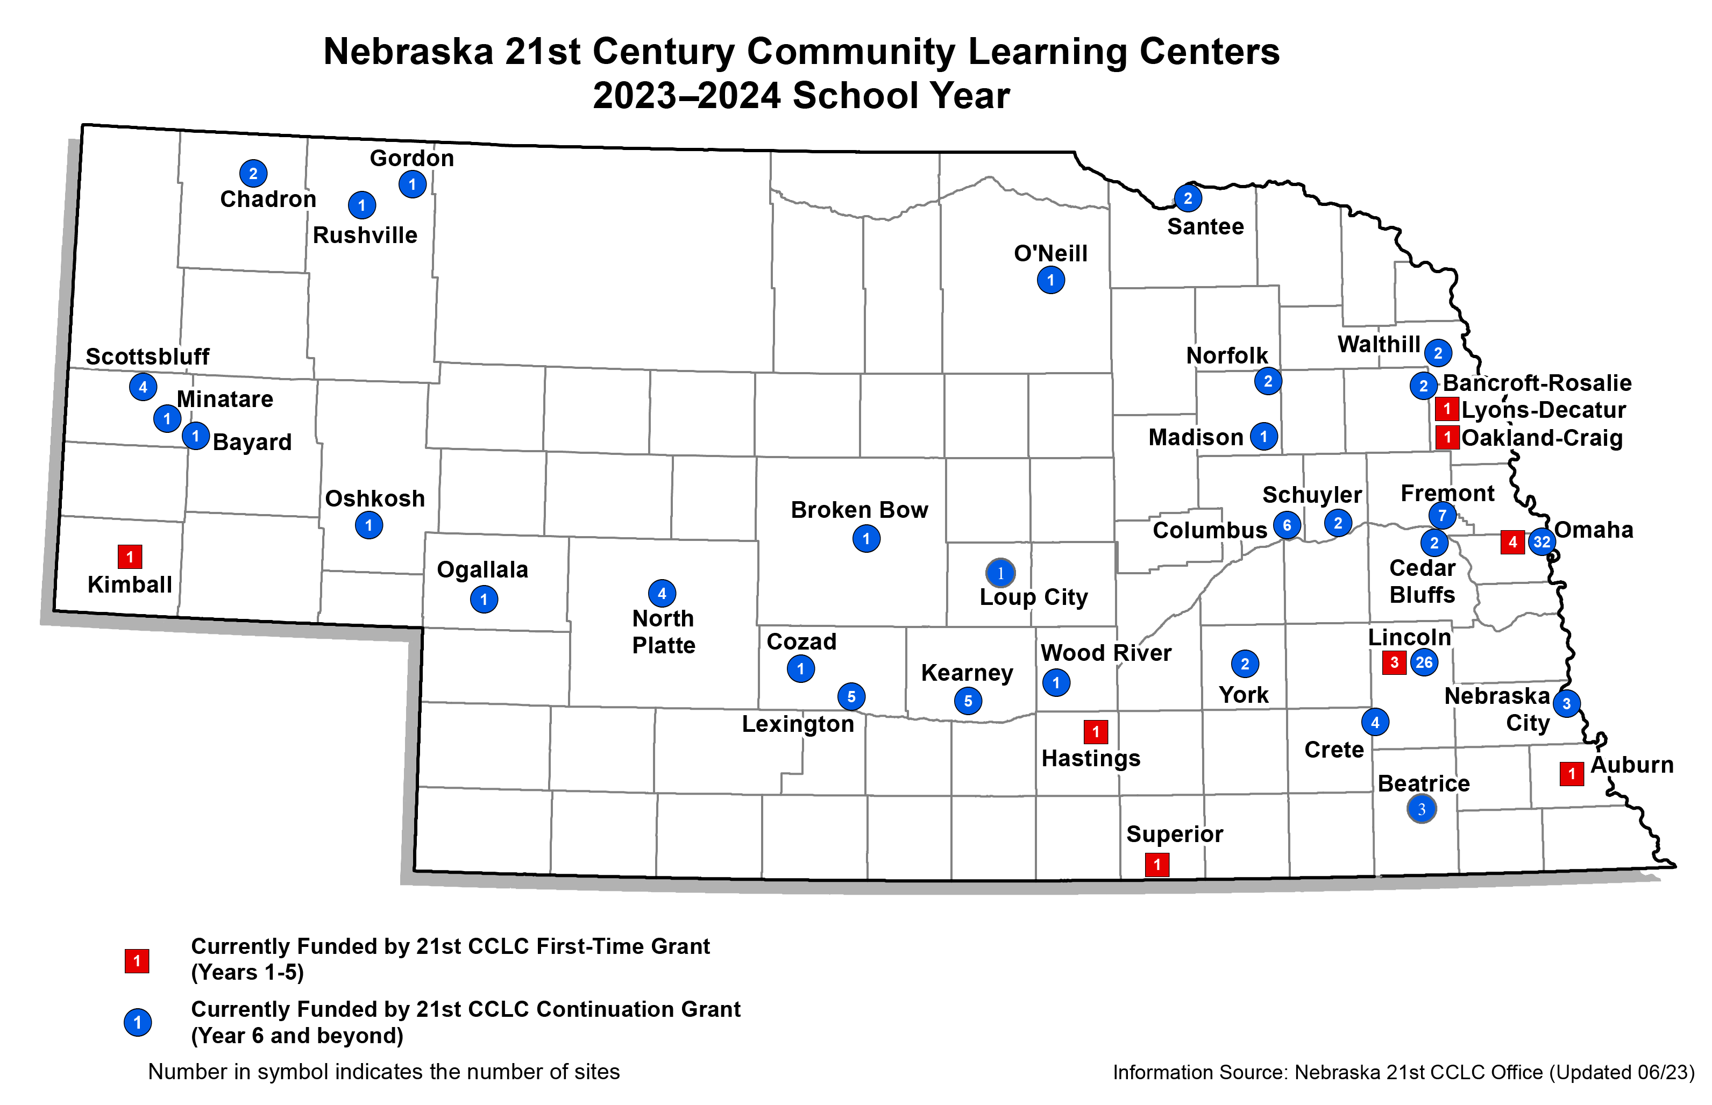
ELOs: 101 & 2.0

Slide 6
Quality Matters – and we know how to build it

Slide 7
Partnerships Matter – and build quality

Slide 8
Supporting Innovations and Sustainability

Slide 9
Sustainability Goals
High quality
Cost effective
Locally sustainable

Slide 10
Sustainability – Engage School Districts
School districts have a big role to play
Partnership to enhance the opportunities to build a stronger community
Strengthens connections with the community, assists in better understanding the needs of youth and families
Ability to use general funds and title funds for staff positions
Include key staff in goal setting ‒‒ filling educational gaps afterschool

Slide 11
Sustainability – Access current resources
A process of addition and subtraction
According to the Afterschool Alliance there are at least 120 sources of federal funding for Expanded Learning
Recent resource from The White House identifies even more resources for Expanded Learning (Pillar 3 of FSCS)
The community collaborative connection: bridge to other resources
ESSA sources at your fingertips:
Title I, Low-Income (A and C-Migrant)
Title IV-B (21st CCLC)
Title VI, Indian, Native Hawaiian, Alaska Native
Title IX, Homeless Education
Creativity with the time and place for education
Notes:
Handout – Federal / State funding resources available for ELO
Notes:
How to fund and sustain these programs? Always the challenge
Major cost is staffing, since taking place in the school and can leverage existing educational resources and spaces.
Schools as the centers of most NE communities – use your high standing to meet other vital community education needs.
Hodge podge of other federal funding sources to help support broader efforts including Title I, …

Slide 12
Sustainability Resources
Afterschool Alliance: https://www.afterschoolalliance.org/fundingfederalataglance.cfm
White House (2023): https://www.whitehouse.gov/wp-content/uploads/2023/01/2023-01-13-WHITE-HOUSE-TOOLKIT_Federal-Resources-to-Support-Community-Schools.pdf

Slide 13
Positioning your ELO program
Case Statement Brochure
Include data about your community.
Include quotes, pictures and stories from students and businesses.
How to solve the need
Cost of the project
Include naming opportunities

Slide 14
Development 101: Telling your story
Your story is so important to donors.
Use data
Use quotes
Use pictures

Slide 15
Sustainability: Get Local Businesses Involved
Is there anywhere in the curriculum that you could involve businesses?
Is there an Engineering or Robotics Club where employees could volunteer?
Is there a place where a business employee could speak about their career and explain their educational journey?

Slide 16
Sustainability: Get Local Businesses Involved
What is the benefit of having businesses volunteer?
It is a relationship builder
The business will get to know you and your programs
Much easier to make a financial ask to a business that knows you
This is a great story

Slide 17
Engaging Local Businesses: Homework
Spend some time researching your funders. Do this by looking at their website and their 990. A quick google search will tell you so much.
Find out how much they give away every year. This will tell you what an ask would look like.
Find out what they give to. What is the mission of their foundation/company? Do you align with their mission.
Find out who is on their board. Do you know any of them?
The most important thing is to know everything you can about them before you send an email asking them for a coffee date.

Slide 18
Engaging Local Businesses: 30-minute meeting
Shake hands and thank them for meeting with you. If you know them, ask them something. How is your golf game these days? Anything to make a connection.
Share a little about yourself and why the afterschool program is so important to you
Share a little about the AS and slide the case statement brochure across the table.
Ask if they have any questions.
Have a formal letter prepared with an ask amount or a naming opportunity. Slide this across the table and say ”John I am here today to ask you to be a part of our AS program or make an investment in our work.”
Thank them for the meeting and you hope they will consider making an investment in our communities AS program.

Slide 19
Sustainability Learning Community
Multiple opportunities to develop sustainability plans:
Get Connected
Regional Connections
Deeper Connects
All these PD opportunities will have strands focusing on sustainability, with resources housed on BSB Toolkit:
https://bsbtoolkit.org/
Omaha - CHI Center
September 22, 2023
Notes:
Close - As part of our partnership with NDE on the NE ELO Innovation Network, we will be focusing on sustainability strategies over the year ahead, launching a statewide PD series and will be providing more information and support.

Slide 20
Summary – ELOs are a key component of a holistic education preparing Nebraska youth to learn, earn and live
ELOs have a proven track record of improving student school and life outcomes nationally and in Nebraska
The pandemic led to new funding to start and expand ELO programs
Federal, state and local funding is available now to support high-quality, cost-efficient and locally sustainable ELO programs
In 2023-24, there will be multiple opportunities to learn about and participate in activities to support ELO program sustainability

Slide 21
Contact us
Jeff Cole – jcole@nebraskachildren.org
Connie Duncan – cduncan@nebraskachildren.org
https://beyondschoolbells.org/

