Slide 1
Tobacco Prevention Mini Grants & the Connection with Star Events
Ranae Aspen, MAS
Statewide Youth Tobacco Specialist
Nebraska Department of Education
531-893-3051 ranae.aspen@nebraska.gov

Slide 2
Office of Coordinated Student Support Services
In 2020, the CDC recognized that Vaping will be a huge emerging issue. Any agency receiving tobacco funding from the CDC was ordered to dedicate funds for a youth tobacco prevention position.
Through a partnership with Tobacco Free Nebraska and the Nebraska Department of Education, Nebraska now has a Statewide Youth Tobacco Specialist housed through NDE.

Slide 3
Overview
Why is youth tobacco prevention in Nebraska & nationwide Important?
Nebraska Data
National Data
What are E-Cigarettes?
E-Cigarette 101
Don’t forget about other tobacco products!
Resources for Tobacco Prevention
CATCH My Breath
Other evidence-based resources
How can No Limits Nebraska Mini Grants connect to after school clubs?

Slide 4
DATA
NEBRASKA
NATIONAL

Slide 5
Is Teen Vaping Really an Epidemic?

Slide 6
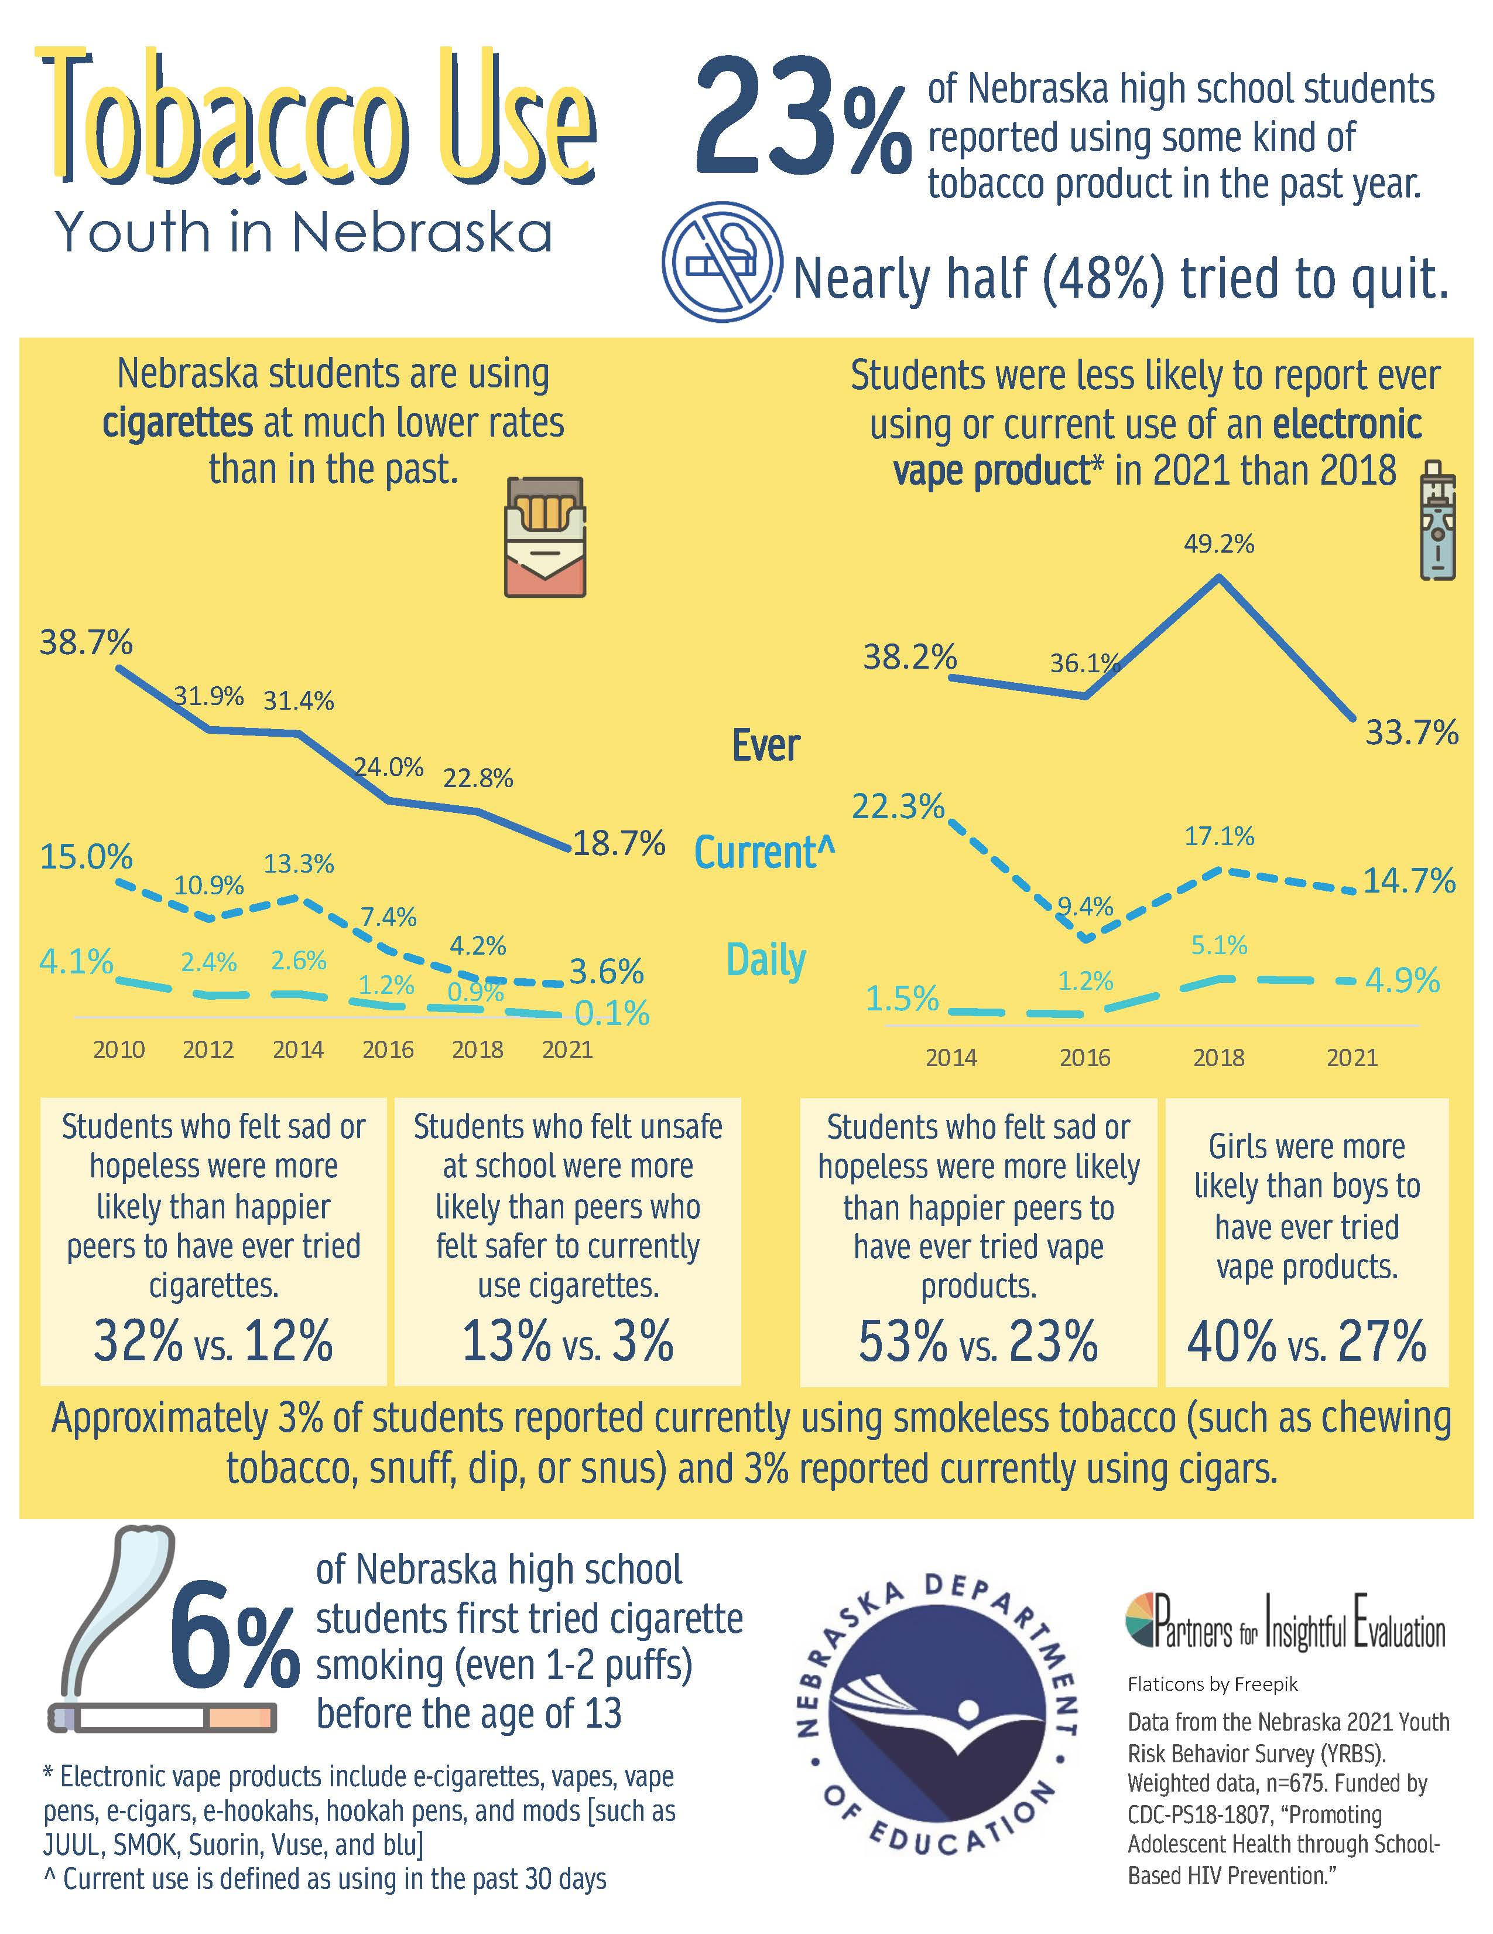
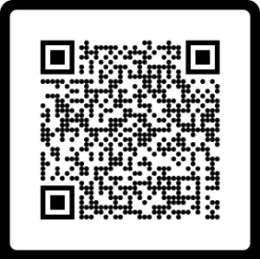
Nebraska Data
23% of students reported using some type of tobacco.
48% of students who reported using tobacco have tried to quit.
53% of our students who felt sad or hopeless have tried vape products versus 23% of our happier students.
2021
This data comes from the Nebraska YRBS – Youth Risk Behavior Survey. To access this infographic and other’s, scan the QR code.

Slide 7
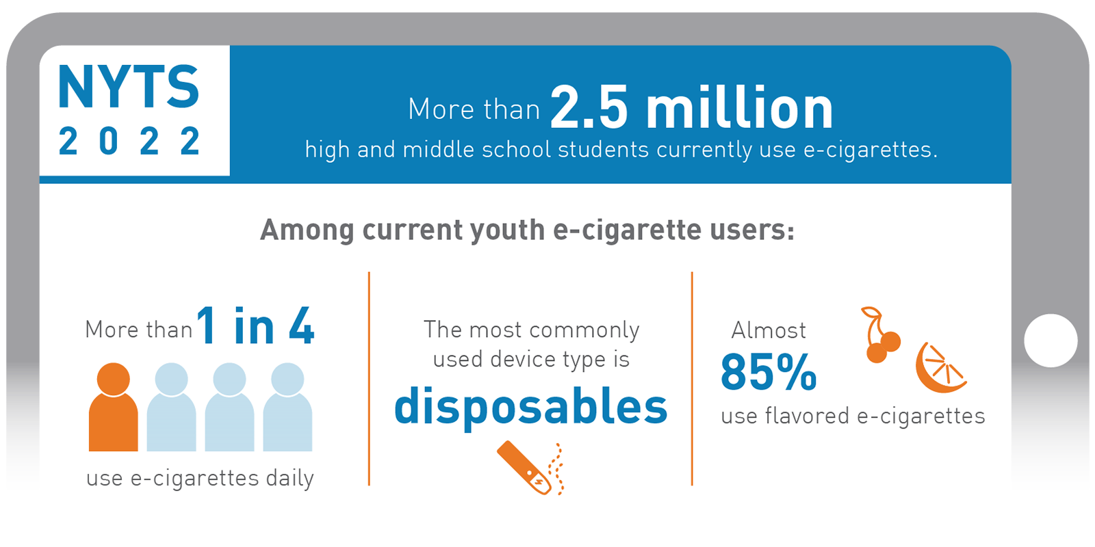
National Data
Electronic nicotine deliver system (ENDS) products, like e-cigarettes are very popular with young people. ENDS remain an ongoing concern.

Slide 8
What are E-cigarettes?
Components of E-Cigarettes
Battery
Heater/Atomizer
Cartridge/Tank
Microprocessor

Slide 9
E-Juice: Sweet Flavors Abound!
81% of kids who ever used tobacco products started with a flavored product.
99% of E-Cigarettes sold in 2015 contained nicotine.

Slide 10
Spot the Vape
Notes:
SCRIPT: You see the following school supplies laying out on your student’s desk. What you may not realize is that some of these “supplies” are actually e-cigarettes. Choose the ones that you think are e-cigarettes.
Hint: There are 6 vaping devices.
How did you do? Pictures B, C, F, G, I and J are actual vaping devices. Don’t worry if you didn’t do so well, a lot of adults struggle with spotting e-cigarettes, especially because there are continually new devices and designs. We also offer this exercise in our free parent resources that can be found on our site.

Slide 11
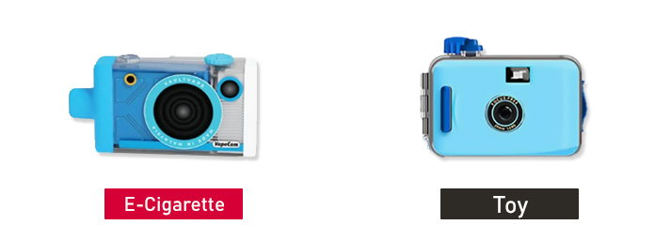
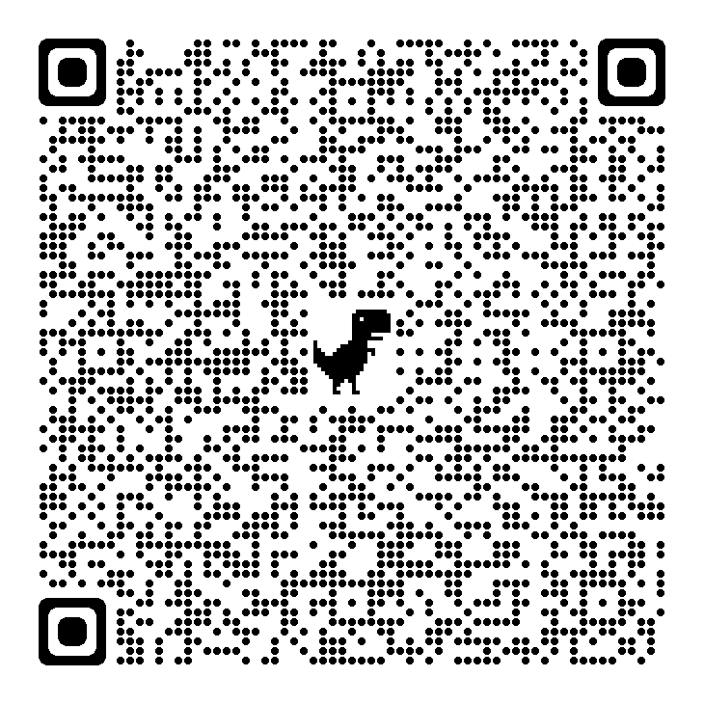
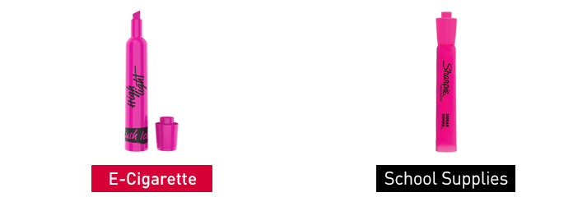
Illegal Vapes that Resemble Characters, School Supplies, Toys and Drinks

Slide 12
After School Programs & Tobacco Prevention
After School Club Resources

Slide 13
After School Programs: Empower Vape-Free Youth

Slide 14
Tools: FREE Resources
CATCH My Breath
CATCH My Breath is a peer reviewed, evidence-based program. It can be used in a variety of settings including after school settings.
Take Down Tobacco Advocacy Training
This is an online resource for tobacco prevention
Stanford Medicine Tobacco Prevention Tool Kit
Theory-based curriculum for educators, parents and middle school/high school students.

Slide 15
Tools: FREE Resources
Tobacco Free Nebraska: E-Cigarettes & Vaping
Nebraska Tobacco-Free School Kit

Slide 16
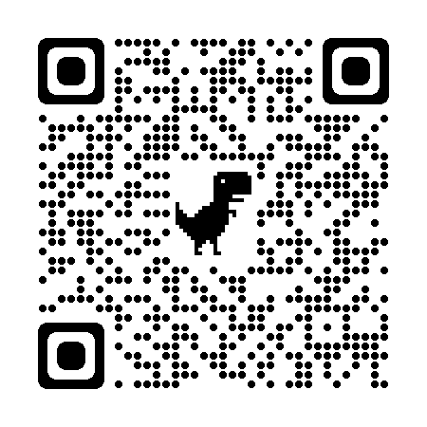
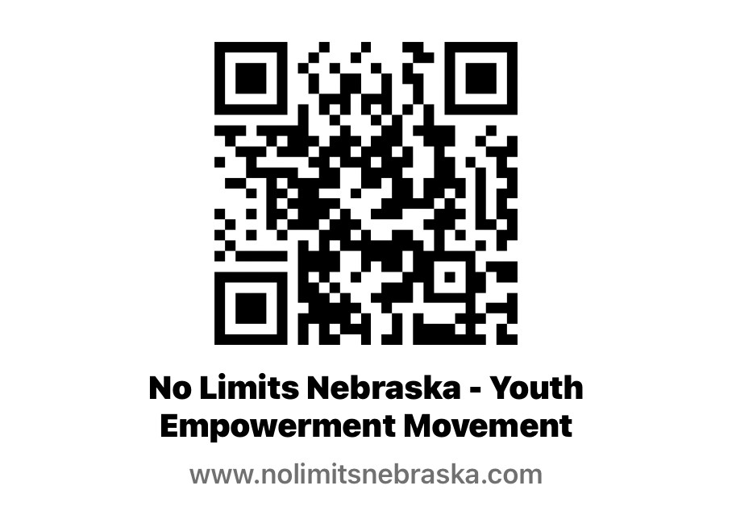
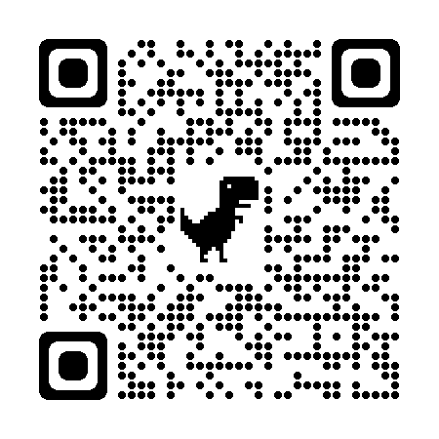
Tools: FREE Resources
Nebraska Department of Health and Human Services: Quit Line
No Limits Nebraska
Resource Center for Mini Grants & No Limits Resources for Schools and Youth

Slide 17
No Limits 2023-2024 Direct Education Plan
Regional Train the trainer sessions statewide for any staff working with tobacco prevention and restorative discipline for students who have violated school tobacco policy.
Mini Grants: $250 for one event and $500 for three student lead tobacco prevention events. Small amount of evaluation will be required.

Slide 18
No Limit Mini-Grants& After School Clubs
Cigarette butt and E-Cigarette
Clean-Up
Sugar Coated Lies
Be Your Own Voice

Slide 19
No Limits Mini-Grant
Grant Details Made Simple:
Organize event (s) to draw public awareness to the impact of youth and the use of tobacco products.
2. $250 for one tobacco prevention event or $500 for two tobacco prevention events.
3. Every event will include a public service announcement (PSA): this can be a slide presentation, video, podcast or digital billboard for your community and the state of Nebraska. Use your imagination, there are “No Limits”
4. Adult Sponsor Required!
***You can always reach out for guidance to be sure you are following best practices of tobacco prevention with your event and your PSA.

Slide 20
No Limits Mini-Grant
Planning Made Simple:
Planning has been made easy!
As a group, select activities that best fit your school and your community. Included in the grant packet will be a planning guide (pg. 4).
Fit activities into the course of the school year, keeping in mind your activities and evaluations must be submitted by April 12, 2024. You may want to align activities with national dates as well as National Great American Smokeout Day (third Thursday in November)to kick off your mini-grant activities!
Provided rubric will be used to evaluate applications but is also a great tool to help you plan your project.

Slide 21
How to Apply for Mini Grants!
Overview of three topics to choose from.
Decide on a topic.
Fill out simple application!
Important dates

Slide 22
Cigarette Butt & E-Cigarette Cleanup
Example 1: Research Laws, Guidance, and Regulations for Clean Air
Example 2: Research Current Policies and Suggest Changes
Example 3: Smokeless Tobacco: E-Cigarettes/Vapes

Slide 23
Sugar Coated Lies
Example 1: Public Policy Concerning Flavored Tobacco
Example 2: Tobacco Use in Media
Example 3: How Big Tobacco Targets Teens

Slide 24
Be Your Own Voice to Create a Tobacco Free Nebraska
Example 1: Investigate Current Tobacco Policy: Legal Age & Taxes
Example 2: Research Current Policies and Suggest Changes
Example 3: Interview Students on E-Cigarettes or Other Tobacco Product Use

Slide 25
How Can Mini Grants Fit Into After School Clubs?
Adult Sponsor Role
Ensure youth fill out application & Evaluation Forms
Receive the grant award paperwork and share with necessary staff in your building.
Spending funds to support mini-grant activities and filling out necessary forms for reimbursement.
Overseeing youth during tobacco-prevention activities.

Slide 26
How Can Mini Grants Fit Into After School Clubs?
Youth Role
Take the lead in filling out the grant application
Plan tobacco-prevention activities
Following up with final evaluation and success stories

Slide 27
Application
No Limits Nebraska Mini-Grant Application

Slide 28
Important Dates
Sept. 18th – Grant Opens
Oct. 31st – Grant Closes
Grant winners announced on a rolling base
April 12th – Projected completed and success stories with evaluation due

Slide 29
Questions?
Ranae Aspen, MAS
Statewide Youth Tobacco Specialist
Nebraska Department of Education
531-893-3051 ranae.aspen@nebraska.gov

