Slide 1
Notes:
Chrystal

Slide 2
Doraan Avey
Digital Learning Director
Nebraska Department of Education
Notes:
Dorann

Slide 3
Sergio Perez
Education Advisor
Education Office, Embassy of Spain
Notes:
Sergio

Slide 4
Chrystal Liu
World Language Specialist
Nebraska Department of Education
Notes:
Chrystal

Slide 5
Objectives
Nebraska World Language Standards Debrief
NDE World Language Resources to support standards implementation
OER Basics and navigation
Notes:
Chrystal

Slide 6
NDE World Language Standards
Notes:
Chrystal

Slide 7
Five Strands of Nebraska WL Standards - 5 Cs
Communication
Culture
Connections
Communities
Cognition
Flyer
Whole document
Notes:
Chrystal

Slide 8
Structure of NE WL Standards
Notes:
Chrystal

Slide 9
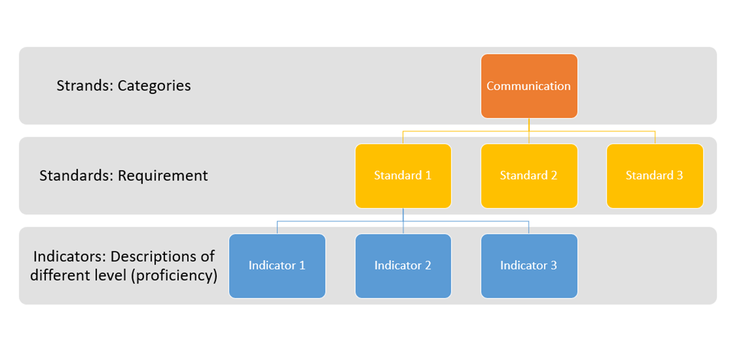
Notes:
Chrystal

Slide 10
What is Cognition?
Refers to “metacognition’ in the standards
Merriam-Webster Definition: awareness or analysis of one's own learning or thinking processes
Notes:
Chrystal

Slide 11
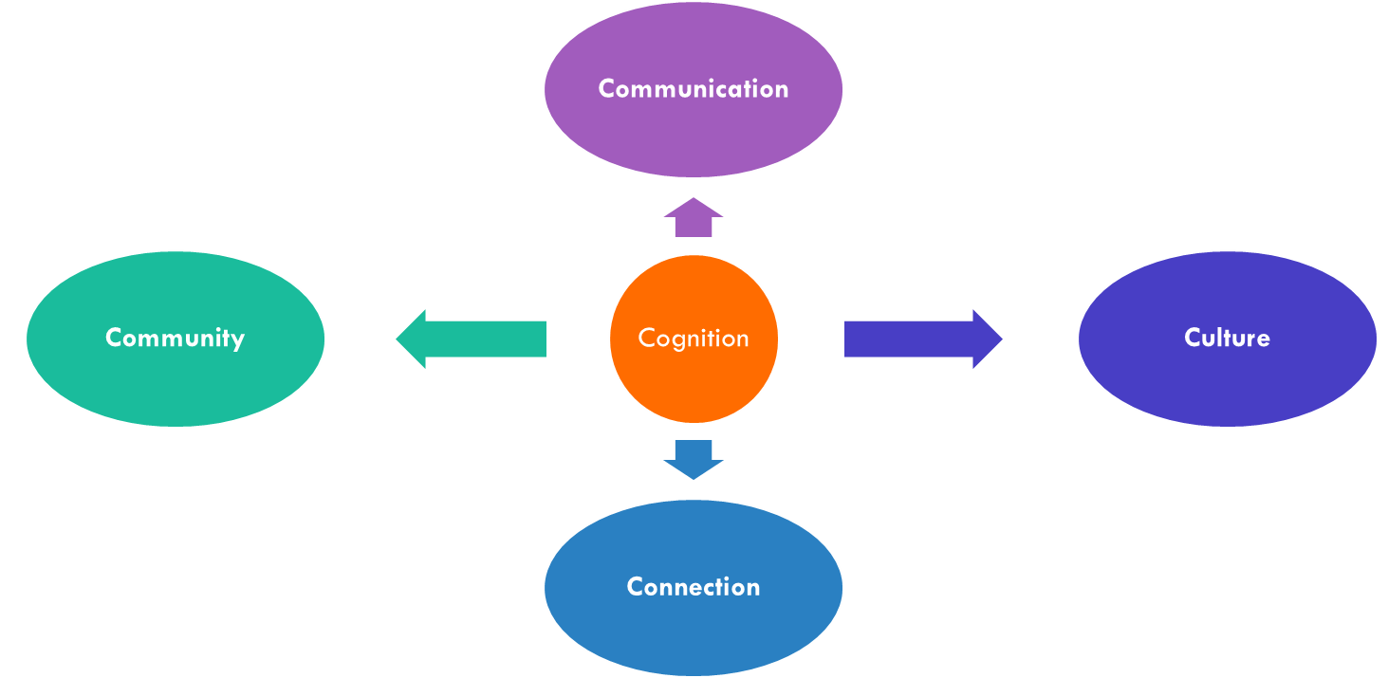
Cognition Strand
Notes:
Chrystal

Slide 12
Cognition Strand
review and reflection
Students explain what they know
and
are able to monitor their own learning journey
With support from their teachers.
Goal setting, self-assessment, and self-autonomy
guidance
Notes:
Chrystal

Slide 13
Why Cognition?
Research has shown a positive impact on:
Student Self-Efficacy
Intrinsic Motivation
Student Perceived Task Value
Capacity for Autonomy
Teacher Rapport
Learning Outcomes
•Moeller, A., Theiler, J., & Wu, C. (2012). Goal setting and student achievement: A longitudinal study. The Modern Language Journal, 96, 153-169.
•Moeller, A., & Yu, F. (2015). NCSSFL-ACTFL Can-Do statements: An effective tool for improving language learning within and outside the classroom. In P. Swanson (Eds.), Dimension 2015 (pp. 50-69). Decatur, GA: SCOLT
•Ziegler, N. (2014). Fostering self-regulated learning through the European Language Portfolio: An intervention mixed methods study. The Modern Language Journal, 98(4), 921-936.
Notes:
Chrystal

Slide 14
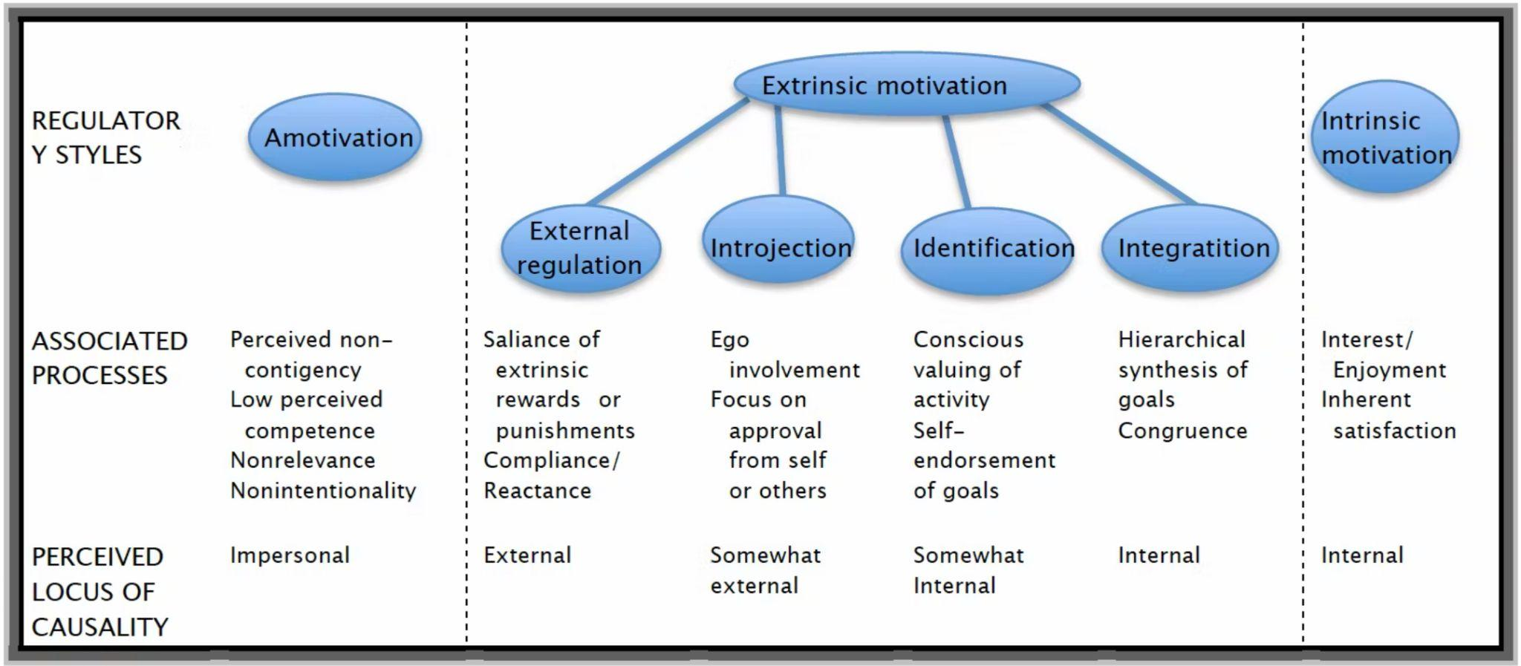
Learners need to have control
RYAN AND DECI, 2000: https://www.sciencedirect.com/science/article/pii/S0361476X99910202
Notes:
Sergio

Slide 15
AUTONOMY
"feeling free and volitional in one’s actions" - is a basic human need. (...) it is nourished by, and in turn nourishes, our intrinsic motivation, our proactive interest in the world around us.
- David Little
Notes:
Sergio

Slide 16
LEARNERS AS EXPERTS
Normally dependant on what the teacher says
Metacognition needs training
Scaffolding
Notes:
Sergio

Slide 17
Multilayered Assessment reference: from planning to Self Assessment
Strand
Standard
Indicator
Can-do descriptor
Notes:
Sergio

Slide 18
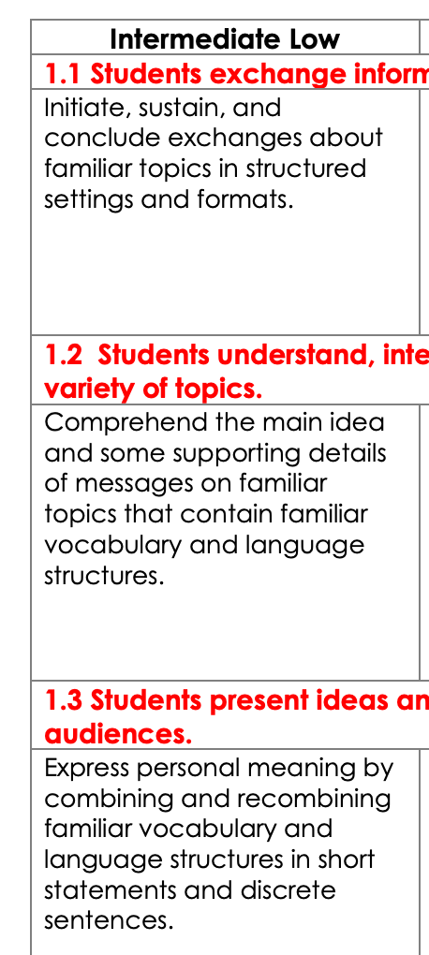
Notes:
Sergio

Slide 19
THE POWER OF CHECKLISTS
Learning portfolio
guide for learning
biography of learning
what they learnt
Notes:
Sergio

Slide 20
Can-do statement & Standards
World Language Standards
ACTFL/ NCSSFL Standards
2019 Nebraska World Language Standards
Challenges with standards
Accessibility: the language & interpretation
Suggested solution: Can-do statement
Notes:
Chrystal

Slide 21
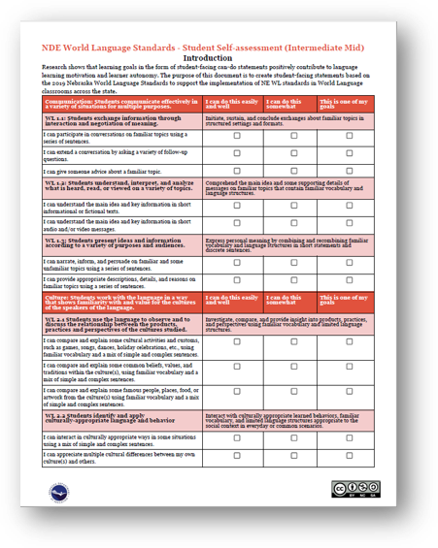
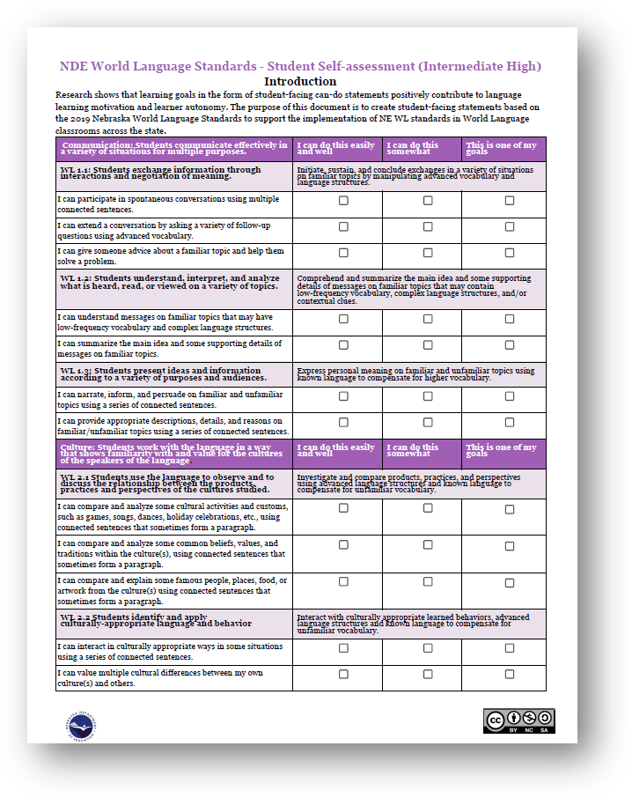
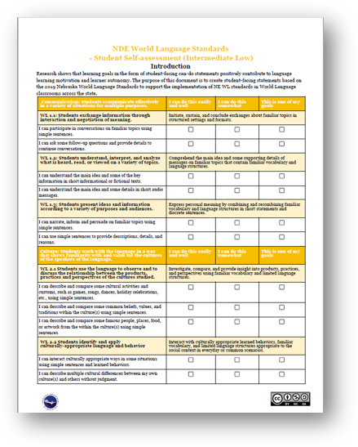
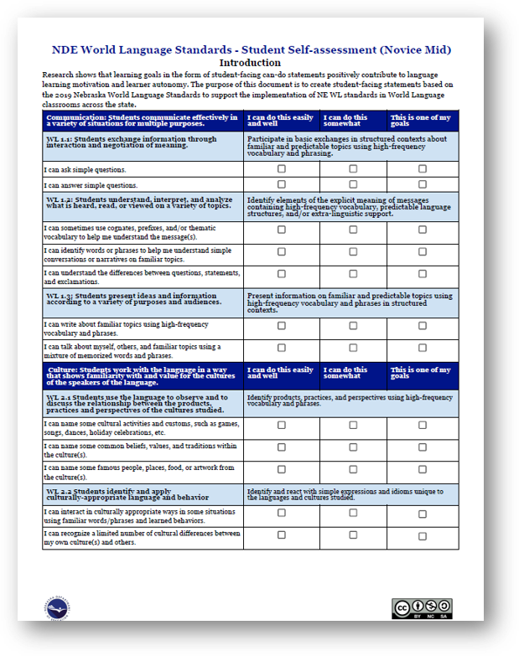
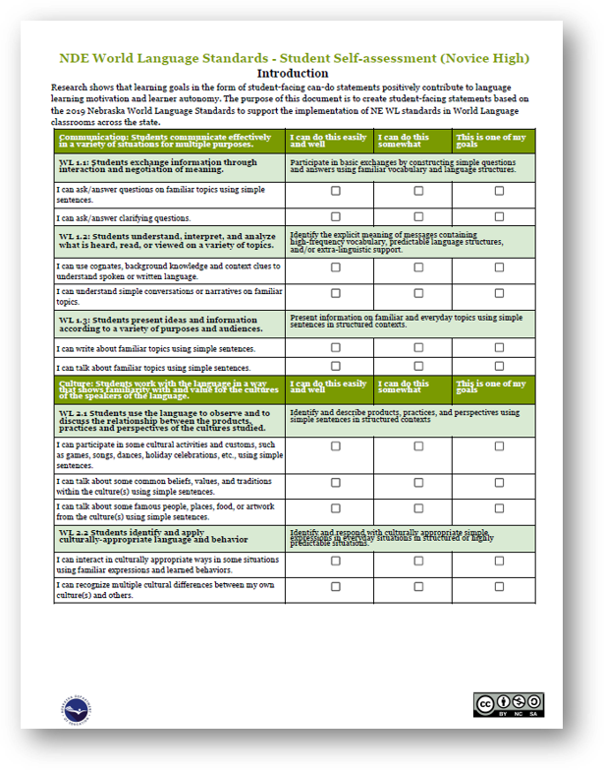
Course Level Self-Assessments
Link to Documents
tinyurl.com/NDEcognition
Notes:
Chrystal

Slide 22
Two Formats
Link to Documents
Circle
Checklist
tinyurl.com/NDEcognition
Notes:
Chrystal

Slide 23
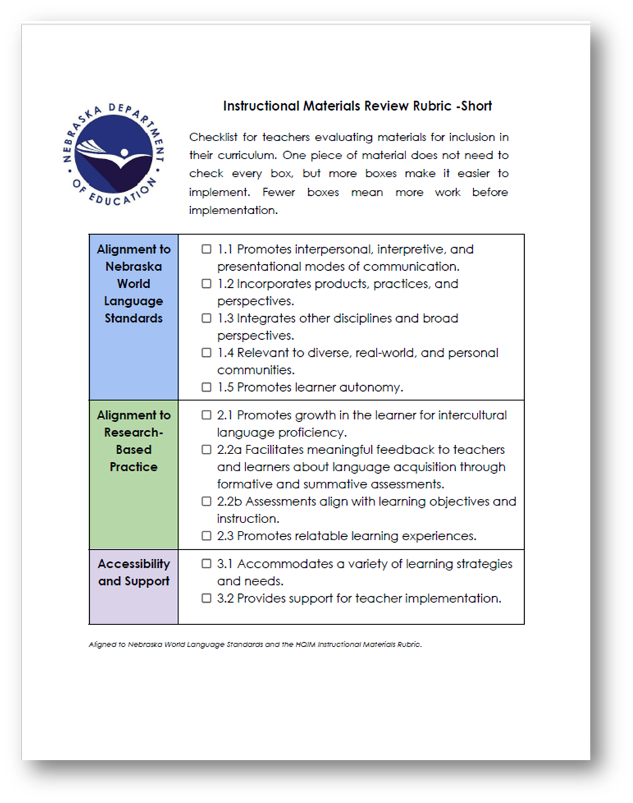
HQIM Initiative - World Language Rubrics
Long Version
Short Version
Notes:
Chrystal

Slide 24
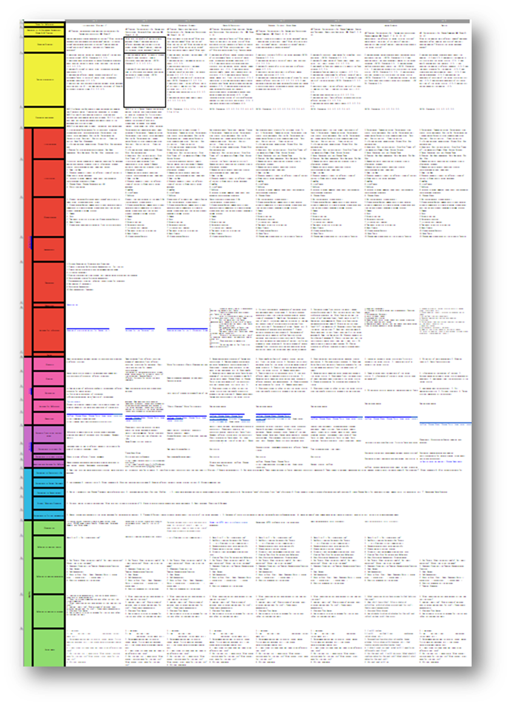
Self-assessment
HQIM Rubric
Curriculum Map
Notes:
Chrystal

Slide 25
NDE World Language OER Development Timeline
2022
2023
2023
2024
2024
July
May
June
May
June
Cohort I:
Self-assessments for Novice and Intermediate levels.
HQIM rubrics reviewed and finalized.
Cohort II:
- Self-assessments for Advanced Level
- Curriculum Map for Level 1
Curriculum Map Review & Finalized
Cohort III:
Curriculum Map for Level II
OER Material creation & Standard Alignments
Notes:
Chrystal

Slide 26
OER Defined
Open Educational Resources (OER) is a term used to describe teaching and learning materials that reside in the public domain or have been released under an open license, so that these materials can be used, adapted, redistributed with no restrictions or with limited restrictions at no cost to learners.
Notes:
Dorann

Slide 27
Benefits of Open Education Resources (OER)
Increased access to high-quality educational opportunities for all.
Students have equitable access to up-to-date, relevant content
Teachers are empowered to tailor learning materials to student needs
Education systems are able to reallocate textbook dollars to other pressing needs
Notes:
Dorann

Slide 28
OER Free & Reuse Rights
Retain
Make and own copies
Reuse
Use in a wide range of ways
Revise
Adapt, modify and improve
Remix
Combine two or more
Redistribute
Share with others
Notes:
Dorann

Slide 29
Copyright vs. Creative Commons/Open Licenses
Notes:
Dorann

Slide 30
Creative Commons Licenses
Most Freedom
OER
Not
OER
Least Freedom
Notes:
Dorann

Slide 31
Place your screenshot here
OER Commons
Notes:
Dorann

Slide 32
Free Account
Start finding the resources you need, saving them, using them and modifying them
Notes:
Dorann

Slide 33
Discover Drop Down
Resources - Explore by Subject area or material type
Collections - Some of the many available collections (most are in the NDE Hub)
Providers - Colleges, nonprofits and other education resource providers
Notes:
Dorann

Slide 34
Hubs
State Hubs
NE, IA, NH, MD, OR, WA . . .
College Hubs
MI, MA, CA, UC-Davis . . .
Non- Profit Hubs
UNESCO, OpenStax . . .
Like minded Hubs
School Librarians, STEM . . .
Notes:
Dorann

Slide 35
Nebraska OER Hub
Notes:
Dorann

Slide 36
What types of content can be OER?
Entire Courses
Course modules
E-textbooks
Streaming video of lectures
Professional Development
Units of Study
Assessments
Software
Video
Activities
Lesson Plans
A Photograph
Rubrics
Charts
Journals
Practice Exercises
Notes:
Dorann

Slide 37
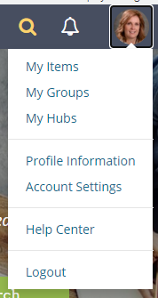
Finding and organizing your content
My items - has all your saved and created content, can make folders
Another way to access groups you join
Another way to access hubs your a member of
Profile - need to update for ease of approving your work
Logout- if you don’t log out you will stay logged in for quite a while
Notes:
Dorann

Slide 38
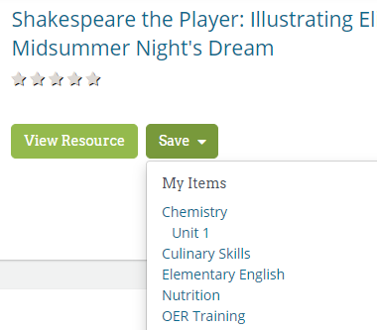
Saving to “My Items”
Search and collect items for a lesson, unit or course
Save these items to “My Items” or folder within
Vet and align the items later
Notes:
Dorann

Slide 39
Finding content
Multiple ways to search and refine your search
Gold spyglass or main Commons page will find everything
Search bar with blue spyglass in NE hub will looks through only items within the hub
Notes:
Dorann

Slide 40
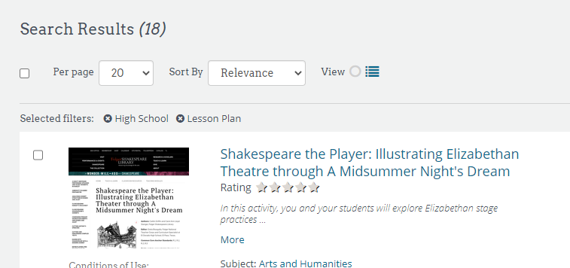
Removing search parameters
To remove a search parameter just click on the cancel button at the top of the search page
Notes:
Dorann

Slide 41
Resources to check out!
The next several slides have links to notable resources.
Notes:
Dorann

Slide 42
NE World Language Collection
Notes:
Dorann

Slide 43
University of Kansas - Language Study
22 resources many full courses
KU Asseso website
Other KU Language Materials
Notes:
Dorann

Slide 44
Boise State University
21 resources for various languages
Take a look at the Let’s Chat resources
French
German
Spanish
Chinese Cultural Website
Notes:
Dorann

Slide 45
Spanish Full Courses
SPA 101 - Beginning Spanish (Canvas)
Spanish 101 Textbook (Canvas)
Spanish 102 Textbook (Canvas)
Introductory Spanish
Notes:
Dorann

Slide 46
French
Francais Interactif
French Distance Learning Units and Pacing Guides
French Grammar Games
Notes:
Dorann

Slide 47
German
German 101
Grenzenlos Deutsch
Willokommen: Deutsch fur Alle
Notes:
Dorann

Slide 48
Chinese
Elementary Chinese 1
Elementary Chinese 2
Notes:
Dorann

Slide 49
Other
COERLL - World Language 78 resources
PBS World Languages and Culture
Center for Applied Second Language studies
Notes:
Dorann - Check these

Slide 50
World Language OER
Search terms
Microsites
Other OER online

Slide 51
THANK YOU!
Any questions?

