Slide 1
NSCAS Roadshow 2023-2024

Slide 2
Statewide Assessment Staff
Director – Trudy K Clark, Ed.D.
Assistant Director – Cassandra Seiboldt
Assessment Program Coordinator - Margaret Sis
Special Education Assessment Liaison - Sharon Heater
ACT Coordinator, Onsite Liaison for the NDE – Iris Owens
Competitive Grants for State Assessments Specialist - Rhonda True
Senior Professional Learning Consultant - Aly Martinez Wilkinson
NAEP Coordinator – Polly Bowhay
Special Guest - ELPA 21 - Anne Hubbell
Office Associate - Kelly Baehr

Slide 3
Thank you!!!!
Thank you to all the educators that participated in
•Item writing
•Alignment studies
•English Language Arts Achievement Level Descriptor reviews
•English Language Arts instructional supports reviews
•Math extended indicator review
•Standard setting and policy reviews
that took place this spring and summer!!! You have amazing educators in your buildings! We appreciate them giving us their valuable time!

Slide 4
Agenda
Formative Assessment Supports Network (FASN)
All Things Science
Professional Learning
NAEP
ACT
ELPA 21 & ALT ELPA
Alternate Assessment
NSCAS Growth
DAC 101

Slide 5
Mission of NDE
To lead and support the preparation of all Nebraskans for learning, earning, and living.

Slide 8
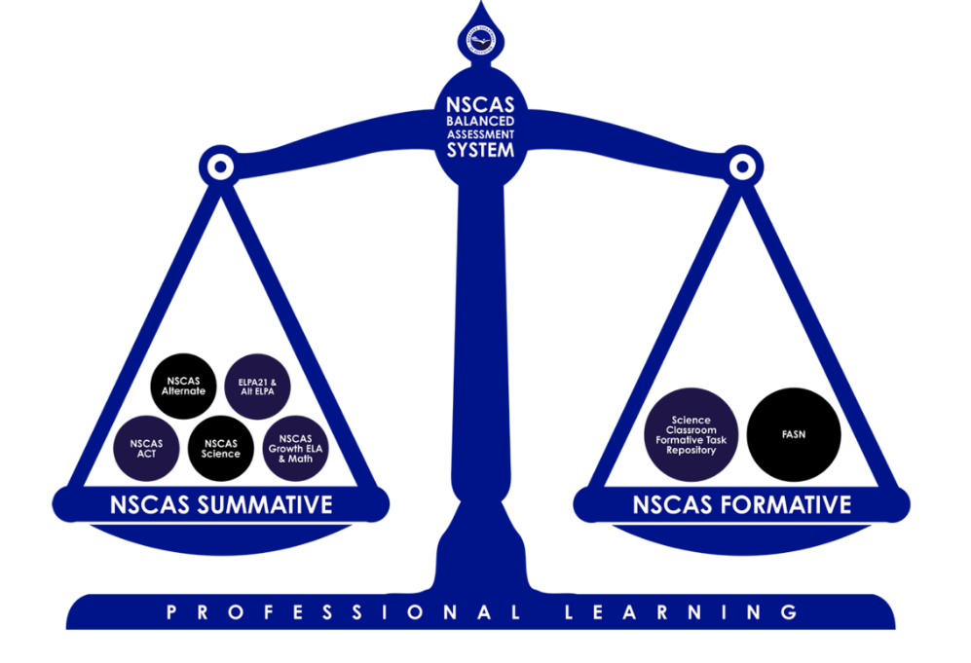
NSCAS Balanced Assessment System

Slide 9
Formative Assessment Supports Network
A system of supports for Nebraska educators designed to advance assessment literacy and focus on the implementation of formative assessment practices to strengthen effective instruction and propel student learning statewide.

Slide 10
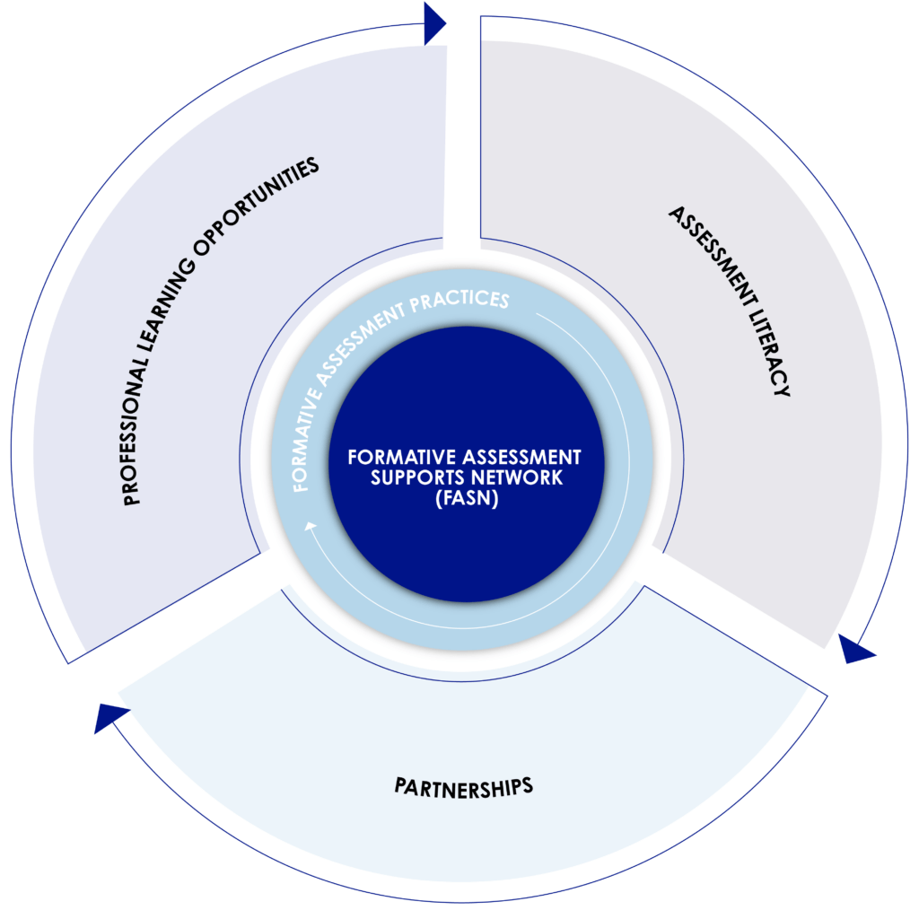
Formative Assessment Supports Network

Slide 11
Formative Assessment Supports Network
“The success of formative assessment as an enabler of learning depends on the knowledge and skills of teachers to implement this approach in collaboration with their students . . . .”
—Margaret Heritage
Source: Margaret Heritage, “Formative Assessment: An Enabler of Learning,” Better: Evidence-Based Education (Spring 2011): 19.

Slide 12
What are the supports?
Professional learning for all program participants
Coaching for teachers
Professional learning communities
Coaches’ network
Customized professional learning for coaches
Professional learning consultant support for coaches
Asynchronous learning resources

Slide 13
FASN
We currently have 10 coaches in our network receiving support from Aly Martinez Wilkinson and, in turn, supporting teachers.
Principals or instructional leads who are looking for resources to support formative assessment practices in the classroom can contact Aly or Cassie and they will connect them to our resources.

Slide 14
All Things Science
Rhonda True
CGSA Specialist
rhonda.true@nebraska.gov

Slide 15
Science Classroom Formative Task Repository
K-12

Slide 16
NE Science System
Instructional Materials Crosswalk example
Instructional Materials
Formative Classroom Assessment Repository
Teacher Guides
Criteria for HQIM
Instructional Shifts
Password: ScienceFA
Design Processes and Tools
Indicators
Assessment Shifts

Slide 17
NE Science System
Instructional Materials Crosswalk
Supporting the development of student sensemaking
Measuring student sensemaking through 3D transfer tasks
Instructional Materials
Formative Classroom Assessment Repository
Teacher Guides
Criteria for HQIM
Instructional Shifts
Design Processes and Tools
Indicators
Assessment Shifts
Notes:
Model with all the component parts of our system

Slide 18
NSCAS Science Assessment System Components
*
*Common Thread: Professional learning for educators*
Interim Assessments (district chosen)
- District Benchmarks with PAD
- MAP Growth
- SIPS End of Unit tasks
Classroom Tasks
(K-12)
NDE Formative Task Repository
K-12
Statewide Summative (5,8,11**)
**ACT for 3rd year cohort

Slide 19
Features to Maintain Consistency
Phenomena and Problem-
focused
Engage diverse sense-
making
Require reasoning with evidence
Grade
appropriate 3D
targets
Demonstrate science under-
standing by doing science

Slide 20
NDE Science Statewide Assessment webpage
Password:
ScienceFA

Slide 21
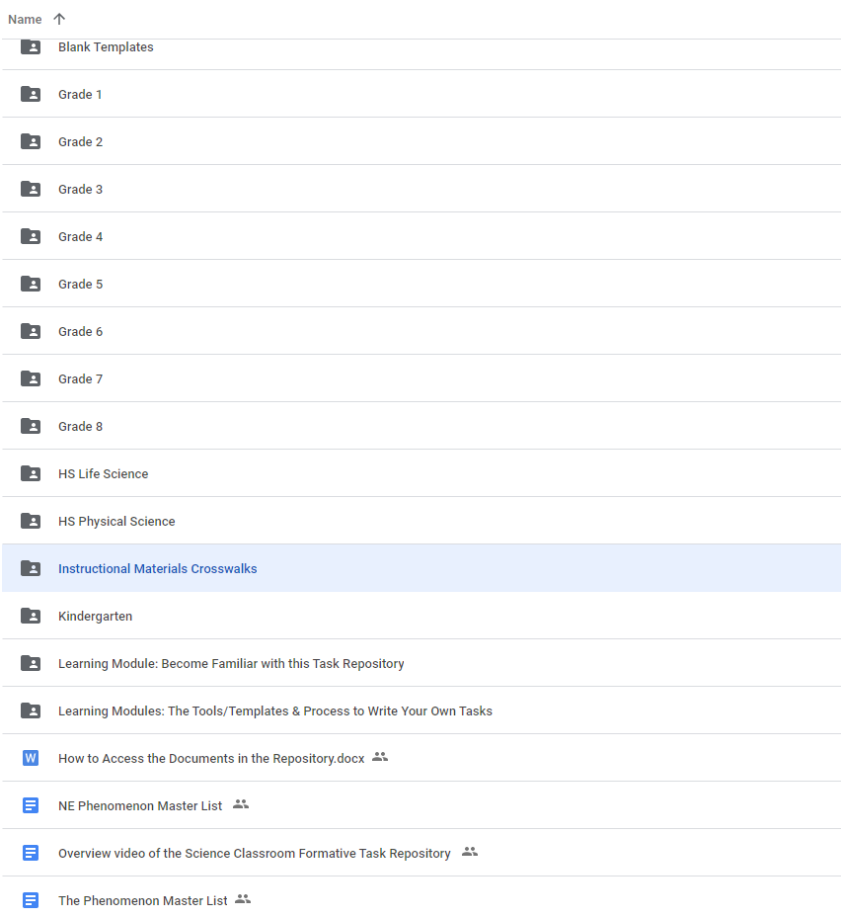
Task Repository
3D tasks for K-12 Developed by NE educators
Focus on NE phenomena
Multiple purposes/uses
Crosswalks to IMs
Educative resources
modules
design tools
administration guides
videos
Password:ScienceFA

Slide 22
Sample 2nd grade task
SC.2.3.1 Gather, analyze, and communicate evidence of the structure, properties, and interactions of matter.
https://docs.google.com/document/d/1wlJav_qc3Q5eXMONII-n4KEk7bNe2oLV/edit

Slide 24
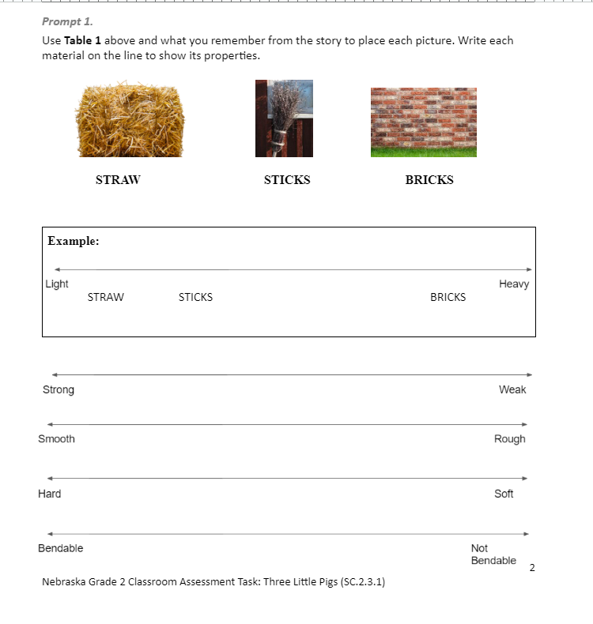

Slide 25
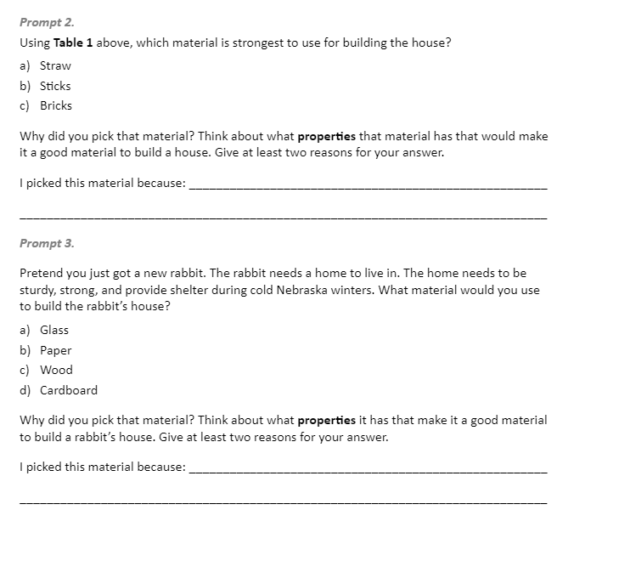

Slide 26
SIPS & CASCIA
Connections to NSCAS Science System

Slide 27
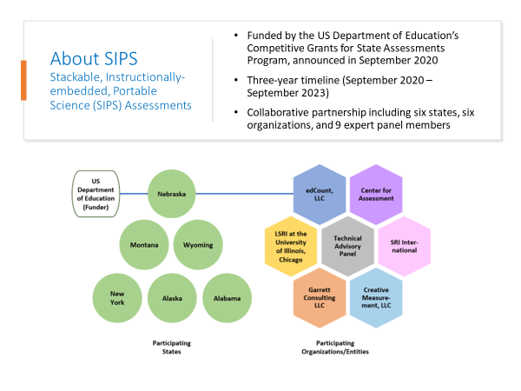

Slide 28
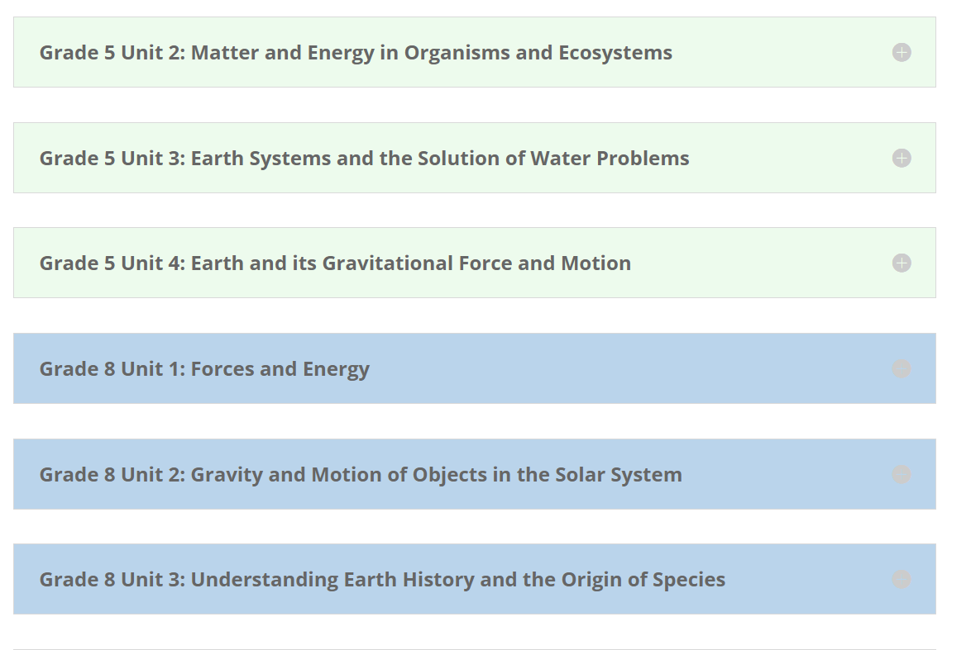
SIPS Resources
Four Units @ 5th & 8th
Built around bundles of performance expectations.
Give opportunity for students to transfer their understanding.
Developed by educators from 6 states.

Slide 30
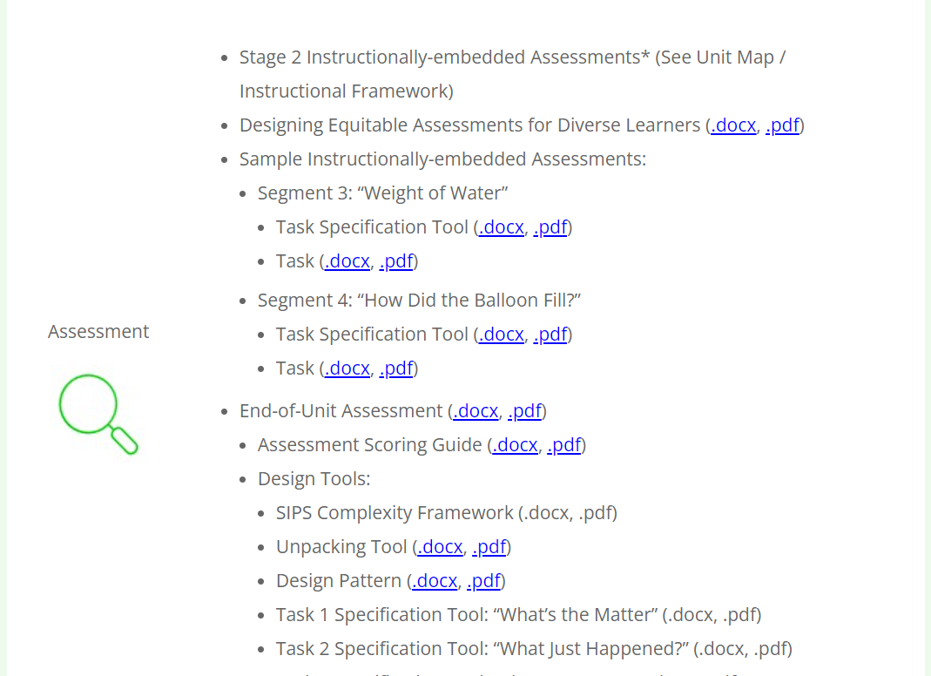

Slide 32
NE Science System
Instructional Materials Crosswalk example
Instructional Materials
Formative Classroom Assessment Repository
Teacher Guides
Criteria for HQIM
Instructional Shifts
Password: ScienceFA
Design Processes and Tools
SIPS Instructional Framework & Resources
Indicators
SIPS EOUs (in the repository for grades 5 & 8)
Assessment Shifts
Notes:
How SIPS fits into NE Science System

Slide 33
SIPS Interim Tasks in the Science Formative Task Repository

Slide 34
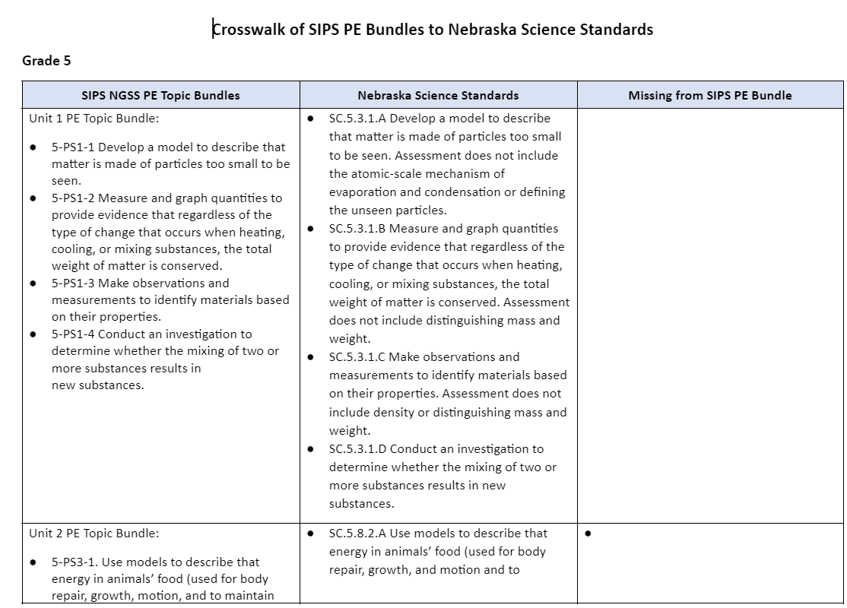
Aligned to NE Standards
Crosswalk of SIPS PE Bundles to
NE Science Standards

Slide 38
2023-24 Pilot in NE
10 districts
six grade 8 teachers
four grade 5 teachers
Administer four SIPS End of Unit Assessments (EOUs)
Score student work and submit
Generates
Individual Student Reports
Classroom Roster Reports
Task Interpretation Guides
Instructional Strategies & Interpretive Guidance to support their instruction and communication with parents.

Slide 39
Available to pilot teachers in 2023-24
Available to all teachers in 2024-25

Slide 40
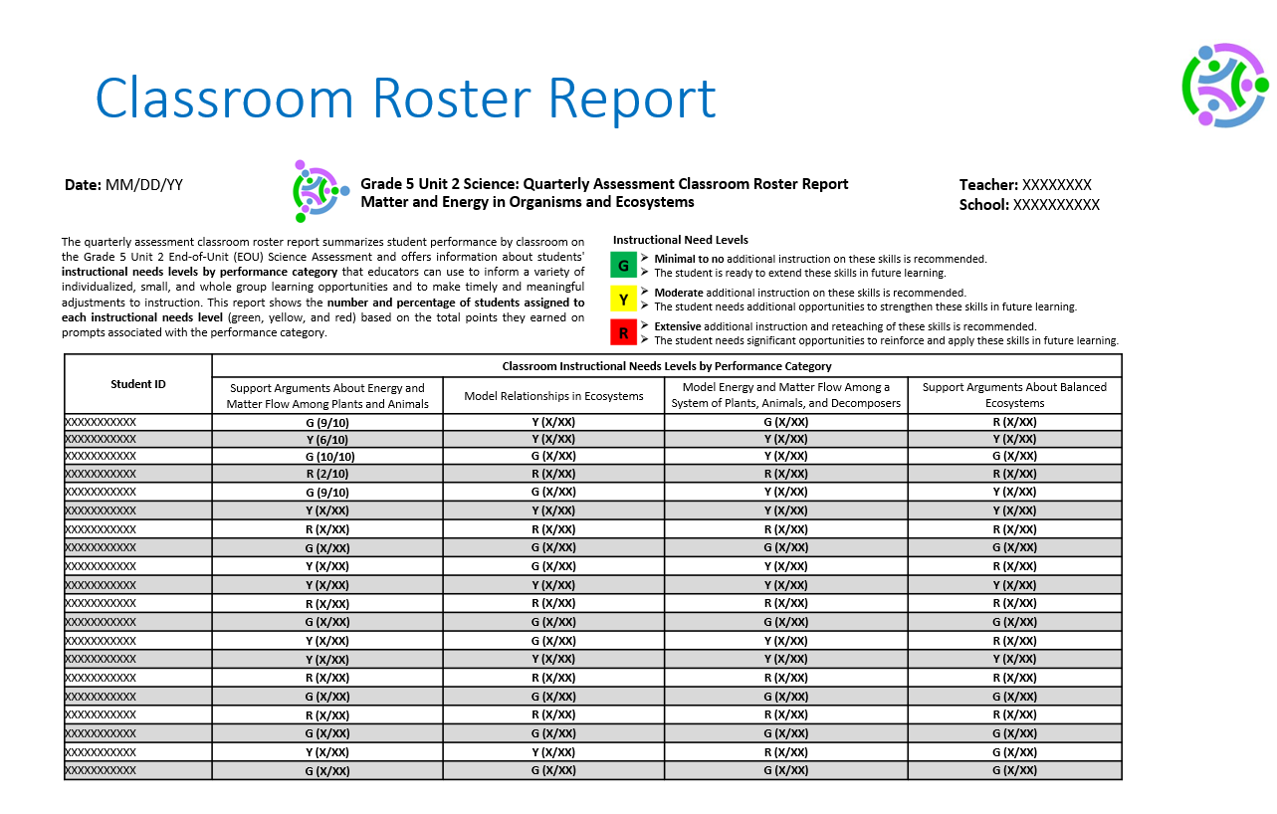
Available to pilot teachers in 2023-24
Available to all teachers in 2024-25

Slide 41
Available to pilot teachers in 2023-24
Available to all teachers in 2024-25

Slide 42
Available to pilot teachers in 2023-24
Available to all teachers in 2024-25

Slide 43
Professional Learning

Slide 44
Professional Learning
·Deepening educator understanding of NSC­AS tools and foundational practices
·Providing data coaching to support the use of MAP® Growth™ and NSCAS Growth data in conjunction with other measures included in NSCAS
·Delivering tailored formative practice and interim offerings that meet the unique needs of learners in each district

Slide 45
NSCAS Professional Learning Goal Statements
Expand assessment literacy across the Nebraska education ecosystem
Build and maintain a student-centric focus in all assessment discussions and decisions to ensure equity for all students
Emphasize and develop formative classroom practices as key components of a balanced assessment approach
Develop and drive data-informed decision-making including assessment results at the student, classroom, school, and system levels
Serve as a resource in response to the differentiated needs of districts and ESUs

Slide 46
Nebraska Balanced Assessment System Definition
Areas of focus
Balanced assessment system plans
Assessment literacy and communication
Appropriate use and interpretation
Culturally responsive pedagogy, curriculum, and assessments

Slide 47
Certified Facilitator Program (CFP)
Advanced train the trainer model
Began in 2017
72 slots for Certified Facilitators
Professional Learning Online
Workshops and webinars
Networking meetings
Monthly eNewletters

Slide 48
Program features
Self-paced online resources for capacity building in product knowledge
Unlimited online access to facilitator/workshop materials once certified in the content
On-demand content, Q&A, and CF webinars
Monthly eNewsletters
Onsite and distance learning training
Dedicated support from NWEA

Slide 49
Role of a Certified Facilitator
Support educators across the state in these areas:
–Developing further assessment literacy
–Implementing formative practice in the classroom
–Interpreting and applying different assessments results

Slide 50
Role of a Certified Facilitator
Provide information about future professional learning needs of Nebraska educators
Continue to develop their own understanding of Nebraska’s system to support a balanced assessment system

Slide 51
NAEP
National Assessment of Educational Progress
Polly Bowhay-Nebraska NAEP State Coordinator
Notes:
NAEP is a federally mandated program. We will receive Nebraska scores but not individual school scores. It is important that our students in Nebraska give their best effort.

Slide 52
NAEP 2022
Main NAEP occurs every other year
4th and 8th
Reading and Math
Results-Nation’s Report Card
https://www.nationsreportcard.gov/
Notes:
NAEP used to occur on “odd years”. We got off track because NAEP was scheduled to happen in 2021 but because of the pandemic NAEP was rescheduled and held in 2022. NCES is recommending that NAEP move back to “odd years”. It will take an act of Congress to move back to “odd years”.

Slide 53
NAEP 2024
4th grade, 8th grade, 12th grade
Reading and Math
Science/8th grade
High School Transcript Study-12th

Slide 54
NAEP 2024
109 districts have been selected
231 schools have been selected
All districts and schools have been notified
Notes:
NAEP test facilitator will bring Microsoft surface pros or chromebooks will be brought to the schools,

Slide 55
Dorchester Public School
East Butler Public Schools
Elba Public Schools
Elgin Public Schools
Elkhorn Public Schools
Emerson-Hubbard Public Schools
Fillmore Central Public Schs
Fort Calhoun Community Schs
Fremont Public Schools
Garden County Schools
Gordon-Rushville Public Schs
Gothenburg Public Schools
Grand Island Public Schools
Gretna Public Schools
Hartington Newcastle Public Schools
Harvard Public Schools
Hastings Public Schools
Heartland Community Schools
Hemingford Public Schools
Hershey Public Schools
High Plains Community Schools
Hitchcock Co Sch System
Homer Community Schools
Howells-Dodge Consolidated Schools
Humphrey Public Schools
Isanti Community School
Johnson-Brock Public Schools
Adams Central Public Schools
Alliance Public Schools
Alma Public Schools
Amherst Public Schools
Arlington Public Schools
Ashland-Greenwood Public Schs
Aurora Public Schools
Bancroft-Rosalie Comm Schools
Bayard Public Schools
Beatrice Public Schools
Bellevue Public Schools
Bennington Public Schools
Blair Community Schools
Boyd County Schools
Bridgeport Public Schools
Central City Public Schools
Central Valley Public Schools
Centura Public Schools
Chadron Public Schools
Cody-Kilgore Public Schs
Columbus Public Schools
Conestoga Public Schools
Creighton Community Public Schs
Crete Public Schools
Crofton Community Schools
Cross County Community Schools
Doniphan-Trumbull Public Schs
Kearney Public Schools
Kenesaw Public Schools
Laurel-Concord-Coleridge Schs
Leigh Community Schools
Lexington Public Schools
Lincoln Public Schools
Malcolm Public Schools
Mead Public Schools
Millard Public Schools
Mullen Public Schools
Nebraska City Public Schools
Neligh-Oakdale Schools
Newman Grove Public Schools
Niobrara Public Schools
Norfolk Public Schools
Norris School Dist 160
North Platte Public Schools
Oakland Craig Public Schools
Omaha Public Schools
Ord Public Schools
Overton Public Schools
Palmer Public Schools
Papillion La Vista Community Schs
Paxton Consolidated Schools
Pierce Public Schools
Plainview Public Schools
Plattsmouth Community Schools
Pleasanton Public Schools
Ralston Public Schools
Randolph Public Schools
Riverside Public Schools
Schuyler Community Schools
Scottsbluff Public Schools
Springfield Platteview Community Schools
Shelby - Rising City Public Schools
So Sioux City Community Schs
South Platte Public Schools
St Paul Public Schools
Stuart Public Schools
Sutton Public Schools
Thayer Central Community Schs
Thedford Public Schools
Tri County Public Schools
Umo N Ho N Nation Public Schs
Valentine Community Schools
Wakefield Public Schools
Walthill Public Schools
Waverly School District 145
Wayne Community Schools
West Kearney High School
Westside Community Schools
Winnebago Public Schools District 17
Wood River Rural Schools
York Public Schools
Notes:
List of Districts

Slide 56
High School Transcript Study-12th grade only
The High School Transcript Study explores the relationship between grade 12 NAEP achievement and high school academic careers by surveying the curricula being followed in our nation’s high schools and the course-taking patterns of high school students through a collection of transcripts.
Bennington Public Schools
Conestoga Public Schools
Crete Public Schools
Gretna Public Schools
Lincoln Public Schools
Mead Public Schools
Millard Public Schools
Norfolk Public Schools
Omaha Public Schools
Paxton Consolidated Schools
Notes:
Contact me with any questions/concerns. I’m happy to problem solve with you. This is not a new study. We will need a school coordinator designated for each school.

Slide 57
New for NAEP 2024
Registration/Information Platform-AMS (Assessment Management System)
NAEP is moving to using school-based internet to conduct the assessment
District Technology Coordinator will complete an internet connectivity survey
On-Site Technology Coordinator will be identified for each school
On-Site Technology Coordinator will have an assessment planning/ zoom meeting with the NAEP testing coordinator prior to the testing date
On-Site Technology Coordinator needs to be on site the day of the assessment to provide credentials and/or help with accessing WiFi on NAEP devices
Notes:
If the school does no have the internet support needed to give NAEP we will use the NAEP private network,as in the past.
NAEP is moving to using school internet and school devices in the future.

Slide 58
NAEP District/School Tasks
School Principal identifies a school coordinator and onsite technology coordinator-September
School Coordinator registers on the AMS system and completes school information-September
District Technology Coordinator registers on the AMS and completes an internet survey-October/November
School Onsite Technology Coordinator registers on the AMS system-October/November
DACs may register on the AMS if they are interested
Notes:
Assessment Management System
Principal and school coordinator can be the same person
School Coordinator and On-Site technology Coordinator can be the same person
Don’t recommend that the principal, school coordinator and technology coordinator all be the same person….contact me if this applies to your school

Slide 59
Supporting NAEP
Please be positive about district/school participation in NAEP
Communicate with schools to make sure principals have assigned a school coordinator and an on-site technology coordinator
I will be in contact with you if there are schools that are not completing the required tasks
Notes:
NAEP is important. We want Nebraska to be well represented NAEP results make national headlines. Our legislature also pays attention to NAEP/Nebraska results.
If your district was not selected this year it will most likely be selected in the future.

Slide 60
Polly Bowhay
531-207-4252
polly.bowhay@nebraska.gov
Notes:
Contact me with any questions/concerns. I’m happy to problem solve with you.

Slide 61
NSCAS ACT 2023-2024
Iris Owens
Nebraska Onsite Liaison

Slide 62
NSCAS ACT- What’s New
EBAE has been retired as a Braille Test Option
Prohibited Behavior policy is updated.
Calculator Policy will no longer be shipped with test materials.
Styli for iPad Approved for Online Testing
Video Monitoring Systems Policy Added to Test Administration Manuals
Pre-recorded Audio- URL
Proctor Caching No Longer Recommended
Extended Online Testing
National Online Testing Pilot
Notes:
EBAE has been retired as a braille option. ACT will continue to offer UEB Math/Science and UEB with Nemeth forms to support our blind and visually impaired students.
Thanks to Dr. Trudy Clark’s persistence, The ACT Prohibited Behavior policy has been updated. Examinees who have been dismissed for prohibited behaviors will be allowed to retest.
The ACT Calculator Policy will no longer be shipped with test materials. Please see the link in the resources page of this slide deck.
ACT does not allow closed-circuit television (CCTV) in the test center/site. Please disable or cover CCTV cameras in the testing room. If your test center/site must use CCTV cameras in the testing room, and they cannot be removed, you must take steps to ensure the cameras are not positioned to capture test content during testing. The test center's/site's use of video monitoring and storage of recordings must fully comply with the laws of your jurisdiction, and you agree that the recording is not done at ACT's request. As a reminder, no other cameras are allowed in testing rooms.
Pre-recorded audio is no longer distributed on USB drives. Pre-recorded audio will be available via the internet. Information will be provided in the Pre-recorded Audio Supplement, which will be posted on your test administration platform home page closer to test dates. If you are unable to access pre-recorded audio via the internet, contact ACT for options.
ACT no longer recommends proctor caching for online testing, and the proctor caching process has been removed from test administration manuals. Eliminating proctor caching will simplify technical readiness documentation from ACT and reduce setup complexity for sites, while not increasing online testing risks.

Slide 63
2023-2024 ACT Test Dates
NSCAS ACT 2023-2024 Test Window 1 Initial
Standard Administration (Paper): March 26, 2024
Accommodations Administration (Paper): March 26-29 & April 1-5
Standard & ACT-Authorized Accommodations (Online): March 26-29 & April 1-5
NSCAS ACT 2023-2024 Test Window 2 Initial and Makeup
Standard Administration (Paper): April 9, 2024
Accommodations Administration (Paper): April 9-12 & April 15-19
Standard & ACT-Authorized Accommodations (Online): April 9-12 & April 15-19
NSCAS ACT 2023-2024 Test Window 3 Make-up Only
Standard Administration (Paper): April 23, 2024
Accommodations Administration (Paper): April 23-26 & April 29-30, May 1-3
Standard & ACT-Authorized Accommodations (Online): April 23-26 & April 29-30, May 1-3

Slide 64
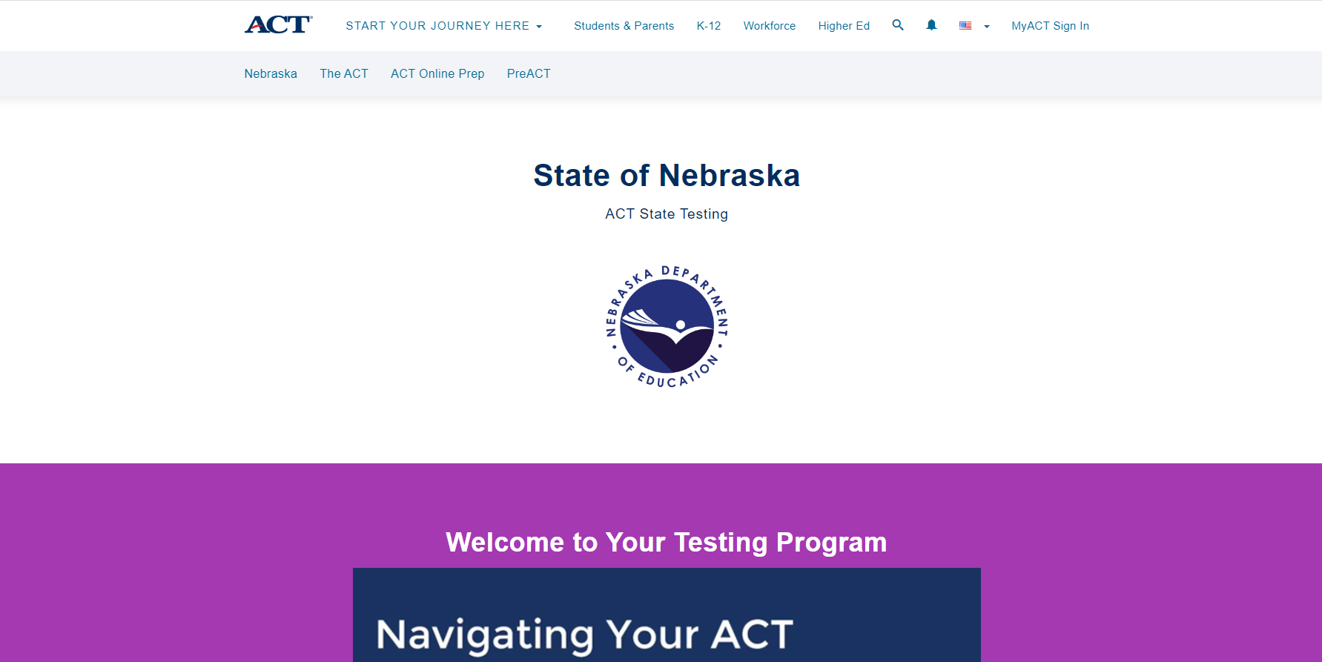
ACT-NE Website
Notes:
I want to encourage you to bookmark and refer to the ACT-Nebraska website for updates on the ACT, PreACT and ACT Online Prep. This is a great location to find videos, trainings, manuals and user guides for all the processes you will complete for the ACT.

Slide 65
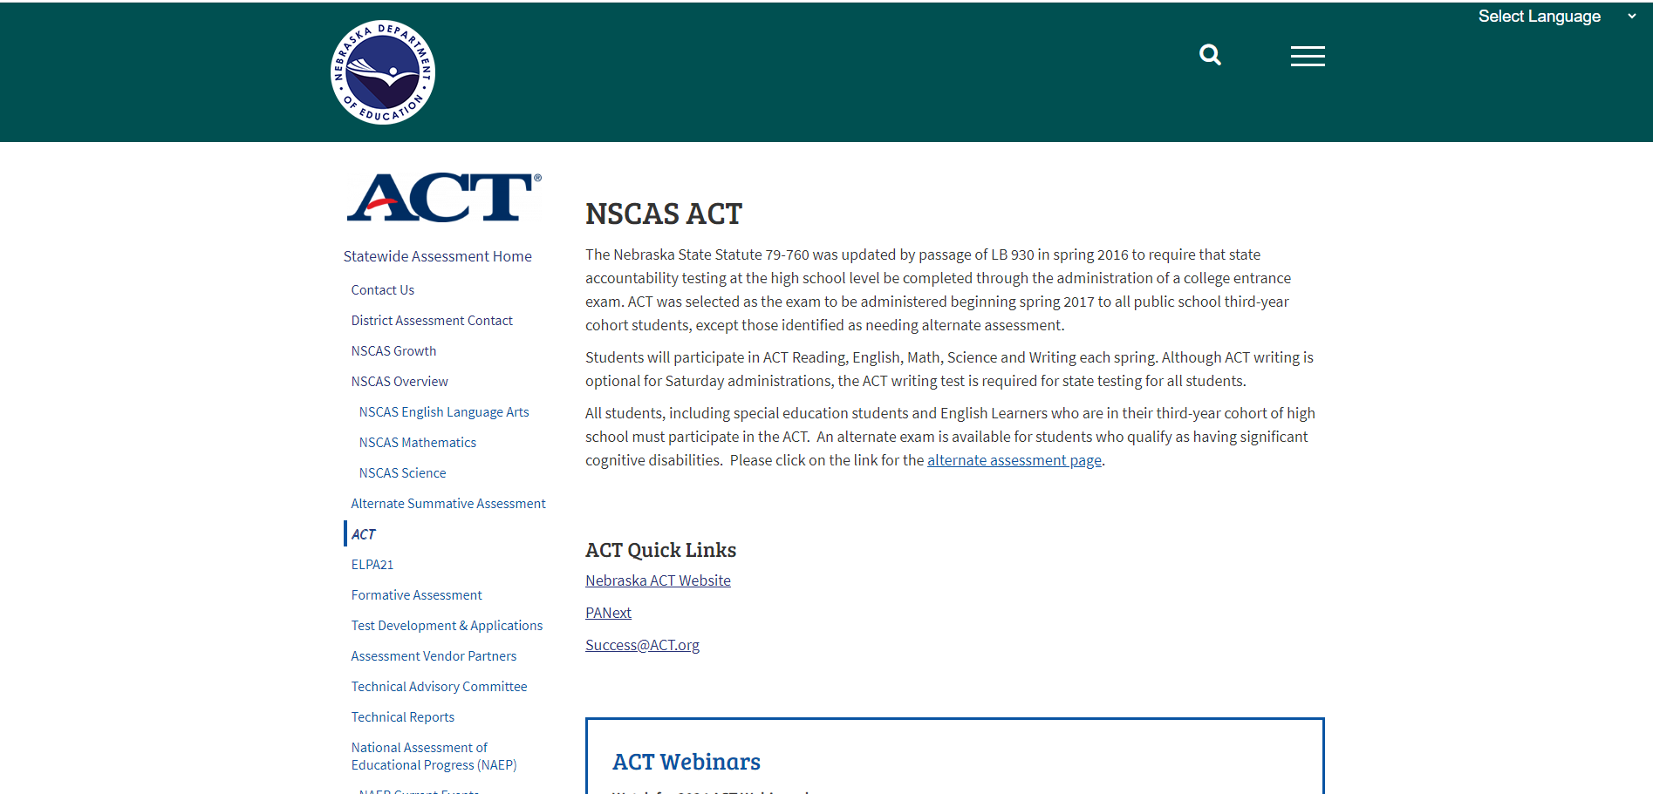
NSCAS ACT Webpage

Slide 66
Who tests? Special Programs, Alternate and Foreign Exchange Students
If you have a 3rd year cohort student who is enrolled in your district, and is not an alternate student, they are expected to test.
Students attending special programs or centers and are part of the 3rd year cohort are expected to test. Contact those who provide student instruction to be sure the student is tested. Accommodations requests are normally requested by the district or school.
ACT does not have an Alternate test, accommodations and English Learners supports can be requested in the Test Accessibility and Accommodations system (TAA).
Foreign Exchange students included in the 3rd year cohort are also expected to take the ACT.

Slide 67
DACs and Test Coordinators
PearsonAccessnext (PAnext)-Every district will be required to have an account for the DAC and each high school will need an account for each school’s test coordinator. Iris can assist with these accounts.
SuccessACT- Accounts for the individual needing access to student score reports and district reports, accounts for Accommodations requests in TAA, are created by the individuals.
Test Coordinators are responsible to be sure proctors and room supervisors are prepared for testing.
Test Coordinators cannot be athletic coaches or have family who will be testing in the same administration.
The ACT Schedule of Events and the Test Coordinator Checklist will be available on the ACT website in October.
If you have a new ACT Test Coordinator for any of your schools, please let Iris or Maggie Sis know.
Notes:
PA next accounts can be set up by the DAC or contact Iris for assistance
Success Accounts are created by the individuals and the access is determined by the role the person plays in the school. Trusted Agent access is the most complete access. If you need assistance with creating the account or access, please contact Iris.

Slide 68
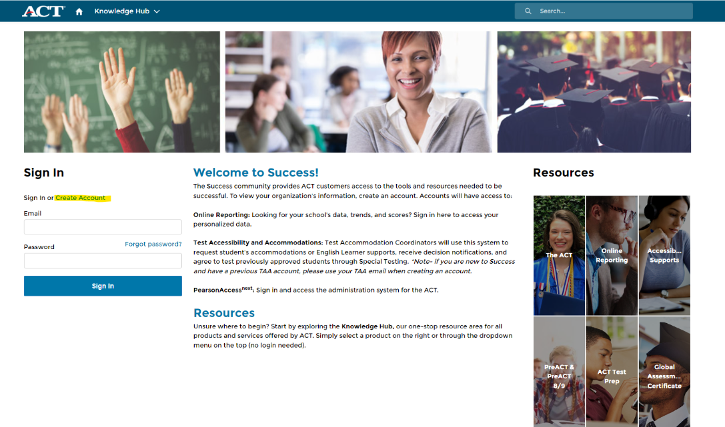
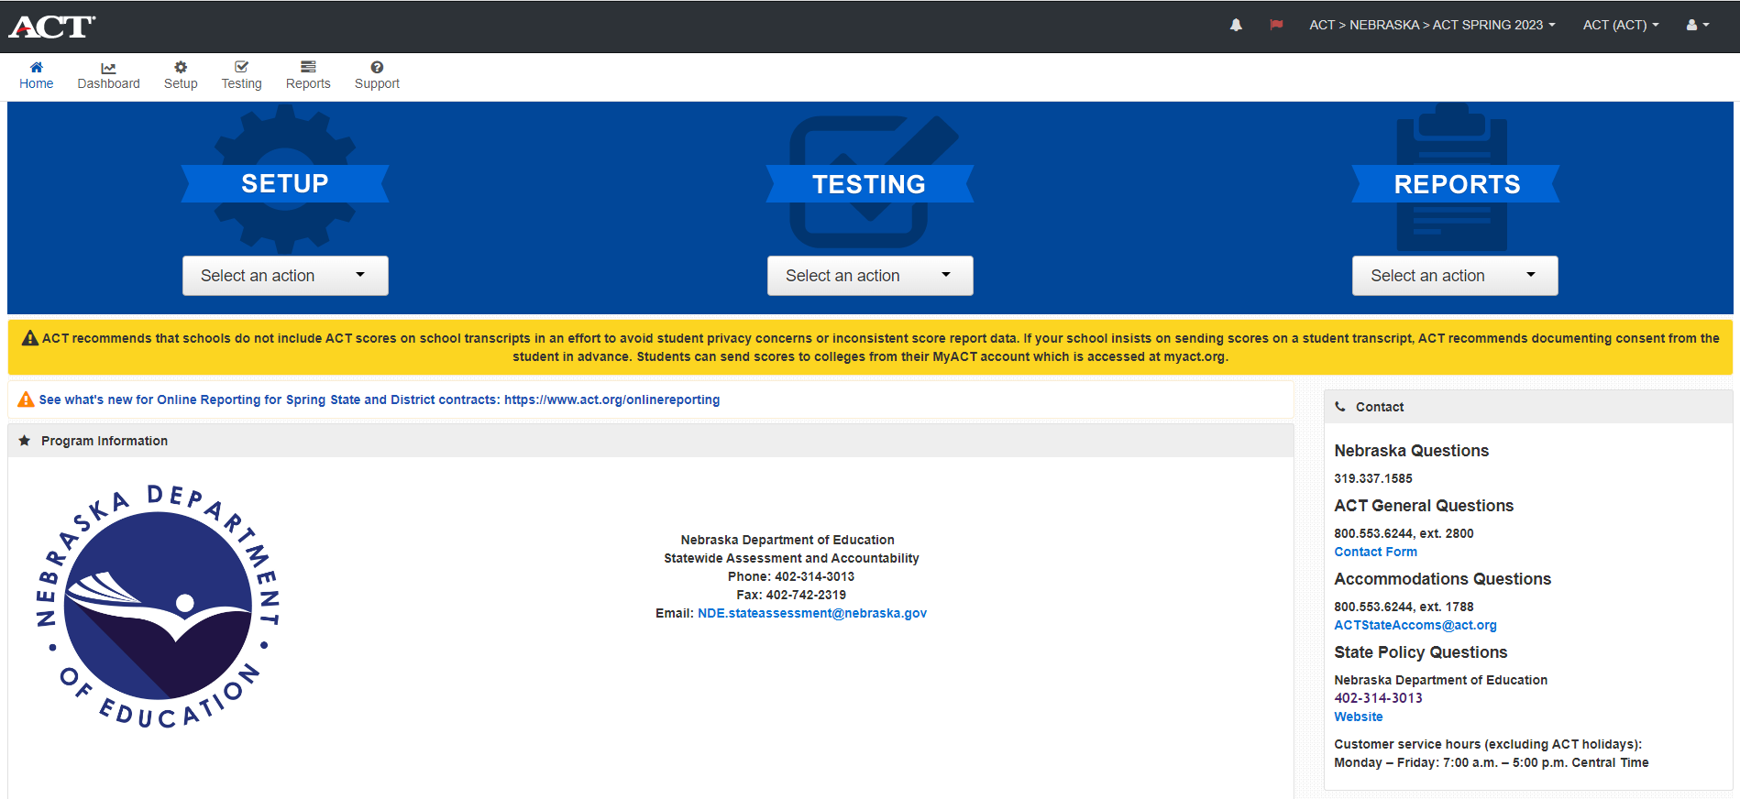
ACT Systems and Platforms
Notes:
PearsonAccessnext- Accounts for the DAC, the Test Coordinator, Technical Coordinator and Room Supervisors who test online. Recommend asking Iris to set up this account for DACs and TCs.
Success.ACT.org Create accounts for test scores, district and school reports and ACT accommodations in the Test Accessibility and Accommodations system (TAA). These accounts are created by the individual, assistance is available from Iris
CCRIS: Readiness.org is the system to order PreACT tests. These accounts are created by the individual.

Slide 69
ACT Accommodations and EL Supports
Accommodations and EL Support requests were opened in TAA on September 11, 2023, and the deadline for initial request is February 2, 2024. NDE and ACT encourage schools to request as early as possible.
ACT Accommodations and EL Support Webinar is scheduled for October 5, 2023, 2 pm. Registration Link
Most accommodations and EL supports can be provided in the Online testing platform.
Audio accommodations still include human reader and now URL with password for internet recording of test.

Slide 70
ACT Misadministrations
Misadministrations 2023: 16 misadministrations were investigated, doubled over the 2022 numbers.
Missing test times, timing overages and wrong test materials were the issues
Testing with unauthorized or unapproved accommodations
Irregularity reports also mentioned bells and announcements were reported as interruptions to testing
Online issues included firewalls not allowing access to the online platform, lack of internet access and sessions set up incorrectly

Slide 71
Prohibited Behaviors
Prohibited Behaviors 2023: 65 prohibited behaviors ended in voided scores; this is compared to 95 in 2022.
Working ahead or behind
Electronic Device going off during testing
Disruptive behavior
Ideas/Suggestions to lessen the possibility of this happening:
Online testing, not able to work ahead or behind
Remove all cell phones from the room
Offer small group or individual testing rooms (local decision)

Slide 72
Prohibited Behaviors
New for Spring 2024:
If a student has a voided test due to prohibited behaviors, they can test again in another test window.
Test Coordinators will need to call ACT Customer Service to be sure to follow instructions for the new test opportunity.

Slide 73
Online Testing
NEW! 27 Online testing dates for all test windows, up from 18 last year. 9 online dates for each window.
2023 saw an increase of over a 1,000 students to test online
Proctor Caching no longer recommended
Additional training for Customer Service Agents to speed up responses and provide correct assistance
iPad keyboards are recommended vs. required
National Online Testing Pilot for 2023-2024 and expectations of online for Saturday testing in 2024 and forward. Paper testing will still be available

Slide 74
District Options
PreACT
Fall PreACT for 3rd year
cohort
Fall PreACT for 2nd year cohort
Spring PreACT for 2nd year cohort
ACT Online Prep
Online Prep that can be used in classroom or individually
Available to 3rd year cohort from Aug 1- June 30

Slide 75
PreACT
Fall and Spring Ordering and Test Windows
PreACT Fall- You may order materials from August 21-November 1, 2023. The test window is October 2– November 22, 2023.
PreACT Spring- You may order materials from January 22- March 22, 2024. The test window is March 4 – April 12, 2024.
ORDER under the Nebraska State Contract
PreACT online will be available in near future

Slide 76
PreACT
PreACT Fall Training Webinar is scheduled for September 21, 2023, and will be recorded. Registration Link
Materials are ordered through CCRIS.
Accommodations are available and will need to be ordered with your standard materials.
Audio accommodations will be via the URL internet recording. The link to the URL and the password will be emailed to the contact who orders the materials.

Slide 77
ACT Online Prep
ACT Online Prep offered to almost 3,000 students, only 740 logged in.
This year the opportunity to use AOP will be available on August 1, 2023, through June 30.
ACT has updated the website with new videos and trainings.
Webinar was presented on August 8 at 10 am CT, link for registration to view recording.

Slide 78
ACT Contacts and Resources
Contact Iris Owens
531.207.9019
iris.a.owens@act.org
ACT NE State Testing Website
NSCAS ACT webpage
Success.ACT.org
CCRIS
ACT Customer Service
800.553.6244 x 2800
ACT Accommodations
800.553.6244 x 1788
ACTStateAccoms@act.org

Slide 79
ELPA21 Assessment Information 2023-2024

Slide 80
Nebraska State Profile 2023
26,543 English Learners
132 English Learners Alt ELPA
8% of total student population

Slide 81
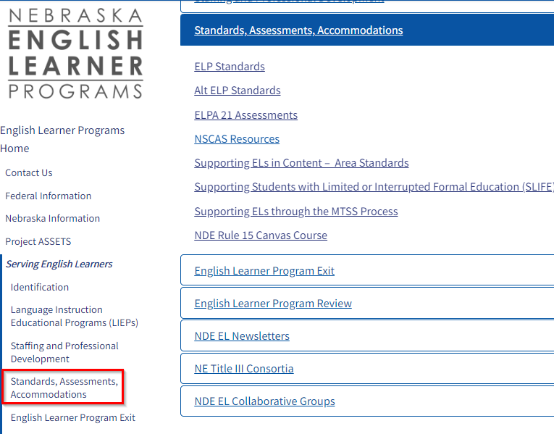
NDE EL Website
Standards, Assessments, and Accommodations

Slide 82
ELPA21 Assessments
ELPA21 Screener
ELPA21 Summative
Alt ELPA

Slide 83
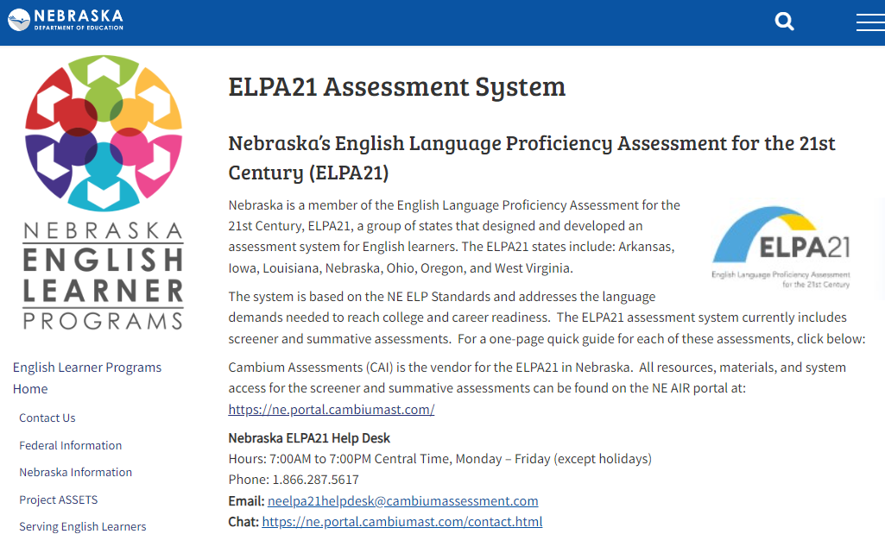
ELPA21 Assessments
ELPA21 Screener
ELPA21 Summative
Alt ELPA

Slide 84
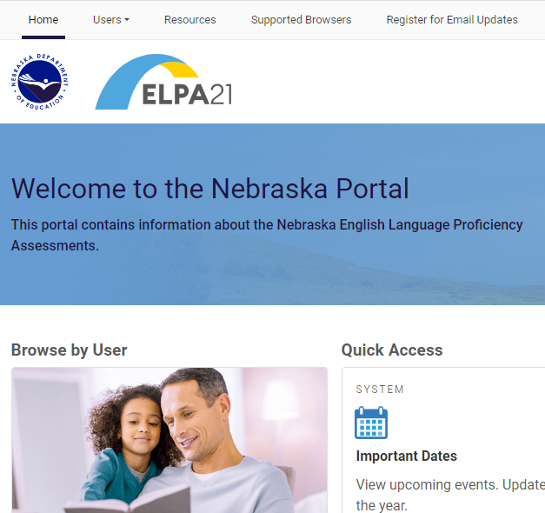
Guidance for New Users
Directions for
Before Testing
During Testing
After Testing
Links to helpful documents
Nebraska Portal: https://ne.portal.cambiumast.com/

Slide 85
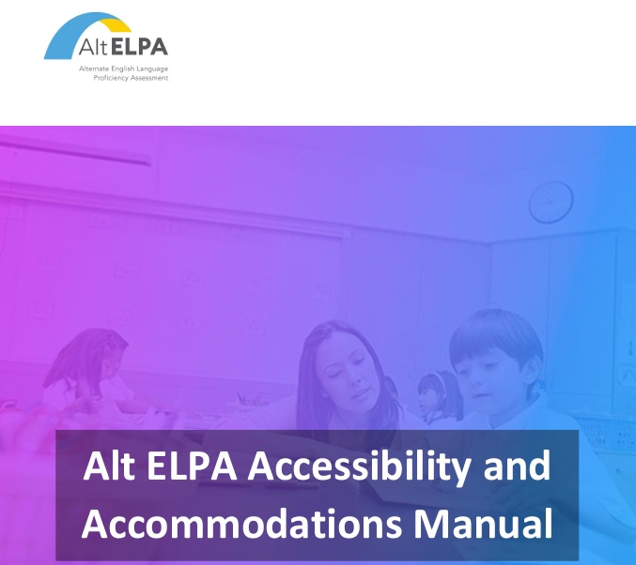
Accessibility and Accommodations
ELPA21 Accessibility and Accommodations Manual
Alt ELPA Accessibility and
Accommodations Manual

Slide 86
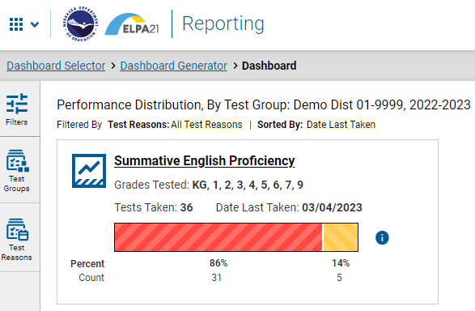
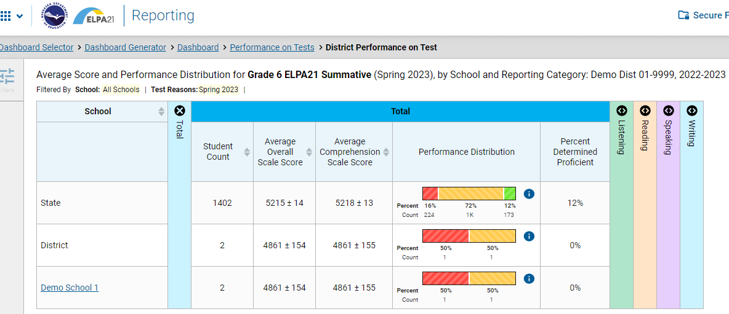
Reporting
Reporting System User Guide
Reporting System Quick Guide

Slide 87
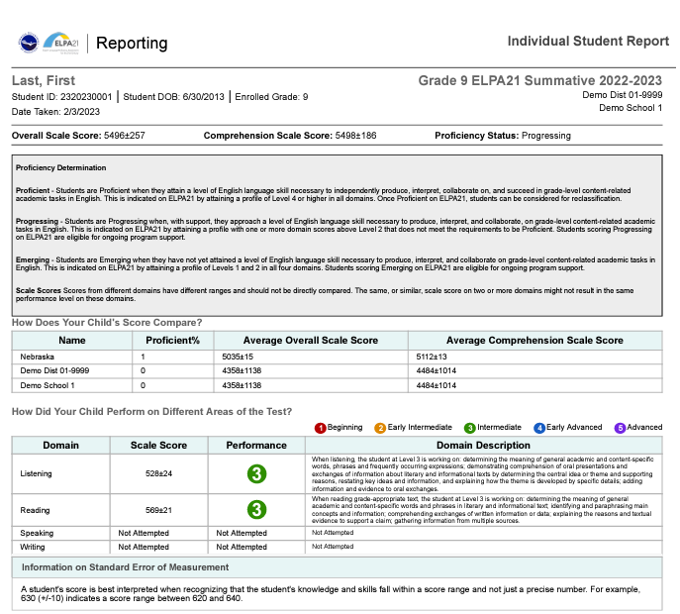
Score Reports - ISR (Individual Score Report)
Demo Student Example
Listening - 3
Reading - 3
Speaking and Writing
Not Attempted

Slide 88
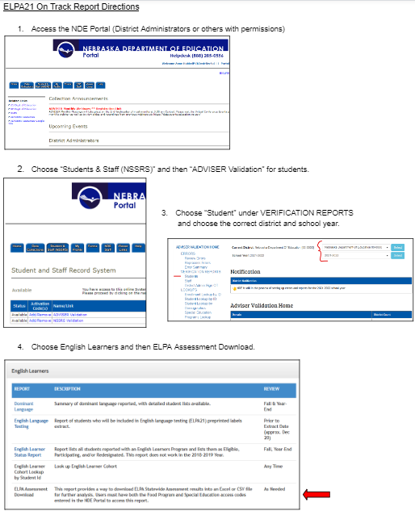
ELPA21 Assessment Download - “On Track” Report
Directions

Slide 89
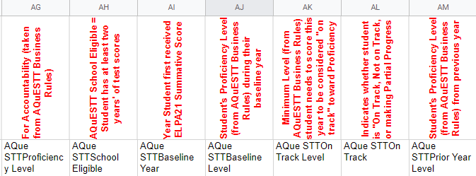
ELPA On Track Report Headings Explained

Slide 90
ELPA Assessment Download “On Track” - Column “AL”

Slide 91
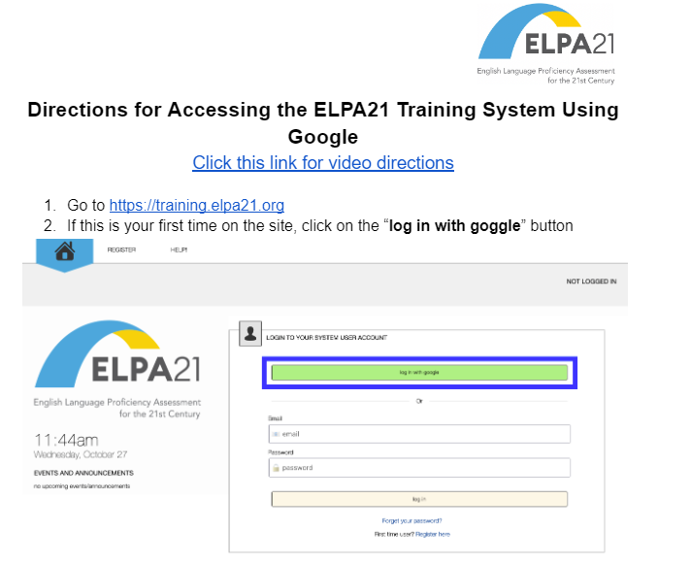
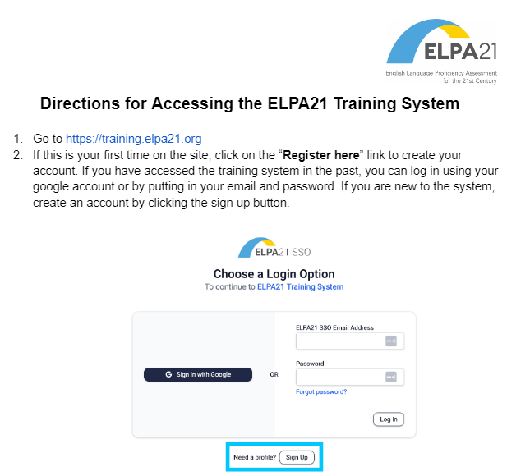
ELPA21 Training Modules

Slide 92
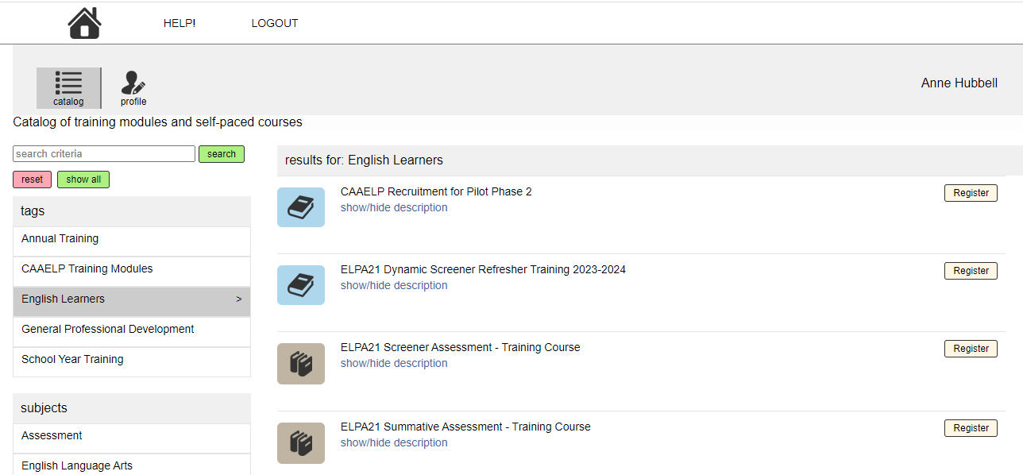
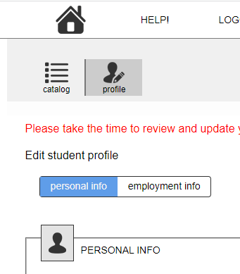
ELPA21 Training Modules

Slide 93
ELP Standards and PLDs (Proficiency Level Descriptors
ELP Standards (Presentation Overview)
Alt ELP Standards
PLDs - all grade bands

Slide 94
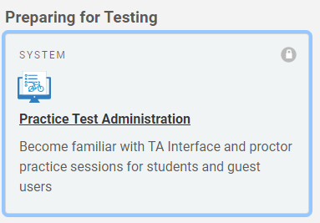
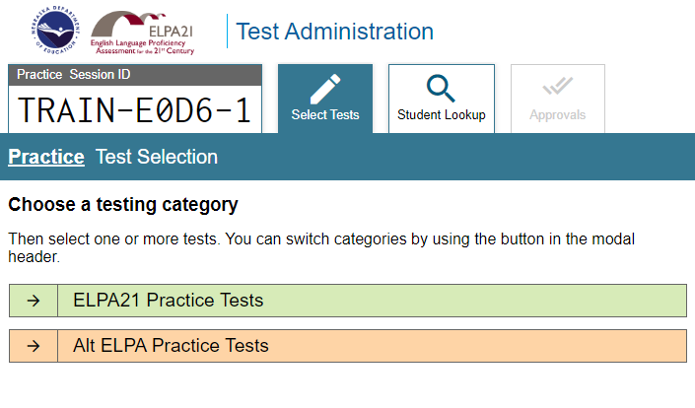
Enrichment and Practice Opportunities for Formative Assessment
ELPA21 Enrichment Activities
EL Toolkits 2021 and 2022 (Can be purchased on the NABE Store Website)
Nebraska Portal - Practice Opportunities

Slide 95
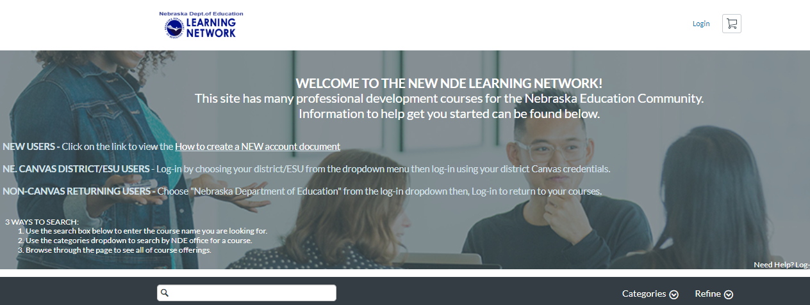
Canvas Courses through NDE
Free for anyone! Can earn a certificate for Professional Learning! Online and Anytime!

Slide 96
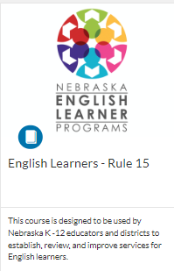
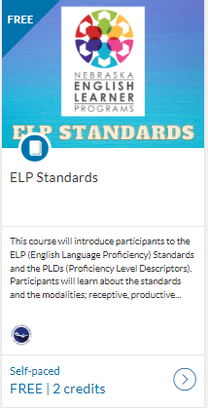
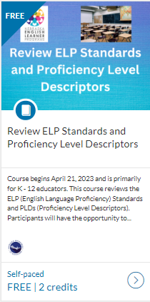
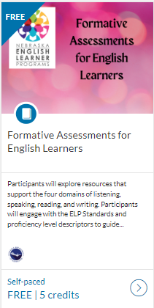
Currently Five Courses for English Learners

Slide 97
Anne Hubbell
English Learner Specialist
anne.hubbell@nebraska.gov
402-405-7017

Slide 98
Alternate Assessment
Sharon Heater
sharon.heater@nebraska.gov
Mary Lenser
mary.lenser@nebraska.gov
Notes:
If you have any questions please reach out to Sharon Heater or Mary Lenser.

Slide 99
NCSAS Alternate Assessment
Students with the most significant cognitive disability
Typically, about 1% of students
Grades 3 – 8, HS (third year cohort) for ELA & Math
Grade 5, 8, HS (third year cohort) for Science
Alternate assessment not ACT
Notes:
Students who take the alternate assessment are those students with the most significant cognitive disability which is about 1% of Nebraska students. Students are tested in grades 3 - 8- and third-year cohort in ELA and Math and grades 5-, 8- and third-year cohort in Science. If students are taking the alternate assessment, they do not take the ACT. Districts need to have a conversation with the parents to make sure that they agree to their child not taking the ACT. There is a place on the alternate assessment criteria where parents can sign that they agree with this determination. Best practices would be that you have them sign this.

Slide 100
Alternate Assessment Flag as entered by districts data manager
Make sure that any student taking the alternate assessment is marked correctly in Adviser
There is a large diversity of cognitive ability for students who take the NSCAS Alternate.
All students, regardless of their cognitive ability, must be administered at least one item on each content assessment to be counted as a participant
If the student does not respond or interact with the assessment and you have sufficient evidence to believe the student is not able to respond, the proctor can stop the assessment
Students that are administered at least one item and do not respond or is not able to interact with assessment should be coded as No Response (NOR)
Document will be available on the alternate assessment page soon
Student cannot be NOR in one content area and take another test in another content area.
Notes:
Students must have the alternate assessment flag marked in Adviser. Review information on the slide. NOR guidance document will be posted on the website. Remember a student who is able to respond in one content area cannot be marked as NOR in another content area. There are other situations where a student doesn’t respond but if they are an NOR student they are not responding because they are not able to interact with the assessment due to their level of the cognitive ability. If you have any questions about these please reach out.

Slide 101
Districts do not receive printed materials
Modes of assessment:
Online (review IEP to help determine what mode to provide student)
Print on demand materials (at the district) (proctor will need to input answers into the platform)
DRC Insight
Recorded proctor training available (will be updated at a later date)
Online Tools Training (practice opportunity for students) available in Insight (also a link on the NDE Alternate Assessment page on website)
NSCAS Alternate Summative Assessment – Nebraska Department of Education
ELA Standard Setting completed July 2023
Science Validation of cut scores completed July 2023
Notes:
DRC does not send out printed materials to districts like in the past. The assessment is available in an online format and paper/pencil which is printed on demand at your district. Proctor will need to enter answers into the online system. If a student is taking the assessment in paper/pencil format it needs to be supported in the IEP that this is the form the student will be using. DRC Insight is where all things alternate assessment will be found. Resources available for the assessment is a recorded proctor training and online tools training which gives student the opportunity to be exposed to the online assessment. Projects that were completed this summer were ELA standard setting and a science validation of the last summer's cut scores.

Slide 102
Determining Student Eligibility
Alternate Assessment Criteria:
Must be reviewed annually and include data to support the decision
Other documents to help in the decision:
Companion to Alternate Assessment Criteria
IEP Team Decision Making Flowchart Alternate Assessment
Most Significant Cognitive Disability Definition
Characteristics of AAS Students (new in 2022)
NSCAS Alternate Summative Assessment – Nebraska Department of Education
Notes:
Determining student eligibility - students must be reviewed every school year just like an IEP to determine if the student still meets all of the criteria and districts must have supporting evidence and data to show how the student meet the criteria. What information did they use. Here is a list of other documents that should be used to help IEP teams determine if the student meets all of the criteria. This link takes you to where these can be found.

Slide 103
One Percent Threshold Requirements
1% Threshold Exception Justification Document
Communication coming later this fall!
All districts are required to complete this document
Take a second to review the directions before sending it in
Make sure all sections required are completed
Do not send any documents that includes student identifiers
Justification Worksheet
Required if you have any students taking the assessment
Make sure staff is being exposed/trained on the NDE Guidance on appropriate identification of students for participation on the alternate assessment.
NSCAS Alternate Summative Assessment – Nebraska Department of Education
Notes:
The 1% threshold is not going away. NDE is still being required to get our participation numbers to 1% as a state. If as a district you are over the 1% threshold then you need to submit to NDE justification as to why you are over. This document is part of the information that Sharon will be sending out within the next couple of months. As you can see on this slide it will be coming to all districts whether you have students or not. You are providing your projection for the 2024 NSCAS assessment. The justification worksheet must be completed by all districts who have students taking the alternate assessment even if you are not over the 1% threshold. USDOE informed us this summer that if states do not reach that 1% then there will interventions from them. This could be a reduction of funds and Nebraska would be required to be on a corrective action plan to improve or add additional requirements for districts to meet. NDE cannot reduce the numbers without districts assistance.

Slide 104
Submission of 1% Information
Timely, Accurate, and Complete Data Submission
Data point for Special Education that is included when district determinations that are issued to all districts.
1% Threshold submission is now a part of this data point.
It is important that districts meet the deadline for submitting the 1% information.
Notes:
Every year the Special Education department has to issue district determinations to inform districts how they are performing on federal regulations. One area that is included is submission of timely, accurate and complete data.Starting this year the submission and completion of the 1% threshold documents is being included in this information. It is very important that you meet the deadline for this submission and that you have all information provided. If you have any questions about this, please contact Sharon Heater.

Slide 105
Alternate Assessment Resources
•ELA Extended Indicators - new
•ELA Instructional Supports – new
•Math Extended Indicators – new (Draft)
Districts should be implementing these even though in draft
•Math Instructional Supports
•Science Extended Indicators
•Science Instructional Supports
Notes:
This is a list of alternate assessment resources available for districts to use with these students. ELA extended indicators, ELA instructional supports and Math extended indicators are all new this summer.

Slide 106
NSCAS Growth

Slide 107
NSCAS Growth 2023-2024
NSCAS Growth optional fall & winter, required in spring
MAP Growth K-10 optional fall, winter, spring
Test design – 2 grades above, no floor
Depending on the student, he/she may not access the full blueprint in F/W
Only in spring will student be guaranteed to meet the blueprint – accountability score comes from spring

Slide 108
NSCAS Growth 2023-2024
First 27 items are on-grade level items
Form the basis of the proficiency/accountability score
All 40-45 items form the basis of the RIT score (except those that test writing in ELA - no comparable metric in MAP G)
NSCAS Growth RIT will report to the hundredth place, like MAP Growth RIT, & will populate MAP Growth Reporting Suite as it did in spring 2023 if it has the smallest SEM

Slide 109
NSCAS Growth Scale Score
Cut scores resulting from July 2023 standard setting process are applied to scale scores going forward. Over 60 NE educators participated in this process.
New ELA & Math cut scores
Science cut scores validated
Alternate ELA & Science scores remain same
In summer of 2024, math cut scores on 2022 standards will be decided and ELA cut scores validated.

Slide 110
Reminders!!!
Access to ADVISER Validation and ADVISER Person ID
Once you have created your NDE Portal account & have access to ADVISER, ask your district administrator (usually your Superintendent) for two access codes:
Program-Food Program (FRL)
Program- Special Education (SPED)
You need access to FRL and SPED data to view Assessment reports in ADVISER Validation.
Reports include roster reviews and result reports for accountability.

Slide 111
Reminders!!!
Data Entry Practices – ADVISER Person ID
Name on the Birth Certificate can be used for the Legal First/Middle/Last/Suffix (include/not include hyphens or apostrophe)
If you use Preferred names in your SIS, ensure you are uploading these same names to ADVISER Person ID as well.
NDE pulls preferred name first, if no preferred name, then will pull legal name
Date of Birth (DOB) can be entered the same time as names
CHANGES TO NAMES OR DOBs MUST BE DONE WITHIN ADVISER PERSON ID

Slide 112
Reminders…
Data Entry Practices – ADVISER Validation
Enrollment records: ensure (dates & grade level) are up-to-date. District can set their bridge to process daily and even multiple times per day.
Full-time Equivalency (FTE): based on percentage of educational services student receives from the district compared to other resources such as exempt-school or private school. It is not based on the number of hours a student attends school per week.

Slide 113
Reminders…
SPED record: ensure the Alternate Assessment Student field is populated (Yes) for all your NSCAS Alternate students
High School Cohort: Cohort is established the first time a student enters 9th grade and does not change. How fast/slow a student earns credits does not change the cohort. Grade level is NOT a factor when NDE pulls 3rd-year high school cohorts for the NSCAS ACT or the NSCAS Alternate Assessment rosters (this includes foreign exchange students).

Slide 114
Reminders…
Data Entry Practices – Include these student populations!
Students attending an external program (aka Rule 18, ESU school/program, Contracted Service Agency). It is the Reporting District’s responsibility to ensure your students are tested!
Recently arrived EL students
Foreign exchange students, in the 3rd-year HS cohort
NonResponsive students (NSCAS ALT) – must attempt to test these students every year
Home-bound students

Slide 115
Reminders…
“Because you enter the data, you control its accuracy!”
ADVISER data is generated by the district through scheduled bridges between your SIS and ADVISER
Run regular comparisons of your students’ names and DOB between your SIS and ADVISER Person ID
Run regular checks on ADVISER Validation Error Reports
Grade Level Report | Invalid Reporting School
Student Demographics Record Missing | Student has Over 100% FTE
Student in Multiple Districts | No Race Reported
Student with No Course Sections | Grade Level Reported outside the Grade Range
Student Age Out of Expected Range

Slide 116
Keep in Mind…
Computer adaptive tests select items that are tailored to a student’s performance throughout the assessment.
Items get easier or harder based on a student’s response to any given item
Items can be difficult or easy for students even within grade.
On the diagnostic portion of NSCAS, the algorithm selects items based on the difficulty level of the items, not its grade level.
A student in 7th or 8th grade could see items aligned to 9-12th grade level standards because these grades are treated as one grade.
A student in 6th grade could see items aligned well below grade level because of the item difficulty.

Slide 117
Keep in Mind…
A student’s RIT score is calculated based on a mixture of student responses (i.e., right/wrong) and item difficulty.
Cannot compare number of right or wrong items – more nuanced
Also impacting student score…
Specific set of items & item difficulty
Student results on specific domains (e.g., numbers, algebra)
Total number of points a student receives on an item
The number of diagnostic items

Slide 118
Keep in Mind…
Item difficulty is referred to in terms of how likely a student is to correctly answer the question based on their ability level.
NSCAS Growth item difficulty is set with the barely proficient student in mind (i.e., a student’s score is right at the cut score for proficiency).
Easy = the student has a 75% probability or better of answering correctly
Medium = the student has between 40% and 75% probability of answering correctly
Hard = the student has a 40% probability or less of answering correctly

Slide 119
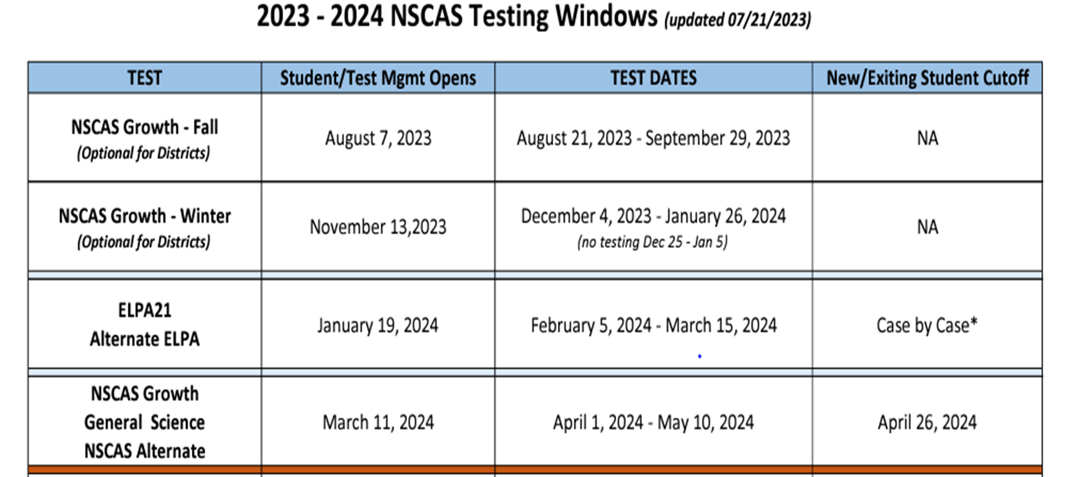
Test Dates

Slide 120
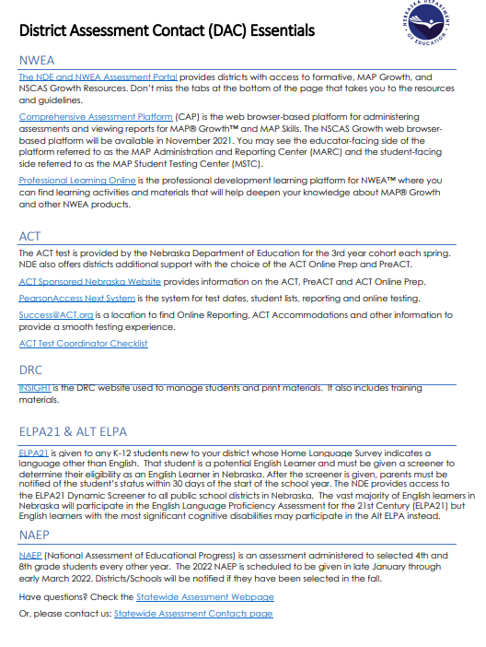
DAC 101
One-page resource for “all-things District Assessment Contact”
The DAC is the contact for ALL subject areas and ALL assessment-related communication within NSCAS. All official assessment notification, passwords, and required assessment decisions will be sent to that one district contact. Much of the communication will be through the DAC FACTS newsletter. It is the DAC’s responsibility to share the information with others in the district. NDE communicate with DACs year-round.
DAC Update Webinars began September 15th. The zoom link for the webinars will be shared via the DAC FACTS newsletter.

Slide 121
DAC FACTS Newsletters
Are the DAC FACTS helpful?
We want your feedback on the way we communicate to DACS.
If you wish to do so via survey, please use this link.

Slide 122
Final Words…
Assessment Plan
RFP

Slide 123
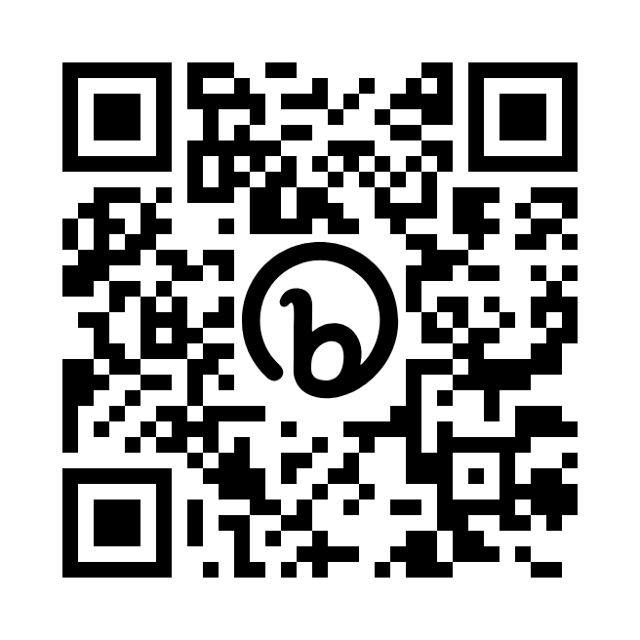
Questions?
Survey

Slide 124
Thank you for coming!

