Slide 1
Welcome to
New Superintendent Orientation
July 2023

Slide 2
School District Funds
Bryce Wilson

Slide 3
CLASSIFICATION OF FUNDS
This information may be found on the Nebraska Department of Education’s website:
  Rule 2:
  https://www.education.ne.gov/wp-content/uploads/2017/10/Clean_Rule2_2021.pdf
  Accounting Structure & Users’ Manual:
  School District
    https://www.education.ne.gov/wp-content/uploads/2023/05/2223DistrictUsersManual_May2023.pdf
    ESU’s
    https://www.education.ne.gov/wp-content/uploads/2023/03/2223ESUUsersManual_March2023.pdf

Slide 4
School District budgeting
Taxing Funds
General
Special Building
Qualified Capital Purpose
Bond
NET OPTION FUNDING
ALLOCATED INCOME TAX
COMMNITY ACHIEVEMENT PLAN AID
EQUALIZATION AID
Notes:
Taxes collected must be spent for the purpose for which they were originally taxed.
Loans / Borrowing – Only between taxing Funds
Close Out a Fund – Proceeds go to the General Fund
Cannot make transfers to the Special Building Fund or Qualified Capital Undertaking Fund
Questions on Use of Funds – Call Us

Slide 5

General fund
Operation of District
No Building Projects
Main Revenue Source: Taxes
Levy is Restricted -
Part of the $1.05
Purpose
Notes:
Operation of District:
Salaries/benefits – 65-70% of total budget
Facilities costs – utilities and
Curriculum Costs
State and Federal Program
Pupil transportation
No building projects
Repairs & Maintenance costs
Replace windows
Main Revenue is Property Taxes
Funding for federal and state programs
State funding – apportionment received by all district

Slide 6
Bond fund
Collect Property taxes
Bond Principal & Interest for Project
Revenue Source: Taxes
Not Part of $1.05
Levy is Restricted to Bond Principal & Interest
Purpose
Notes:
Purpose:
Collect property taxes to pay for Bond Principal, Bond Interest, related costs
Revenue Source:
Property Taxes
Levy is restricted to amount needed to pay Bond Principal and Interest
Many times the county treasurer retains the property tax revenue in a special fund and makes the payments for the district.
The Bond Fund shall be used to record tax receipts, investment interest, and the payment of bond principal, interest, and other related costs (i.e. trustee fees).
If the fund balance is not sufficient to meet interest or bond retirement payments from the Bond Fund, the General Fund shall be used for these payments.
Revenue from a levy to retire bonds in any school district is retained in a separate fund by the county treasurer, the financial institution serving as a fiscal agent, or the school district.
Proceeds from a bond issue shall be deposited into the Special Building Fund to be expended on the actual building project.
The tax levy for this fund is restricted to expenditures for principal and interest on bonds.

Slide 7
Qualified Capital Purpose
Undertaking Fund
Accessibility Barriers
Life Safety Codes
Mold Abatement & Removal
Asbestos Removal
Revenue Source: Taxes
Local Board Approval to Issue Bonds
Not Part of $1.05
3¢ / 5.2¢
Purpose
Notes:
Purpose:
Collect property taxes to pay for Bond Principal, Bond Interest, related costs
Revenue Source:
Property Taxes
Levy is restricted to amount needed to pay Bond Principal and Interest
Main advantage in using the QCPUF is that your levy could be outside the $1.05 levy limit. Not as much as an issue in recent years with the higher property valuations
Many times the county treasurer retains the property tax revenue in a special fund and makes the payments for the district.
A Qualified Capital Purpose Undertaking Fund may be established for:
the removal of environmental hazards,
the reduction or elimination of accessibility barriers in school district buildings,
the repayment of a qualified zone academy bond issued for a qualified capital purpose,
A Qualified Capital Purpose Undertaking Fund may be established for (con’t):
modifications for life safety code violations, and
mold abatement and prevention projects
Bonds for this purpose would include, but not be limited to:
Qualified School Construction Bonds
Build America Bonds
Any other bonds authorized by ARRA
The School Board may issue bonds for any Qualified Capital Purpose Undertaking Fund project.
General Fund expenditures for the purpose of this fund are not allowable.
The tax levy and duration of this fund is restricted.

Slide 8
Special Building Fund
Revenue Source: Taxes
Levy is Restricted
14¢ (*17.5¢)
Part of the $1.05
New Building Projects, Purchase Sites & Buildings
Purchase Furnishings for New Facilities
Improvement of Site
Purpose
Notes:
Purpose: - Improvement to the Site
Purchase or Improve Sites
Build, Alter or Improve Facilities
Furnish New Facilities
Revenue Sources:
Bond proceeds
Sale of Property
Tax receipts
Levy is restricted
LB 788 in Legislature to lower the maximum levy to 5¢. With vote of people, the levy can be 14¢
Bill has a provision for districts with a higher levy in place prior to passage for a specific project, they can continue with that higher levy through the 2024-25 school year - 7 years from 2017/18
A Special Building Fund is established to:
Acquire or improve sites
Erect, alter or improve buildings
Cost to furnish new buildings
Provides a way to identify cost associated with construction activities
The primary sources of revenue for the Special Building Fund are:
sale of bonds
the sale of property
tax receipts
General Fund expenditures for the purpose of this fund are not allowable.
The tax levy for this fund is restricted.

Slide 9
Taxing funds
Tax proceeds must be spent for the purposes for which they were originally collected.
Building projects cannot be paid out of the General Fund.
Interfund Loans can be made between Taxing Funds
*One Exception – General can be used for Bond payment in a shortfall situation.

Slide 10
Depreciation fund
School Buses
Computers
Textbooks
Spread out Capital Outlay Costs
Revenue Source: General Fund Transfers
Restricted by Allowable Reserves Limit
REPLACEMENT
Purpose
Notes:
Purpose:
Spread out costly capital outlay costs over a period of years.
Revenue Source:
Transfers from the General Fund that are expensed to appropriate category
Set up Accounts by Expenditure Type
Instructional, Transportation, Building
Restricted by Allowable Reserve Limit
A Depreciation Fund is established to facilitate the eventual purchase of costly capital outlay
Spreads replacement costs over a period of years
Funds are shown as an expense from the General Fund and the Depreciation Fund will show the revenue as a transfer from the General Fund.
Special Building vs Depreciation Fund
Special Building – IMPROVEMENT TO THE SITE – NEW
Depreciation - REPLACEMENT OF EXISITING
Important in how the board motion is worded
Track –
If have a track – could be a depreciation project, but you know a new one track would always be an improvement to the site
Roof-
Replacement – depreciation fund
Improved roof – Special Building Fund
Find mold in the roof – could use QCPUF – a good contractor can always find some mold in a roof
This fund is considered to be a component of the General Fund.
The Depreciation Fund is restricted by statute as part of the allowable reserve limitation.

Slide 11
Employee benefit fund
Reserve General Fund Money for Benefit of District Employees
Early Retirements
Unemployment Compensation
Deductibles
Revenue Source: General Fund Transfers
Restricted by Allowable Reserves Limit
Purpose
Notes:
Purpose
Reserve General Fund for District Employee Benefits
Revenue Source:
Transfers from the General Fund that are expensed to appropriate category
Set up Accounts by Expenditure Type
Unemployment, Early Retirement, Deductibles
Cash Reserve is Restricted by Allowable Reserve Limit
Is established to reserve General Fund money for the benefit of school district employees.
Funds are shown as an expense from the General Fund and the Employee Benefit Fund will show the revenue as a transfer from the General Fund.
A school district may divide this fund into more than one account to allocate a portion of this fund for different valid purposes:
Unemployment compensation
Early retirement
Health insurance deductibles
The cash reserve of this fund is restricted by statute as part of the allowable reserve limitation
The Employee Benefit Fund is considered to be a component of the General Fund

Slide 12
Contingency fund
Uninsured Losses by District
Legal Fees for Defense against Public Losses
Revenue Source: General Fund Transfers
Budgeted Expenditures limited to 5% of Total General Fund Budget
Purpose
Notes:
Purpose:
Fund District Uninsured Losses and Legal Fees
Revenue Source:
Transfers from the General Fund that are expensed to appropriate category
Budgeted Expenditures from this Fund cannot exceed 5% of General Fund Total Budget
Usually used by larger districts
Authorized by statute to fund uninsured losses and legal fees.
Expenditures from this fund shall not exceed five percent of the total budgeted General Fund expenditures of the school district.
Funds are shown as an expense from the General Fund and the Contingency Fund will show the revenue as a transfer from the General Fund.

Slide 13
Activities fund
District Extra-Curricular Activities & Student Organizations
Oversight of Financial Transactions for Student Activities
Revenue Source: Organization & Activity Fundraisers. General Fund Transfers
Purpose
Notes:
Purpose:
Account for Financial Transactions for District Extra-Curricular Activities and District Student Organizations
Revenue Source:
Activity/Organization Fund Raising
General Fund Transfers if deficits occur
Activities Fund cannot be used to record General Fund Operational Costs or to be used as a Clearinghouse for the General Fund
The Activities Fund is required to account extra-curricular activities
If included in the General Fund the school district’s operational costs would be distorted
The Activities Fund is not to be used to record general operation revenues or expenditures, nor shall this fund be used as a clearinghouse for the General Fund.
The school district may divide this fund into more than one account to allocate a portion of this fund for different purposes
If deficits in such activities are incurred, they shall be covered by funds transferred from the General Fund

Slide 14

School Nutrition fund
Financial Activities of all Nutrition Programs
Staff Salaries, Food/Supplies,
Kitchen Equipment,
Contractors
Revenue Source: Lunch Sales, Federal & State Reimbursement,
General Fund Transfers.
Purpose
Notes:
Purpose:
Operation of all Nutrition Programs for the District
Food and Supplies
Salaries/Benefits of Nutrition Staff
Kitchen and Related Equipment
Contracted Food Services
Important to show kitchen equipment purchases in School Nutrition Fund
Cannot carry over more than 3 months expenses into following school year.
NDE will ask for valid rationale and how district will lower it.
Federal Reimbursement rate could be decreased if not resolved
Revenue Source:
Sales of Lunches
Federal Reimbursement
State Reimbursement
General Fund Transfers
The School Nutrition Fund shall reflect a record of all revenues and expenditures for the operation of all Nutrition Programs
If a deficit is incurred in the operation, the deficiency shall be covered by funds transferred from the General Fund.

Slide 15
Cooperative fund
Shared Teacher or Administrator,
Program Between Two or More Districts
ONLY used by District Serving as Fiscal Agent to Pay Shared Expense
Revenue Source:
Payments from other participating political subdivisions
General Fund Transfers by District serving as Fiscal Agent.
Purpose
Notes:
Purpose:
Used by a District serving as fiscal agent between the district and one or more other districts or other agency
Examples: Shared Teacher or Administrator, Shared Instructional Programs between Districts
Revenue Source:
District serving as Fiscal Agent – General Fund transfer expensed to appropriate category
Member Districts: Tuition paid – Instructional Program; Salary/Benefits – Shared Teacher or Administrator
Can be an agreement between district and another public agency – like a city.
The Cooperative Fund may be used by the school district acting as the fiscal agent for any cooperative activity between one or more public agencies.
All school districts, including the school district acting as the fiscal agent, shall show the payment for services to the cooperative in their General Fund.

Slide 16
Student Fee fund
Record Transactions Fee-Based Programs
Extra-Curricular Activities,
Post-Secondary Education,
Summer/Night School
(No Other Allowable Uses)
Revenue Source:
Fees Collected by Each Category.
Not Funded by Tax Revenue
Purpose
Notes:
Purpose:
Record Transactions for Fee-Based Programs
Extracurricular Activities
Postsecondary Education
Summer or Night School
Revenue Source:
Only from Fees Collected for Programs/Activities Listed Above
Expenditures must be for the purposes for which the fees were collected.
The Student Fee Fund is a separate fund not supported by tax revenue.
Includes money collected from students pursuant to the Public Elementary and Secondary Student Fee Authorization Act (§79-2,125 through §79-2,135).
Included are fees for:
Extracurricular Activities
Postsecondary Education
Summer or Night School.
Expenditures from this fund must be for the purposes for which the fees were collected.

Slide 17
Budget Planning 101
Enrollment Option
Michelle Cartwright

Slide 18
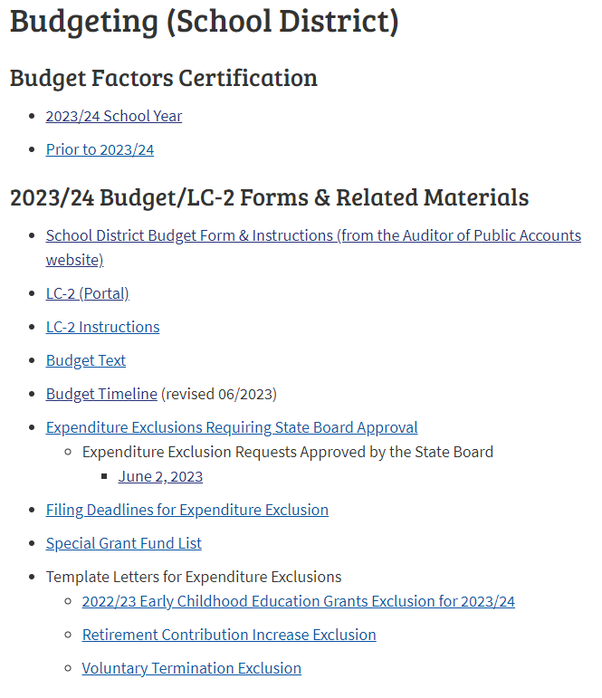
Budget Information & Tools Available on FOS Website
https://www.education.ne.gov/fos/budgeting-school-district/

Slide 19
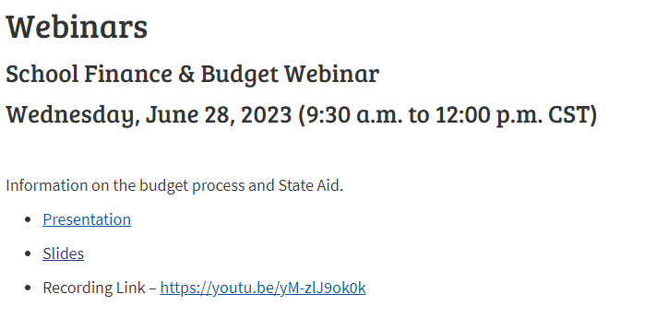
Budget Information & Tools Available on FOS Website
https://www.education.ne.gov/fos/webinars/

Slide 20
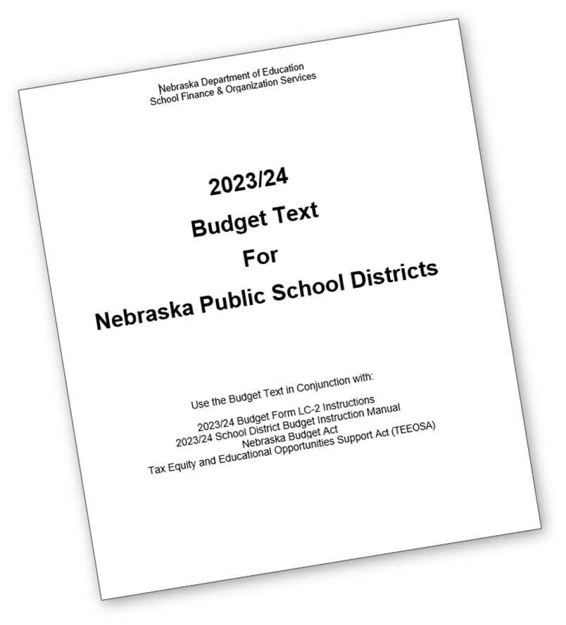
Budget Text – NDE Document
Explanation of budgeting terms
Reviews
  Taxing funds and allowed levies
  Accessing unused Budget Authority
  Levy and Expenditure Exclusions
  Procedure for holding special elections for a levy override and/or to exceed Budget Authority
  Template examples
https://www.education.ne.gov/fos/budgeting-school-district/

Slide 21
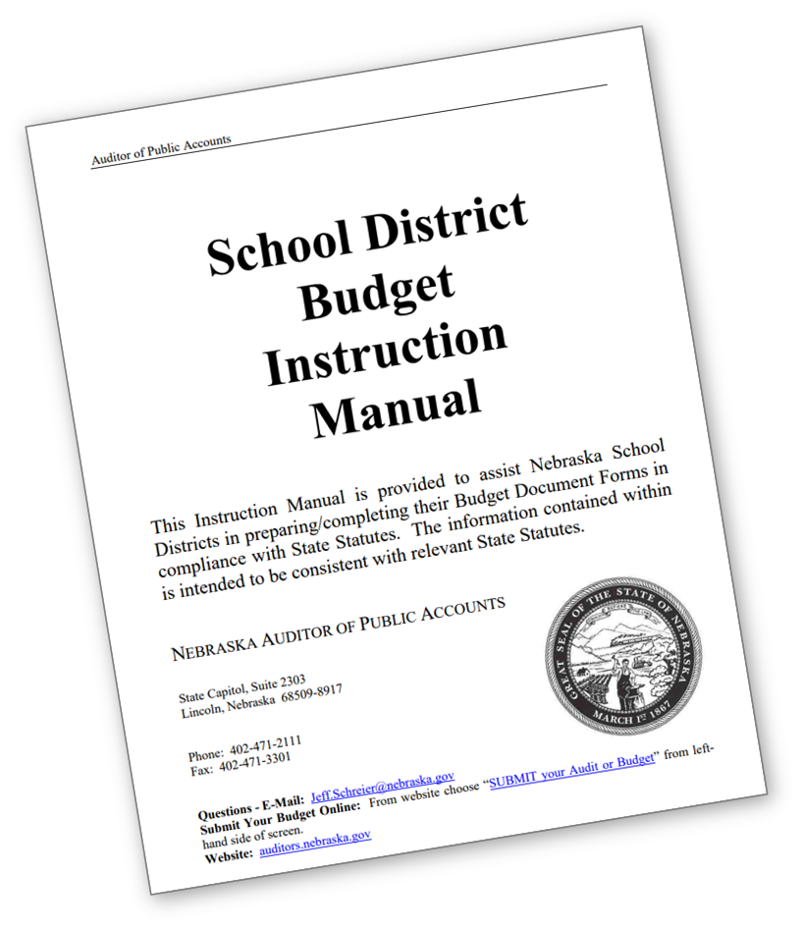
Budget Document Instruction Manual – APA
Instruction Manual for completing the District Budget Document Forms
In-depth statute references
Reviews Legislative changes
https://auditors.nebraska.gov/Budget_Info/B2022-2023/2022-2023_Budget_Forms_and_Info.html

Slide 22
School District Budget Cycle
Review Current Budget
Board Input on District Levy & Tax Request
Budget Workshop with Board
Hold Hearings
& Adopt
Monitor Spending through School Year
Amendment Needed?

Slide 23
No Standard Method
  Evaluate District Needs & Limitations
    Know Board goals
    Build in percentage and/or actual totals
    Review prior year budget and audit
    Certified Budget Authority
    Property Tax Authority
    Cash Flow planning
  Budget to a Specific Levy
    Board may determine maximum levy
    New Bonds/Building projects included
  Seek guidance from out-going supt, NCSA mentor, and NDE
  Review Budget Text and APA Instruction Manual for latest budget & statute updates, detailed help, etc.
Preparing District Budget
Notes:
Completing the Budget provides a school district with the authority to levy and to spend district funds

Slide 24
Consider In Your Planning
General
Fund
Disbursements
Salaries & Benefits
Instructional Materials – Tech needs
Building/Grounds Maintenance
Pupil Transportation
SPED Instruction/Transportation (plan for the unplanned)
Pupil Support
Staff Support
Support to Other Funds

Slide 25
General Fund Revenue Sources
Local/County 56%
Property Taxes
Motor Vehicle Taxes
State 35%
State Aid
State Grants
Federal 8%
Loans
Non-Revenue less than %
Title Grants
IDEA Grants
ESSER
Medicaid
Sale of property
Insurance proceeds
Interest
Fines & Licenses
Apportionment
SPED Reimbursement
Transfers from other funds
*Data source for percentages from 2021/22 State AFR

Slide 26
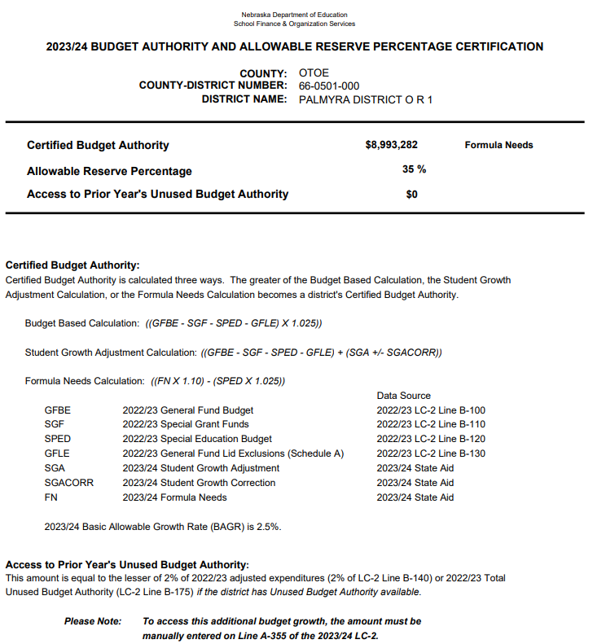

Certified Budget Authority
Certified on or before March 1 each year
  Re-certified on June 9th, 2023
See Budget Text pg 2 for calculation explanation
  Budget, Student Growth, or Formula based method
Populated into LC-2
*Property Tax Authority Certification?
https://sfos.education.ne.gov/Default

Slide 27
Up Against Budget Authority?
Provisions in statute allow specific items to be outside of the General Fund expenditure limitation.
Utilize Exclusions
  Special Grant Funds
    ESSERS
    Early Childhood
    Short Term Borrowing
  Properly ‘estimate’ SPED expenses
  General Fund Lid Exclusions - Schedule A
    Retirement Contribution
    Impact Aid
If still exceed all exclusions
  Take a vote of the people
  Amount approved by public is for one school fiscal year
  Must budget the total amount approved to carry over for future years.
  Becomes part of the base
  Entered manually into LC-2

Slide 28
Budgeting tool to help with cash flow
Not cash in the bank
Info entered in budget worksheets auto populates and calculates in
LC-2, total cannot exceed allowable amount
Total Allowable Reserves
Employee Benefit Fund Necessary Cash Reserve
General Fund Necessary Cash Reserve
Depreciation Fund
Total Requirements
Reference: See Budget Text – Allowable Reserve Limitation for more info

Slide 29
Calculation of Total Allowable Reserves
Allowable Reserve Percentage is based on District’s ADM
General Fund Budget | $5,000,000
Allowable Reserve Percentage | 45%
Total Allowable Reserves | $ 2,250,000
Reference: See Budget Text – Allowable Reserve Limitation for more info

Slide 30
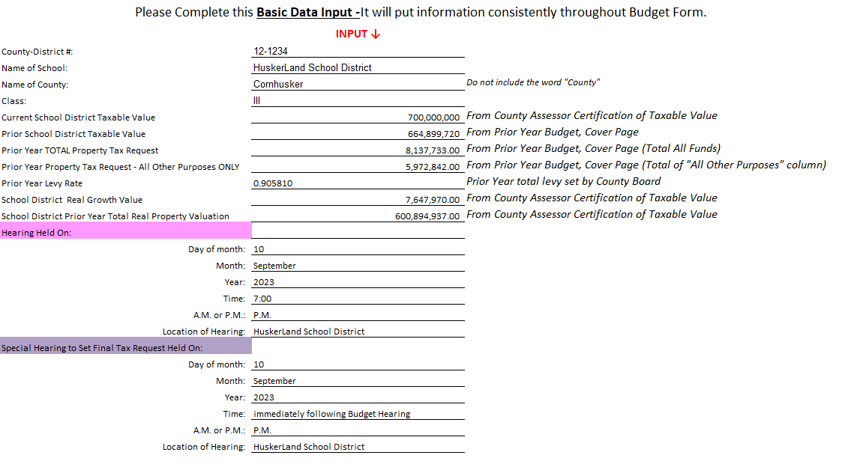
Budget Document Form – UPDATED Basic Data Input
New line added excluding principle & interest on bonds
Enter estimated valuations, then update with certified
Filters information to other worksheets
https://auditors.nebraska.gov/Budget_Info.html

Slide 31
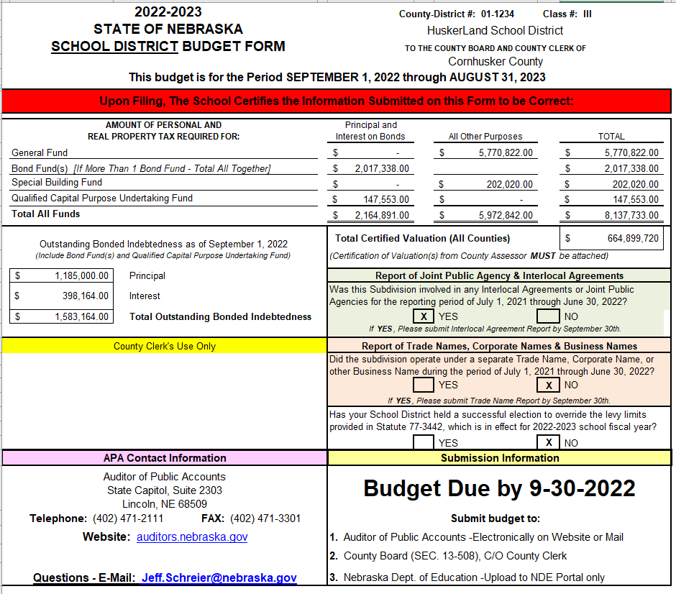
Budget Document Form – Info for Basic Data Input
Prior Year Budget Doc
Cover Page Tab
If principle & interest on bonds the numbers will be different

Slide 32
Joint Public Hearing Updates
Tax asking exceeds 2% plus real growth
  Joint public hearing required with other Political Subdivisions in the County
  Scheduled between Sept. 14 – Sept. 24th (revised)
    ^{After 6:00 P.M.}
  Information for hearing must be sent to the County Assessor by Sept. 4th (revised)
  Postcard will be sent to property taxpayers/owners
  Elected official must be present (new)
Excludes bond principle & interest (new)
Check the County mailing prior, if possible, for errors
Budget Hearing can be held prior to JPH but not adopted

Slide 33
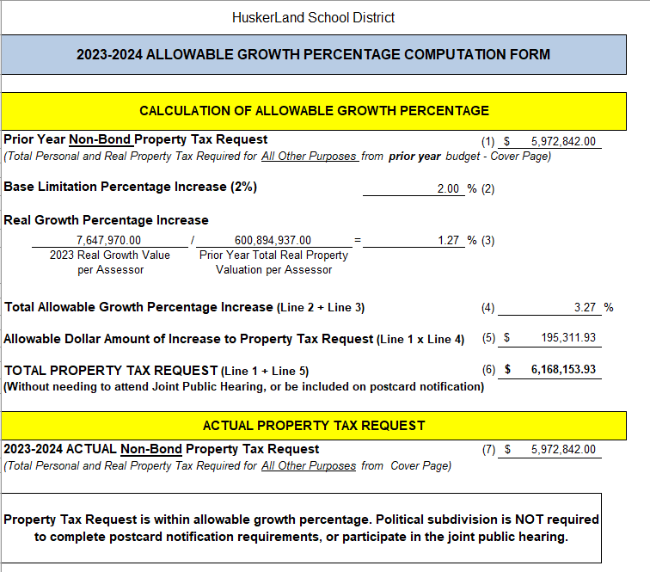
Budget Document Form – Update to Tab
Provides calculation test to see if allowable growth percentage was exceeded
Auto fills from other budget worksheets
Now excludes Bond P/I
Message will say NOT or MUST if required to hold Joint Public Hearing
If JPH required submit to County Assessor by 9/4 (new date)

Slide 34
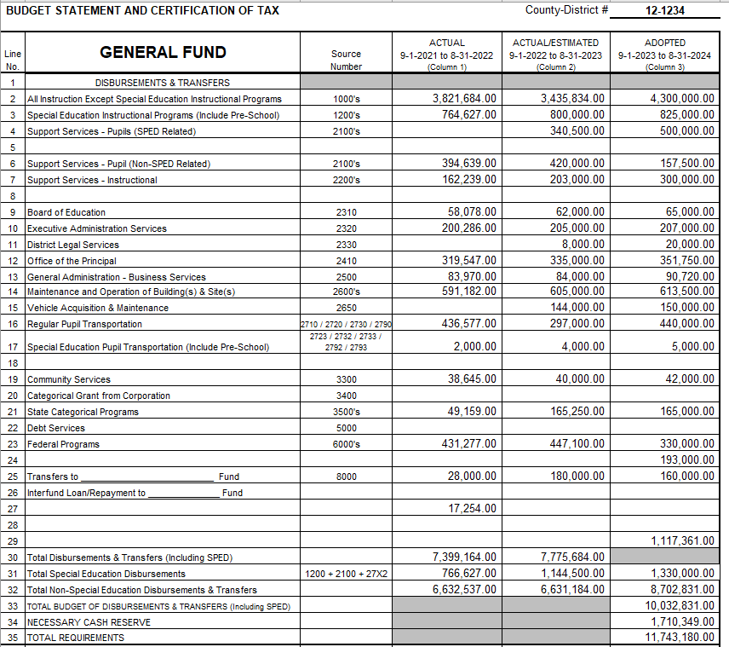
Budget Document Form – Fund Worksheets
Information is manually keyed into all Fund worksheets
Data entered in worksheets populates information to:
  Cover Page
  Summary Pages
  Hearing Notices
  Schedule B

Slide 35
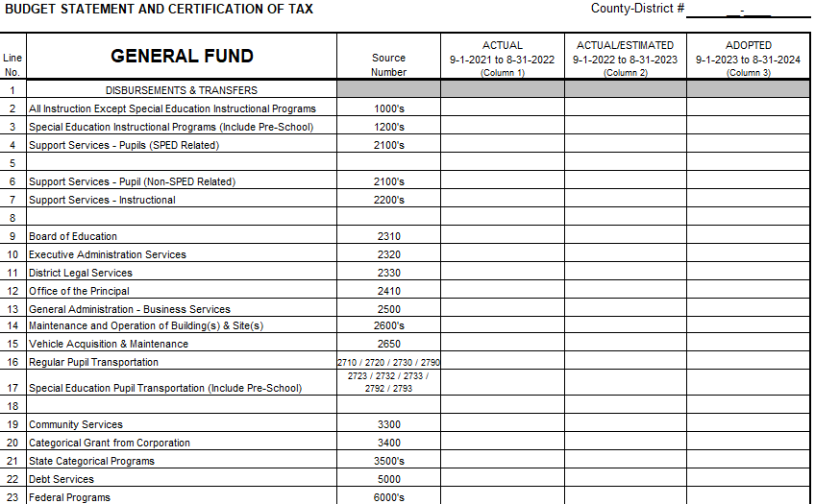
Budget Document Form – Fund Worksheets
Enter 2021/22 AUDIT info
Enter most recent YTD Board Financial Report plus estimate for rest of year
Enter planned budget – including anticipated increases, planned purchases & transfers

Slide 36

Data Entry Reminders
Enter the correct State Aid Amount from State Aid Certification Document
Motor Vehicle Taxes
  Enter similar $ to previous year
County Treasurer’s Balance
  Estimate from prior years
Beginning and Ending Balances
  Use actual balances from audit
  Second column of worksheet can be used to reach the desired levy

Slide 37
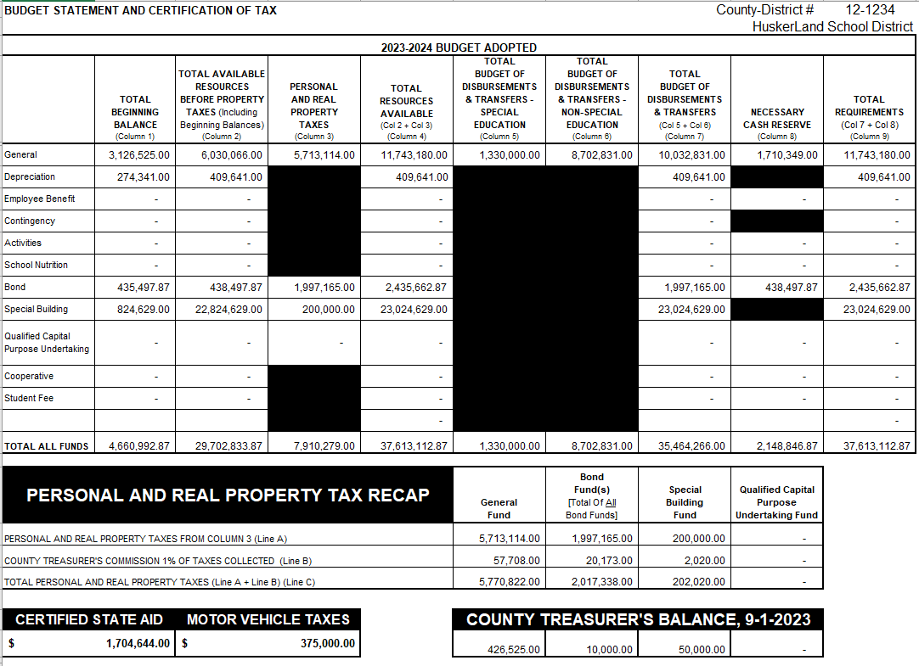
Budget Document Form – Budget Pg 2-4
Information autofill’s into pages 2, 3, and 4 from the Fund worksheets
Snapshot of your budget
Do not key into the pages labeled 2, 3, 4
Do not add/remove lines in Sched B

Slide 38
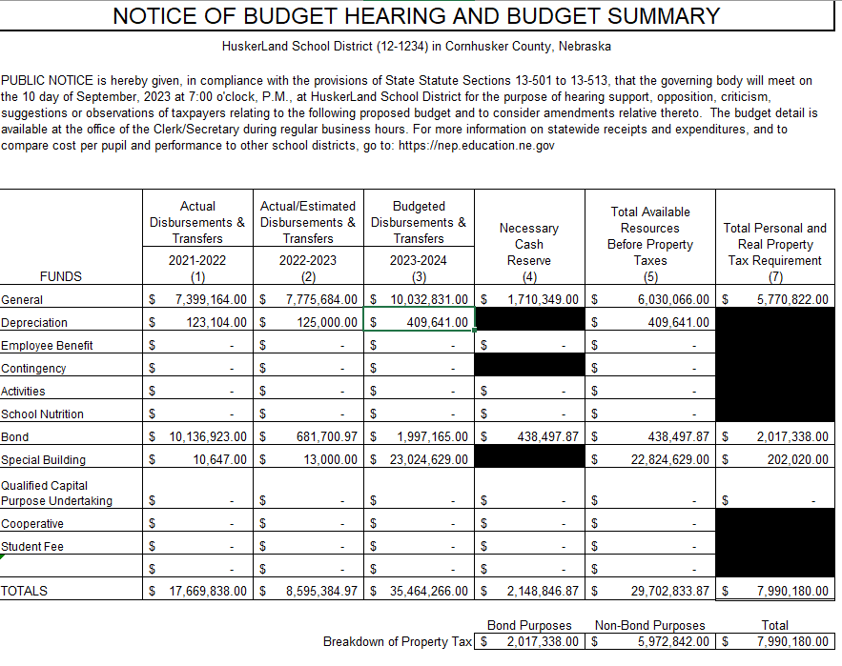
Budget Document Form – Budget Hearing Notice
Autofills – do not key into
Published in newspaper 4 days prior to hearing (does not include hearing date)
Confirm it gets printed, need proof of publication to submit later

Slide 39
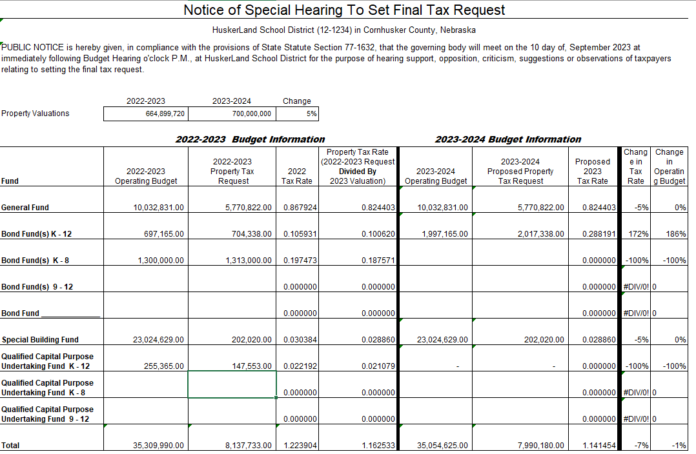
Budget Document Form – Special Hearing Notice
Enter 22/23 adopted info, LY budget
2023/24 data will autofill
Tax Levy will calculate
First glimpse of totals for Property Tax Authority Cap
  General & Building Funds only
Hide lines for funds not used
Published if no JPH required, same guidelines as Budget Hearing

Slide 40

Calculations – For Fun…
How to Calculate Levy?
(Total Tax Request ÷ Assessed Valuation) x 100 = Levy
($4,389,899 ÷ $443,000,000) x 100 = .990948
How Much Will My Levy Generate in Property Taxes?
(Levy x Valuation) ÷ 100 = Property Tax Request
(.990948 x $443,000,000) = $4,389,899
Additional 1¢ in Levy Generates Additional Property Taxes
Move decimal 4 spaces to the left on district valuation
$443,00.0,000. valuation = $44,300 additional pennies!

Slide 41

End of CURRENT Year Budget Reminders
Review current budgets to avoid overspending and/or to see if an amendment is needed
If spending authority remains in General Fund, may want to transfer to other funds:
    Depreciation Fund
    Employee Benefit Fund
    School Nutrition Fund
    Activity Fund
Unspent General Fund budgeted authority will increase 2023/24 Beginning General Fund Cash Balance

Slide 42
Need to Amend the Current Year’s Budget?
Must amend if any fund exceeds total budget of disbursements & transfers out
Should be amended prior to exceeding budget
Hearing by August 30th
Total Requirements must equal Total Resources available
Property Tax request cannot change if Tax Levy has been set
Refinancing bonds to get a lower interest rate?
Summer building projects costing more than expected?
Lunch & Activities Funds are frequently amended in the summer
Now is the time to review year-to-date spending on all funds.
https://www.education.ne.gov/fos/process-for-amending-a-budget/ or Budget Text pg. 16

Slide 43
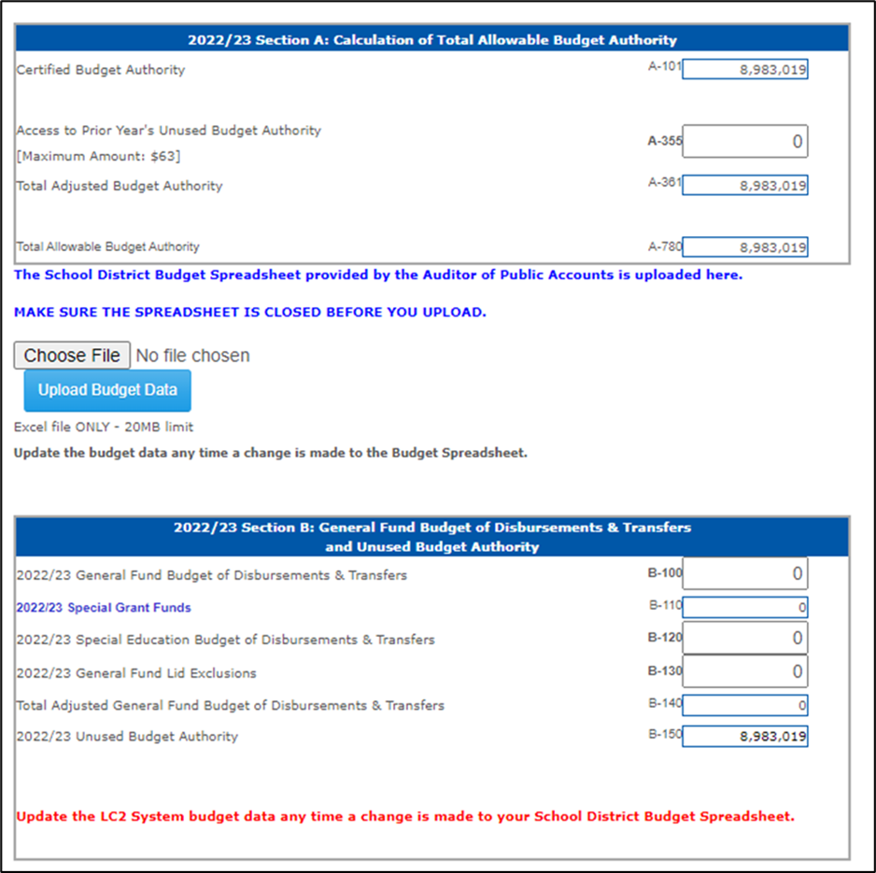
Amending the Budget for LC-2
LC-2 must be revised if these funds are amended:
  General Fund
  Depreciation Fund
  Employee Benefit Fund Cash Reserve
Make sure Allowable Reserves have not been exceeded
Run through LC-2 before Board Approves
Must contact NDE to unlock LC-2
https://www.education.ne.gov/fos/process-for-amending-a-budget/

Slide 44
Amending the Budget - Recap
Fund(s) must be amended before being overspent
LC-2 may need to be amended
Hearing Notice To Amend
  Budget as originally adopted
  Proposed amended budget
  Rationale for amending
  Include statement “Will not impact the tax request for the current year”
Submit documentation to:
  State Auditor
  County Clerks
  NDE
Documents required:
  Proof of Publication
  Board Minutes
  Page 2 of Budget Document
https://www.education.ne.gov/fos/process-for-amending-a-budget/

Slide 45
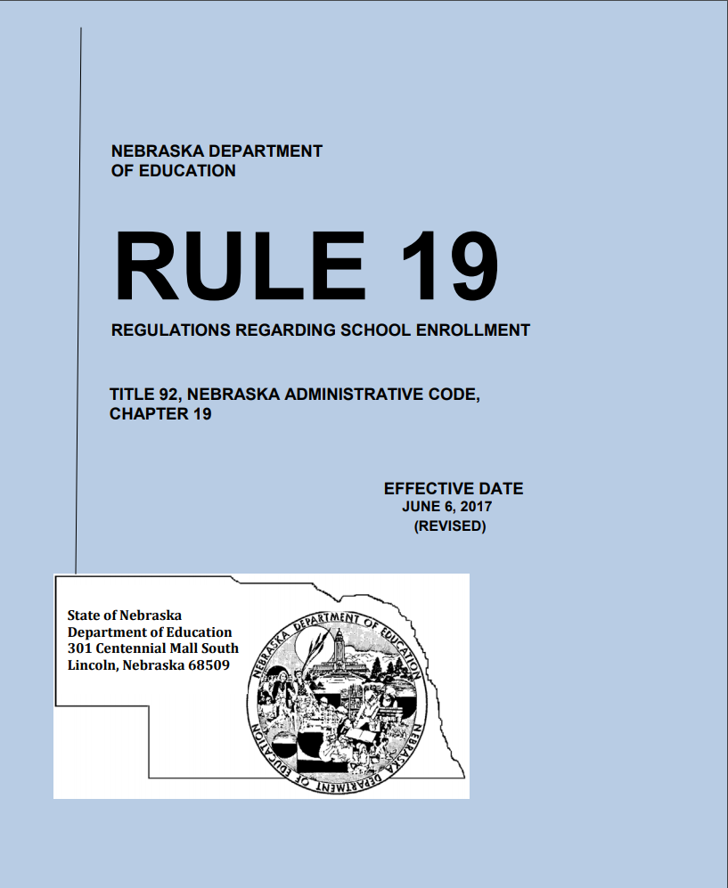
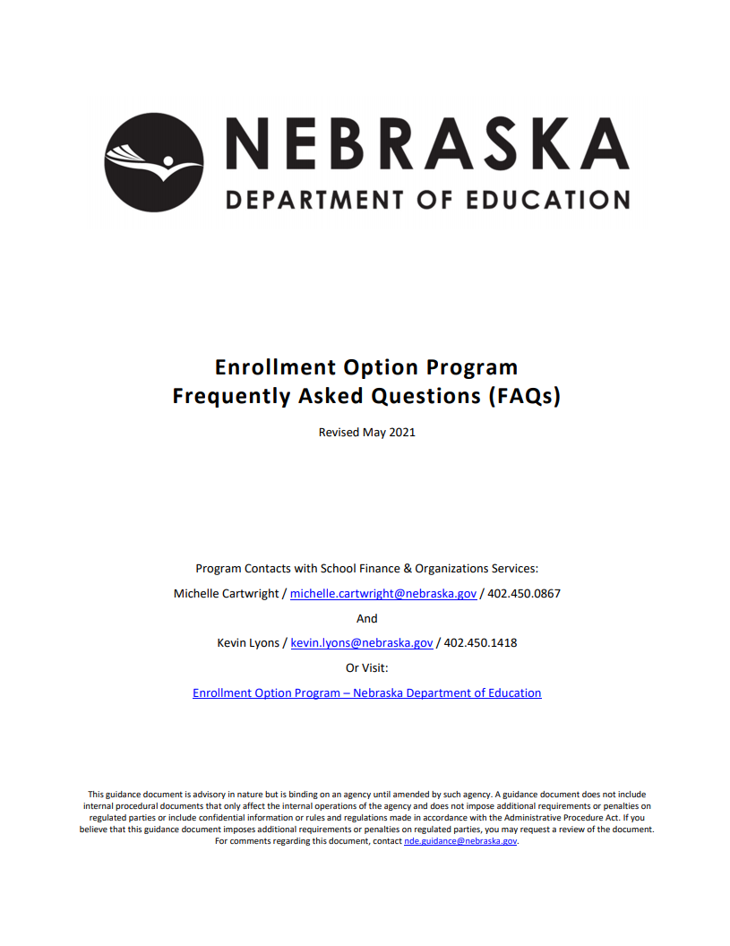
Enrollment Option Program
No Changes!
https://www.education.ne.gov/fos/enrollment-option-application-instructions-faqs/

Slide 46
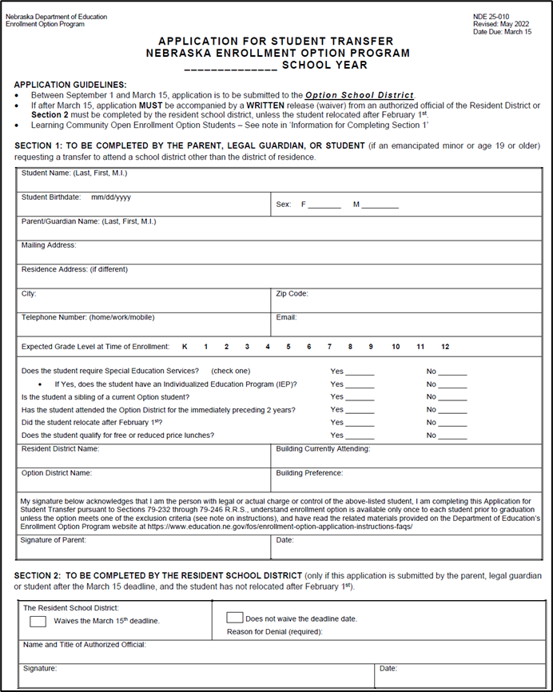
Enrollment Option Application
Application revised every May
Only K – 12
Districts retain application until student graduates or reaches age 21
Deadlines state where the application goes first
  By March 15th – Option District
  After March 15th – Resident to waive deadline
Final copy to Resident District timely

Slide 47
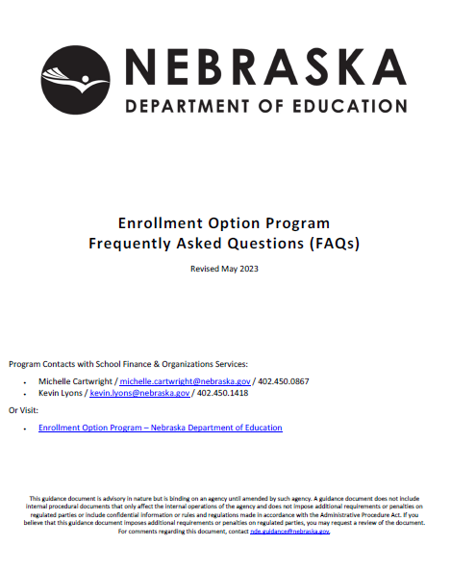
Enrollment Option FAQ’s
Exceptions to the “one and done”
Option Student treated as a Resident Student
Free Lunch/Transportation
Etc….
Spanish version available
Program Contacts:
  Michelle Cartwright
    michelle.cartwright@nebraska.gov / 402.450.0867
  Kevin Lyons
    kevin.lyons@nebraska.gov / 402.450.1418

Slide 48
Budget Levy, Spending
Exclusions & LC2
Stephanie DeGroot

Slide 49
General Fund Exclusions – Allow for Additional Budget Authority
Levy Exclusions
Allows districts to levy more than the $1.05 levy limit
Found on Budget Document Forms, Schedule B
No State Board Approval needed
Expenditure Exclusions
Allows districts to spend more than their Certified Budget authority
Most need State Board Approval
Found on Budget Document Forms, Schedule A
Notes:
There are two types of General Fund Exclusions

Slide 50
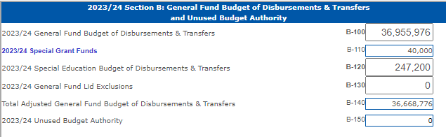
General Fund Expenditure Exclusions
State Board Approval Is Not Required:
Special Education Budget
  Includes SPED Transportation & SPED related student services (21XXs, excludes 219X’s)
Special Grant Funds
  Found in LC-2 (Sec B, line B-110)
  60+ programs pre-approved each year by State Board, commonly used programs:
Notes:
State Board of Education Approval is required for most expenditure exclusions
Two exceptions
SPED Transportation
SPED-related student services
Special Grant Funds – Pre-Approved are found on the LC2

Slide 51
Supplemental Grants on the Special Grant List
Appear at bottom of Special Grant Fund List with
Need State Board Approval
*Email requests to Stephanie
*Include name, amount, & purpose
Insurance Settlements
Inter-fund Loans
Reimbursements for Wards of the Court
Repayments to County Governments for Previous Overpayments
Short Term Borrowing
Grants from City or County Government
Grants from Corporations, Foundations, or Other Private Interests
Notes:
Items located at the bottom of the Special Grant fund list Do require state board approval since they are specific to your district. A couple of things to consider…
Insurance Settlements:
Consider depositing settlements into your Special Building Fund, so you don’t have to request state board approval when you need to spend those funds.
In recorded in the Special Building Fund, then it wouldn’t impact per pupil costs
Inter-fund loans:
The General Fund may loan to another taxing funds
You have two years to repay an inter-fund loan
Short Term borrowing
Need a load from the bank to help get through a shortfall in revenue during the year.
Must repay this in a year

Slide 52
Early Childhood Education Grant & New Elementary Site
Early Childhood Pre-populated on LC-2
Need State Board Approval
Remains in the base for calculation of future budget authority
New Elementary Attendance Site(s)
Exclusion is for costs related to first year of operation
Must qualify for State Aid Elementary Site Allowance
Salaries, Utilities, Bldg. Maint.
Notes:
Early Childhood grants will pre-populate in the LC2 & will remain in the budget base when budget authority is calculated the following spring.

Slide 53
Repairs to Infrastructure
*Damage by a Natural Disaster
*Must be declared a disaster by Governor or FEMA
* Flooding
* Tornados
* Wildfires

Slide 54
Distance Education Courses
* To qualify, a district must be providing distance education course through ESU Coordinating Council to other schools
* Exclusion is the amount received as payment from another school

Slide 55
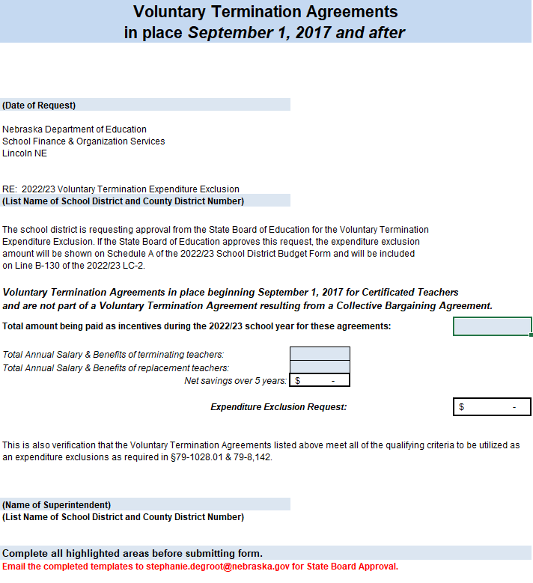
Voluntary Termination Agreements
Exclusion is for amount paid for agreements during the 2022/23 year
Includes certificated teachers only up to $35,000 per person
Does not have to be cash could be insurance coverage
Incentives paid within 5 years or prior to teacher being Medicare eligible – whichever comes first
Must show 5-year savings
Cannot be included in a collective bargaining agreement
Template available on FOS website

Slide 56
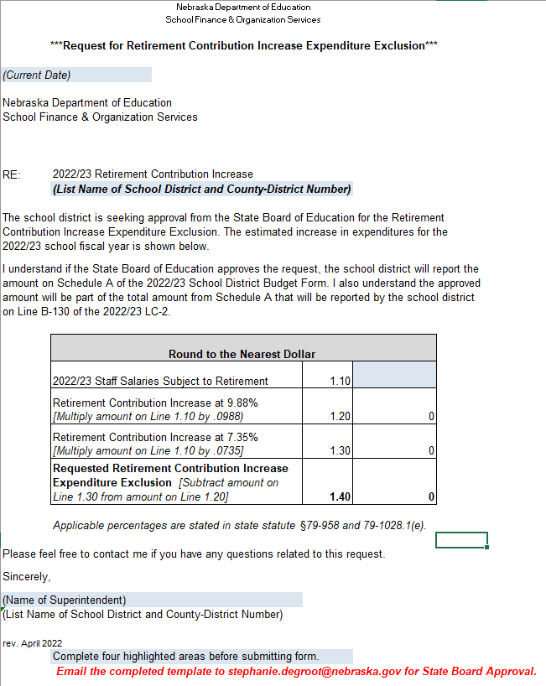
Retirement Contribution Increase
Exclusion is for the difference between the district’s contribution rate of 9.88% and the statutory rate of 7.35%
Template available on FOS website

Slide 57
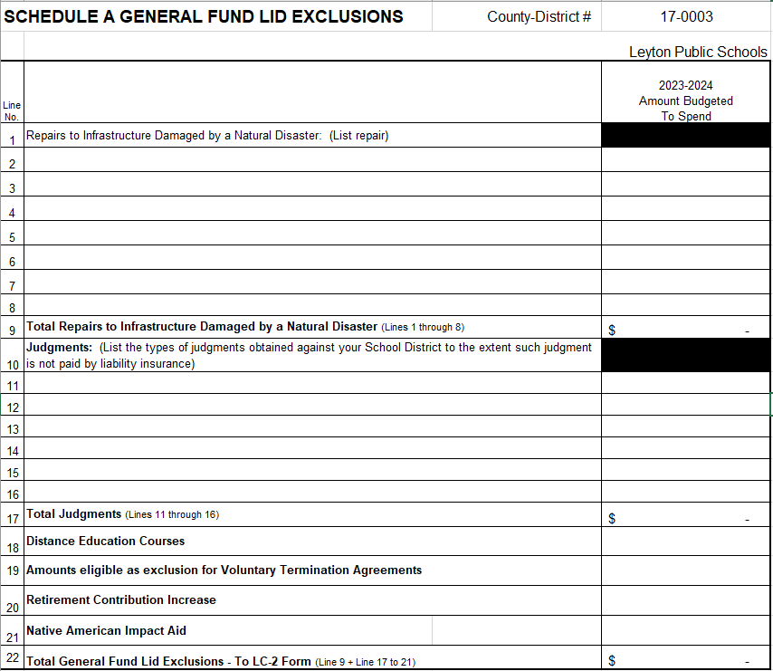
Schedule A
Need State Board Approval
Repairs to Infrastructure
Judgements
Distance Education
Voluntary Terminations
Retirement Contributions
Native American Impact Aid
Email requests to: Stephanie.degroot@nebraska.gov

Slide 58
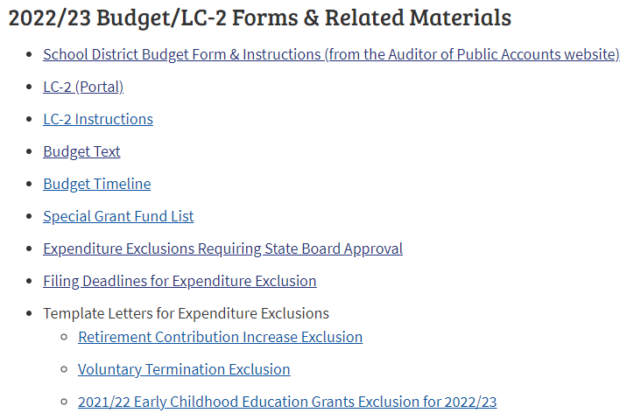
Available Templates
* Found on FOS Website
* Calculate for you

Slide 59
Requesting State Board Approval
Exclusion templates available on FOS website
  Calculate for you
Send requests to NDE via email
Stephanie.degroot@nebraska.gov
  Provide details of the grant request
    Name and purpose of grant
    Amount of grant
  Use templates provided on FOS Website
  Include District Agency ID
  Round all amounts
  Email in pdf format
  Timeline to request State Board Approval on FOS website
  Approval is posted on website within 5 working days after meeting
May include in budget planning before State Board Approval is posted.

Slide 60
LC-2 Lid Computation Form
Located in the NDE Portal
  Need new Activation Code each year
Instructions found on FOS website
New Section D – Property Tax Authority
Budget Form (excel format)
  Upload to LC2, it will auto populate
New Superintendent this year?
  Register in NDE Portal
Need help with NDE Portal?
  Call 888-285-0556 or ADVISERHelp@nebraskacloud.org
Notes:
An activation code is required for all data collections in the NDE Portal.
For the LC-2, there is one activation code.
This activation code allows the user to key and submit LC2 information,.

Slide 61
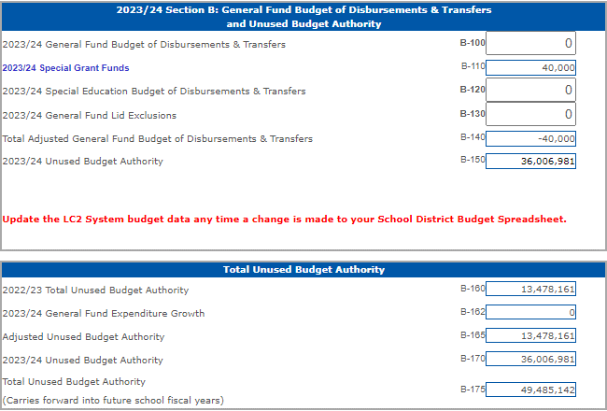
LC-2 Purpose
Confirms your budget is in compliance and does not exceed spending limitations
Error messages appear if limitations are exceeded
Special Grant Funds (B-110)
Calculates Unused Budget Authority (B-150) *Goal is $0
District approves after budget is adopted *Copies sent to APA & County
Required docs for NDE are submitted through LC2

Slide 62
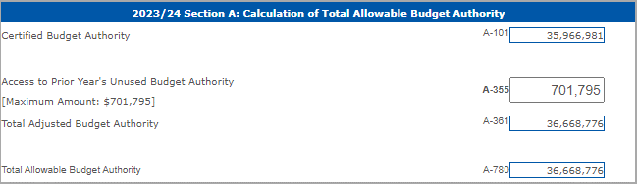
LC-2 Access Unused Budget Authority
Amount listed is lesser of:
  2% of the prior year’s adjusted General fund expenditures or
  The prior year’s total unused budget authority
Provides Additional Budget Authority for 2023/24
Notes:
Remember earlier Michelle talked about unused budget authority, here is where it’s going to pre-populate

Slide 63

LC-2 Additional Budget Authority
Notes:
If you did go to a vote of the people, here is where you are going to mark yes & enter the amount.

Slide 64
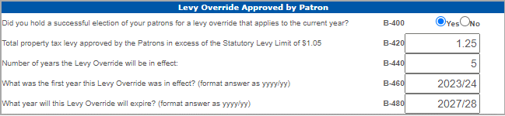
Levy Override

Slide 65
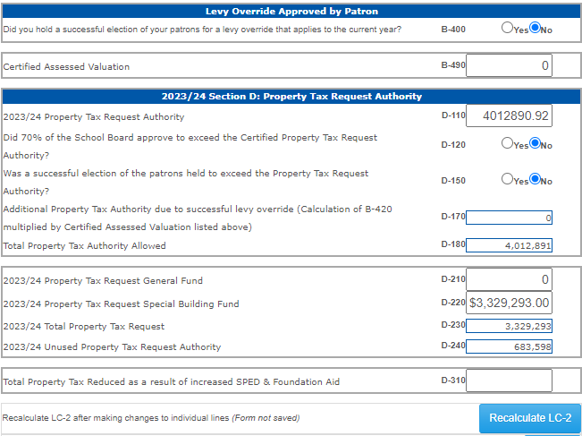
LC-2 New Section D – Property Tax Authority
*Certified Assessed Valuation & Property Tax Request Authority will prepopulate from Budget docs
*If YES on additional authority – amount will prepopulate
*D-180 will show your Total Amount Allowed

Slide 66
LC-2 Tips & Tricks
Upload an excel format of your budget into the LC2
Remember to recalculate & save often
Goal for Unused Budget Authority is zero
Unlimited uploads to check status of limitations
Remember to save Special Grant Funds list before returning to the LC2
Don’t forget to upload docs in PDF format after District Approval
Notes:
An activation code is required for all data collections in the NDE Portal.
For the LC-2, there is one activation code.
This activation code allows the user to key and submit LC2 information,.

Slide 67
LC-2 Error Messages
LC-2 Cannot be submitted with error messages!
Access to Prior Year’s Unused Budget Authority Exceeded
Budget Authority Exceeded
Allowable Reserves Exceeded
Levy Info/Dates Don’t Match
Property Tax Authority Exceeded

Slide 68

Budgeting Checklist
Confirm
Expenditure Exclusions sent in?
LC2
Use LC2 while working on your budget
Verify
Is the Budget within spending & levy limits?
Match
Does the LC-2 & Budget match?
Notify
Is a Joint Public Hearing required? Notify by Sept. 4th
Confirm
Does hearing notice match the budget docs?
Publish
Publish Hearing Notice – 4 days before hearing

Slide 69
Budgeting Checklist
Confirm
Confirm Hearing Notices were published in newspaper.
Reserve
Reserve adequate time for public comment at budget hearing
Approve
Approve LC-2 after board adopts budget
Submit
Submit budget docs to NDE, APA, Clerks – by Sept 30th
Submit
Submit Tax Resolution to County – by Oct 15th
Confirm
Make sure County sets your Tax Request correctly? No changes after November 5th

Slide 70
Submitting Budget Documents to NDE via LC-2
After Budget is adopted, click “District Approval”
LC-2 Upload Feature appears after clicking “District Approval”
Review Checklist, pdf listed items
  Upload as single PDF only
  Do not mail in documents to NDE
Confirmation email will be sent to you:
  District Approval
  PDF documents are uploaded
  NDE approves LC-2 and budget docs

Slide 71

Pupil
Transportation
Awesome job on Pupil Transportation Collection!!!
ELDT – New training available through Nebraska Safety Center
Don’t forget all pupil transportation drivers need to two-hour refresher course

Slide 72

Email Exclusion Requests To: stephanie.degroot@nebraska.gov

Slide 73
TEEOSA 101
STATE AID CALCULATION
Kevin Lyons

Slide 74

Lump-Sum Payment for
2022/23 Positive Prior Year Correction
Equal to or Greater than $1,000
On or before July 15 - NDE notifies district
Must respond by August 15
On or before September 15 - District notification of
board approval
Less than $1,000
NDE makes payment without application

Slide 75
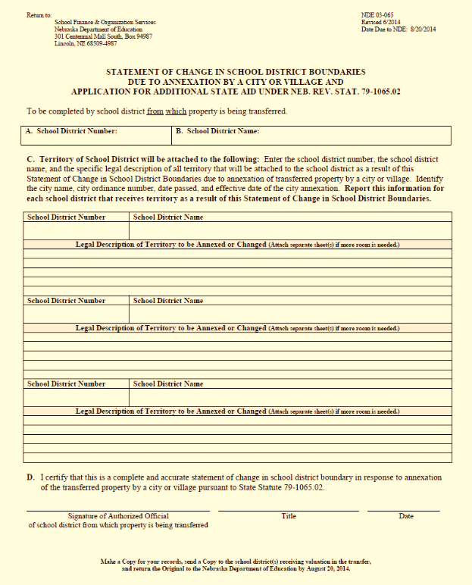
Statement of Change in School District Boundaries due to Annexation by a City or Village
  Forms available upon request
  Forms Due: AUGUST 20
Kevin Lyons
Director of School Finance
kevin.lyons@nebraska.gov
402-450-1418

Slide 76
School Finance Data Review
ADVISER
  Average Daily Membership (ADM)
  Fall Membership (October 1st)
  Option In/Out
  Contracted Students
  Qualified Early Childhood
  Limited English Proficient (LEP)

Slide 77
Consolidated Data Collections (CDC)
  Days in Session/Instructional Program Hours (completed June 30)
  Pupil Transportation Report (completed June 30)
  Superintendent Pay Transparency Act (on or before August 1)
The following collections are Due 10-15-2023
  Summer School Student Unit (Due 10-15-23)
  Assessed Valuation and Levies
  Estimated Expenditures for Poverty and LEP
  PK Instructional Program Hours/K Program
  Elementary Site Allowance
  Two-Year New School Adjustment Application
  Student Growth Adjustment

Slide 78
Superintendency Pay Transparency Act
T
Timeline required by statute:
On or before August 1:
Submit entire approved contract (pdf) on Portal
September 30:
Schedule D submitted with district budget
October 1:
Withholding state & local funds started for schools not submitting superintendent contract through NDE Portal (CDC)

Slide 79
What is TEEOSA?
Tax
Equity and Educational Opportunities
Support
Act
Statute that defines State Aid
Creates the basic concept for the present state aid formula
Equalization Aid and Foundation Aid – largest components of State Aid
Complex matrix of formulas

Slide 80


TEEOSA AID PROCESS
CERTIFICATION
  Calculated in the spring for following year
  Statute v. Actual
  Reason for push back
    Suppose to be open ended formula
    Difficult during budget years
    Difficult with RIF deadlines
RECALCULATION
  Recalculated in the fall for the current year
  Update the formula
  Creates prior year correction
CALCULATED TWICE PER YEAR

Slide 81
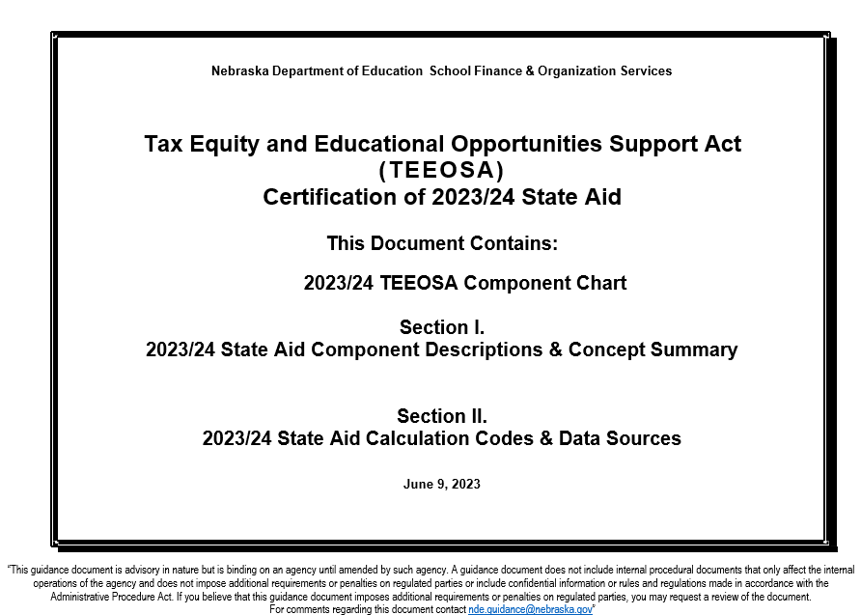
TEEOSA Document
Decodes
the components of Equalization Aid
Resource
for more detailed information
Available
on NDE’s website

Slide 82
Nebraska Department of Education
School Finance and Organization Services
2023/24 TEEOSA Component Chart
Basic Funding
Special Receipts Allowance
Poverty Allowance
Limited English Proficiency (LEP)
Allowance )
Transportation Allowance
Focus School & Program Allowance
Summer School Allowance
Distance Education & Telecommunications (DETA) Allowance
Elementary Site Allowance
Community Achievement Plan Allowance
Non-Qualified LEP Adjustment
System Averaging Adjustment
Student Growth Adjustment
Two-Year New School Adjustment
Poverty Correction
LEP Correction
Student Growth Correction
Needs Stabilization
NEEDS
minus
RESOURCES
equals
EQUALIZATION AID
Yield From Local Effort Rate
Net Option Funding
(w/ Reduction)
Allocated Income Tax Funds
Other Actual Receipts
Community Achievement Plan Aid
Foundation Aid
COLOR CHART:
Blue – Allowances
Green – Adjustments
Purple – Corrections
Maroon – Foundation Aid
Orange – Equalization Aid
Red – Prior Year Correction
TOTAL CALCULATED STATE AID (FUNDING SOURCES)
Net Option Funding
(w/ Reduction)
Allocated Income Tax Funds
Community Achievement Plan Aid
Foundation Aid
Equalization Aid
Prior Year Correction

Slide 83



NEED SOURCES
FORMULA STUDENTS
  Grades K - 12
  Qualified 4-year-olds (60% Rate)
  Contracted to another district
GENERAL FUND OPERATING EXPENDITURES
  Revenues & expenses from Annual Financial Report
PROPERTY VALUE
  Tax Base
  District's ability to pay
COST SHARING FORMULA

Slide 84





CATEGORIES OF NEEDS
BASIC FUNDING
  Estimated amount required to generally operate a school district with a specified number of students
  Calculated by a comparison group
  Average general fund operating expenditures
ALLOWANCE
  Based on estimated or actual expense
  District specific
  Addresses a specified situation by reducing basic funding
ADJUSTMENT
  Increases the needs
  Adds money to formula
  Addresses a specified situation without reducing basic funding
CORRECTION
  Added or subtracted
  Corrects for an allowance or an adjustment
  Occurs 2 years later
STABILIZATION
  An amount added or subtracted
  Keeps the needs from growing or declining by more than a specific rate
COSTS TO EDUCATE THE STUDENTS

Slide 85
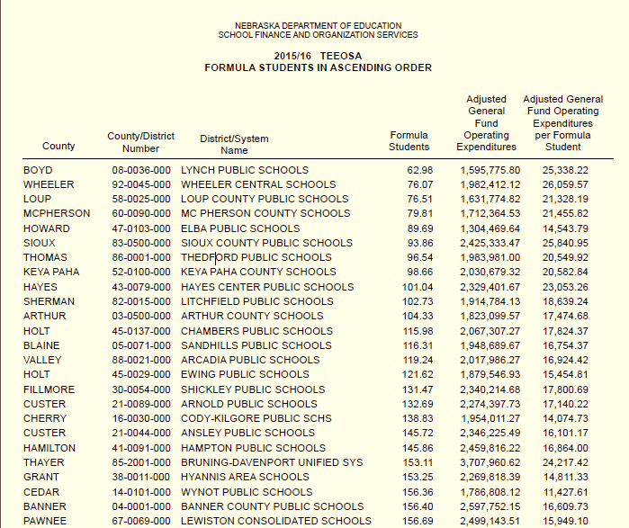
Basic Funding
ESTIMATED AMOUNT
required to generally operate a school district with a specified number of students
CALCULATED BY COMPARISON GROUP
Using the 10 larger and 10 smaller districts closest in size and measured by formula students
ADJUSTED GFOE
is averaged when calculating basic funding

Slide 86
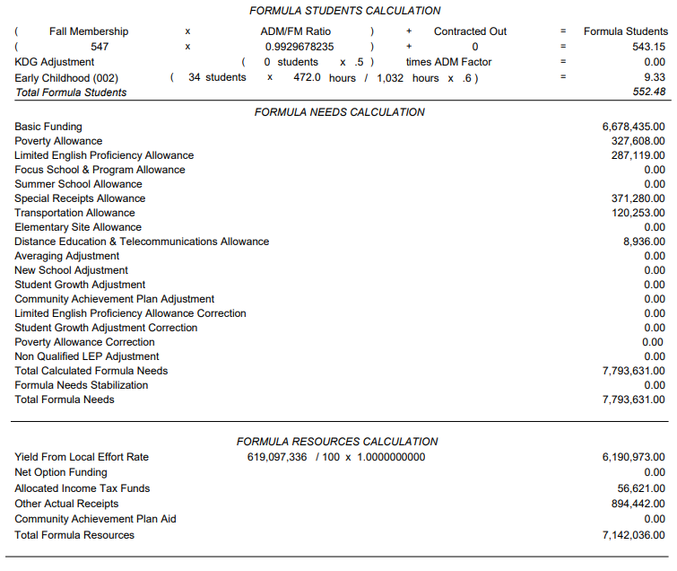
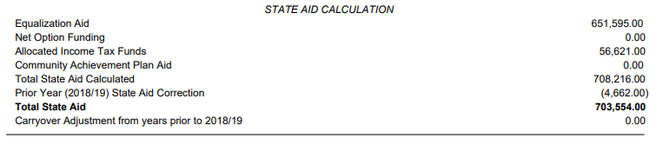
State Aid Certification Form

Slide 87
NEED & ALLOWANCES
Transportation
Distance Education & Telecommunication
Elementary Site
Summer School
Focus School & Programs
Special Receipts
Poverty/Limited English Proficiency (LEP)
Community Achievement
2021/22 ALLOWANCES
Recognizes Funding
For….

Slide 88
2021/22 ADJUSTMENTS
Adds Money to the Formula For….
NEED & ADJUSTMENTS
Student Growth
Two-Year New School
System Averaging

Slide 89
NEED & CORRECTIONS
NEED & CORRECTIONS
OCCURS…Two years after the district receives the allowance.
Compares the estimated to what occurred.
WHY…….Aligns the funding with when the expenditure or
student growth is expected.
Poverty & Limited English Proficiency Corrections
  Subtract any excess allowance received
  Penalized if plan requirement are not met
  LEP – Disqualified for current Year; minimum spending requirement are not met
Student Growth Correction
  An amount added or subtracted
  Aligns with actual student growth

Slide 90





COMPONENTS OF RESOURCES
YIELD FROM LOCAL EFFORT RATE
  Property tax capacity
  Local Effort rate – hypothetical tax rate
  Applies a tax rate to valuations
NET OPTION FUNDING
  Provides funding for the additional students being educated
  Enrollment Option Program
ALLOCATED INCOME TAX
  Distributes a percentage of individual income taxes back to the school district
OTHER ACTUAL RECEIPTS
  Power district sales tax
  Fines/license fees
  Tuition
  Interest
  Special Education
  State Wards
  Motor vehicles
  Non-Categorical Federal Funds
COMMUNITY ACHIEVEMENT PLAN AID
  Aid for cooperative programs in the Learning Community
  Sharing of administrative and instructional staff for approval and accreditation requirements
FOUNDATION AID
  School District’s Formula Students multiplied by $1500
REVENUE SOURCES

Slide 91
Foundation Aid
  Starting with 2023/24 Certification
  $1,500 per Formula Student
  2023/24 & 2024/25 (Year 1 & 2) full amount included in Equalization calculation
  2025/26 (Year 3) & thereafter 60% of Foundation Aid included in resources - $900
Net Option Funding
  Amount Reduced by $1,500 per net positive option student
LB 583 TEEOSA Changes

Slide 92
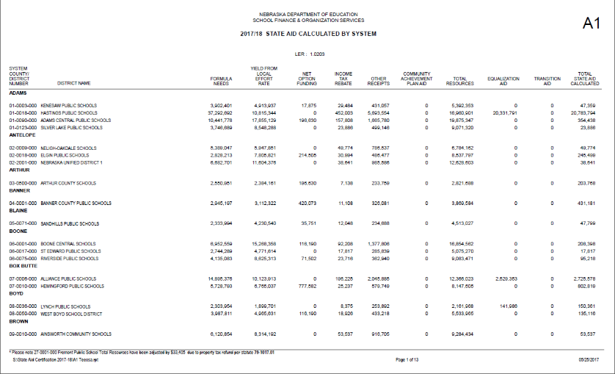
Prior Year Correction
2022/23
Prior Year
Correction
2023/24
TEEOSA Aid
2022/23 Certification
DIFFERENCE
2022/23 Recalculation

Slide 93
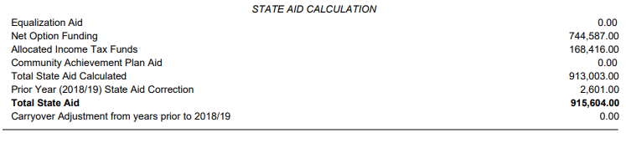
Prior Year Correction
Included on State Aid Certification Form
Positive Correction:
Lump-Sum Payment
  Over $1000 can be paid in Sept. through an application process.
  Under $1000 is automatically paid w/o application
  If a district does not request a Lump-Sum Payment, it will be included in the 10 monthly installments
Negative Correction:

Slide 94
COMMON QUESTIONS
Why does our school district receive very little state aid?
  Possibly a non-equalized district
    Do not receive equalization aid
    Resources are greater than your needs
    Equalization Aid is largest component of TEEOSA Aid
    Property rich = less support from the state
  We are finally having more districts move back into equalization although slowly.
    Decreased valuations
    Decreased enrollment

Slide 95

COMMON QUESTIONS
I’m a non-equalized district
….does TEEOSA aid matter?
ALLOCATED INCOME TAX
COMMUNITY ACHIEVEMENT PLAN AID
FOUNDATION AID
EQUALIZATION AID
NET OPTION FUNDING
2023/24 TEEOSA Aid Certification
64 Equalized Districts
180 Non-Equalized Districts

Slide 96
COMMON QUESTIONS
Does my general fund levy rate
have any effect on TEEOSA aid?
    No, general fund levy rate does not affect TEEOSA aid.

Slide 97
COMMON QUESTIONS
Can districts maximize
their financial situation?
Understand the components of formula need
Code revenues and expenses correctly
Look at the whole picture when determining where to code expenses
Submit verified data by the due dates

Slide 98
Kevin Lyons
Director of School Finance
School Finance and Organizational Services kevin.lyons@nebraska.gov
402-450-1418

Slide 99
Federal Grant Information

Slide 100
Federal Grants
ESSA Consolidated Grant | Description | Disbursement Code
Title I – A | Provides support for educationally disadvantaged students | 6200
Title I – D | Neglected and Delinquent | 6230
Title II – A | Professional Development or Class Size Reduction | 6310
Title III – EL | English Language Learners | 6925
Title III – IE | Immigrant Education | 6926
Title IV – A | Student Support and Academic Achievement (well-rounded, safe and healthy, & effective use of technology) disbursement | 6969

Slide 101
Additional Federal Grants
Grant | Description | Disbursement Code
SFI Grant (Support For Improvement) | Buildings identified as CSI (Continuous School Improvement) | 6212
RLIS | Rural and low-income school | 6330
SRSA (REAP) | Small Rural School Achievement Program | 6992
Competitive Grants
McKinney-Vento | Districts that have identified at least 20 students experiencing homelessness | 6991
Stronger Connections Grant | Title IV Safe & Healthy Uses ( no construction ) Due 8/23/2023 – Ends 9/30/2026 | 6424

Slide 102
COVID-Related Federal Grants
Grant | Type of Grant | End Date | Disbursement Code
CRRSA – ESSER II | Formula Based All districts | Ends 9/30/2023 | 6997
ARP – ESSER III | Formula Based All districts | Ends 9/30/2024 | 6998
ARP-HCY I (Homeless Children and Youth) | Competitive Grant Select districts | Ends 9/30/2025 | 6993
ARP-HCY II (Homeless Children and Youth) | Formula Based Grant Select districts | Ends 9/30/2025 | 6994

Slide 103
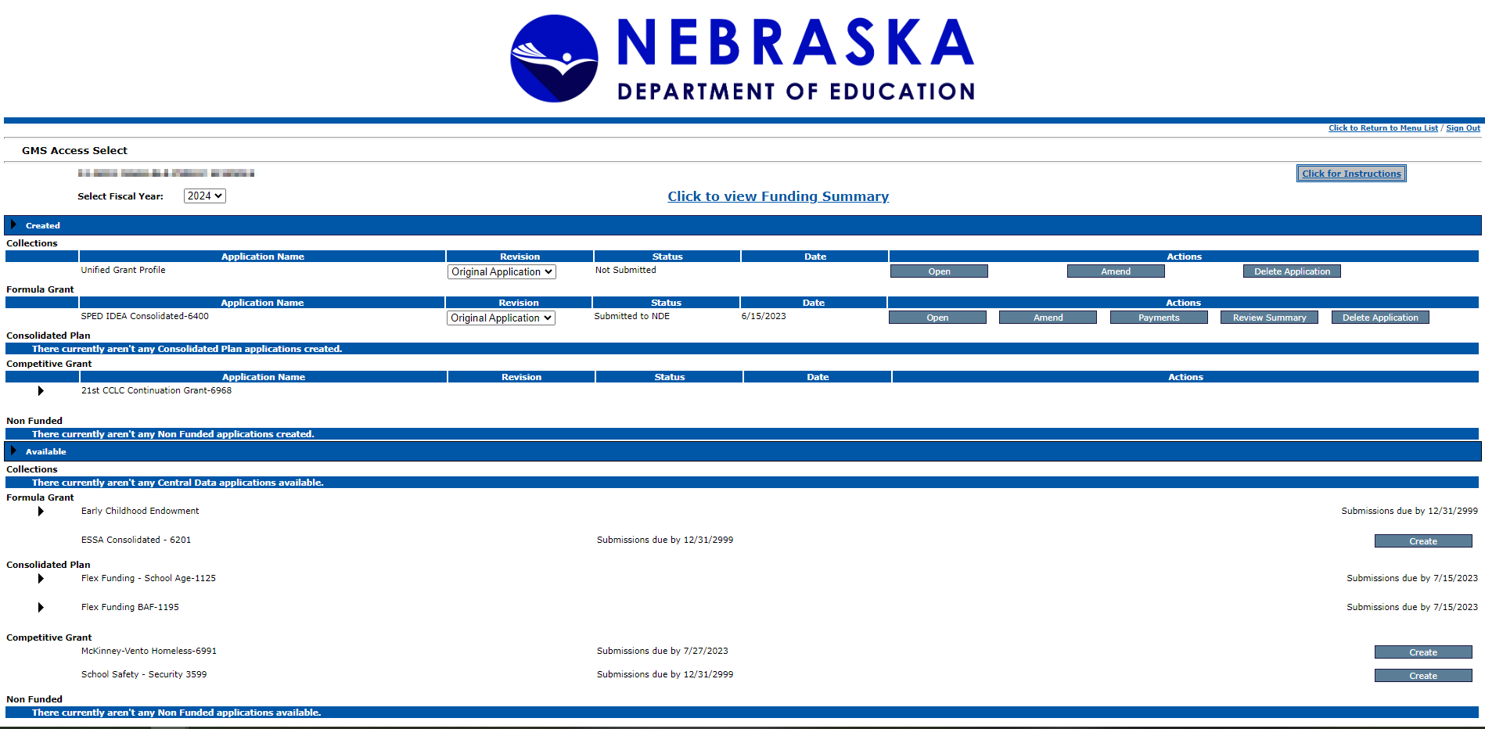
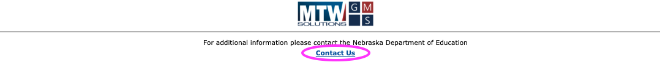
GMS Overview

Slide 104
ESEA Federal Programs Team
Beth Wooster | Senior Administrator | beth.wooster@nebraska.gov | 402-310-1390
Kirk Russell | Asst. Administrator & Title I-A Director | kirk.russell@nebraska.gov | 402-405-4616
Dottie Heusman | Title I-A, School Improvement | dottie.heusman@nebraska.gov | 402-219-4802
Jim Kent | Title I-A, Title II-A, Title IV-A | jim.kent@nebraska.gov | 402-405-6456
Ann Carmoney | Title I-A, McKinney-Vento, REAP | ann.carmoney@nebraska.gov | 402-525-7109
Vacant Position | Title I-A, Title I-D, Nonpublic Ombudsman |  | 402-219-3303
Vacant Position | Title III, EL Assessment & School Improvement |  | 402-405-5212
Anne Hubbell | Title III EL & IE Specialist | anne.hubbell@nebraska.gov | 402-405-7017
Benjamin Zink | Title I-C Migrant Program | benjamin.zink@nebraska.gov | 402-416-9876
Rhonda Wredt | Office Associate - Title I-A, I-D, II-A, IV-A, ESSER | rhonda.wredt@nebraska.gov | 513-510-8773
Rebecca Heavican | Office Associate - Title I-C, III, M/V, ARP-HCY | rebecca.heavican@nebraska.gov | 402-417-8231

Slide 105
New Superintendent
Wrap up
Bryce Wilson

Slide 106
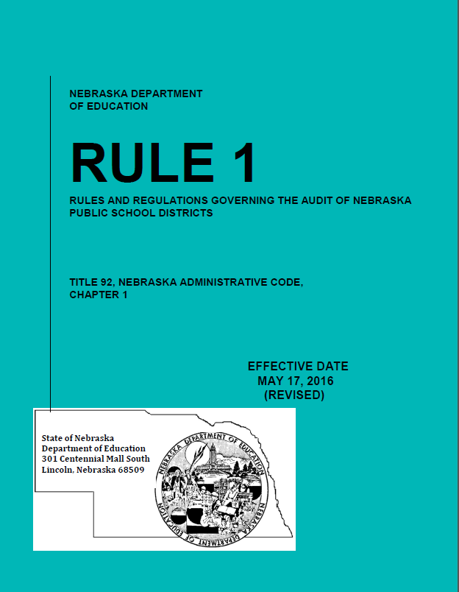
Audit Requirement
State Statute §79-1089 requires that a public accountant or a certified public accountant annually examine all financial records maintained by school districts.
Important part of Nebraska’s Transparency and Accountability Program.

Slide 107
Audit Requirements
Average Daily Membership must be audited by your independent auditors.
Template available for auditors.
School District must have individual capable of overseeing financial statement preparation otherwise:
Must hire acct firm to prepare f/s that is different from the firm that audits the f/s.

Slide 108
Superintendent Pay Transparency Act -- Budget Schedule D
Timeline required by statute:
At least 3 days before meeting, publish/post for returning Supt:
  Meeting notice detailing current costs and estimated future costs
  Proposed contract or amendments to contract (pdf)
Within 2 days after board approval, publish/post for new Supt:
  Entire approved contract (pdf)
  Meeting Notice

Slide 109
Mileage Reimbursement Rates
$.655 per mile Effective July 1, 2022
Regular Resident District Students:
$1.8668 per mile
Qualify if living 4 miles from school
Reimburse from 3 miles
One way travel once a day
Enrollment Option Students
$.9334 per mile
Qualify if on free lunch
Reimburse from 3 miles
One way travel once a day

Slide 110
NDE Portal
School Districts report most of their information to NDE through NDE Portal
https://portal.education.ne.gov
Data Collections
Consolidate Data Collection
ADVISOR – Student Information System
Notes:
CDC – Upload AFR information, LC-2, Summer School Student Units, Days in Session, etc.
NSSRS – Upload Assessment, Early Childhood, enrollment, membership and attendance, etc.

Slide 111
Enables districts to create, submit, and amend certain grant applications.
Allows districts to create and submit grant reimbursement requests.
Assists districts in tracking the status of applications, allocation, and reimbursements amounts.
Grants Management System (GMS)

Slide 112
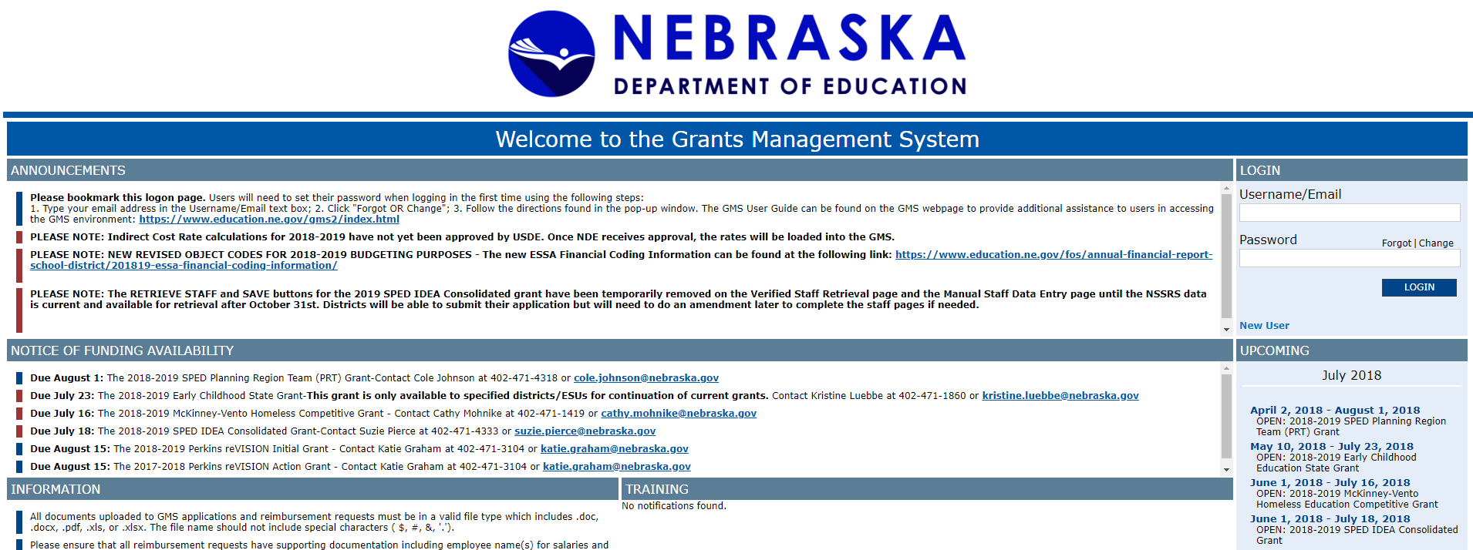
Accessing GMS
https://nde.mtwgms.org/NDEGMSWebv02/logon.aspx

Slide 113
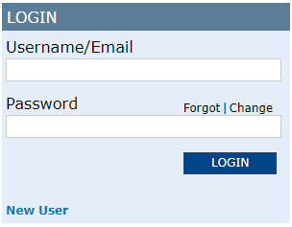
Accessing GMS
First Time Use:
Type your email address in “Username/Email test box”
Click “Forgot/Change”
Follow directions in next pop-up window
For Assistance, contact: NDEGMSData@nebraska.gov

Slide 114
GMS related questions
Grant Applications (Title) – Beth Wooster
Phone - (402) 310-1390
E-Mail - beth.wooster@nebraska.gov
Grant Applications (IDEA) – Suzie Pierce
Phone - (531) 530-9096
E-Mail -Suzie.Pierce@nebraska.gov Greg.Prochazka@nebraska.gov
Grant Reimbursement Request – Sara Leber
Phone – (402) 890-8977
E-Mail - Sara.Leber@nebraska.gov
Activation codes and Technical Assistance
E-Mail - NDEGMSData@nebraska.gov

Slide 115
Website Addresses
Nebraska Department of Education
http://www.education.ne.gov
Finance & Organizational Services
http://www.education.ne.gov/FOS
Nebraska Department of Education Portal
https://portal.education.ne.gov
NDE Payment Information
https://www.education.ne.gov/fos/payment-information/

Slide 116

Budget Assistance
Administrators’ Days – Crowne Conference Center
  Second Floor
  July 26th & July 27th
    8 a.m. – Noon
    1 p.m. – 3 p.m.

Slide 117
Notification of State Payments
Department of Education Payment Information
https://sfos-payment.education.ne.gov/
Grants Management System (GMS)
Payment Information
Audit Confirmation
All District Payments from State of Nebraska
paul.haas@Nebraska.gov
Request to receive email notification of all payments to district from State of Nebraska
Email must be sent from Superintendent
Only one email per district

Slide 118


Follow Bryce on Twitter
bryce wilson@NDE_Finance
School finance related reminders
Upcoming school finance due dates
Legislative updates

Slide 119
NDE School Finance Team
Bryce Wilson
bryce.wilson@nebraska.gov 402-471-4320
Kevin Lyons
kevin.lyons@Nebraska.gov 402-450-1418
Michelle Cartwright
michelle.cartwright@nebraska.gov 402-450-0867
Stephanie DeGroot
stephanie.degroot@nebraska.gov 402-540-0649
Notes:
RUSS END

Slide 120


Slide 121

Thank You!

