Slide 1
2023 SCHOOL FINANCE & BUDGET WEBINAR

Slide 2
Auditor of Public Accounts
Jeff Schreier – Audit Manager, Budget Review Coordinator
jeff.schreier@nebraska.gov
402.471.2111
auditors.nebraska.gov
June 2023

Slide 3
2023-2024 Budgets
No major changes to forms this year
Forms released last Friday
Budgets and Interlocal Agreement Reports due September 30th
LB 243 and 727 main bills this year with provisions related to political subdivision budgets

Slide 4
Budget Submission to APA
Budgets must be submitted to County Clerks, State Auditor and NDE
Submit online through auditors.nebraska.gov (preferred)
Click “Submit your Audit or Budget” on the left hand side of homepage
Mail
Auditor of Public Accounts
PO Box 98917
Lincoln, NE 68509

Slide 5
Joint Public Hearing Changes – LB 727
Updates to Joint Public Hearing process/requirements based on actual experiences last year
Sections of bill related to Joint Public Hearing have Emergency Clause – effective when signed by governor
So will be in effect for 2023-2024 budget season

Slide 6
Joint Public Hearing Changes – LB 727
At least one elected official from each participating political subdivision must attend
An elected official may be the designated representative from a participating political subdivision.
The presence of a quorum or the participation of elected officials at the joint public hearing does not constitute a meeting for Open Meeting Acts purposes

Slide 7
Joint Public Hearing Changes – LB 727
Hearings held
September 14 – 23
And before budget is filed with State Auditor
Participating subdivisions now provide information electronically to County Assessor rather than Clerk
Work with your County Assessor regarding how to submit the necessary information

Slide 8
Joint Public Hearing Changes – LB 727
Website of each participating political subdivision must have link to the political subdivision's proposed budget
Does not apply to:
a county with a population of less than ten thousand inhabitants,
a city with a population of less than one thousand inhabitants,
or, for joint public hearings prior to January 1, 2024, a school district.

Slide 9
Joint Public Hearing Changes – LB 727
Tax request for School District bonds is excluded from definition of “Property Tax Request”
In other words: Increase in tax request for bonds does not count against the allowable growth percentage when determining whether the School District needs to attend Joint Public Hearing

Slide 10
LB 243 – School Districts
Department of Education to calculate each School District’s “Property Tax Request Authority”
Tax Request must be within this authority
No changes on APA’s budget forms for this
Will be handled through LC-2

Slide 11
Adopted Budget Different than Publication
Statute 13-506
If budget adopted is different than what was published, need to publish a summary in same manner as original publication within 20 days after adoption

Slide 12
Common Issues during Budget Reviews
All required documentation not submitted
LC-2 printout
Special Grant Funds List
School Board minutes approving budget
Proof of Publication
Certification of Taxable Valuation from County Assessor(s)
Beginning Balances do not agree to Prior Year Ending Balances, or audit report or AFR

Slide 13
Budget Amendments
Amendments must be made prior to end of the fiscal year
Must file amendment with State Auditor, NDE, and County Clerks
Example and instructions can be found on State Auditor website
Required to submit:
Pages of Budget that changed; do not need complete budget
Board Minutes approving amendment
Proof of Publication for Amendment Hearing

Slide 14
Audit Reports
Audit Reports due to State Auditor by November 5th
Can submit online through auditors.nebraska.gov (preferred method)
Or mail hardcopy
Penalty for filing audit report late
If a political subdivision required to file a report with the Auditor of Public Accounts fails to file such report by the applicable due date, the Auditor of Public Accounts may assess the political subdivision a late fee of twenty dollars per day for each calendar day the required report remains not filed. … The total late fee assessed…shall not exceed two thousand dollars per filing.

Slide 15
Questions?
Nebraska Auditor of Public Accounts
Jeff Schreier – Audit Manager, Budget Review Coordinator
402.471.2111
Jeff.Schreier@nebraska.gov
auditors.nebraska.gov

Slide 16
School District Budget & LC-2 Michelle Cartwright and Stephanie DeGroot

Slide 17
Budget Information Available on FOS Website
https://www.education.ne.gov/fos/budgeting-school-district/

Slide 18
Budget Text – NDE Document
Explanation of budgeting terms
Reviews
Taxing funds and allowed levies
Accessing unused Budget Authority
Levy and Expenditure Exclusions
Procedure for holding special elections for a levy override and/or to exceed Budget Authority
https://www.education.ne.gov/fos/budgeting-school-district/

Slide 19
Budget Document Instruction Manual – APA
Instruction Manual for completing the District Budget Document Forms
In-depth statute reference
See for more on LB 644
Updated each year to incorporate Legislative changes
https://auditors.nebraska.gov/Budget_Info.html

Slide 20
Certified Budget Authority
Certified on or before March 1 each year
Re-certified on June 9th, 2023
See Budget Text pg 2 for full calculation explanation
Budget, Student Growth, or Formula based
Populated into LC-2
https://sfos.education.ne.gov/Default

Slide 21
Up Against Budget Authority?
Provisions in statute allow specific items to be outside of the General Fund expenditure limitation.
Utilize Exclusions
Special Grant Funds
ESSERS
Early Childhood
Short Term Borrowing, etc
Properly ‘estimate’ SPED expenses
General Fund Lid Exclusions - Schedule A
Retirement Contribution
Impact Aid, etc
Hold public vote to exceed Certified Budget Authority
Ballot language must include statement to include access to expenditure exclusions
Amount approved by public is for one school fiscal year.
Must budget the total amount approved to carry over for future years.
Becomes part of the base

Slide 22
Budgeting tool to help with cash flow Not cash in the bank Entered in budget worksheets, auto populates and calculates into LC-2, total cannot exceed allowable amount
Total Allowable Reserves
Employee Benefit Fund Necessary Cash Reserve
General Fund Necessary Cash Reserve
Depreciation Fund
Total Requirements
Reference: See Budget Text – Allowable Reserve Limitation for more info

Slide 23
Calculation of Total Allowable Reserves
Allowable Reserve Percentage is based on District’s ADM
General Fund Budget | $5,000,000
Allowable Reserve Percentage | 45%
Total Allowable Reserves | $ 2,250,000
Reference: See Budget Text – Allowable Reserve Limitation for more info

Slide 24
Budget Form – Basic Data Input
New line added excluding principle & interest on bonds
Enter estimated valuations, then update with certified
Filters information to other worksheets

Slide 25
Form pre-populates data from other pages Double check to see if JPH required If JPH required submit data to Co Assessor by Sept 4th
Budget Form – PT Request Act

Slide 26
Budget Form – Fund Worksheets
Enter audit, current year and budget information
Start now - current year and budget can be updated as needed
Data here is populated to Cover Page, Summary Pages, etc.
21/22 AUDIT
or
AFR
Current year actual
Planned Budget

Slide 27
Budget Data Entry Reminders
Enter the correct State Aid Amount from State Aid Certification Document
Motor Vehicle Taxes
Enter similar $ to previous year
County Treasurer’s Balance
Estimate from prior years
Beginning and Ending Balances
Use actual balances from audit
Second column of worksheet can be used to reach the desired levy

Slide 28
Budget Document Form – Budget Pages 2-4
Information autofill’s into pages 2, 3, and 4 from all Fund worksheets
Snapshot of your budget(s)
Do not key into the pages labeled 2, 3, and 4
Do not key or delete lines into Schedule B

Slide 29
General Fund Exclusions
Levy Exclusions
Allows districts to levy more than the $1.05 levy limit
Found on Budget Schedule B
No State Board Approval needed
Expenditure Exclusions
Allows districts to spend more than their Certified Budget authority
Most need State Board Approval
Notes:
Districts have two types of exclusions to allow for more flexibility in budgeting
Exclusions provide districts the ability to exceed statutory limitations
$1.05 Levy limit
Certified Budget Authority
Levy Exclusions are found on Schedule B
Expenditure Exclusions are found on Schedule A

Slide 30
General Fund Expenditure Exclusions State Board Approval Is Not Required:
Special Education Budget
Includes SPED Transportation & SPED related student services (21XXs, excludes 219X’s)
Special Grant Funds
Found in LC-2 (Sec B, line B-110)
60+ programs pre-approved each year by State Board, commonly used programs:
Notes:
State Board of Education Approval is required for most expenditure exclusions
Two exceptions
SPED Transportation
SPED-related student services
Special Grant Funds – Pre-Approved are found on the LC2

Slide 31
Supplemental Grants on the Special Grant List
Appear at bottom of Special Grant Fund List with Need State Board Approval *Email requests to Stephanie *Include name, amount, & purpose
Insurance Settlements
Inter-fund Loans
Reimbursements for Wards of the Court
Repayments to County Governments for Previous Overpayments
Short Term Borrowing
Grants from City or County Government
Grants from Corporations, Foundations, or Other Private Interests
Notes:
Items located at the bottom of the Special Grant fund list Do require state board approval since they are specific to your district. A couple of things to consider…
Insurance Settlements:
Consider depositing settlements into your Special Building Fund, so you don’t have to request state board approval when you need to spend those funds.
In recorded in the Special Building Fund, then it wouldn’t impact per pupil costs
Inter-fund loans:
The General Fund may loan to another taxing funds
You have two years to repay an inter-fund loan
Short Term borrowing
Need a load from the bank to help get through a shortfall in revenue during the year.
Must repay this in a year

Slide 32
Early Childhood Education Grant & New Elementary Site
Early Childhood Pre-populated on LC-2
Need State Board Approval
Remains in the base for calculation of future budget authority
New Elementary Attendance Site(s)
Exclusion is for costs related to first year of operation
Must qualify for State Aid Elementary Site Allowance
Salaries, Utilities, Bldg. Maint.
Notes:
Early Childhood grants will pre-populate in the LC2 & will remain in the budget base when budget authority is calculated the following spring.

Slide 33
Schedule A
Need State Board Approval
Repairs to Infrastructure
Judgements
Distance Education
Voluntary Terminations
Retirement Contributions
Native American Impact Aid
Email requests to: Stephanie.degroot@nebraska.gov

Slide 34
Requesting State Board Approval
Exclusion templates available on FOS website
Calculate for you
Send requests to NDE via email
Stephanie.degroot@nebraska.gov
Provide details of the grant request
Name and purpose of grant
Amount of grant
Use templates provided on FOS Website
Include District Agency ID
Round all amounts
Email in pdf format
Timeline to request State Board Approval on FOS website
Approval is posted on website within 5 working days after meeting
May include in budget planning before State Board Approval is posted.

Slide 35
LC-2 Lid Computation Form
Located in the NDE Portal
Need new Activation Code each year
Instructions found on FOS website
New Section D – Property Tax Authority
Budget Form (excel format)
Upload to LC2, it will auto populate
New Superintendent this year?
Register in NDE Portal
Need help with NDE Portal?
Call 888-285-0556 or ADVISERHelp@nebraskacloud.org
Notes:
An activation code is required for all data collections in the NDE Portal.
For the LC-2, there is one activation code.
This activation code allows the user to key and submit LC2 information,.

Slide 36
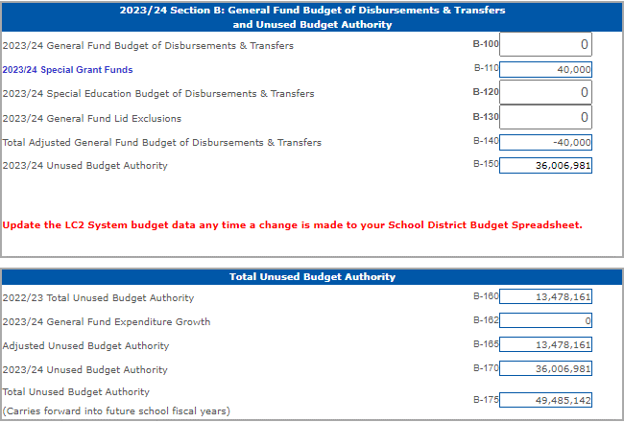
LC-2 Purpose
Confirms your budget is in compliance and does not exceed spending limitations
Error messages appear if limitations are exceeded
Special Grant Funds (B-110)
Calculates Unused Budget Authority (B-150) *Goal is $0
District approves after budget is adopted *Copies sent to APA & County
Required docs for NDE are submitted through LC2

Slide 37
LC-2 Access Unused Budget Authority
Amount listed is lesser of:
2% of the prior year’s adjusted General fund expenditures or
The prior year’s total unused budget authority
Provides Additional Budget Authority for 2023/24
Notes:
Remember earlier Michelle talked about unused budget authority, here is where it’s going to pre-populate

Slide 38
LC-2 Additional Budget Authority
Notes:
If you did go to a vote of the people, here is where you are going to mark yes & enter the amount.

Slide 39
Levy Override

Slide 40
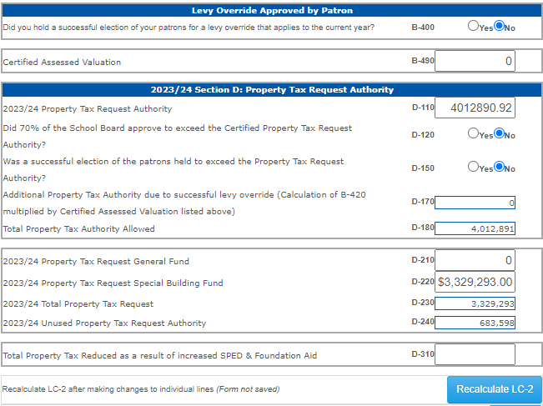
LC-2 New Section D – Property Tax Authority
*Certified Assessed Valuation & Property Tax Request Authority will prepopulate from Budget docs
*If YES on additional authority – amount will prepopulate
*D-180 will show your Total Amount Allowed

Slide 41
LC-2 Tips & Tricks
Upload an excel format of your budget into the LC2
Remember to recalculate & save often
Goal for Unused Budget Authority is zero
Unlimited uploads to check status of limitations
Remember to save Special Grant Funds list before returning to the LC2
Don’t forget to upload docs in PDF format after District Approval
Notes:
An activation code is required for all data collections in the NDE Portal.
For the LC-2, there is one activation code.
This activation code allows the user to key and submit LC2 information,.

Slide 42
LC-2 Error Messages LC-2 Cannot be submitted with error messages!
Access to Prior Year’s Unused Budget Authority Exceeded
Budget Authority Exceeded
Allowable Reserves Exceeded
Levy Info/Dates Don’t Match
Property Tax Authority Exceeded

Slide 43
Budgeting Checklist
Expenditure exclusion requests sent in?
Use LC-2 while working on budget.
Is the budget within spending, levy & property tax limits?
Does the LC-2 & budget match?
Is Joint Public Hearing required?
Does hearing notice match the budget doc?
Publish hearing notices
Notes:
Once you’ve worked your way through the budget documents and worked your way through LC2 then refer to this checklist to make sure you have everything completed

Slide 44
Budgeting Checklist
Confirm Hearing Notices were published in newspaper.
Reserve adequate time for public comment at budget hearing
Approve LC-2 after board approves budget
Submit budget docs to NDE, APA, Clerks
Submit Tax Resolution to County
Tax Request set correctly?

Slide 45
Submitting Budget Documents to NDE
LC-2 Upload Feature appears after clicking “District Approval”
Review Checklist, pdf listed items and upload through the LC-2
Upload as single PDF
Confirmation emails sent when:
District admin approves
PDF documents are uploaded
NDE approves LC-2 and budget docs
Do not mail in budget documents
Notes:
Ok Michelle is going to go over some end of year reminders with you.

Slide 46
Current Year 2022/23 Budget Reminders
Review current budgets to avoid overspending and/or see if an amendment is required
If spending authority remains in General Fund, may want to transfer to other funds:
Depreciation Fund
Employee Benefit Fund
School Nutrition Fund
Activity Fund
Unspent General Fund budgeted authority will increase 2023/24 Beginning General Fund Cash Balance

Slide 47
Need to Amend the Current Year’s Budget?
Per Statute must amend before overspending occurs
Required if ANY fund will exceed total budget of disbursements & transfers out
Hearing and Approved by August 31
Total Requirements must equal Total Resources available
Property Tax request cannot change if Tax Levy has been set
Required Action
Hearing Notice To Amend
Budget as originally adopted
Proposed amended budget
Rationale for amending
Include statement “Will not impact the tax request for the current year”
Documents to submit
Proof of Publication
Board Minutes
Page 2 of Budget Document
Submit documentation to:
State Auditor
County Clerks
NDE
https://www.education.ne.gov/fos/process-for-amending-a-budget/ or Budget Text pg 16

Slide 48
Amending the LC-2
LC-2 must be revised if these funds are amended:
General Fund
Depreciation Fund
Employee Benefit Fund Cash Reserve
Make sure Allowable Reserves have not been exceeded
Run through LC-2 before Board approves
Must contact NDE to unlock LC-2
https://www.education.ne.gov/fos/process-for-amending-a-budget/

Slide 49
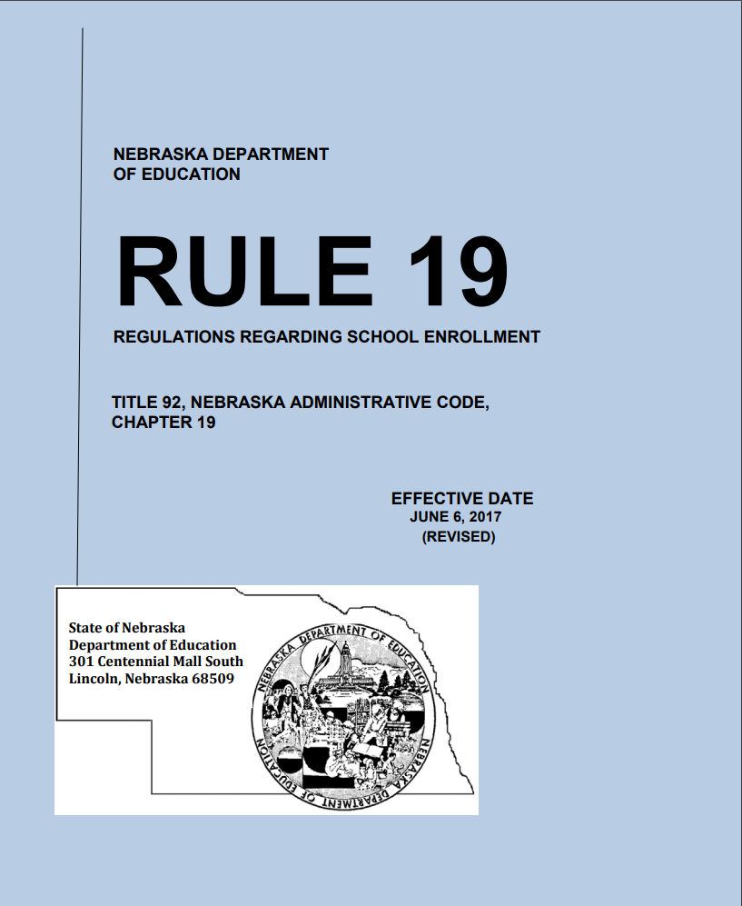
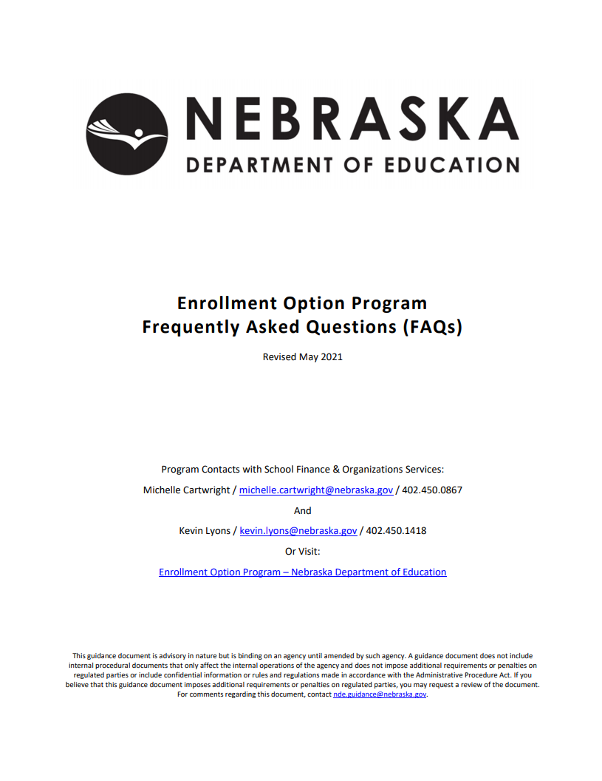
Enrollment Option Program
No Changes!
https://www.education.ne.gov/fos/enrollment-option-application-instructions-faqs/

Slide 50
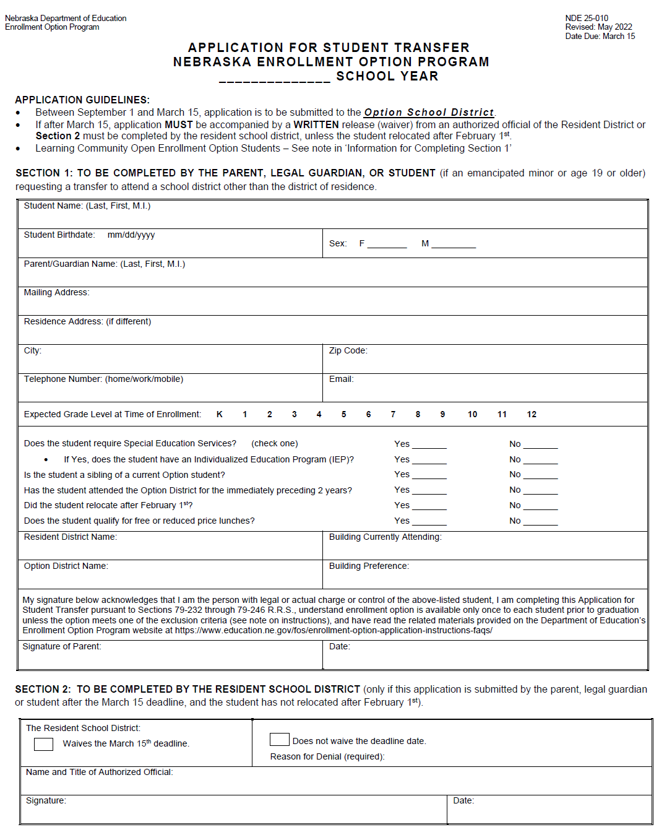
Enrollment Option Application
Application revised every May/June
Use most current version
Spanish version available upon request
Districts retain application until student graduates or reaches age 21
Program Contacts:
Michelle Cartwright
michelle.cartwright@nebraska.gov / 402.450.0867
Kevin Lyons
kevin.lyons@nebraska.gov / 402.450.1418

Slide 51
Kevin Lyons
State Aid

Slide 52
Lump-Sum Payment for
2022/23 Positive Prior Year Correction
Equal to or Greater than $1,000
On or before July 15 - NDE notifies district
Must respond by August 15
On or before September 15 - District notification of
board approval
Less than $1,000
NDE makes payment without application

Slide 53
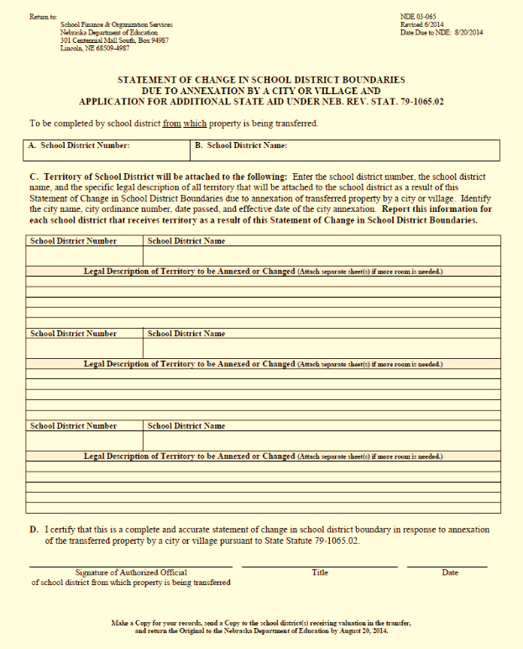
Statement of Change in School District Boundaries due to Annexation by a City or Village
Forms available upon request
Forms Due: AUGUST 20
Kevin Lyons
Director of School Finance
kevin.lyons@nebraska.gov
402-450-1418

Slide 54
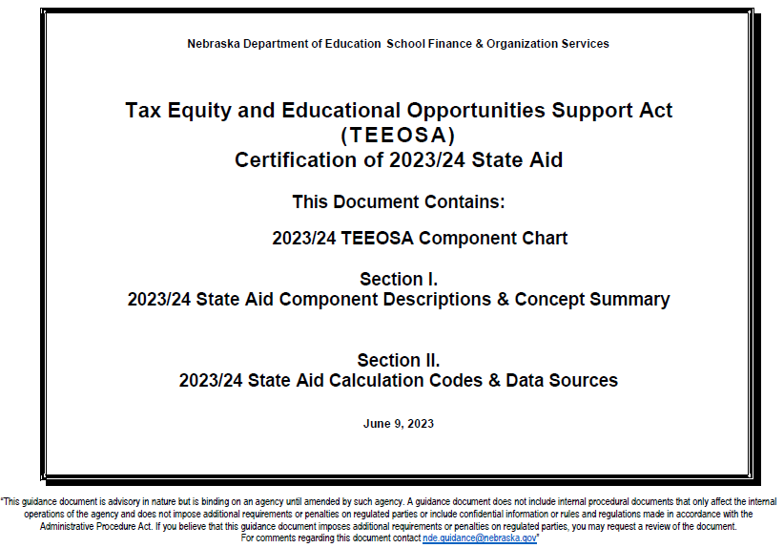
TEEOSA Document
Decodes
the components of Equalization Aid
Resource
for more detailed information
Available
on NDE’s website

Slide 55
TEEOSA DATA SYSTEMS
PORTAL
CDC (Consolidated Data Collection)
Instructional Program Hours
Pupil Transportation Report
Due Date: June 15
Audit Window: June 30
NDE

Slide 56
Consolidated Data Collections (CDC)
Days in Session/Instructional Program Hours (completed June 30)
Pupil Transportation Report (completed June 30)
Superintendent Pay Transparency Act (on or before August 1)
The following collections are Due 10-15-2023
Summer School Student Unit
Assessed Valuation and Levies
Estimated Expenditures for Poverty and LEP
PK Instructional Program Hours/K Program
Elementary Site Allowance
Two-Year New School Adjustment Application
Student Growth Adjustment

Slide 57
Superintendency Pay Transparency Act
T
Timeline required by statute:
On or before August 1:
Submit entire approved contract (pdf) on Portal
September 30:
Schedule D submitted with district budget
October 1:
Withholding state & local funds started for schools not submitting superintendent contract through NDE Portal (CDC)

Slide 58
TEEOSA DATA SYSTEMS
PORTAL
ADVISER
Nebraska Public and State Operated Districts: submission of data from their local Student Information System (SIS) to ADVISER
Fall Membership
Average Daily Membership
NDE’s Focus
State Aid
SPED
NDE

Slide 59
2023/24 Recalculation
CERTIFICATION
Fall Membership
Assessed Valuation
2021/22 Annual Financial Report (AFR)
RECALCULATION
Average Daily Membership (ADM)
Certified Valuation
Amended 2021/22 Annual Financial Report (AFR) Due: July 15

Slide 60
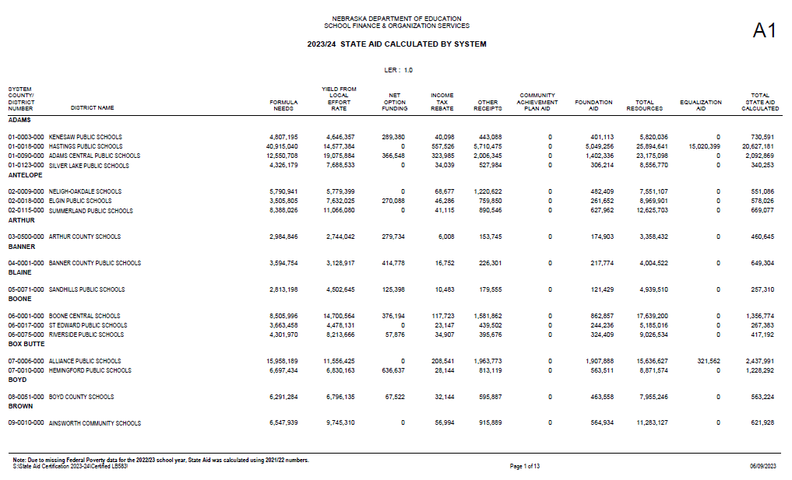
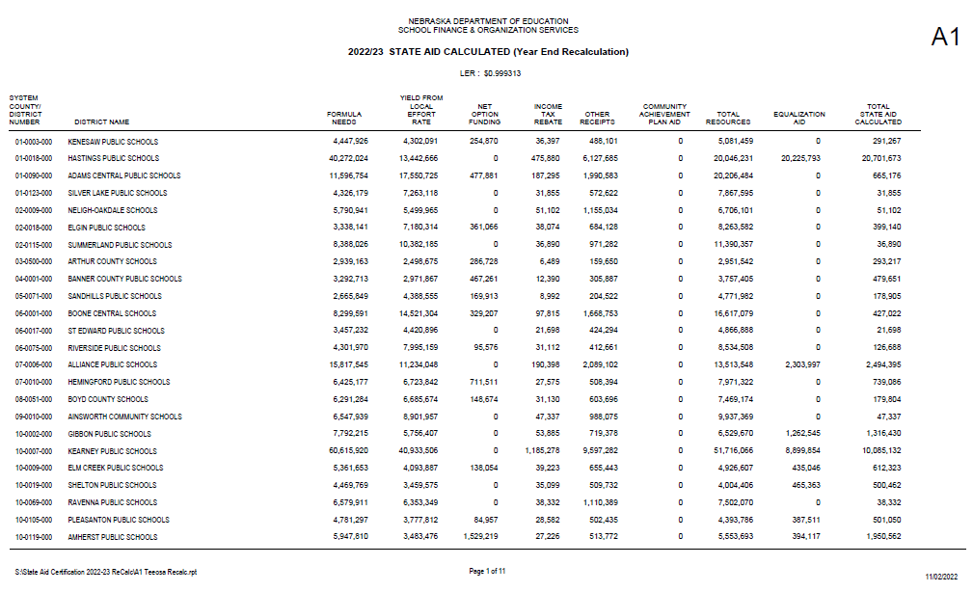
2023/24 Recalculation
2023/24 Certification
2023/24 Recalculation
Local Effort Rate
Balancing Factor

Slide 61
Prior Year Correction
2022/23
Prior Year
Correction
2023/24
TEEOSA Aid
2022/23 Certification
DIFFERENCE
2022/23 Recalculation

Slide 62
LEP & Poverty
Expenditure Requirement
2022/23
Expenditures
117.65% level of Expenditures
Coding
Reports available identifying required level
Assist with 20/21 AFR
2024/25
Expenditures
Report this fall
Sept 1 – Oct 15
CDC Collection – Estimated Expenditures for LEP and Poverty

Slide 63
Foundation Aid
Starting with 2023/24 Certification
$1,500 per Formula Student
2023/24 & 2024/25 (Year 1 & 2) full amount included in Equalization calculation
2025/26 (Year 3) & thereafter 60% of Foundation Aid included in resources - $900
Net Option Funding
Amount Reduced by $1,500 per net positive option student
LB 583 TEEOSA Changes

Slide 64
Section 79-528:
Fall school district membership reported as of October 1
Section 79-1003:
Qualified early childhood education fall membership reported as of October 1
Fall
Membership Reporting

Slide 65
Kevin Lyons Director of School Finance School Finance and Organizational Services kevin.lyons@nebraska.gov 402-450-1418

Slide 66
2023 School Finance Legislation
Bryce Wilson – Finance Officer NDE

Slide 67
LB 583 – What changes? - TEEOSA - SPED Funding

Slide 68
LB 583 – SPED Reimbursement
Increases State School Age Excess Cost Reimbursement to 80%ish.
Districts can estimate this amount by taking (2022/23 qualifying expenditures x .80).
Payments made to Districts Dec 2023 – June 2024.
Reimbursement was approximately 42% this year.
Benefits both equalized and non-equalized districts.

Slide 69
LB 243 – Property Tax Authority
Creates a third mechanism for limiting school district taxation
Levy lid
Spending lid/budget authority
Property Tax Authority
Functionally it’s more of a Revenue Lid than a Property Tax Lid
Applies to General Fund and Special Building Fund ONLY.
Allows for revenue growth each year
3% for all districts
Membership growth – K12 fall membership
Poverty growth – Direct Cert Medicaid Free and SNAP
LEP growth – LEP students used for TEEOSA Calc

Slide 70
LB 243 Calculation
Base Amount
Growth Percentage
2022/23 General and Building Fund Property Tax Request
+
2021/22 SPED Reimbursements
+
2022/23 TEEOSA Paid
+
Other General and Building Fund Revenue’s Not Excluded
3% Base Growth Amount
+
Student Enrollment Increase
+
Poverty Student Percentage Increase
+
LEP Student Percentage Increase

Slide 71
LB 243 Calculation - Continued
New Year Revenue Cap
Property Tax Authority
New Year Revenue Cap
-
2021/22 Other General Fund and Special Building Fund Revenue
-
2022/23 SPED Reimbursements
-
23/24 TEEOSA to be Paid
=
General and Special Building Fund Property Tax Authority
Base Amount
X
1+Growth Percentage
=
New Year Revenue Cap

Slide 72
Total Property Tax Authority Calculation
General and Building Fund Property Tax Authority
+
Additional Board Approved Property Tax Authority
+
Active Levy Override Amount
+
Additional Amount Approved by 60% of District Voters
=
Total General and Building Fund Property Tax Authority
Board Approval for additional percentage
ADM 471or less = 7%
ADM 3,044 – 472 = 6%
ADM 10,000 – 3,045 = 5%
ADM 10,001 plus = 4%
Requires 70% Board Approval

Slide 73
Revenue Excluded from Calculation
All Federal Revenue – ESSER Funds
Grants/Donations
Bond Revenue
Merged District Revenue
Any other funds than Gen/Build
Insurance proceeds
Proceeds from sale of property in Special Building Fund
Financing Proceeds

Slide 74
2023/24 Budget Process LC-2 Calculation

Slide 75
Frequently Asked Questions
Does board approved additional amount carry forward?
Yes, but that may change during the next legislative session.
When does the Board need to approve additional amount?
Board will have to approve prior to submission of Budget.
Requires publication in local newspaper one week prior to board vote.
What if we don’t tax for the full amount of our property tax authority?
Unused authority (including additional amount approved by the board……possibly) will be available in future years.
Included in base for future years calculation.

Slide 76
LB 644 – What Did We Learn
Increasing tax asking by 2% plus real growth
Replaces the property tax hearing
Joint hearing with other Political Subdivisions in the County.
Between Sept. 14 – Sept. 24th
^{After 6:00 P.M.}
Information for joint hearing must be sent to the County Clerk by Sept. 4th.
Postcard must be sent to all affected property taxpayers.
Elected official must attend.
Check the County Mailing Prior if Possible.
Hold Budget Hearing Early if Possible.

Slide 77
Increase in Special Education
Qualifying district must meet the following requirements:
Over $50k spent annually on SPED
Or at least .5% of annual budget spent on SPED
Increase over 7% spent on SPED from prior year from Sept 1 – Dec 31.
If qualifying can request early reimbursement for amount in excess of threshold by Jan 15th.
NDE must make payment by Jan 31st.
Any early payment reduces reimbursement the following year.

Slide 78
Annual Financial Report

Slide 79
Reason for Amendments - SPED
SPED –
Maintenance of Effort
Coding SPED costs to Regular Education (1100’s)
Final Financial Report
Requesting more reimbursement than what is coded to reimbursable accounts on the AFR
600’s vs 700’s Capital Exp vs Expense
ESSER Funds
Coding more SPED expenditures to Federal Accts than Revenue
Decreases reimbursement from the State
Make sure costs for SPED for birth – Pre-K is coded to IDEA
No state reimbursement for birth – Pre-K

Slide 80
Annual Financial Report
2022/23 USER’s Manual now available
Master Code List is available
Test your upload file in the test upload site NOW….
Requires districts to test upload before audit begins

Slide 81
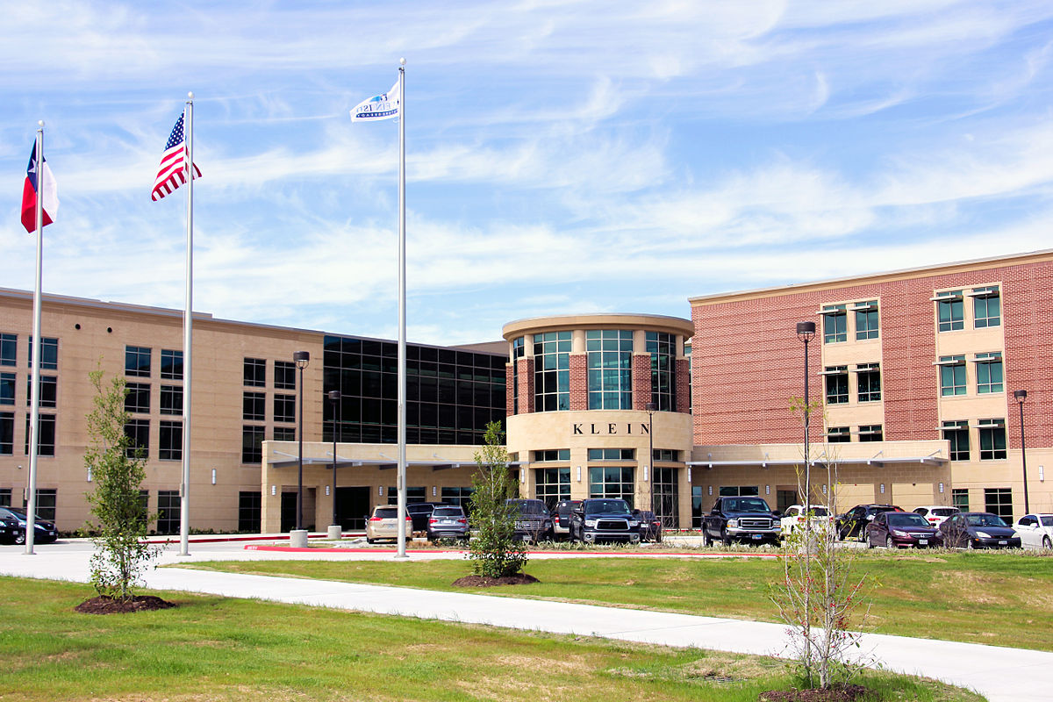
Value of Building & Contents
Included in Per Pupil Cost Calculations
3% of Total Value of Building & Contents
Enter Value of Building & Contents by District and by School
District includes all facilities other than actual school instructional buildings
Bus Barn
Administration Building – if separate
Athletic Fields

Slide 82
Allocating District Expenses
School level allocations
District determines amount for each school
Account reported with school number (12-0125-003)
More accurate information
NDE automatically allocates by ADM if reported with district number (12-0125-000)
Districts can change NDE allocations if not appropriate
No more than 50% can be coded to the District level

Slide 83
AFR Submission – November 1
AFR System Opens October 1
Utilize the AFR Summary Report to confirm financial information aligns with audit
Financial Info submitted must align with audit – might request pre-lim info from auditor
Notification to district to adjust/correct info
Financial Information must be uploaded again

Slide 84
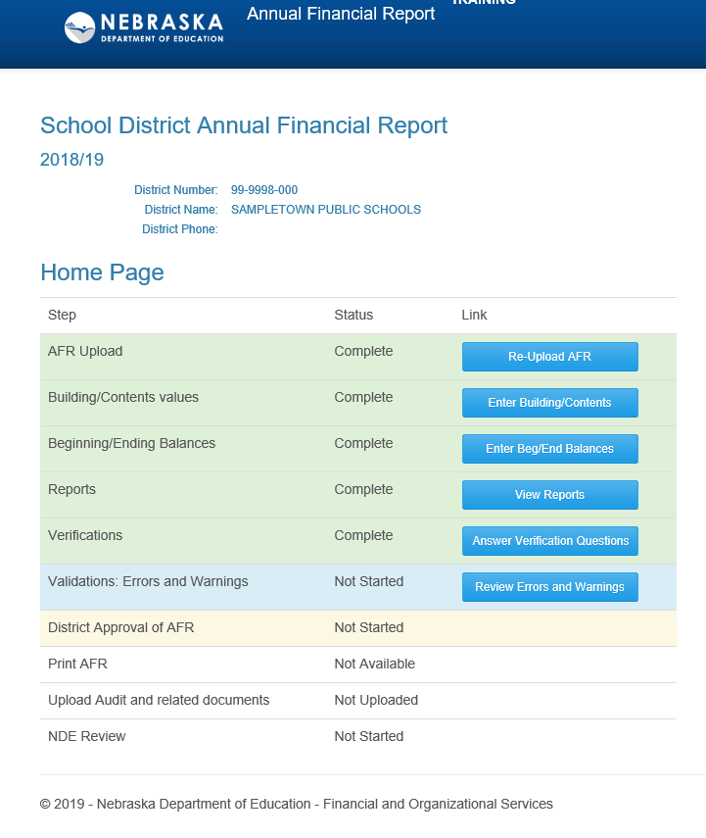
Three Steps in AFR Upload Process:
Building/Contents Value
Beginning/Ending Balances
Reports
District Number: 99-9998-000
District Name: SAMPLETOWN
District Phone: (402)999-9999
Not Started

Slide 85
Report Display Page
Updated Report – SPED Expenses Qualifying for State Reimbursement (FFR eligible) and MOE Qualifying expenditures

Slide 86
District Audits
Based on district level transactions
Need some testing on expense allocations
REQUIRES the following statement: A sample of expense allocations were tested verifying appropriate allocating to the school building level.
Supplemental Schedule in specific format and order:
Functions
Fund Totals
Fund Beginning & Ending Balances
Account codes should be listed
Verify financial info matches district audit when uploaded into
NDE Financial Data Reporting System

Slide 87
Districts must have individual capable of overseeing financial statement preparation
01
If there is no one capable of overseeing financial statement preparation?
02
Separate firm must prepare the financial statements
03

Slide 88
Federal Fund Overview
CARES Act – Passed on March 27, 2020
Elementary and Secondary School Emergency Relief (ESSER) Fund
Function codes 4996/6996
Obligated prior to September 2022
COMPLETED
Coronavirus Response and Relief Act – Passed December 21, 2020
ESSER II Funds
Function codes 4997/6997
Obligated prior to September 2023
Davis Bacon Requirements for construction
Payment Extension???
American Rescue Plan Act – March 11, 2021
Function codes 4998/6998
20% must be used to address learning loss
Obligated prior to September 2024
Payment Extension???

Slide 89
Federal Funds Indirect Cost Rate
Districts must either apply indirect cost to ALL grants (Federal and Non-Federal) or NO grants.
We are seeing indirect cost applied inconsistently as we monitor Federal programs.
Districts may decide to apply an indirect cost rate less than the calculated amount.
Must be applied consistently to all grants
Exceptions: grants with lower allowable rates

Slide 90
Indirect Cost Rates
2023/24 Indirect Cost Rates were excessive in many ESU’s and some schools.
It appears that technology costs coded to administrative code (2500 Central Services) instead of educational codes may be at least a part of the issue.
2500 should only include technology needed for general operation of the district.
Technology related to learning for students or for instructional of staff should be coded into 2200’s Support Services Instruction.
Sub-Awards/Sub-Contracts – for Federal Grants
$25,000 or less (object code 395) – included in the ICR calculation
More than $25,000 (object code 396) – excluded from the ICR calculation

Slide 91
ESSA Consolidated App Title I, II, III & IV
The Application is similar to last year.
Opening date will be July 18th
Closing date is September 29
Federal Programs Team will have a session at Admin days and available in a workroom for application support on Wed and Thur.

Slide 92
Monitoring Common Errors
> Time and effort
Most common error we find is entities appear to use budgeted and not actual, T&E is actual time worked and paid for all activities.
Second most common error we find is entities charging salary only to a grant. This is unable per 2 CFR 430 and 431- benefits must be included as well
Last error we find is claims for reimbursement not matching accounting records – amendments or journal entries after the reimbursement occurs.
> Policies and Procedures
Most common error is entities do not have all the required policies and procedures for grants. Need policies and procedures for the following; Equipment and inventory, Procurement, Record retention , Suspension and Debarment, Financial Management, Program Income, Cost sharing or matching, and Compensation – Personal services and fringe benefits
> Coding Issues
After a reimbursement is paid the allowable expenses are moved which then makes them unallowable.

Slide 93
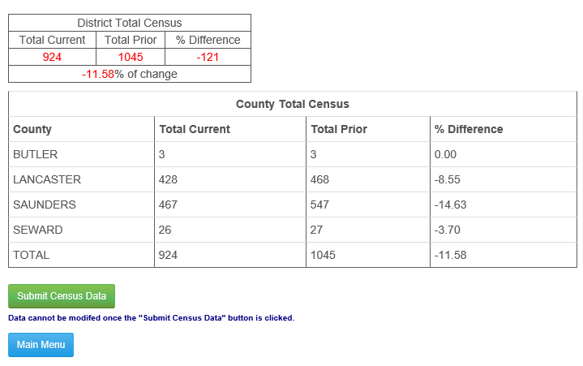
Census Collection
Count of district resident children age 5-18 as of June 30
Factor in Calculation of County Fines & Licenses and Apportionment
Prior year’s counts & percentage increase/decrease are included for comparison purposes
Due date July 10
Audit window open from July 11 - 20
Questions? Contact:
Michelle Cartwright 402-450-0867
Stephanie DeGroot 402-540-0649
Crawford
Decatur
Lucas
Mills

Slide 94
Online Exempt School System
Rule 13 Exempt students can register online.
School districts can check enrollment status online.
New System in Development for 2023/24.

Slide 95
Opportunities for Budget Assistance

Slide 96
New Superintendent Orientations
North Platte
July 18th
8:30 a.m. – 3:00 p.m.
Milford – ESU #6
July 20th
8:30 a.m. – 3:00 p.m.
Both Sessions will be offered via Zoom &
in-person.

Slide 97
Budget Assistance
Administrators’ Days
July 26th & July 27th
8 a.m. – Noon
1 p.m. – 4 p.m.
Dedicated Budget Rooms – Upstairs

Slide 98
Budget Assistance
Call in to set up an appointment for budget help
or
Email in budget and discuss during phone calls

Slide 99
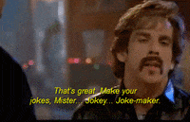
School Finance Team Bryce Wilson bryce.wilson@nebraska.gov 402-471-4320 Kevin Lyons kevin.lyons@nebraska.gov 402-450-1418 Stephanie DeGroot stephanie.degroot@nebraska.gov 402-540-0649 Michelle Cartwright michelle.cartwright@nebraska.gov 402-450-0867 https://www.education.ne.gov/fos/
Bryce Wilson @NDE_Finance

Slide 100
Thank You!

