Slide 1
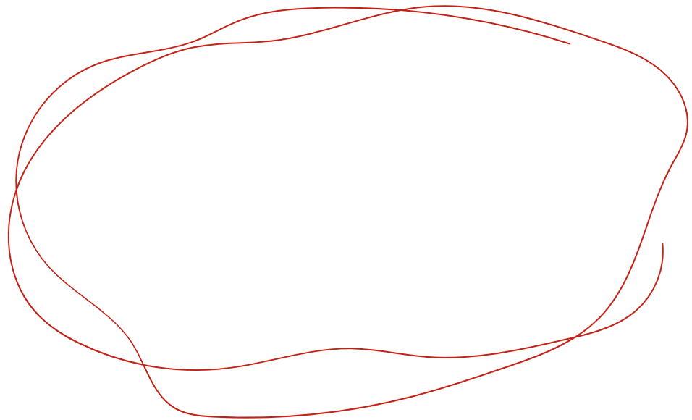
DISCOVER AND
DESIGN
@2023
STAY CONNECTED--May 18, 2023 @ 12:00
Jackie Steffen and LaDonna Werth, Nebraska Extension
The University of Nebraska does not discriminate based upon any protected status. Please see go.unl.edu/nondiscrimination.

Slide 4
Early Childhood Team

Slide 5
DISCOVER AND DESIGN
@2023
https://fitandhealthykids.unl.edu/discover-and-design
The University of Nebraska does not discriminate based upon any protected status. Please see go.unl.edu/nondiscrimination.

Slide 6
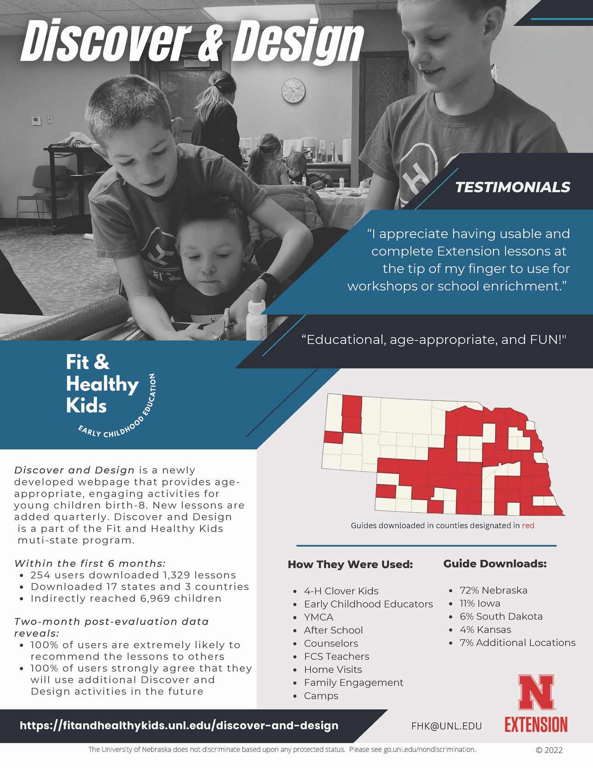
What is it?

Slide 7
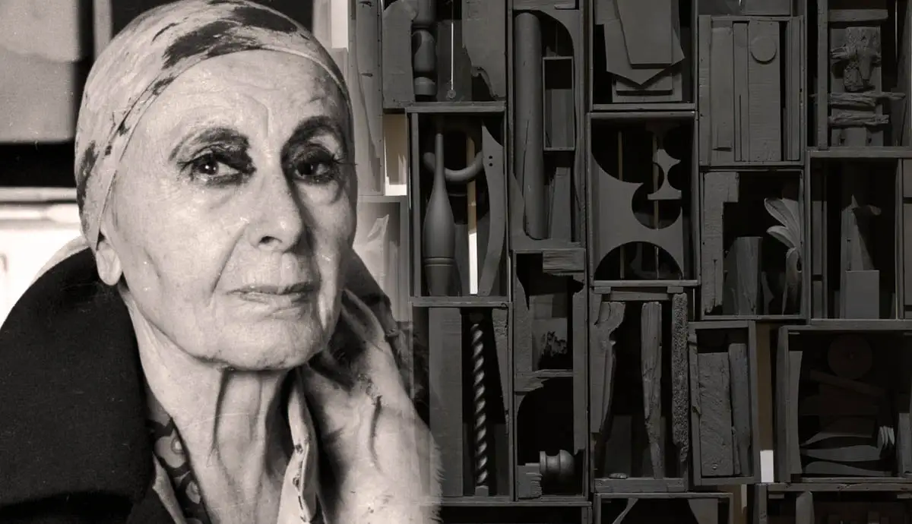
Louise Nevelson

Slide 8
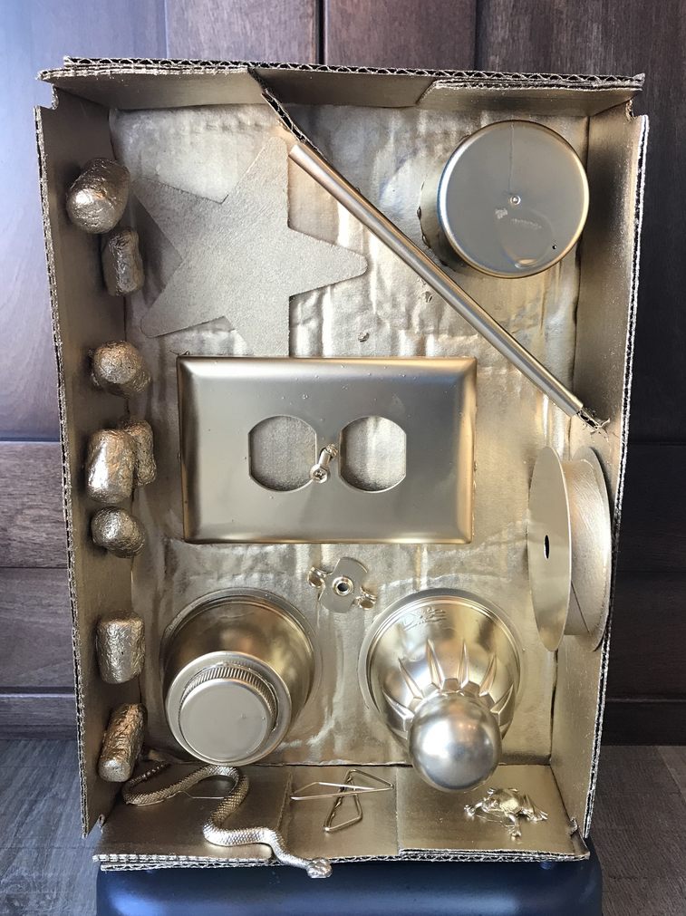
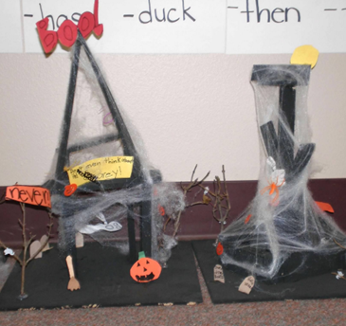
Assemblage
Wood/Paper Sculptures

Slide 9
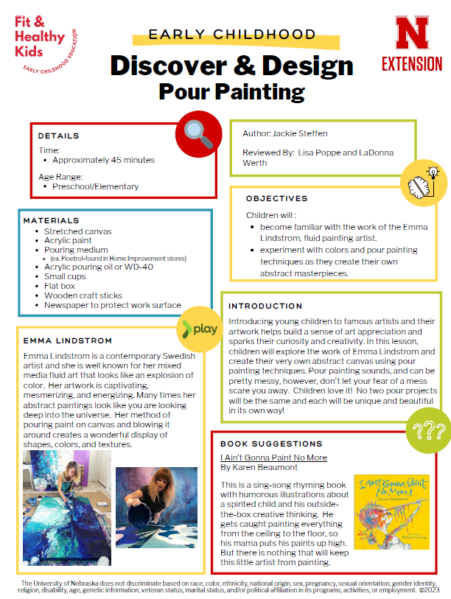
Emma Lindstrom

Slide 10
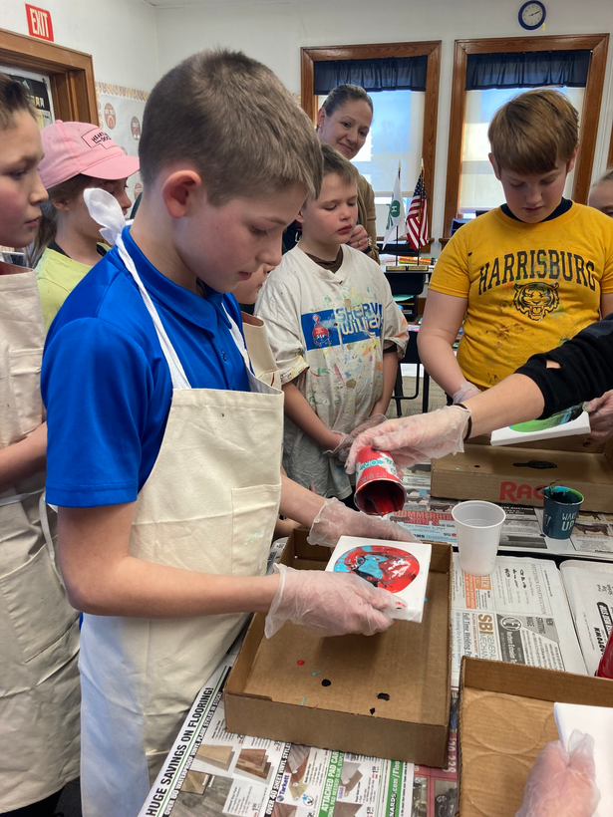
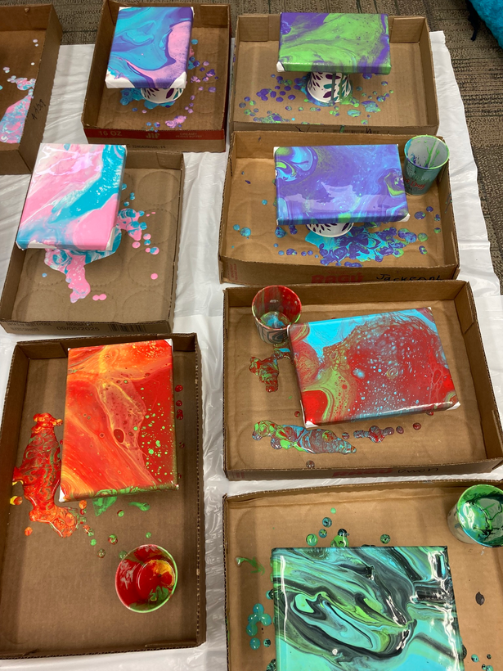
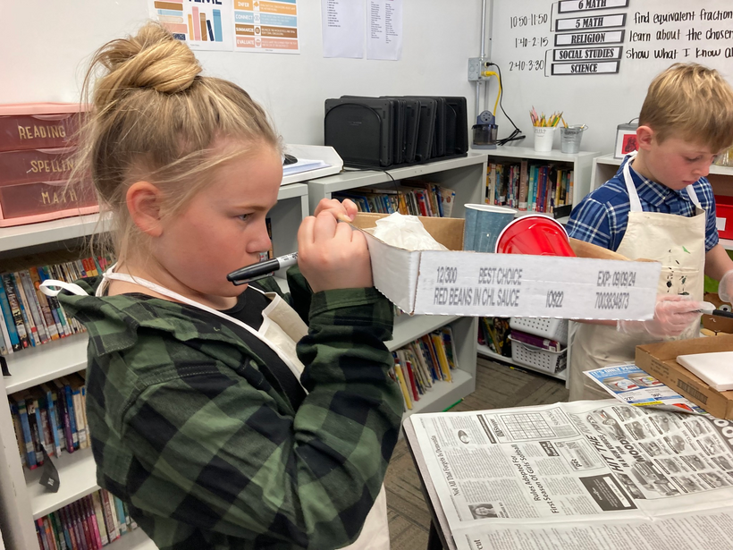
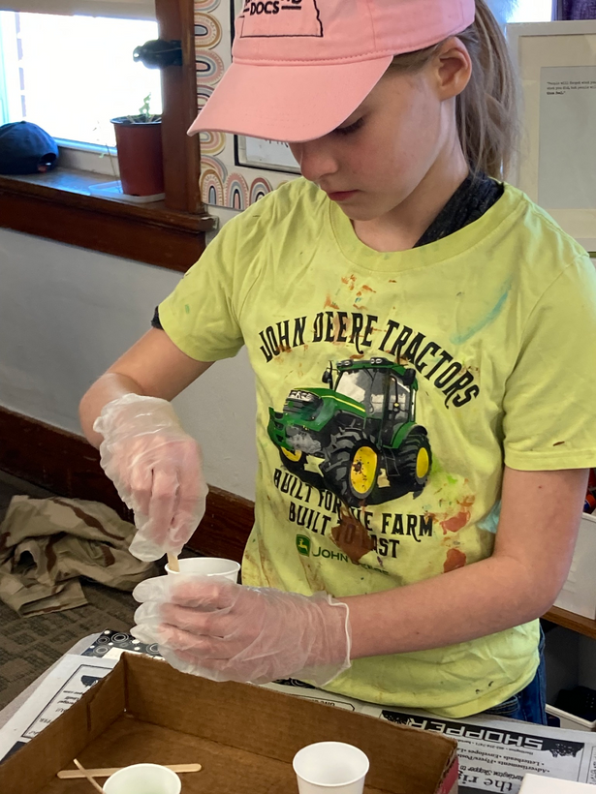
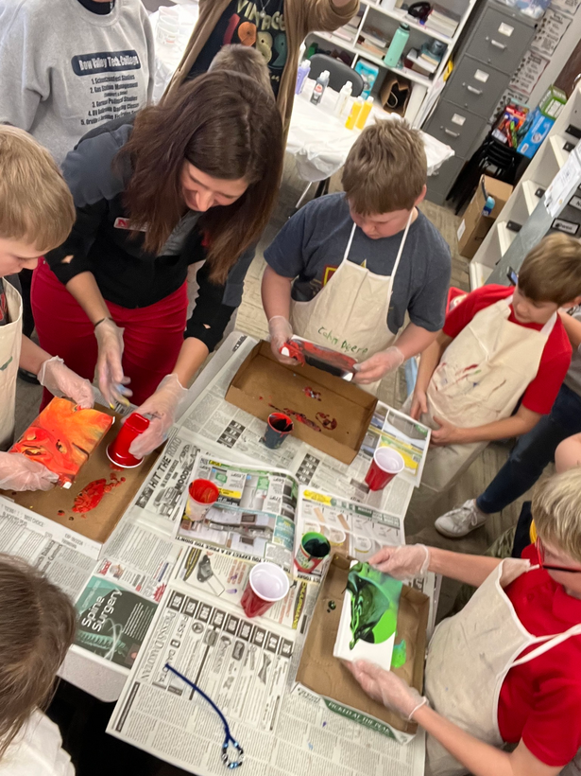
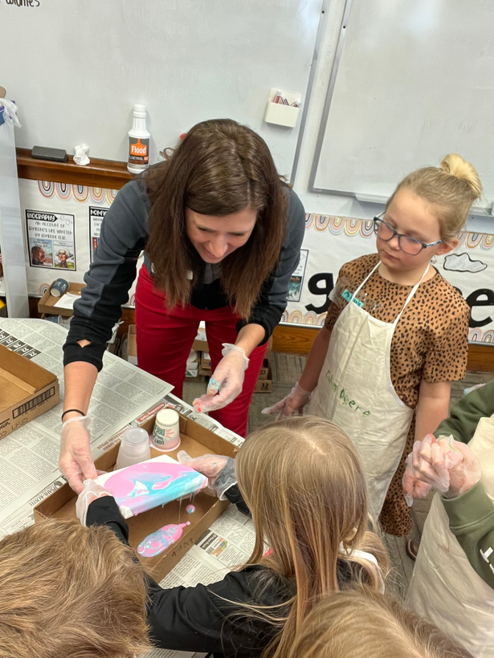
Pour Painting
in Action

Slide 11
DISCOVER AND DESIGN
@2023
https://fitandhealthykids.unl.edu/discover-and-design
The University of Nebraska does not discriminate based upon any protected status. Please see go.unl.edu/nondiscrimination.

Slide 12
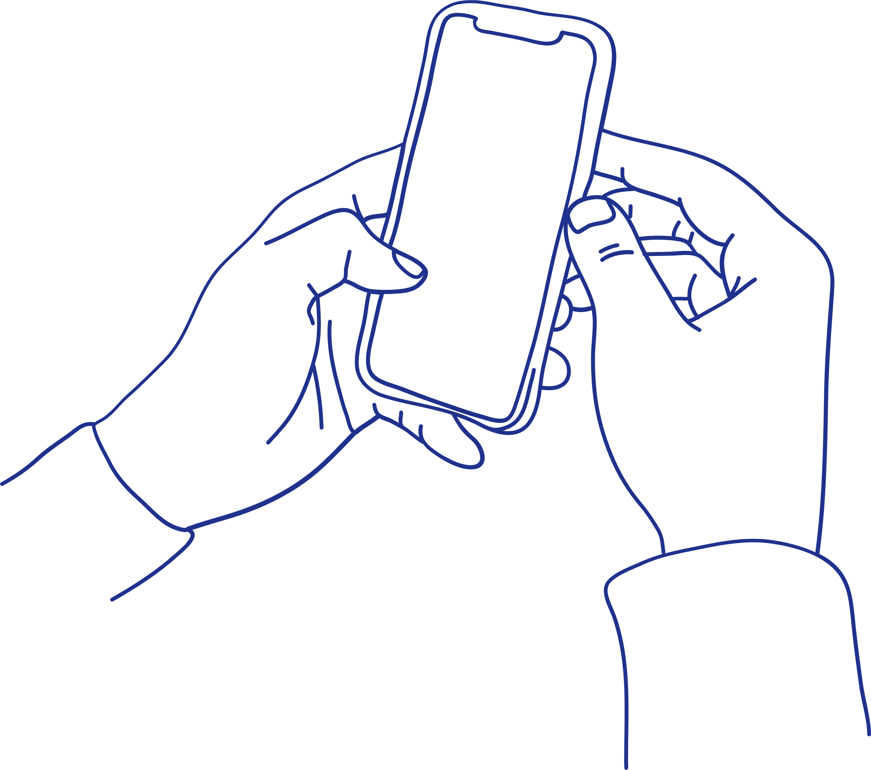
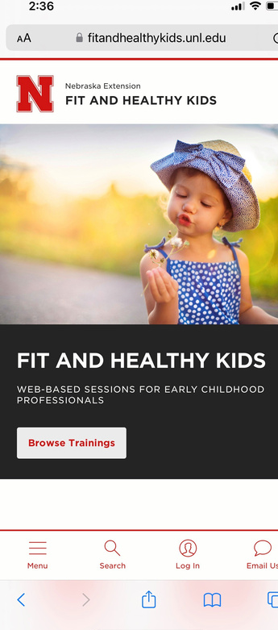
Stay Connected Fit and Healthy Kids
HTTPS://FITANDHEALTHYKIDS.UNL.EDU/

Slide 13
Materials for You
Family Engagement
HTTPS://FITANDHEALTHYKIDS.UNL.EDU/

Slide 14
Pass the Pointer

Slide 15
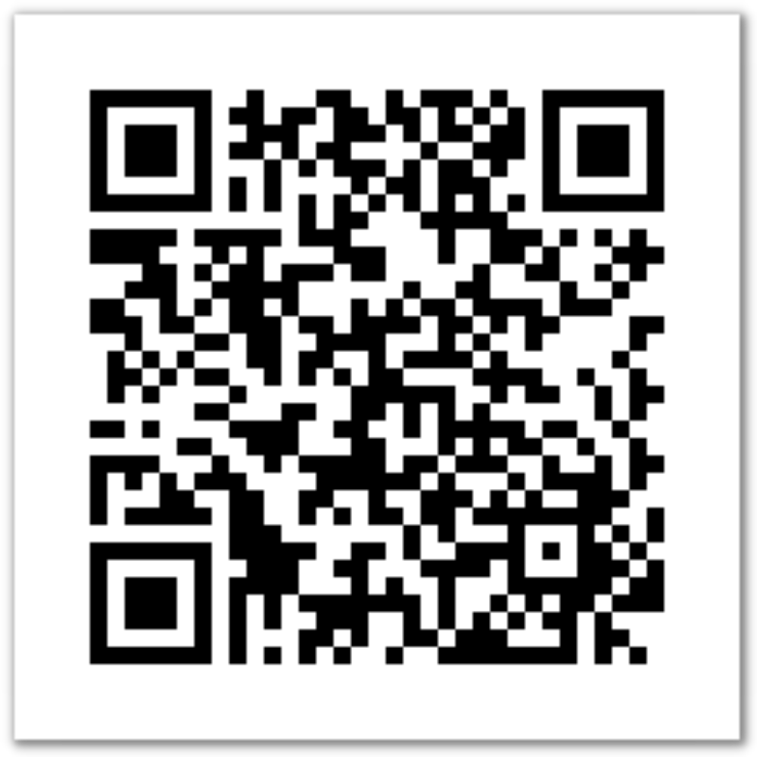
Evaluation
https://go.unl.edu/dd

Slide 16
Questions
https://fitandhealthykids.unl.edu/
Any questions:
Jackie: jsteffen2@unl.edu
LaDonna: ladonna.werth@unl.edu
fhk@unl.edu

