Slide 1
4-H Reading Connections
All Together Now

Slide 4
History

Slide 6
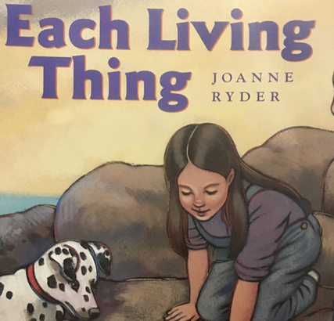
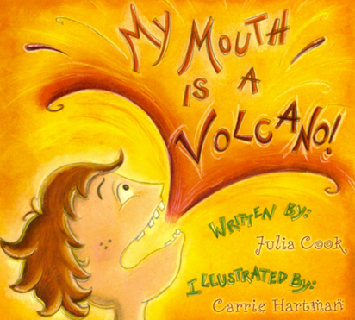
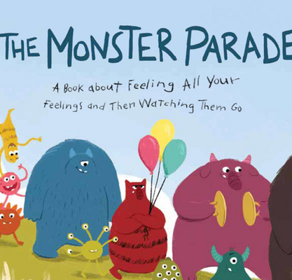
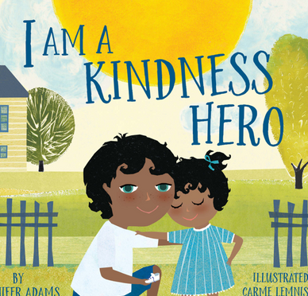
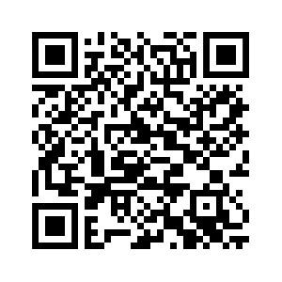
2023 STEM Imagination Guides
"All Together Now"
QR Code for website:
https://child.unl.edu/nebraska-4-h-stem-
reading-connections-program

Slide 7
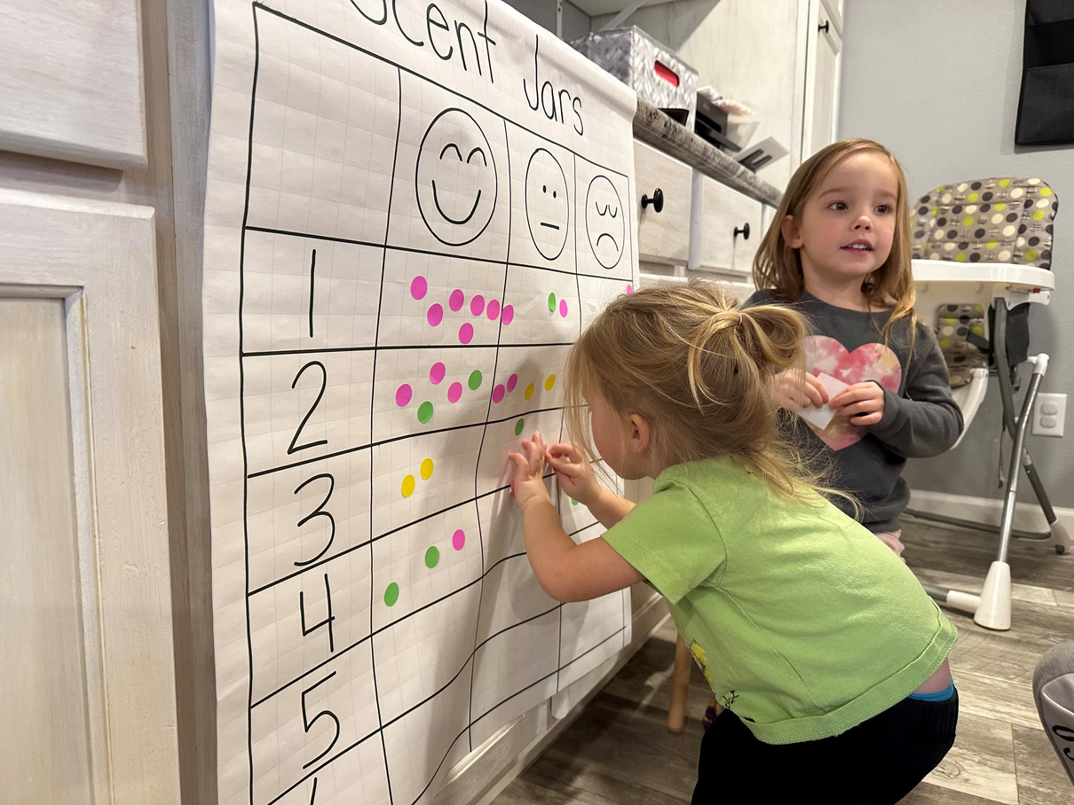
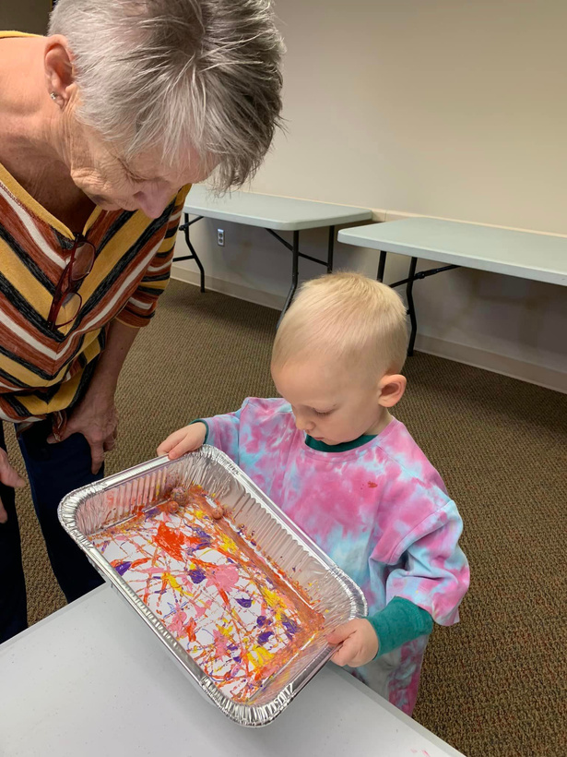
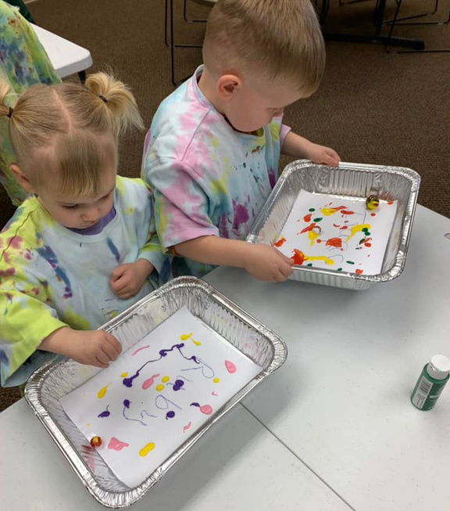
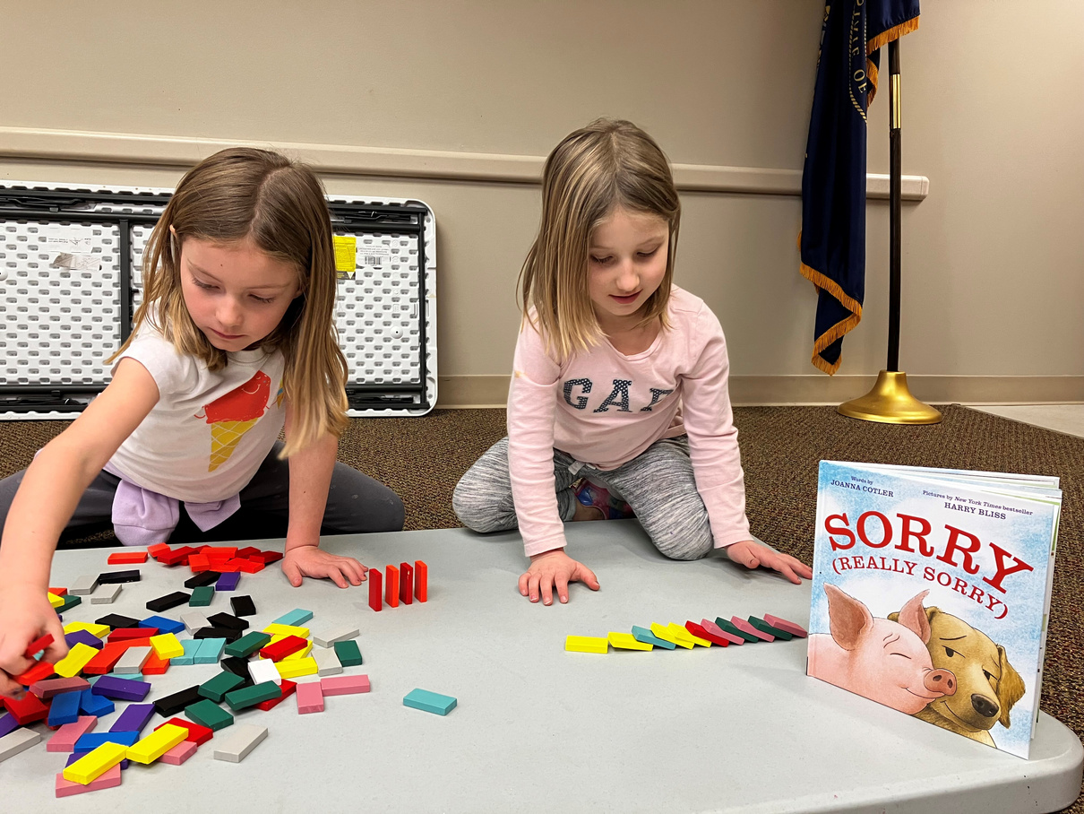
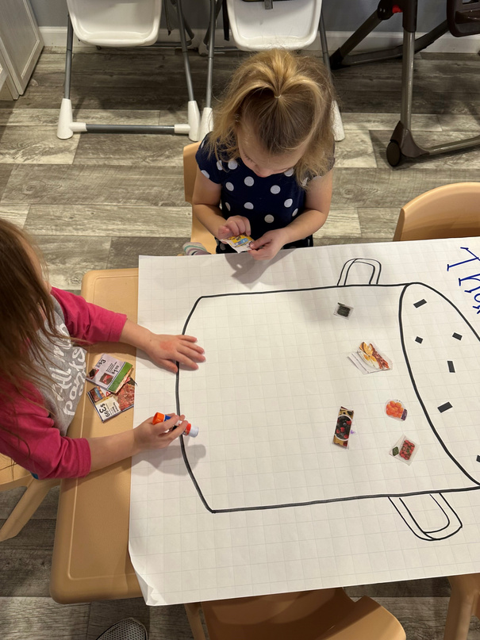
Pilot Study
This Imagination Guide provides a great jumping off point of a theme and can go many directions for learning content.

Slide 8
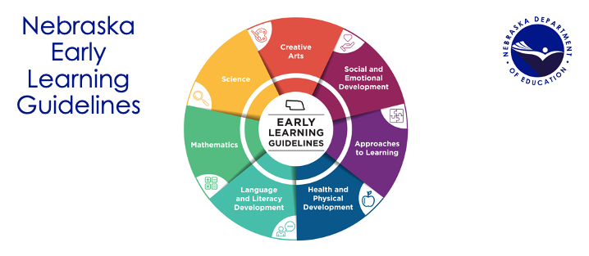
Nebraska Early Learning Guidelines

Slide 9
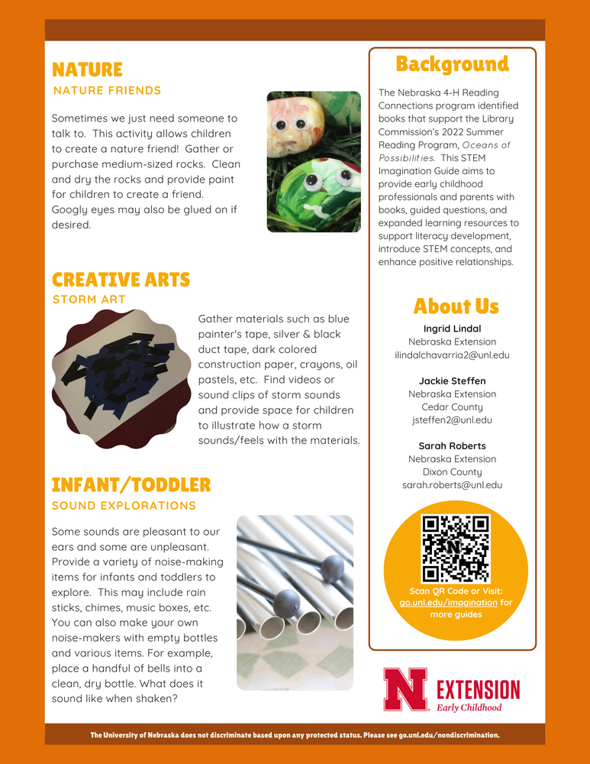
2023 Guide Template

Slide 10
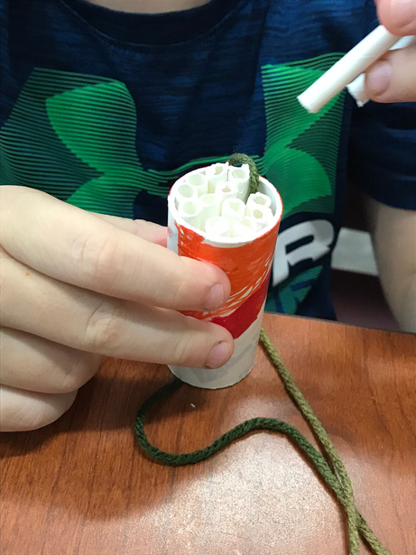
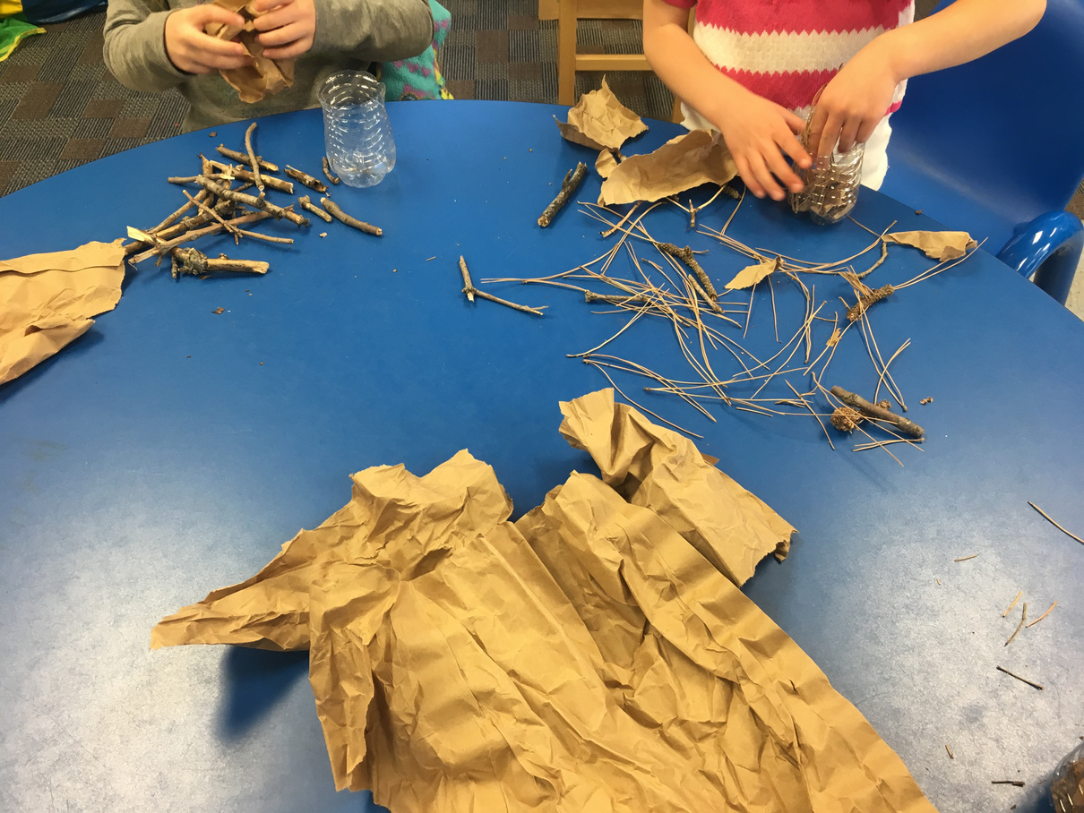
Each Living Thing

Slide 11
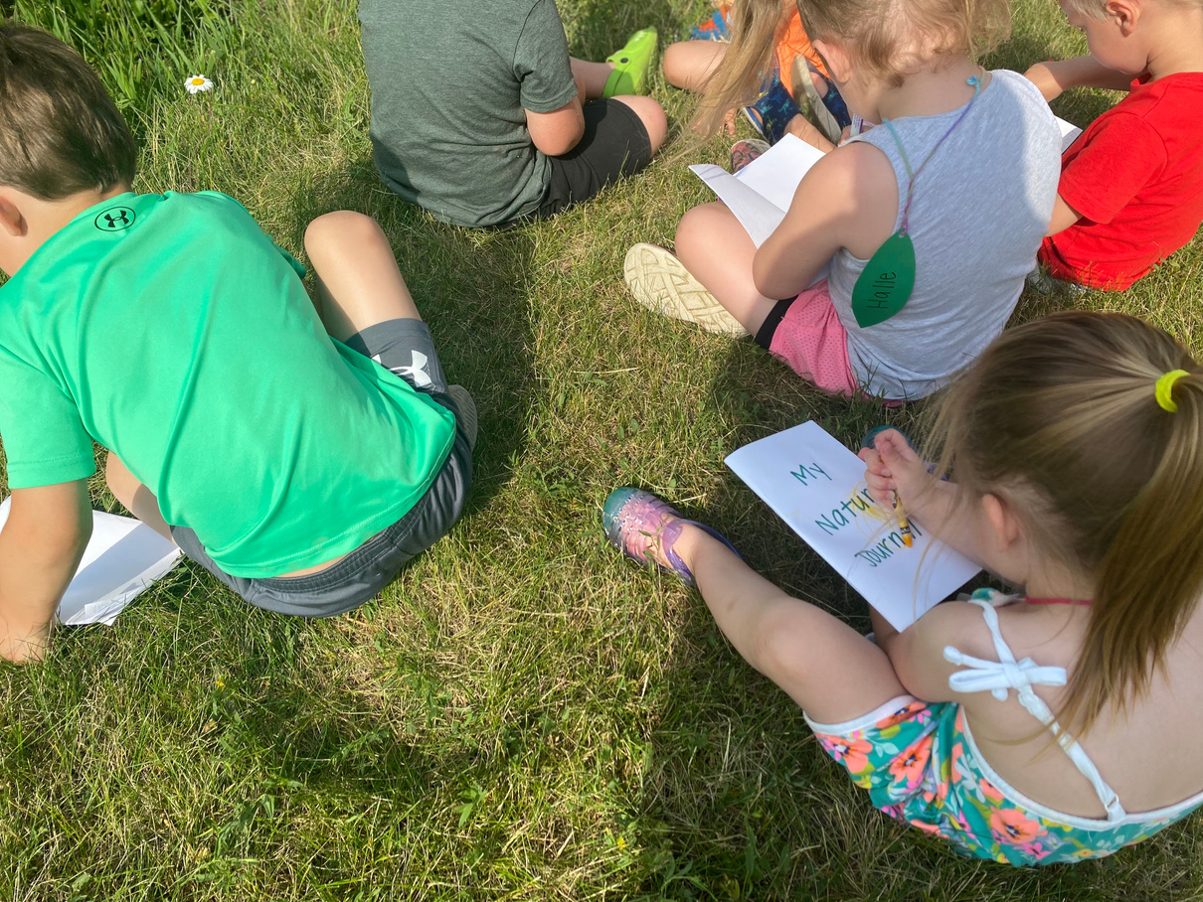
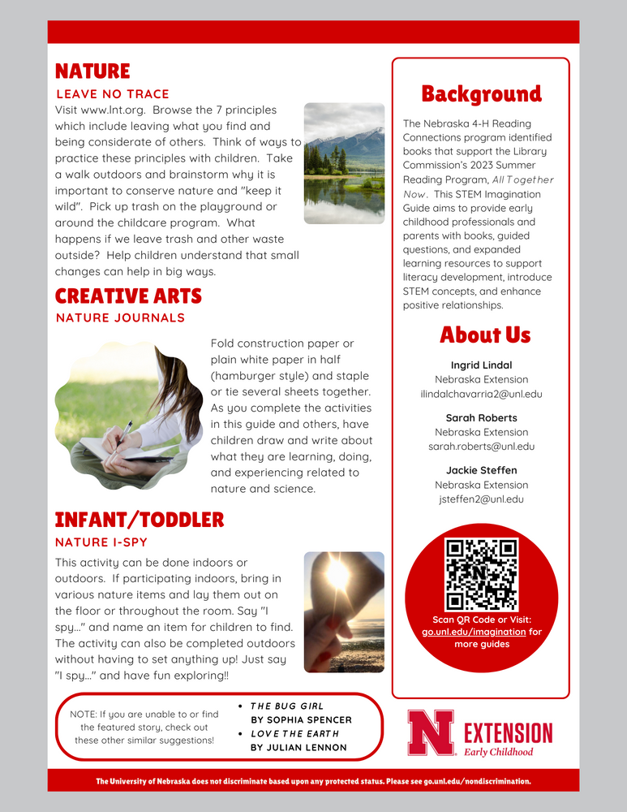
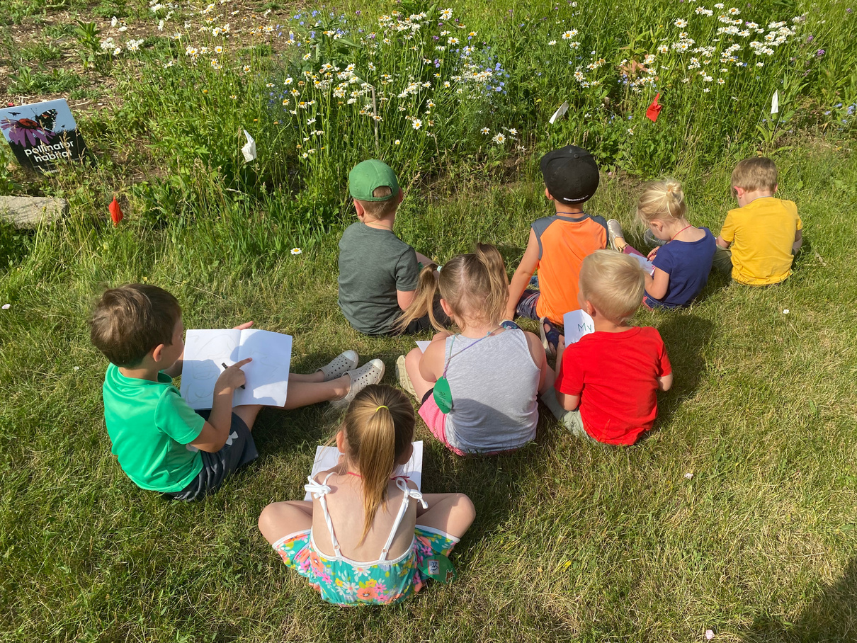
Each Living Thing

Slide 12
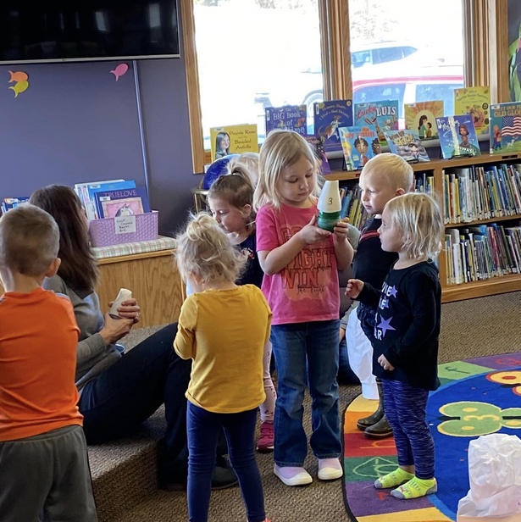
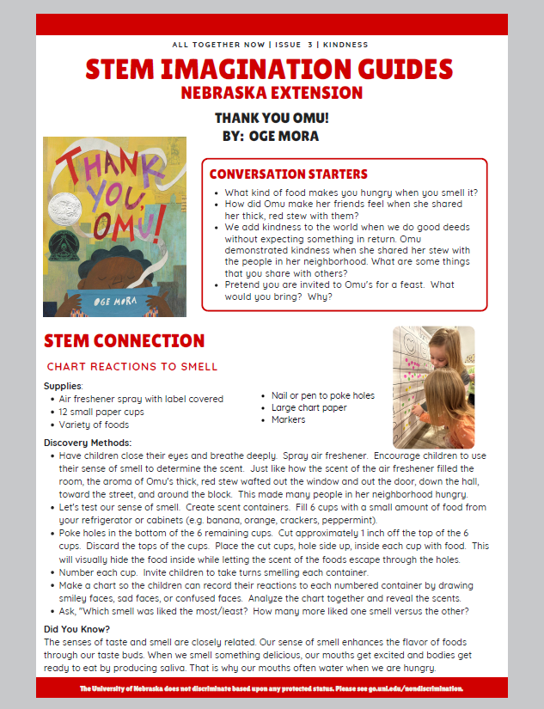
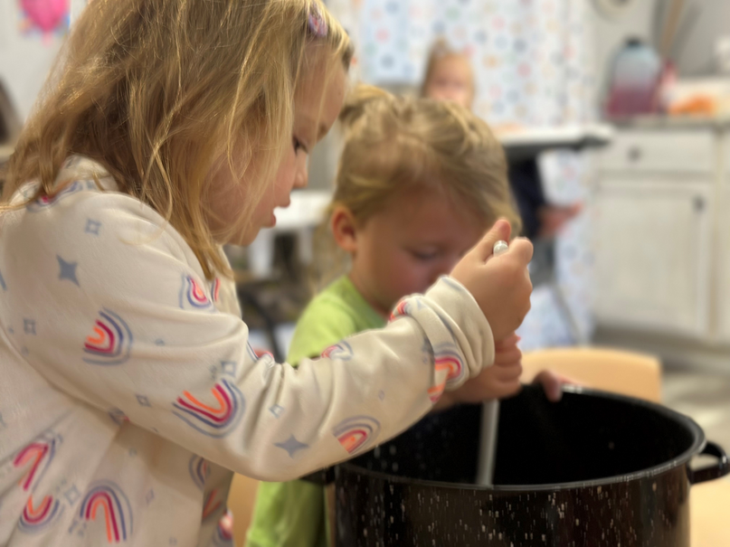
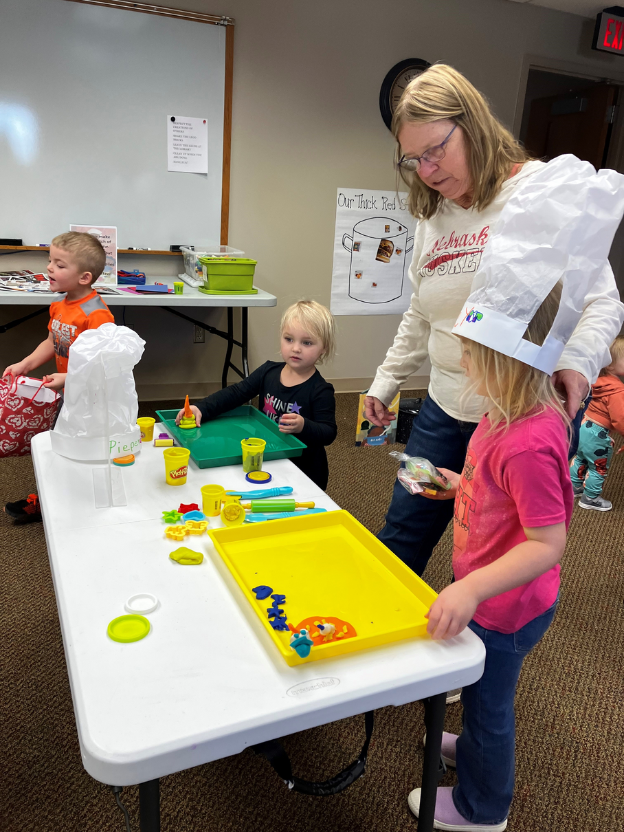
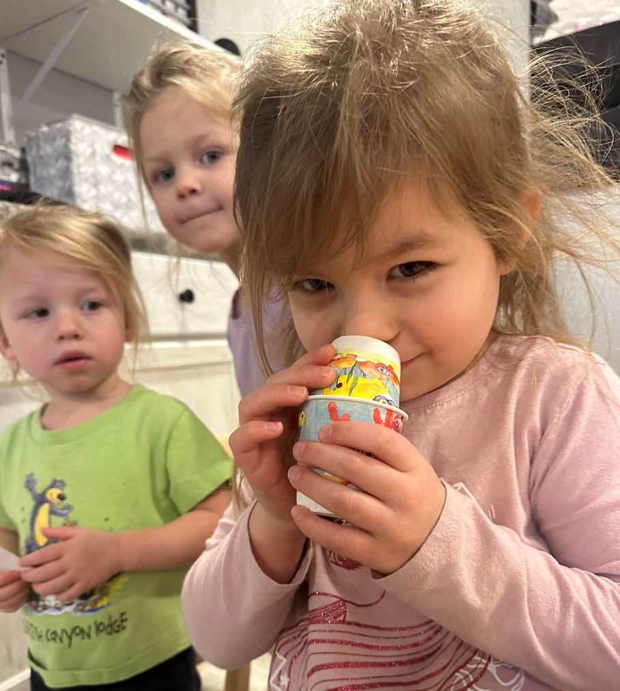
Thank You, Omu

Slide 13
New This Year!
Board Books for Infants/Toddlers
Spanish Options

Slide 14
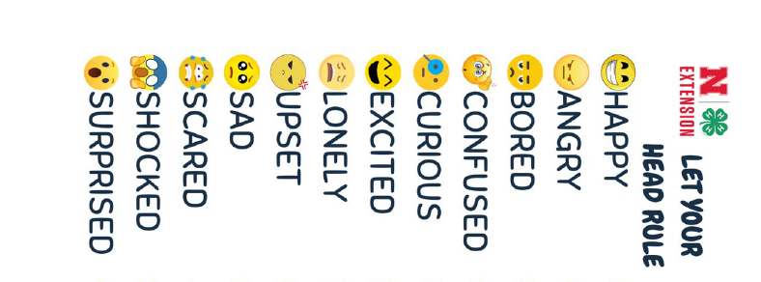
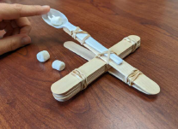
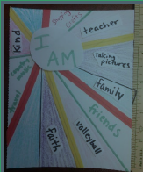
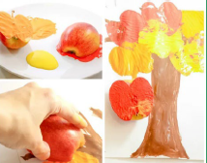
Lessons
HEALTH
HANDS
Friendship Apple Salad
Characteristic of a good friend
Teamwork
Apple STEM activity - Stay strong and not turn brown
Apple painting
HEART
Collaborative Art:
"I Am Enough"
Group garden mural
Take home "I Am" art piece
HEAD
Knowing & naming our emotions
Finding common ground in teams
Putting the pieces together
Simple/Complex machines
Create a Gumball Machine or Marshmallow Catapult

Slide 15
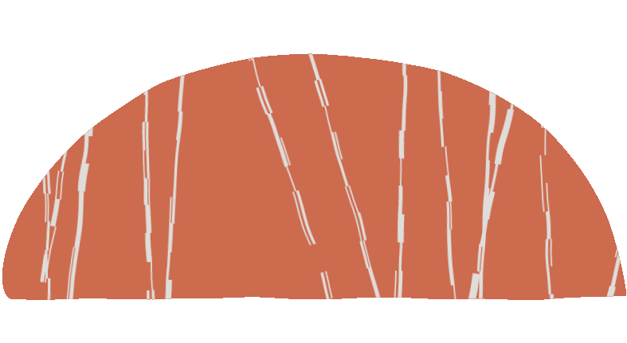
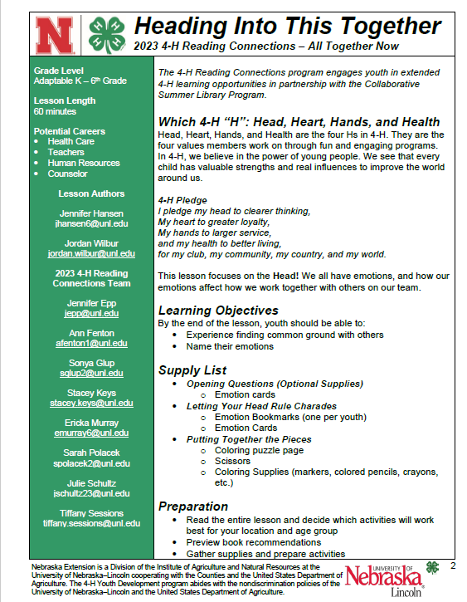
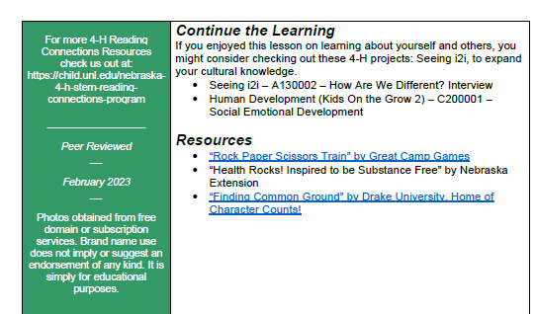
Lesson overview

Slide 16
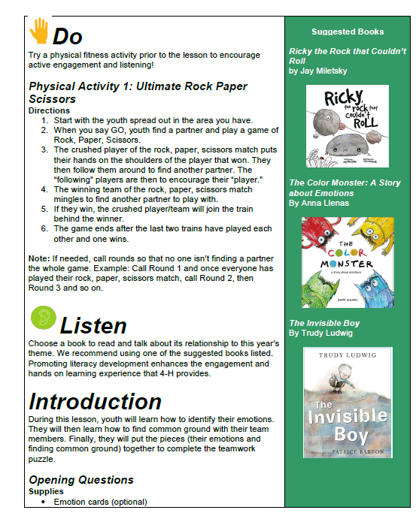
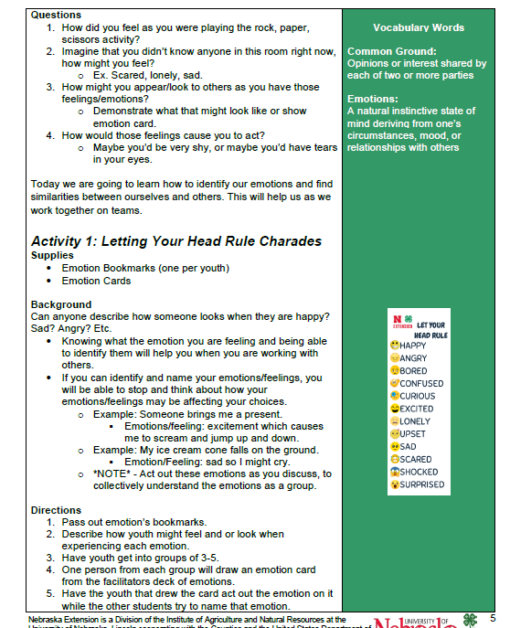

Slide 17
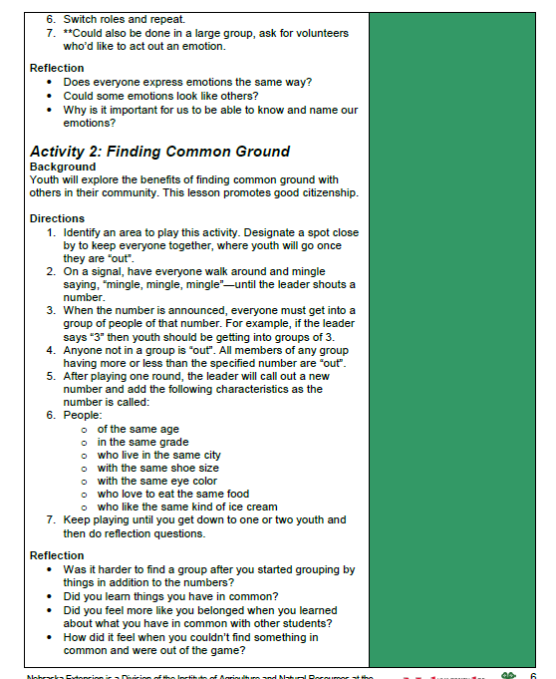
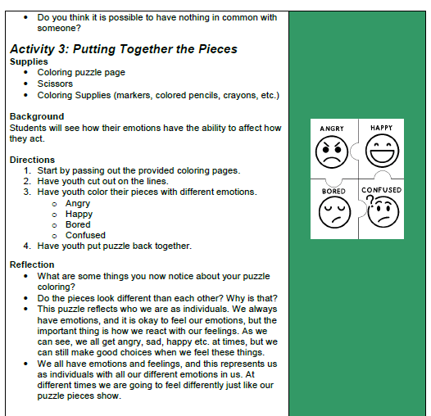

Slide 18
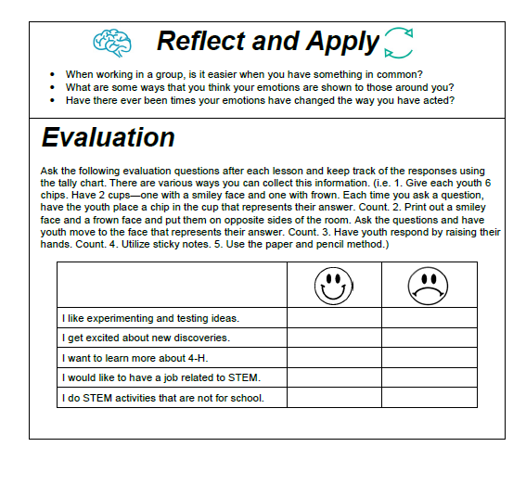

Slide 20
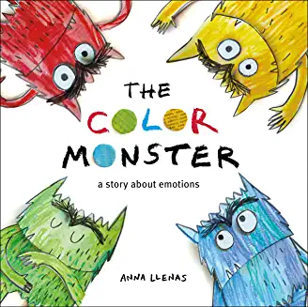
Suggested Books for 2023
Head - Heading into This Together Lesson
o Ricky the Rock That Couldn’t Roll by Jay Miletsky
o The Color Monster: A Story about Emotions by Anna Llenas
o The Invisible Boy by Trudy Ludwig
•

Slide 21
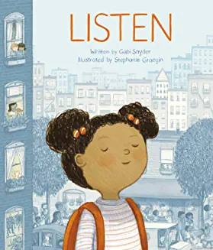
Suggested Books for 2023
Heart - I Am Enough
o I Am Enough by Grace Byers
o Listen by Gabi Snyder
•

Slide 22
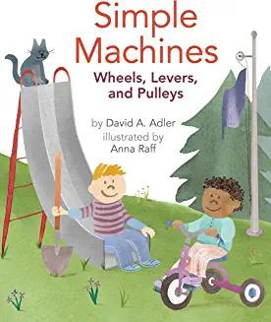
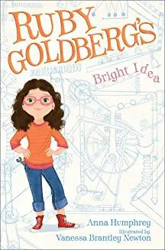
Suggested Books for 2023
Hands – Gumball Machine/Marshmallow Catapult
o Simple Machines by David A Adler and Anna Raff
o Izzy Gizmo and the Invention Convention by Pip Jones
o Ruby Goldberg's Bright Idea by Anna Humphrey

Slide 23
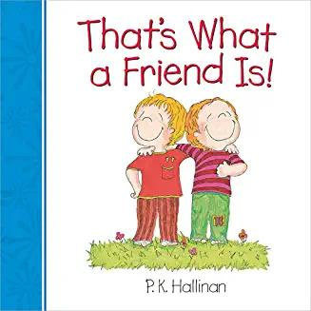
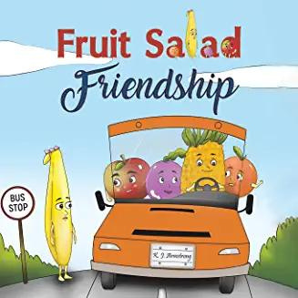
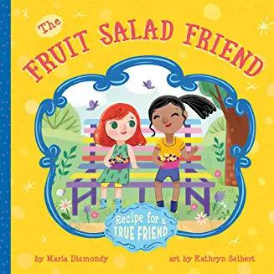
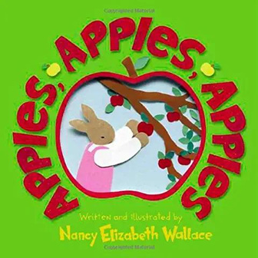
Suggested Books for 2023
Health – An Apple a Day
o “That’s What a Friend is!” By P.K.Hallinan,
o “Fruit Salad Friendship” By KJ Armstong
o “The Fruit Salad Friend: Recipe for a True Friend” By Maria Dismondy
o “Apples, Apples, Apples” By Nancy Elizabeth Wallace

Slide 24
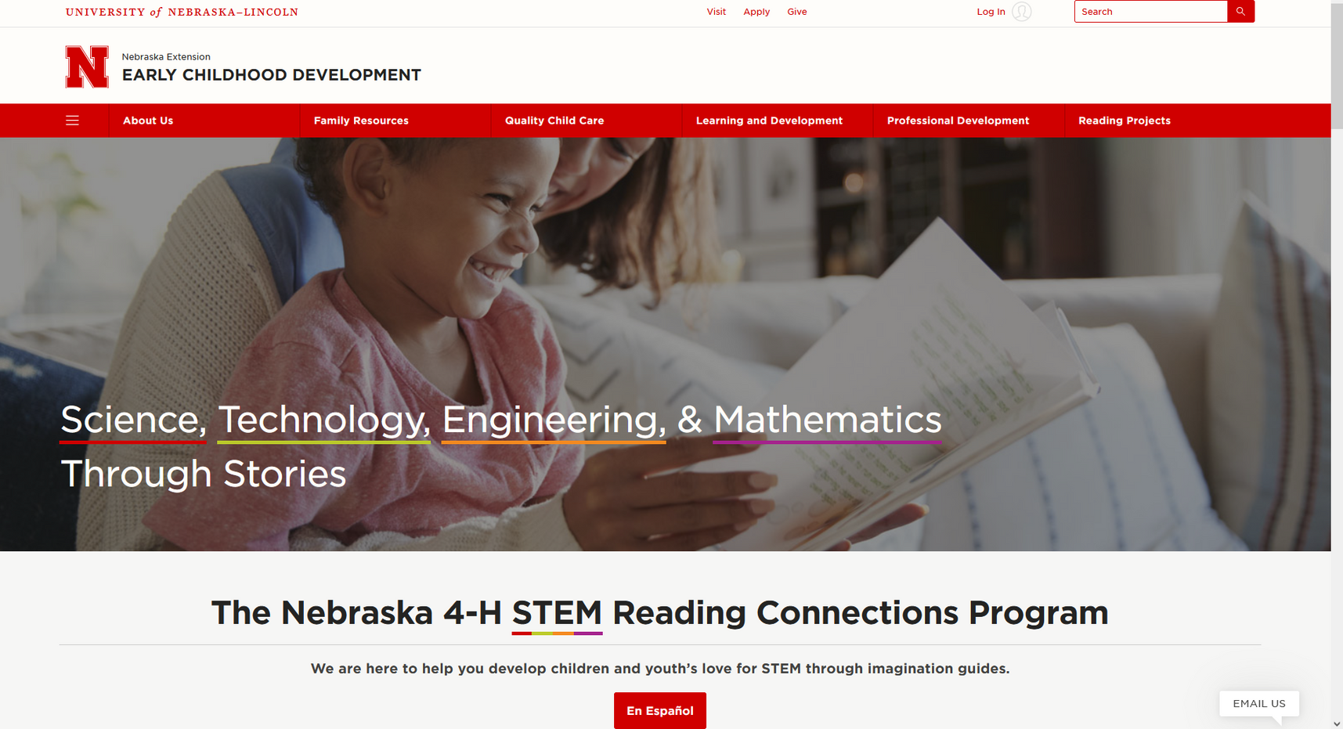
Website Tour
QR Code for website:
https://child.unl.edu/nebraska-4-h-stem-
reading-connections-program

Slide 25
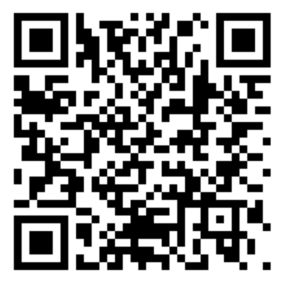
Questions?
Jennifer Hansen -jhansen6@unl.ed
Jackie Steffen - jsteffen2@unl.edu
Sarah Roberts - sarah.roberts@unl.edu
Notes:
Link for survey data: https://ssp.qualtrics.com/jfe/form/SV_bHD61YpDqbVI1P8

