Slide 1
All Things Science
NSCAS Formative & Summative
SIPS Science Grant
Rhonda True
CGSA Specialist
rhonda.true@nebraska.gov

Slide 2
NSCAS Science
Timeline
2017
2018
2019
2020
2021
2022
Operational Test
Standard Setting
Board approval of cut scores
NCCRS-S Adoption
Visioning
Task Force
Pilot Development
Pilot
Begin Formative Classroom Repository Development
Field Test
Continue Formative Repository

Slide 3
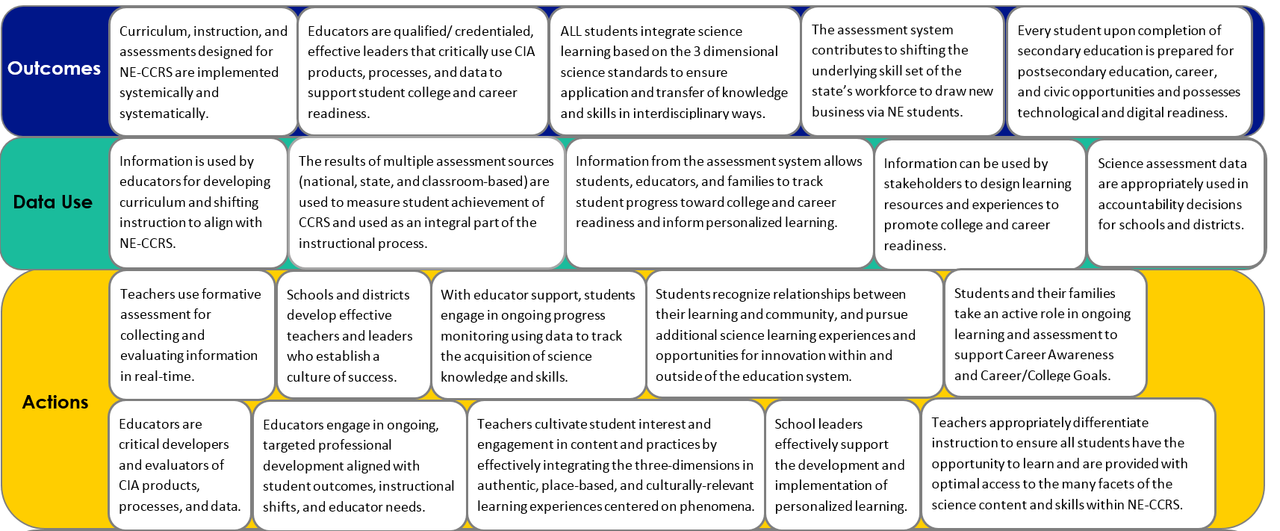
Assessment Theory of Action
Theory of Action
Curriculum, instruction, and assessments designed for NE-CCRS are implemented systemically and systematically.
Educators are qualified/ credentialed, effective leaders that critically use CIA products, processes, and data to support student college and career readiness.
ALL students integrate science learning based on the 3 dimensional science standards to ensure application and transfer of knowledge and skills in interdisciplinary ways.
The assessment system contributes to shifting the underlying skill set of the state’s workforce to draw new business via NE students.
Every student upon completion of secondary education is prepared for postsecondary education, career, and civic opportunities and possesses technological and digital readiness.
Outcomes
Outcomes

Slide 4
Nebraska’s Science Assessment Claims
Overall Claim
Students can demonstrate the scientific literacy necessary to be civic minded decision makers and demonstrate readiness for college, career, and lifelong learning through application of science and engineering practices and crosscutting concepts within and among the disciplines of science.
Critical Consumers of Information
Students can gather, analyze, and communicate information from multiple sources to use as evidence to make sense of familiar and unfamiliar phenomena and problems.
Interconnectedness of Science
Students can make connections between disciplinary core ideas within the physical science, life science, and Earth and Space sciences domains, across multiple science domains, and across multiple content areas (such as mathematics and English language arts) to make sense of familiar and unfamiliar phenomena and problems.
Notes:
Our shareholders also provided the foundation for our science assessment system claims. Ultimately, we want our students to be scientifically literate, to be critical consumers of information, and to see the interconnectedness of science. NSCAS Science is completely new and very different from old science test. Tasks are 3-dimensional and require critical thinking and sense-making.

Slide 5
NSCAS Science Assessment System Components
*
*Common Thread: Professional learning for educators*
Interim Assessments (district chosen)
- District Benchmarks with PAD
-Map Growth
-SIPS End of Unit tasks
Classroom Tasks
(K-12)
NDE Formative Task Repository
K-12
Statewide Summative (5,8,11**)
**ACT for 3rd year cohort

Slide 6
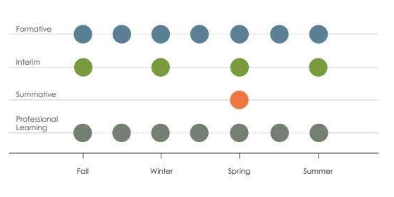
Coherence

Slide 7
NE Science System
Instructional Materials Crosswalk example
Instructional Materials
Formative Classroom Assessment Repository
Teacher Guides
Criteria for HQIM
Instructional Shifts
Password: ScienceFA
Design Processes and Tools
Indicators
Assessment Shifts

Slide 8
NE Science System
Instructional Materials Crosswalk
Supporting the development of student sensemaking
Measuring student sensemaking through 3D transfer tasks
Instructional Materials
Formative Classroom Assessment Repository
Teacher Guides
Criteria for HQIM
Instructional Shifts
Design Processes and Tools
Indicators
Assessment Shifts
Notes:
Model with all the component parts of our system

Slide 9
Features to Maintain Consistency
Phenomena and Problem-
focused
Engage diverse sense-
making
Require reasoning with evidence
Grade
appropriate 3D
targets
Demonstrate science under-
standing by doing science
Notes:
The summative assessment is just one component of the NSCAS-Science system. These 5 features have been identified to help ensure we maintain consistency across all components of the system.

Slide 10
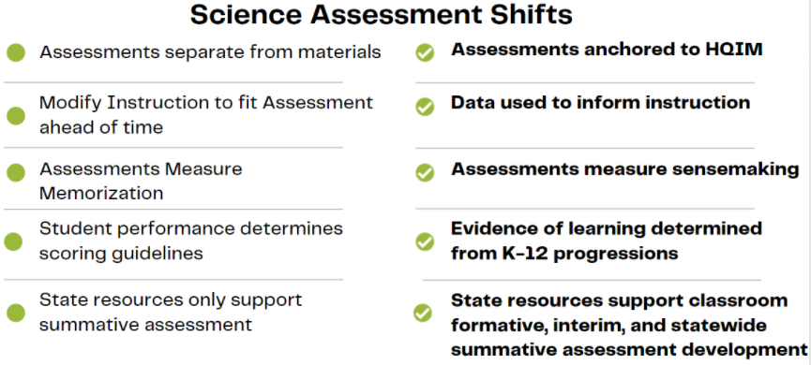

Slide 11
Building from the Classroom Level
Quality Summative Assessments
Quality Interim Assessments
Quality Formative Assessments
Quality Instruction
Quality Standards
Building in this direction makes Summative Assessment at the service of instructional shifts instead of the other way around.

Slide 12
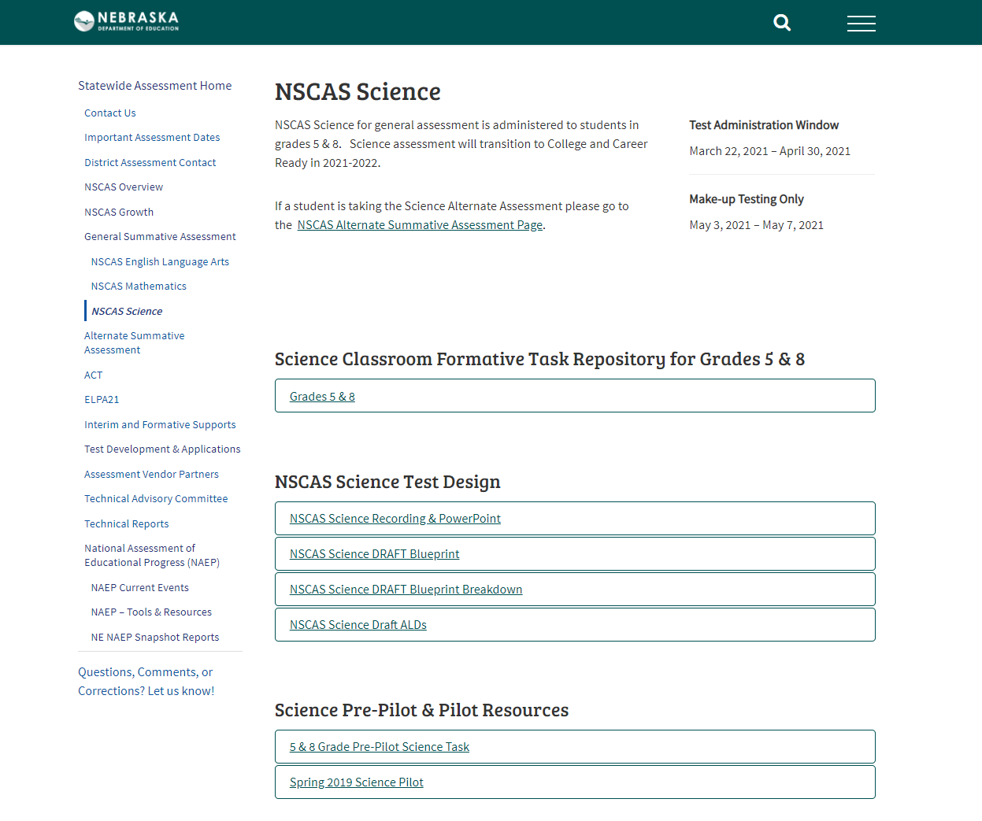
Formative Classroom Repository
Password:
ScienceFA

Slide 13
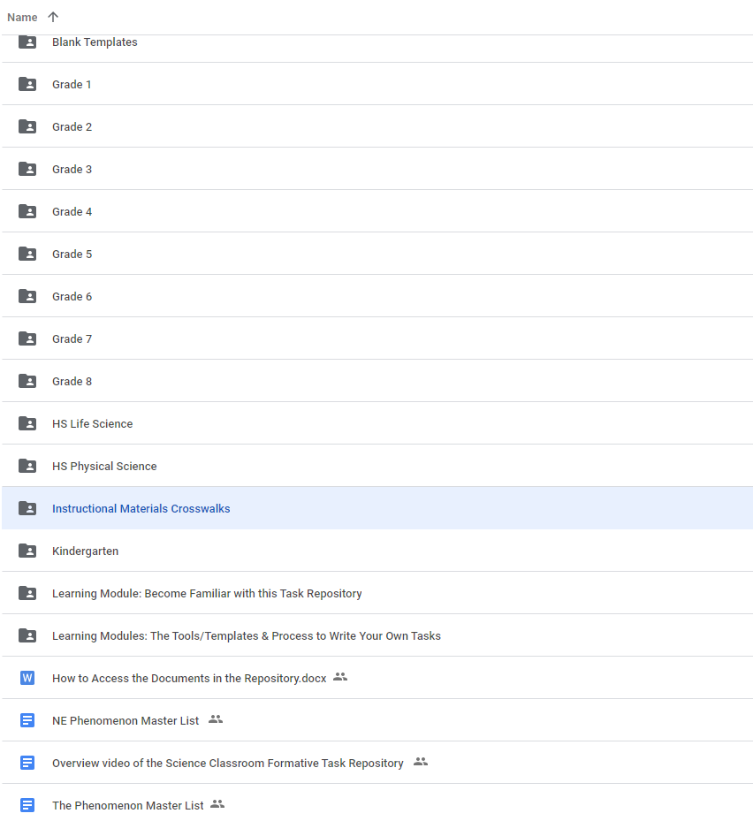
Repository
3D tasks Developed by NE educators
Focus on NE phenomena
Multiple purposes/uses
Crosswalks to IMs
Educative resources
modules
design tools
administration guides
videos
Password: ScienceFA

Slide 14
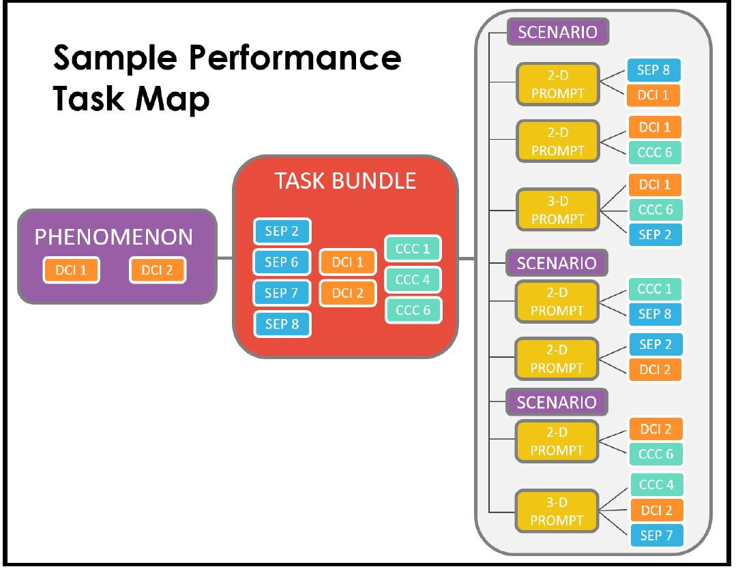
Statewide Summative Task Model

Slide 15
Stackable, Instructionally- embedded, Portable Science (SIPS) Assessments

Slide 16
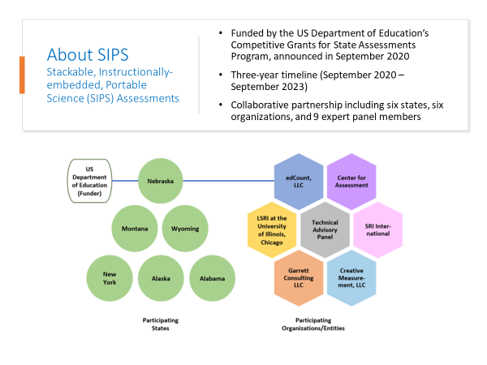

Slide 17
SIPS Project Goals
Leverage Existing Frameworks and Resources to:
Create
Create a bank of instructionally-embedded, science assessment tasks aligned with an actionable performance scale
Multiple common science assessment tasks are embedded within replacement instructional units and can also be administered on a stand-alone basis.
Build
Build state and local educators’ capacity to offer high quality science instruction, evaluate students’ learning, and make data-based instructional decisions
State and local educators participate in task development using a principled assessment design process that supports practitioners’ fluency with the standards
Engage
Engage educators, students, and parents in a partnership for student success across a range of circumstances
Tasks and replacement units are designed to be portable, allowing for student learning and assessment to take place under a wide range of instructional settings

Slide 18
SIPS Project Deliverables
1 - Project Foundations
SIPS website
Project Theory of Action
Claims, measurement targets, and performance level descriptors
Yearlong curriculum and assessment planning tools (student profiles, learning progressions, curricular alignment tools and templates)
2 – Curriculum and Common Assessment Development
Two year-long model courses (~4 units each) at grades 5 and 8 aligned to NGSS thematic or topics bundles
Bank of instructionally-embedded common science assessments aligned with an actionable performance scale
Virtual classroom assessment design workshops with participating educators from SIPS partner states
Year 1
Year 2
3 – Pilot Study and Measurement Models
Pilot study administration and summary of findings
Refinement of curricular units and common assessments
Measurement models
Dissemination plan
Year 3
Notes:
In utilizing our ToA and keeping in mind the overall goals for the project and the benefits of using a principled-design approach, what does that look like for the SCILLSS project in terms of deliverables?
Year 1: Established project foundations – set up the project website. Developed theories of action for each partner state and for the project. Developed local and state self-evaluation protocols in partnership with ACS and initiated the development of a series of 5 assessment literacy modules.
Years 2 and 3: We launched the development of a collection of classroom and state assessment resources using a principled-design approach. The goal is to articulate a replicable design process that states and local districts can use to scale up the work in their states. With that design process, we are providing a suite of resources and tools to serve as models of the outcomes of the design process. These resources include, for state assessment, measurement targets, task models, design patterns, and sample items, and for classroom assessment, task models, tasks, and sets of annotated student artifacts.
Year 4: We will focus on reporting and dissemination in the form of conference presentations, journal articles, white papers, project reports, etc. We will also help our partner states think through next steps in the development of an action plan for each state.

Slide 19
Thank You

