Slide 1
NSCAS ACT 2022-2023
Iris Owens ACT Liaison

Slide 2
ACT CONTACTS
You may receive emails about the ACT from the following:
State Testing statetesting@act.org
ACT Accommodations ACTStateAccoms@act.org
Iris Owens iris.a.owens@act.org
The Nebraska Department of Education Statewide Assessment, DAC updates
NDE.stateassessment@nebraska.gov
stacey.weber@nebraska.gov
DACs or Test Coordinators contact for questions:
Iris Owens iris.a.owens@act.org or 531-207-9019 (8am-5pm CST, M-F)
ACT Customer Support 800-553-6244 ext. 2800 (8am – 8pm CST, M-F)
ACT Accommodations 800-553-6244 ext. 1788 (7 am – 5 pm CST, M-F)
NDE Statewide Assessment Office 402-314-3013 (8am-5pm CST, M-F)

Slide 3
NSCAS ACT Test Windows Spring 2023
Test Window 1
Standard Administration (Paper): March 21, 2023
Accommodations Administration (Paper): March 21-24 & March 27-31
Standard & ACT-Authorized Accommodations (Online): March 21-23 & March 28-30
Test Window 2
Standard Administration (Paper): April 4, 2023
Accommodations Administration (Paper): April 4-7 & April 10-14
Standard & ACT-Authorized Accommodations (Online): April 4-6 & April 11-13
Test Window 3 MAKEUP ONLY*
Standard Administration (Paper): April 18, 2023
Accommodations Administration (Paper): April 18-21 & April 24-28
Standard & ACT-Authorized Accommodations (Online): April 18-20 & April 25-27
*Remember that you will have a choice between the first two assessment windows for your initial test date. Any subsequent window could be used for makeup testing. The third paper test date, April 18, is for makeup only. Online testing can be done on any of the 18 dates available..

Slide 4
ACT-Nebraska Webpage

Slide 5
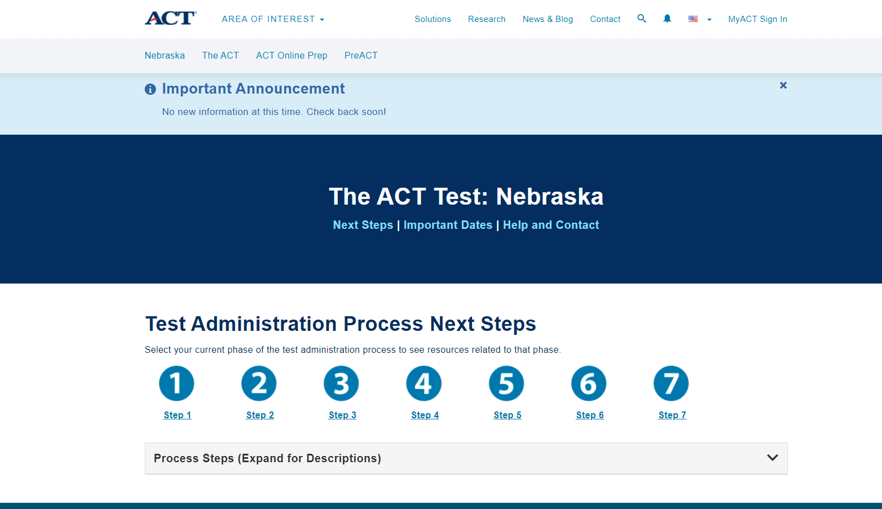
Notes:
The Schedule of Events is coming soon, and we will announce when that is on this website.

Slide 6
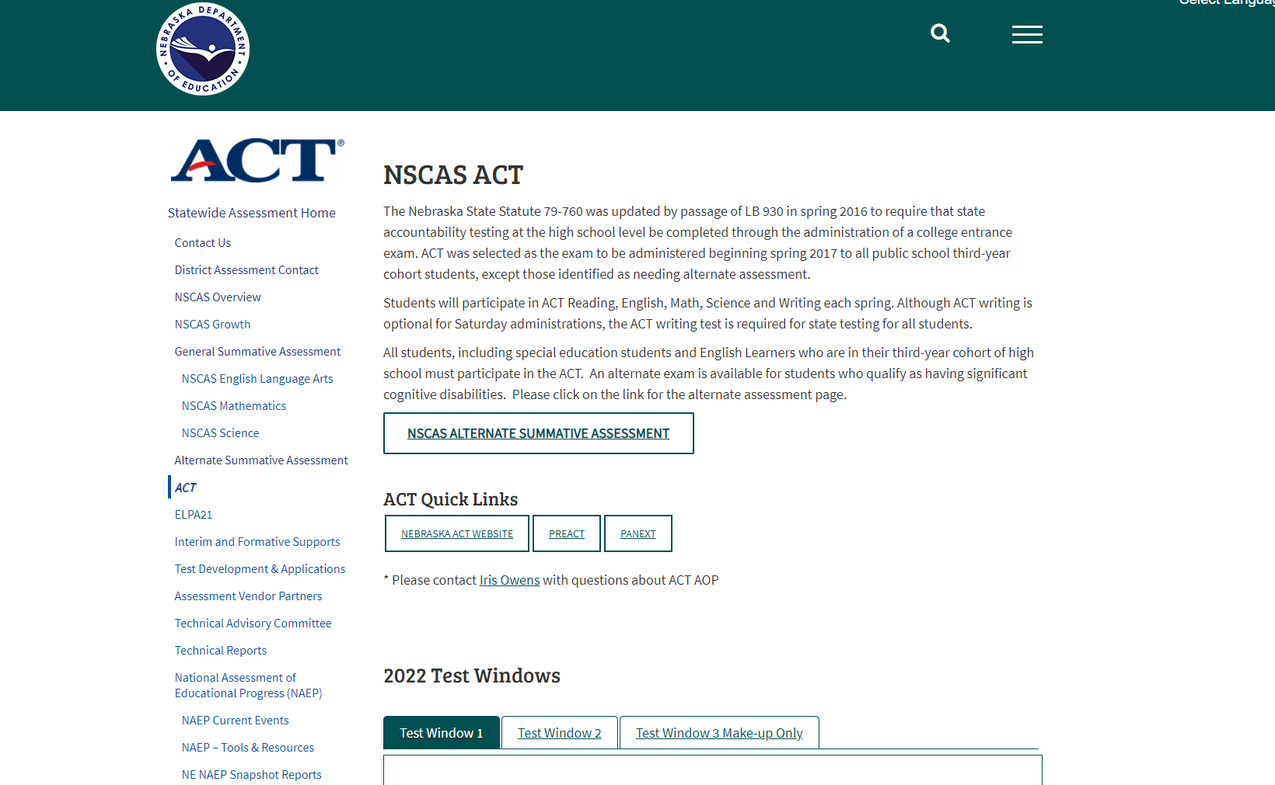
NDE Website - NSCAS ACT Page

Slide 7
ACT Accommodations and EL Supports
Accommodations are available for any student with an IEP, 504 plan, or EL Supports. These are requested on the Test Accessibility and Accommodations System (TAA). This system can be found at Success.ACT.org.
Apply for Spring Accommodations as early as possible, before the end of the first semester. TAA opens September 12, 2022. The deadline is late Jan or early Feb, but the system will have a lot of requests coming in at that time. The earlier you can do this, the better.
Accommodation analysts are looking for information on what happens in the classroom.
Provide the IEP or 504 plan as well as the Teacher survey. For EL students, a letter with the school’s letterhead and all supports that are normally provided in the classroom as well as a screenshot of the student class schedule showing an EL class is helpful. You may include additional information that the staff believes will give a complete picture of the student’s needs.
Changes in Test Coordinators for the TAA System - contact Iris or call the Accommodations Department for assistance. ACT Accommodations 800.553.6244 x 1788.

Slide 8
PearsonAccess^{next} (PA next)
PearsonAccess^{next} (PA next) system is the location for schools to provide test dates and review student rosters as well as setup online testing. DACs, test coordinators, tech coordinators and room supervisors (online testing) will need to create accounts.
The Schedule of Events is coming soon.
Each District will select the test window they want to use as their initial test date. This selection is documented in PA next. The system will be open for spring test information on November 7, 2022.
Deadline to “Select Test Date” is Friday, December 9, 2022.
Profile reports and student data files for both district and school are in PA next starting August 18 and will be removed November 4, 2022. Download reports for your access before November 4. This will be the last year Profile reports and student data files will be available in PA next. These reports can be found in Success.ACT.org now and in the future.
The NDE Statewide Assessment team will provide the student roster of 3rd year cohorts to ACT. Schools and Districts will need to review roster in Jan.
If you need access to the PA Next system, please contact Iris.

Slide 9
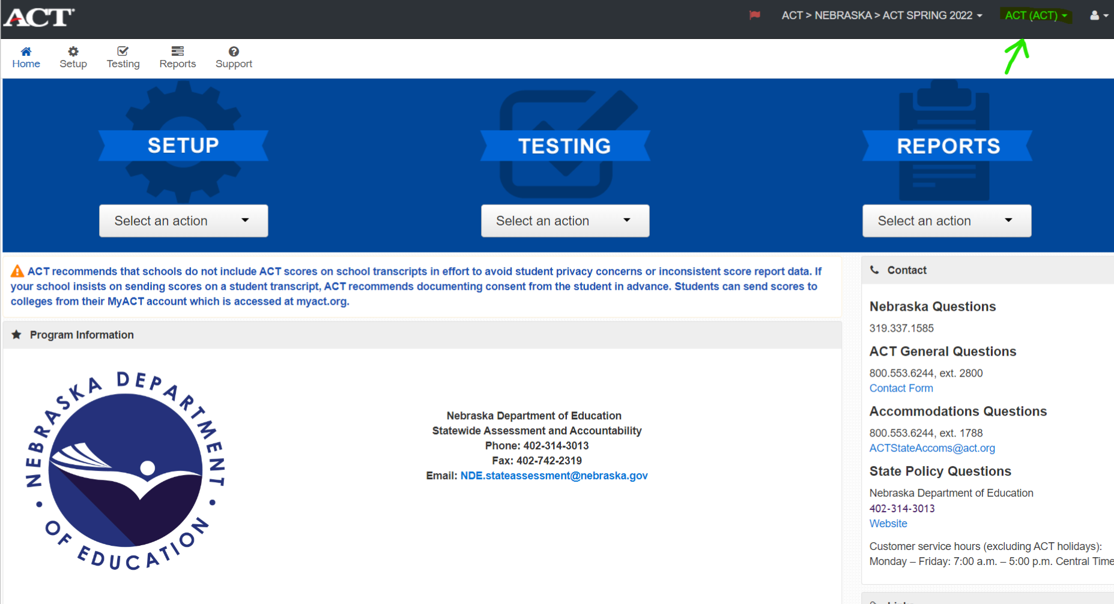

Slide 10
ACT Parental Consent Form
Parental Consent Guidance
NDE Parental Consent Form
NDE Parental Consent Form Spanish
NDE Parental Consent Form Telephone

Slide 11
Online Testing
Online Testing for the ACT State Test can be used for most students, including those who require accommodations, for the initial test or as a makeup option.
Detailed information about testing online can be found in the ACT Administration- Online Testing Manual and Technical Requirements for the ACT Test Taken Online.
Proctor Caching is not mandatory, but strongly recommended, especially if more than a few students are testing.
Setup with the Mock Administration and Browser Lockdown are essential to the success on the Online Test.
All Online Accommodations must be requested in TAA 800.553.6244 x 1788.

Slide 12
ACT District Choice 2022-2023
Once again, district superintendents were provided a survey to choose one of the options NDE purchased for their district. If you have questions about your district choice, please contact Iris.
PreACT Test: Each district could choose from a fall test window for third-year cohort (usually juniors), second-year cohort (usually sophomores), or a spring test window for the second-year cohort (usually sophomores) only.
ACT Online Prep (AOP): Each 3rd year cohort student will have AOP available to them for 365 days from initial log-in.

Slide 13
ACT Online Prep (AOP)
Opening October 10, 2022, new DACs will receive an email from ACT in late September with instructions and log in information.
If your school needs additional licenses, email Iris
Once student logs in, access is good until June 30, 2023.
AOP provides 2 full length practice tests and 2 writing prompts that are AI scored, with four additional sample questions for each section and 3,000 practice questions.
The system has an updated Course Organization, New Study Schedule, Test tips, Navigation Menu, In-App Support, Course Selection.

Slide 14
Test dates for the PreACT
Fall test window is October 10 - November 23, 2021. ACT has provided a Schedule of Events for the fall PreACT.
Spring PreACT will have a separate Schedule of Events available in January/February.
Spring test window is TBD for mid-March to April. ACT will provide an email with Schedule of Events including instructions on ordering and deadlines in January/February.
You will need to order for your test window. If testing in the spring, you must wait until February to order. Make sure to order under the Nebraska State Contract. If you order under the Standard PreACT or the Bundle, the district will be charged, not the state.
For assistance with the PreACT, please call 877.789.2925 option 5 or email customer service at preact@act.org. You may also contact Iris for more information.

Slide 15
Important Things to Remember
Prohibited Behaviors and Misadministrations can be avoided. Make students aware to not work ahead or behind and turn off cell phones. Proctors need training and reminders of the process to have a good testing experience.
Online testing provides 18 test dates; districts - consider for makeup dates as an introduction to using the online option for all students.
Accommodation requests can be made as early as September 12, 2022. Consider having requests entered before the end of the first semester.
If you have questions about anything ACT, don’t hesitate to ask Iris. Call or email with any questions you have.
NDE and ACT will provide more webinars to assist you. Date/Time TBD.

Slide 16
Questions?

