Slide 1
Facilitator Notes
No breakout rooms are required for this session; however, seating should allow for brief small-group discussions of questions and prompts throughout the session.
You will need to show four videos, all with sound.
Ensure that each participant has:
A copy (electronic or paper) of the Session 1 Video Reflection and a way of completing it (e.g., computer, tablet, pencil)
A copy (electronic or paper) of the appendix to Zearn and TNTP’s 2021 report Accelerate, Don’t Remediate
An Internet-enabled device and access to the Session 1 Closing Reflection (two short-answer prompts on a Google Form)

Slide 2
Nebraska’s 2022 College and Career Ready Standards for Mathematics
Notes:
[Welcome participants, make sure everyone has the necessary materials, and facilitate brief introductions if needed.]

Slide 3
What (Not) to Expect from this Series
Envisioning Excellent Math Instruction
Supporting Standards Implementation
Session 1 Agenda
Notes:
Here is our agenda for this session. We’ll start with some framing and a preview of what you can expect–and not expect–from our time together. Then we’ll dive into some examples of excellent instruction that will help us work toward a shared vision for teaching and learning mathematics in Nebraska. Finally, we’ll talk more concretely about ways of supporting implementation of our improved math standards.

Slide 4
What (Not) to Expect from this Series
Envisioning Excellent Math Instruction
Supporting Standards Implementation
Session 1 Agenda

Slide 5
Rollout Session 1: An Instructional Vision
Session 1: A Vision for Excellent Math Instruction
Session 2: The Improved Standards and Key Shifts (Part 1)
Session 2: The Improved Standards and Key Shifts (Part 2)
Session 4: Preparing Teachers to Implement the Standards
Notes:
As you know, this is a four-session series designed to support you in launching implementation of the improved standards in your contexts. You’ll see that it’s the middle two sessions that really dive into the standards themselves and specific examples of standards-aligned instruction. The first and last sessions frame that work with bigger-picture considerations: instructional visioning in this first session, and action planning in Session 4.

Slide 6
Why Start with Vision?
“Perceptions among teachers serving different types of students (e.g., more students qualifying for free or reduced priced lunch) differ on ‘aspects of rigor’ targeted by particular standards.”
“More specific messaging and guidance may be needed so that teachers can implement standards in ways that align with state and district visions.”
Notes:
You may be wondering why the series is structured in this way–and, more specifically, why we’re focusing this whole first session on an instructional vision when our task is to roll out improved standards. Experience as well as findings from a multi-state study of college- and career-ready standards implementation informed our approach here. This study’s authors, who were from RAND, analyzed a large sample of teacher survey data and found that different teachers often interpreted the same standards in very different ways. More specifically when it came to mathematics standards, [read first bullet point]. The researchers concluded that [read second bullet point]. They called this providing teachers with the “interpretive lens” they needed to understand and then implement the standards with integrity and equity. So the goals of this session are, first, to develop and norm on an interpretive lens that we will then bring to our discussions of standards-aligned instruction in sessions 2 and 3, and, second, to prepare you to do the same for educators in your schools and districts by communicating a clear vision for excellent math instruction along with a theory of action for how that vision can be realized.
[Source: https://www.rand.org/pubs/research_reports/RR1529-1.html]

Slide 7
Moving Beyond Unpacking
“Unpacking” or “breaking down” standards sometimes:
Produces checklists of isolated skills that encourage drill-and-kill instruction rather than conceptual coherence and higher-order thinking;
Focuses narrowly on standards without sufficient attention to framing such as glossary definitions and guidance on instructional shifts; and
Produces “clarification” documents that prove more confusing than helpful to educators who were not involved in the unpacking process.
Notes:
We should also make clear right now that even in Sessions 2 and 3 we will not be spending time “unpacking” specific grade-level standards in great detail. Instead, we’ll be highlighting the intent and logic underlying the shifts and improvements that have been made and the larger instructional vision they are designed to serve. It’s not that we are against unpacking as a rule–teachers certainly need to see and study their standards! But [voice over three bullet points on slide]. So we simply don’t believe that this brief statewide rollout series, at the beginning of the implementation process and without many of your colleagues in the room, is the right place for unpacking to occur. We know that your efforts to support implementation of the standards will be just beginning at the end of this series, and we want to equip you with everything you need to lead that implementation in your contexts rather than try to take your place in that leadership role.
[Bullet points adapted from: https://www.k-state.edu/ksde/alp/resources/CautionaryNote-Module5.pdf
Note that Appendix B at the end of this presentation points to several resources that might support standards unpacking or similar activities. Session 4 gives participants dedicated time to explore these resources if desired, but they are included here just in case they are helpful to show participants.]

Slide 8
The Instructional Core
Principle: “If you change any single element of the instructional core, you have to change the other two to affect student learning.”
Student
Instructional Rounds in Education (City, Elmore, Fiarman, & Teitel, 2009)
Task
Teacher
Content
Notes:
All of what I’ve said thus far reflects a conceptual framework with which you’re probably familiar: the instructional core. One key principle grounding this conceptual framework is the one shown here: [read quotation on slide]. In other words, the instructional core is like a three-legged stool: if you adjust one leg without adjusting the others accordingly, you just fall off. This framework is what grounds our approach to this standards rollout and our hopes for subsequent standards implementation efforts in your individual schools and districts. It tells us that if we expect the new standards to accomplish anything on their own, we’re misguided; to make real change for students, we have to view and use standards within the larger context of the instructional core, attending not only to what students should learn, but also to how they engage with that content, how teachers facilitate that engagement, and how high-quality tasks and instructional materials ground the work done in classrooms every day. This is why tasks are at the center of the instructional core: they are where students, teachers, and content come together and do the work of teaching and learning.

Slide 9
What (Not) to Expect from this Series
Envisioning Excellent Math Instruction
Supporting Standards Implementation
Session 1 Agenda
Notes:
So with that framing in mind, let’s talk about what a strong instructional core in mathematics looks like in Nebraska.

Slide 10
Starting With Students
Principle: “Task predicts performance—not what the curriculum says students are supposed to do or what the teacher thinks she is asking students to do, but what students are actually doing.”
Instructional Rounds in Education (City, Elmore, Fiarman, & Teitel, 2009)
Student
Task
Teacher
Content
Notes:
We’re going to build out a comprehensive vision, but we’re going to start by focusing just on the most important component of the instructional core: the students. After all, what happens on paper or in adults’ heads–improvements to standards, unpacking of standards, elegant action plans, any of it–simply does not matter if it doesn’t affect what students are actually doing in classrooms across the state.
And rather than starting with an abstract vision statement that we could each interpret in our own way, we’re going to begin with concrete examples of specific students doing specific things in specific classrooms–just like we have students begin with the concrete before moving to the abstract when learning math.

Slide 11
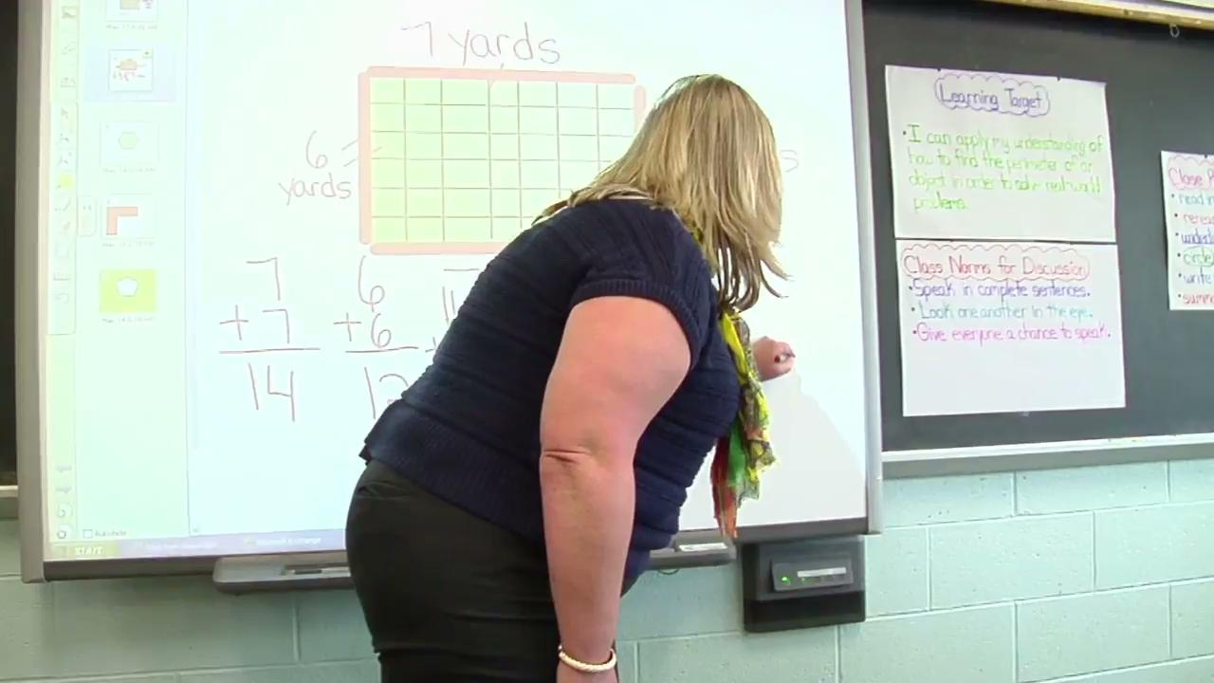
Example 1
What do you see and hear students doing?
Student
Task
Eureka Math, Grade 3
Module 7: Geometry and Measurement Word Problems
Teacher
Content
(video from EngageNY)
Notes:
So as I play this video clip, which is from a grade 3 Eureka Math lesson on perimeter, use your reflection guide to note down everything you can about what students in this classroom are doing. There’s a minute of teacher talk at the start to get you up to speed on what’s going on in the lesson.
[Make sure participants see where to take notes in their video reflection guide, then play the video clip (length: 3:30). Possible responses include:
Working in pairs and small groups; working with manipulatives; arranging and counting tiles; explaining what they’re doing
Confusing perimeter and area, watching the teacher model the measurement of perimeter, then understanding the difference
Re-counting or watching each other re-count after making a mistake, smiling and acting to correct the mistake when they notice it
Checking their work once they believe they’ve corrected a mistake to see if they’ve got the right answer
Saying to a partner, “I think I’ve got it” and helping them manipulate the tiles; trying again when incorrect
Solving a problem with more than one right “answer” (configuration of tiles)
If participants get stuck, ask questions like
What is one thing you heard a student say?
What do you see students doing with their hands?
Who are the students talking to?
Where are the students?
You can also scaffold them from lower-inference to higher-inference observations by asking questions like
What do you think she was trying to accomplish in that moment?
Why do you think he said that?
What do you think they felt when that happened?
Because this is the first video, this one is brief, includes more teacher framing than the next two, and doesn’t need to be discussed extensively in small groups. Use this whole-group share-out as a quick check to make sure participants are noticing what students are doing–not focusing just on the teacher’s actions. Make sure they identify that students are persevering to solve a challenging problem, trying again or trying a different way when they get stuck, smiling rather than getting discouraged when they catch a mistake, helping one another figure things out, explaining what they’re doing, and building on prior learning by connecting but also distinguishing between perimeter and area.]

Slide 12
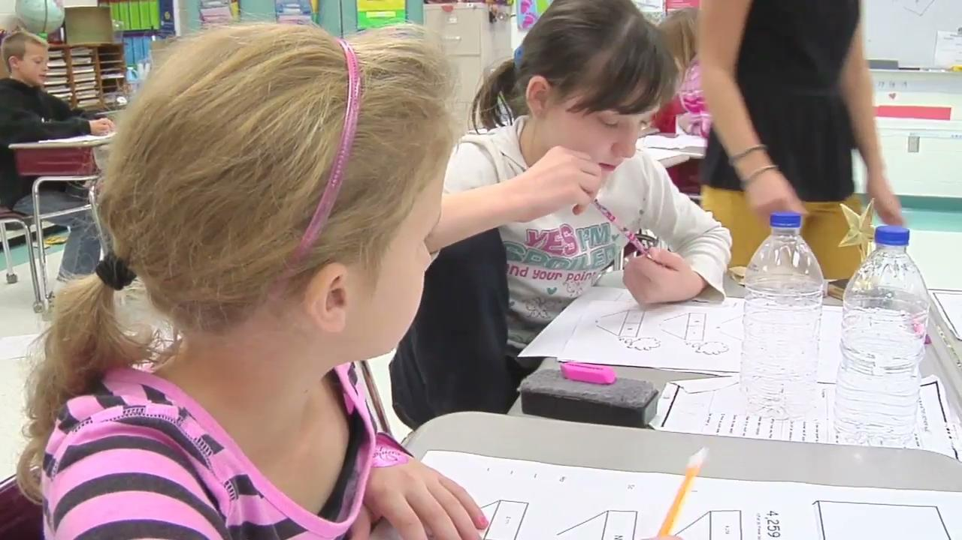
Example 2
What do you see and hear students doing?
Student
Task
Eureka Math, Grade 4
Module 1: Place Value, Rounding, and Algorithms for Addition and Subtraction
Teacher
Content
(video from EngageNY)
Notes:
Okay, we’re starting to build a vivid picture of what students are doing when math instruction is strong. Let’s gather some additional data to begin fleshing out a more robust vision for student experiences.
[Have participants use their reflection guide to capture observations as before while you play the video clip (length: 5:13).
This time, give them 3m to compare notes and discuss in small groups before leading a 2m whole-group debrief.
Participants may observe that students are:
Explaining their reasoning for choosing a certain method of approaching a task
Interpreting tape diagrams to figure out what mathematical situation each represents
Making lots of “because” statements (also once asking “What do you mean by correct?”)
Making connections to previous work (“the pumpkin problem”) when stuck, then saying “Oh!”
Eliminating inaccurate models and explaining why each is inaccurate given the situation at hand
Discussing addition and subtraction in terms of “the whole” and “parts” (which will help with fractions)
Working in groups and making suggestions to one another about how to solve a problem
Saying to one another “I think we should…” and identifying multiple valid strategies
Focusing more on modeling accurately than on jumping to getting the right answer
Not just saying an answer, but explaining how they arrived at it
Make sure before moving on that participants have articulated observations about students
Accurately modeling problems
Making connections to prior and future learning
Explaining “how” and “why”
Talking about content with peers
Evaluating various approaches to a task
Encourage participants to add to their notes if they hear something they didn’t notice at first.]

Slide 13
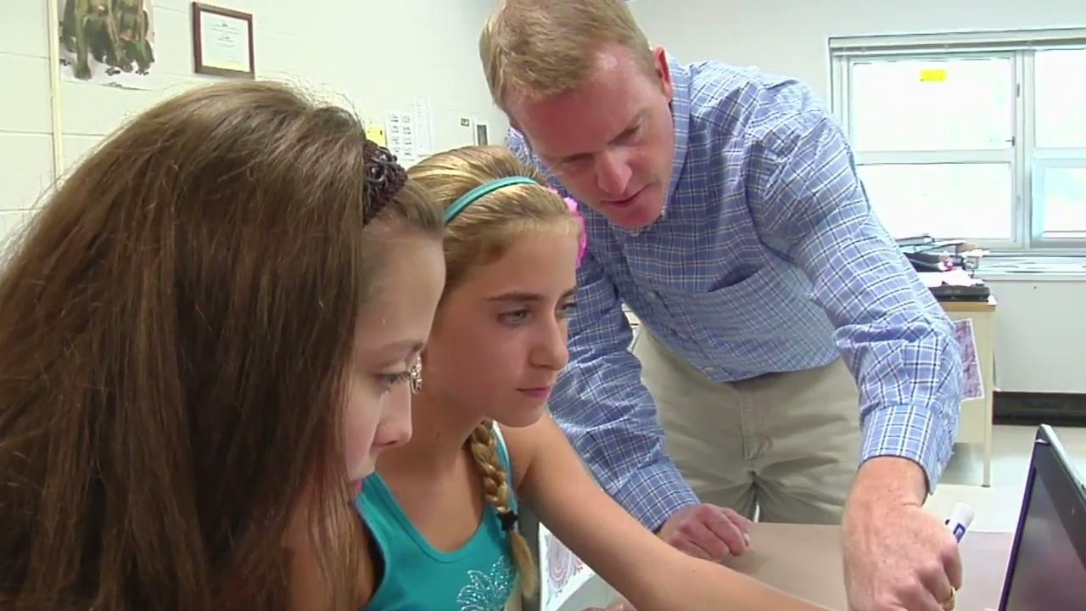
Example 3
What do you see and hear students doing?
Student
Task
Eureka Math, High School
Module 4: Connecting Algebra and Geometry through Coordinates
Teacher
Content
(video from EngageNY)
Notes:
Okay, we’ve added a lot to our picture of what student learning of mathematics looks like in a strong instructional core. Let’s look at just one more video–this one from a very different context (high school).
[Have participants use their reflection guide to capture observations as before while you play the video clip (length: 5:08).
Once more, give them 3 minutes to discuss at their tables before facilitating a 2m whole-group debrief. At minimum, participants should observe that students:
Explain their reasoning to one another (including pointing out and explaining others’ errors when needed!)
Realizing when they need prior learning (Pythagorean Theorem) and using it appropriately in a new situation
Experimenting strategically: “Now we need to…” “Oh, that could work,” “What about…” and “All right, let’s try…”
Working on a challenging, open-ended problem (and also working again with perimeter, as the grade 3 students were)]

Slide 14
How do these students’ actions and experiences compare to those of students in your context?
Notes:
Okay, we’ve gathered a lot of data on what student learning can look like in a variety of mathematics contexts. Let’s pause now to synthesize and reflect: [read the prompt on the slide]. What’s similar? What’s different?
[Have participants discuss for 5m in small groups and then share out with the whole group.
Push participants to confront any cognitive dissonance this activity provokes, and to avoid blaming factors entirely beyond their control for any ways in which students in their contexts lack access to opportunities like the ones shown in the video. That’s not to say that they need to be hard on themselves! They’ll have plenty of time in later sessions to plan next steps for their own leadership; this is just an opportunity to raise awareness of what changes might be needed.
It may also be helpful to encourage participants to make concrete, low-inference comparisons (e.g., “When I observe math classes in my context I see much more teacher talk than student talk, while in the video examples there was much more student than teacher talk”) rather than before jumping to explanations or abstractions (e.g., “The teaching I observe isn’t as well planned” or “Students in my classrooms aren’t as engaged”).]

Slide 15
Notes:
Now that we have vivid, specific instances in mind of the kinds of things we want to see students doing, let’s look at the more abstract, generalized version of those things. This of course is our set of mathematical processes. [Voice over slide, or give participants a moment to read it to themselves, or have volunteers read the processes aloud for the group.] Much of what we talked about in those videos was student engagement in the processes: problem-solving, reasoning, representing, connecting, communicating.

Slide 16
Vision, Part 1: Students Engage in Processes
Student
Task
Teacher
Content
Notes:
So the processes are our vision for what students are doing in the instructional core when it comes to mathematics in Nebraska. And what do the processes actually look like in practice, not just on paper? The answer, or one part of the answer, is in those sample videos we watched.

Slide 17
Notes:
It’s important to note, though, that the processes don’t occur in isolation. They rely on worthwhile content: complex, important mathematical problems, reasoning, and ideas [point to circled words on slide] that can support the level of cognitive engagement the processes describe. This is why you can’t get very far focusing on just one leg of the stool, just one component of the instructional core. If we want students to be connecting mathematical ideas, we need to engage them with ideas that are connected and coherent. If we want students justify their ideas, we need to make sure they have the conceptual understanding they need in order to do so. And if we want students to do any of these things, we need to give them enough time with the content to do so rather than rushing them through topic after superficial topic.

Slide 18
Vision, Part 2: Content Reflects the Shifts
Focus on the priorities of grade-level standards
Coherence of concepts within and across lessons, units, and years
Rigor: conceptual understanding, procedural skill and fluency, and authentic application
Student
Task
Teacher
Content
Notes:
You probably noticed that what I was saying about content just now was beginning to sound a lot like our college- and career-ready instructional shifts for mathematics. That’s because those three shifts continue to define our vision for the kinds of mathematics content with which Nebraska students engage. So they provide the second leg of our stool, the second component of our vision. If what we want students to be doing are the processes, what we want them to be doing them with is content reflective of the shifts. We saw this in the videos as well: students “going deep” on challenging content (focus), building explicitly on prior learning (coherence), applying their thinking to authentic scenarios (rigor), and more. The shifts, of course, are what our content standards aim to exemplify.

Slide 19
Our Vision Thus Far
Student
Task
Teacher
Content
Notes:
Let’s take stock of our vision as we’ve articulated it thus far. In the terms of the instructional core, we’ve identified that in essence we want students [point to the Student box] applying the processes to standards, or content [point to the Content box], reflective of the shifts. That’s really what this graphic from the new standards is communicating: the interplay between processes and content that is so critical to our vision for math instruction in Nebraska.

Slide 20
What about Teachers?
Student
Imagine a teacher with access to instructional materials that fully support our vision as we’ve defined it thus far: the processes and shifts.
This teacher does not need to create units and lessons from scratch. How might we define this teacher’s role?
Task
Teacher
Content
Notes:
But what about teachers? Before high-quality instructional materials were widely available, a large portion of teachers’ bandwidth was taken up by creating curriculum materials from scratch or reworking low-quality materials to better support teaching and learning. Of course, that may still be the situation in systems that have not yet adopted high-quality materials, and we’ll be talking more about that problem in Session 4, but for now let’s consider an ideal scenario where a teacher does have access to strong, standards-aligned materials that integrate the processes with content reflective of the shifts. What is that teacher’s role in mathematics instruction? We know it’s vital–more important than ever. But it isn’t designing units and lessons. What is it? [Pause if desired to elicit some thoughts.] Of course there are a million ways to answer that question, because it’s impossible to capture the incredible complexity of a teacher’s work in any way other than actually doing that work. But I want to focus for a few minutes on one of the most important ways in which individual teachers affect teaching and learning every day.

Slide 21
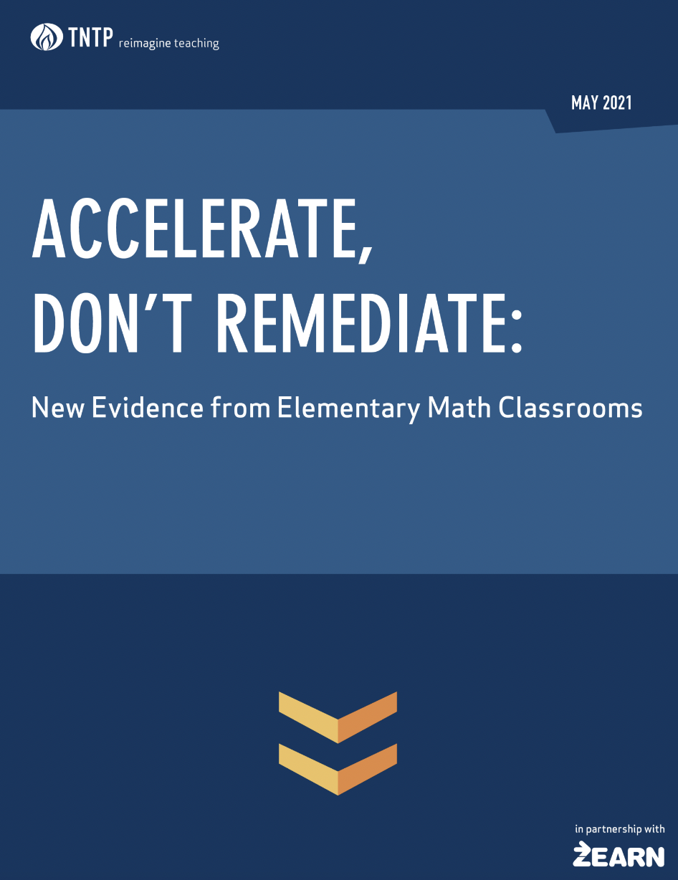
Same Materials, Different Outcomes
Notes:
Let’s take a minute to watch this clip, which summarizes the study shown on the right-hand side of the screen.
[Play video at https://about.zearn.org/insights/publications-learning-acceleration (link is embedded in slide)
After the video, you may want to clarify for participants that the study described defined “struggle” as students’ repeatedly selecting the wrong answer even after being provided targeted scaffolds, or “boosts.” Productive struggle is a really important and valuable part of effective education, in math and every other discipline! But the research we’re citing here is talking about unproductive struggle–struggle without progress, otherwise known as frustration.
Also elicit brief responses if desired, especially if participants are unfamiliar with the concept of acceleration and the acceleration work being done in Nebraska. The next slide will facilitate a deeper dive into the concept, however.]

Slide 22
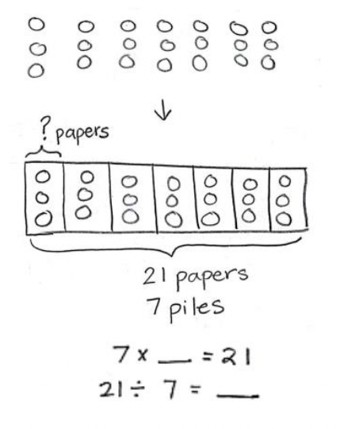
Teachers Ensure Access to Grade-Level Content
Access and read the Appendix (“Learning Acceleration Example”) from the TNTP report on Zearn.
Reflect and discuss:
How does the instruction described compare to what you see in your context?
What factors might have influenced each teacher’s decision-making?
Notes:
Let’s dig a little deeper. Those findings are pretty stunning, but they’re difficult to interpret without a clear picture of what exactly teachers in the study were doing to accelerate or remediate students. [Have participants follow the directions on the slide, discussing first in small groups and then as a whole group. Responses to the reflection questions do not need to arrive at any particular destination right now, but they do need to demonstrate that participants are continuing to think critically about the instruction that occurs in their own contexts and to acknowledge the system-level factors that influence individual teachers’ instruction. This is “mindset” work that will come to fruition in later sessions.
End the discussion with a focus on the slide’s title. Explain that this is our priority for teachers’ role in our vision for a strong math core: ensuring that every single student has meaningful access to grade-appropriate learning as defined by the standards.]

Slide 23
Our Vision Thus Far
Students engage in math processes
Tasks are from high-quality materials
Teacher ensures equitable access
Content is focused, rigorous, coherent
Notes:
Okay, let’s pause once more to take stock of what we’ve articulated. [Voice over the slide.]

Slide 24
What Will Success Look Like?
“Successful math users have an approach … that sets them apart from less successful users. They approach math with the desire to understand it and to think about it, and with the confidence that they can make sense of it.”
“The difference between the high- and low-achieving students [in a study] was not that the low-achieving students knew less mathematics, but that they were interacting with mathematics differently. Instead of approaching numbers with flexibility … they seemed to cling to formal procedures … not abandoning them even when it made sense to do so.”
Jo Boaler, “Developing Mathematical Mindsets”
Notes:
There’s just one more piece of our vision we need to define. We’ve talked a lot about student experiences with content in classrooms and how teachers facilitate them, but what’s the larger point here? What outcomes are we hoping those experiences produce for students? To help us answer that question in a way specific to mathematics, we turn to Jo Boaler, a prominent expert at Stanford who has done a lot of research and writing on math education. One point she makes again and again is that successful use of mathematics is not just about mastering content; it’s about developing what she calls “mathematical mindsets”--and two key components of mathematical mindsets are confidence and flexibility. [Read the excerpts on the slide. Elicit reactions as desired, and/or ask participants to describe how they saw students exhibiting confidence and flexibility in the videos they viewed earlier.
Source: https://www.aft.org/ae/winter2018-2019/boaler]

Slide 25
Putting It All Together: A Vision for the Core
All students become flexible, confident users of mathematics in life and work
…by making sense of and solving problems, reasoning critically about mathematics, and representing, communicating, and connecting mathematical ideas
…with grade-level content, coherent learning progressions, and a rigorous balance of conceptual understanding, procedural skill and fluency, and authentic application.
College, career, and life readiness
Mathematical processes
Grade-level standards and instructional shifts
Notes:
Okay, let’s put all these pieces together. We’ve said that, in a strong instructional core for mathematics in Nebraska, we want all students [point to the first bullet} to become successful users of mathematics as demonstrated by flexibility and confidence both within and beyond classroom walls, and we believe that will happen if they–again, all students–engage in the mathematical processes [point to the second bullet] in the context of content [point to the third bullet] that reflects both the college- and career-ready shifts and the expectations of grade-level standards. And while we’re keeping the focus on students here, as is appropriate, you can see how skillful and knowledgeable teachers, an acceleration approach, and high-quality instructional materials are all absolutely necessary to the realization of this ambitious vision.

Slide 26
The improved mathematics standards are designed to support this vision more strongly than ever.
They are not designed to alter the vision.
Notes:
You may be thinking that this vision isn’t exactly new or surprising. If so, you’re right: it’s not. In making the latest improvements to the standards we haven’t suddenly changed our mind about what makes for great math instruction. The improvements are designed to support our vision more strongly, not to change it. This is an important point for educators wondering what the implications of the improvements will be for their everyday work. The message here is not that everything is going to be new and different; it’s that we need to make some strategic adjustments to ensure that we can actually get where we’ve been trying to go.

Slide 27
How Might These Changes Support the Vision?
Processes:
More visual and narrative guidance on all processes and their integration with the content standards
Reintroduction of Reasoning: “Reason quantitatively and abstractly and consider the reasoning of others”
Number:
More focus in elementary grades on number sense: the ability to work flexibly and creatively with numbers
Geometry, Data, Algebra:
Added specificity at each grade level and clarity regarding connections between grades
Stronger foundations in earlier grades to prepare students for advanced work in high school
Notes:
Now again, we’re not going to be digging into the details of the standards here. We’ve posted a crosswalk that lists all the discrete differences between the 2015 standards and the 2022 ones, and we urge you and your colleagues to make use of that crosswalk once you’re ready to zoom in on individual standards. [The crosswalk is listed and linked in Appendix B.] But let’s take a minute to think about the gist and intent of the changes, at a high level, and identify the ways in which they are designed to support our vision. [The bullet points on the slide summarize the comparison table beginning on page 3 of the Key Features and Talking Points document linked in the Appendix slide. For example, the table notes that the written narrative in the standards describing the processes has been revised and that a new visual has been developed to communicate the integration of the processes with grade-level standards. If desired, you can have participants engage directly with that resource here instead of just relying on the slide.
In any case, have participants discuss in small groups and then share their thoughts with the larger group. Responses may be along the lines of:
More emphasis and guidance on the processes and how they integrate with grade-level content aligns with the vision for a strong instructional core with students engaging actively with content
The emphasis on number sense helps ensure that students become flexible and confident users of mathematics as described in the vision and in research on what constitutes success in math.
Stronger, earlier emphasis on key content (like data) helps ensure that all students can access the more advanced content they encounter at higher grade levels, serving the vision’s goal of equity.
Stronger and more explicit K-12 learning progressions in areas like data and statistics help ensure that content is coherent, one of the three college- and career-ready shifts articulated in the vision.
Close this discussion by reminding participants that this is what we mean when we talk about giving teachers an interpretive lens through which to view the standards. If I’m a grade 4 teacher noticing a new fraction standard I need to teach, the point is not simply to “cover” that standard; the point is the vision, and I need to interpret and then teach the standard in ways that align fully to the vision: ensuring that all students can access and master it within grade 4; integrating it with the processes in meaningful, authentic student tasks; encouraging students to use their new learning in creative and flexible ways; and so on.]

Slide 28
The Instructional Core
What happens when we try to improve learning outcomes without attending to student engagement, content, or teacher practice?
Student
Task
Instructional Rounds in Education (City, Elmore, Fiarman, & Teitel, 2009)
Teacher
Content
Notes:
[This slide is hidden because facilitators may not have time for the activity it facilitates. If you would like to do the activity but don’t have time in this session, you might also consider incorporating it into Session 4.]
Let’s round out our segment on envisioning a strong math core by summing up why this comprehensive approach to instructional improvement is so important.
[Divide participants into three groups. Assign each group one “leg” of the three-legged stool of the instructional core, and then give each group 3m to discuss: What goes wrong–what does it look like and what are the effects–when we try to improve learning outcomes without attending to that leg of the core? Have each group share their thoughts with the whole group. Reflections should resemble the excerpts below, which are from the article cited.
Missing teacher knowledge and skill: “A failure to address teachers’ knowledge and skill as part of a curriculum-based improvement strategy typically products low-level teaching of high-level content… Teachers assign high-level text or complex problems and then structure student learning around familiar fill-in-the-blank worksheets. Or teachers walk students through a straight procedural explanation of how to find the answer, leaving he students in the role of recoding what the teachers says, rather than actively thinking through the problems for themselves.”
Missing content: “If you invest in teacher professional development—teacher knowledge and skill— without a clear understanding of where you expect it to lead in thers of the actual content that students are expected to master, then you get a random innovation across classrooms and the innovation has no system-wide or schoolwide impact on student learning… [Additionally], if you raise the level of teachers’ knowledge and skill in general pedagogy without anchoring it in the content, you get high-level practice disconnected from a clear understanding of what students are actually learning, and from the specific issues that students have with specific cognitive tasks.”
Missing student engagement: “If you raise the level of content and the knowledge and skill of teachers without changing the role of the student in the instructional process, you get another common situation in American classrooms: Teachers are doing all, or most, of the work, exercising considerable flair and control in the classroom, and students are sitting passively, watching the teacher perform.”]

Slide 29
What (Not) to Expect from this Series
Envisioning Excellent Math Instruction
Supporting Standards Implementation
Session 1 Agenda
Notes:
So what does all this mean for our standards implementation efforts over the next year and beyond?

Slide 30
More RAND Findings: What Teachers Need
Access to high-quality instructional materials aligned to the standards
Deep understanding of the standards and their intent
Time and capacity to change their practice
…all in the context of a clear vision and message on implementation.
Student
Task
Teacher
Content
Notes:
Let’s return to that RAND study we cited earlier. We’ve talked about the importance of giving teachers an interpretive lens they can use to understand the standards, but here’s the fuller quotation from that section of the report: “Teachers’ preparedness to implement standards relies on several key requirements. First, teachers need access to high-quality instructional materials aligned with their standards that will support their work to help students meet standards. Second, teachers need to be able to understand the content standards deeply in order to represent that content to students at a wide range of achievement levels. Third, teachers must be willing and able to engage in the sometimes time-consuming and challenging work to change their instructional practice to address new content and concepts introduced by newer standards and instructional resources aligned with those standards. However, the extent to which teachers meet these requirements depends on the interpretative lenses through which teachers view their state standards and are given messages about how to implement them.” So access to high-quality materials, opportunities to deepen understanding of the standards, and ongoing support for instructional improvement are all key components of any successful standards implementation effort–and, by extension, any effort to strengthen the instructional core at scale. This makes sense given not only that the instructional core is that complex three-legged stool we’ve been talking about, but also that what students are doing–actual tasks–are at the center of that core. High-quality materials shape teacher knowledge and practice and student engagement in a number of helpful ways, but most basically and obviously, they provide high-quality tasks.

Slide 31
Aligned Supports
To implement standards well, teachers need:
Access to high-quality instructional materials aligned to the standards
Deep understanding of the standards and their intent
Time and capacity to change their practice
…all in the context of a clear vision and message on implementation.
An updated Bridge Document for math will be released soon to demonstrate alignment between instructional materials and the new standards.
Notes:
So when you think about standards implementation in the context of the instructional core, it becomes clear that a wide variety of initiatives and resources are helpful and even essential to what we’re trying to do with our improved math standards. For example, knowing the importance of standards-aligned materials to standards implementation efforts, NDE is releasing an updated Bridge Document demonstrating alignment between the materials reviewed by the Nebraska Instructional Materials Collaborative and our new standards. I can tell you right now that materials meeting expectations for alignment to the legacy standards will also meet expectations for alignment to the new standards–some details might differ, but overall quality and alignment will not–so please don’t throw out your well-aligned materials just because the standards changed! But you can expect that Bridge Document to help you manage the details of the transition. [If you are delivering this session after the Bridge Document is released, adjust the slide accordingly.]

Slide 32
Aligned Supports
To implement standards well, teachers need:
Access to high-quality instructional materials aligned to the standards
Deep understanding of the standards and their intent
Time and capacity to change their practice
…all in the context of a clear vision and message on implementation.
The statewide PL series on acceleration is designed to strengthen understanding of grade-level expectations.
Notes:
Similarly, when we look at that second condition for success and think back to what we saw the teacher doing in Classroom Two from the Appendix to the acceleration study, we understand that teachers need a deep understanding of not only their own grade level’s expectations but also how expectations progress through the grades in the standards. Because these are such critical components of effective learning acceleration, the statewide PL series that NDE is offering in partnership with TNTP is another valuable and relevant resource in the multifaceted work of standards implementation.

Slide 33
Aligned Supports
To implement standards well, teachers need:
Access to high-quality instructional materials aligned to the standards
Deep understanding of the standards and their intent
Time and capacity to change their practice
…all in the context of a clear vision and message on implementation.
The Math Acceleration Project supports districts with implementation of high-quality, standards-aligned materials.
Notes:
We also need to acknowledge that teachers need support as they do the difficult work of translating their understanding of grade-level expectations into effective everyday practice. High-quality materials are necessary but not sufficient here; teachers need ongoing implementation support and professional learning opportunities, grounded in the standards and in the specific high-quality instructional materials they use with their students, in order to make change. One valuable source of this kind of support here in Nebraska is our Math Acceleration Project partnership with Instruction Partners. Again we’ll talk more in Session 4 about possible next steps for each of your contexts, but you may want to consider reaching out to your ESU and getting involved in this work if you’re not already. Even if your ESU isn’t participating, it can reach out to one who is. It’s common knowledge just how much time teachers across the country waste in ineffective professional learning experiences; we have to disrupt that pattern if we want to see real change in student outcomes, and curriculum-embedded learning is what we need in order to make that happen.

Slide 34
Additional Supports and Resources
Student
Task
Teacher
Content
Notes:
In fact, since our vision for a strong mathematics core in unchanged, a wide variety of resources and supports can continue to help us as we work to implement these improved standards. They’re all different–in form and format as well as in substance and purpose–but they’re all interconnected, both with the standards and with one another.

Slide 35
Content Area Standards Implementation Framework
Notes:
I’ll just leave you with our state framework for standards implementation, which you may also be familiar with and which we’ll also be using more extensively in Session 4. [Point out the four phases, beginning with Exploration; the five priorities, including instructional materials and professional learning; and the many key players listed in the center–not just teachers.] So again, we’ll get into the details more in Session 4, but what I hope this initial look and description makes clear is that we as a state are taking a comprehensive, multifaceted approach to supporting standards implementation and want to support you to do the same in your schools and districts.

Slide 36
What is one key takeaway you got from this session?
What is one priority you have for implementing the improved standards in your school or system?
Session 1 of 4
Closing Reflection
Notes:
We’ll close with a brief written reflection, which you’ll complete using Google Forms.
[Note that Appendix A on the next slide summarizes the most important takeaways from the session. You might choose to display it after participants have completed their reflections, to use it for your own purposes as you review their responses and plan next steps, or to display it before the closing reflection and adapt the reflection questions accordingly.]

Slide 37
Appendix A: Key Takeaways
Effective standards implementation requires:
Attention to all “legs” of the instructional core–teacher, students, and content–and how they interact around high-quality tasks
A clear, shared instructional vision to ensure consistent, equitable interpretations of standards in alignment with their intent
Our vision for math in Nebraska is that every student becomes a flexible, confident user of mathematics by applying the mathematical processes to focused, coherent, rigorous, grade-appropriate content.

Slide 38
Appendix B: More Standards Resources
The NDE has made detailed information about the standards and their revision process available on their website at www.education.ne.gov/math/mathematics-standards-revision
Resources include:
Key Features and Talking Points with an overview of the standards’ structure and content and a chart summarizing the main differences between the 2015 and 2022 standards
Crosswalk showing details of changes made to standards
Revision Process Overview with details about timeline, representation on the writing committee, and much more
Implementation Overview clarifying the four stages of implementation and implications for summative assessment

