Slide 1
Connecting with Students Experiencing Homelessness through Outreach and Identification
<<Add branding and contact information here>>

Slide 2
Today’s Roadmap
Outreach and identification
McKinney-Vento Act provisions
Strategies for implementation
Resources for more information

Slide 3
Warm-Up Question
True or False?
According to research by the University of Chicago, the rate of homelessness in urban areas is four times (4x) the rate of homelessness in rural areas.

Slide 4
McKinney-Vento Basics
Subtitle VII-B of the McKinney-Vento Homeless Assistance Act
Was reauthorized by Title IX, Part A of the Every Student Succeeds Act
Establishes the definition of homeless used by U.S. public schools
Addresses the unique educational barriers and challenges faced by students experiencing homelessness
Requires state education departments to designate a State Coordinator for Homeless Education and school districts to designate a local homeless education liaison; access contact information at https://www.education.ne.gov/federalprograms/title-vii-b/

Slide 5
McKinney-Vento Definition of Homeless
Children and youth who lack a fixed, regular, and adequate nighttime residence, including
Sharing the housing of other persons, due to loss of housing, economic hardship, or a similar reason
Living in motels, hotels, trailer parks, camping grounds due to the lack of alternative adequate accommodations
Living in emergency or transitional shelters, or abandoned in hospitals
Living in a public or private place not designed for or ordinarily used as a regular sleeping accommodation
Living in cars, parks, public spaces, abandoned buildings, substandard housing, bus or train stations, or similar settings
Migratory children living in the above circumstances
42 U.S.C. §11434a(2)
Unaccompanied youth (children and youth experiencing homelessness while not in the physical custody of a parent or guardian)
42 U.S.C. §11434a(6)

Slide 6
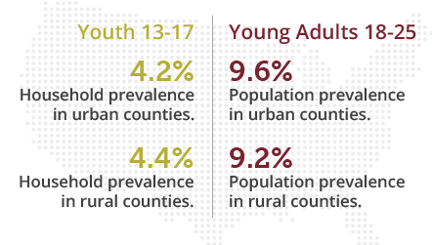
The Research: Rural v. Nonrural
Rates of youth homelessness are statistically identical in rural and nonrural areas
Source: Chapin Hall, Missed Opportunities: Youth Homelessness in America, National Estimates

Slide 7
Identification under McKinney-Vento
Identification is the first step to ensuring educational access and success for students experiencing homelessness
References to identification are woven throughout the McKinney-Vento Act, including as
A state and district responsibility [42 U.S.C. §11431(2); 42 U.S.C. §11432(d)(2); 42 U.S.C. §11432(g)(1)(B); 42 U.S.C. §11432(g)(7)]
A duty of the local liaison [42 U.S.C. §11432(g)(6)(A)(i)]

Slide 8
Identification under McKinney-Vento
A data collection and public posting requirement [42 U.S.C. §11432(f)(1)(A)]
A focus of professional development for local liaisons and district/school staff [42 U.S.C. §11432(d)(5)(A)]
A focus of school-community coordination [42 U.S.C. §11432(g)(5)(C)(i)]
A focus of district subgrant funds usage [42 U.S.C. §11433(a)(1); 42 U.S.C. §11433(c)(2)(A)]
Identification also is a focus of American Rescue Plan-Homeless Children and Youth (ARP-HCY) funding

Slide 9
Outreach under McKinney-Vento
Liaisons must ensure that children and youth experiencing homelessness are identified by school personnel through outreach and coordination activities with other entities and agencies [42 U.S.C. § 11432(g)(6)(A)(i)]
Liaisons must ensure that public notice of homeless students’ rights is posted in an understandable manner in locations frequented by parents, guardians, and unaccompanied youth [42 U.S.C. § 11432(g)(6)(A)(vi)]
Student Rights

Slide 10
Outreach under McKinney-Vento
State Coordinators and school districts must inform school personnel, community partners, and children, youth, and parents/guardians experiencing homelessness of the duties of the local liaison [42 U.S.C. § 11432(g)(6)(B)]
State Coordinators must publish an annually updated liaison list on the state education department’s website [42 U.S.C. § 11432(g)(6)(B)]
Liaison Duties

Slide 11
Identification “Benchmarks”
Experiences of homelessness are correlated with experiences of poverty
Consider the following benchmarks when assessing district identification efforts
5-10%
of students eligible to receive free or reduced-price meals
10%
of students experiencing poverty
Source: Auditor of the State of California, Youth Experiencing Homelessness: California’s Education System for K–12 Inadequately Identifies and Supports These Youth
Sources: Urban Institute, What Will It Take to End Homelessness? Census Bureau: Poverty Estimates by School District by School Year

Slide 12
Outreach and Identification Strategies
Create a centralized phone number and/or website for accessing information and supports
Reach out to previously identified students using information on file
Create and distribute simple awareness materials (flyers, posters) where youth and families may congregate
Leverage community partners to share information and refer children, youth, and families
Leverage existing distribution channels to share information (school meals and other supports)
Leverage technology (social media, text, email, etc.)

Slide 13
Outreach and Identification Strategies
Include housing questions in enrollment forms (online and paper); ensure immediate enrollment without proof of residence
Consider supporting increased liaison capacity and/or designating school-level points of contact to “extend” the liaison’s reach
Consider engaging “outreach teams”, including school counselors, school social workers, school-based partner organization staff, and other appropriate staff
Incorporate information into district and school staff training about recognizing homelessness and referring students in need to help

Slide 14
Outreach and Identification Strategies
Use sensitive and intentional language in outreach materials
Describe living situations rather than use the word “homeless”
Create a safe space for accessing help
Relieve concerns about child welfare involvement
Be consistent and persistent; multiple outreach attempts may be needed
Keep communications and awareness materials clear and simple
Share information in common languages in your community
Check in regularly once a connection has been made

Slide 15
Cool-Down Question
Consider…
Which outreach or identification strategy shared today might you use moving forward?
What next step do you need to take to implement this strategy?

Slide 16
Resources
NCHE educational rights posters
Youth version, English
Youth version, Spanish
Parent version, English
Parent version, Spanish
Order in hard copy (free in limited quantity) at https://nchehelpline.org/

Slide 17
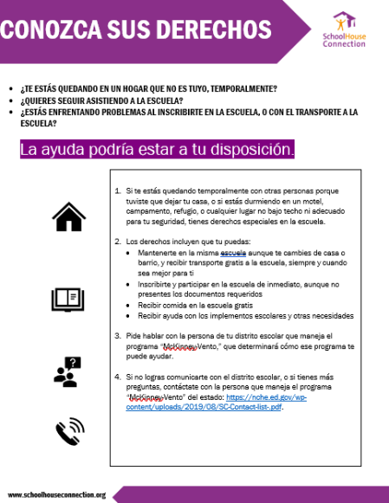
Resources
SchoolHouse Connection “Know Your Rights” posters
New Mexico Public Education Department Homeless Student Referral Form for Community Partners
Kern County Schools (CA) community partner student referral form in PDF format | in online format
Northwest New Mexico McKinney-Vento Facebook webpage

Slide 18
Thanks for Joining!
<<Add branding and contact information here>>

