Slide 1
McKinney-Vento 101:
Understanding and Implementing the Law in Nebraska
<<Add branding and contact information here>>

Slide 2
Today’s Roadmap
The McKinney-Vento Homeless Assistance Act
Identifying students experiencing homelessness
Summary of rights and supports available to eligible students
Resources for more information

Slide 3
McKinney-Vento Basics
Subtitle VII-B of the McKinney-Vento Homeless Assistance Act
Was reauthorized by Title IX, Part A of the Every Student Succeeds Act
Establishes the definition of homeless used by U.S. public schools
Addresses the unique educational barriers and challenges faced by students experiencing homelessness
Requires state education departments to designate a State Coordinator for Homeless Education and school districts to designate a local homeless education liaison; access contact information at https://www.education.ne.gov/federalprograms/title-vii-b/

Slide 4
McKinney-Vento Basics: Breaking it Down
State education departments and school districts must
Review and revise laws, regulations, practices, or policies
that may act as a barrier to
the identification of,
or the enrollment, attendance, or success in school of
children and youth experiencing homelessness
42 U.S.C. §11431(2)

Slide 5
Homelessness: Challenges and Effects
Challenges
Due to homelessness, students may
Be unable to meet school enrollment requirements
Move around and change schools a lot
Be hungry, tired, and anxious
Not have school supplies or a quiet place to study
Not have access to reliable transportation
Not have a parent or guardian to help them
can lead to
Effects
As a result, students experiencing homelessness are more likely to
Be chronically absent from school
Get lower grades
Have special education needs
Score poorly on assessment tests
Drop out of school

Slide 6
The Research: Risk Factors
Lack of a high school credential is the single largest factor placing youth at risk of experiencing homelessness
Source: Chapin Hall, Missed Opportunities: Youth Homelessness in America, National Estimates

Slide 7
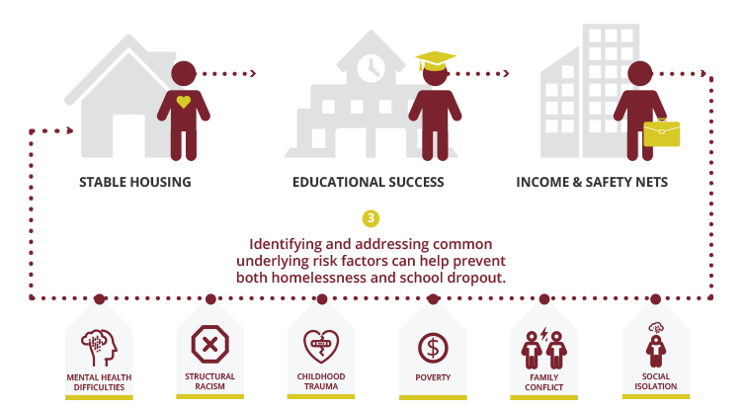
The Research: A Bidirectional Relationship
Source: Chapin Hall, Missed Opportunities: Education Among Youth Experiencing Homelessness in America

Slide 8
Role of the Local Liaison
Local liaisons must
Ensure the identification and school enrollment of students experiencing homelessness
Connect families experiencing homelessness to early childhood services
Refer families experiencing homelessness to other services (housing, health and mental health care, etc)
Support the informed engagement of parents
Disseminate public notice of McKinney-Vento rights and services
Provide professional development to school personnel
Support unaccompanied homeless youth
42 U.S.C. §11432(g)(6)(A)

Slide 9
Who Is Homeless?
Children and youth who lack a fixed, regular, and adequate nighttime residence, including
Sharing the housing of other persons, due to loss of housing, economic hardship, or a similar reason
Living in motels, hotels, trailer parks, camping grounds due to the lack of alternative adequate accommodations
Living in emergency or transitional shelters, or abandoned in hospitals
Living in a public or private place not designed for or ordinarily used as a regular sleeping accommodation
Living in cars, parks, public spaces, abandoned buildings, substandard housing, bus or train stations, or similar settings
Migratory children living in the above circumstances
42 U.S.C. §11434a(2)
Children and youth not in the physical custody of a parent or guardian living in the above circumstances
42 U.S.C. §11434a(6)

Slide 10
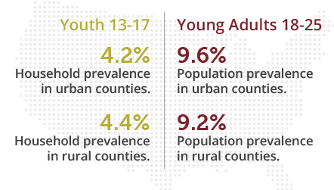
The Research: Rural v. Nonrural
Rates of youth homelessness are statistically identical in rural and nonrural areas
Source: Chapin Hall, Missed Opportunities: Youth Homelessness in America, National Estimates

Slide 11
Determining McKinney-Vento Eligibility
The local liaison has the authority and responsibility to ensure that eligible students are identified
Eligibility determinations should be made on a case-by-case basis, considering the circumstances of each student
Pay close attention to the legislative wording, as it may provide needed clarity
Download NCHE’s Determining Eligibility for McKinney-Vento Rights and Services brief for more information

Slide 12
Immediate Enrollment
Children and youth experiencing homelessness have the right to immediate school enrollment
even if lacking paperwork normally required for enrollment (birth certificate, proof of residence, previous school records, immunization/health records, etc.)
even if they do not have a parent or legal guardian present
Enrollment is defined as “attending classes and participating fully in school activities” [42 U.S.C. § 11434a(1)]

Slide 13
School Selection and Transportation
Children and youth experiencing homelessness have the right to attend
The school of origin [42 U.S.C. § 11432(g)(3)(I)(i)]
The school that a child or youth attended when permanently housed, or the school in which the child or youth was last enrolled
The local attendance area school [42 U.S.C. § 11432(g)(3)(A)(ii)]
Any public school that nonhomeless students who live in the attendance area in which the child or youth is actually living are eligible to attend
School of origin transportation must be provided at the request of the parent or guardian, or, in the case of an unaccompanied youth, at the request of the local liaison [42 U.S.C. §11432(g)(1)(J)(iii)]

Slide 14
Determining Best Interest
In determining best interest, the school district shall
Presume that keeping the child or youth in the school of origin is in the child’s or youth’s best interest, except when doing so is contrary to the request of the parent, guardian, or unaccompanied youth
Consider student-centered factors related to the child’s or youth’s best interest, including factors related to the impact of mobility on achievement, education, health, and safety, giving priority to the request of the parent, guardian, or unaccompanied youth
42 U.S.C. §11432(g)(3)(B)

Slide 15
What if We Disagree?
If, after conducting the best interest determination, the district determines that it is not in the student’s best interest to attend the school requested by the parent, guardian, or unaccompanied youth
The district must provide the parent, guardian, or unaccompanied youth with a written explanation of the reasons for its determination…
in a manner and form understandable to the parent, guardian, or unaccompanied youth…
including information regarding the right to appeal [42 U.S.C. §11432(g)(3)(B)]
The child or youth shall be immediately enrolled in the school in which enrollment is sought, pending final resolution of the dispute, including all available appeals [42 U.S.C. § 11432(g)(3)(E)(i)

Slide 16
Barriers: A Deeper Dive
In addressing educational barriers, school districts must
Address barriers related to outstanding fees or fines, or absences [42 U.S.C. § 11432(g)(1)(I)]
Ensure students receive appropriate credit for full or partial coursework satisfactorily completed at a prior school [42 U.S.C. § 11432(g)(1)(F)(ii)]
Address barriers to accessing academic and extracurricular activities, including magnet school, summer school, career and technical education, advanced placement, online learning, and charter school programs [42 U.S.C. § 11432(g)(1)(F)(iii)]

Slide 17
Higher Education
School counselors must assist students experiencing homelessness with college preparation and readiness [42 U.S.C. § 11432(g)(1)(K)]
Local liaisons must inform unaccompanied youth of their independent student status on the Free Application for Federal Student Aid (FAFSA) and assist with verification of this status [42 U.S.C. § 11432(g)(6)(A)(x)(III)]

Slide 18
For More Information
NDE homeless education webpage
SchoolHouse Connection website
National Center for Homeless Education website
U.S. Department of Education EHCY Program Non-Regulatory Guidance

Slide 19
Thanks for Joining!
<<Add branding and contact information here>>

