Slide 1
Facilitator Notes: Materials
This session centers on the same four units (for grades 1, 2, 5, and 10) featured in Session 1. As with Session 1, consider adjusting the slides and Reflection Guide to omit any lessons not relevant to any of your participants.
Each participant needs access to:
An electronic or paper copy of the Reflection Guide and a means of completing it (e.g., laptop, pen) during the session
The 2021 standards and the unit- and lesson-level instructional materials referenced (probably electronic given their volume)
The Closing Reflection (a Google Form with open-response and multiple-select items) on an Internet-enabled device

Slide 2
Facilitator Notes: Logistics
This session does not have any distinct breakout segments; instead, it alternates between independent thinking and work time, brief partner or table conversations, and whole-group presentation and discussion. Participants may be focused on different grade levels in their individual thinking and exploration, but key takeaways are the same for everyone.
Review materials ahead of time and plan and monitor pacing carefully to avoid rushing or dragging the individual think time. Participants do not need time to analyze every detail on every page, but they do need time to read and process, but they. In particular, the closing reflection may take longer than those of other sessions.

Slide 3
Facilitator Notes: Customization
This session is designed to be relevant both to participants who already have high-quality, standards-aligned materials in place and to those who do not. Consider your audience and tailor the session more narrowly if possible or necessary. For example, if all participants are already using high-quality materials, they may not need to compare the sample materials with their own or review the NIMC reports on their materials. In contrast, if all participants are unfamiliar with the NIMC reports, they may need considerable scaffolding to complete the closing reflection productively.

Slide 4
Nebraska’s College and Career Ready Standards for English Language Arts
Notes:
[Introduce yourself, welcome participants, and make sure everyone has the necessary materials.]

Slide 5
Nebraska’s Vision for ELA Instruction
Regular practice with complex texts and their academic language
Reading, writing, and speaking grounded in evidence from varied texts
Building knowledge both through and for content-rich nonfiction and fiction
Systematic, explicit, evidence-based instruction in foundational literacy skills
…for ALL students
Notes:
Let’s begin by re-grounding ourselves in Nebraska’s vision for excellent and equitable ELA instruction. [Voice over the slide as in previous sessions, making sure not to omit the “all students” point.] This vision is constant across our 2014 and 2021 ELA standards, but the 2021 shifts give us stronger and more current tools for realizing it.

Slide 6
Initial Standards Rollout Goals
Articulate a shared vision of excellent ELA and literacy education for all Nebraska students.
Describe the major standards revisions and how they contribute to the instructional vision.
Prepare to marshal resources to support the implementation of the standards and the manifestation of the instructional vision.
Notes:
Our goals for this four-session standards rollout sequence are also familiar to you by now. Again, we know that standards implementation is a long game and that the important work will be done by you and your colleagues and students in schools across Nebraska over the next several years. What we want to do in our time together is make sure you have everything you need to do that work.
This session and the next one, our last, will emphasize the third goal shown here—getting you ready to marshal the resources you need to realize the vision and implement the standards and shifts we discussed in Session 2. Today, we’ll focus on two critical and interconnected types of resources teachers need: high-quality instructional materials and aligned implementation supports.

Slide 7
Standards Rollout Sequence
Session 1: The Standards in Instruction
Session 2: The 2021 Standards and Shifts
Session 3: The Standards in Materials
Session 4: Preparing to Implement
Notes:
Of course instructional materials are only one piece of the complex instructional systems we all work in, and by the end of Session 4 we will have “zoomed out” to address a number of other pieces. But materials are an important enough anchor for instruction that it’s worth a bit of a deep dive into the ways in which they can and should support teachers’ work and students’ achievement in the context of standards implementation.

Slide 8
The Instructional Core
If you change any element, you need to change the others.
Task predicts performance.
City, Elizabeth A., Elmore, R., Fiarman, S., & Teitel, L. (2009). Instructional rounds in education. Harvard Educational Publishing Group.
Student
Task
Teacher
Content
Notes:
The reason for this is probably best expressed by that concept of the three-legged instructional core that we evoked in previous sessions. You’ll remember this graphic and the two tenets shown here from our first two sessions. No matter what else we’re doing in and around schools, if we’re not changing the everyday interactions among teachers, students, and content in classrooms, then we’re not going to move the needle on student learning. And at the center of this instructional core are the tasks teachers use to engage students in the content—standards-aligned tasks that should be provided to teachers by their instructional materials so that they can focus their bandwidth and expertise on the complex, situation-dependent engagement and success of individual students with the tasks and content.

Slide 9
1. Welcome and Framing 2. Standards in Materials 3. Materials in Teaching 4. Back to the Standards
Agenda for Today
Notes:
The purpose of this session is not to convince you that instructional materials are important. We know you know they are. It is to explore and illustrate the complex relationship among standards, materials, and instruction so that you are ready to harness the power of strong instructional materials—whatever that looks like in your role and context—to support implementation of our new standards and constant vision for excellent and equitable ELA instruction. We’ll end the session with a reflection designed to point you toward productive next steps relevant to your context: for example, if you’re pretty confident in the materials you already use, you may want to think about what teachers need in order to use them effectively to help students meet or exceed our new standards, whereas if your materials don’t seem up to the job of supporting teachers to implement the new standards, you may want to think about upgrading.
First, though, let’s analyze some specific examples of high-quality materials and their relationships to college- and career-ready standards.

Slide 10
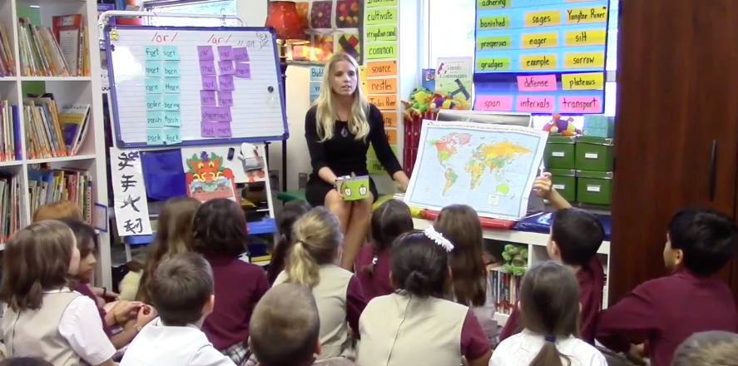
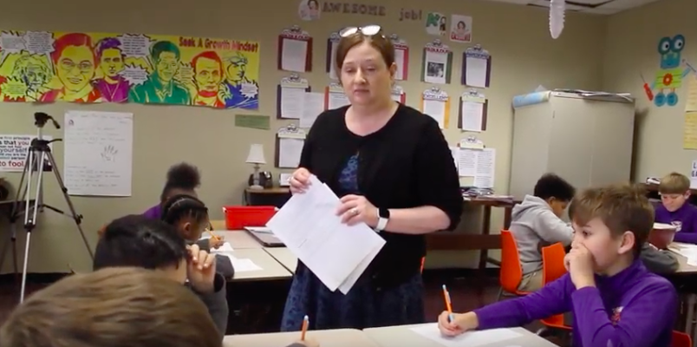
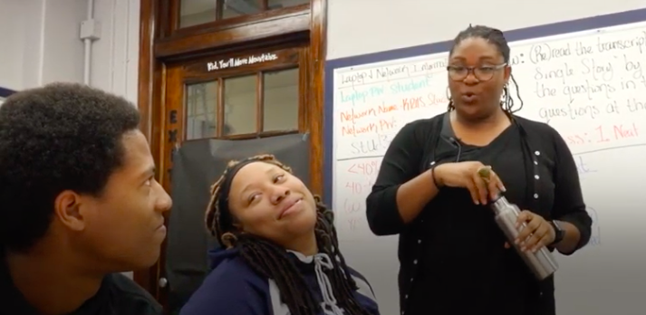
Remember Session 1?
Notes:
Remember the video segments we viewed in Session 1? This was the grade 1 foundational skills lesson featuring a swim meet and the “ai” [as in bike] sound; the grade 2 lesson on Chinese New Year, the grade 5 one on Galileo Galilei, and the grade 10 one on Chinua Achebe’s novel Things Fall Apart. We’re now going to look at some of the instructional materials those teachers were using to bring their ELA standards to life in their classrooms. You may notice that their standards are a little different from Nebraska’s, though they are college- and career-ready standards similar to ours; we’ll use these openly available resources to build shared understanding to begin with, and then we’ll be sure to come back and apply our thinking to our own state standards and local contexts.

Slide 11
Choose a Focus
Focus | Unit Materials | Lesson Materials
Grade 1 foundational skills | CKLA Skills, Unit 2 alignment chart and introduction (unit PDF pp. v–7) | Lesson 1: Vowel Digraph “ee” (unit PDF pp. 8–17)
Grade 2 knowledge & comprehension | CKLA Listening & Learning, Early Asian Civilizations unit alignment chart and introduction (unit PDF pp. v–11) | Lesson 1: The Indus River Valley, Part I (unit PDF pp. 12–24)
Grade 5 English language arts | Louisiana Guidebooks, The Making of a Scientist unit overview (unit PDF pp. 327–331) | Lesson 1: Observation, Inference, and Discovery (separate PDF)
Grade 10 English language arts | Louisiana Guidebooks, Things Fall Apart unit overview (unit PDF pp. 211–217) | Lesson 4: Unoka and Okonkwo (lesson PDF pp. 28–37)
Notes:
For today, you’re going to choose just one of these four grade levels to be your focus. This table also appears on the first page of your reflection guide, which you’re going to be using throughout today’s session. [Make sure everyone has a reflection guide.] Choose what feels most relevant for now; you all have access to all the materials, so you can always go back and review others on your own after the session.

Slide 12
Unit Materials Review
Focus | Unit Materials | Lesson Materials
Grade 1 foundational skills | CKLA Skills, Unit 2 alignment chart and introduction (unit PDF pp. v–7) | Lesson 1: Vowel Digraph “ee” (unit PDF pp. 8–17)
Grade 2 knowledge & comprehension | CKLA Listening & Learning, Early Asian Civilizations unit alignment chart and introduction (unit PDF pp. v–11) | Lesson 1: The Indus River Valley, Part I (unit PDF pp. 12–24)
Grade 5 English language arts | Louisiana Guidebooks, The Making of a Scientist unit overview (unit PDF pp. 327–331) | Lesson 1: Observation, Inference, and Discovery (separate PDF)
Grade 10 English language arts | Louisiana Guidebooks, Things Fall Apart unit overview (unit PDF pp. 211–217) | Lesson 4: Unoka and Okonkwo (lesson PDF pp. 28–37)
Notes:
To start with, let’s take a look at how each set of instructional materials framed the units in which the lessons we viewed were situated. Find the unit materials that match your chosen focus [give participants time to navigate to their materials]…

Slide 13
How would you describe the role of standards in the materials’ organization and design of student learning experiences?
In your reflection guide…
Notes:
…and take some time to review them with this question in mind [read question aloud]. There’s a spot on your reflection guide for you to jot notes, examples, and questions as you go. [Provide individual work time. Participants should be working toward the conclusions detailed in the notes for slide 19; their initial insights may just be along the lines of “the standards aren’t really the headlines” or “the learning isn’t organized by standard,” and the examples on the next few slides should help advance their thinking.]

Slide 14
How do the four examples shown on the slides reinforce or extend your findings?
In your reflection guide…
Notes:
You’ve probably noticed that the next row on your reflection guide references further examples shown on slides. Those are what I’m going to show you now, one at a time. Jot notes as I go, and then we’ll pause to discuss.

Slide 15
Notes:
Those of you who reviewed the grade 1 materials will recognize this. It’s from a standards alignment chart illustrating where specific standards show up in specific lessons over the course of the unit. Whether you reviewed these materials or not, see if you can glean any additional insights into our reflection question on the role of standards from studying this example. How are standards showing up in these instructional materials? [Provide individual think time.]

Slide 16
Notes:
Our second example is from the grade 5 materials. Again, what can you glean about the role of ELA standards in high-quality instructional materials? What is it that the materials are doing with the standards? [Provide individual think time.]

Slide 17
Notes:
Here’s example 3 of 4, from the grade 10 unit materials. How are standards showing up or being used here? [Provide individual think time.]

Slide 18
Notes:
Here’s the last example, from the grade 2 materials some of you reviewed. This is a trickier one, since no standards are referenced explicitly, but again, think about the role of college- and career-ready standards here. What’s their relationship to these teacher-facing instructional materials? [Provide individual think time.]

Slide 19
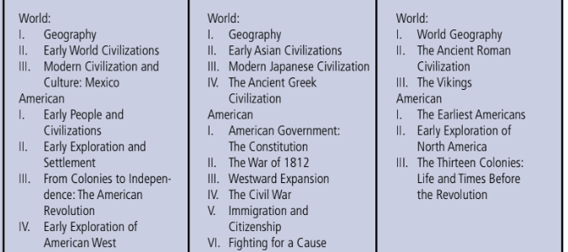
- Core Knowledge Sequence
Notes:
That last example deserves just a little more elaboration. Here is a screenshot from another teacher resource within the CKLA materials, showing the types of historical knowledge students build in their ELA units each year if their teachers use CKLA consistently across grades. You’ll see Early Asian Civilizations and other second grade content there in the center, the Early World Civilizations content mentioned in the previous slide in the first grade column on the left, and then on the right the aspects of world (and US) history they should be ready to learn about in third grade. So when we talk about building knowledge intentionally in our vision for excellent and equitable ELA instruction, it’s not just at the level of the unit or even the year–it’s intentional sequences of knowledge built across years, across a student’s whole educational experience. It’s just a good reminder that these materials provide.

Slide 20
How do these materials compare to those you have used?
In your reflection guide…
Notes:
Okay, just one more reflection question, to get you thinking about your own contexts, and then we’ll discuss. [Provide individual think time.]

Slide 21
What do high-quality instructional materials do with and for standards?
Notes:
[Have participants discuss with a neighbor then facilitate a whole-group share-out. Key takeaways are on the next slide. It’s not important at this time for participants to articulate much about how their materials compare to these, though they may do so productively and in ways relevant to the points above. That question is intended primarily to plant a seed and shape their responses to the other questions.]

Slide 22
Organize
Concretize
Scaffold
What do high-quality instructional materials do with and for standards?
Notes:
[Make sure all participants understand and take away at least these three points before moving on, and invite them to add other verbs as desired.]
HQIM organize standards into coherent learning experiences centered on foundational skills or texts and topics—because individual standards are designed to set outcomes, not organize learning experiences. A given standard shows up in multiple lessons throughout a unit because instruction should not focus on one standard at a time. Strong materials do the work of “bundling” standards into sequences of tasks and experiences.
HQIM concretize standards by providing the substance or content students are expected to manipulate using the standards. College- and career-ready standards in ELA are meant to “wrap around” knowledge and be used as means to the end of building knowledge and understanding—not used as ends in themselves or in the largely content-free forms in which they appear in standards documents. Strong materials infuse content into standards.
HQIM scaffold standards by arranging learning experiences in ways that make grade-level achievement more accessible to all students. The lesson-level materials in the next segment will illustrate this more clearly, but slide 15 shows how coherent knowledge-building curriculum at the unit level, with the background knowledge it builds, is one of the most powerful scaffolds students can have for accessing complex text. Strong materials are scaffolds for standards.

Slide 23
1. Welcome and Framing 2. Standards in Materials 3. Materials in Teaching 4. Back to the Standards
Agenda for Today
Notes:
We’ve been talking about all the things materials do with or for standards and students, but of course they can’t do anything without teachers. And we’ve been analyzing materials at the unit level--and that’s really, really important, because it’s impossible to make the most of individual lessons without understanding how they fit together into the big, knowledge-building picture--but we haven’t been getting into the details of individual lessons. So in this next segment, we’re going to zoom in to the lesson level and shift our focus from what materials “do” to what teachers need to know and do in order to implement materials effectively. We want to build a complete picture of how standards, materials, teachers, and students interact to realize our vision for excellent and equitable ELA instruction.

Slide 24
Lesson Materials Review
Focus | Unit Materials | Lesson Materials
Grade 1 foundational skills | CKLA Skills, Unit 2 alignment chart and introduction (unit PDF pp. v–7) | Lesson 1: Vowel Digraph “ee” (unit PDF pp. 8–17)
Grade 2 knowledge & comprehension | CKLA Listening & Learning, Early Asian Civilizations unit alignment chart and introduction (unit PDF pp. v–11) | Lesson 1: The Indus River Valley, Part I (unit PDF pp. 12–24)
Grade 5 English language arts | Louisiana Guidebooks, The Making of a Scientist unit overview (unit PDF pp. 327–331) | Lesson 1: Observation, Inference, and Discovery (separate PDF)
Grade 10 English language arts | Louisiana Guidebooks, Things Fall Apart unit overview (unit PDF pp. 211–217) | Lesson 4: Unoka and Okonkwo (lesson PDF pp. 28–37)
Notes:
Take a moment now to find the specific lesson in the unit you’re focusing on for today. This may not be the exact same lesson we viewed on video, but it will be related because it’s in the same unit. (It didn’t seem productive to send you all straight into the 14th or 20th lesson of a unit without any familiarity with the preceding lessons, even after watching those videos, which is why we’re just working with Lesson 1 in each unit.) If you’re focusing on grades 1 or 2, you’ll just be scrolling down a few pages in the same PDF you used to analyze the unit-level materials. If you’re focusing on the grade 5 unit, you’ll find Lesson 1 in a PDF of its own; if you’re focusing on grade 10, you’ll find Lesson 4 in a PDF that has materials for all lessons within the Things Fall Apart unit.

Slide 25
What would a teacher need to have, know, and do in order to deliver this lesson effectively?
In your reflection guide…
How would you describe the role of standards in the lesson’s design?
How do these materials compare to those in your school or district?
Notes:
As you review the lesson materials, begin by considering these same two questions—what the materials are “doing” with the standards and how they compare to materials in your own context—but then shift into a focus on what a teacher would need in order to deliver the lesson effectively. Your reflection guide provides space to jot thoughts on all of these questions. [Provide individual think time.]

Slide 26
What would a teacher need to have, know, and do in order to use these materials effectively?
Notes:
[Facilitate a brief share-out and discussion; this topic will be explored further in Session 4, and it’s important not to let it turn into a rabbit hole in the current session, which needs to stay focused on materials (while also seeding this other conversation). The key takeaway for now is that “there is a lot going on” in high-quality instructional materials that teachers need time and support to understand and internalize before they deliver instruction.]

Slide 27
1. Welcome and Framing 2. Standards in Materials 3. Materials in Teaching 4. Back to the Standards
Agenda for Today
Notes:
We’ve now articulated a great deal about what strong materials do with standards and what strong teachers do with materials. Let’s apply all this good thinking to our own standards. Go ahead and navigate now to a grade level of your choice in the standards. You’ll be using those grade-level standards to answer the next couple of questions. [Make sure participants have the standards.]

Slide 28
In your reflection guide…
Vision
What features or characteristics of instructional materials will be most helpful to teachers in implementation?
Shifts
Standards
Notes:
Review those standards for your chosen grade level as well as the more holistic vision and shifts reproduced on your reflection guide. Then, applying our earlier discussion of the relationships between standards and materials, jot some notes on what these standards, shifts, and vision demand of instructional materials. These may be things your existing materials already do, or things you wish they did but they don’t; for now, just think about the ideal materials. [Facilitate a think-pair-share. Key takeaways should connect to the vision and shifts. For example, materials must structure research-based sequences of foundational reading and sentence-level writing skills, provide appropriately complex texts sequenced to build knowledge, and so on. Participants focused on their grade levels may articulate more specific versions of these takeaways—e.g., “materials need to support students’ use of pronouns in their writing”—and it will be helpful for the sake of the group for you to distil the more universal principles underlying their comments (e.g., “materials need to support explicit writing instruction in context”).]

Slide 29
In your reflection guide…
Vision
What knowledge, skills, or experiences will help teachers make the most of their materials in implementation?
Shifts
Standards
Notes:
Now, applying our discussion of what teachers need in order to make the most of strong materials, consider what teachers will need to maximize the potential of their materials to support our standards, shifts, and vision. What will teachers need to know and understand about their materials, and what will they need to do or be able to do with their materials, as they work to realize our vision and implement our standards? [Facilitate a think-pair-share. Key takeaways will likely point to “standards implementation” activities and opportunities for teachers that might follow and build on this four-session rollout series. For example, teachers may need to strengthen their understanding of the science of reading or English syntax through professional learning, or they may need to practice classroom routines that engage students effectively in complex informational text. Participants will be expected to think more concretely about such next steps in Session 4, but this is a time to seed ideas.]

Slide 30
Session 3: Key Takeaways
High-quality instructional materials support standards-aligned instruction by organizing, concretizing, and scaffolding standards for teachers and students.
High-quality materials are necessary, though not sufficient, to ensure that teachers have what they need to deliver standards-aligned instruction effectively.
Materials the Nebraska Instructional Materials Collaborative identifies as being of high quality are aligned with the state’s vision and standards.
Notes:
Your last task for today will be a closing reflection. Before you do that, though, I want to be sure that we’re normed on today’s key takeaways. We talked mostly about the details of the first one [voiceover first bullet], I hope in ways that underscore the second [voiceover second bullet]. The third might be unexpected, but it relates to your closing reflection and to our work in Session 4. You’re probably familiar with the Nebraska Instructional Materials Collaborative reports on the quality and alignment of various instructional materials, but you may be wondering whether they’re still applicable now that our standards have changed. The answer is yes. In fact, with these more rigorous and up-to-date standards, high-quality materials as defined by our Materials Matter work are more important than ever. Keep that in mind as you complete today’s closing reflection and think ahead to Session 4, where we’ll get more concrete about what your next steps on the journey of standards implementation will be.

Slide 31
Closing Reflections
Notes:
[Direct participants to the Google Form. Note that the form directs them to ask you for assistance if they have trouble answering the question of whether the instructional materials they use have a report available from the Nebraska Instructional Materials Collaborative, so you will want to be ready to help people navigate that site if needed. The link is in the Google Form.]

