Slide 1
How to get Your School to Listen to You: Bullying Prevention
CESAR Torres
School Safety
Notes:
2 minutes:
Who has felt frustrated when you talk to your school and they don’t understand?
Has mama bear/ papa bear ever came out?
Here is some important information that may help.

Slide 2
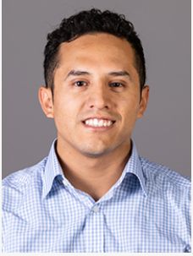
About Me

Slide 3
Objectives
Define bullying and rediscover your school bullying policy
Examine response to incidents of bullying
Discuss and identify ways to support your student's mental health during incidents of bullying

Slide 4
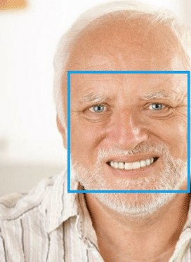
How are you feeling?
A
B
C
D
E

Slide 5
How do you define bullying ?
In break out rooms discuss (7 minutes)
How you define bullying?
What has been your experience when discussing bullying with your school?
Please assign someone to take notes
Please assign someone who is comfortable reporting back to the big group

Slide 6
Notes:
7 minutes:
Step 1: get all the facts!
Step 2: Consider if it fits the definition of bullying
Step 3: consider if it is an emergency
Step 4: Keep your cool, communicate with your student, identify how you can best help them, make a plan to call the school.
Step 5: Meet with your teacher first, take a collaborative approach, stating that you are worried about your student, note changes in their behavior, and how it has affected their education. State that you want to work together with the school.
Step 6: Make a plan and monitor if things get better,.
Step 7: if the school does not respond, follow the steps here.

Slide 7
Who is the first person you contact?
A. Teacher
B. Principal
C. Superintendent
D. Nebraska Department of Education
F. Student’s parents

Slide 8
Statue 79-2,137
School district; development and adoption of bullying prevention and education policy; review.
(1) The Legislature finds and declares that:
(a) Bullying disrupts a school's ability to educate students; and
(b) Bullying threatens public safety by creating an atmosphere in which such behavior can escalate into violence.
(2) For purposes of this section, bullying means any ongoing pattern of physical, verbal, or electronic abuse on school grounds, in a vehicle owned, leased, or contracted by a school being used for a school purpose by a school employee or his or her designee, or at school-sponsored activities or school-sponsored athletic events.
(3) On or before July 1, 2009, each school district as defined in section 79-101 shall develop and adopt a policy concerning bullying prevention and education for all students.
(4) The school district shall review the policy annually
Notes:
1 minute: ensure they know what state law is regarding bullying

Slide 9
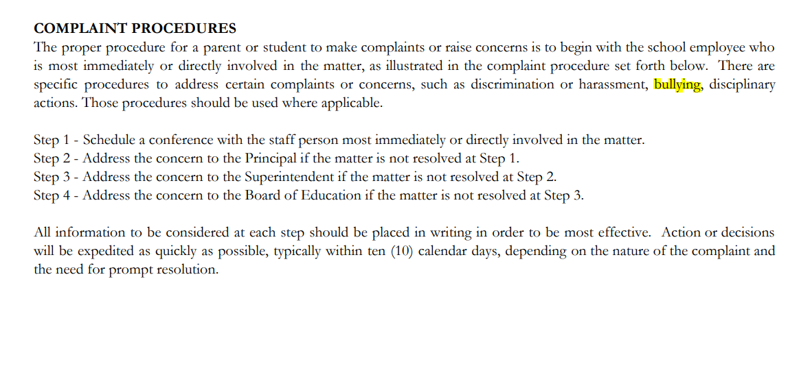
Reporting Procedures
Ensure that you obtain a copy:
School’s bullying policy
Student handbook
Discipline policy
Reporting procedures

Slide 10
How do I support my student’s mental health?
Build Trust
Communicate!
Notice changes in behavior
Follow their lead
Identify the support they need
What do you need help with?
What questions do you have?
Notes:
Quick wright- 2 minutes to think about questions- write some thoughts.
Making people take a moment to consider information.
Parking lot strategy-

Slide 11
Outcomes
The Victim:
Bystander
Perpetrator
Increased depression and anxiety, missing and skipping school, increased used of tobacco and other drugs.
anger, depression, social anxiety, criminal convictions as adults , alcohol and drug abuse
hopelessness, frustration, depression, anxiety, health complaints, decreased academic achievement, and academic participation
National Bullying research center, 2020; CDC, 2018
Notes:
1 minute
Purpose: ensure they know the outcomes and the severity

Slide 12
Positive Stress
Effects
Briefly increases heart rate
Slightly elevates adrenaline and other stress hormones
Sensations
Excitement
Tolerable Stress
Elevates stress hormones to a greater degree
Calls for substantial adult support
Fear
Grief
Toxic Stress
Excessive or prolonged activation of stress hormones
Disrupts brain function
Terror
Hopelessness
Negative expectations
Notes:
Provide an example of an adult situation
Have them write down examples of positive, tolerable, and toxic stress on stick color coded sticky notes. When giving examples, give a couple but don’t use all the easy ones, ensure that they have some one their own, and then debrief.
Pack of stick notes?
You should animate this slide so that positive stress comes first, so that I can pause between each one/ transition topic. You can think about kids and adult related questions.

Slide 13
My student is being bullied because they are different….
How would you bring this to the attention of your school?
Students with a disability
Protected populations
Gender and LGBTQ+ populations
Title IX and Sex Discrimination (ed.gov)
Students with Disabilities - National Bullying Prevention Center (pacer.org)

Slide 14
Small group activity
1. What do you do when dual relationships happen (for example, the bully perpetrator is an administrator's son/daughter, or the teacher is doing the bullying?)
2. How do you help a teenager who does not want to report bullying (for example is afraid of being targeted for “snitching” or is afraid of being outed due to identifying as LGBTQ+)
3. How do you notice when your son/daughter is a victim of bullying? How would you notice if it is occurring online?
4.How can my student protect themselves (e.g., is physically attacked)- Should they fight back?
Professional Practices Criteria – Nebraska Department of Education
Protections from retaliation
Anonymous reporting
Follow student’s lead
Confidentiality
The Trevor Project | For Young LGBTQ Lives
Technology Policy , Bullying Policy
Cyberbullying Research Center - How to Identify, Prevent and Respond
School Discipline Policy
Notes:
In person- if your interested in question one, hold up 1,
Divide room in groups, depending on size (keep groups not bigger than 5)
Or you can have white paper and tape- put 1 on a wall, then 2, 3, and they go to question. – would be better for social distancing.

Slide 15
Objectives
Define bullying and rediscover your school bullying policy
Examine response to incidents of bullying
Discuss and identify ways to support your student's mental health during incidents of bullying

Slide 16
How are you feeling?
A
B
C
D
E

Slide 17
BE SAFE BE KIND

