Slide 1
2022 NSCAS Alternate
Test Administration Training

Slide 2
2022 NSCAS Alternate Key Dates
Student PreID information provided to DRC
January 20
Test Administration Training
February 17-18
Student and Test Management open in the DRC INSIGHT Portal
February 17 – May 6
Student Test Booklets and Test Administration Manuals available for printing in the DRC INSIGHT Portal
March 3
NSCAS Alternate Testing Window
March 21 – May 6
Last day to enter student responses in DRC INSIGHT and Demographics, Accommodations, and Testing Codes in the DRC INSIGHT Portal
May 6

Slide 3
Eligible Grades for NSCAS Alternate Testing
Grades 3-8 and High School (third-year cohort) English Language Arts and Mathematics
Grades 5, 8, and High School (third-year cohort) Science
Students are required to take all subjects of either the NSCAS General or NSCAS Alternate tests for their eligible grades. Students may not take the NSCAS Alternate for some subjects and the NSCAS General for other subjects.

Slide 4
Online Administration
Alternate Assessment is available for online administration via the DRC INSIGHT test engine
NOTE – Please see the DRC INSIGHT Portal Guide for information on the test login process.
Students capable of using touch-enabled devices or other computer-based input devices are able to respond to items themselves
If a student cannot select responses in the DRC INSIGHT test engine, Proctors will capture the student’s responses and enter them into the online system to be scored

Slide 5
Online Administration
On-demand Student Test Booklets available for printing
Districts do not receive and return test materials
NOTE: Test Administrators/Proctors are not required to navigate through every item on the test if a student who is being administered the test does not or ceases to respond to items. Tests may be ended on the last item administered.
A Proctor Training video providing detailed direction on administering the NSCAS Alternate tests online is posted to the NDE Assessment webpage (Proctor Training).

Slide 6
Special Note for External Programs
Students attending an external program (Rule 18, ESU school or program, or an approved contracted agency) – are required to participate in NSCAS testing.
Districts need to reach out to the school program and make testing arrangements with the external program.
Discuss your options and decide what arrangement is best for the student.
If staff at an external program needs access to the DRC INSIGHT test engine please contact DRC Customer Service or Maggie Sis at NDE.

Slide 7
Scheduling the Test
Flexibility during the first 6 weeks of the window
Week 7 intended for make-ups; make-ups are required
Recommend scheduling early in the window
To allow flexibility in scheduling testing across multiple test sessions and days, the online tickets for the NSCAS Alternative tests do not expire
Be certain proctors understand the key dates and the district’s testing schedule.

Slide 8
Test Security
Tests are to be administered on a one-to-one basis
Test content is to be viewed only by those individuals directly responsible for test administration
Test Administrators and Proctors should study the NSCAS Alternate Administration Manual and become familiar with the test format prior to test administration
Do not discuss, disseminate, or otherwise reveal the contents of the test to anyone

Slide 9
Test Security
Do not keep, copy, reproduce, or use any test content
All printed materials (i.e., Administration Manuals, Student Test Booklets, and online test tickets) must be destroyed locally by the end of the testing window
All digital copies of files must be deleted/removed by the end of the testing window

Slide 10
Test Security
Students must not be left alone with test materials
Students cannot take test materials out of the testing site
Do not coach or provide feedback in any way, including prompting or answering questions related to the contents of the test
Do not alter, influence, or interfere with a test response in any way
Refer to the NSCAS Alternate Administration Manual for complete Test Security procedures

Slide 11
Student Information
Students identified in ADVISER as taking the alternate assessment are pre-assigned to online test sessions
Students who weren’t pre-identified must be added to the DRC INSIGHT Portal Student Management application and test sessions
Student Details are precoded for pre-identified students but must be entered for new students
Accommodations and Testing Codes must be entered into the DRC INSIGHT Portal Student Management application, when applicable
Enter or edit student information in the DRC INSIGHT Portal by the last day of the NSCAS Alternate Testing Window—May 6.

Slide 12
DRC INSIGHT Portal→ Student Management→ Student Detail
To enter/edit Student Detail…
Expand the “My Applications” dropdown at the top of the screen
Select the “Student Management” application under “PARTICIPANT PREPARATION”
Select the “Manage Students” tab
Use the filters on the Manage Students tab to find the student or students whose information you want to enter/edit and select the “Find Students” button

Slide 13
DRC INSIGHT Portal→ Student Management→ Student Detail
View/Edit Student Detail for Individual Students
In the Manage Students search results, select the “View/Edit” button in the “Action” column
When the “Edit Student” window opens, select the “Student Detail” tab
Edit student’s name and Date of Birth in the fields provided or use dropdowns to edit other details
Select the “Save” button to return to your original search results
Update information in ADVISER. NDE will verify student information before reporting.

Slide 14
Accommodations
Accommodations for students with IEP or 504 Plans and English Language Learners must be reported in the DRC INSIGHT Portal Student Management application
Refer to the NSCAS Accessibility Manual on the NDE website for information on how to select, administer, and evaluate use of accessibility supports for instruction and assessment
https://www.education.ne.gov/assessment/nscas-system/#nscas-accessibility

Slide 15
Accommodated Testing Materials
No accommodated versions of the NSCAS Alternate assessment are provided
Districts may provide tests in large print or another format that supports the student’s primary mode of communication
Districts must securely destroy any tests provided in these formats
NDE does not provide manipulatives/objects for the NSCAS Alternate tests, but they are allowed if their use is a normal part of a student’s instruction and in the student’s IEP

Slide 16
IEP Accommodations to be Reported
Report the following accommodations in the DRC INSIGHT Portal Student Management application, when applicable
Paper/Pencil—paper/pencil test instead of online format
Mathematical Supports—abacus, calculation device, number line, addition/multiplication charts, etc.
Assistive Technology—alternate response options, word processor or similar keyboarding device used to respond to items
Specialized presentation of test—colored paper, tactile graphics, color overlay, magnification device, background color, etc.

Slide 17
DRC INSIGHT Portal→ Student Management→ Accommodations
To enter/edit a student’s accommodations…
Expand the “My Applications” dropdown at the top of the screen
Select the “Student Management” application under “PARTICIPANT PREPARATION”
Select the “Manage Students” tab
Use the filters on the Manage Students tab to find the student or students whose accommodations you want to enter/edit and select the “Find Students” button
There are two options for updating accommodations

Slide 18
DRC INSIGHT Portal→ Student Management→ Accommodations
OPTION 1: Enter/Edit for Individual Students
In the Manage Students search results, select the “View/Edit” button in the “Action” column
When the “Edit Student” window opens, select the “Accommodations” tab
Select the checkbox next to each applicable accommodation; Note that you must report the accommodation for each subject tested, as accommodations may vary by subject
Select the “Save” button to return to your original search results
Enter or edit accommodations by the last day of the NSCAS Alternate Testing Window—May 6.

Slide 19
DRC INSIGHT Portal→ Student Management→ Accommodations
OPTION 2: Assign the Same Accommodation(s) to Multiple Students
In your search results, check the boxes to the left of the students’ names for all the students whose accommodations you want to update
Select the “Update Accommodations” button
Select the checkbox next to each applicable accommodation shown in the “Update Accommodations for Multiple Students” window
Select the “Save” button to return to your original search results
Enter or edit accommodations by the last day of the NSCAS Alternate Testing Window—May 6.

Slide 20
Testing Codes
Testing codes indicate reasons students weren’t tested or specific conditions that apply to some students who were tested
Testing codes affect how student results are reported in the statewide accountability system
Testing codes are not pre-coded
Every student in the DRC INSIGHT Portal Student Management application must have a completed test result or a testing code indicated by May 6.

Slide 21
Testing Codes
Reasons a student was not tested
COVID-19 Waiver (COV)—Student did not test because of ongoing & continued concern about exposure to COVID-19. Waivers granted through the NDE Statewide Assessment office.
Emergency Medical Waiver (EMW)—Waivers granted through the NDE Statewide Assessment office. Scores waived.
Parent Refusal (PAR)—Student’s parent or guardian expressly indicates student should not be tested. Student receives a zero score.
Student Refusal (STR)—Student not tested due to student's refusal to take the test. Student receives a zero score.

Slide 22
Testing Codes
Reasons a student was not tested continued
Unable to Test (UTT)—District was unable to test the student during the testing windows due to excessive absences or suspensions/expulsion. Student receives a zero score.
Exempt (EXP)—Student exempt from testing due to certain circumstances, such as s student requiring an unavailable accommodation; student attending an out-of-state facility; or testing irregularities. NDE Statewide Assessment verification required.
Full-Time Equivalency (FTE)—Full-Time Equivalency is less than 51% so the student is excluded from testing.

Slide 23
Testing Codes
Reasons a student was not tested continued
Invalid (INV)—Student's assessment was invalidated, such as security breach or student refuses to finish test. NDE Statewide Assessment verification required.
Not Currently Enrolled (NCE)—Students not enrolled during the test window.
Other (OTH)—Student was not tested for reasons not covered by other descriptions. For example, occurrence of a natural disaster. NDE Statewide Assessment verification required.
Remove (RMV)—Student left the district before the test window; student is a full-time home-schooled student; or there are duplicate student records. NDE Statewide Assessment verification required.

Slide 24
Testing Codes
Conditional codes
Student Not Responsive (NOR)—Student is unable to interact and respond to any item on the test. Credit given for participation. Must be indicated for each subject separately. Scores include in the state accountability system.***
General (GEN)—Student was originally coded as an Alternate student, but district administered the Growth Assessment or the ACT.
*** Tests may be ended on the last item administered.
Test Administrators/Proctors are not required to navigate through every item on the test if a student is administered the test but does not, or ceases to, respond to items.

Slide 25
DRC INSIGHT Portal→ Student Management→ Testing Codes
To enter/edit a student’s testing code(s)…
Expand the “My Applications” dropdown at the top of the screen
Select the “Student Management” application under “PARTICIPANT PREPARATION”
Select the “Manage Students” tab
Use the filters on the Manage Students tab to find the student or students whose testing codes you want to enter/edit and select the “Find Students” button

Slide 26
DRC INSIGHT Portal→ Student Management→ Testing Codes
Enter/Edit for Individual Students
In the Manage Students search results, select the “View/Edit” button in the “Action” column
When the “Edit Student” window opens, select the “Testing Codes” tab
Choose all applicable testing codes using the check boxes and dropdowns that appear
Select the “Save” button to return to your original search results
Students must be assigned to test sessions in order for testing codes to appear.

Slide 27
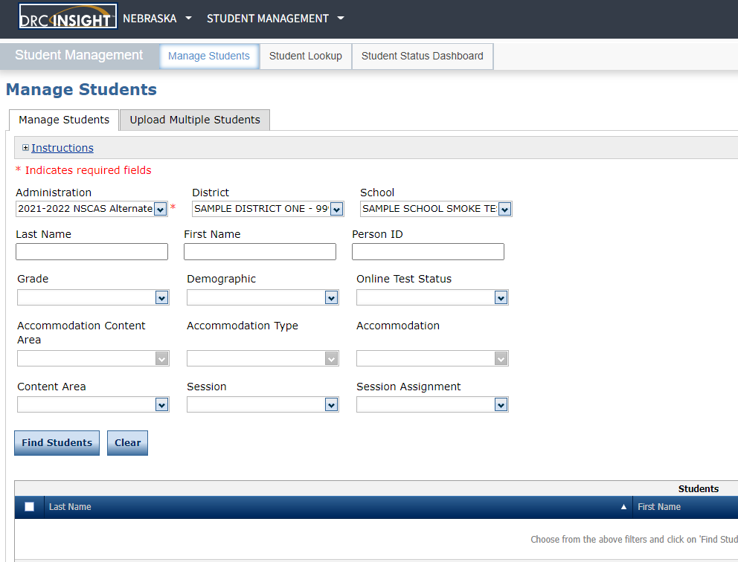
DRC INSIGHT Portal Student Management DEMO

Slide 28
Test Materials for Proctoring NSCAS Alternate
NSCAS Alternate Administration Manual(s)
Online Test Ticket(s) printed from the DRC INSIGHT Portal Test Management application
Student Test Booklet(s) for students requiring paper/pencil administration
Administration Manuals and Student Test Booklets are form specific. Each district was pre-assigned either Form A or Form B.
BE SURE THE FORM ON THE MANUAL AND TEST BOOKLET MATCHES THE FORM INDICATED ON THE ONLINE TEST TICKET.

Slide 29
DRC INSIGHT Portal→ General Information→ Documents
To print Administration Manuals and Student Test Booklets…
Expand the “My Applications” dropdown at the top of the screen
Select the “General Information” application
Select the “Documents” tab
Leave “Document Type” filter set to “(All)” and select the “Show Documents” button
Use the “Open PDF” or “Save PDF” button in the “Action” column next to the document you want to print, then print the documents needed for test administration

Slide 30
Test Materials for Proctoring NSCAS Alternate
All NSCAS Alternate Administration Manuals and Student Test Booklets contain secure test content and must not be downloaded electronically and stored locally
Printed NSCAS Alternate Administration Manuals, Student Test Booklets, and online Test Tickets must be stored securely until testing is finished
Do not send any materials to DRC.
Districts are responsible for secure destruction of printed NSCAS Alternate materials.

Slide 31
DRC INSIGHT Portal Test Management Application
The DRC INSIGHT Portal Test Management application is the point of access for these online test administration activities
Printing Online Test Tickets
Adding New Students to Test Sessions
Monitoring Testing Status
** NOTE - The DRC INSIGHT Test Engine is where student’s login using the Test Tickets.

Slide 32
DRC INSIGHT Portal→ Test Management→ Manage Test Sessions
To print Online Test Tickets for a Test Session
Expand the “My Applications” dropdown at the top of the screen
Select the “Test Management” application under “TEST PREPARATION”
Select the “Manage Test Sessions” tab
Select the District and School for which you want to print tickets and select the “Show Sessions” button
Use the “Print All Tickets” button in the “Action” column to print the Student Test Roster and Tickets for all students assigned to that test session
It is best practice to add new students to test sessions before printing Online Test Tickets.

Slide 33
DRC INSIGHT Portal→ Test Management→ Adding New Students
To add new students to an existing Test Session
Expand the “My Applications” dropdown at the top of the screen
Select the “Test Management” application under “TEST PREPARATION”
Select the “Manage Test Sessions” tab
Select the District and School for which you want to add a student and select the “Show Sessions” button
Select the “View/Edit” button in the “Action” column to open the “Edit Test Session” window
Select the “New Student” button
Complete the required “Student Detail” information and, if applicable, “Accommodations” then select the “Save” button to add the student directly to the test session

Slide 34
DRC INSIGHT Portal→ Test Management→ Adding New Students
To add new students when a Test Session has not been created for a student’s grade
Expand the “My Applications” dropdown at the top of the screen
Select the “Student Management” application under “PARTICIPANT PREPARATION”
Select the “Manage Students” tab
Select the “Upload Multiple Students” tab
Select the District (required) and School (optional) for which you want to add students
Produce a file containing required student information according to the File Layout and Sample File
Select “Browse…” to find the file, then select the “Upload” button to load the file

Slide 35
DRC INSIGHT Portal→ Test Management→ Adding New Students
The system will verify student information meets requirements outlined in the File Layout; check back after a few minutes to see if the file was accepted or generated an error report
If an error report was generated, correct the errors shown in the report and repeat the upload process until the file is free of errors
Students added using this process will be added directly to new test sessions for the form assigned to the district; Student Detail, Accommodations, and Testing Codes can then be edited
This is the recommended process for adding students when a new test session is needed. Districts can also add students and test sessions manually following the process detailed in the DRC INSIGHT Portal User Guide.

Slide 36
DRC INSIGHT Portal→ Test Management→ Testing Status
To monitor testing status
Expand the “My Applications” dropdown at the top of the screen
Select the “Test Management” application under “TEST PREPARATION”
Select the “Manage Test Sessions” tab
Select the District and School for which you want to check status and select the “Show Sessions” button
Use the “Edit/Print Ticket Status” button in the “Action” column to view the “Testing Status” window

Slide 37
DRC INSIGHT Portal→ Test Management→ Testing Status
Students’ tests will be assigned one of three statuses
Not Started—the online Test Ticket has not been used
In Progress—the online Test Ticket was used to log into the test, but the test has not been ended; only the Started date/time is populated
Completed—the test has been ended; Started and Completed date/times are both populated
NSCAS Alternate Test Tickets do not “lock” after periods of inactivity or overnight to facilitate flexible scheduling
Tests in a Completed status are locked. Contact DRC Nebraska Customer Service at (866)342-6280 if there is a need to unlock a completed test.

Slide 38
2020 NSCAS Alternate Reports
DURING TESTING WINDOW—View Online Results provides preliminary raw scores for operational items for tests in Completed status
JUNE (TBD)—Districts provided access to preliminary reports and data file in the DRC INSIGHT Portal Report Delivery application
August (TBD)—Districts provided access to final reports and data file in the DRC INSIGHT Portal Report Delivery application
Results are not released to the districts until public release of reports. NDE will provide information on the public release of 2022 NSCAS results as it becomes available.

Slide 39
Questions
& Answers
NSCAS Alternate Customer Service
Call Toll Free - (866) 342-6280
necustomerservice@datarecognitioncorp.com
8:00 A.M. – 5:00 P.M. CST
7:00 A.M. – 5:00 P.M. CST (March 21 – May 13, 2022)

