Slide 1
Stay Connected
Community Schools
10/14/21

Slide 2
Definition
A community schools process is one that works to improve coordination, integration, accessibility, and effectiveness of services for children and families, particularly for children attending high-poverty schools, including high-poverty rural schools.
This will take time, it is an ongoing process...
Notes:
Mariella
A lot of schools already doing the work
Every kid has the access to the opportunities

Slide 3
It’s a process, not an ending...
Notes:
Joe - It is a process, tends to work best with a dedicated person
If it is a part of a job for 10 people it wont be as coordinated and systematic as we need.

Slide 4
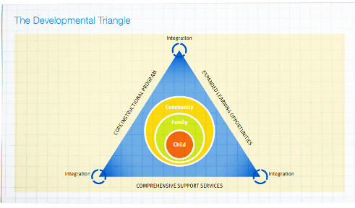
Conditions for Success
•Shared Leadership/Governance
•The Whole Child Perspective
•Responsiveness to needs
•Partnerships
•Integration
•High Quality Programs and Services
•Family Engagement
•Evaluation
•Sustainability
Notes:
Mariella - MTSS Framework

Slide 5
Examples and Resources
Lincoln Public Schools – CLCs
In Some Cities, Closing the Achievement Gaps Is Not for Schools to Fix Alone
City Connects
Community Schools Playbook
Learning Policy Institute Resources
SUN Community Schools
FAQs
Individualized Student Success Planning - HGSE
Notes:
Joe

Slide 6
Examples and Resources Cont...
North Dakota Full-Service Community Schools Consortium
Scaling Up School and Community Partnerships: The Community School Strategy
Four Pillars of Community Schools
Notes:
Joe/Mariella

Slide 7
Moving Forward
Establish a Leadership Team
Identify school-community programming goals
Integrated Student Supports
Extended Learning Time & Opportunities
Active Family & Community Engagement
Map existing resources
Analyze what’s working and what needs strengthening & identify gaps
Oversee the process of implementing
Develop a strategic action plan (who, what, and when of the steps for moving forward)
Re-engage partners or start new partnerships
Notes:
Mariella
Identify a need from the Need Assessment
Prioritize the need and set a goal
Align goal to vision and mission
Find partners

Slide 9
Where do community organizations fit?
What does the school need? Specifically?
Academic Supports?
Social/Emotional Supports?
Financial Supports?
What can the organization bring to the table? Specifically?
What does a continued partnership look like?
Or is this a one time effort?
What is the best entry point?
School based?
Principal/AP
District?
PTA/Person?
Notes:
Joe

Slide 10
Question and Answer
Open floor for question/answer and discussion of community schools approach
Notes:
Mariella/Joe

