Slide 1
NSCAS ACT Workshop
Spring Testing 2022

Slide 2
NSCAS ACT SPRING 2022 Test Windows
Test Window 1
Standard Administration (Paper): March 22, 2022
Accommodations Administration (Paper): March 22-25 & March 28-31 & April 1
Standard & ACT-Authorized Accommodations (Online): March 22-24 & March 29-31
Test Window 2
Standard Administration (Paper): April 5, 2022
Accommodations Administration (Paper): April 5-8 & April 11-15
Standard & ACT-Authorized Accommodations (Online): April 5-7 & April 12-14
Test Window 3 MAKEUP ONLY
Standard Administration (Paper): April 19, 2022
Accommodations Administration (Paper): April 19-22 & April 25-29
Standard & ACT-Authorized Accommodations (Online): April 19-21 & April 26-28
Please remember that you will have a choice between the first two assessment windows.
Any subsequent window could be used for makeup testing. The third window (April 19) is for makeup only.
Notes:
What are the test dates for the ACT in the spring?

Slide 3
New This Cycle:
Accommodations Terminology
Late Consideration is now called Qualified Exceptions to the Deadline
Test Date Terminology
Manage Participation is now called Test Date Selection
Notes:
What is new for Spring 2022?

Slide 4
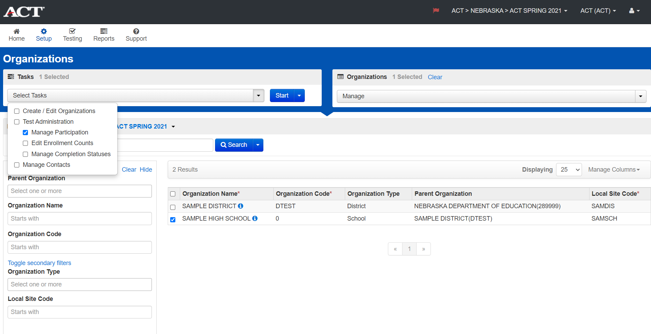
Selecting Test Window
Step 2: Configuration
Notes:
How do I select my test date? The window to select test dates will open on November 1st. Under the Setup Icon, select Organizations, select your high school and then Manage Participation under Select Tasks. This will take you to a page with the test window choices and paper and online choices. If you are using online for makeup tests only, please be sure to select the paper test date you will test most of your students. The instructions for this can also be found under Step 2 of the ACT sponsored website- Configuration.

Slide 5
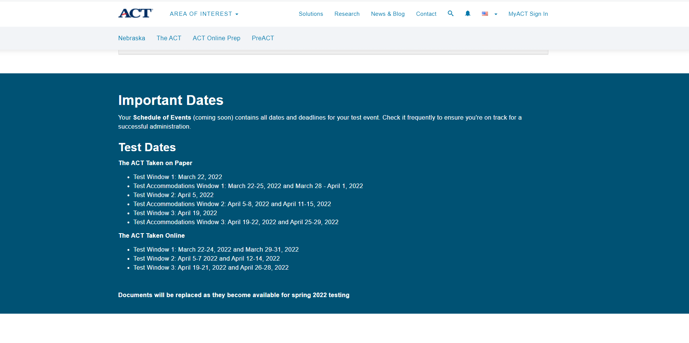
Schedule of Events ACT Sponsored Website
Notes:
The schedule of events will be available on the ACT sponsored website, coming soon. Your schedule of events will contain information about all the key tasks and milestones, as well as links to register for ACT’s standard administration and accommodations training sessions.
NDE will notify DACs when the Schedule of Events is posted on the website.

Slide 6
ACT ACCOMMODATIONS and EL SUPPORTS

Slide 7
New Accommodations Policy
ACT’s Accommodations Team is applying the policy during their reviews and ensuring that students with IEPs or 504 Plans that list the requested accommodations are approved
TAA continues to ask for additional documentation, like educational evaluations, that are not necessary for approval if the student has an IEP or 504 Plan
TACs must upload documents under these categories in order to submit in TAA
Notes:
What is the new Accommodation policy? As was announced in July, students who already receive accommodations at their school under the Individuals with Disabilities Education Act (IDEA) and Section 504 of the Rehabilitation Act will automatically be eligible to receive the allowable testing accommodations when they register for the ACT with accommodations. ACT believes this change will ensure requests for accommodations are reviewed and approved in a more efficient manner when compared with previous administration cycles. Please note that this back end policy change will not impact what testing staff are required to do to submit requests for examinees in TAA. It is still vital that testing staff submit the appropriate documentation in ACT’s TAA system prior to the deadline dates which will be reflected on your schedule of events.
Regardless of the new policy, Super important that districts start the accomodations process as soon as possible.

Slide 8
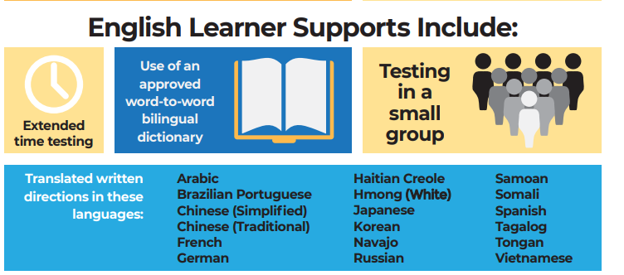
Accommodations
What accommodations are allowed? What documents do I need to have? Quick Start Guide for Requesting Accommodations
Are there accommodations for EL students?
Notes:
What accommodations are allowed? What documents do I need to have? The most common accommodation requested is extended time, however there are many other options. Use this link to see what and how to request accommodations as well as seeing what documents you will need to include in your request.
Are there accommodations for EL students? There are supports available for EL students, read from slide. Please note that EL supports may be requested on their own or in conjunction with any ACT authorized accommodation.

Slide 9
Accommodations
Who can request an accommodation?
Can more than one person request accommodations?
What is the difference between Reconsideration and Late Consideration?
Who requests accommodations for the students in external programs?
What is the deadline for spring 2022 accommodations? Friday, January 21, 2022.
Notes:
Who can request an accommodation? Any school member of staff can have the Test Accommodation Coordinator access. It is common for the ACT test coordinator or SPED educator at the high school to have this position.
Can more than one person request accommodations? Everyone who has access to the TAA is assigned the role of Test Accommodations Coordinator (TAC). Organizations- schools or districts may have more than one TAC. ACT recommends that you have at least two TACs, so you have a back-up user if needed. Note: There used to be a Test Coordinator and TAC role in TAA, now everyone is considered a TAC.
What is the difference between Reconsideration and Late Consideration? Reconsiderations are for requesting ACT to reconsider accommodations that were not initially approved. IMPORTANT: Requests for reconsiderations must be submitted prior to reconsideration deadline. Late Consideration is now called Qualified Exception to the Deadline. These requests are for students who may have moved into the district after the initial accommodation deadline or has received a new or updated accommodation after the deadline. Reconsideration deadline is Jan. 28, 2022.
Who requests the accommodations for the students in external programs? This is a decision made between the home school and the program. Normally, we suggest the accommodation be requested by the entity that has the IEP or 504.
What is the deadline for spring accommodations? The deadline is January 21, 2022. It is recommended to request accommodations before the end of the semester. To give you opportunities to request a reconsideration if needed.

Slide 10
Success.ACT.org

Slide 11
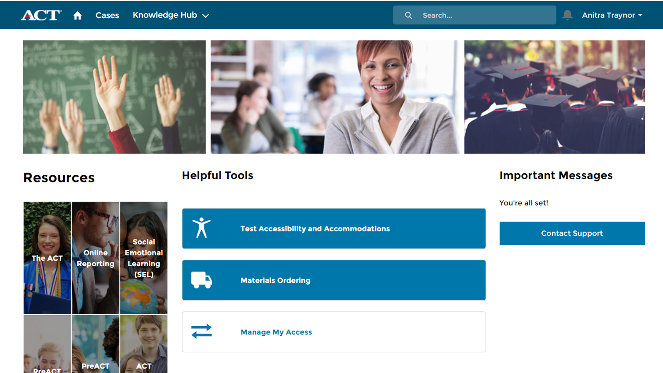
www.success.act.org
Notes:
What is Success.ACT.org? Success.Act.org is an [click] website which is used to access ACT’s online reporting system and TAA. This allows for one interface, username and password to access both online reports and TAA.
The test accessibility and accommodations system or TAA is the site used by to submit requests for ACT authorized accommodations and supports for examinees.
The online reports portal is dynamic, interactive reporting tool. It allows users to create custom reports which work best for their institution to interpret and use the data to best serve their students.
To create an account, please register at www.success.act.org.

Slide 12
Trusted Agent
The trusted agent is a role ACT developed for your district to protect personally identifiable information and control who is granted access to the online reporting system and TAA.
They can be people such as principals, counselors, or anyone that has authority to view, access, or utilize ACT data, as aligned with your specific district and school policies regarding access to individual or aggregate report data. The Trusted Agent role assumes the responsibility of granting, terminating, and managing user access within the district. They can also view and export data and reports for districts and schools in their jurisdiction.
Notes:
What is a trusted agent? Who can be a trusted agent? Read slide. Note: Consider having more than one trusted agent for a backup. Superintendents can receive the trusted agent code to grant this access. Contact Iris for more information.

Slide 13
PearsonAccess^{next}

Slide 14
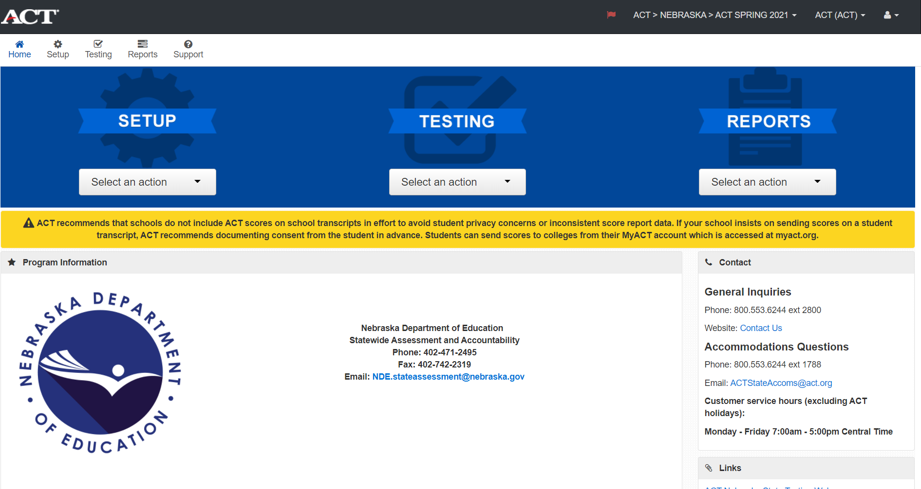
Notes:
What can I find in PearsonAccess next? PANext or PAN are abbreviations of the PearsonAccess next system. This system will be the place you notify ACT when and how you will test this spring. This is also where you will go to verify that the list of students associated with your organization is accurate. If you're planning to test online this is where you will go to create online sessions.
How do I set up an account? If you don’t have an account in PA Next, please contact Iris and provide your name, email address and if you are the DAC or test coordinator.
When will students be available in PA Next? NDE will provide ACT the student list in January and the list for you to review will be available mid January. Schools are not required to submit the student list to ACT but need to update their information in ADVISER for NDE to provide the most up to date information to ACT.
What about our students in External Programs? Students will be moved to the program student list, please contact programs to make sure they are planning on providing the test and how to assist the program with any accommodations or other information needed. Iris and Maggie Sis work with the programs to be sure they have what they need as well. Communication is the key to making sure ALL students can test.

Slide 15
ACT Online Testing

Slide 16
Online Testing
Options for Online Testing
Paper for most students and Online for makeup testing
Split the student list in half, half Paper and half Online
All students test Online
Notes:
What options are there for online testing?

Slide 17
Online Testing
PROS
More dates to test – 18 dates online vs. 3 dates for paper/pencil
Reduce materials to handle
Earlier score availability
Ease of administration
Reduced Misadministration risk
Writing Prompt
CONS
Pretest Setup
Infrastructure and devices
Notes:
Why should our school consider Online Testing?

Slide 18
Online Testing
From Jason Craig at South Sioux High School. They have been testing all students online since 2017.
We begin requesting accommodations for students on 504"s, IEP's and English Language Learners immediately when the window opens to do so.
Our tech department is fantastic! They make sure we have all things "technology" ready for the morning of the test. We have chrome books fully charged with test nav open in each testing room. Students simply log in with the credentials given to them with their authorization tickets. We strategically have test rooms near an internet access point. Also, the entire tech team is in the high school outside of the testing rooms. The tech department makes sure we have fully charged chrome books for the students who test over multiple days.
We have the third-year cohort students watch a video during homeroom prior to the testing regarding test nav. This ensures the students are able to navigate Test Nav and decrease any anxiety a student may have due to taking the test online rather than paper pencil. The video is short, but highlights what students need to know.
We train each staff member on testing protocols and how to navigate Pearson Access Next. The Monday before the test, all staff members check in with me to ensure they are able to log into Pearson Access Next and answer any last-minute questions.
Notes:
What are some best practices for testing Online?
Jason graciously allowed me to share these tips.

Slide 19
State Use Questions

Slide 20
State Use Questions
Has the school received parental consent that allows ACT to share scores and information with third parties?
• Default will be “blank”.
• The student is not yet 18 years of age, and the school has NOT received parental consent to release scores or information to third parties.
Notes:
What are the state use questions?
Who are to answer these questions?

Slide 21
State Use Questions cont.
2. If this student did not test, select the reason below:
Alternate Assessment (ALT)
COVID-19 Waiver (COV)
Emergency Medical Waiver (EMW)
Exempt (EXP)
Full Time Equivalency (FTE)
Not Currently Enrolled (NCE)
Other (OTH)
Parental Refusal (PAR)
Removed (RMV)
Student Refusal (STR)
District Unable to Test (UTT)
Waived Score Replacement (WSR)

Slide 22
State Use Questions cont.
3. If the student was dismissed for prohibited behavior select the reason below:
Walked out with test incomplete or refused to complete test
Worked ahead/behind
Looked at another examinee’s answer document
Possessed phone, alarm or other device that sounded
Used unauthorized calculator or unapproved tools
Other

Slide 23
MyACT

Slide 24
MyACT- Preparing Examinees
Students Complete Non-Test Information in MyACT
Deadline is two days after examinees complete testing
30 minutes (approximately)
Each examinee will need:
Personalized copy of the Non-Test Instructions for Students
One copy of the Taking the ACT booklet
Examinees will answer questions at MyACT.org
Notes:
Do students have to create accounts in MyACT? All examinees will complete demographic information and college reporting choices in MyACT.
When will they be able to set up accounts? Examinees may complete this prior to testing or they will have up until 2 days after testing to finish the non-test information. Schools will receive individualized instructions approximately 4 weeks before the test date.
The non-test session will take about 30 minutes and you may schedule either in-school sessions for all students or ask them to complete it individually on their own time.
Each examinee will need their own personalized copy of the MyACT Non-Test Instructions for Students and a copy of the Taking the ACT State and District Testing guide. These can be created with the blank template on your ACT-hosted webpage if students were added to PearsonAccess Next after the SDU deadline.
Complete instructions are available on the ACT-hosted testing webpage in the Preparation stage. Schools can also access the MyACT User Guide for Test Coordinators on their ACT-hosted website. This guide provides information regarding the benefits for creating a MyACT account and providing their non-test information as well as tips and troubleshooting.

Slide 25
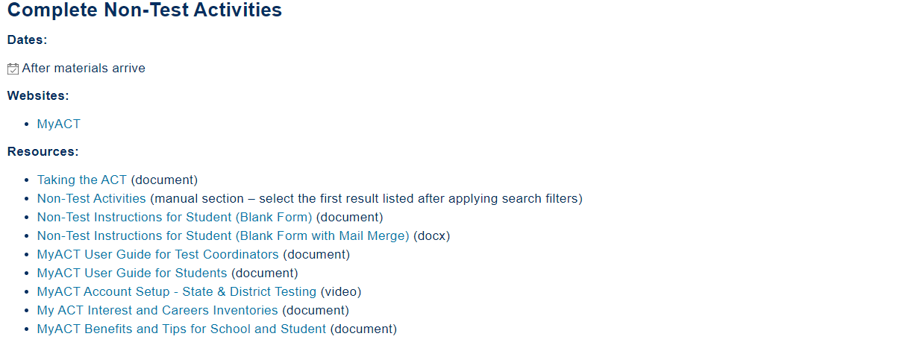
MyACT- Preparing Examinees
Notes:
Do I have to wait for the individualized instructions to have students create MyACT accounts?
Are there instructions for the MyACT?
What if students don’t have access to the internet? Contact Iris for assistance.

Slide 26
Parental Consent Requests

Slide 27
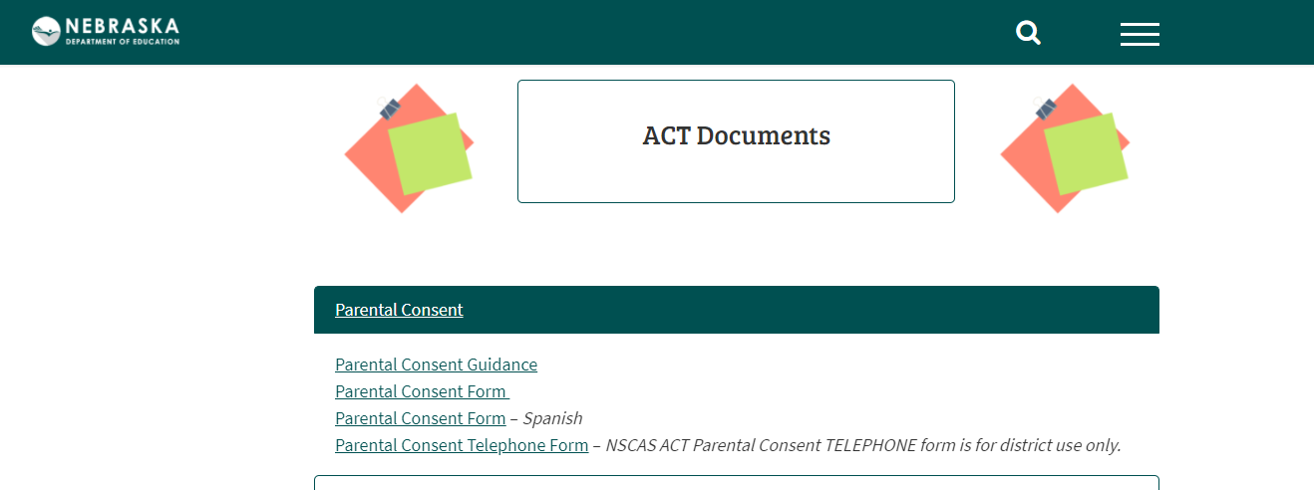
Parental Consent Forms education.ne.gov/assessment/act/
Notes:
JEREMY
Does NDE still want schools to obtain Parental Consent?
Do we send these forms to NDE or ACT?
Where is the form?

Slide 28
Score Replacement Requests

Slide 29
Score Report Replacements
ACT Score Replacement form can be found on the NDE website.
https://cdn.education.ne.gov/wp-content/uploads/2021/01/ACT-Score-Replacement-Form-2020-2021.docx
This score report can be used as a replacement for the NSCAS ACT Test and is intended for students with high scores that do not want to test again and should be used sparingly. The replacement scores must meet the scores for all three content areas in the table below to qualify for requests.
Notes:
JEREMY

Slide 30
Prohibited Behaviors and Misadministrations

Slide 31
Prohibited Behaviors
Common prohibited behaviors-
Students working ahead or behind
Cell phone usage or other electronics that disrupt test sessions
How to Avoid them-
Consider discussing the consequences of these actions
Responsibility of the Test Coordinators and Proctors
Notes:
JEREMY
What are common prohibited behaviors and how do we avoid them?
2017-18 report had 42
2018-19 report had 76
2020-21 report has 94
Deterrent

Slide 32
PreACT

Slide 33
PreACT
Fall testing window is from October 11- November 24
Spring ordering will be available in February 2022
Spring testing window is from March 14-April 29, 2022
Be sure to return all tests that the school is wanting to be scored in one batch to obtain one score report.
District and school reports will be available in the Success Online Reporting system this winter.
Printed reports will be sent to districts and schools after the window is closed.
Notes:
What are test dates and what is new about the PreACT?

Slide 34
ACT Online Prep

Slide 35
ACT Online Prep (AOP)
ACT Online Prep is available to districts that chose this option now.
Students can access the accounts now and once they log in, they have 365 days to use the account.
Where do we get extra seats or licenses for AOP? Contact Iris for assistance.
ACT Online Prep Success Training Toolkit
Notes:
When can students get their accounts?
How long can they use the accounts?
Where can I find out more on how to use AOP?

Slide 36
NSCAS ACT ISRs
What process will Nebraska use for NSCAS ACT ISRs?
Retain the same process as 2021
Provide students and/or families form letter following the spring 2022 NSCAS ACT Administration
NSCAS ACT ISR 2021 Additional Guidance – Posted 3.2.21
NSCAS ACT Family Letter – Posted 3.1.21 (Give to students after testing)
NSCAS ACT Family Letter – Spanish – Posted 3.5.21 (Give to students after testing)
Notes:
JEREMY

Slide 37
ACT Fee Waivers
In 2020-2021 Nebraska schools only ordered 4,007 fee waivers for juniors and seniors.
Of those 4,000 fee waivers, only 48% were used.
Nebraska has over 20,000 students in 11th and 12th grade that would qualify for the free National test.
Four free tests with or without the writing test, are available for each qualified student, The Official ACT® Self-Paced Course, Powered by Kaplan® for 6 months, score reports to six college choices and unlimited score reports after registration!
Request a Waiver or Deferral of College Admission Applications Fee.
Order Fee Waivers at www.readiness.act.org.

Slide 38
Contact List
Iris Owens- Onsite Liaison
iris.a.owens@act.org or call 531-207-9019.
ACT State Customer Service
800.553.6244 x 2800
ACT Accommodations
800.553.6244 x 1788

Slide 39
NSCAS ACT Test Windows 2023
Test Window 1
Standard Administration (Paper): March 21, 2023
Accommodations Administration (Paper): March 21-24 & March 27-31, 2023
Standard & ACT-Authorized Accommodations (Online): March 21-23 & March 28-30, 2023
Test Window 2
Standard Administration (Paper): April 4, 2023
Accommodations Administration (Paper): April 4-7 & April 10-14, 2023
Standard & ACT-Authorized Accommodations (Online): April 4-6 & April 11-13, 2023
Test Window 3 MAKEUP ONLY
Standard Administration (Paper): April 18, 2023
Accommodations Administration (Paper): April 18-21 & April 24-28, 2023
Standard & ACT-Authorized Accommodations (Online): April 18-20 & April 25-27, 2023 Please remember that you will have a choice between the first two assessment windows. Any subsequent window could be used for makeup testing. The third window (April 19) is for makeup only.
Notes:
Please note the color is different in this slide to remind you these are the 2023 test dates.

Slide 40
Questions?

