Slide 1

2021 Skilled and Technical Sciences Fall In-service
We are the Builders of the Future Workforce

Slide 2
2021 STS Workshop Agenda
NCE and STS Updates
Course Standards and Programs of Study
Industry Representatives
SkillsUSA Update
Group Share
Industry Tour
AdvanceCTE, 2019
Notes:
Big picture, Perkins V builds upon Perkins IV.

Slide 3
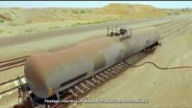
This Really Sucks!

Slide 4
Safety Instructions
Restrooms
Fire
Tornado
CPR
Emergency Caller
Active Shooter
Please quiet cell phones

Slide 5
Whose Here?
Introduce yourself
Name
School
What you teach
How long you have been teaching
Favorite activity away from teaching
AdvanceCTE, 2019
Notes:
Big picture, Perkins V builds upon Perkins IV.

Slide 6
Websites of Interest
https://www.education.ne.gov/STS
http://www.skillsusanebraska.org
https://www.education.ne.gov/NCE
http://www.careersafeonline.com/
AdvanceCTE, 2019
Notes:
Big picture, Perkins V builds upon Perkins IV.

Slide 7
ESSER Funds
ESSER funds description
i. The ESSER III funding enables Nebraska school districts to promote safe school operations and equity-driven, sustainable, evidence-based programs to serve students – especially those who are the furthest from opportunity – and to continue to strengthen teaching and learning.
ii. NDE ESSER III Website: https://www.education.ne.gov/esser/esser-iii-arp/
iii. NDE ESSER Planning Guidance: https://cdn.education.ne.gov/wcontent/uploads/2021/06/NDE-ESSER-III-Planning-Guidance_6.22.21.pdf
Advocate for CTE to be included in the implementation of the plan:
i. Review the district’s plan – available on the district’s website.
ii. Identify area(s) of alignment between CTE programming and plan objectives.
iii. Share a plan with a budget/estimated cost (consider the sustainability of the investment)
**If it’s approvable through Perkins, it’s approvable through ESSER

Slide 8
ESSER Funds (continued)
If you want more information…
The ESSER III funding enables Nebraska school districts to promote safe school operations and equity-driven, sustainable, evidence-based programs to serve students – especially those who are the furthest from opportunity – and to continue to strengthen teaching and learning:
consistent with the Centers for Disease Control and Prevention’s (CDC) Operational Strategy for K-12 Schools to the greatest extent practicable; address the many impacts of COVID-19 on students, including from interrupted instruction;
implement strategies to meet students’ social, emotional, mental health, and academic needs;
offer crucial summer, afterschool, and other extended learning and enrichment programs;
support early childhood education;
invest in staff capacity; and
avoid devastating layoffs at this critical moment, ensuring that all students have access to teachers; counselors, and other school personnel to support their needs

Slide 9
Firstar Fiber, Inc.
Director of Sales and Marketing
Danielle Easdale
Inbound Sales Manager
Jeff Heck

Slide 10
VIRTUAL NEBRASKA ENERGY WORKFORCE CONSORTIUM
OCT. 18-22 • 9:30-11 AM / 1-2:30 PM CDT
CAREERS BEING SHOWCASED WILL INCLUDE:
Oct. 18 • Corporate Services: Customer Service, Auditing, SkillsUSA
Oct. 19 • IT & Computers: Graphic Design, Cyber Security, Utilities Technology, Bots
Oct. 21 • Plant and Technicians: Lineman/Gas Technicians, Drones, Water Filtration
Oct. 22 • Engineering, Alternative Energy & Environmental: Engineers, Wind Energy, Chemistry
TO PARTICIPATE IN OUR VIRTUAL CAREER DAYS, REGISTER ONLINE AT: BIT.LY/2WExI50.
FOR QUESTIONS CONTACT MICHELLE HOMME AT: MHOMME@OPPD.COM OR 402-490-2235.

Slide 11
Nebraska Association of Skilled and Technical Sciences Educators (NASTSE)
NASTSE Membership
Become a member at NebraskaSTSteachers.org
Member benefits:
Professional development during the annual conference and other workshops/seminars
Networking with like-minded professionals
Awards and recognition for exemplary programs and individuals
Provide leadership for pre-service and new teachers
Promote our organization and the field of Skilled and Technical Sciences
Advance technological literacy for ALL

Slide 12
For NASTSE Panhandle and Elkhorn District
The NASTSE organization currently has two board positions open:
Panhandle Trustee and Elkhorn Trustee. We are looking for candidates who
are willing to commit to a two year term. The responsibilities of a district
trustee include hosting an annual social for teachers in your district and
attending quarterly board meetings to assist in the planning of NCE
conference events related to Skilled and Technical Sciences. If interested,
please email Matt Bova at bova.matthew@westside66.net

Slide 13
NCE/NASTSE Conference Presenters
The Nebraska Career Education Conference is a great way for Skilled and Technical Sciences teachers to network and see the great things educators across our state are doing. Please consider presenting a unit of study that you feel is worth sharing with other teachers in our state. Conference presenters receive a $100 stipend for presenting a 45-minute session. If interested, please email the Department of Education Liaison, Tony Glenn at tony.glenn@nebraska.gov. RFP’s will be coming out later this fall.

Slide 14
Are You Promoting You and Your Program?
NASTSE Teacher of the Year
NASTSE High School Program of the Year
NASTSE Middle School Program of the Year
NCE STS Teacher of the Year
NCE CTE Program of the Year
Partnerships, Administrators, Rich Katt Awards need nominees.

Slide 15
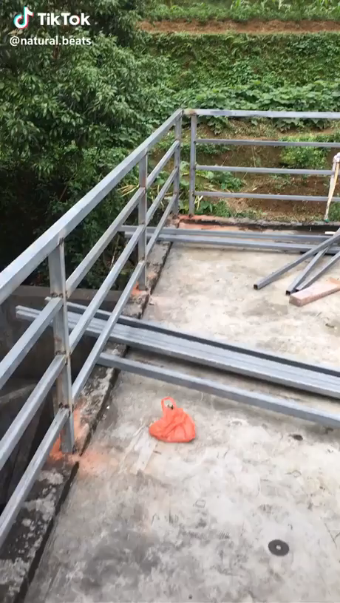
This guy needs a break!

Slide 16
NEW Course Standards and Programs of Study
Writing was done in July.
In the process of cleaning them up and formatting.
Hopefully they go the commissioner and deputy commissioner for approval yet this fall.
Once approved, they will be ready for the 2022-2023 school year.
Current “Legacy Standards” are used for 2021-2022 school year.

Slide 17
Rock Star Course Standard Writers
Aaron Jones – Waverly
Amanda Woodward – Lincoln North Star
Brandon Thoene – Ralston
Don Seehusen – Schuyler
Jessie Zweep – Louisville
Nathan Smith – Cross County
Randy Stribley – Papillion-LaVista South
Scott Gibson – Millard West
Will Winchester - Hershey

Slide 18
Skilled and Technical Sciences
2021 Program of Study Change Summary (DRAFT)
Skilled and Technical Sciences
Legacy Program of Study | Revised Program of Study | Primary Updates | Rationale
Architectural Design | Architectural Design | Work-based Learning added | To create opportunities for additional student learning
Construction | Construction | Work-based Learning added Changed Electricity to Residential Electricity | To create opportunities for additional student learning The name change better reflects the course content
PLTW | N/A | Included in Engineering | To eliminate a separate Program of Study
Engineering | Engineering | Work-based Learning added | To create opportunities for additional student learning
Energy | Energy | Work-based Learning added | To create opportunities for additional student learning
Manufacturing | Manufacturing | Work-based Learning added | To create opportunities for additional student learning
Welding | Welding | Work-based Learning added | To create opportunities for additional student learning
TDL – Technician | TDL – Technician | Added Power Equipment Work-based Learning added | This course is for a small engines semester course. Course code to be added. To create opportunities for additional student learning To create opportunities for additional student learning
TDL – Supply Chain | TDL – Supply Chain | Work-based Learning added

Slide 19
2021 Revised Programs of Study (DRAFT)
Skilled and Technical Sciences
Program of Study Name | Introductory | Intermediate | Capstone | Expanded Learning Opportunity
Architectural Design | Introduction to STS | Architectural Design 1, OR Housing and Interior Design (FCS) | Architectural Design 2 | Architecture & Construction WBL Experience
Construction | Introduction to STS, OR Residential Electricity | Construction Trades 1, OR Structural Systems (AG) | Construction Trades 2 | Architecture & Construction WBL Experience
Engineering | Introduction to STS, OR Engineering Design and Systems Thinking, Or PLTW Principles of Engineering, OR PLTW Intro to Engineering Design | Engineering Problem Solving, OR Robotics, OR PLTW Aerospace Engineering, OR PLTW Civil Engineering and Architecture, OR PLTW Computer Integrated Manufacturing, OR PLTW Digital Electronics | Systems Engineering and Project Management, OR Advanced Robotics, OR PLTW Engineering Design and Development | Energy & Engineering WBL Experience

Slide 20
2021 Revised Programs of Study (continued) (DRAFT)
Energy | Fundamentals of Energy | Sustainable Energy | Physics and Mathematics of Energy | Energy & Engineering WBL Experience
Manufacturing | Introduction to STS, OR Drafting and Design | Manufacturing Processes - Woods, OR Manufacturing Processes - Metals, OR Manufacturing Processes - Plastics OR Introduction to Electronics | Manufacturing Production - Woods, OR Manufacturing Production - Metals, OR Manufacturing Production - Plastics, OR Introduction to Mechatronics, OR Advanced Electronics or Manufacturing WBL Experience | Advanced Manufacturing-Woods or Advanced Manufacturing-Metals or Advanced Manufacturing-Plastics
TDL- Technician | Introduction to Skilled and Technical Sciences -OR- *Power Equipment -OR- Power and Technology (AG) | Transportation 1 | Transportation 2, OR Collision repair | Transportation 3 or Transportation, Distribution , and Logistics WBL Experience
TDL- Supply Chain | Introduction to TDL | Distribution and Logistics | Business Logistics | Transportation, Distribution , and Logistics WBL Experience

Slide 21
2021 Revised Programs of Study (continued) (DRAFT)
Welding | Introduction to Skilled and Technical Sciences | Welding 1 or Ag Welding | Welding 2 – OR – Metals and Fabrication (AG) (Equivalent to Welding 2) | Welding 3 or Manufacturing WBL Experience

Slide 22
Course and Program of Study Reporting
Fill out worksheet with YOUR Course Title, NDE Course Title and NDE COURSE CODE.
Identify the Programs of Study you provide.
Turn these into your Data Steward.

Slide 23



Slide 24

SkillsUSA is a Career Technical Student
Organization (ctso)
professional LEADERSHIP ORGANIZATION
BUILT FOR
STUDENTS
LED BY
STUDENTS
Notes:
SkillsUSA is a professional leadership organization that prepares students to thrive in skilled careers.
When we say PLO, we mean that it is built for students and led by students
Every chapter elects its own students to serve as president, treasurer, and work on committees and serve through community service
Focused on skilled careers—everything from healthcare to HVAC, construction to cosmetology
A chance to connect students with the careers of greatest opportunity
And give them everything they need to succeed

Slide 25
As a CTSO:
1) We offer students opportunities in Leadership
2) We allow them to Showcase their Skills through competition
**these are offered through the operation
of the local chapters and through our
Conferences

Slide 26

SkillsUSA is a
Partnership of
STUDENTS, Teachers and Industry
Notes:
SkillsUSA is a partnership of students teachers and industry making sure we have a skilled workforce today and in the future.

Slide 27
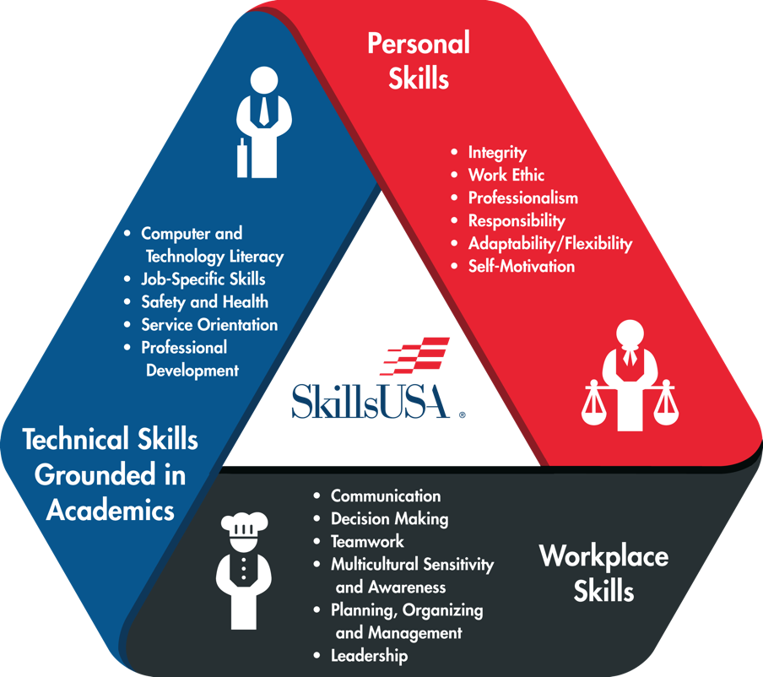
HOW SkillsUSA WORKS:
THE FRAMEWORK
IS THE KEY
Personal
Skills
Technical
Skills
The SkillsUSA Framework quantifies and measures how students fulfill the mission of the organization “to empower members to become world-class workers, leaders and responsible American citizens.”
Workplace
Skills
Notes:
The framework is the key – quantifies and measures the SkillsUSA mission
Three components:
Technical skills grounded in academics—
Defined in partnership with industry
Every year, industry partners make sure it’s up to date and connected to needs
When partners in building trades told us we needed to incorporate steel framing—
The very next year, if you went to our national competition, you’d see students competing in a design that required both wood and steel framing
Workplace skills—Communication, Decision-making, Teamwork, Leadership--
The skills you need in ANY career these days
Personal skills—The hardest to define and the easiest to overlook, but the most important to long-term success
Integrity, Work Ethic, Professionalism, Responsibility, Motivation
Employing the Framework creates a culture of work

Slide 28

WHY OUR MISSION MATTERS TODAY
BUSINESSES NEED SKILLED TALENT
STUDENTS NEED
Employability skills
Skilled trade
workers:
executives:
89%
#1
of all first-time
hires who lose their job do so
because of a lack of employability skills
hardest jobs to fill
Notes:
Let’s begin with why our mission matters today
The simples way to look at it is:
Businesses need skilled talent, while students need a better path to career success
[From the Talent Shortage Survey Results. 2011, by ManpowerGroup]
In the U.S., skilled trades workers are No. 1 among the Top Ten hardest jobs to fill. Technicians rank 4th, behind sales reps and nurses.
[From “The Boiling Point: The Skills Gap in U.S. Manufacturing,” 2011, by Deloitte Development LLC on behalf of The Manufacturing Institute. Based on surveys of a nationally representative sample of 1,123 U.S. manufacturing executives in July and August of 2011]
68% of the respondents identified a high skilled, flexible workforce as most important to meeting his or her company’s business success during the next 3-5 years.
Meanwhile, 17 percent of U.S. students are failing to graduate high school and
Among HS dropouts, 81 percent say they wanted more “real-world” learning opportunities—
That’s from TIME Magazine survey for a cover story in 2006
That’s why we need to get to the next level.

Slide 29

WHAT Employers really want in an Employee
Someone who shows up everyday
Someone who shows initiative
Someone with leadership skills
A Team Player
Basic technical and academic skills

Slide 30
Yearly Conferences
East/West Fall Leadership Conferences – Leadership and Career Awareness
Mid-America Leadership Conference
East/West Middle School Conference – Competition and Career Awareness, some leadership
State Leadership and Skills Conference – Leadership and Skills Competition

Slide 31
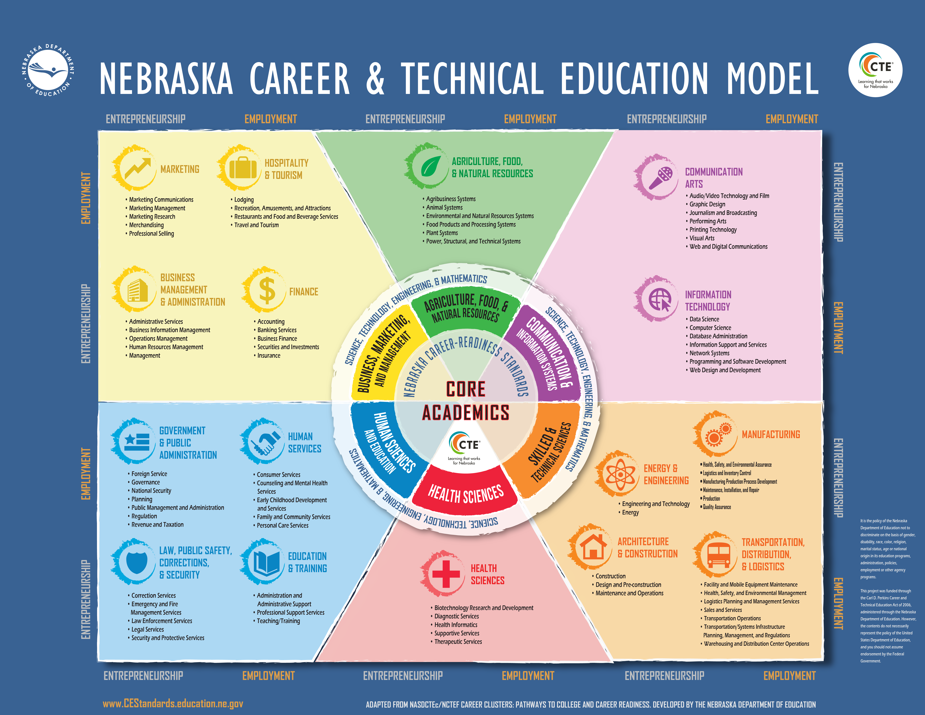
Notes:
This is our CTE model that is posted in almost every school in the state. Not for sure, but Tony has probably shared this with the council over the years. We have 6 Career Fields and with in those career fields we have 16 career clusters and under the clusters we have pathways to careers.

Slide 32




Skilled & Technical Sciences
Energy & Engineering
Engineering /Design Technology
Mobile Robotics
Urban Search & Rescue
Drone Technology
Mechatronics
Electronics Technology
Architecture & Construction
Architectural Drafting
TeamWorks
Masonry
Carpentry
Electrical Const. Wiring
HVACR
Plumbing
Sheet Metal
Industrial Motor Control
Manufacturing
Additive Manufacturing
Technical Drafting
Cabinetmaking
Automated Manufacturing
CNC Technician
CNC Milling
CNC Turning
Precision Machining
Welding.
Welding Fabrication
Welding Sculpture
.
Transportation, Distribution, & Logistics
Automotive Service
Automotive Refinishing
Collision Repair
Diesel Equipment
Mobile Electronics Installation
Motorcycle Service
Power Equipment Technology

Slide 33

Health Sciences
Nurse Assisting
Basic Health Care Skills
Medical Assisting
First Aid/CPR
Medical Math
Medical Terminology
Health Knowledge Bowl
EMT

Slide 34




Human Sciences & Education
Government & Public Administration
Human Services
Early Childhood Education
Customer Service
Law, Public Safety, Corrections, & Security
Criminal Justice
Crime Scene Investigation
Firefighting
Education & Training

Slide 35




Business, Marketing, and Management
Marketing
Advertising Design
Business Management & Administration
Customer Service
Job Interview
Finance
Hospitality & Tourism
Culinary Arts
Commercial Baking
Restaurant Service

Slide 36


Communications & Information Systems
Information Technology
Web Design
Computer Programming
Information Technology Services
Internetworking
Technical Computer Applications
Arts, A/V Technology, & Communications
TV/Video Production
Audio/Radio Production
Photography
Broadcast News Production
Digital Cinema Production
3-D Visualization and Animation

Slide 37

Agriculture, Food & Natural Resources
AFNR
Career Pathways Showcase
Drone Technology

Slide 38

2021-2022 Competition Theme

Slide 39
Thanks for Being Here !!
Any Questions ??
Notes:
Start with our core proposition—if you only remember one thing:
SkillsUSA is a unique opportunity to both strengthen the future of your program and open up great futures for America’s CTE students
A unique solution to two problems
Going to try to prove this to you over the course of the presentation

Slide 40
Happy Landings!
https://youtu.be/TFUWCf9yPO8

Slide 41

Thank You Claas Manufacturing!

