Slide 1
Welcome We are glad you are here!

Slide 2
4 Phases of Hazards, Threats, and Incidents Planning

Slide 3
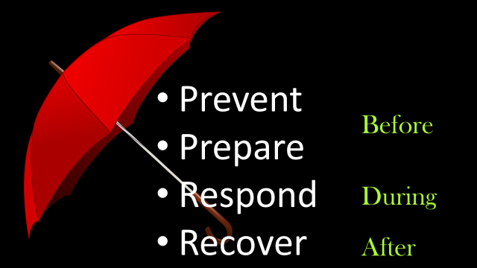

Slide 4
Recovery is the
phase of a hazard, threat, or incident.
longest

Slide 5
Prepare to Recover

Slide 6
Tactics are intel driven…

Slide 7
But the environment dictates the tactics.

Slide 8
School Safety….
Equipping & Preparing for the
“It won’t happen here.”

Slide 9
Safety & Security is the job of ALL staff
Yes, more than the administrators

Slide 10
Rather than facilities and gadgets
School safety is about what people do…..

Slide 11
EOP
If you buy it, it gathers dust. If you build it, it gathers fingerprints.
I Love You Guys Foundation

Slide 12
Prevention
happens
everyday.

Slide 13
Relationships… Matter!
students • staff • parents •
community partners

Slide 14
Common Language
Between students, staff, families and responders
Notes:
Just as with PBiS, common language is a strength of PFA. Administrators need to ensure that staff, students, and families understand Standard Response Protocol language.

Slide 15
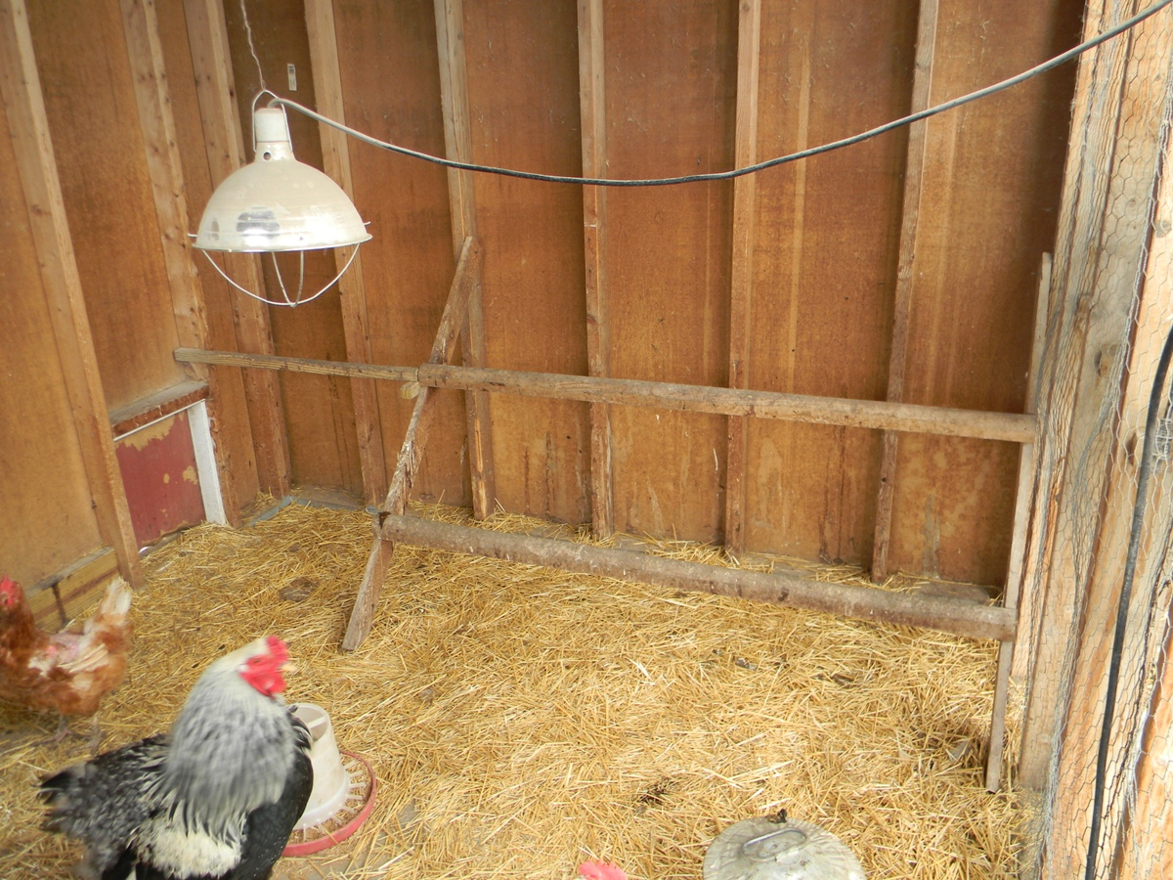
Continuity of Operations Plan (COOP)….it’s not about chickens!
Nor is it chicken feed!
Notes:
Explain what is a COOP…******
By a show of hands…in your reaction, how many of you watch the COOP video that we provided?
How does it differ from the EOP…..
They NEED BOTH…..not just one.

Slide 16
Human Detectors
are the best detectors

Slide 17
Why a reporting line is important…..
Teach Students, Staff, Families:
What to look for.....
What to listen for.....
Safety about you or someone else?
What in your gut tells you there is a concern?

Slide 18
What are you doing to prevent bullying?

Slide 19
Bullying has a major effect on student academic performance as well mental and physical health.

Slide 20
LGB youth experience bias-based bullying more frequently than heterosexual youth. 40% of LGB students considered suicide. (CDC, 2015)

Slide 21
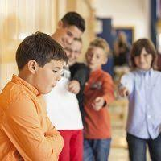
71% of school shooters reported they had been bullied.

Slide 22
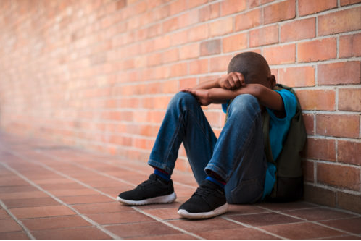
Are you caring for your vulnerable students?

Slide 23
Safety doesn’t happen by accident.

Slide 24
Crisis isn’t a
choice,
Response is…

Slide 25
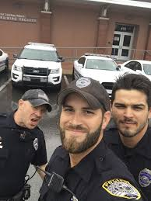
Cops own the crime….

Slide 26
Fire owns the flames…..

Slide 27
Paramedics own the patients…..

Slide 28
Schools own the students….

Slide 29
In an emergency…..
It takes cops, fire, paramedics, and schools to work together to handle an emergency.

Slide 30
Training and Drills Scheduled?

Slide 31
Are you ready to
ROK?

Slide 32
Recovery Starts
the moment the
crisis begins.

Slide 33
50% of all school shooters come through the front entrance.
Are your office staff prepared?

Slide 34
Incident Command System
smarter,
Work
not harder!

