Slide 1
Leading from the middle with NSCAS Growth
Implementing a first-of-its-kind assessment system that puts students, learning, and teaching first
Jeremy Heneger Ed.D., Director of Statewide Assessment

Slide 2
Introducing NSCAS Growth
The journey
Where we are going
The details
Under the hood
The experience
Management and testing
The results
Data and reports
The impact
Professional learning

Slide 3
The journey

Slide 4
Leading the nation
This school year (2021-22), we will embark upon a preliminary transition to an adaptive, through-year assessment for English language arts (ELA) and mathematics, grades 3-8
We will be the first in the nation implementing this kind of model
NSCAS Growth will help us unify state and district tests so we can:
support instruction and
improve equitable learning opportunity with
results that are actionable at both the classroom and systems level
NSCAS Growth

Slide 5
The journey started in 2017-18
“We’ve been intent on implementing an assessment system that helps students prepare for success in postsecondary education, career, and civic life,” said Commissioner of Education Matthew Blomstedt. “We’re building a model system to understand the individual successes and challenges of each student, which allows us to provide all Nebraska children with educational experiences tailored to their needs.”

Slide 6
Evolving the system in response to educators
Nebraska educators expressed a desire for an assessment system that:
Provides insights that inform daily instruction
Is aligned to standards
Accelerates learning for all students
Is easy to use/administer with consistent experiences for students and teachers
Produces understandable, applicable results
Helps reveal which schools need support
Includes collaborative, ongoing professional learning
Supports a single assessment model/less testing

Slide 7
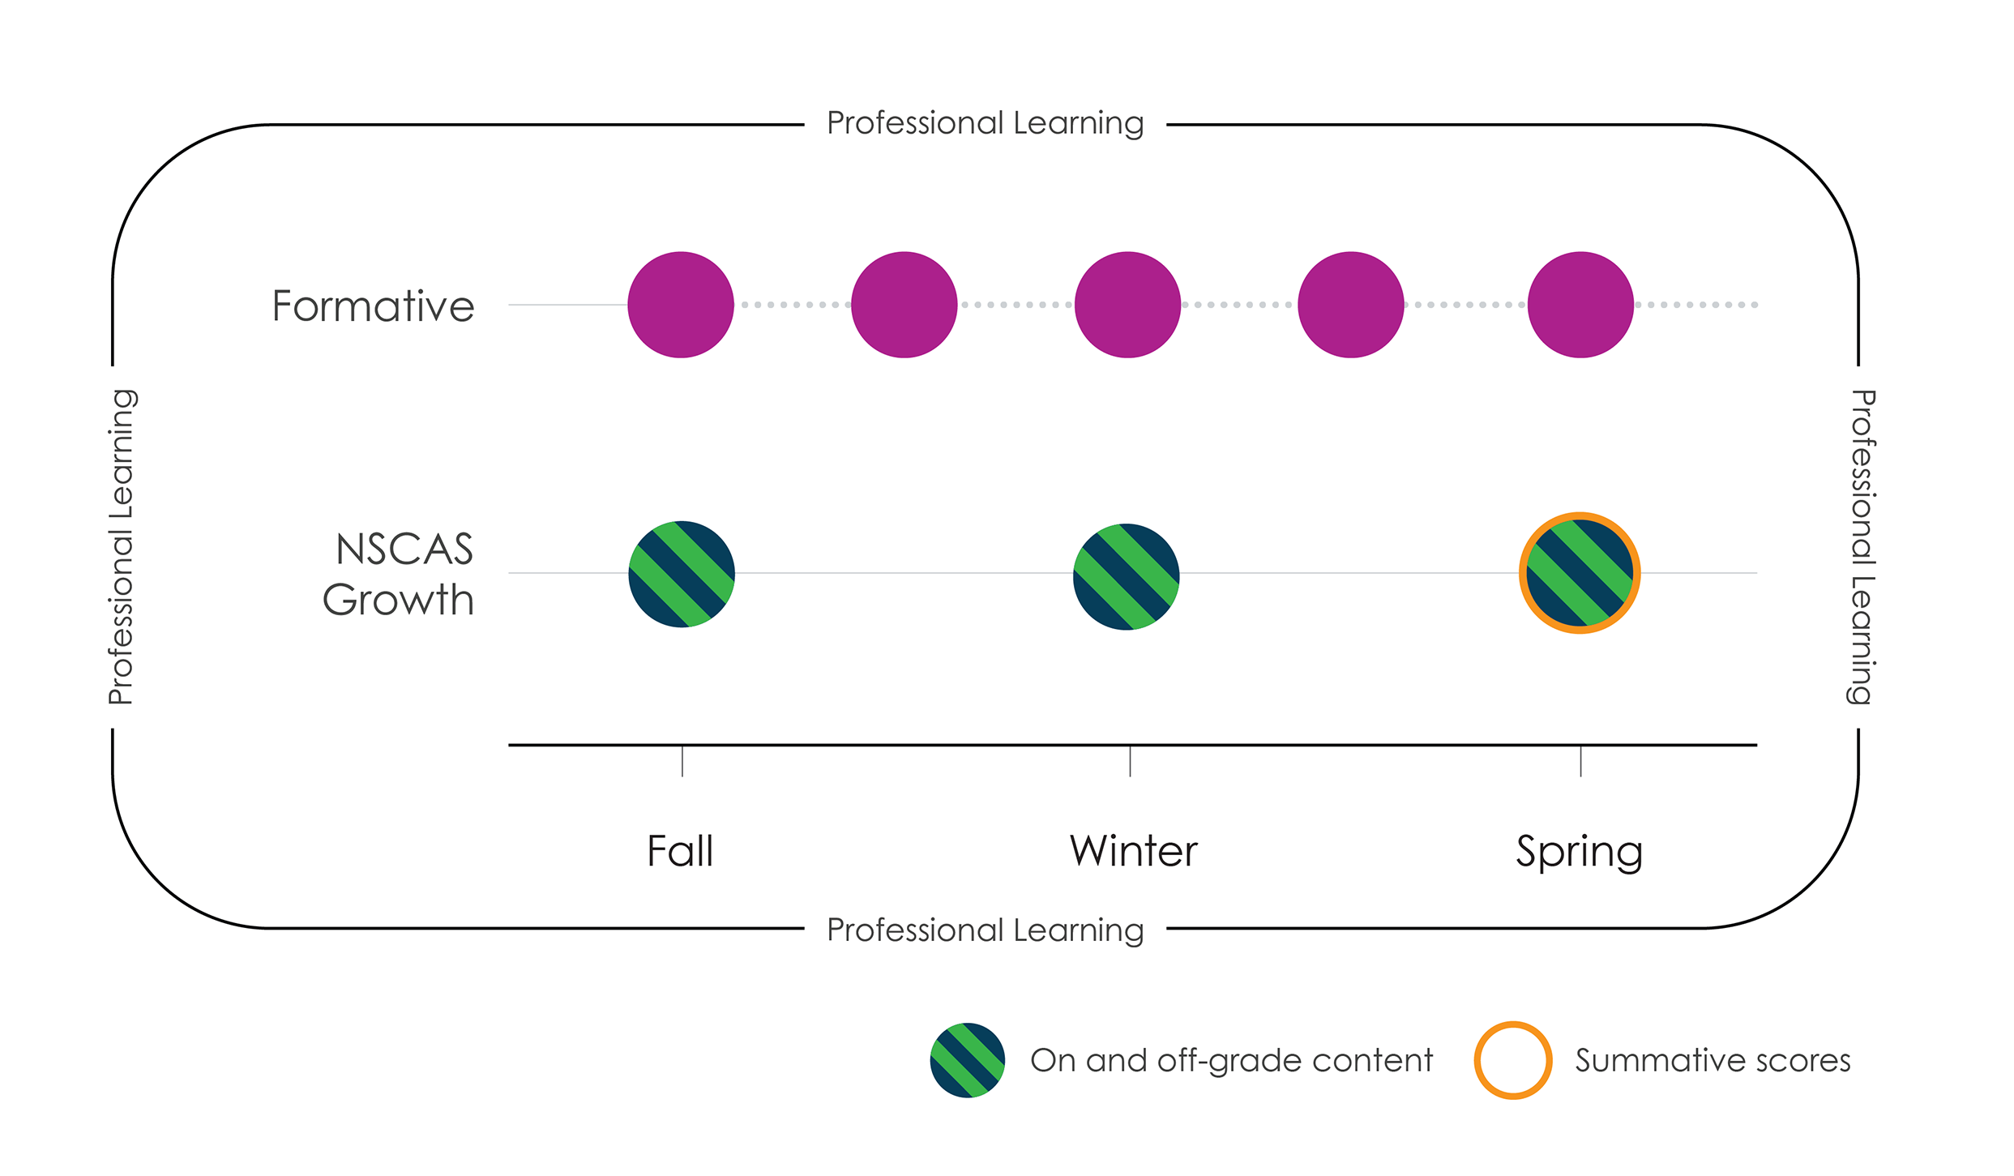
The outcome: NSCAS Growth
Assessments administered fall, winter, and spring:
Assess student performance relative to Nebraska’s grade-level expectations and summative blueprint
Adapt off grade-level as needed to reveal student learning needs
Produce summative proficiency scores at year’s end

Slide 8
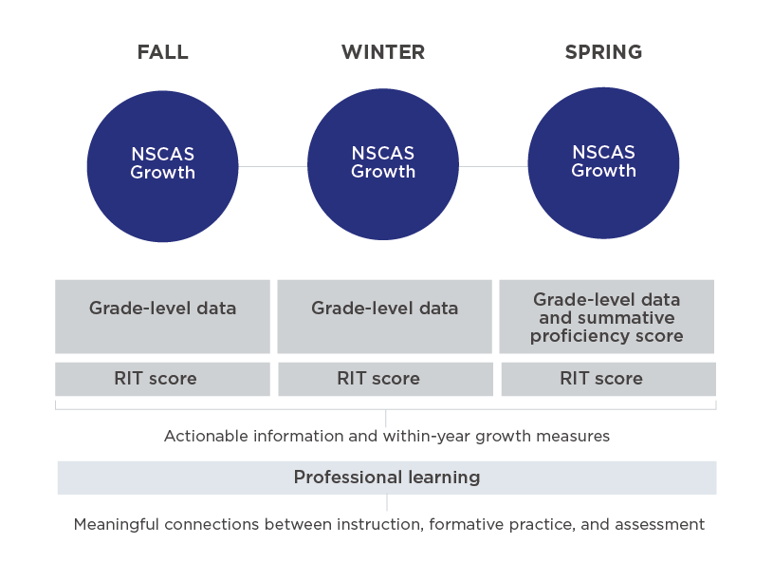
NSCAS Growth benefits
Utility
Normative and criterion-referenced information throughout the year to support teaching and learning
Efficiency
One platform and set of protocols.
Replaces MAP Growth and the NSCAS General summative
Coherence
Common conception of student learning/common scales across all three assessments
Opportunity
Schools and students have more opportunity to show growth (NDE sees fall- to-spring growth vs. changes in summative performance alone)

Slide 9
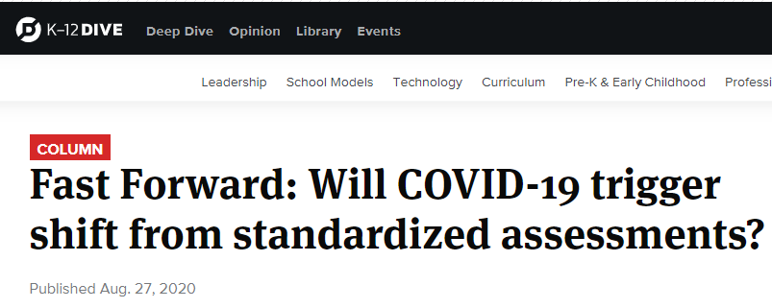
Showing Nebraskans – and the nation – that growth matters
AQuESTT Tenet Change
A balanced assessment system that includes results from multiple sources is used to measure student growth and achievement of Nebraska’s college and career ready standards. A balanced assessment system is a necessary part of the instructional process to improve achievement and growth for each student.
“That ability to get two different measures of growth should increase how much weight we put on growth instead of simply status or proficiency," said Jeremy Heneger, director of statewide assessment at the Nebraska Department of Education.
The shift, said Heneger, is also an attempt to emphasize the instructional feedback provided by interim assessments and incorporate growth in accountability metrics . . .

Slide 10
How we’ll get there
2021-22: Preliminary transition
NSCAS Growth pilot in winter; NSCAS Growth in spring
MAP Growth recommended as well, as NSCAS Growth not yet operational
2022-23: Operational transition
NSCAS Growth in fall, winter, and spring
MAP Growth and NSCAS General Summative no longer needed

Slide 11
The details

Slide 12
NSCAS Growth research
Study 1 (Spring 21): Linking study – establish item bank, statistical link
Study 2 (Winter 21/22): NSCAS Growth pilot – validate model
Study 3 (Spring 22): NSCAS Growth census – verify that score trends are consistent with both the linked RIT and NSCAS scale scores​
Operational (2022-23): If study outcomes are as expected, we will transition to operational NSCAS Growth in Fall 2022

Slide 13
NSCAS Growth winter pilot
Pilot Objectives
Validate the Nebraska adaptive through-year model
Experience the assessment and platform ahead of the spring census administration
Provide feedback on test administration and reporting to support improvements
Caveats
Pilot will not feature a complete suite of reports and tools
Results may not represent the timing/turnaround expected in operational year
Districts will need to decide if they should administer MAP Growth in the winter if scores are used for high-stakes decision-making or used with MAP Accelerator or other content connections

Slide 14
NSCAS Growth content
Item bank is made up of items from MAP Growth and NSCAS General Summative
All items are reviewed by NE educators for alignment and appropriateness
Content is aligned to NE standards, NE summative blueprint, and NE Range Achievement Level Descriptors

Slide 15
Challenge and support every student with Range Achievement Level Descriptors (ALDs)
Measure student learning as it progresses from beginning to advanced understanding within each grade-level standard
Enable finer on-grade adaptivity, while still adapting off-grade for students performing above or below grade level
Help educators meet students where they are while supporting productive struggle to propel students forward
 | Developing | On track | College & Career Ready Benchmark
MA 4.2.1.a Algebra | Determines an equation that represents the situation when given a simple math process or context . . . | Determines a one-step algebraic expression with a variable for an unknown to represent a . . . | Solves two-step whole number equations that include the use of a letter to represent the unknown . . .
Notes:
NSCAS Growth will not only be aligned to Nebraska standards and summative blueprint, but also to NE range achievement level descriptors (RALDs). Range achievement levels describe the range of skills across performance levels for each standard and include examples of what a student should know and be able to do as understanding in a concept/skill area becomes more sophisticated.
Items tagged to Range ALDs support finer on-grade adaptivity, enabling the assessment to adapt down to the very beginning skill levels or up to the most advanced skill levels within a grade level, while still adapting off-grade level as needed.
In addition, because the assessment is rooted in Range ALDs, the results help educators know whether students are at a beginning, developing, proficient, or advanced skill level for each standard, providing teachers with examples of how to increase or decrease complexity with more on-grade access points for students across a range of achievement.

Slide 16
Student-focused test design
The test engine uses what was learned about the student in the previous test and what is being learned in the current one to inform item selection.
We can stop asking questions we already know the answers to about what students know and use the time saved to ask questions we do not know the answers to yet.
In other words, individual learning needs help guide results, ultimately improving their utility.
Notes:
Psychometrics/test design
The responsive approach of the assessment engine – which uses what was learned in the previous test and what is being learned in the current one to inform the questions posed to each student – enables individual learning needs to help guide results, ultimately improving their utility for each student.
On-grade content is prioritized over off-grade content.​
Content within the grade is prioritized by percent of the blueprint.

Slide 17
How it works
The test begins with on-grade items to estimate a student’s achievement level
Then it can refocus the blueprint and move below and beyond grade as needed in response to student performance
When moving off-grade, content from the adjacent grades above and below is prioritized over other grades
Notes:
Once the assessment has determined at which performance level the student is operating relative to grade-level expectations, the blueprint adjusts on-the-fly to maximize what can be learned about the student. For example, proficient students can access advanced on-grade content and advanced students can access above-grade content to show what they can do. Students at developing levels of performance may shift into beginning on-grade content or even into content from the grade(s) below depending on what is needed to determine the best opportunities to address deficits in learning.
Areas for support are prioritized over areas of strength; the engine can determine if there is an area of challenge that can be targeted, even for proficient students
Results of the previous test move forward with the student to inform the next assessment event. So not only is each test adaptive, each administration is adapting based on the previous results to help create a more informative assessment experience for educators and a more efficient experience for students.

Slide 18
The experience
Notes:
Now that we know more about the test design we can talk about the experience of administering NSCAS Growth

Slide 19
Platform for NSCAS Growth
New, enhanced platform – neither the MAP Growth nor the NSCAS General Summative platform
New platform aims to address feedback from NE educators re: existing platform:
Time spent creating test sessions
Difficulties transferring students between districts
Need for more flexible user roles
More streamlined approach to off-site testing (such as external programs)
Notes:
We have been gathering and listening to feedback from NE educators about improvements that were needed from both MAP Growth and NSCAS Summative. Ultimately, we understood that to make these improvements that we needed to upgrade the assessment platform to address the needs expressed by NE educators.

Slide 20
New platform highlights
Test Sessions can automatically be created by class information provided in the roster​.
In-platform ability to transfer students between districts and notifications to DACs when students have been transferred​.
Flexibility to differentiate between home school and testing site if different.
Students will be grouped by testing status and shown as a percentage to easily identify testing progress​.
Accommodations/accessibility may be assigned automatically with roster upload.
Notes:
Test Sessions can automatically be created by class information provided in the roster​
In-platform ability to transfer students between districts and notifications to DACs when students have been transferred​
Currently exploring options for Clever and auto-roster districts to continue automated rostering​
Tests and Accommodations are automatically assigned to the student for that Test Administration via the profile​
Can select a Home Campus and Testing Campus when students test in a different location​
Can select Out-of-District testing for off-site test administration locations (Such as External Programs)​
As with MAP Growth and NSCAS, student tests have unique login credentials​
Login credentials are available to DACs and Proctors via test tickets provided to students​; test tickets help reduce student error such as choosing the wrong name during login.
Students log in using a new Secure Browser application​

Slide 21
Training resources
District and School resources:​
Assessment Coordination Guide​
Proctor Guide​
System and Technology Guide​
How-to videos
Test administration webinars
Student Resources​
Item Type Sampler​
Tools and Accommodations instructional videos
Notes:
We will provide resources….important to note that NE educators and students know how to do this. We have been working with online systems for some time and most will have no problem adapting to the new platform. If we can overcome a pandemic then we should have no problem mastering this new system.

Slide 22
The results
Notes:
While the testing experience matters, what is more important, because this is what drives our education system to improve, are the results.

Slide 23
NSCAS Growth data
Information produced by NSCAS Growth
What
When
RIT scores, including access to national norms
Fall, winter, spring
Grade-level data based on indicators used to
determine summative proficiency
Fall, winter, spring
Projected summative proficiency scores
Fall, winter
Official summative proficiency scores
and classification
Spring
Remember that 2021-22 is a preliminary transition year, so MAP Growth could also be administered if RIT is used for high-stakes decision-making or MAP Accelerator/curricular connections
Notes:
This part should be comforting, NSCAS Growth will continue to produce RIT scores. Our educators, students and parents are familiar with this score and being able to track growth over time. We will continue to get that information in addition to National Norms .
Additionally, we are going to get enhanced grade level data based on NE standards

Slide 24
Reports on testing itself
Available as part of NSCAS Growth winter pilot (2021-22)
District and school levels of tracking (like Student Testing Progress)​
Testing Status reports​
District/School of Attendance reports
District/School of Accountability reports
Testing Registration reports
NTC usage reports
Transfer reports (into/out of a given district)
Notes:
Enhanced ways to track student testing processes. Be able to slice and dice the data to understand who has and who has not tested. We have been working really hard to make sure the testing experience is as interim like as possible.
Part of the services available to users with different roles include reports on testing itself.
Testing management for school users to track active testing and scheduling
Testing status in an interactive dashboard
Testing status reports in csv for independent review/analysis
Attendance management to track current enrollment details prior to/after testing
Transfer notifications/reports
Track students’ schools of attendance and accountability easily
See progress over time with registration reports
Data management reports
See counts of NTCs applied by school/district

Slide 25
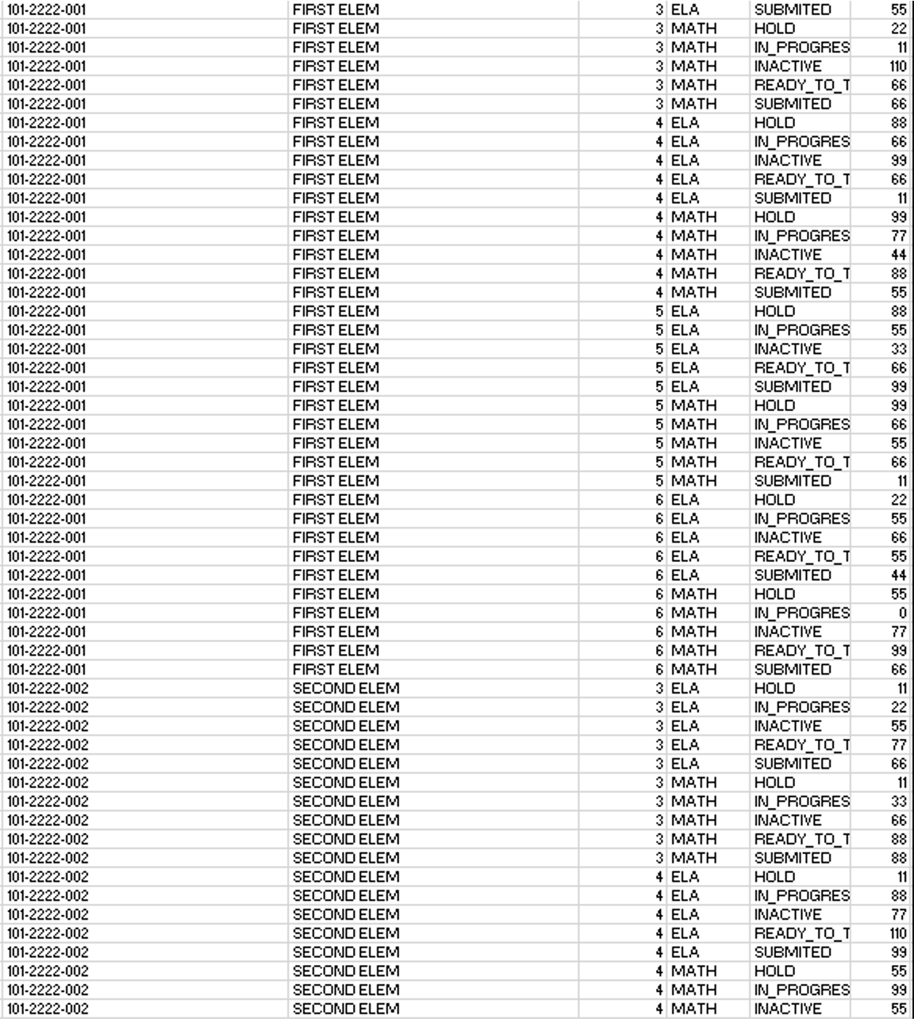
State/ESU management reports
Available as part of NSCAS Growth winter pilot (2021-22)
Organization report
ESU/state testing status reports
NTC usage reports
Transfer reports
Notes:
Combination of interim and summative assessment will create more cohesive system that is better informed at each level. State and ESU users will be able to monitor current organization structures, aggregated testing status by district, NTC usage by district, and transfers across organizations.

Slide 26
Score reports
Winter pilot 2021-22
Interactive reporting via user interface​
Classroom reports​ and grouping
Drill down to student and item level from entity level​
CSV/PDF downloads available
Instructional utility
Plus, in Spring 2022:
Longitudinal comparisons for students
Achievement Level breakdown for student performance
Notes:
Continue to use our interim system for instructional utility working hard to retain the best of MAP Growth and then provide even better information about students are their current grade level. We will be able to track growth in the year and across years.

Slide 27
Score reports
Accountability insights – Spring 2022
Interactive reporting via user interface​
Student content area report​s
Classroom reports​
School reports​
District, ESU, and State aggregations​
Longitudinal comparisons
Notes:
We are going to have Better data to be responsive to accountability. Today’s summative system that inform accountability determinations, there is limited data and what is available comes too long after the assessment is finished. In NSCAS Growth, educators will receive actionable information almost immediately, life they are accustomed to having with interim assessments like MAP Growth. The system will also provide better to NE educational system at level to continue to inform important policy and resource decisions.

Slide 28
When will data be available?
Information produced by NSCAS Growth – 2021-22
What
When
RIT scores, including access to national norms
Within 72 hours of student test completion
Scores may be subject to change with analysis
Updated during active testing on screen refresh
Grade-level data based on indicators used to
determine summative proficiency
Projected summative proficiency scores
Official summative proficiency scores
and classification
After calibration (Spring 2022 testing)
Remember that 2021-22 is a preliminary transition year, so MAP Growth should also be administered if RIT is used for high-stakes decision-making or MAP Accelerator/curricular connections
Notes:
This is where we currently are with intent for increased efficiency in 2022-23

Slide 29
Making NSCAS Growth data actionable
An online resource (the Achievement Level Explorer) will help Nebraska educators more easily access and use Nebraska range ALDs
Once fully operational, NSCAS Growth will also include a new tool (similar to the Learning Continuum) rooted in Nebraska’s range ALDs
Notes:
NE educators have been using NWEA’s Learning Continuum and we will continue to have access to that tool because we will continue to get RIT scores. We are also developing an additional tool that is directly connected to NE standards and will provide better insights as to where students are in terms of grade level content. This tool is already been developed and we will continue to update and enhance the tool as we move forward.

Slide 30
The impact
Notes:
We believe the results of NSCAS Growth will ultimately lead to improved educational impact.

Slide 31
Videos and webinars
Videos for districts to use to introduce NSCAS Growth
“Universal video” introducing NSCAS Growth in the context of Nebraska’s commitment to supporting educational equity
Intended audience: educators, parents, board members, legislators, and other community members)
“Educator video” introducing NSCAS through the lens of school leaders, teachers, paraprofessionals
Intended audience: district administrators, educators of all levels
“Vignette” webinars tackling more specific, technical details
Intended audience: district assessment coordinators and others interested in going deeper on NSCAS Growth
Notes:
To make sure NE educators are informed about the new system we have created a series of resources that continue to dig in the details of NSCAS Growth. We are relying on district and school leaders to take information back to their staffs. We have created two introductory videos. This presentation. Another series of four vignettes to dig even deeper into specific technical details of our adaptive through-year assessment model.

Slide 32
NSCAS Growth materials
NSCAS Growth one-sheet
NSCAS FAQ
NSCAS Growth PowerPoint
Notes:
We also have some additional digital resources. We encourage you to share these resources and learn more about how these assessments will support the important work you do everyday.

Slide 33
Professional learning
Webinar(s) will support understanding of NSCAS Growth reports and data expected from the 2021-22 winter pilot and spring administration
Professional learning for 2022-23 will support effective use of grade-level and grade-independent data from NSCAS Growth to inform instruction and foster student learning
Notes:
Emphasize ongoing role of Nebraska certified facilitators in delivering professional learning

Slide 34
NSCAS Growth FAQ Sessions
NSCAS Growth Q&A
Recording
Planned Q&A sessions with vignette release
Tuesday, August 10th 1-2 PM CT
Wednesday, August 18th 3-4 PM CT
Tuesday, September 7th 12-1 PM CT
Notes:
Going to be questions…we have created opportunities to ask your questions. As always, please contact the statewide assessment office if you have additional questions.

Slide 35
Please contact us if you have questions!
Contact Us Link
Statewide Assessment Office
402-314-3013
nde.stateassessment@nebraska.gov
Jeremy.Heneger@nebraska.gov
Notes:
As always, please contact the statewide assessment office if you have additional questions.

Slide 36
Thank you!
Notes:
As I come to a close, I want to emphasize a couple of points…First, NSCAS Growth is innovative and we believe better than our current system…but it is not finished yet. We will continue to build and update the system. Like educators across the state we are dedicated to the continuous improvement process and as such we will continue to seek out, listen to, and do our best to improve NSCAS growth for educators and students across the state. Second, our attitude about change impacts our students…students responded well when NE educators implemented MAP Growth and that attitude shaped the way students felt about that assessment. Recognizing that our attitudes will shape how students feel about this change is important. I would much rather test students that feel positive about showing growth as opposed to students that are concerned or worried about change. Of course change is difficult but focusing on the positives will enable the system to positively impact learning across the state.
Finally, this is not my new assessment or Nebraska Department of Education’s new assessment. This is Nebraska’s new assessments model. NE educators have always been a part of assessment development and their input will continue to improve the system moving forward. Finally, I want to thanks all NE educators for their expertise and passion. You make a difference for each and everyone of our students. We appreciate you and the difficult job you do. Thanks for your time today.

