Slide 1
Professional Learning Opportunities in 2021-22
Aly Martinez Wilkinson, Trudy Clark, Dennison Bhola

Slide 2
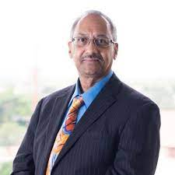
Trudy Clark
Assistant Director of Statewide Assessment
Aly Martinez Wilkinson
Professional Learning Consultant
Dennison Bhola
Professional Learning Consultant

Slide 3
NSCAS Professional Learning Goal Statement
Through partnership and engagement with the Nebraska Department of Education, Public School Districts, Educational Service Units (ESUs), and NWEA®, the NSCAS professional learning goal is to strengthen the capacity of all Nebraska educators, including the Certified Facilitators, through system-wide professional learning (grounded in best practices for professional learning and academic content standards) to increase the role-based knowledge, skills, and explicit transfer-to-practice of all aspects of the Nebraska Student Centered Assessment System (NSCAS) balanced assessment system.

Slide 4
NSCAS Professional Learning Goal Statement
Expand assessment literacy across the Nebraska education ecosystem in ways that are specific to NSCAS Growth, and classroom-based formative practice
Build and maintain a student-centric focus in all assessment discussions and decisions to ensure equity for all students
Emphasize and develop formative classroom practices (learning targets and success criteria, questioning and feedback, activating learnings) as key components of a balanced assessment approach
Develop and drive data-informed decision-making including assessment results at the student, classroom, school, and system levels
Serve as a resource in response to the differentiated needs of districts and ESUs and provide research-based resources grounded in best practices for adult learning

Slide 5
Nebraska Balanced Assessment System Definition
STUDENT ACHIEVEMENT AND GROWTH
A balanced assessment system that includes results from multiple sources is used to measure student growth and achievement of Nebraska’s college- and career-ready standards. A balanced assessment system is a necessary part of the instructional process to improve achievement and growth for each student.

Slide 6
Nebraska Balanced Assessment System Definition
Areas of Focus
Balanced assessment system plans
Assessment literacy and communication
Appropriate use and interpretation
Culturally responsive pedagogy, curriculum, and assessments

Slide 8
Certified Facilitator Program Features
Self-paced online resources for building capacity in product knowledge
Unlimited online access to facilitator/workshop materials once certified in the content
On-demand content, Q&A, and CF webinars
Monthly eNewsletter for Certified Facilitators
Onsite and distance-learning training for each workshop certification
Dedicated support from NWEA Partner Accounts and Professional Learning to support your work

Slide 9
Certified Facilitators
72 Certified Facilitators across the state
District leaders
ESU staff developers

Slide 10
Role of a Certified Facilitator
Support educators across the state in:
Developing further assessment literacy
Implementing formative practice in the classroom
Leveraging MAP Growth results in the classroom
Interpreting and applying General Summative Assessment results
Provide information about future professional learning needs of Nebraska educators
Continue to develop their own understanding of Nebraska’s system to support a balanced assessment system

Slide 11
What Certified Facilitators Emphasized in 2020–2021

Slide 12
Resources
NWEA Connection, the online community
https://community.nwea.org/welcome
Nebraska and NWEA Assessment Portal
https://community.nwea.org/community/nebraska
Nebraska Course in Professional Learning Online
https://community.nwea.org/community/professional-development
Resource Center –
https://www.nwea.org/resource-center/

Slide 13
Professional Learning 2021-22
Save the Date!
https://dpdol.nwea.org/public/NE/NE_YR5_SavetheDate_Flyer_2021-22.pdf

Slide 14
Certified Facilitator Offerings
MAP Growth Assessment
Applying Reports
Essential Reports for Teachers and additional for Administrators
Student Growth and Goal Setting
Informing Instruction
Differentiated Instruction
Responsive Planning for Instruction
Data Protocols

Slide 15
Certified Facilitator Offerings
Assessment Literacy Practices
Student-Centered Assessment Literacy
Applying Classroom Assessment Standards
Using ALDs to Ensure Classroom Rigor
Triangulating Data for Instructional Insights

Slide 16
Certified Facilitator Offerings
Formative Assessment Practices
Activating Learners
Clarifying Learning:
Eliciting Evidence:
Providing Feedback

Slide 17
Student Learning
W. James Popham defines Assessment Literacy as an "individual's understanding of fundamental assessment concepts and procedures deemed likely to influence educational decisions." When assessment-literate educators make educational decisions based on appropriate assessments, the decisions they make will almost always improve students' learning.
The formative assessment process is key in this relationship of assessment and student learning. In the FA process, educators make instructional decisions regarding next steps as a result of the evidence obtained from the assessment.
Popham, W.J. (2018) Assessment Literacy for Educators in a Hurry. ASCD: Alexandria, VA

Slide 18
Formative Assessment Supports
The Nebraska Department of Education believes the Formative Assessment process is an integral part of a Balanced Assessment System.
PL from NWEA on formative assessment includes
Clarifying, sharing & understanding learning intentions & criteria for success
Engineering effective classroom discussions, activities, and learning tasks that elicit evidence of learning
Providing feedback that moves learning forward
Activating learners as instructional resources for one another & as owners of their own learning

Slide 19
Clarity

Slide 20
What is the formative assessment process?
Formative assessment is a planned, ongoing process used by students and teachers during learning and teaching to elicit and use evidence of student learning to improve student understanding of intended disciplinary learning outcomes and support students to become self-directed learners.
The formative assessment cycle asks teachers and students to consider three essential questions:
1. Where is the learner going?
2. Where is the learner now?
3. What’s next in the learning journey?

Slide 21
Formative Assessment in the Classroom
Where is the learner going?
Where is the learner right now?
How does the learner get there?
What am I doing?
Am I getting it?
What do I do to get where I need to be?
What are we (my peers) learning?
Are we getting it?
What do we do to get where we need to be?

Slide 23
Nebraska Teacher and Principal Performance Standards

Slide 24
Best Practices Formative Assessment
CCSSO
Michigan Assessment Consortium
2021 Conference
John Hattie, Susan Brookhart, Dylan Wiliam, Margaret Heritage, Rick Stiggins, Jan Chappuis, Ken O’Connor, Patricia Reeves, Jim Pelligrino, Myron Dueck, Thomas Guskey
Chase Nordengren, Erin Beard, Steve Underwood, Brooke Mabry

Slide 25
The Continuing Educator - Podcast
Exploring Professional Learning Strategies for the Post-Covid Era
Episode 1: Why do we grade? with Thomas Guskey and Chase Nordengren
Episode 2: What is “Grading for Learning?” with Myron Dueck and Brooke Mabry
Episode 3: The problem with grading behavior with Matt Townsley and Chris Thoms
Episode 4: Giving students a do-over with Ken O’Connor and VaShawn Smith
Episode 5: What’s in your gradebook? with David Woodward and Katie Budrow
Episode 6: Tools for success: Get started with grading for learning with Heather McClure and Roberto D’Erizans
https://thecontinuingeducator.buzzsprout.com/

Slide 26
NDE Resources
Formative Assessment Support Network
Formative Assessment Repository
New professional learning lead in formative assessment practice
Professional learning in support of assessment literacy
Acknowledgement of assessment literacy practice competencies

Slide 28
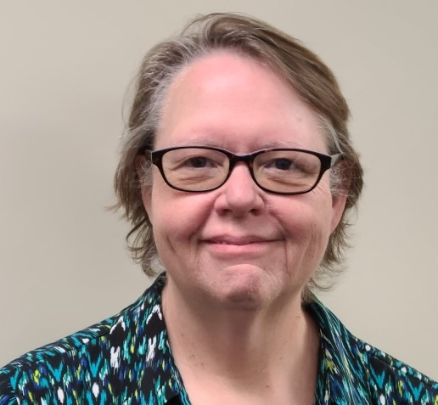
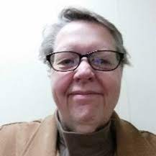
Trudy Clark
Assistant Director of Statewide Assessment
trudy.clark@nebraska.gov
Aly Martinez Wilkinson
Professional Learning Consultant
aly.martinez.wilkinson@nwea.org
Dennison Bhola
Professional Learning Consultant
dennison.bhola@nwea.org

