Slide 1


2019 Skilled and Technical Sciences
Fall In-service Workshop
STS – Teaching Skills That Keep Nebraska Growing

Slide 2
2019 STS Workshop Agenda
NCE and STS Updates
New Perkins Legislation
Course Standards, Career Readiness Standards and Programs of Study
Workplace Experiences
SkillsUSA Update
Group Share
Industry Tour
AdvanceCTE, 2019
Notes:
Big picture, Perkins V builds upon Perkins IV.

Slide 3
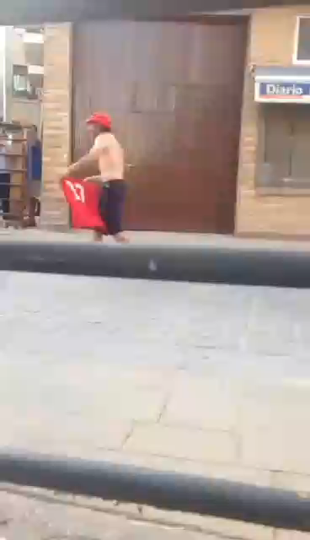

Slide 4
Safety Instructions
Restrooms
Fire
Tornado
CPR
Emergency Caller
Active Shooter
Please quiet cell phones
AdvanceCTE, 2019
Notes:
Big picture, Perkins V builds upon Perkins IV.

Slide 5
Whose Here?
Introduce yourself
Name
School
What you teach
How long you have been teaching
Favorite activity away from teaching
AdvanceCTE, 2019
Notes:
Big picture, Perkins V builds upon Perkins IV.

Slide 6
Websites of Interest
https://www.education.ne.gov/STS
http://www.skillsusanebraska.org
https://www.education.ne.gov/NCE
http://www.careersafeonline.com/
AdvanceCTE, 2019
Notes:
Big picture, Perkins V builds upon Perkins IV.

Slide 7
Strengthening Career & Technical Education for the 21st Century
Perkins V

Slide 8
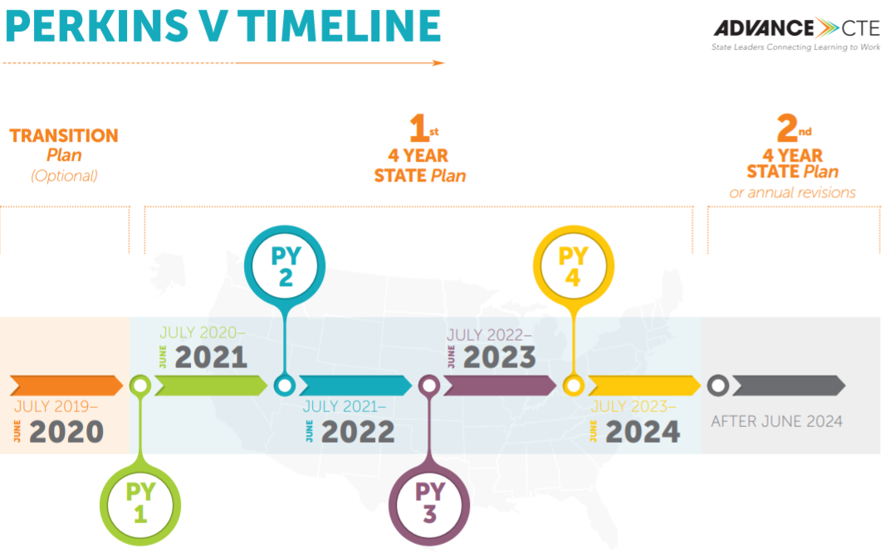
July 1, 2019 kicked off our year of planning to transition from the old law to the new law. All aspects of the new law must be implemented by July 1, 2020. We’re currently writing our Nebraska Perkins V State Plan.
Notes:
The US Department of Education recognizes that it will take time for States to update their CTE systems, policies, and programs to align with the requirements of Perkins V. To provide for an effective transition to Perkins V, the implementation of certain provisions have been delayed until Fiscal 2020. NE’s Perkins V Sate plan will cover 2020-24.
The State plan outlines our vision for CTE in Nebraska, as well as how we plan to implement and meet all requirements of the law.

Slide 9
Perkins V: Purpose
“…increasing learner access to high-quality Career Technical Education (CTE) programs of study. With a focus on systems alignment and program improvement, Perkins is critical to ensuring that programs are prepared to meet the ever-changing needs of learners and employers.”
AdvanceCTE, 2019
Notes:
Big picture, Perkins V builds upon Perkins IV.

Slide 10

Major Tenet:
Program Improvement
Maintains commitment to programs of study
Introduces comprehensive local needs assessment
Increases statewide reserve fund to spur local innovation and implement programs of study
Increases focus on alignment to labor market needs
Stronger focus on equity, including a new purpose on increasing opportunities for special populations
Notes:
New requirement that funds must be used to develop, coordinate, implement, or improve CTE programs to meet the needs identified in the comprehensive needs assessment
Maintains that funds must support CTE programs that are of sufficient size, scope, and quality to be effective

Slide 11

Major Tenet:
Flexibility
  Enables financial support for career exploration to go as low as grade 5
  Aligns to the Every Student Succeeds Act (ESSA) and Workforce Innovation and Opportunity Act (WIOA)

Slide 12

Major Tenet:
Data & Accountability
  Defines who is included in the accountability system (only Concentrators)
  Changes the process for setting performance targets
    Includes strengthened stakeholder engagement process
  Focuses on disaggregation of data
Notes:
Reports only on CTE Concentrators
Graduation rates (ESSA)
Academic proficiency (ESSA)
Student placement (2nd quarter after exiting)
CTE program quality*
The percentage of CTE concentrators in CTE programs that lead to non-traditional fields
Postsecondary
Student placement/retention (2nd quarter after program completion)
Credential attainment
The percentage of CTE concentrators in CTE programs that lead to non-traditional fields

Slide 13
We’ve been busy! Perkins V State Planning Activities:
Stakeholder Engagement
Stakeholder Consultation
State Board of Education meetings
Regional and nation-wide workgroups
Secondary/Postsecondary Alignment assessment
Development of the Comprehensive Local Needs Assessment
Developing new annual funding application
Governor consultation
Public hearings, public comment periods coming

Slide 14
So what’s new?
The Comprehensive Local Needs Assessment
Student Performance Data
Size, Scope, & Quality
Local Workforce Alignment
Progress Towards Implementing CTE Programs of Study
Recruitment, Retention, and Training of Faculty and Staff
Progress Toward Improving Access & Equity
Notes:
Requires significant stakeholder engagement.
To be updated every 2 years.
It’s important for teachers to be engaged in this process as funding will not be restricted to the outcomes of the CLNA.

Slide 15

So what’s new?
The Local Application
  In July, eligible recipients (stand-alone districts and consortia) will submit an application outlining the results of their comprehensive local needs assessment and “big picture” for CTE (9 required elements).
  This application will be submitted once and cover 2020-2024 (it can be updated)
    Each year thereafter, the local recipient will submit an annual budget detailing how proposed expenditures address the outcomes in their comprehensive local needs assessment, move forward their big vision for CTE, and address any equity or performance gaps.
Notes:
This replaces the local plan – now the local application:
Results of Comprehensive Local Needs Assessment
Information on the CTE course offerings and Programs of Study
Description of career exploration and career guidance activities
How to improve the academic and technical skills of CTE students
How equal access for activities that prepare special populations for high-skill, high-wage, and in-demand occupations; non-traditional fields will be provided; and ensure that members of special populations will not be discriminated against
Work-based Learning Opportunities
Early postsecondary experiences
Disparities or gaps in performance between groups of students in each of the plan years, and if no meaningful progress has been achieved prior to the third program year, a description of the additional actions that will be taken to eliminate these disparities or gaps
Recruitment, preparation, retention, and training, including professional development, of teachers, faculty, administrators, and specialized instructional support personnel

Slide 16

So what’s new?
Uses of Perkins Funds
  The allowable and non-allowable uses of Perkins funds has not changed
  However, ONLY activities (or expenditures) that support the outcomes of the comprehensive local needs assessment will be approved
Notes:
Imperative everyone is a part of the CLNA profess and data reporting is accurate

Slide 17
Statewide Activities & Priorities highlights
Secondary-Postsecondary Alignment
  Programs of Study are now defined in Perkins V and span Secondary and Postsecondary. As we revise standards in 2020 we will focus narrowly on aligning secondary and postsecondary programs.
Work-Based Learning
  Likely program-quality indicator*
  WBL Summit and additional professional development opportunities
  Significant coordination with business/industry across the state
Equity and Access
  Using disaggregated data to help identify any barriers for the successful participation in, completion of, and transition to CTE programs
Notes:
*What this means: NDE will be federally held accountable for the percentage of CTE Concentrators who participate in WBL (we will continue to work at increasing our percentage)
What this DOESN’T mean: every teacher is responsible for creating a WBL program

Slide 18
Statewide Activities & Priorities highlights
Systemic Career Development
Career Readiness Standards
reVISION
reVISION Middle
Sustained (not stand-alone) professional development
Data dashboards
Early postsecondary opportunities
Recognized postsecondary credentials
Co-curricular and expanded learning opportunities
Contextualized core academic courses
High-quality, standards-aligned instructional materials
And more!

Slide 19
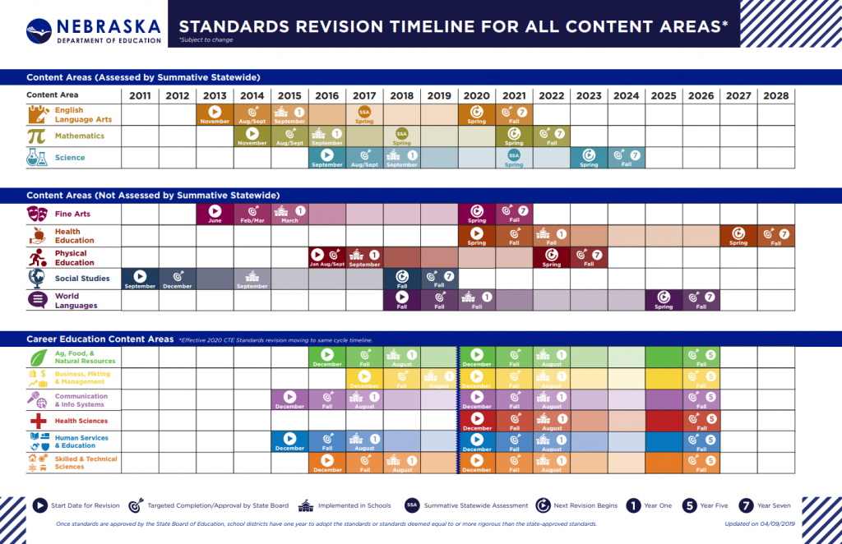
Standards 2020
Notes:
Beginning in 2020, all CTE career fields and programs of study will be updating or developing standards. There are ample opportunities for teachers to be a part of this very important process. More information to come! For those areas where standards were recently updated, we expect only minimal changes.

Slide 20
STS Standards
Refinements not Reconstruction
Expand on Career Readiness in Standards
We will be looking for team members in for the four clusters

Slide 21

Nebraska Career Development
New Model and Toolkit!
Self-Awareness
Nebraska Career Development Toolkit
www.education.ne.gov/nce/careerdevelopment
Why Career Development?
PreK-12 Program Planning
Career Development Model
Family Engagement
Transitions for All Students
Lesson Plans
Resources
Career Exploration
Career Planning & Management

Slide 22

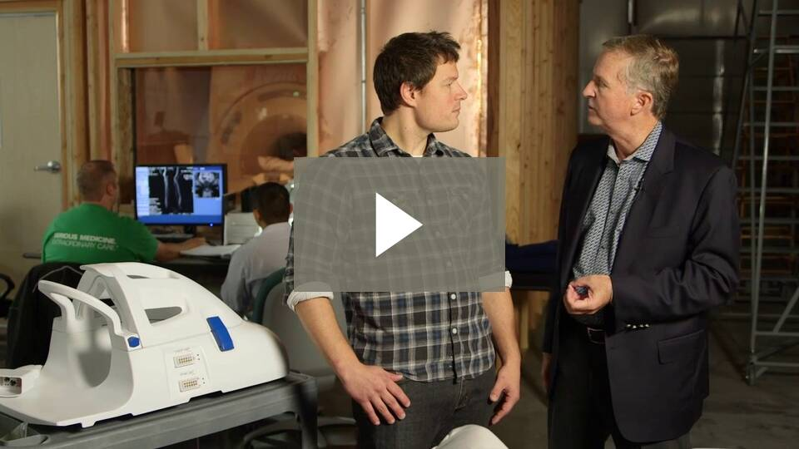
Career Exploration Resources
Nebraska Career Videos & Teacher Discussion Guides
  www.necareertours.com

Slide 23


Career Development Resources
Nebraska Career Connections
  www.nebraskacareerconnections.org
Clusters At-A-Glance
Career Development Toolkit
    www.education.ne.gov/nce/careerdevelopment

Slide 24

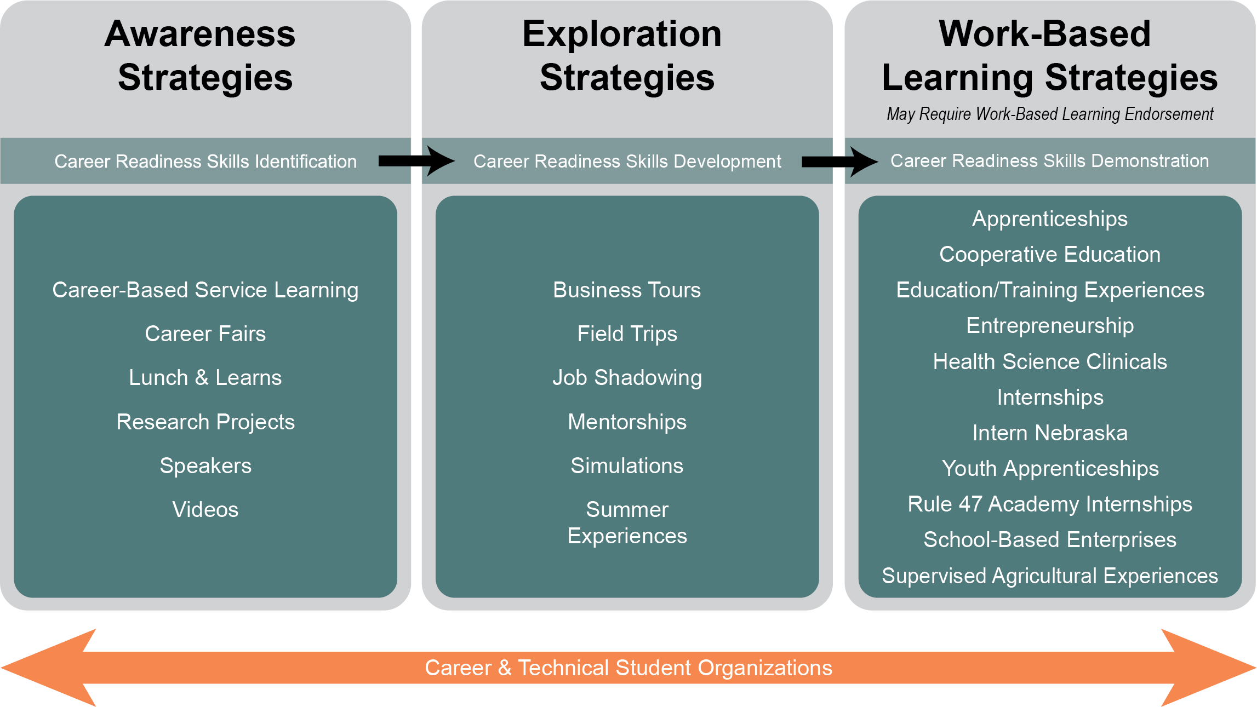
This Nebraska Workplace Experiences Continuum illustrates how Workplace Experiences become more focused as a student progresses through their education.
www.nebraskaworkplaceexperiences.com

Slide 25
What are Workplace Experiences?
Educational strategies that provide opportunities for students to enhance their learning, explore career options, and demonstrate their academic, technical, and Career Readiness Skills in authentic work settings.
These experiences are integrated into curricular offerings and assessed accordingly.
www.nebraskaworkplaceexperiences.com

Slide 26
Why Workplace Experiences?
According to Gallup, business leaders value an internship or on-the-job training more than the college major or college grades of employees.
Students may be 19-20 before they take their first full-time job.
Students who have four or more exposures to work earn 18% more.

Slide 27
WBL Supplemental Endorsement
(Previously called Cooperative Education-Diversified Occupations Supplemental Endorsement)
Allows you to coordinate, teach, and supervise programs of instruction that develop career and life skills
  Requires a minimum of three (3) semester hours in the supervision and coordination of work-based learning programs
  Available only to those who have either (A) 1,000 of verified hours of paid work-based experience, or (B) at least 300 hours of supervised work experience under the direction of the college or university recommending the endorsement

Slide 28
Workplace Experiences
What does your school/district currently do?
How does your school/district plan to move forward with workplace experiences?

Slide 29
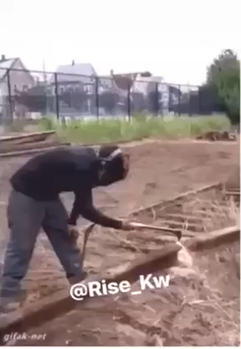
Let’s Take A Break
AdvanceCTE, 2019
Notes:
Big picture, Perkins V builds upon Perkins IV.

Slide 30
STS Standards
https://www.dropbox.com/sh/84q6f4b4f1x9zh1/AABKh1tvSKbRBevkp8aNWuwUa?dl=0
A course must meet 80% of the standards
Indicators help to determine IF you are meeting the standards
Strategies help to determine HOW you can meet stanards.

Slide 31
Course Code Worksheet (Couse Names and Codes on back)

Slide 32
Program of Study Sheet (Highlight the courses and programs of study that your school offers)

Slide 33
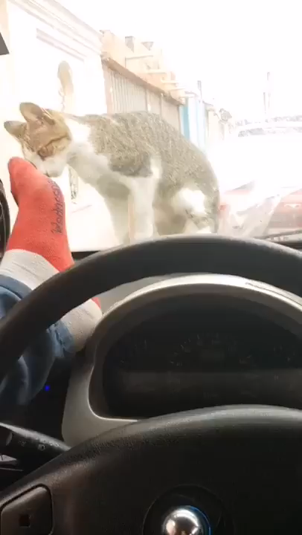

Slide 34



Slide 35


SkillsUSA Theme 2019-20

Slide 36

SkillsUSA is a
professional LEADERSHIP ORGANIZATION
BUILT FOR
LED BY
STUDENTS
STUDENTS
THAT PREPARES STUDENTS TO
THRIVE IN SKILLED CAREERS.
CAREERS OF GREATEST
EVERYTHING THEY NEED
OPPORTUNITY
TO
SUCCEED
Notes:
SkillsUSA is a professional leadership organization that prepares students to thrive in skilled careers.
When we say PLO, we mean that it is built for students and led by students
Every chapter elects its own students to serve as president, treasurer, and work on committees and serve through community service
Focused on skilled careers—everything from healthcare to HVAC, construction to cosmetology
A chance to connect students with the careers of greatest opportunity
And give them everything they need to succeed

Slide 37

SkillsUSA is a unique opportunity to
STRENGTHEN THE FUTURE
OF YOUR PROGRAM
and
OPEN UP GREAT FUTURES
FOR AMERICA’S CTE STUDENTS
Notes:
Start with our core proposition—if you only remember one thing:
SkillsUSA is a unique opportunity to both strengthen the future of your program and open up great futures for America’s CTE students
A unique solution to two problems
Going to try to prove this to you over the course of the presentation

Slide 38

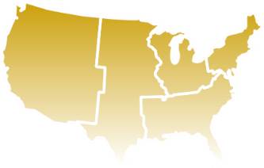



HOW SkillsUSA WORKS: FACTS
395,000
4,000
52
MEMBERS
SCHOOLS & COLLEGES
STATES & Territories
130
600+
OCCUPATIONAL PROGRAMS
NATIONAL PARTNERS
Notes:
Now let’s get into how SkillsUSA works—beginning with some basic facts
Organization with 395,000 members including students, educators and alumni--One of the nation’s largest individual membership associations
We have chapters in 4,000 schools and colleges, mostly at the high school level but also MS and college—in all 50 states plus 1 territory
80% CTE schools have SkillsUSA chapters—that means that the places where communities have made significant investments in CTE—they’re relying on SkillsUSA
We offer 130 different occupational programs and 70 plus career pathways
600 businesses, trade associations and labor unions—at the NATIONAL level; thousands more at the state level

Slide 39
HOW SkillsUSA WORKS in Nebraska: FACTS
2800
20+
LOCAL CHAPTERS
90 HS
10 C/T
15+ MS
MEMBERS
Industry PARTNERS
80
OCCUPATIONAL PROGRAMS
Notes:
Now let’s get into how SkillsUSA works—beginning with some basic facts
Organization with 395,000 members including students, educators and alumni--One of the nation’s largest individual membership associations
We have chapters in 4,000 schools and colleges, mostly at the high school level but also MS and college—in all 50 states plus 1 territory
80% CTE schools have SkillsUSA chapters—that means that the places where communities have made significant investments in CTE—they’re relying on SkillsUSA
We offer 130 different occupational programs and 70 plus career pathways
600 businesses, trade associations and labor unions—at the NATIONAL level; thousands more at the state level

Slide 40
High Schools with SkillsUSA Chapters
Adams Central Anselmo-Merna Arlington
Ashland-Greenwood Axtell Bancroft-Rosalie
Beatrice Bellevue West Bennington
Blair Boone Central Brady
Broken Bow Central City Columbus
Cozad Crofton Cross County
Deshler Elkhorn Elmwood-Murdock
ESU #2 Academy Fairbury Fort Calhoun
Fremont Career Pathways Institute - GI Gretna
Grand Island Northwest Hastings Hershey
Homer Kearney Kenesaw
Lexington Lincoln East Lincoln North Star
Lincoln Northeast Lincoln Southeast Logan View
Louisville Malcolm Maxwell

Slide 41
High Schools continued:
Metropolitan CC Millard North Millard South
Millard East Clearwater/Orchard Niobrara
Norfolk Norris North Bend Central
North Platte Omaha Benson Magnet Omaha Burke
Omaha Bryan Omaha Career Ctr Omaha North
Omaha Northwest Papillion-La Vista Papillion-La Vista South
Platteview Plattsmouth Ralston
Ravenna Raymond Central Scottsbluff
Seward Sidney South Central Unified
South Sioux City Sterling Syracuse
Tekamah-Herman Thayer Central The Career Academy
Thedford Wahoo Waverly
Weeping Water Westside York
Yutan

Slide 42
College/Technical Chapters
CCC-Columbus CCC – Grand Island
CCC-Hastings Metropolitan Community College
Nebraska Western CC Southeast CC-Lincoln
Southeast CC-Milford University of NE – Lincoln
Wayne State College

Slide 43
Middle School Chapters
Anslemo-Merna Beveridge-Omaha Elmwood-Murdock
Hastings LaVista Louisville
Niobrara Papillion Clearwater/Orchard
Platteview Raymond Central Seward
Sterling Thayer Central Thedford
Wahoo

Slide 44
New Schools we are planning on for ‘19-20
Omaha Central Aurora Hitchcock Co.
East Butler Kimball Laurel-Concord
Loup City Maywood Wakefield
Macy Dawes MS CCC-GI (Criminal Justice)
Battle Creek Harvard
Watch List: Crete, Gothenburg, Conestoga, Pius X, Nebraska City, Wausa-MS

Slide 45

Nebraska Career Readiness Standards
1) Applies appropriate academic and technical skills
2) Communicates effectively and appropriately
3) Contributes to employer and community success
4) Uses critical thinking
5) Utilizes technology
6) Demonstrates innovation and creativity
7) Manages personal career development
8) Models ethical leadership and effective management
9) Works productively and demonstrates cultural competence
10) Makes sense of problems and perseveres in solving them
11) Attends to personal and financial wellbeing

Slide 46
SkillsUSA Mission Statement:
SkillsUSA empowers its members to become world-class workers, leaders and responsible American citizens.
SkillsUSA improves the quality of our nation's future skilled workforce through the development of Framework skills that include personal, workplace and technical skills grounded in academics.

Slide 47
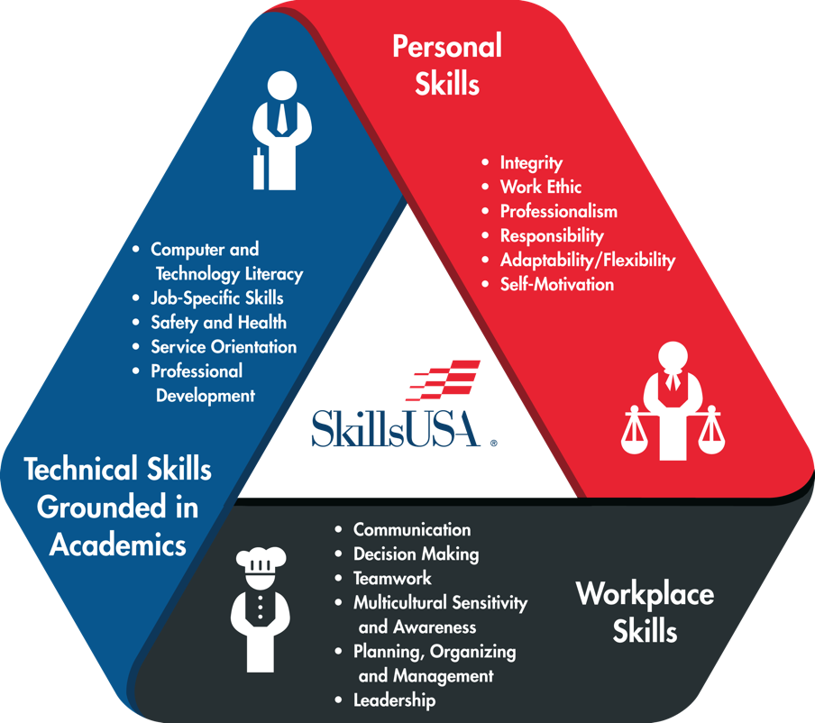
HOW SkillsUSA WORKS:
THE FRAMEWORK
IS THE KEY
Personal
Skills
The SkillsUSA Framework actualizes how students fulfill the mission of the organization “to empower members to become world-class workers, leaders and responsible American citizens.”
Technical
Skills
Workplace
Skills
Notes:
The framework is the key – quantifies and measures the SkillsUSA mission
Three components:
Technical skills grounded in academics—
Defined in partnership with industry
Every year, industry partners make sure it’s up to date and connected to needs
When partners in building trades told us we needed to incorporate steel framing—
The very next year, if you went to our national competition, you’d see students competing in a design that required both wood and steel framing
Workplace skills—Communication, Decision-making, Teamwork, Leadership--
The skills you need in ANY career these days
Personal skills—The hardest to define and the easiest to overlook, but the most important to long-term success
Integrity, Work Ethic, Professionalism, Responsibility, Motivation
Employing the Framework creates a culture of work

Slide 48
SkillsUSA members develop into well-rounded people with technical, academic and employability skills that will help them get a job and have a successful career.
SkillsUSA is an essential part of career and technical education. It provides the opportunity to develop technical, academic and employability skills, and it makes career and technical education more relevant to the demands of the work force.

Slide 49
What Employers really want in an employee:
Someone who shows up everyday
Someone who shows initiative
Someone with leadership skills
A teamplayer
Basic technical and academic knowledge
Give me that person and I can train them in my craft.

Slide 50
As a CTSO:
1) We offer students opportunities in Leadership
2) allow them to showcase their skills through competition.
3)These are offered through the running of the POW in local chapters and through our conferences.

Slide 51
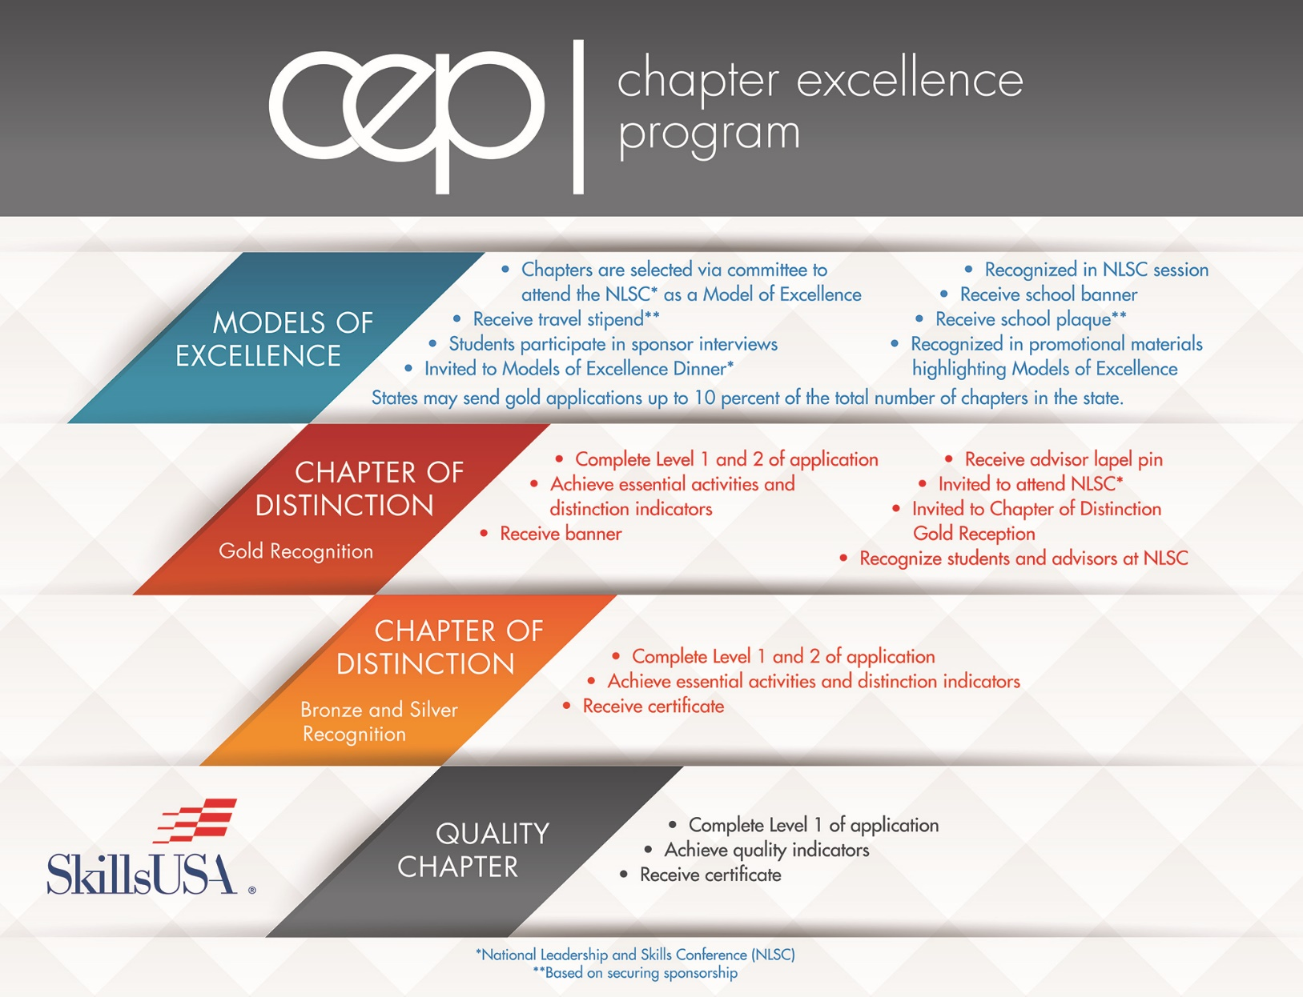

Slide 52
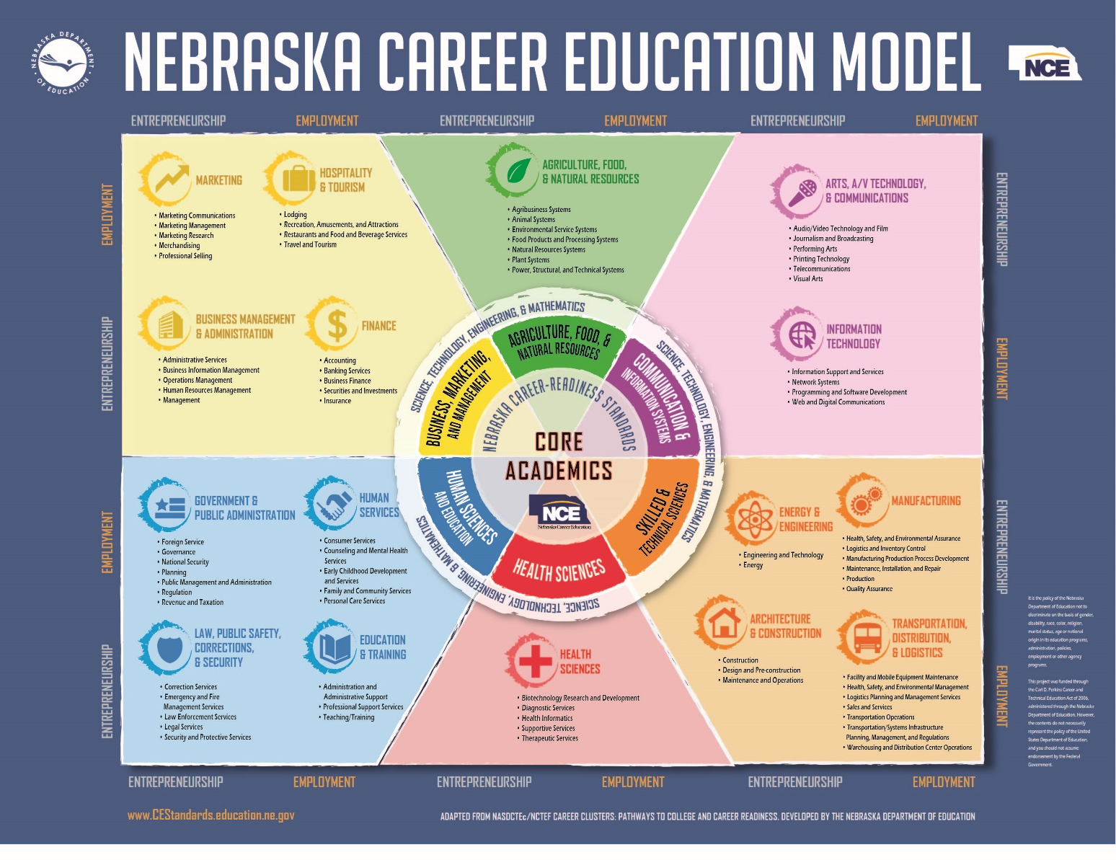

Slide 53




Skilled & Technical Sciences
Energy & Engineering
Engineering /Design Technology
Mobile Robotics
Urban Search & Rescue
Drone Technology
Mechatronics
Electronics Technology
Architecture & Construction
Architectural Drafting
TeamWorks
Masonry
Carpentry
Electrical Const Wiring
HVACR
Plumbing
Sheet Metal
Industrial Motor Control
Manufacturing
Additive Manufacturing
Technical Drafting
Cabinetmaking
Automated Manufacturing
CNC Technician
CNC Milling
CNC Turning
Precision Machining
Welding.
Welding Fabrication
Welding Sculpture
.
Transportation, Distribution, & Logistics
Automotive Service
Automotive Refinishing
Collision Repair
Diesel Equipment
Mobile Electronics Installation
Motorcycle Service
Power Equipment Technology
Collision Estimating

Slide 54

Health Sciences
Nurse Assisting
Basic Health Care Skills
Medical Assisting
First Aid/CPR
Medical Math
Medical Terminology
Health Knowledge Bowl
EMT

Slide 55




Human Sciences & Education
Government & Public Administration
Human Services
Early Childhood Education
Customer Service
Law, Public Safety, Corrections, & Security
Criminal Justice
Crime Scene Investigation
Firefighting
Education & Training

Slide 56




Business, Marketing, and Management
Marketing
Advertising Design
Business Management & Administration
Customer Service
Job Interview
Finance
Hospitality & Tourism
Culinary Arts
Commercial Baking
Restaurant Service

Slide 57


Communications & Information Systems
Information Technology
Web Design
Computer Programming
Information Technology Services
Internetworking
Technical Computer Applications
Arts, A/V Technology, & Communications
TV/Video Production
Audio/Radio Production
Photography
Broadcast News Production
Digital Cinema Production
3-D Visualization and Animation

Slide 58

Agriculture, Food, & Natural Resources
AFNR
Career Pathways Showcase
Drone Technology

Slide 59


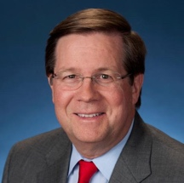
HOW SkillsUSA WORKS:
THE WORD FROM EMPLOYERS
“The thing about SkillsUSA that’s so cool and the reason that my foundation has supported it for years is that it is deliberately focused on celebrating a skill. Three million jobs right now exist in the trades and transportation and commerce. The skills gap is real. Training kids and getting them excited to do the jobs that exist ought to be job one. SkillsUSA does that in a big way.”
“For over a decade, Lowe’s has partnered with SkillsUSA to help students gain the valuable professional, workplace and technical skills needed to succeed. Our partnership is helping develop world-class leaders of tomorrow and ensuring our country has a talented, skilled workforce for years to come.”
“SkillsUSA students are in demand and they are better equipped than anyone out there. This organization improves lives and is indeed creating a better world.”
Jim Lentz
CEO
Toyota North America
Troy J. Dally
Senior Vice President, General Merchandising Manager, Seasonal and Services, Lowe’s Companies, Inc.
Mike Rowe
mikeroweWORKS Foundation
Notes:
Let’s not forget the perspective of the employers
[We can show you quotes like this all day]
“For over a decade, Lowe’s has partnered with SkillsUSA to help students gain the valuable professional, workplace and technical skills needed to succeed. Our partnership is helping develop world-class leaders of tomorrow and ensuring our country has a talented, skilled workforce for years to come.”
Troy J. Dally, Senior Vice President, General Merchandising Manager, Seasonal and Services, Lowe’s Companies, Inc.
“SkillsUSA students are in demand and they are better equipped than anyone out there. This organization improves lives and is indeed creating a better world.”
Jim Lentz, president, Toyota Motor Sales
“The thing about SkillsUSA that’s so cool and the reason that my foundation has supported it for years is that it is deliberately focused on celebrating a skill. Three million jobs right now exist in the trades and transportation and commerce. The skills gap is real. Training kids and getting them excited to do the jobs that exist ought to be job one. SkillsUSA does that in a big way. It’s about excellence and competition and being good at what you do, and eventually through all of that —learning who you are. SkillsUSA is working.”
Mike Rowe, mikeroweWORKS Foundation

Slide 60


Notes:
You’ve seen what we can do for you, and what we do for students,
We’re here to talk to you because we’re not done

Slide 61


Slide 62


Slide 63
Thanks for listening!!
Any Questions??

Slide 64
NEWC
Nebraska
Energy
Workshop
Consortium

Slide 65

N.A.S.T.S.E
Nebraska
Association
of
Skilled
and
Technical
Sciences
Educators
https://nebraskaststeachers.org/

Slide 66
STS Contacts
Tony Glenn
Tony.glenn@nebraska.gov
402-471-4819
Greg Stahr
Greg.stahr@nebraska.gov
402.471.0898
Resources from this presentation can be found at www.education.ne.gov/STS

Slide 67


