Slide 1
Preventing the Summer Slide
Abby Burke, Ed.D.
Reading Specialist
Nebraska Department of Education
abby.burke@nebraksa.gov

Slide 2
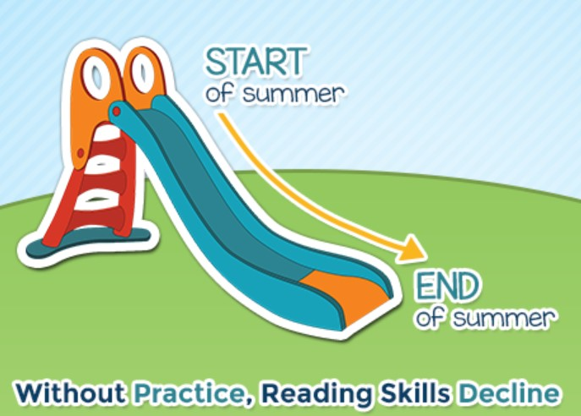
Research Shows
Summer slide is a decline in reading ability and other academic skills that can occur over the summer months when school isn’t in session.
Numerous studies show that kids who don’t read during summer break actually slip in reading ability by the time fall rolls around.

Slide 3
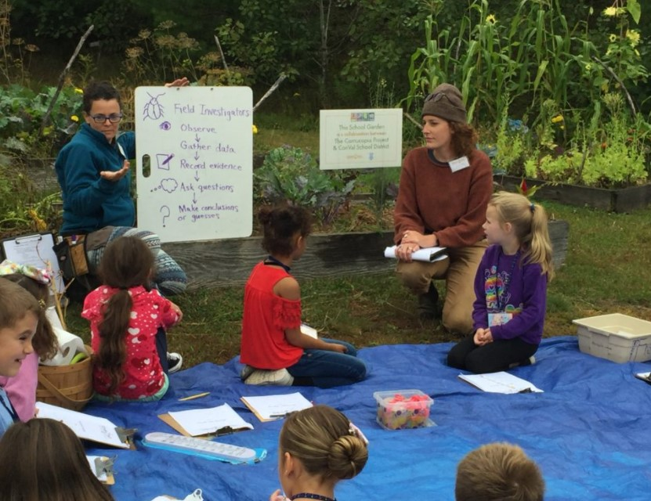
Describe evidence of literacy in this photo

Slide 4
Read about the Topic

Slide 5
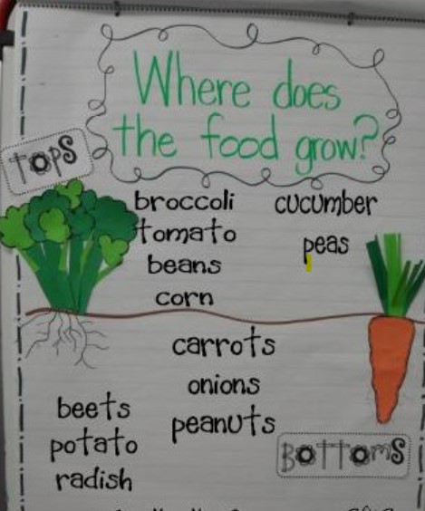
Connect Reading and Writing about the Topic

Slide 6
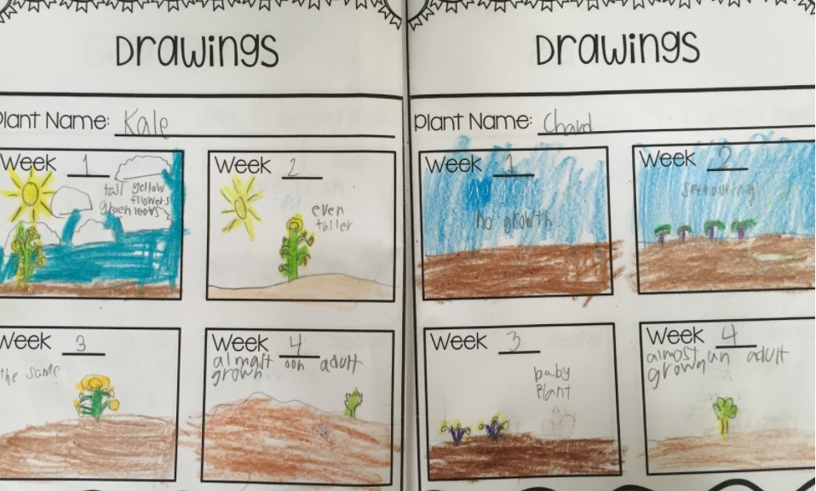
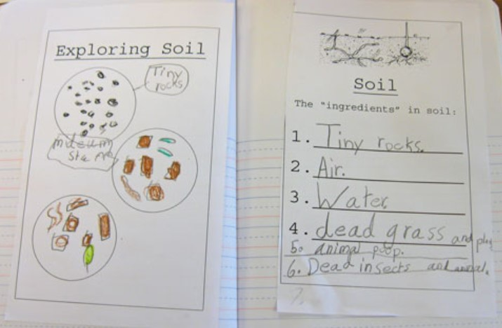
Draw and Write about the Topic

Slide 7
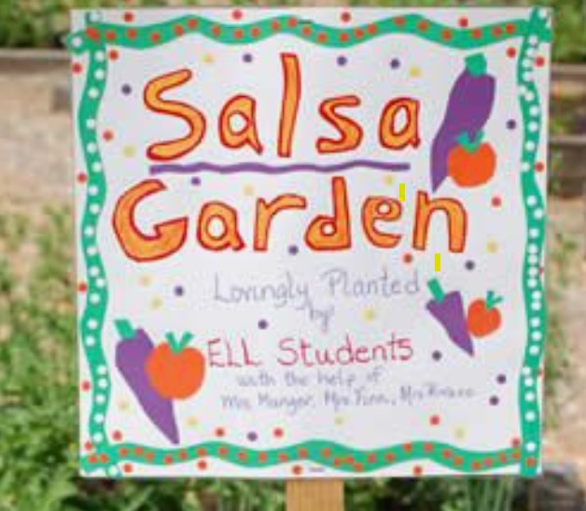
Talk about the Topic

Slide 8
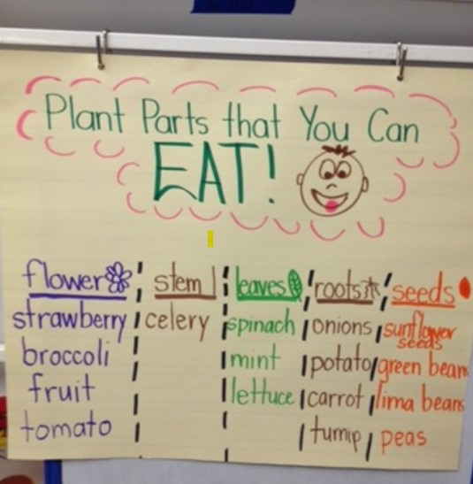
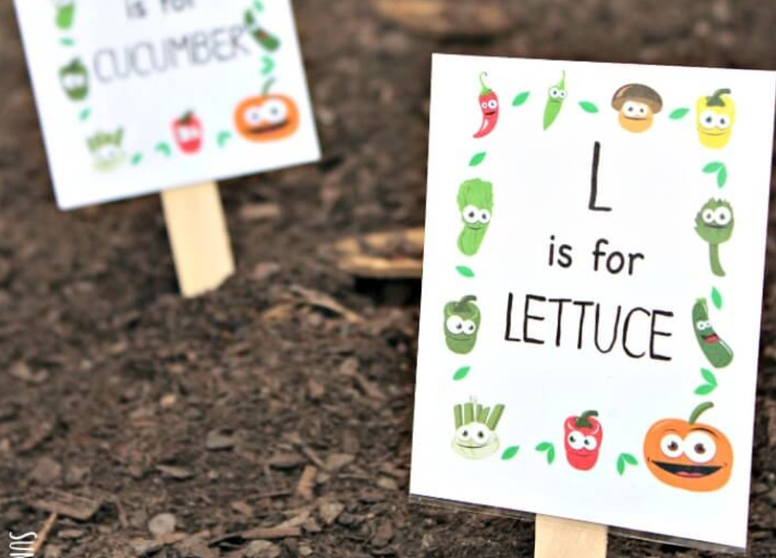
Write Together about the Topic

Slide 9
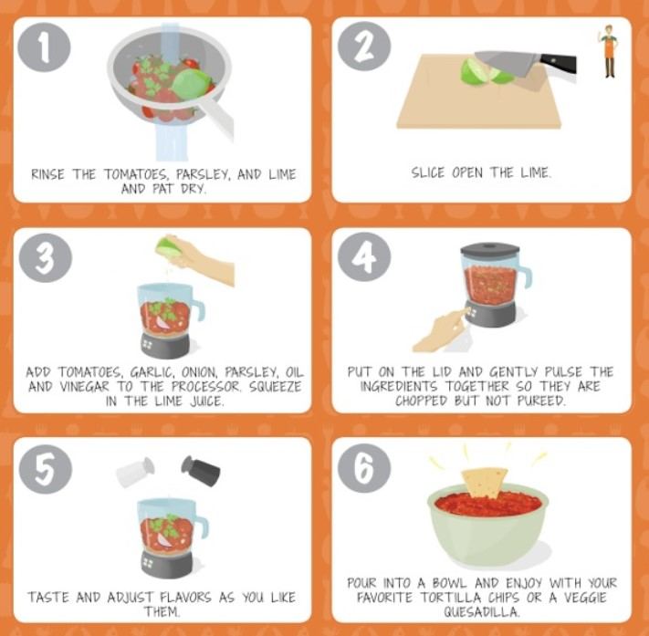
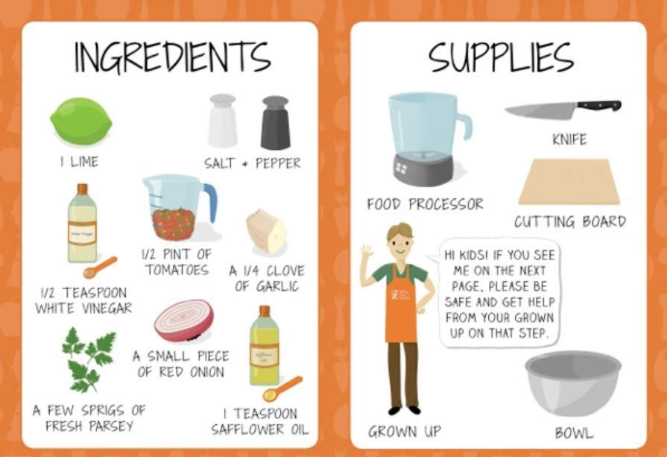
Integrate the Topic across Academic Area: Science, Social Studies, Math and Reading

Slide 10
Literacy Development in Action
https://youtu.be/dGqzekOVfsE

Slide 11
Reflections from our time together today….
I used to think _______________________.
But now I know ______________________.
I commit to __________________.

