Slide 1
NSCAS ACT Spring Online Testing Benefits

Slide 2
NSCAS ACT Test Date Options
 | Standard Time Paper | Accommodations Test Window Paper | Online Standard and Accommodations Testing Window
Test Window 1 | March 23, 2021 | March 23-26 & March 29-April 2 | March 23 –25 & March 30 - April 1
Test Window 2 | April 6, 2021 | April 6-9 & April 12-16 | April 6-8 & 13-15
Test Window 3 | April 20, 2021 | April 20-23 & April 26-30 | April 20-22 & 27-29
Select Test Date Deadline Monday November 30, 2020
Notes:
Please note that Accommodations can be used with the Online test if requested in the Test Accessibility and Accommodations System (TAA).

Slide 3
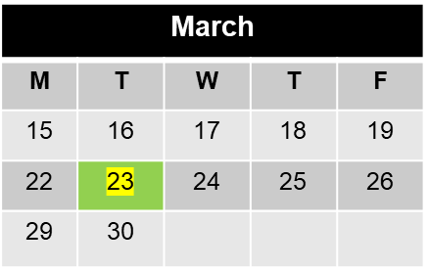
Standard Time Paper Test Dates
3 Testing Options
April
M | T | W | T | F
 |  |  | 1 | 2
5 | 6 | 7 | 8 | 9
12 | 13 | 14 | 15 | 16
19 | 20 | 21 | 22 | 23
26 | 27 | 28 | 29 | 30
Notes:
Here is a visual representation of the standard time paper test date options. There are 3 standard time paper test dates this spring.

Slide 4
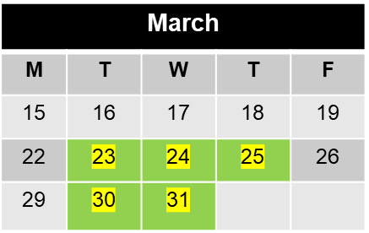
Online Testing Available Dates
18 Testing Options
April
M | T | W | T | F
 |  |  | 1 | 2
5 | 6 | 7 | 8 | 9
12 | 13 | 14 | 15 | 16
19 | 20 | 21 | 22 | 23
26 | 27 | 28 | 29 | 30
Notes:
Here is a visualization of the online test dates that are available across all three online test window this spring. As you can see, there are almost continuous dates available for approximately 6 weeks across the three windows if you utilize the online administration option. There are a total of 18 days when online assessments can be administered this spring.

Slide 5
Advantages to Online Testing
6 times more test dates (more testing flexibility)
Handle fewer test material
Reduce misadministration risk
Timing of test provided
Typing vs. handwriting the answer to Writing Prompt
Notes:
In summary here are some of the advantages for online vs paper test administrations this spring.

Slide 6
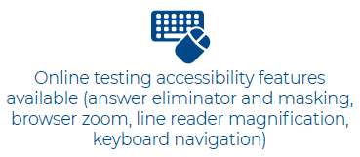
Online Accommodations Options
Notes:
In addition to standard time administration, students who require certain accommodations and supports may be able to leverage the online administration option.
Examinees who require extended time, stop-the-clock breaks, or text-to-speech can be tested online. Additionally, the online testing accessibility features include an answer eliminator, masking, browser zoom, line reader magnification, and keyboard navigation.

Slide 7
Pre Test Activities for
Paper Testing Schools
Select Test Dates
Verify Student Enrollment
Receive materials that will need to be secured
Order additional materials (if applicable)
Train room supervisors and proctors
Sort materials for distribution to room supervisor
Conduct non-test session with students
Notes:
This slide is a high level over of the pre test activities for schools who are going to utilize the paper administration option.
Please note that the non-test session is different this year compared to previous administration cycles. Starting this spring all non-test sessions will be completed in MyACT regardless of test mode. Instead of requiring that this non-test activity take place prior to the test date, students can complete that activity at myact.org up to 4 days after the test is administered.
The answer document for this spring will still contain minimal identifying information, which students complete on or before the test date. It will take approximately 10-15 minutes for students to bubble in the required fields on the answer document on the day of the test.

Slide 8
Pre Test Activities for Online Testing Schools
Select Test Dates
Verify Student Enrollment
Receive materials that do not need to be secured
Conduct pre test session with students
Create test sessions and assign students to sessions
Validate and lockdown devices
Print authorization tickets and obtain seal codes
Proctor cache content (recommended but not required)
Notes:
This slide provides an overview of the pre test activities for online testing schools. All students will be loaded into PANext with a paper testing mode, so examinees who are to test online will need their testing mode changed from paper to online.
As with a paper test administration, students will complete their Interest Inventory and Student Profile non-test activity in MyACT. This can be completed up to 4 days after the test. Additionally, there will be minimal non cognitive and identifying information collected on the test day within TestNav.

Slide 9
Post Test Activities
Online test sites
Package Admin forms and scratch paper for return, one package
Create sessions for makeup testing (if applicable)
Paper test sites
Package answer documents, test books and alternate format materials and Admin forms for return, multiple packages
Order materials for makeup testing (if applicable)
Notes:
This is a high level overview of the activities required after the test is administered. The packaging of paper materials for return is much more comprehensive and time consuming than the activity that is required for online testers primarily due to the amount of paper that is needed to support a paper administration. Schools who use paper testing will need to manually place an order in PANext for test window 2 or three if that window is being used for makeup testing. These orders will need to be submitted during predefined order windows and failure to meet the deadline means the school will not receive materials.
Schools who test online have less secure paper material that needs to be returned to ACT, and therefore the work to package the material isn’t as time consuming or cumbersome. There is also greater flexibility in when online test sessions can be created. Sessions can be created leading up to the test date itself which allows school staff greater flexibility in when and who is tested

Slide 10
NSCAS Phase I Pilot/ NSCAS Science Field Test Scheduling Guidance (NSCAS General)

Slide 11
NSCAS 2021 Scheduling Guidance
Grade Level | Content Area | Approximate number of test questions* | Recommended Scheduled Testing time*
3 – 8 | Phase 1 Pilot Mathematics | 35 | 60 minutes
3 – 8 | Phase 1 Pilot ELA | 35 | 60 minutes
5 and 8 | Science Field Test | 20 and 17 | 60 minutes
*Estimated-Vast majority of students should finish the assessment in this time or less.

Slide 12
Test Stopping Recommendations
Balancing test time and instruction is important. Most students should not need more than 1 hour to complete one subject. Districts may stop a student at 2 hours unless educators feel there is an educationally valid reason to continue and one of the following is true:
The student is still actively engaged in testing
The student has a documented need for extended time
The student requests additional time

Slide 13
2021 ELPA21 Summative
February 8 – March 19, 2021

Slide 14
No remote administration of ELPA21
Some of the issues:
Item security
Student access (bandwidth in the home, troubleshooting)
Standardization
Cost to replace items exposed by non-secure test environment
Validity of scores

Slide 15
Students who are remote learning during testing window
LEAs should provide an option for parents who want their student(s) to test to bring them in to test
Practice tests may be accessed at home via ELPA21 website: https://www.elpa21.org/elpa21-resources-for-remote-el-instruction/
Students who do not test will have a Reason Not Tested (RNT) code – likely Unable To Test (UTT) but still finalizing
Students who do not test will retain their EL status
RNT codes may be entered Feb. 22 – April 2nd

Slide 16
Important Dates
1/11/21– NDE data pull from district SIS to ADVISER to TIDE.
2/8 -3/19/21 – ELPA21 Summative window
2/22-4/2/21 – Reason Not Tested Codes may be entered
Early May 2021 – scores available

Slide 17
Allyson Olson Anne Hubbell allyson.olson@nebraska.gov anne.hubbell@nebraska.gov (402) 471-4694 (402) 471-2451

