Slide 1
Statewide Assessment Regional Workshop
October 2020

Slide 2
Statewide Assessment Staff
Director-Dr. Jeremy Heneger
Assistant Director-Dr. Trudy Clark
Assessment Program Coordinator-Maggie Sis
Special Education Assessment Liaison-Sharon Heater
Title III Director/ELPA21Coordinator-Allyson Olson
ACT Onsite Liaison-Iris Owens
NWEA Professional Learning Lead-Aly Martinez Wilkinson
Enhanced Assessment Grant Coordinator/Interim NAEP Coordinator-Rhonda True
Office Associates-Tyrina Webster & Stacey Weber
Notes:
Jeremy will introduce us.

Slide 3
Agenda
8:30-9:00 Check In
9:00-10:30 2020-2021 Assessment and Accountability Plan
10:30-10:40 Break
10:40-12:00 NSCAS Updates
Notes:
Probably done earlier but since we are only doing this once.

Slide 4
2020-21
Statewide Assessment and Accountability Plan
Notes:
Plans for spring….adapt to changes as they arise.
Thanks for your time and your work.

Slide 5
In 2020-2021, assessment should…
Help identify unfinished learning that may exist for each student.
Inform instruction and meet students’ needs, especially for the 2020-2021 Essential Content for ELA and mathematics.
Leverage existing data.
Have a clear purpose grounded in supporting teaching and learning.
Notes:
Social Emotional Learning///LaunchNE

Slide 6
Statewide Assessment: 2020-2021Priorities
  Support districts in leveraging assessment data to inform and guide teaching and learning.
  Assist with the transition to through-year adaptive summative assessment.
  Allow for research related to the impact of COVID.
Notes:
Commissioner asked us to reexamine our priorities for 2020-21 because of the impact of COVID and because we are approaching a point of transition.

Slide 7
Pivot Resources to Support Districts
Series of 5 & 8 Grade Formative Classroom Tasks
Extended Science Indicators for Non-Tested Grades
  Help Establish Grade Level Expectations for Students that Qualify for NSCAS Alternate
Instructional Clarification for Extended Science Indicators
  Provide Teachers with Instructional Suggestions for Teaching Extended Science Indicators for Students that Qualify for NSCAS Alternate
Pay for MAP Growth in Grades K-2 and 9-10
Notes:
Yet this fall, do not have specific dates but DAC Update as soon as these new resources are posted.

Slide 8
NSCAS Summative Assessments
Assessment | Grades | Content Area(s) | Spring 2021 Plan
ELPA21 | K-12 | English Learner Proficiency Test | Standard Administration
NSCAS ACT | High School | English Language Arts Mathematics Science | Standard Administration
NSCAS Alternate | 3-8, and High School | English Language Arts Mathematics | Standard Administration
NSCAS Alternate | 5, 8, and High School | Science | Census Field Test
NSCAS General | 5 and 8 | Science | Census Field Test
NSCAS General | 3-8 | English Language Arts Mathematics | Replace with NSCAS I Pilot

Slide 9
What does this mean for 2020-2021 NSCAS Summative?
(ELA & Math Grades 3-8)

Slide 10
Replace Spring 2021 NSCAS General Summative with NSCAS Phase I Pilot
NSCAS Phase I Pilot
  35 item assessment for both ELA and Mathematics.
  23 items based on current Table of Specifications (blue print).
    Fully adaptive at grade level
  7 field-test items to produce additional content for Through-Year Adaptive item bank.
  5 MAP Growth items to assist in understanding the relationship of NSCAS and MAP Growth.
Notes:
Current Iteration

Slide 11
Spring 2021 NSCAS Phase I Pilot
NSCAS Phase I Pilot
  Rationale:
    The fully adaptive CAT version allows for the quickest move to through-year assessment.
    Each student receives a specific test based on ability.
    Reduces spring testing time as compared to NSCAS.
    Uses Nebraska standards and blueprint.
      Same percentage of indicators
Notes:
Feedback provided to districts: Under further review, Vocab 25, Reading Comp 50, Writing Skills 25,

Slide 12
Recommendation:
2020-2021 Reporting and Accountability
No public reporting or individual student reports (ISRs) for parents.
Classifications and designations remain the same for 2020-2021.
  In other words, 2018-2019 classifications and designations would be maintained.
Begin waiver process from USDOE and work with Nebraska officials.

Slide 13
Recommendation:
2020-2021 Reporting and Accountability
Rationale:
  Changing nature of NSCAS Summative:
    Movement to through-year adaptive
  COVID impact on 2019-2020:
    Lack scores for AQuESTT Growth and Improvement Score Calculations
    Lack science score, moved field test to spring 2021
  COVID Uncertainty on 2020-2021:
    Uncertainty of impacts on teaching & learning
    Mixture of remote, in-person, and hybrid learning

Slide 14
Summative Statewide Assessment: Spring 2021
Assessment | Grades | Content Area(s) | Spring 2021 Plan | Timing
NSCAS ACT | Third-Year Cohort | ELA Mathematics Science | Standard Administration | Approximately 4 Hours
NSCAS Alternate | 3-8, and Third-Year Cohort | ELA Mathematics | Standard Administration | Varies Based on Individual Need
NSCAS Alternate | 5, 8, and Third-Year Cohort | Science | Census Field Test | Varies Based on Individual Need
NSCAS General | 5 and 8 | Science | Census Field Test | Estimated the Average Student will Need 90 Minutes. Recommend 2 Sessions
NSCAS General | 3-8 | ELA Mathematics | Replace with NSCAS Phase 1 Pilot | Estimated the Average Student will Need 60 Minutes. Recommend 1 Session per Content
ELPA21 | K-12 | English Learners | Standard Administration | 4 Separate Domain Tests Total time varies by grade level K-3 approx. 60 minutes; 4-12 approx. 120 – 150 minutes.
Notes:
Grade levels---all students Either General or alternate all students.

Slide 15
Participation Expectations-Exemptions
For both
  NSCAS Phase I Pilot (General ELA and Mathematics Grades 3-8)
  NSCAS General Science Field Test (Grades 5 & 8)
No Paper/Pencil or Translated Version
  Students requiring Paper/Pencil or Translated Versions are Exempt
  THIS YEAR ONLY (Spring 2021)
  Does not include NSCAS Alternate

Slide 16
Participation Expectations
As always the NDE expects 100% participation
  Federal Guidelines expect 95% participation
  Unusual Circumstances
  Completed Test or Reason Not Tested
Reason Not Tested
  Parent/Student Opt Out
  Emergency Medical Waiver
  COVID Wavier-Available 2020-21 Only
    To be determined if available for ELPA21-Stay Tuned
Notes:
Or someplace else – Jeremy clarify paper/pencil clarification
Sharon says Do a Good Job and science

Slide 17
Remote Testing*
NSCAS Summative Assessments will not have a remote option
  DO NOT violate security or assessment construct
Districts should plan to test remote learners
  Bring students to school or substitute location
  If families refuse: Use COVID Waiver
*ELPA21-Still determining availability of remote testing and COVID Waiver
Notes:
Jeremy – NSCAS vs Interim

Slide 18
NSCAS Updates

Slide 19
Security Agreements
Sent on Tuesday, October 6th
From Margaret.Sis@echosign.com
Sent to all DACs and Principals
Deadline Friday, October 16th

Slide 20
Data Processes
Clean Data Takes Team Work!

Slide 21
NSCAS Data Clean-Up
ADVISER
  Enrollment
    MAP Growth/NSCAS Phase I Pilot Rosters merge & records will not be deleted
    Students enrolled up to the last day of regular testing window are expected to test
  FTE
    FTE of 51% or higher is expected to test
  High School Third-Year Cohort
    Cohort year for 2021 testing season is “2022”
    ADVISER Request does require a review and not always approved

Slide 22
NSCAS Data Clean-Up
ADVISER (con.’t)
  Who Reports What (Version 4.0 dated 07/17/2020)
    https://cdn.education.ne.gov/wp-content/uploads/2020/07/Who-Reports-What-ADVISER-V-4.0-_-2019-2020_Final_-7-17-20-20.pdf
  Updating ADVISER
    Before June 30 – update your SRS/SIS and ensure data is bridged into ADVISER
    After June 30 – Submit a Follow-Up Request through your SRS/SIS
    Updates can take a few days, the later into the clean-up calendar

Slide 23
NSCAS Data Clean-Up
New Not Tested Codes
  GEN (General Assessment – for NSCAS Alternate only)
  STR (Student Refusal)
  TXT (Testing at External Program – for NSCAS General only)
NLE (No Longer Enrolled)
  Can be used for students who left your district before testing begins OR for students who are new to the district & tested at their previous district.
Notes:
Announced but not used

Slide 24
NSCAS Clean-up Calendar 2020-21
(Tentative)
Pre-Rostering Clean-up
  December 2020
Pre-Testing Clean-up
  February 2021
Post-Testing Clean-up
  Rnd 1 – May/June 2021
  Rnd 2 – June 2021
  Final – July 2021
NEP Review
  August/September 2021
7-10 day window at each phase
Do not wait 2 days before deadline to start review
ADVISER updates can take a few days to correct
Notes:
Anticipated

Slide 25
NSCAS Reporting Calendar 2020-21
(Tentative)
  Scheduled release dates for final student data files, ISRs and summary reports
    ACT & Alternate - August 2021
    General - September 2021
    NEP site (to the public) - September 2021
*Reports are available on the vendor sites until around mid November 2021.
Download your files and reports as soon as possible and save them in your own district’s local safe environment.
Notes:
Time limits
Process to download and store
Accessibility
Method to hand off to next DAC

Slide 26
NSCAS ACT
Notes:
Jeremy thanks them for Fall testing

Slide 27
Fall ACT
Order Standard materials due by October 9
Order Accommodation materials by October 14
For Make up October 20
Notes:
Thanks them
Jeremy fixReminder – unique times
No writing test

Slide 28
NSCAS ACT
Spring 2021
ACT test for the 3rd year cohort
ACT with Writing, available in paper or online
Accommodations and EL supports are available
Two test dates to choose from and an additional makeup date
Notes:
Jeremy

Slide 29

What’s New
ACT State Test Spring 2021

Slide 30
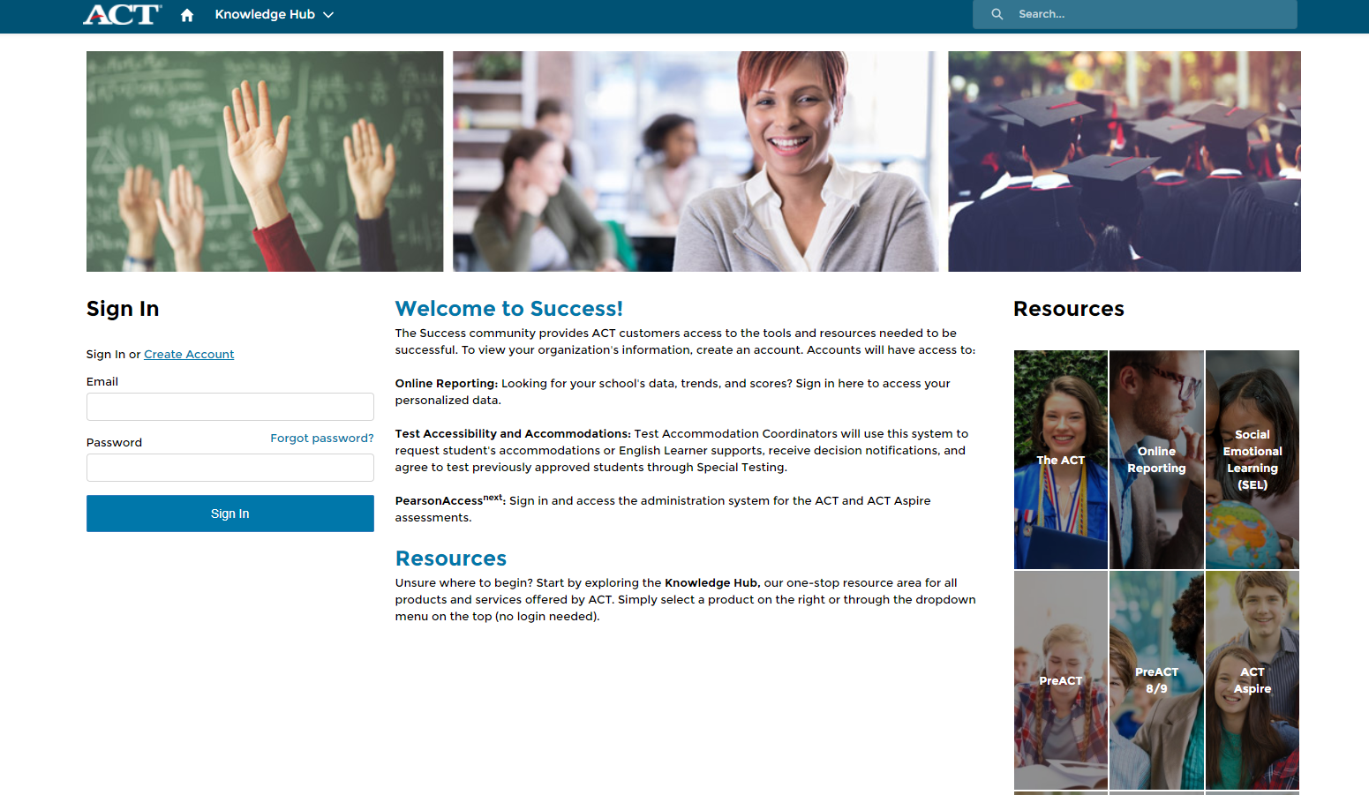
Success.ACT.org
Notes:
Iris starts here…
Success.act.org will be an important resource for the upcoming spring administration of the ACT. This will be where you navigate to access the online reporting and TAA systems.

Slide 31
Success.ACT.org
Trusted Agent- Responsible for Managing Access
Online Reporting
Test Accessibility and Accommodations
PearsonAccess^{next}
Notes:
The user who is established as the Trusted Agent is responsible for managing user access at their school or district. Last spring ACT distributed Trusted Agent access codes via physical letter which was addressed to the district Superintendent. While the access code must be delivered to the Superintendent, anyone that the Superintendent deems to be the appropriate individual to serve as the Trusted Agent can use the access code to establish their account at success.act.org.
If the Trusted Agent has not yet been established it is vital that the account be established ahead of the spring administration cycle.
Success.act.org is also where you will be able to navigate the online reporting system. Starting with the spring 2021 reporting cycle, all data and reports that result from the state test events will be accessible in the online reporting system. Data and reports will no longer be posted in PANext.
The ‘front door’ of the Test Accessibility and Accommodations (TAA) site has moved to success.act.org. If you had access to TAA in it’s old location, you should be able to access TAA by navigating to success.act.org and creating an account using the same email address that was used for your previous TAA account. If you did not have access to TAA previously and need access now, your Trusted Agent can invite you to TAA, or you can request access to TAA which your Trusted Agent can then approve. Please be sure to conduct these activities ASAP to ensure you’re not scrambling for access as key deadline dates approach.
Finally, you will be able to link to PANext from success.act.org. Please note that there is still a link to PANext embedded at your ACT hosted state testing website.

Slide 32
The ACT Online Reporting System
ACT will be providing the spring 2021score reports for students, high schools and districts in success.act.org under the Online Reporting system. All of these reports were previously available in Pearson Access Next, but will not after this fall administration.
This new system will be a location to find previous scores as well as current test administration information. Schools and districts will have access to state and national information.
Notes:
If you have any issues with access to this system in success.act.org, please contact me for more information.

Slide 33
ACT Online Testing
  Proctor Caching Requirements
  ACT has changed the current requirement for Proctor Caching from a required task to a recommended task for online testing. This means that districts who do not proctor cache will not be switched to paper admins. The districts must determine if they meet the minimum 100 kbps requirement.
  According to EducationSuperHighway, 100% of districts in Nebraska could access internet speeds of 100 kbps in 2018.
  NDE is strongly advising to continue to setup the proctor caching, as well as the mock administration and browser lockdown if you are testing online.
Notes:
This information was new last year. I did want to mention this again as a reminder. With all of the hybrid teaching options, it is in your school’s best interest to look into using the online testing for makeups or even your initial test. The flexibility will be useful as we move forward into our new normal.

Slide 34
ACT Accommodations and EL Supports
Access to Test Accessibility and Accommodations System - TAA
In Fall 2020, ACT created a new “front door” to the TAA system. If you have any questions about the access to the TAA system, please email Iris at iris.a.owens@act.org.
Accommodations for the spring test will be open November 1.

Slide 35
ACT 2021TEST DATES

Slide 36
ACT SPRING 2021 TEST DATES
Test Window 1
Standard Paper - March 23, 2021
Accommodations Administration Paper - March 23 - 26, March 29 - 31, & April 1 - 2
Online Standard and Accommodations - March 23 - 25, March 30 - 31, & April 1 (Tuesday, Wednesday, Thursday only)
Test Window 2
Standard Administration Paper - April 6, 2021* (* Tuesday after Easter)
Accommodations Administration Paper - April 6 - 9 & April 12 - 16, 2021
Online Standard & Accommodations - April 6 - 8 & April 13 - 15, 2021 (Tuesday, Wednesday, Thursday only)
Test Window 3 Makeup Only
Standard Administration Paper - April 20, 2021
Accommodations Administration Paper - April 20 - 23 & April 26 - 30
Online Standard and Accommodations - April 20 - 22 & April 27 – 29 (Tuesday, Wednesday, Thursday only)

Slide 37
Important Dates
10/5 ACT Online Prep opens this week, email will be sent
Schedule of Events released – TBD
Fall PreACT test window closes on October 30
11/2 PA Next and Accommodations opens
11/30 Manage Participation Deadline
Spring PreACT information and ordering Jan/Feb

Slide 38
ACT Webinars
Accommodations Webinar Mid November
Test Administrations #1 Webinar January
Test Administrations #2 Webinar February
These dates are TBD at this time, they will be included in the Schedule of Events with dates and links to registration.

Slide 39
PearsonAccess^{next}
(PA Next)

Slide 40
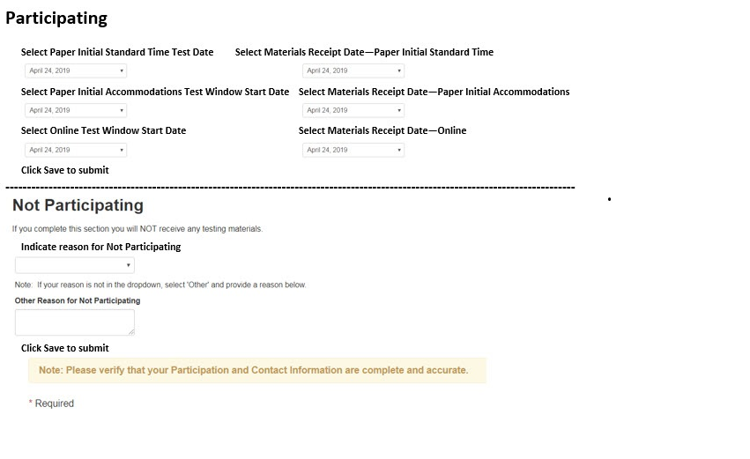
Manage Participation Deadline11/30/2020

Slide 41
ACT Online Prep and PreACT

Slide 42
District Choices
ACT Online Prep and PreACT were the district choices for 2020-2021. There was a rise in requests for the AOP.
Notes:
Based on choices emails with directions

Slide 43
ACT Fee Waivers

Slide 44
2019-2020 Fee Waivers for Nebraska
Nebraska students used 77% of the fee waivers distributed in 2018-2019.
In 2019-2020, only 70% of fee waivers distributed to Nebraska schools were used.
30% were unused, 7% more than the year before.
Approximately 21,000 11th and 12th graders were eligible for the fee waivers. 3,334 fee waivers were requested and 2,300 were used.

Slide 45
ACT Fee Waivers
What the ACT Fee Waiver Covers-
Eligible students may use a maximum of FOUR separate fee waivers. These waivers cover the registration and late fees for either the full ACT with writing or no writing.
The waiver covers one HS report and up to six college choices at registration. After registration, the student can request unlimited regular score reports for free.
Additional benefits include access to online Test Prep Tools and access to the ACT Self-Paced Course powered by Kaplan, all at no cost.
https://www.act.org/content/dam/act/unsecured/documents/FeeWaiver.pdf
Notes:
Free Additional Score Reports
You can send additional ACT score reports for free to colleges and/or scholarship agencies at any time during your college search process. Your fee waiver covers one report to your high school and up to six college choices. After registration, you can request up to an additional 20 regular score reports for free.
Apply to Colleges—For Free
College application fees can really add up, but there’s good news! Students who test with an ACT fee waiver may also request a Waiver or Deferral of College Admission Applications Fee. To have a college application fee waived, you must submit your fee waiver directly to the college you are applying to (not to ACT).

Slide 46
How to Order Fee Waivers
Go to the College and Career Readiness Information System (CCRIS)
Select the radio button “Go to Ordering”
If you don’t have an account, you will need to create one
Questions? Call ACT at 800.553.6244 x 2800

Slide 47
Important Reminders

Slide 48
Important Reminders
Bookmark the ACT-Nebraska website.
Continue to pay close attention to forms and which window they are assigned.
Get accommodation requests in early.
Avoid non-college reportable.
Do not hesitate to call Iris.
All third-year cohort students need to take NSCAS ACT or NSCAS Alternate. DO NOT test students that are not in the third-year cohort.
Plan for students in external programs.
Read your ACT emails, manuals and supplements.
Notes:
Iris

Slide 49
Misadministrations and
Prohibited Behaviors
Notes:
Jeremy

Slide 50
Misadministrations
Misadministrations Can Cause Scores to be Cancelled
Reasons for Scores to be Cancelled
Rooms not set up correctly | Standard time use with Accom materials
Conflict of Interest with staff | Accom use with Standard time materials
Unauthorized transferred materials | Additional information provided
Advanced access to test content | Tests timed incorrectly
Pre-test info completed on test day | Tests administered on the wrong day
Tests not given in correct order | Different timing codes in same room
Test materials are duplicated | Answers not transferred properly
Notes:
I hope none of you have a misadministration and even fewer prohibited behaviors during your test. If you can avoid these common reasons, you will have fewer scores that are canceled due to a misadministration. [read screen]
Test booklets are one of the common mistakes Nebraska makes, since State Testing is different than National testing. In National tests, examinees with Timing Code 6- Extended Time use Standard tests and are in a different room. With the State Test, all accommodations use the Accommodations Test materials.
Many schools have called about staff with family members. According to ACT Test Administration, if you have a family member testing in the state of Nebraska during this test window, you cannot be a Test Coordinator. You can be a proctor or room supervisor if you are not in the same room as the family member. The example I like to share is Joan’s cousin Susan has a son testing in Gering, Joan is a test coordinator in Ponca. Joan will need to find a substitute test coordinator, but she can assist with the accommodations room in her school.
If you believe a misadministration occurred, call ACT immediately for assistance. There are many instances that ACT will allow the student to test again.

Slide 51
Watch for and Document Irregularities
Watch for and Document Irregularities
Prohibited Behavior by Students
Working or Looking Behind or Ahead in the test booklet
Giving or Receiving Assistance
Marking Ovals After Time is Called
Copying or Removing Test Materials
Using Notes or Aids (including prohibited calculators)
Accessing electronic devices (including cell phones)
Using inappropriate behavior or causing distractions
Notes:
Here are some examples of Prohibited Behavior by Students, Individual Irregularities, and Group Irregularities.
Complete a detailed Irregularity Report for each occurrence and attach the affected answer documents to the report as necessary
Do not submit an Irregularity Report if no irregularities occur.
If you are just suspicious that a prohibited behavior has occurred, give the examinee a warning and monitor their further activity. Complete an Irregularity Report with your suspicions and the actions that were taken.

Slide 52
ACT Score Replacement

Slide 53
ACT Score Replacements
Due to the optional test this fall for the cohort who was not able to test in spring 2020, score replacements were not processed.
This will be available again for spring 2021 accountability.
The form is found on the ACT page of the NDE Assessment website.
Notes:
Jeremy-intended for students with extremely high scores and students must meet the criteria

Slide 54
Parental Consent
US Department of Education Guidelines
Family Educational Rights and Privacy Act (FERPA)
Individuals with Disabilities Education Act (IDEA)
Protection of Pupil Rights Amendment (PPRA)
Districts will need to obtain parental consent
  Fill out Interest Inventory
  ACT to share information with third parties
NDE has samples on the Assessment website for you to use.
Paper, electronic or phone confirmations will be accepted.
Notes:
Jeremy

Slide 55
ACT Contact Information
Iris Owens iris.a.owens@act.org
ACT Accommodations ACTStateAccoms@act.org
District testing or other ACT products Carrie Ridenour Carrie.Ridenour@act.org

Slide 56
NSCAS Alternate

Slide 57
Alternate Assessment
2020-2021 NSCAS Testing Windows
ELPA21
  February 8-March 19
NSCAS General & Alternate
  March 22-April 30 Primary Window
  May 3-May 7 Make up Window
Notes:
Sharon

Slide 58
Alternate Assessment
Based on Alternate Assessment Flag as entered by the districts data manager
Districts do not receive materials
  Online or Print on demand materials (at the district)
  Proctors input answers into the online system
DRC INSIGHT
Recorded proctor training available
Online Tools Training (Practice Opportunity) available in INSIGHT (formally eDIRECT)
Census Field Test for Science

Slide 59
1% Wavier Request Public Comment
To apply for a wavier, NDE is required to put our proposal out for public comment
NDE’s request will be made available on the NDE website/Assessment

Slide 60
Alternate Assessment
1% Threshold documents are still required to be completed this year
Justification for the Exception to the 1% Threshold for Alternate Assessment
  Communication coming the around the end of October
    Change in document for this year – question #3 is not required this year (USDOE told us that we got a pass for this year)
    All districts are required to complete this document
Justification Support Worksheet
  Needs to be completed by all districts
  Section on training of staff is not required for this school year only
Notes:
Sharon

Slide 61
Alternate Assessment New Resource
  Science Extended Indicators
    Instruction Clarifications
      Include Sample Tasks/lessons to support grades 5, 8 and high school
    Updated Science Extended Indicators will be posted soon
    Please make sure you are sharing this information with your special education staff
    Science Extensions for other grades will be coming
Notes:
Sharon

Slide 62
NSCAS General

Slide 63
NSCAS General
2020-2021 NSCAS Testing Windows
ELPA21
  February 8-March 19
NSCAS Phase I Pilot, Science Field Test & Alternate
  March 22-April 30 Primary Window
  May 3-May 7 Make up Window
Notes:
Sharon

Slide 64
Supported Devices
Technology – Supported Devices
Proctor Station
Student Devices
Windows 7, 8.1, or 10
  Microsoft Edge or IE 16
Mac OS X v10.12 to 10.14
  Safari 11 or higher
PC and Mac
  Firefox 64 or higher
  Chrome 71 or higher
Chromebook v65 or higher
  Chrome 71 or higher
iPad – not fully supported
Windows 7, 8.1, or 10
Mac OS X v10.12 to 10.14
iOS 9 to 13
Chromebook OS 65 or higher

Slide 65
ELPA21– Supported Devices
Test Delivery System for Test Administrators is web-based.
Student Devices
Windows 8, 8.1, or 10
Mac OS X v10.11 to 10.16
Linux (64-bit or 32-bit)
  Fedora 30-31 LTS (Gnome)
  Ubuntu 16.04 LTS (Gnome)
Linus (64-bit only)
  Ubuntu 18.04, 20.04 LTS (Gnome)
iOS/iPadOS (Ipads)
  12.4, 13.4, 14a
Chrome OS 84+
For more information, refer to: https://ne.portal.cambiumast.com/core/fileparse.php/3694/urlt/ELPA21_Technology-Setup-Quick-Guide_20-21.pdf

Slide 66
Phase I Pilot & Science Field Test Supports
  Item Type Sampler is currently available both online and in paper
    English and Spanish are available for download now through the Assessment Portal, there will be an order process for large print and Braille.
  Pre-assessment
    The pre-assessment is a paper form made up of a subset of items from the online item sampler that reflect a range of ALDs to help educators understand alignments and still get information on student performance.
  Professional Learning support
    To help educators identify and understand differences in ALDs, Range ALD progressions supporting documents tied to the Item Type Samplers will be available.

Slide 67
NSCAS Science

Slide 68
Waiver
What does this mean for statewide science assessments in 2020-2021?
5th and 8th grade students will only have to take one science test in the spring of 2021.
The tests in the spring of 2021 for 5th and 8th grade students will be a required field test aligned to Nebraska’s College and Career Ready Standards for Science (NCCRS-S).
Districts will not receive results from the field tests. Field tests are conducted to “test” the assessment questions/prompts not “test” students.
Results from the field test will not be reported to the public on the Nebraska Education Profile (NEP) nor be used in the calculations of the AQuESTT accountability system.
Field tests are used to inform the process as we move towards an operational test in 2021-2022.
What does this mean for science teaching and learning 2020-2021?
Grade-level science instruction should be aligned to Nebraska’s College and Career Ready Standards for Science (NCCRS-S). Teaching towards the legacy science standards should be discontinued.

Slide 69
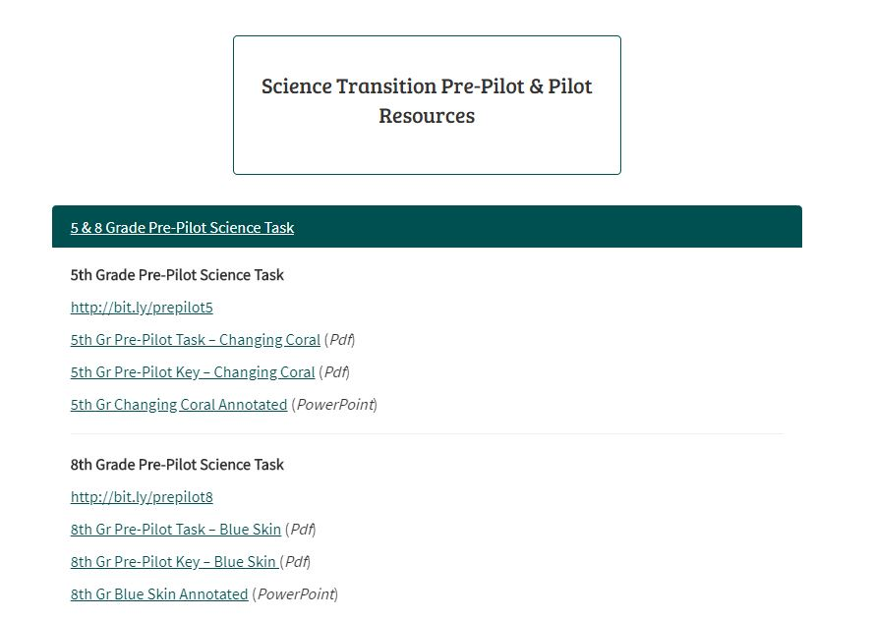
Found on the NDE Statewide Assessment webpage

Slide 70
5th grade pre-pilot task http://bit.ly/prepilot5
5th Gr Pre-Pilot Task – Changing Coral (Pdf)
5th Gr Pre-Pilot Key – Changing Coral (Pdf)
5th Gr Changing Coral Annotated (PowerPoint)

Slide 71
8th grade pre-pilot task http://bit.ly/prepilot8
8th Gr Pre-Pilot Task – Blue Skin (Pdf)
8th Gr Pre-Pilot Key – Blue Skin (Pdf)
8th Gr Blue Skin Annotated (PowerPoint)

Slide 72
Additional Resources
Test Blueprint and supporting material
  Recording introducing the materials
Item Type Sampler (practice opportunity)
Guidance on Scheduling
ALDs
Notes:
Jeremy needs to add link

Slide 73
Strengthening Claims-based Interpretations and Uses of Local and Large-scale Science Assessment Scores
(SCILLSS)
Funded by the US Department of Education’s Enhanced Assessment Instruments Grant Program (EAG)
Collaborative partnership including three states (MT, WY & NE) four organizations, and 10 expert panel members
Four year timeline (April 2017 – December 2020)
Resources Available:
Website: scillsspartners.org
Tools/templates & process guides to develop classroom formative science tasks including a facilitators toolkit to lead the work
Assessment literacy modules
Assessment system self-evaluation protocol
Notes:
Rhonda

Slide 74
Stackable, Instructionally-embedded, Portable Science (SIPS) Assessments
Funded by US Department of Education’s Competitive Grants for State Assessments (CGSA)
Collaboration with 8 states (AL, AK, MT, WY, NM, NY, SC, NE) & 5 organizations (edCount LLC, the Center for Assessment, the Learning Sciences Research Institute at the University of Illinois, SRI International, and Creative Measurement, LLC)
Three year timeline: (October 2020 to September 2023)
Objectives and Activities
Develop prototype science units with common instructionally embedded assessments at grades 5 and 8
Engage educators in classroom assessment development workshops to develop this bank of tasks and grow their assessment literacy
Engage educators to evaluate students’ learning and make appropriate instructional decisions
Notes:
Rhonda

Slide 75
  Science Formative Classroom Task Development & Repository for Grades 5 & 8
  Collaboration - NDE, NWEA and edCount, LLC
  One week in June & July
  50+ participants from districts, ESUs and NWEA
  24 formative classroom tasks were created for each 5th and 8th grades that cover the breadth of the grade standards
  Developing a repository to house the tasks with all the design tools to support the development of the tasks.
  More information to be coming about this soon!
Notes:
Rhonda

Slide 76

NAEP 2021
  Math & Reading
  Grades 4 & 8
  Assessment window January 25 to March 19, 2021
  Sampled schools have been notified
        54 districts
        100 Schools
      (smaller sample this year)
Notes:
Rhonda

Slide 77
NSCAS Interim
(MAP Growth)
Questions should be directed to NWEA Customer Service.
Phone: 855-225-9926
Email: NWEANebraska@nwea.org

Slide 78
Remote Testing Resources
NWEA Community page compiling all remote testing resources available
Guidance for scheduling and planning remote testing
Proctor pre-test checklist provides a list of what proctors need to test
Video tutorials available to show remote testing in action on Community page
Parent-facing letters and guidance to help appropriately support students during testing
Troubleshooting guide for help resolving any technical issues that may occur
Resources: MAP Growth Remote Testing Resources, Recommendations for Remote MAP Growth Testing, Proctor Pre-Test Checklist, Remote Testing Troubleshooting Guide,

Slide 79
MAP Growth 2020 Norms
MAP Growth 2020 Norms released in July
  Data collected over 2015-16, 2016-17, 2017-18 School Years
  Added Course-Specific Math Norms (Geometry, Algebra 1&2)
  Term pairs of Spring-to-Fall added
  Added instructional weeks of 0 and 1
K-2 Scale Maintenance
  In July, NWEA performed scale maintenance on K-2 tests
  Conversion File available to compare pre- and post-scale maintenance
  RIT scores
Resources: MAP Growth 2020 Norms FAQ, Course-Specific Math Norms FAQ, MAP Growth K-2 Scale Maintenance FAQ, K-2 Scale Maintenance Conversion File Help Section

Slide 80
Spanish MAP Growth Updates
Text-to-Speech now available for Spanish tests in the
subjects of Math and Reading
Accessible Tests available in Spanish for students needing
Screen Reader application support
Updated Spanish MAP Growth Reading Norms

Slide 81
Comprehensive/Combined Data File Updates
Additional information available in the CDF including:
  Student State ID, School State ID
  Rapid-Guessing Percentage
  Growth Quintiles (Lo, LoAvg, Avg, HiAvg, Hi)
Columns and fields have shifted, partners may need to
update database systems to ingest this new information
and new format
Resources: New Data Fields in CDF Community Article

Slide 82
Recovery & Goal Setting Data File
Recovery & Goal Setting Data File
  Student-level file that helps identify students most impacted by interrupted learning due to COVID-19
  Learn how students' normative achievement changed from a prior term in the 2019-20 school year
  Determine the growth needed for students to reach their pre-COVID-19 achievement levels by spring
  Also find out the growth needed to reach 50th (average) percentile to help with appropriate goal setting
Resources: Recovery and Goal Setting Data File Help Section
Notes:
MAP Growth Future Release (Estimated Aug 24th – Sept 11th)
Recovery & Goal Setting data file (student level data file that helps identify students that were most impacted by the interrupted learning caused by the Covid-19 pandemic).
Updated Spanish Reading Norms (Updated norms will include status norms for fall, winter, and spring and growth norms for fall-to-winter, fall-to-spring, and winter- to-spring term pairs. The updates will be available for grades K-8).
K-2 Scale maintenance conversion file (simple data file that allows users to compare our previous K-2 data to the new K-2 scale alignment data)

Slide 83
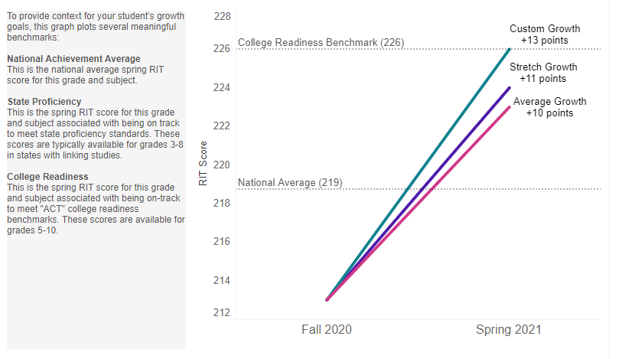
MAP Growth Goal Explorer Tool
New Tool to Help Better Set Goals
Provides average amount of Growth + Stretch Goal and Custom Goal options
Can help educators set higher goals due to loss
Resources: MAP Growth Goal Explorer Tool
Notes:
Partners can input a MAP Growth score from spring and see where a student might have landed in the fall. This can help educators understand potential loss due to summer or COVID-19. Can only input one student at a time.

Slide 84
Professional Learning
Notes:
Aly

Slide 85
Professional Learning
Professional Learning Lead - Nebraska
  Aly Martinez Wilkinson
Certified Facilitator (CF) Program
  72 CFs across the state
  Monthly eNewsletter
  4 recorded and 6 live webinars
  Workshops to provide content which can be delivered to schools and districts
  Professional Learning "Save the Date"
Notes:
Aly

Slide 86
Balanced Assessment System Workshops
Assessment Literacy
Formative Assessment
Quality Classroom Assessment (New)
  October 21 & 23, full day
Triangulating Data for Instructional Insights
  November 17 or 19, a.m. session
  Applying Classroom Assessment Standards
    November 17 or 19, p.m. session
  Using ALDs to Ensure Classroom Rigor
  January 26 or 28, a.m. session
  Student-Centered Assessment Literacy
  January 26 or 28, p.m. session
Clarifying Learning:
  December 1 or 3, a.m. session
Providing Feedback
  December 1 or 3, p.m. session
Activating Learners:
  April 13 or 15, a.m. session
Eliciting Evidence:
  April 13 or 15, p.m. session
Notes:
Aly
School and district leaders deepen their knowledge of essential elements for supporting a balanced assessment system that maximizes student growth and achievement.
Describe attributes of and purpose for a balanced assessment system
Reflect on key assessment practices for student engagement

Slide 87
Registration and Plus-Ones
Work with CFs for registration
Upcoming

Slide 88
Writing with Evidence
Engage in examining the skills necessary for students to succeed in evidence-based writing
Explore strategies for teaching writing that can boost these skills.
Plan how to implement expanded or new ideas in your classroom
  Understanding and developing best instructional practices to support evidence-based writing across the curriculum
  Strengthen classroom practices that ensure students are on a trajectory to succeed with post-secondary writing challenges
Notes:
Aly

Slide 89
Questions???

Slide 90
Thank you!

