Slide 1
Raising the Bar: Nebraska’s World Language Standards
Stephanie Call,
Education Specialist, World Language
Office of Teaching, Learning & Assessment
stephanie.call@nebraska.gov
Register NOW at: https://forms.gle/Akx7GdaEKcHpuFpN8

Slide 2
Stephanie Call
Education Specialist, Nebraska Department of Education
Spanish: Advanced High-Superior
French: Novice Low-Novice High
Register NOW at: https://forms.gle/Akx7GdaEKcHpuFpN8

Slide 3
Introductions
Why do you think this is your proficiency level?
Name, School, Language
Proficiency Level
Register NOW at: https://forms.gle/Akx7GdaEKcHpuFpN8

Slide 4
Learning Targets
I can identify and find information in the standards document.
I can compare the standards document with my current program model.
Register NOW at: https://forms.gle/Akx7GdaEKcHpuFpN8

Slide 5
Introduction to the World Language Standards
Dissecting the Standards

Slide 6
The Five Strands of World Language Learning
Communication
Culture
Connections
Communities
Cognition

Slide 7
Activity: Search and Find

Slide 8
Reading the Nebraska World Language Standards
Strands
“Essential ingredients” or areas of concentration
Standards
Broad, overarching goals of what students should be able to do at any level
Indicators
Specific learning targets for a specific level

Slide 9
Indicators by Language Level
NOVICE
INTERMEDIATE
ADVANCED
Identify
Recognize
Recite
Choose
Compare
Contrast
Explain
Connect
Associate
Dissect and examine
Reason
Elaborate

Slide 10
Indicators by Language Level
NOVICE
INTERMEDIATE
ADVANCED
Words
Phrases
Short, concrete ideas
Strongly familiar, predictable
Phrases
Simple sentences
Simple, concrete details
Familiar
Longer sentences
Richer detail
Across time frames
Familiar and unfamiliar

Slide 11
Establishing A Goal
Connecting the Standards to Programming

Slide 12
So what grade is Novice?

Slide 13
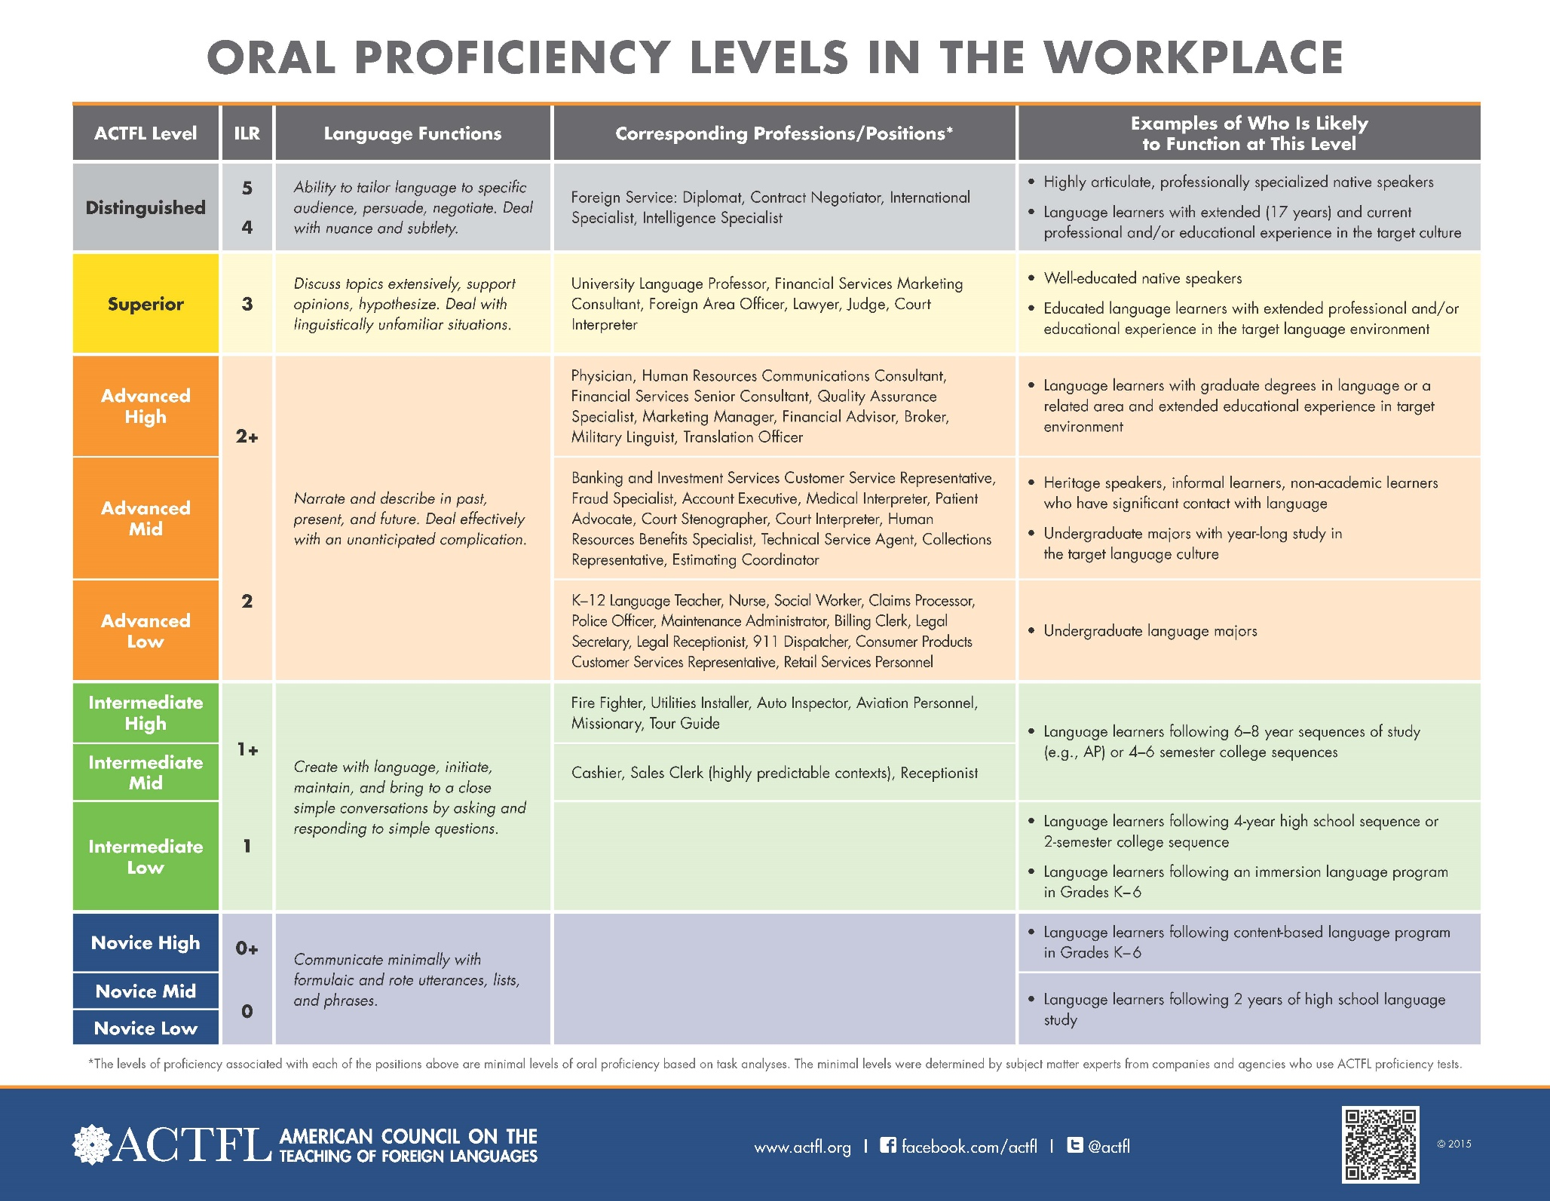

Slide 14
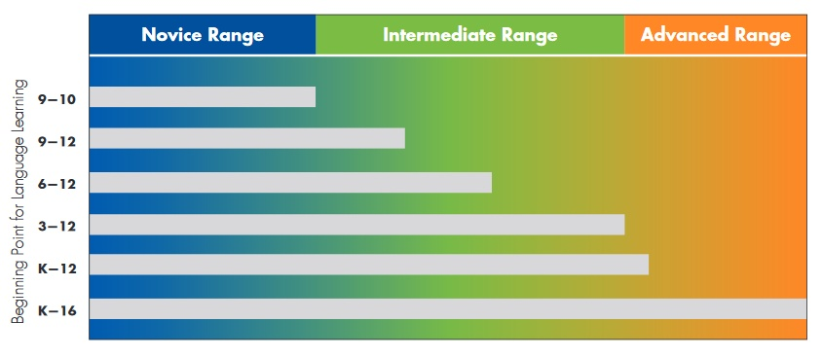
Source: “Figure 4: Time as a Critical Component for Developing Language Performance”, ACTFL Performance Descriptors for Language Learners, 2012 Edition, Alexandria, VA: ACTFL, p. 6.

Slide 15
In Real Terms
Job Posting: Monster.Com, Posting active 7/29/2019
Language Proficiency Level: Advanced Low
Years of Study: 9-12 school years

Slide 16
Assignment: Perspectives
Parents | Administrators
Counselors | Students
Consider how individuals in the following roles might respond to the WL Standards?
What questions will they have?
What thoughts or concerns will they have?
What might appeal to them?

Slide 17
Standards and Indicator Breakdown
What does this document have to do with my practice?

Slide 18
Activity: Status Quo Expectations

Slide 19
Activity: Activity by Standards

Slide 20
What do I do in my class?
List activities that you do in your class that specifically focus on this standard.
You may reference indicator level.

Slide 21
Phases of Implementation
Let’s Get Started!

Slide 22
Exploration | Initial | Scale Up | Deep Implementation and Sustainability
Designate a team | Share with all stakeholders the established proficiency goal | Fully implement new curriculum, instruction, materials, and resources | Collaborate with external organizations to support and grow programming
Become familiar with NE WL Standards | Develop plan that addresses areas of need in curriculum and materials | Create an ongoing review process to assess development | Monitor implementation process and make adjustments as needed
Establish ultimate proficiency goal shared by all stakeholders | Develop plan to address areas of need in instruction and development | Share with all stakeholders progress and goals | Share with all stakeholders progress and goals
Create a timeline for implementation | Create collaboration opportunities to grow change efforts | Create focus groups for areas of support such as modes, assessment, digital resources, etc. | Develop consistent conversations with graduates to assess
Review and determine areas of need | Ensure that revised standards are guiding discussion and planning | Develop a system to track student assessment | Develop a systemic review of assessments, feedback, and needs

Slide 23
What’s Next
Raising the Bar

Slide 24
Instructional Shifts
Emphasis on student use of language
Embedded interculturality
Connections to careers, academic pathways
Student responsibility for learning

Slide 25
Fear: What makes me nervous/worried?
Positive: What do you like? What are you looking forward to?
Question: What question or consideration do you have?

Slide 26
Stay informed.
World Language Review
Facebook
Get connected.
NILA
Regional roundtables
Share out.
Community stakeholders
Guidance counselors
Administrators

Slide 27
Stephanie Call
Education Specialist, World Language
Nebraska Department of Education
stephanie.call@Nebraska.gov
402-471-4331

