Slide 1
Nebraska World Language Standards
Stephanie Call
Education Specialist, World Language
Nebraska Department of Education
Register NOW at: https://forms.gle/Akx7GdaEKcHpuFpN8

Slide 2
Marhabaan مرحباً
Ismi Stephanie. اسمي ستيفاني
Register NOW at: https://forms.gle/Akx7GdaEKcHpuFpN8

Slide 3
?Kayf halakum? كيف حالكم
Kways
Mush saab
Kab
Register NOW at: https://forms.gle/Akx7GdaEKcHpuFpN8

Slide 4
?Kayf halik / halak?
Kways
Mush saab
Kab

Slide 5
Stephanie Call Education Specialist, World Language stephanie.call@nebraska.gov 402-471-4331 education.ne.gov/worldlanguage
Spanish Teacher
Prom Advisor
Yearbook Advisor
Speech Coach
Class Advisor
Department Chair
Curriculum Coordinator
Community Outreach
Character Development Coordinator
School Improvement Committee
Technology Integration Specialist
Summer School Asst. Principal
BS Education (Spanish)
University of Nebraska Lincoln
MS Technology Integration
Lesley University
MS Educational Leadership-Principal and Curriculum Coordinator
Cardinal Stritch University
Register NOW at: https://forms.gle/Akx7GdaEKcHpuFpN8

Slide 6
I can summarize the impact of the world language standards on curriculum and instruction.

Slide 7
Language is Fundamental
Understanding the function of world language learning

Slide 8
Q: What is the function of world language learning?
A: To provide an underlying skill that supports every possible career field, higher education option, and life choice.
“It suddenly struck me that that tiny pea, pretty and blue, was the Earth…I didn’t feel like a giant. I felt very, very small.”
Neil Armstrong

Slide 9
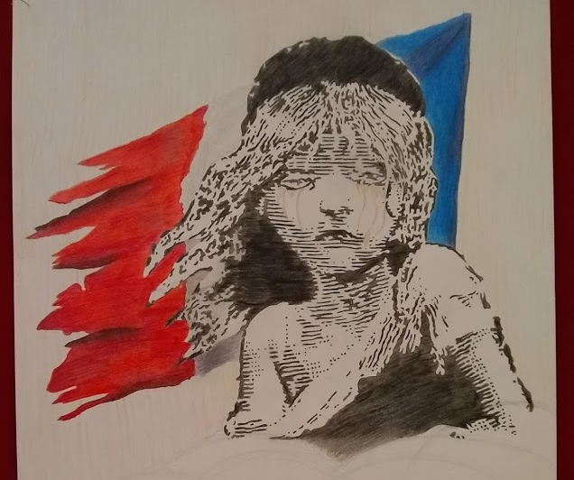
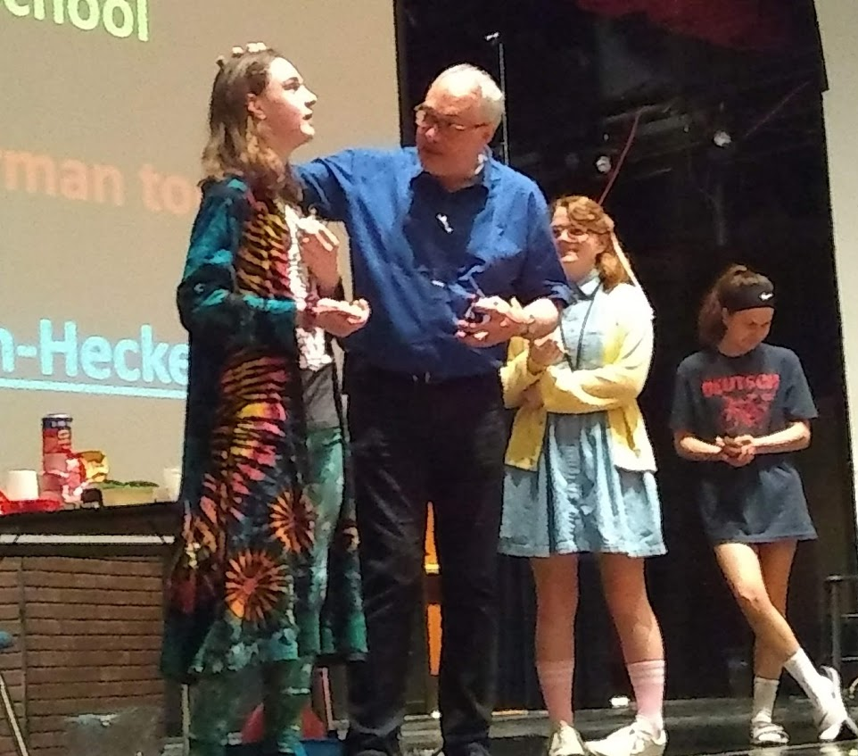
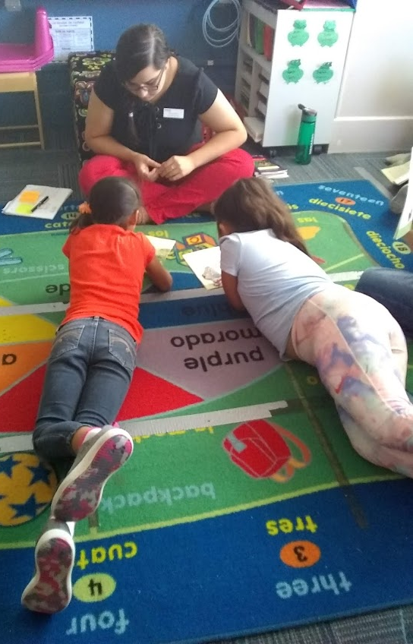
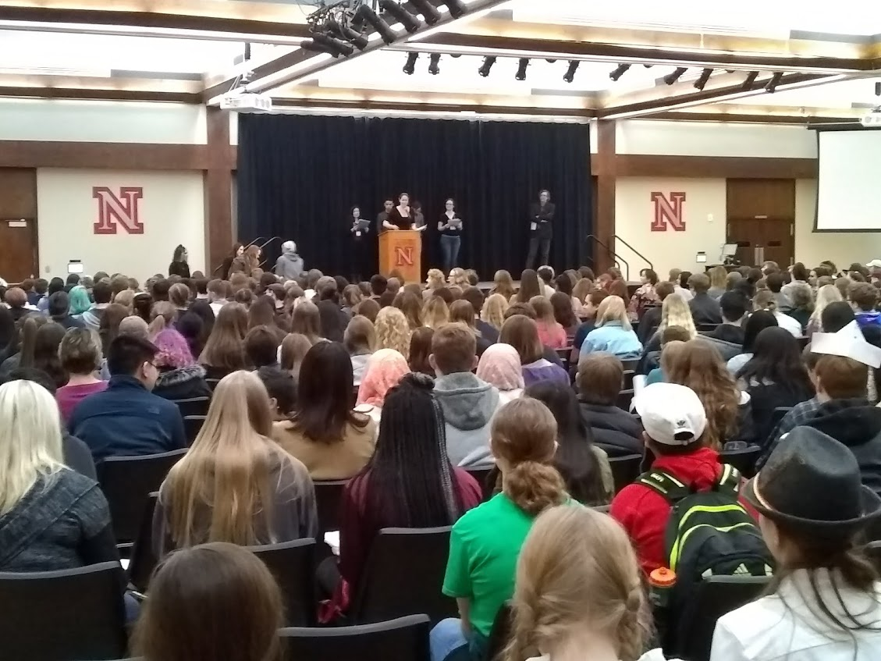
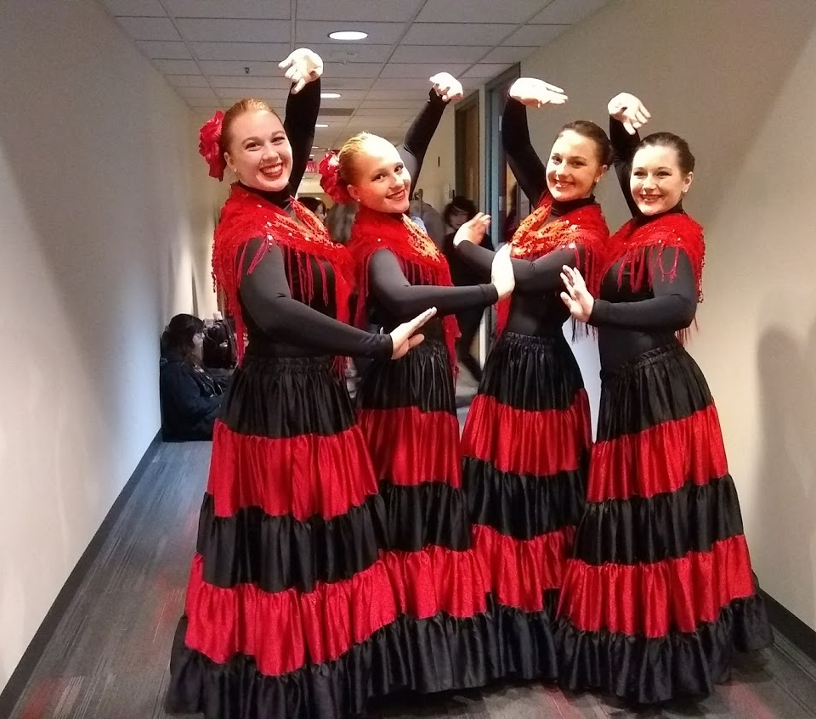
Using the Language

Slide 10
Standards: Shifts
What are the paradigm shifts in the revised World Language standards?

Slide 11
World Language Standards
Strands
Five areas of focus that should be a part of any world language program at all levels. These are our foundational beliefs.
Standards
Ten overarching goals that students should be able to do, know, or think at any level of language learning.
Indicators
Learning targets for specific proficiency levels.

Slide 12
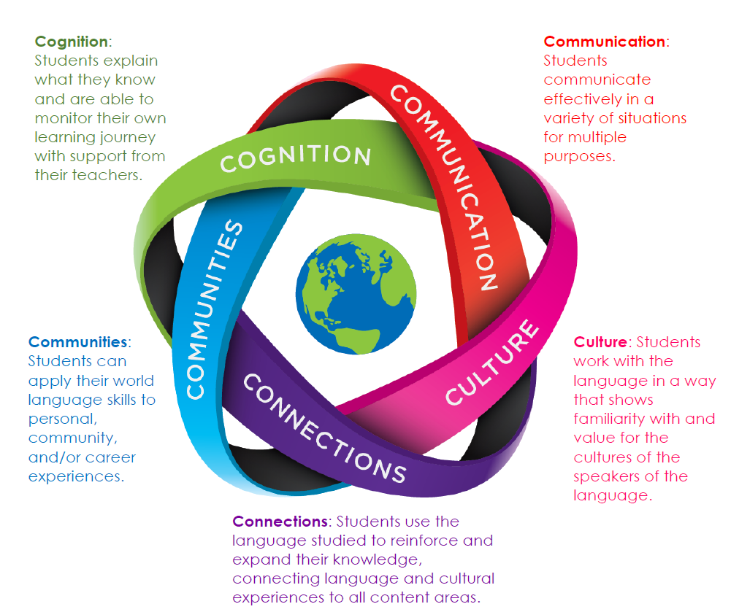
Strands

Slide 13
Paradigm Shifts
Emphasis on student use of language
Embedded interculturality
Connections to careers, academic pathways
Student responsibility for learning

Slide 14
Impacts on Curriculum and Instruction
What textbook do I have to buy?

Slide 15
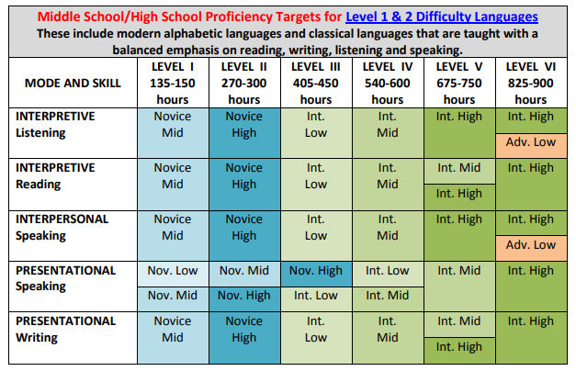
District Needs Assessment
Each district will have to determine the level of proficiency required at the end of the program.
“Proficiency Targets”, Ohio Department of Education, June 2014

Slide 16
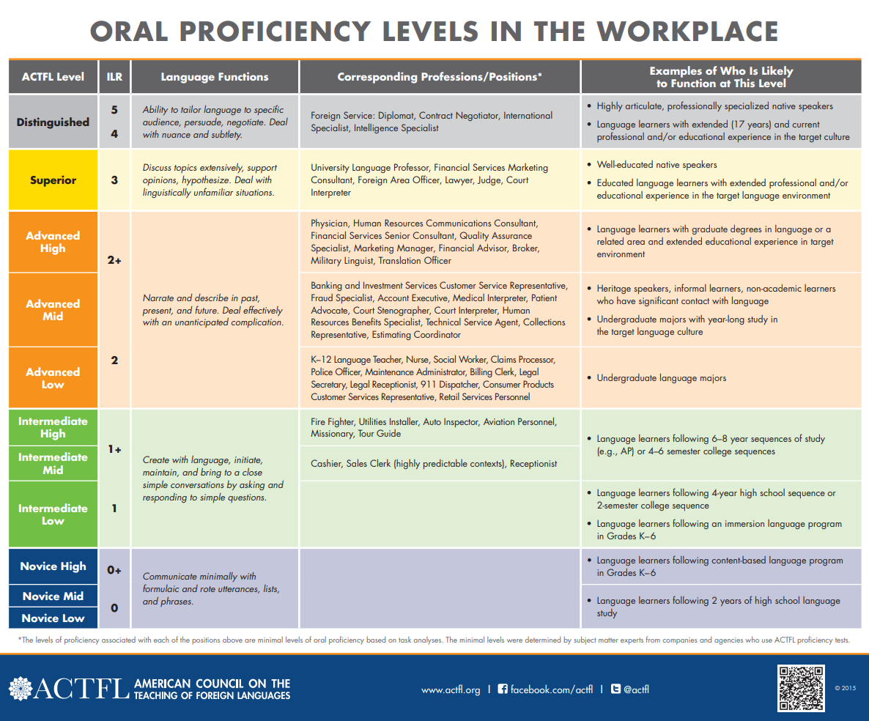
An example…
Notes:
This chart shows the level of language proficiency needed to perform successfully at different jobs. Novice proficiency is characterized by short messages on predictable, everyday topics using isolated words or phrases. Intermediate language proficiency indicates an ability to create simple questions, answers, and descriptions in brief sentences that are at least minimally connected. Advanced proficiency reflects the ability to engage in conversation in a variety of settings with creative, complex, and descriptive language. A cashier would only need to learn a few specific expressions as the amount of interaction is limited by setting. However, a financial advisor would have to be able to understand the needs of the client, negotiate a financial package, and use specific financial terms.

Slide 17
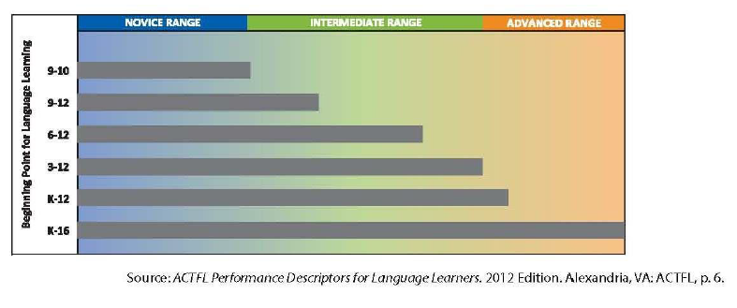
Time as a Critical Component for
Developing Language Performance
Notes:
Time is the most critical component in developing language performance. There are, of course, other influencing factors such as student interest, teacher ability, and access to support and resources. However, assuming the law of averages, this chart indicates that a student who studies a second language during the first two years of high school will, at best, meet the Novice High level. A student who has the advantage of 12 years of study will meet the Advanced Low level of language proficiency. This is more logical than one might first think. English is a requirement from pre-K through grade 12. Our students can speak English as early as Kindergarten, but clearly we feel that they are not prepared for college yet.

Slide 18
In Real Terms
Language Proficiency Level: Advanced Low
Years of Study: 9-12 school years
Job Posting: Monster.Com, Posting active 7/29/2019

Slide 19
Curriculum
Establish a goal for proficiency at the end of the program.
Create a pathway to proficiency using indicator guidelines.

Slide 20
Curriculum Materials
The standards are about what students DO, KNOW, or UNDERSTAND. It’s less about the materials and more about how they’re used.

Slide 21
Instruction
Students are responsible for:
Learning objectives
Learning applications
Learning plans
Speaking
Reading
Writing
Applying languages to community and career
Connecting language to other content areas
Connecting to language resources
Embedding a cultural understanding in language use

Slide 22
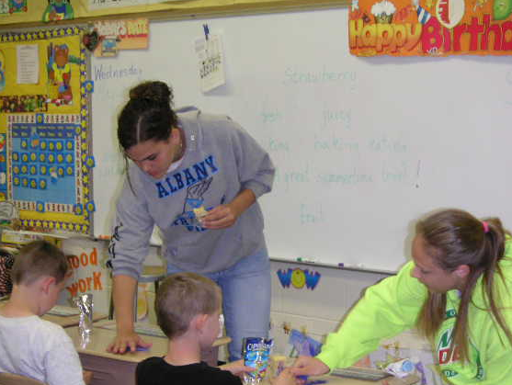
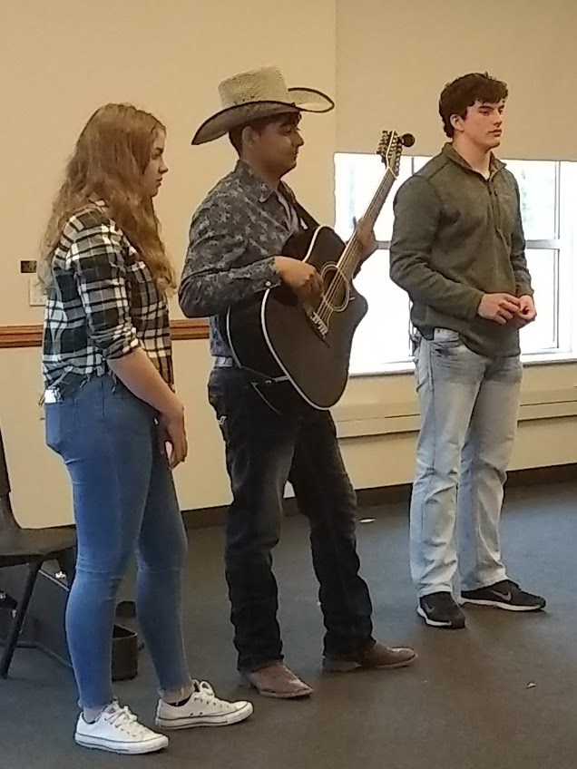
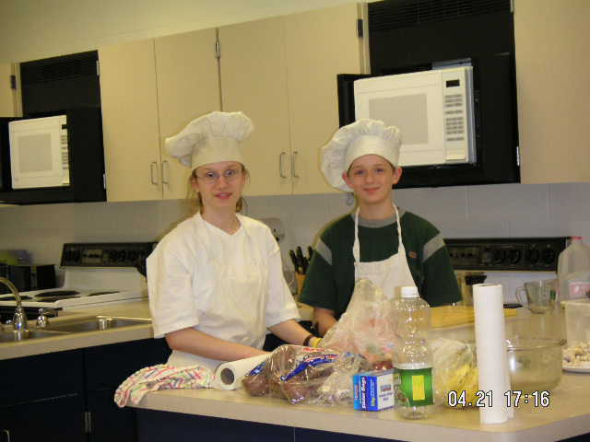
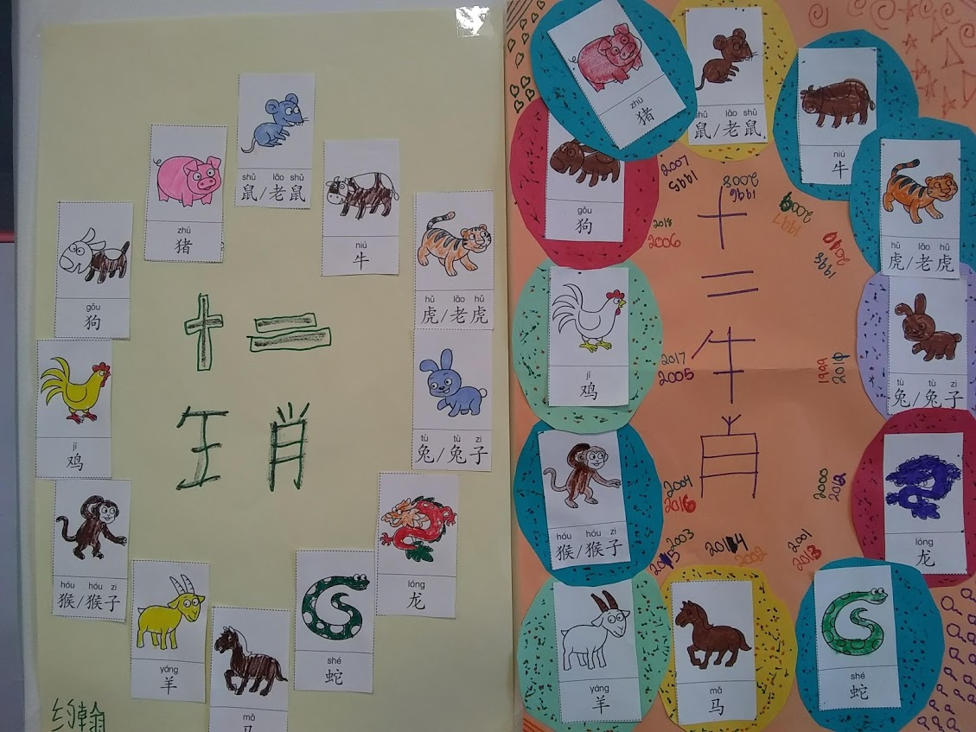
Instruction Looks Like…

Slide 23
Implementation
How and when do the standards have to be implemented?

Slide 24
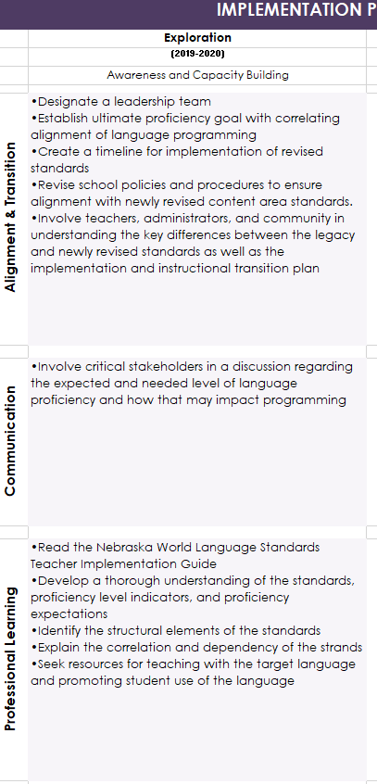
Implementation
Gradual
Responsive to district needs assessment

Slide 25
WL Review Website Facebook

Slide 26
Ma’ al-salamah مَع السَلامة
Stephanie Call Education Specialist, World Language stephanie.call@nebraska.gov 402-471-4331 education.ne.gov/worldlanguage

