Slide 1
NSCAS Science
Test Design
December 2019

Slide 2
Presenters
Jeremy Heneger-Director of Statewide Assessment at the Nebraska Department of Education
Kellen Conroy-Teaching & Learning Specialist at ESU1
Rhonda True-Enhanced Assessment Grant Coordinator at the Nebraska Department of Education
Notes:
Thanks to Kellen and Rhonda and all NE educators that have been instrumental in the development of NSCAS Science. The new CCR science standards require a paradigm shift and that includes the way that educators all over the country are approaching large scale science assessment. NE educators from classrooms, buildings, districts, and ESU have been integral to this transition from the writing of the standards to the development of the assessment. Can’t thank them enough for the pushing themselves and us towards the new assessment.

Slide 3
Topics for the presentation
Field Testing 2020
Blueprint and test design
The NCCRS-S Language and Connections to the Blueprint
Available Resources
Notes:
May want to download the blueprint before you continue with the presentation

Slide 4
NSCAS Science Census Field Test
Spring of 2020 for both NSCAS Science General (5 & 8) and Alternate (5, 8, & 11)
Field Test-we are testing the test as opposed to testing students
Making sure the tasks and prompts are of high technical quality.
Student, schools, and districts will not receive scores. Scores will not be reported or used in accountability.
Notes:
Census-all students, need all students because we need to field test as many tasks as possible
Typically field test is embedded but this is stand-alone

Slide 5
NSCAS Field Test - Design
Task-based and focused on a phenomenon/problem
Multiple prompts, typically 6-8 per task
All prompts are at least 2-dimensional
No standalone or 1-dimensional prompts
Reflects the proportion of 3-dimensional elements (SEP, DCI, & CCC) in the NCCRS-S
Allows for any combination of 3-dimensional elements in tasks and prompts to make sense of phenomena
DCI will be grade level target
Unlike ELA and Mathematics it is NOT adaptive
Student will not be able to go back, important information will be brought forward
Notes:
Tasks-information on left graphs, text, visual
prompt/questions on right

Slide 6
NSCAS Field Test - Length
Number of tasks: About 6 per form
4-5 operational tasks
(1-2 field test embedded tasks during operational years)
Number of prompts: About 42 per form
36 operational prompts, range of +-2 prompts
Time to administer:
The average students should complete in about 75 minutes
Estimates based on pilot information
Expect large variability
NDE will communicate additional information with NSCAS Scheduling Guidelines
Recommending 90 minutes and dividing it into 2 sessions

Slide 7
Item Type Samplers for NSCAS General
Available December 20, 2019
Opportunity for 5th and 8th grade students to experience the test format and design prior to field testing
Important for all students to have an opportunity to experience the samplers prior to Field Test
Based on Spring 2019 Pilot Test, but updated
Each grade will have 2 practice tasks
Approximately 5 prompts per task

Slide 8
Online Tool Training (OTT)
for NSCAS Alternate
Already available in DRC INSIGHT-password to access
Opportunity for 5th, 8th, and 11th grade students to experience the alternate test format and design prior to field testing
Important for all students to have an opportunity to experience the OTT prior to Field Test

Slide 9
Table of Specification (TOS)
vs.
Blueprints
Essentially synonymous and can be used interchangeably
Selected blueprint because the new design is significantly different than the legacy design
Purpose is twofold
Test design consistency
Transparency

Slide 10
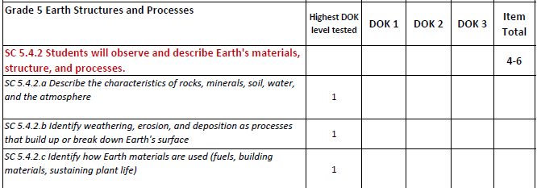
Legacy
Table of Specification (TOS)

Slide 11
New NSCAS Blueprint
Notes:
Frequency
Gather analyze
Test would be too long if we had enough tasks to test all the grade level content
Frequent yearly
Infrequent two year
Rare three years------not know which year
Topics at grade level
SEP and CCC grade bands so they are all eligible
SEP Asking questions and defining problems & Constructing explanations and designing solutions are broken apart

Slide 12
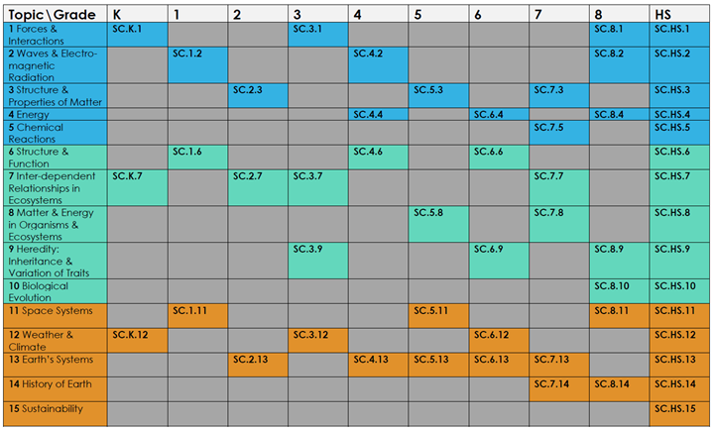
New NSCAS Blueprint
Notes:
Frequency
Gather analyze
Test would be too long if we had enough tasks to test all the grade level content
Frequent yearly
Infrequent two year
Rare three years------not know which year
Topics at grade level
SEP and CCC grade bands so they are all eligible
SEP Asking questions and defining problems broken apart
Construction explanations and designing solutions

Slide 13
New NSCAS Blueprint
Notes:
Frequency
Gather analyze
Test would be too long if we had enough tasks to test all the grade level content
Frequent yearly
Infrequent two year
Rare three years------not know which year
Topics at grade level
SEP and CCC grade bands so they are all eligible
SEP Asking questions and defining problems broken apart
Construction explanations and designing solutions

Slide 14
New NSCAS Blueprint
Notes:
Topics are a progression
SEP and CCC grade bands but also have progressions
Science and Engineering Practices and Crosscutting Concepts as represented in Appendices F and G, respectively, of the Next Generation Science Standards (NGSS; NGSS Lead States, 2013)^{[1]} demonstrate the growth in complexity and sophistication across the grades.
[1] NGSS Lead States. (2013). Next Generation Science Standards: For states, by states. Washington, DC: The National Academic Press. Retrieved from https://www.nextgenscience.org/search-standards. Next Generation Science Standards is a registered trademark of Achieve. Neither Achieve nor the lead states and partners that developed the Next Generation Science Standards were involved in the production of this product, and do not endorse it.

Slide 15
The NCCRS-S Language and Connections to the Draft NSCAS Science Blueprint
Notes:
Kellen
Image: Nebraska College and Career Ready Standards for Science: https://cdn.education.ne.gov/wp-content/uploads/2017/10/Nebraska_Science_Standards_Final_10_23.pdf
Let’s take a look at the language of the Nebraska College and Career Ready Standards for Science and how the language connects to the Draft NSCAS Science Blueprint.

Slide 16
What we want students to know
What we want students do
How we want students to think
Notes:
Kellen
Image: Nebraska College and Career Ready Standards for Science: https://cdn.education.ne.gov/wp-content/uploads/2017/10/Nebraska_Science_Standards_Final_10_23.pdf
(From previous slide) Let’s take a look at elements of the Nebraska College and Career Ready Standards for Science and how those elements connect to the Draft NSCAS Science Blueprint.
The NCCRS-S are written 3-Dimensionally meaning that included in every indicator is a Science and Engineering Practice (SEP), a Disciplinary Core Idea (DCI), and a Crosscutting Concept (CCC). As we look at the image here, we can see when we break each down, what we’re asking of teaching and learning.
Science and Engineering Practices (SEPs)
What we want students to do
Will be bold within the NCCRS-S Indicators
Total of 8
Are written as examples within the indicators. A combination of practices may be used to help students make sense of the content.
Disciplinary Core Ideas (DCIs)
What we want students to know
These will have no special text features within the NCCRS-S Indicators (i.e. no bold, italicized, underline, etc.)
Total of 13
From where Nebraska’s 15 Topics in the Topic Progression (Appendix A of the NCCRS-S Document) come from.
Crosscutting Concepts (CCCs)
How we want students to think
These will be underlined within the NCCRS-S
Total of 7
The DRAFT NSCAS Science Blueprint that Jeremy referred to earlier, also encompasses the 3-Dimensions of the NCCRS-S so that teaching, learning, and assessment align. However, it is important to note that while the NSCAS Statewide Science Assessment is at Grades 5 & 8, K-12 science education is immensely important and topics included in the K-12 Topic Progression (Appendix A) connect to and build on one another as students progress through their education.

Slide 17
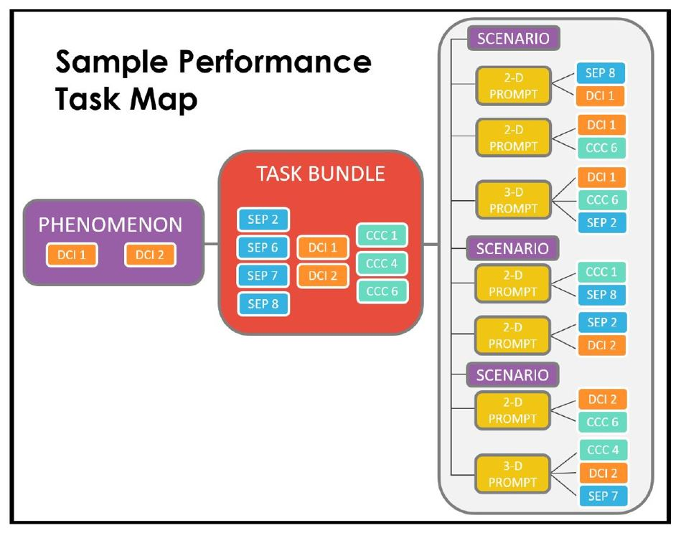
Notes:
Kellen
The text below comes from Appendix B: Performance Task Map included in the NE Science - Draft Public Blueprint Updates 12-18-19
“The performance task map below shows how tasks for the assessment are constructed and how they might fit into the 3-dimensional elements. Writers select one or more DCIs then find a phenomenon to match. Other 3-dimensional elements are then selected that will support the DCIs and the phenomenon. Finally, the task is written. The task is made up from one or more scenarios, which are non-interactive and consist of text and/or graphics. Each scenario supports one or more prompts, which are the interactive pieces that require a student response.”

Slide 18
Available Resources
NDE Science
Science Assessment Transition
Updated Item Samplers for Grades 5 & 8
NCCRS-S Draft Teacher’s Guides
Currently download as Microsoft Word Documents
NCCRS-S Standards
NSCAS Science Update
From 2019 Administrator Days
Draft NSCAS Science Blueprint Spreadsheet (Via Google)
Notes:
Kellen
Highlight and briefly discuss the resources that have been linked to the slide.
Links to resources include:
NDE Science - https://www.education.ne.gov/science/
Science Assessment Transition - https://www.education.ne.gov/assessment/nscas-science-assessment-transition/
NSCAS Science Update (2019 Admin Days) - https://www.education.ne.gov/assessment/nscas-science-assessment-transition/#1533760763284-062273c5-75c0
Draft NSCAS Science Blueprint Spreadsheet - https://docs.google.com/spreadsheets/d/1c4e8Z6XD390TbZC4xbG3bY24HaY0ajkxWoffpPy0Fp4/edit?usp=sharing
Provide a tour of the document
Discuss Columns (Why are some SEPs divided?)
Viewing rights, however one can make a copy and adapt as needed
NCCRS-S Document - https://cdn.education.ne.gov/wp-content/uploads/2017/10/Nebraska_Science_Standards_Final_10_23.pdf

Slide 19
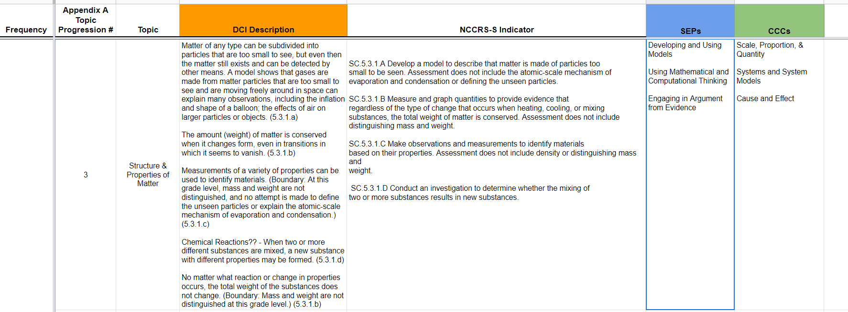

Slide 20
Notes:
Kellen
Image: This image was originally included in a presentation from NDE (Sara Cooper) during the 2017-18 school year.
Direction for NCCRS-S in both instruction and assessment.
As we continue to learn more about the Nebraska College and Career Ready Standards for Science in terms of the language, organization, and the 3-Dimensional Components, we can begin to make better sense of these elements and begin moving towards figuring out how best to implement our learning into teaching, learning, and assessment practices.

Slide 21
NSCAS Science Assessment Questions can be directed to:
Rhonda True, Enhanced Assessment Grant Coordinator
Phone: 402.471.2947
E-mail: rhonda.true@nebraska.gov
Thanks for watching!
Notes:
Teacher Guides (NDE Science webpage) detailed NGSS Element descriptions were main sources for NE educators during task development

