Slide 1
Statewide Assessment Regional Workshops
October 2019

Slide 2
Statewide Assessment Staff
Director-Jeremy Heneger
Assistant Director-Dr. Trudy Clark
Assessment Program Coordinator-Maggie Sis
Special Education Assessment Liaison-Sharon Heater
ACT Coordinator-Iris Owens
NWEA Professional Learning Lead-Aly Martinez Wilkinson
Enhanced Assessment Grant Coordinator/Interim NAEP Coordinator-Rhonda True
Office Associates-Tyrina Webster & Stacey Weber

Slide 3
Agenda
8:30-9:00 Check In
9:00-10:30 NSCAS Innovation
10:30-10:40 Break
10:40-10:50 Formative Assessment
10:50-12:00 NSCAS Update
Data
NSCAS ACT
NSCAS General
NSCAS Alternate
Professional Learning

Slide 4
The Nebraska Student-Centered Assessment System (NSCAS)
Update on Innovation and Evolution
How do we utilize the current components of NSCAS and strengthen integration and cohesion?

Slide 5
Evolving the Current System
Creating a unified model will facilitate both equity of opportunity and outcomes for students.
Additionally, we can…
Provide improved instructionally relevant data to educators.
Promote educator inquiry about next steps to take for each student.
Track student growth across time and districts
Reduce testing and maximize instructional time.
Continues to build a cohesive balanced assessment system for students and educators

Slide 6
Pathway to Innovation
 | NSCAS General ELA/Math Grades 3-8

Slide 7
Pathway to Innovation
 | NSCAS General ELA/Math Grades 3-8
School Year
18/19 Business as Usual
19/20 Building
20/21 Building
21/22 Transforming

Slide 8
What about science?
Operational Spring 2021
Field Test Development Summer 2019
NWEA Meeting April 2018
Field Test Spring 2020
Pilot
Spring 2019
Visioning
Nov. 2017
Task Force
Jan. 2018
Maintain the current timeline…
Adoption
Sept. 2017
Notes:
Jeremy: Rationale for extra year: time to develop new assessment system, time for districts to implement and change instruction
Pilot and field test--purpose

Slide 9
Historical Context
Statewide Assessment in Nebraska
Notes:
If we want to understand where we are headed it is often important to understand where we have been. Not go as far back as STARS.

Slide 10
2007 Unicameral Revised Statute 79.760.03
“For school year 2009-10 and each school year thereafter, the State Board of Education shall implement a statewide system for the assessment of student learning and for reporting the performance of school districts and learning communities pursuant to this section. The assessment and reporting system shall measure student knowledge of subject matter materials covered by measurable academic content standards selected by the state board.”
Notes:
Law that created NeSA

Slide 11
Statewide Assessment Purpose
Nebraska Revised Statute 79.60.03
(a) Determine how well public schools are performing in terms of achievement of public school students related to the state academic content standards;
(b) Report the performance of public schools based upon the results of state assessment instruments and national assessment instruments;
(c) Provide information for the public and policymakers on the performance of public schools; and
(d) Provide for the comparison among Nebraska public schools and the comparison of Nebraska public schools to public schools elsewhere.
Notes:
Read over the list What do you notice? What is there? What isn’t? NeSA was designed to fulfill these purposes….other purposes would have necessitated different designs.
Educator’s priorities are different from policy makers and educators had different needs and wants. Competing purposes create tension in the system.

Slide 12
What we heard from Nebraska educators
Insights that inform daily instruction
Alignment to standards
Accelerates learning for all students
Easy to use/administer with consistent experiences for students and teachers
Understandable, applicable results
Helps reveal which schools need support
Collaborative, ongoing professional learning
A single assessment model/less testing
Notes:
As late as late as this past year…these are type of things educators were telling us they wanted out of statewide assessment. These aren’t new ideas but once again.
Really the reason for the Check4Learning system. Item bank that was meant to support a different purposes other than those described in the law.

Slide 13
Statewide Assessment Purpose
Nebraska Revised Statute 79.60.03
(a) Determine how well public schools are performing in terms of achievement of public school students related to the state academic content standards;
(b) Report the performance of public schools based upon the results of state assessment instruments and national assessment instruments;
(c) Provide information for the public and policymakers on the performance of public schools; and
(d) Provide for the comparison among Nebraska public schools and the comparison of Nebraska public schools to public schools elsewhere.
Notes:
NDE level what could be done to support purposes other than those you see on this slide? As we moved forward high quality, technically sounds summative assessments. Built out Check4Learning to support formative/classroom assessments. Get to a time of change at NDE and the creation of AQuESTT. Accountability

Slide 14

AQuESTT Assessment Tenet
The State Board believes the results of multiple assessment sources (national, state, and classroom- based) should be used to measure student achievement of college and career ready standards, and be used as an integral part of the instructional process.
Areas of Focus
Individualized/Adaptive
classroom-based
State
National/International
Notes:
AQuESTT created out of a push for Accountability. In many ways the adoption of the AQuESTT Tenets afforded the assessment office a new mandate to support Assessment in a broader context that went far beyond the purposes stated in law. Tenet encourage NDE to support balanced assessment and called out using assessment as an integral part of the instructional process.

Slide 15
Nebraska State Board of Education Position Statement on Assessment of Student Learning
“…believes schools and districts should utilize a balanced assessment system that includes formative, interim, and summative assessments to inform instruction and program development, monitor progress, and evaluate student learning for all content areas and grade levels. Rule 10 highlights the important role assessment plays within the instructional process:
“…assessments are used to measure and help improve student achievement by informing instruction…”
“Assessment should be: Focused on improved student learning: Measures growth to inform and guide instruction”
Notes:
Stiggins FOR
Assessment should be:
Focused on improved student learning: Measures growth to inform and guide instruction
The guidance from the SBoE and the Commissioner in the form of position statement along with AQuESTT Tenet cause the assessment office to construct a very different RFP.

Slide 16
2017 Request for Proposal Detailed the need for a vendor partner that could support balanced assessment
Included:
Description of needs based on federal and state statute
Language from AQuESTT around balanced assessment
Prioritized assessments as an instructional tool
Called for the measurement of higher order thinking skills
Asked for the measurement of growth on a vertical scale, and or adaptive items in order to measure growth in student learning more accurately
Sensitivity to testing time and timeliness of reporting results
Notes:
Not an all inclusive list. But here of some examples of the innovation that was incorporated in our RFP for statewide assessment. Ultimately, allowed NWEA to write a very different kind of RFP proposal that moved beyond what one would typically see in an RFP for statewide assessment.

Slide 17
Language from NWEA’s RFP Proposal
As Nebraska looks innovatively towards assessments that align with the six tenets of AQuESTT, we (NWEA) believe we can work with Nebraska to fulfill and support your vision. With multiple, meaningful measures that are personalized and provide individualized instructional information; that adapt to minimize the burden of testing on students, teachers, and schools; that help students as they grow and are prepared for life after school; and that connect assessment and learning opportunities; we believe we can specifically and successfully support Nebraska in creating a truly innovative and balanced assessment system.
Notes:
This is just a sample of the language but it is easy to see how this language matches better with the language of the Board’s position statement or the AQuESTT Assessment Tenet as opposed to language that can be found in state statute. This type of language and NWEA’s proposal as a whole embraced Nebraska’s vision for assessment. Easy to say that individuals at NDE and NWEA and educators across the state felt that the new partnership held a great deal of promise for the future of assessments in NE.

Slide 18
Full of Promise
Nebraska had high-quality, technically sound statewide assessments
Item bank written by Nebraska educators
Moving towards innovative item types
Transitioning to CCR aligned assessments
86% of Nebraska’s districts were using MAP Growth
Approximately, 50 educators across Nebraska were a part of NWEA’s Certified Facilitator Program
Notes:
At the time that NWEA was awarded the RFP. NWEA was already a known entity and considered a quality partner.
Many educators hoped MAP Growth could be the new state test. People that understood federal requirements and NWEA knew that MAP Growth’s design did not meet federal requirements for statewide assessments.
Some expecting the fulfillment of the promise much quicker…change takes time. NWEA new to the statewide summative world.

Slide 19
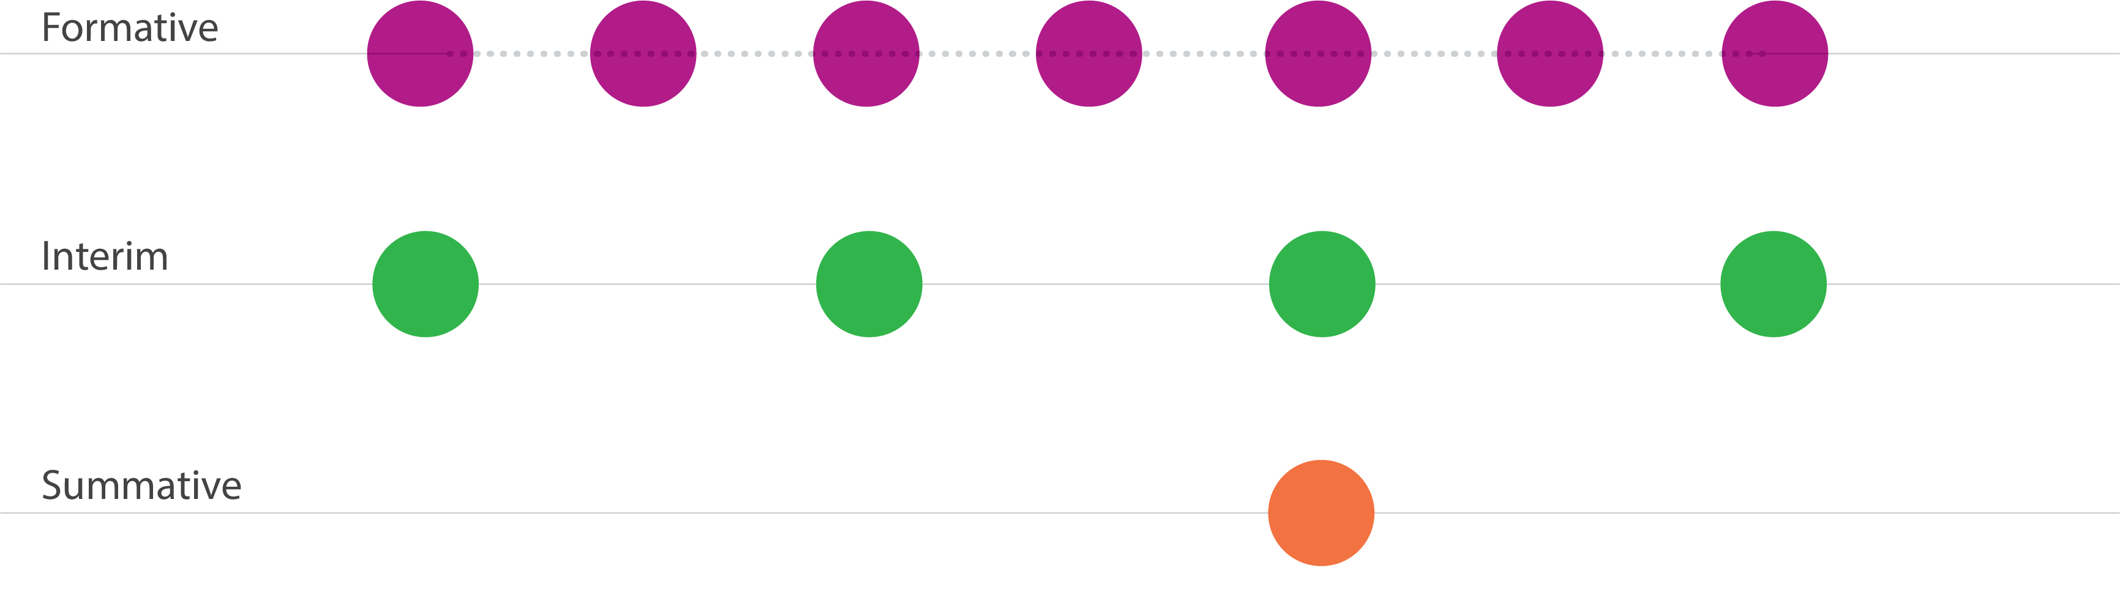
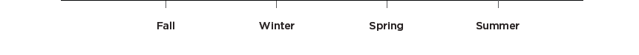
Current Components of NSCAS
Professional Learning
Professional Learning
Professional Learning
Professional Learning
Professional Learning
Professional Learning
Professional Learning
Professional Learning
Notes:
Focus on balance assessment, each is a part of the system but they lack integration and cohesion

Slide 20

NSCAS Program Overview
TestWiz - Navigate Item Bank and Check4Learning Item Bank
MAP® Growth™ (3-8)
Reading
Language
Science
Mathematics
Grades 3-8
English Language Arts
Mathematics
Grades 5 and 8
Science
Notes:
Each of the levels of the assessments stand alone and have minimal integration. Each are aligned or provide information about NE Standards. Depending on the content. Interim…prediction of student’s summative results
Overall, if used correctly, each of these types of assessment could be hugely beneficial but for the most part they operated in their own lanes. From the very beginning, we were talking about further integration and educators kept asking about further integration. We have been exploring integration options as we built the foundation of the NSCAS system.
Adaptive-larger item banks
Vertical Scale
Quicker Return of Results

Slide 21
Current Landscape
Statewide Assessment in Nebraska
Notes:
So that bring us up to date. Before we look at the future and how we fulfill the promise of evolving NSCAS, we will take a deeper look at the current landscape of NSCAS.

Slide 22
NSCAS General ELA & Math
Aligned to NE CCR Standards
ELA (Completed year three)
Math (Completed year two)
Includes Multiple Choice (MC) and Technology Enhanced (TE) Items
Computer Adaptive Test
Adaptive at grade level
Paper Accommodated form
Untimed-Single Session but can be Divided into Multiple Sessions
Near Immediate Results in 2019-2020
Notes:
Number of Test Events in spring 2019
Math=144,240
ELA =144,233

Slide 23
The Traditional Summative Model
Features
Fulfills purposes laid out in law.
Measures attainment and retention
Domain sampling supports year-to-year growth inferences
Meaning of score is clear
Scales up even under different pacing guides
Fall
Winter
Spring
Math Content
Summative
Math Content
Math Content
Challenges
Burdensome test event
Feedback comes too late
Too much cumulative testing
Summer loss and gains are mixed in with year-to-year growth
Excludes within-year growth
Total Score

Slide 24
NSCAS Interim
MAP Growth 3-8
Optional to Districts
Can be Utilized Four Times a Year
Computer Adaptive
Immediate Results
More Information for Teachers, Schools, and Districts
Rostering is District Responsibility

Slide 25
MAP Growth
Features
Each administration is independently adaptive
Timely feedback to inform instructional decisions
Supports off-grade and on-grade growth
Within year and across year growth
Common vertical scale
Norm-referenced
Measures retention
Fall
Winter
Spring
Interim
Interim
Interim
Math Content
Math Content
Math Content
Total Score
Total Score
Total Score

Slide 26
The landscape of testing in Nebraska
Number of Students Tested on MAP Growth
 | 17/18 |  | 17/18 |  |  |  | 18/19
Students tested in the Fall | 126,726 |  | 126,726 |  |  |  | 138,211
Students tested in the Winter | 95,135 |  | 95,135 |  |  |  | 117,497
Students tested in the Spring | 93,815 |  | 93,815 |  |  |  | 103,114
Number of Districts Testing MAP Growth by Term
 | FALL 17/18 | WINTER 17/18 |  | SPRING 17/18 | FALL 18/19 | WINTER 18/19 |  | SPRING 18/19
Math | 241 | 174 |  | 187 | 243 | 191 |  | 191
Reading | 241 | 174 |  | 182 | 243 | 188 |  | 191
Language Usage | 208 | 133 |  | 140 | 209 | 145 |  | 142
Science | 222 | 134 |  | 158 | 223 | 147 |  | 160
*244 Districts

Slide 27
Evolving NSCAS
Statewide Assessment in Nebraska
Notes:
So we have two major components of NSCAS…Summative and MAP Growth…Like I said they are operating more or less independently of one another. But the promise of our NSCAS “System” work is to make this parts work together. To integrate to fulfill purposes laid out in law and the needs of our educaors.

Slide 28
NSCAS Adaptive Through-Year Model
Goals:
Provide more useful data throughout the year to guide instruction.
Reinforces assessment as an instructional tool.
Examines learning in context.
Multiple opportunities to showcase student learning within the context of Nebraska’s College and Career Ready Standards.
Decreases overall testing time.
Utilizes the strengths of NSCAS General Summative & MAP Growth.

Slide 29
What we heard from Nebraska educators
Insights that inform daily instruction
Alignment to standards
Accelerates learning for all students
Easy to use/administer with consistent experiences for students and teachers
Understandable, applicable results
Helps reveal which schools need support
Collaborative, ongoing professional learning
A single assessment model/less testing
Notes:
As late as late as this past year…these are type of things educators were telling us they wanted out of statewide assessment. These aren’t new ideas but once again.
Really the reason for the Check4Learning system. Item bank that was meant to support a different purposes other than those described in the law.

Slide 30
NSCAS Adaptive Through-Year Model
Simply put, this model combines the current NSCAS Summative and NSCAS Interim into a hybrid model.

Slide 31
NSCAS Adaptive Through-Year Model
Allows multiple measures from one model and:
Summative proficiency scores once/year for accountability purposes.
Grade-level performance data up to three times a year – in time for districts to adjust instruction.
Growth as year-to-year changes in aggregate summative performance.
Growth as how much each student learns during the year, regardless of achievement level.

Slide 32
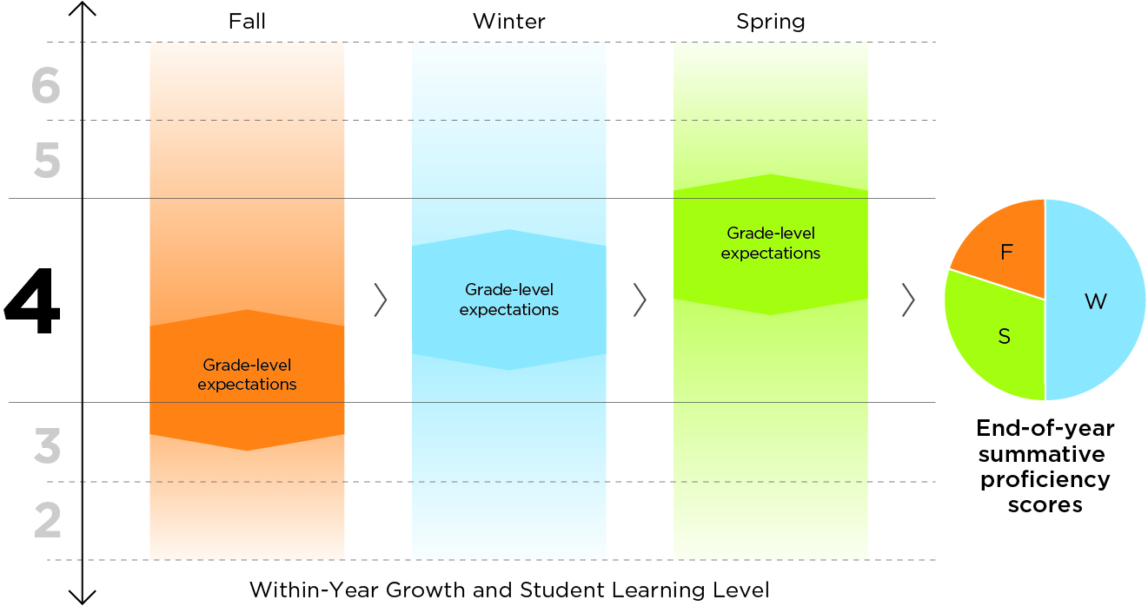
Adaptive Through-Year Model Essentially hybrid of summative and interim
Keeps what educators like about MAP
Up to three administrations with common blueprint
Each administration about as long as a MAP administration; picks up from where student left off
State-aligned ELA and math content to measure proficiency
Computer Adaptive Test (CAT) using prior information, allowed off grade level in fall and winter
CAT using prior information may allow off grade level in the spring conditional on research and state policy and peer review processes
Highly configurable
Optional
but
Encouraged
Optional
But
Encouraged
Required
Priors
Priors
Priors
Notes:
Optional and required labels
What we mean by highly configurable:
-Students who are ready for on grade items get a common blueprint across the 3 administrations
-Students at earlier stages of learning get off grade items – using the blueprint for the grade level at which the child is functioning

Slide 33
Adaptive Through-Year Model
Advantages
Timely feedback
Should reduce total testing time
Allows a multiplicity of pacing guides and scales up well
Domain sampling preserves construct
Supports off-grade and on-grade growth; within-year and across-year growth; normed-reference and criterion-referenced growth.
Avoids complex psychometric models
Measures retention
Likely to pass peer review
Fall
Winter
Spring
Math Content
Math Content
Math Content
Interim Results
Updated
Interim Results
Updated
Interim Results
Information from all tests to determine proficiency
Notes:
Hypothetical Three student examples

Slide 34
Retaining the best of MAP Growth
The new model will:
Take about the same amount of time per content
Measure student performance & growth irrespective of grade level, within and across years
Produce RIT information in fall, winter, & spring
Provide access to NWEA’s norms so growth can be considered in context of similar students nationally
Be adaptive, accounting for differences in scope & sequence (local control is retained)
Include access to the Learning Continuum or a similar, improved tool
Support student mobility (test scores & longitudinal history will follow students from one school or district to another)
Notes:
NWEA currently estimates that tests should take about 60 minutes on average to complete
Like MAP Growth, student-level results will be available immediately and aggregate level results (class/school/district) will be available 24 hours after testing
If asked about Spanish:
NWEA intends to eventually provide the through-year solution in Spanish. NWEA first needs to get the solution field tested and operationalized in English but Spanish will be the next logical step in terms of languages.
If asked about test engagement:
We are looking at ways to eventually add test engagement functionality to the solution.

Slide 35
Retaining & improving aspects of the NSCAS Summative
The new model will:
Measure student performance relative to grade-level expectations, adding criterion-referenced information to reports in fall, winter, & spring
Provide information based on Nebraska’s Achievement Level Descriptors (ALDs) to better support teachers in helping students reach & exceed standards-based learning targets
Potentially improve the Learning Continuum by transforming it into a tool rooted in Nebraska’s ALDs
Provide multiple chances for students to demonstrate proficiency (or beyond) vs. just one chance at year’s end
Nebraska educators will continue to have a strong voice in the assessment system.
Notes:
Scores:
The new hybrid assessment will provide a linked RIT score as well as a proficiency score and classification in the fall, winter, and spring. In the spring, a summative score reflecting end-of-year achievement will also be provided for accountability purposes. The summative score is the culmination of the student’s performance across the three assessments. In other words, the spring test is not a traditional summative test – it is built from the student’s performance on the two previous assessments. That said, if a student enters a school in the spring from out of state and hasn’t completed the fall and winter tests, the system can accommodate him/her; however, the test may be longer and/or adapt less outside of grade level.
ALDs:
Range ALDs allow focused item development to specific levels at each standard. Because the hybrid solution is based on ALDs, the assessment reports will provide teachers with ideas and examples of how to increase or decrease complexity with more on-grade access points to help find the point of productive struggle for students across a range of achievement. In other words, teachers get more insight on how to engage struggling/beginning students in grade-level content, to challenge students performing within grade level to reach proficiency, and to support deeper learning by helping students move beyond proficiency to college/career ready levels of understanding.
Multiple chances:
Traditionally students have one chance to demonstrate proficiency with the annual summative test. This new solution gives students multiple opportunities to show that they have mastered a concept. The spring test is still needed for summative scores but is based on previous performance; it’s not starting from scratch and retesting students on what they have already shown that they have learned (though it will be designed to efficiently check for retention).

Slide 36
How it will feel different from current state
No more need to administer two tests (or trade MAP Growth for NSCAS Summative) in the spring
Spring test is just one of three interim tests – about the same length as fall & winter tests, provided the student completed those tests
Processes will become standardized across fall, winter, & spring – e.g. accommodations, security, retake policies, test windows, etc.

Slide 37
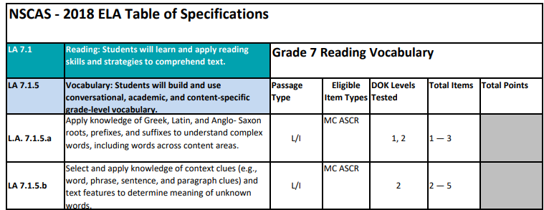
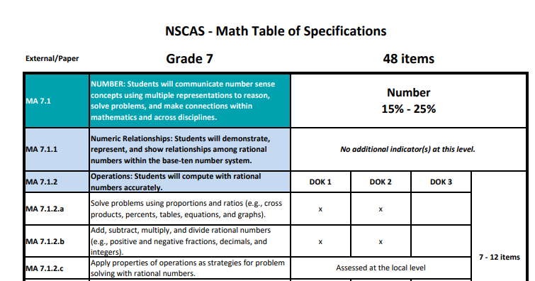
Adaptive Through-Year Model
Trend Data
Maintains current trends because we are essentially using the same Table of Specifications (TOS)
Student’s summative score will be based on the details included in current TOS
Notes:
We are not changing the expectations but rather trying to give more information through out the year in order to inform instruction.

Slide 38
Adaptive Through-Year Model
Multiple Opportunities
Students who take the Fall and Winter assessments, (Remember they are optional) will have multiple opportunities to show demonstrate mastery on indicators included in the TOS.
Notes:
We are not changing the expectations but rather trying to give more information through out the year in order to inform instruction.

Slide 39
Item banks…
MAP Growth
(Interim)
NSCAS General
(Summative)

Slide 40
Student Experience
Not all that different from what the majority of our students currently experience.
Incumbent on adults to create a positive atmosphere.
Still be able to see results and create goals; hopefully even more informed about end of the year expectations

Slide 41
NSCAS Adaptive Through-Year Model
Goals:
Provide more useful data throughout the year to guide instruction.
Reinforces assessment as an instructional tool.
Examines learning in context.
Multiple opportunities to showcase student learning within the context of Nebraska’s College and Career Ready Standards.
Decreases overall testing time.
Utilizes the strengths of NSCAS General Summative & MAP Growth.

Slide 42
We have already started this work together
With Nebraska educators we have done:
Range ALD generation
Item writing workshops
Content and Bias review meetings
Standard setting
Partnering with 72 Certified Facilitators to provide ongoing professional learning
Future planning of Professional Learning in partnership with Certified Facilitators and NDE

Slide 43
Engaging Nebraska Stakeholders
Assessment Advisory Groups (4 meetings throughout the year)
Assessment Innovation meetings (3 one day meetings with up to 15 educators)
Alignment of MAP Growth items to NSCAS Summative ALDs (part of USDOE grant)

Slide 44
Pathway to Adaptive Through-Year Model
 | NSCAS General ELA/Math Grades 3-8
School Year
18/19 Business as Usual | MAP Growth + NSCAS General Summative
19/20 Building | MAP Growth + NSCAS General Summative (and MAP Growth on NSCAS TSM pilot in winter followed by linking study in spring)
20/21 Building | MAP Growth + NSCAS General Summative (with potential modification as NDE & NWEA work to create a model that brings the best of both worlds together)
21/22 Transforming | Implement adaptive through-year assessment model
Notes:
Currently 4 different studies are scheduled.

Slide 45
Considerations
Current path that will be continual informed as we continue forward.
We do not have all the details or answers.
We want you to ask questions and voice concerns.
Trying really hard to make the evolution smooth and to be transparent.
Also, working hard to identify and then mitigate potential unintended consequences.

Slide 46
Considerations
We have a list of thing we are keeping in mind and working on addressing.
Implications for AQuESTT Accountability
Implications for NE Reading Act
How students would move into and out of the model.
Transition from K-2 to the adaptive through-year model
Transition from 3-8 to other high school assessments
Identifying current uses of MAP Growth and trying to maintain as much of those uses as possible.
School Improvement, grants, placements, awards

Slide 47
What can districts do to prepare?
Recommendations provided by members of the Assessment & Accountability Advisory Committee
Reexamine the grades levels and frequency that your students take MAP Growth.
Examine if your district is maximizing the potential usefulness of MAP Growth data
Consider how MAP Growth and NSCAS professional learning could fit in your PL plans.
Consult ESU or District Certified Facilitators

Slide 48
Next Steps…
NDE will record this presentation
Post the recording and additional documentation to the Statewide Assessment website
Gather questions from Regional Workshops and compile a FAQ to be posted
When the materials are ready NDE will send out a DAC email with links

Slide 49
Questions?

Slide 50
Formative Assessment
An Important Component of a Balanced Assessment System
Notes:
Trudy

Slide 51
Formative Assessment
Formative assessment is a planned process a teacher uses to check for understanding in an effective way in order to guide instruction. As a result of the formative assessment process, teachers adjust their ongoing instructional activities or students adjust the procedures they’re currently using to try to learn the instructional target/goal.
Both Dylan Wiliam and Richard Stiggins have used the phrase assessment for learning to describe the formative assessment process.
Notes:
Research by Dylan Wiliam and others suggested there was a 50-70% increase in the rate of student learning using the formative assessment process in the classroom.
Trudy

Slide 52
NDE Formative Assessment Supports
Presently the Nebraska Department of Education offers support for formative assessment through TestWiz, which includes Check4Learning and the Navigate Item Bank™. Check4Learning provides teacher-generated items that can be used to create test items. The Navigate Item Bank™items were written by and aligned by the assessment vendor.
Notes:
Trudy

Slide 53
NDE Formative Assessment Supports
NDE is interested in knowing what supports Nebraska educators believe have value.
Possible Supports:
Create and provide templates of formative tools
Enhance Check4Learning (bring in teachers to write items)
Enhance TestWiz (bring in teachers to write items)
Notes:
Trudy

Slide 54
NDE Formative Assessment Supports
Possible Supports:
Provide examples of formative assessments per grade level band (e.g. K-2, 3-5, 6-8, 9-12)
Provide examples of formative assessments per discipline (e.g. ELA, math, science, social studies, etc.)
Create/support a data management tool for formative assessments (e.g. along the lines of Schoology or Formative)
Notes:
Trudy

Slide 55
NDE Formative Assessment Supports
Possible Supports:
Develop Professional Learning opportunities for formative assessment instruction/ development
Develop writing prompts
Create formative assessments based on Achievement Level Descriptors (ALDs).
Notes:
Trudy

Slide 56
Assessment for learning is an important component of an assessment system. NDE wants to expand formative assessments supports in order to encourage effective teaching practices.
Notes:
Trudy

Slide 57
NSCAS Updates

Slide 58
NSCAS Data
Clean data is a partnership!

Slide 59
NSCAS Data Clean-Up
ADVISER
Enrollment
MAP Growth/NSCAS GEN Rosters merge & records will not be deleted
Students enrolled up to the last day of regular testing window are expected to test
FTE
FTE of 51% or higher is expected to test
High School Third-Year Cohort
Cohort year for 2020 testing season is “2021”
ADVISER Request does require a review and not always approved

Slide 60
NSCAS Data Clean-Up
ADVISER (con.’t)
Who Reports What (Version 3.1 dated 4/24/19)
https://cdn.education.ne.gov/wp-content/uploads/2019/05/Who-Reports-What-ADVISER-V-3.1-_-2018-2019-FINAL.pdf
Updating ADVISER
Before June 30 – update your SRS/SIS and ensure data is bridged into ADVISER
After June 30 – Submit a Follow-Up Request through your SRS/SIS
Updates can take a few days, the later into the clean-up calendar

Slide 61
NSCAS Data Clean-Up
New Not Tested Codes for 2019-20
GEN (General Assessment – for NSCAS Alternate only)
STR (Student Refusal)
TXT (Testing at External Program – for NSCAS General only)
NLE (No Longer Enrolled)
Can be used for students who left your district before testing begins OR for students who are new to the district & tested at their previous district.

Slide 62
NSCAS Clean-up Calendar 2019-20 (Tentative)
Pre-Rostering Clean-up
December 2019
Pre-Testing Clean-up
February 2020
Post-Testing Clean-up
Rnd 1 – May/June 2020
Rnd 2 – June 2020
Final – July 2020
NEP Review
August/September 2020
7-10 day window at each phase
DO NOT wait 2-days before deadline
ADVISER updates can take a few days to correct

Slide 63
NSCAS ACT

Slide 64
What’s New
ACT State Test 2020

Slide 65
ACT Online Testing
Proctor Caching Requirements
ACT has changed the current requirement for Proctor Caching from a required task to a recommended task for online testing. This means that districts who do not proctor cache will not be switched to paper admins. The districts must determine if they meet the minimum 100 kbps requirement.
According to EducationSuperHighway, 100% of districts in Nebraska could access internet speeds of 100 kbps in 2018.
NDE is strongly advising to continue to setup the proctor caching, as well as the mock administration and browser lockdown if you are testing online.

Slide 66
ACT Accommodations and EL Supports
6 New EL Languages
In Spring 2020, ACT will add the following languages to EL Supports;
Hmong
Japanese
Navajo
Portuguese
Samoan
Tongan

Slide 67
Customer Care Transition
ACT is announcing a shift in our Customer Care support. In fall 2019, we are transitioning our Customer Care contact functions to STARTEK, a company that provides comprehensive contact center and customer engagement solutions. We expect this transition will be seamless and result in improved speed, quality, and performance of service. NDE and educators will continue to use the same resources, phone, and email contacts that are used currently.
As always, you may contact Iris Owens in the NDE Statewide Assessment office with any questions or concerns at 402.471.4316.
iris.a.owens@act.org or iris.owens@nebraska.gov

Slide 68
ACT Test Center Manager (TCM)
Test Center Manager (TCM) is an interactive, digital application that ACT testing staff use to manage test center information and administer the ACT at National test sites. The TCM application streamlines test day activities, simplifies staff training, provides data to ACT in real time, and aligns with ACT’s green initiative by eventually eliminating paper manuals and administration forms. 2018-2019 was the first year of implementation of this tool into the National testing program for the ACT. Overall, TCM has been positively received by National testing staff and therefore we are now ready to begin planning for the implementation of TCM into State Testing programs.

Slide 69
ACT 2020 TEST DATES

Slide 70
Test Window 1
Standard Paper March 24, 2020
Accommodations Paper March 24-27 and March 30 - April 3
Online Standard and Accommodations March 24-26 and March 31, April 1, 2 (Tuesday, Wednesday, Thursday)
Test Window 2
Standard Paper April 7, 2020
Accommodations Paper April 7-10 and April 13-17
Online Standard and Accommodations April 7, 8, 9 and April 14, 15, 16 (Tuesday, Wednesday, Thursday)
Test Window 3 Makeup Only
Standard Paper April 21, 2020
Accommodations Paper April 21-24 and April 27-May 1
Online Standard and Accommodations April 21, 22, 23 and April 28, 29, 30 (Tuesday, Wednesday, Thursday)

Slide 71
ACT Test Window Crosswalk
ACT Test Dates | Labeled in ACT Systems
Test Date 1 Paper Test Date: 3/24/2020 Online Window: 3/24-26 & 3/31-4/2 Accommodations Window: 3/24-27 & 3/30-4/3
Test Date 2 Paper Test Date: 4/7/2020 Online Window: 4/7-10 & 4/13-17 Accommodations Window: 4/7-9 & 4/14-16
Test Date 3 Makeup Only Paper Test Date: 4/21/2020 Online Window: 4/21-24 & 4/27-5/1 Accommodations Window: 4/21-23 & 4/28-30

Slide 72
ACT Test Window Crosswalk
ACT Test Dates | Labeled in ACT Systems
Test Date 1 Paper Test Date: 3/24/2020 Accommodations Window: 3/24-27 & 3/30-4/3 Online Window: 3/24-26 & 3/31-4/2 | INITIAL TEST DATE
Test Date 2 Paper Test Date: 4/7/2020 Accommodations Window: 4/7-10 & 4/13-17 Online Window: 4/7-9 & 4/14-16 | MAKEUP TEST DATE
Test Date 3 Makeup Only Paper Test Date: 4/21/2020 Accommodations Window: 4/21-24 & 4/27-5/1 Online Window: 4/21-23 & 4/28-30 | EMERGENCY TEST DATE

Slide 73
Important Dates
10/7 ACT Online Prep opens this week, email will be sent
Week of 10/14 Schedule of Events released
11/1 Last day to download reports from PA Next
11/4 PA Next and Accommodations opens
11/30 Manage Participation Deadline

Slide 74
ACT Webinars
Tuesday, November 5, 2019, 10 am Accommodations: https://event.on24.com/wcc/r/2088964/8E1750EDA2492D856C2567C52539A8BD
Thursday, January 16, 2020, 10 am Test Administration Training #1: https://event.on24.com/wcc/r/2088997/D95AF2E12B16C962DC78CB43047CE96B
Thursday, February 13, 2020, 10 am Test Administration Training #2: https://event.on24.com/wcc/r/2089015/256968E94607945AB18CDEFCE31EAFB0

Slide 75
Pearson Access Next (PA Next)

Slide 76
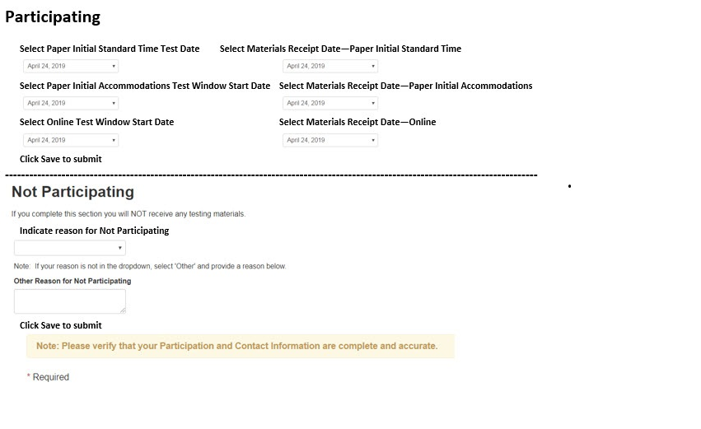
Manage Participation Deadline11/30/2019

Slide 77
ACT Online Prep and PreACT

Slide 78
ACT Online Prep (AOP) Opens October 2019
ACT Online Prep Choice | 2018-2019 | 2019-2020
Districts | 145 | 114
Student Count | 6,302 | 4,752

Slide 79
PreACT Fall Test Dates Oct.1-Nov. 27, 2019
Test Window | Districts 2018-2019 | Students 2018-2019 | Districts 2019-2020 | Students 2019-2020
Fall 3rd year Cohort-Juniors | 23 | 1,311 | 18 | 1,340
Fall 2nd year Cohort-Sophomores | 24 | 10,320 | 41 | 5,324
Spring 2nd year Cohort- Sophomores | 57 | 5,840 | 75 | 7,809

Slide 80
ACT Score Replacement

Slide 81
2019 ACT Score Replacements
10 forms submitted
7 students qualified
5 perfect scores
6 students took the writing
Notes:
Jeremy

Slide 82
ACT Fee Waivers

Slide 83
2019 Percent of Fee Waivers Used in Nebraska
Notes:
Fee waivers represent a great opportunity for low socio-economic students to retest without incurring any fees.
ACT sends waivers to every school and the school is responsible for issuing the waiver to examinees. The student who receives the waiver is then tasked with registering for the exam on a national test date. Typically these waivers are offered to underserved learners.

Slide 84
ACT Fee Waivers
What is included in the ACT Fee Waiver Program:
•ACT Test fees are covered ($68 value with writing test)
•Free Learning Resources
•ACT Online Prep for 6 months ($39.95 value)
•ACT Rapid Review - All Access ($99 value)
•ACT Academy
•Free Additional Score Reports
•Apply to Colleges for FREE
Notes:
Free Additional Score Reports
You can send additional ACT score reports for free to colleges and/or scholarship agencies at any time during your college search process. Your fee waiver covers one report to your high school and up to six college choices. After registration, you can request up to an additional 20 regular score reports for free. Apply to Colleges—For Free
College application fees can really add up, but there’s good news! Students who test with an ACT fee waiver may also request a Waiver or Deferral of College Admission Applications Fee. To have a college application fee waived, you must submit your fee waiver directly to the college you are applying to (not to ACT).

Slide 85
How to Order Fee Waivers
Go to the College and Career Readiness Information System (CCRIS)
Select the radio button “Go to Ordering”
If you don’t have an account, you will need to create one
Questions? Call ACT at 800.553.6244 x 2800

Slide 86
Lessons Learned 2019

Slide 87
Lessons Learned
Continue to pay close attention to forms and which window they are assigned.
Get accommodation requests in early.
Avoid non-college reportable.
Do not hesitate to call Iris.
All third-year cohort students need to take NSCAS ACT or NSCAS Alternate. DO NOT test students that are not in the third-year cohort.
Plan for students in external programs.
Notes:
Jeremy

Slide 88
ACT Writing Test- What you need to know
Trained readers- Each essay is scored by two trained readers on a scale of 1-6 in each of the four writing domains. Each domain score represents the sum of the two readers’ scores (2-12). If the readers’ ratings disagree more than one point, a third reader will evaluate the essay and resolve the discrepancy.
3rd reads- A third reader is provided if the reader ratings disagree. This is normally a supervisor or reader with many years of experience.
Why a writing test may have no score- The most common reasons a student will not have a writing score:
•The student did not copy the essay to the answer folder
•The essay was off topic
•The student only copied the question
•The student only wrote a few words, not a complete essay
•The student wrote questionable or inappropriate language
•Illegible
•Not in English
•Blank or voided

Slide 89
Misadministrations and Prohibited Behaviors

Slide 90
Misadministrations
Misadministrations Can Cause Scores to be Cancelled
Reasons for Scores to be Cancelled
Rooms not set up correctly | Standard time use with Accom materials
Conflict of Interest with staff | Accom use with Standard time materials
Unauthorized transferred materials | Additional information provided
Advanced access to test content | Tests timed incorrectly
Pre-test info completed on test day | Tests administered on the wrong day
Tests not given in correct order | Different timing codes in same room
Test materials are duplicated | Answers not transferred properly
Notes:
I hope none of you have a misadministration and even fewer prohibited behaviors during your test. If you can avoid these common reasons, you will have fewer scores that are canceled due to a misadministration. [read screen]
Test booklets are one of the common mistakes Nebraska makes, since State Testing is different than National testing. In National tests, examinees with Timing Code 6- Extended Time use Standard tests and are in a different room. With the State Test, all accommodations use the Accommodations Test materials.
Many schools have called about staff with family members. According to ACT Test Administration, if you have a family member testing in the state of Nebraska during this test window, you cannot be a Test Coordinator. You can be a proctor or room supervisor if you are not in the same room as the family member. The example I like to share is Joan’s cousin Susan has a son testing in Gering, Joan is a test coordinator in Ponca. Joan will need to find a substitute test coordinator, but she can assist with the accommodations room in her school.
If you believe a misadministration occurred, call ACT immediately for assistance. There are many instances that ACT will allow the student to test again.

Slide 91
Watch for and Document Irregularities
Watch for and Document Irregularities
Prohibited Behavior by Students
Working or Looking Behind or Ahead in the test booklet
Giving or Receiving Assistance
Marking Ovals After Time is Called
Copying or Removing Test Materials
Using Notes or Aids (including prohibited calculators)
Accessing electronic devices (including cell phones)
Using inappropriate behavior or causing distractions
Notes:
Here are some examples of Prohibited Behavior by Students, Individual Irregularities, and Group Irregularities.
Complete a detailed Irregularity Report for each occurrence and attach the affected answer documents to the report as necessary
Do not submit an Irregularity Report if no irregularities occur.
If you are just suspicious that a prohibited behavior has occurred, give the examinee a warning and monitor their further activity. Complete an Irregularity Report with your suspicions and the actions that were taken.

Slide 92
Individual Irregularities
Examinees Who Leave Early
Test Item Challenges
Defective Test Materials
Duplicating Test Materials
Failure to Follow Directions in Marking Responses
Examinees Who Become Sick
Irrational Behavior
Prohibited Behavior at the Test Site
Dismissal for Prohibited Behavior

Slide 93
Group Irregularities
Interrupting a Test
Disturbances and Distractions
Emergency Evacuation
Rescheduled Examination
Missing or Stolen Test Materials
Mistiming of Tests or Breaks
Power Failure

Slide 94
Summary of Misadministrated or Prohibited Behaviors Spring 2019
Row Labels | Count of NOTES
OTHER | 19
Possessed Phone, Alarm | 13
Walked Out with Incomplete Test | 4
Worked Ahead or Behind | 35
Grand Total | 71
If a misadministration occurs, contact ACT and NDE immediately to discuss options!
Notes:
Jeremy

Slide 95
Parental Consent
US Department of Education Guidelines
Family Educational Rights and Privacy Act (FERPA)
Individuals with Disabilities Education Act (IDEA)
Protection of Pupil Rights Amendment (PPRA)
Districts will need to obtain parental consent
Fill out Interest Inventory
ACT to share information with third parties
NDE is working on additional guidance and samples and will provide as soon as possible
Notes:
Jeremy

Slide 96
NSCAS Alternate

Slide 97
Alternate Assessment
2019-2020 NSCAS Testing Windows
ELPA21
February 3-March 13
NSCAS General & Alternate
March 16-April 24 Primary Window
April 26-May 1 Make up Window
Notes:
Sharon

Slide 98
Alternate Assessment
Based on Alternate Assessment Flag in the districts data manager
Districts do not receive materials
Online or Print materials
Proctors input answers
DRC INSIGHT
Recorded proctor training available
Online Tools Training (Practice Opportunity) available in INSIGHT (formally eDIRECT)
Census Field Test for Science

Slide 99
Alternate Assessment
Justification for the Exception to the 1% Threshold for Alternate Assessment
Communication coming the first part of November
Change in document
All districts are required to complete these documents
Justification Support Worksheet
New this year: describe the training that was provided to all staff who participate as an IEP Team member and/or placement team on the Alternate Assessment Guidelines
New Resources:
1% Exception Background Information
Completing the Justification Document
1% Threshold Guidance
Notes:
Sharon

Slide 100
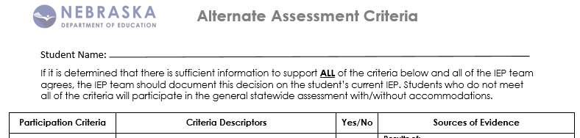
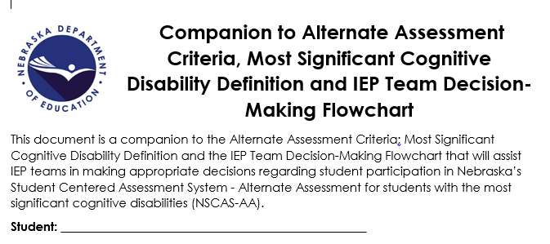
Alternate Assessment Criteria
Alternate Assessment Criteria Document
Updated
New Resource available
Companion to Alternate Assessment Criteria
Notes:
Sharon

Slide 101
NSCAS General

Slide 102
NSCAS General
2019-2020 NSCAS Testing Windows
ELPA21
February 3-March 13
NSCAS General & Alternate
March 16-April 24 Primary Window
April 26-May 1 Make up Window
Notes:
Sharon

Slide 103
Supported Devices
Technology – Supported Devices
Proctor Station
Student Devices
Windows 7, 8.1, or 10
Microsoft Edge or IE 16
Mac OS X v10.12 to 10.14
Safari 11 or higher
PC and Mac
Firefox 64 or higher
Chrome 71 or higher
Chromebook v65 or higher
Chrome 71 or higher
iPad – not fully supported
Windows 7, 8.1, or 10
Mac OS X v10.12 to 10.14
iOS 11 to 12
Chromebook OS 65 or higher

Slide 104
New for Summative
Updated Online Item Type Samplers
Text to Speech Eligibility Criteria
English Learner- Monitor
Text to Speech for Science Field Test
NDE is developing guidelines about which students that could be assigned Text to Speech

Slide 105
New Features and Functionality for Summative (continued)
Science field test
No paper/pencil material for Science
iPad Highlighter (OS versions 12.2 and above)
Shipping Paper/Pencil Materials Directly to External Programs
Score Reporting Timelines

Slide 106
MAP Growth
Questions should be directed to NWEA Customer Service.
Phone: 855-225-9926
Email: NWEANebraska@nwea.org

Slide 107
MAP Growth - Student Test Engagement
In-product guidance to encourage student test engagement ​
Auto-pause feature to mitigate rapid-guessing behavior​
Test History Search and new download to easily identify and batch-assign students to a new test ​
New report showing only students who reach the rapid-guessing threshold ​
New system configuration option to support district retesting policy for rapid-guessing

Slide 108
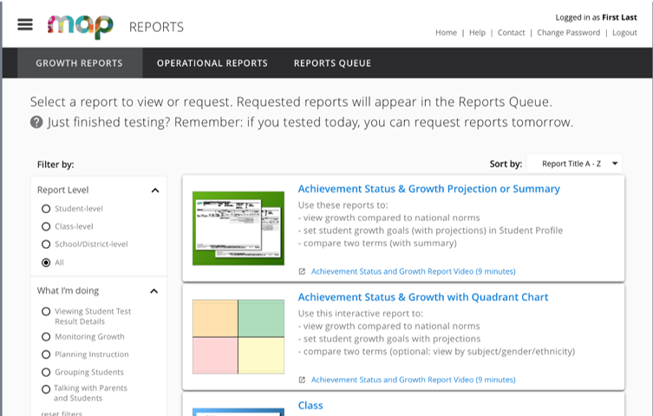
New MAP Growth Report Navigation
Intuitive design with images and descriptions
Filterable by aggregation level and purpose
Recommended and sortable order
Link to Professional Learning resources

Slide 109
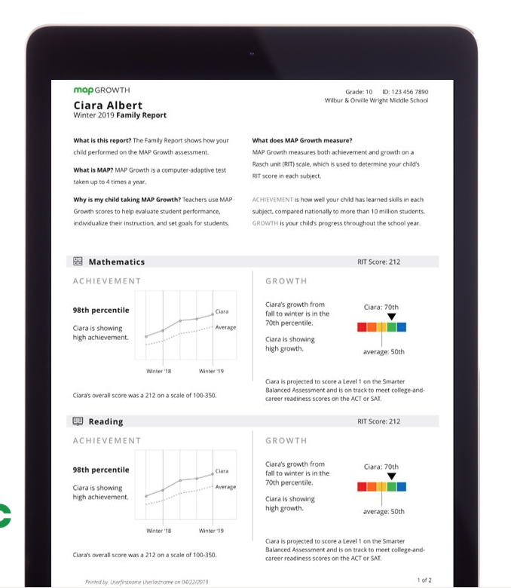
Family Report
Designed specifically for parents
Leverage the existing Student Profile print functionality
Batch printable at class level

Slide 110
Spanish MAP Growth
Mathematics | Reading
Spanish Math RIT Score and national norms | Spanish Reading RIT scores and user norms
English and Spanish math are not treated as separate subjects for reporting | Spanish Reading will be treated as a separate subject
Shared Learning Continuum – English and Spanish math | Spanish-specific Learning Continuum
 | Spanish Reading will populate in all reports other than Projected Proficiency
Included in MAP Growth licenses

Slide 111
Professional Learning
Notes:
Aly

Slide 112
Professional Learning
Professional Learning Lead - Nebraska
Aly Martinez Wilkinson
Certified Facilitator (CF) Program
72 CFs across the state
Monthly eNews
4 recorded and 6 live webinars
Workshops to provide content which can be delivered to schools and districts
Professional Learning Catalog of Events
Notes:
Aly

Slide 113
Balanced Assessment System for Leaders
Deepen knowledge of essential elements for supporting a balanced assessment system that maximizes student growth and achievement
Describe attributes of and purpose for a balanced assessment system
Reflect on key assessment practices for student engagement
Full Day Workshop offered in February 2020
18th North Platte
19th Lincoln
20th Kearney
21st La Vista
Notes:
Aly
School and district leaders deepen their knowledge of essential elements for supporting a balanced assessment system that maximizes student growth and achievement.
Describe attributes of and purpose for a balanced assessment system
Reflect on key assessment practices for student engagement

Slide 114
Evidence-Based Writing
Engage in examining the skills necessary for students to succeed in evidence-based writing
Explore strategies for teaching writing that can boost these skills.
Plan how to implement expanded or new ideas in your classroom
Understanding and developing best instructional practices to support evidence-based writing across the curriculum
Strengthen classroom practices that ensure students are on a trajectory to succeed with post-secondary writing challenges
Notes:
Aly

Slide 115
Evidence-Based Writing
Two Full Day Workshops
Middle School
Science and ELA
Day 1 offerings:
February
25 Scottsbluff
26 Kearney
27 Lincoln
March
4 Wakefield
5 La Vista
6 La Vista
Day 2 offerings:
May
26 Scottsbluff
27 Kearney
28 Lincoln
June
2 Wakefield
3 La Vista
4 La Vista
Notes:
Aly

Slide 116
NSCAS Science

Slide 117

Development Timeline
Field Test Spring 2020
Pilot Spring 2019
Pilot
Development Summer 2018
Operational Spring 2021
Field Test
Development Summer 2019
Future
Field Test
Development Summer 2020
VisioningNov. 2017
Task Force Jan. 2018
Adoption Sept. 2017
Notes:
This is where Nebraska is in their Science Development Timeline.

Slide 118
Waiver
What does this mean for statewide science assessments in 2019-2020?
5th and 8th grade students will only have to take one science test in the spring of 2020.
The tests in the spring of 2020 for 5th and 8th grade students will be a required field test aligned to Nebraska’s College and Career Ready Standards for Science (NCCRS-S).
Districts will not receive results from the field tests. Field tests are conducted to “test” the assessment questions/prompts not “test” students.
Results from the field test will not be reported to the public on the Nebraska Education Profile (NEP) nor be used in the calculations of the AQuESTT accountability system.
Field tests are used to inform the process as we move towards an operational test in 2020-2021.
What does this mean for science teaching and learning 2019-2020?
Grade-level science instruction should be aligned to Nebraska’s College and Career Ready Standards for Science (NCCRS-S). Teaching towards the legacy science standards should be discontinued.

Slide 119
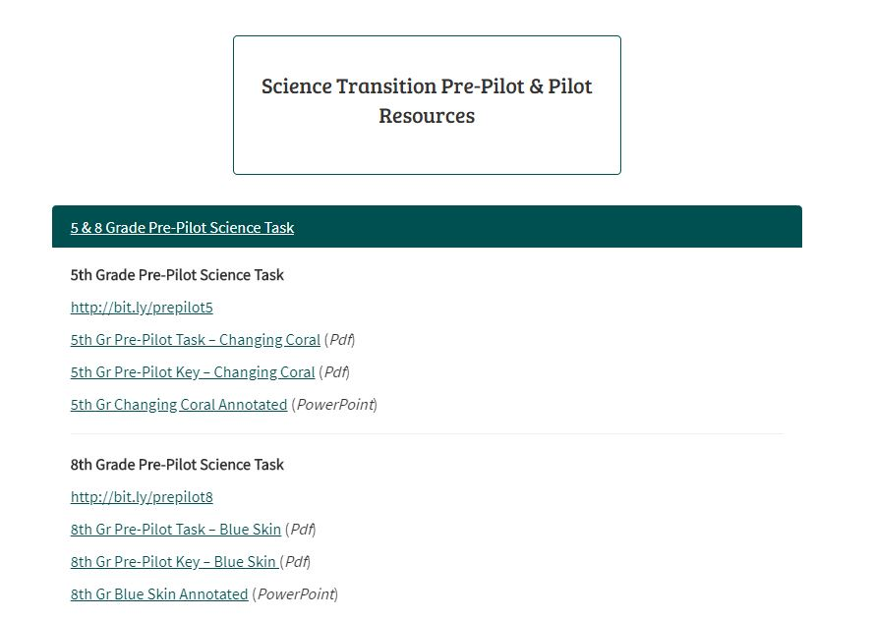
Found on the NDE Statewide Assessment webpage

Slide 120
5th grade pre-pilot task http://bit.ly/prepilot5 5th Gr Pre-Pilot Task – Changing Coral (Pdf) 5th Gr Pre-Pilot Key – Changing Coral (Pdf) 5th Gr Changing Coral Annotated (PowerPoint)

Slide 121
8th grade pre-pilot task http://bit.ly/prepilot8 8th Gr Pre-Pilot Task – Blue Skin (Pdf) 8th Gr Pre-Pilot Key – Blue Skin (Pdf) 8th Gr Blue Skin Annotated (PowerPoint)

Slide 122
Additional Resources Available Soon
Test Blueprint and supporting material
Recording introducing the materials
Item Type Sampler (practice opportunity)
Guidance on Scheduling

Slide 123
SCILLSS

Slide 124
Strengthening Claims-based Interpretations and Uses of Local and Large-scale Science Assessment Scores (SCILLSS)

Slide 125
About SCILLSS
One of two projects funded by the US Department of Education’s Enhanced Assessment Instruments Grant Program (EAG), announced in December, 2016
Collaborative partnership including three states, four organizations, and 10 expert panel members
Nebraska is the grantee and lead state; Montana and Wyoming are partner states
Four year timeline (April 2017 – December 2020)
Notes:
The Strengthening Claims-based Interpretations and Uses of Local and Large-scale Science Assessment Scores (SCILLSS) project is funded by the US Department of Education’s Enhanced Assessment Instruments Grant Program. As lead state and grantee, the Nebraska Department of Education is working in collaboration with two other state education agencies, Wyoming and Montana, along with four organizations, and a technical advisory panel of 10 experts that contribute an essential combination of expertise in principled-design, measurement, assessment literacy, and classroom practices to support the implementation of this project.

Slide 126
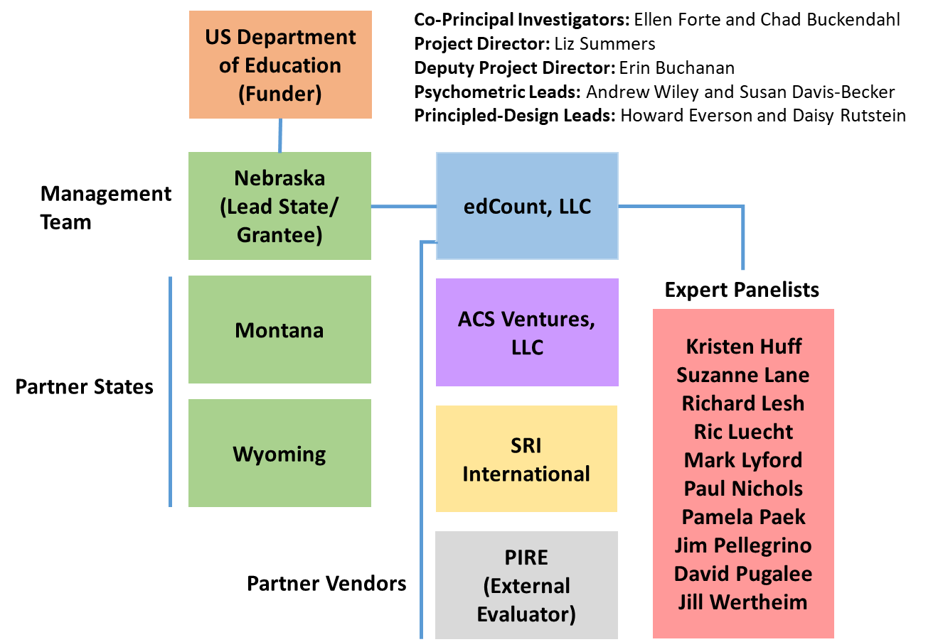
SCILLSS Partner States, Organizations, and Staff
Notes:
We have quite a distinguished list of expert panelists also involved with SCILLSS. The purpose of having a technical advisory committee is to seek feedback, commendations, and recommendations to improve the overall quality of each of the SCILLSS’ deliverables. The expert panelists will convene, along with the management team and state leads, at the SCILLSS’ annual yearly meetings to contribute expertise and experience in meeting the project goals. At various stages in the project, TAC members will contribute to different tasks during the design and development phases rather than upon completion during the yearly meetings.

Slide 127
Project Deliverables
Year 1
Year 2
Year 3
Year 4
1 - Project Foundations
SCILLSS website
Local and state self-evaluation tools
Theory of Action (ToA) template
Common project ToA
Three (3) state-specific ToAs
Assessment literacy module #1 & 2
Three (3) prioritized claims
2 - Large-scale assessment resources
Three (3) sets of claim-specific PLDs
Three (3) sets of claim-specific measurement targets, task models, design patterns
Classroom-based assessment resources:
Six (6) task models
Six (6) tasks
Six (6) sets of student artifacts
Professional learning for educators
Assessment literacy module #3-5
3 - Classroom-based assessment resources:
Six (6) task models
Six (6) tasks
Six (6) sets of student artifacts
Educators pilot classroom tasks
Set of Professional Learning tools to accompany the classroom templates and white paper.
Large-scale assessment resources
Three (3) sets of task-specific sample items
4 - Reporting and Dissemination
One (1) post-project survey
Three (3) post-project action plans (one per state)
Two (2) summary briefs
16 quarterly reports
Three (3) annual reports
One (1) culminating project report

Slide 128
SCILLSS Resources and Student Learning
SCILLSS Goal 1, Coherence: Establish a means for states to strengthen the meaning of statewide science assessment results and to connect those results with local science curriculum, instruction, and assessment
SCILLSS Goal 2, Support Implementation of Principled-Design: Strengthen the knowledge base and experience among stakeholders in using principled-design approaches to create and evaluate quality science assessments that generate meaningful and useful scores
Student learning in relation to goals and expectations
Interim and other classroom assessments
Guide to Developing Three-Dimensional Science Tasks for Classroom Assessments
Purpose: To guide implementation of principled-approaches for developing three-dimensional tasks aligned to NGSS-like standards for use within classrooms
Audience: Local educators and administrators
Format: Guidebook; templates; tasks; exemplars
Professional Learning Sessions on Using a Principled Approach to Designing Classroom Assessment Tasks
Purpose: To support local educators in applying principled-design in the development of classroom assessment tasks that link to curriculum and instruction
Audience: Local educators and administrators
Format: Workbook; templates; PPT slides; guiding questions
Annual assessments
SCILLSS
Guide to Developing Three-Dimensional Science Tasks for Large-Scale Assessments
Purpose: To guide implementation of principled-approaches for developing three-dimensional tasks aligned to NGSS-like standards for large-scale science assessments
Audience: State administrators; vendors
Format: Guidebook; templates; tasks; exemplars
resources
A Principled-Design Approach to Creating PLDs and Building Score Scales
Purpose: To explain how and why to develop PLDs and score scales using a principled-design approach
Audience: State and local educators; vendors
Format: White paper
Assessment Fundamentals
Self-Evaluation Protocols
Purpose: To support educators in evaluating the quality of the assessments in their assessment systems
Audience: State and local educators; vendors
Format: Protocol
Assessment Literacy Workbook
Purpose: To strengthen educators’ understanding of and ability to make good decisions about assessments
Audience: State and local educators; vendors
Format: Digital workbook
Theory of Action Principles
Assessment systems are developed such that they can inform improvements to curriculum and instruction
Assessments are equitable, accessible, and culturally relevant for widest range of students
Educators use student performance data appropriately to monitor progress toward CCR and to inform teaching
State assessments connect coherently to local C-I-A in a way that provides comprehensive coverage of the standards
Stakeholders collaborate to effectively coordinate alignment of C-I-A systems
https://www.scillsspartners.org/
Notes:
All the tools that the project has developed and how they are part of the assessment system impacting student learning

Slide 129
Assessment Literacy Digital Workbook Series Overview
Chapter 1 | Validity, validity evidence, and the assessment life cycle (design and development, administration, scoring, analysis, reporting, score use)
Chapter 2 | Construct Coherence: To what extent do the test scores reflect the knowledge and skills we’re intending to measure, for example, those defined in the academic content standards?
Chapter 3 | Comparability: To what extent are the test scores reliable and consistent in meaning across all students, classes, and schools?
Chapter 4 | Accessibility and Fairness: To what extent does the test allow all students to demonstrate what they know and can do?
Chapter 5 | Consequences: To what extent are the test scores used appropriately to achieve specific goals?

Slide 130
Accessing the Digital Workbook Series
Digital Workbook on Educational Assessment Design and Evaluation: Creating and Evaluating Effective Educational Assessments can be found on the SCILLSS Resource page.

Slide 131
Tools to support Principled-design Elements for Developing Science Tasks
Phase | State Summative Elements (Grades 5, 8, 11) | Classroom Elements (Grades 5, 8, 11)
Domain Analysis | Overall Claim Measurement Targets Elaborated (Unpacked) Dimensions Integrated Dimension Maps | Unpacking Tool
Domain Modeling | Design Patterns | Task Specifications Tool
Task Conceptualization | Task Templates Task Specifications Item Specifications
Assessment Development | Tasks Scoring Rubrics/Scoring Notes | Tasks Scoring Rubrics/Scoring Notes
Notes:
4 Phases. focus on the Classroom Elements and share these are the tools for each phase. Exemplars of each tool are also in the paper for grades 5, 8 and 11.

Slide 132
Accessing the Classroom Task
A Guide to Develop Classroom-based Next Generation Science Standards Assessment Tasks: A Principled-design Approach can be found at this link.

Slide 133
Thank you!

