Slide 1
Instructional Leadership
Creating Practice from Theory
Peter DeWitt, Ed.D.

Slide 2
Learning Intentions
To understand:
The definitions of instructional leadership
6 important components of instructional leadership
To make this practical for your current context.
cc: UNDP in Europe and Central Asia - https://www.flickr.com/photos/46920115@N03

Slide 3
“The more leaders focus their influence, their learning, and their relationships with teachers on the core business of teaching and learning, the greater their likely influence on student outcomes.”
(Robinson et al., 2018, p. 23).

Slide 4
Instructional leadership is when those in a leadership position focus their efforts on the implementation of practices that will positively impact student learning.
DeWitt. 2019

Slide 5
I am confident I’m an instructional leader
cc: UNDP in Europe and Central Asia - https://www.flickr.com/photos/46920115@N03

Slide 6
I’m confident my principal is an instructional leader?

Slide 7
Motivation
Agency
Capacity Beliefs
Context Beliefs
These are beliefs about whether, for example, the working conditions in the school will support teachers’ efforts to instruct in the manner suggested by the school’s improvement initiatives.
Includes such psychological states as self-efficacy, self-confidence, academic self-concept, and aspects of self- esteem.
(Leithwood, Mascall. Educational Administration Quarterly. Vol. 44, No. 4 (October 2008) 529-561).

Slide 8
Instructional Leadership Framework
Focus On Learning
Student Engagement
Instructional Strategies
Collective Efficacy
Implementation
Evaluation
Learning
DeWitt. 2019

Slide 9
What is the relationship between instructional leadership and the leadership you feel you are practicing?
cc: UNDP in Europe and Central Asia - https://www.flickr.com/photos/46920115@N03

Slide 10
Implementation
Program Logic Model
Implementation Cycle

Slide 11
Program Logic Model
Activities
What activities will help you meet your goal?
Outputs
How will you begin taking actionable steps
Impact
How will students/teachers benefit?
Needs
Resources necessary to meet your goal
Inputs
What is our current reality?
What does our evidence show us?
Where do we want to improve?
DeWitt. 2019

Slide 12
Stage 1: Discussion of New Practice to be implemented
Clearly articulated vision of the new practice
Stage 2: Actual Implementation
Reflection/Evidence/Evaluate
Stage 3: Second round of implementation
Reflection/Evidence/ Evaluate
Stage 4: Embedded in collaborative culture
Reflect/Evidence/Evaluate
Who will it help? How is it better than what we are already doing?
Is this an embedded part of the collaborative culture?
Implementation Cycle for Instructional Leaders
How are teachers involved?
Adapted from Odom et al (2014), Fixsen et al (2005), DeWitt (2019).
How did round 2 go?
Staff feedback?
Who will be involved?
What does successful implementation look like?
How will it be implemented? Who will do it? Pilot? Whole staff? Can teachers/staff provide feedback of how it is going?
What works? What doesn’t?
Notes:
Adapted from Odom et al (2014), Fixsen et al (2005), DeWitt (2019).

Slide 13
Focus On Learning
Knowledge Dimensions
Surface, Deep and Transfer
Equity of Content

Slide 14
Cognitive Process Dimension
Knowledge Dimension
Factual Knowledge | Factual knowledge includes isolated bits of information, such as vocabulary definitions and knowledge about specific details.
Conceptual Knowledge | Conceptual knowledge consists of systems of information, such as classifications and categories.
Procedural Knowledge | The knowledge of skills.
Metacognitive Knowledge | Metacognitive knowledge refers to knowledge of thinking processes and information about how to manipulate these processes effectively.
Anderson, L.W., & Krathwohl, D.R. (2001).

Slide 15
Cognitive Process Dimension
Knowledge Dimension
Factual Knowledge | When was JFK assassinated? What are some of the reasons that contributed to the Vietnam War? What does a .40 effect size mean in Hattie’s research?
Conceptual Knowledge | What is the relationship between Harry Potter and the Sorcerer Stone and The Hobbit? What is the relationship between the research around school leadership and what you experience in your school?
Procedural Knowledge | What is the order of operations? How would you go about sounding out that first word in the sentence?
Metacognitive Knowledge | What did I learn today that challenged my thinking?

Slide 16
Student Engagement
On average teachers ask 200 questions per day and students ask 2 questions per student per week. Janet Clinton
Around 70% of time students are in cooperative learning groups, but 80% of that time is spent on individual work. Rob Coe
75% of class time is spent on instruction.
Teachers out-talk students by 3 to 1.
Students responding to teacher questions accounted for 5% of class time.
Less than 1% was associated with open questions. John Goodlad (1994. p. 230).
Alienation?

Slide 17
How often do you and your staff engage in dialogue around student engagement?
cc: UNDP in Europe and Central Asia - https://www.flickr.com/photos/46920115@N03

Slide 18
Instructional Strategies

Slide 19
Hattie’s Research
Over 1,400 Meta-analysis
300 million students
251 influences on learning…
.40 – a year’s worth of growth for a year’s input

Slide 20
Rank The Influences
Jigsaw Activity
Co-Teaching
One-to-One Laptops
Classroom Discussion
cc: UNDP in Europe and Central Asia - https://www.flickr.com/photos/46920115@N03

Slide 21
Rank The Influences
Jigsaw Activity 1.20
Classroom Discussion .82
Co-Teaching .19
One-to-One Laptops .16
cc: UNDP in Europe and Central Asia - https://www.flickr.com/photos/46920115@N03

Slide 22
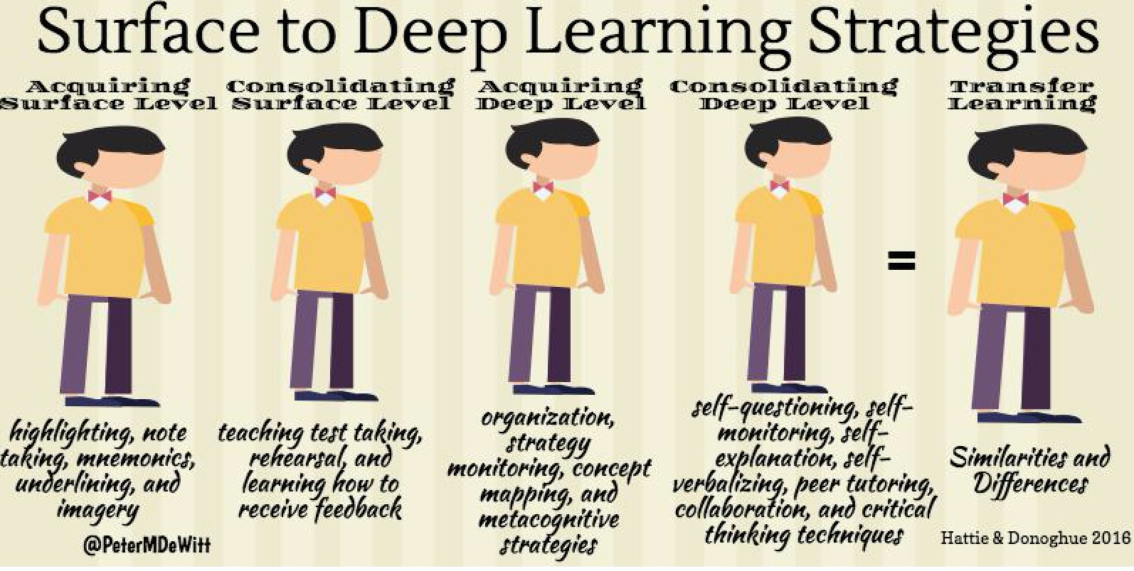

Slide 23
Collective Efficacy
Establish diverse group of thinkers
Team building – Do we believe in each other?
Co-construct goal (i.e. Learning)
Implement strategies (Try and try again)
Collect evidence of impact
DeWitt (2018).

Slide 24
Self-Efficacy
“Refers to beliefs in one’s capabilities to organize and execute the courses of action required to produce given attainments”
Bandura, 1977

Slide 25
Research Study
Shape A
Shape B
Shape C
Reference: Amerstock, I., Janosz, M., & Bowman, R. (2012). Teachers’ efficacy beliefs: predictors and influences. The Journal of Educational Research, 105, p. 319-328.

Slide 26
Research Study
Shape A
Reference: Amerstock, I., Janosz, M., & Bowman, R. (2012). Teachers’ efficacy beliefs: predictors and influences. The Journal of Educational Research, 105, p. 319-328.

Slide 27
Research Study
Extremely High Self-Efficacy
High Collective Efficacy
Shape A
Reference: Amerstock, I., Janosz, M., & Bowman, R. (2012). Teachers’ efficacy beliefs: predictors and influences. The Journal of Educational Research, 105, p. 319-328.

Slide 28
Research Study
Shape B
Reference: Amerstock, I., Janosz, M., & Bowman, R. (2012). Teachers’ efficacy beliefs: predictors and influences. The Journal of Educational Research, 105, p. 319-328.

Slide 29
Research Study
Self-efficacious
Expectations
Shape B
Reference: Amerstock, I., Janosz, M., & Bowman, R. (2012). Teachers’ efficacy beliefs: predictors and influences. The Journal of Educational Research, 105, p. 319-328.

Slide 30
Research Study
Shape C
Reference: Amerstock, I., Janosz, M., & Bowman, R. (2012). Teachers’ efficacy beliefs: predictors and influences. The Journal of Educational Research, 105, p. 319-328.

Slide 31
Research Study
Highly disturbed individual who has a tendency to blurt out obscenities.
Shape C
Reference: Amerstock, I., Janosz, M., & Bowman, R. (2012). Teachers’ efficacy beliefs: predictors and influences. The Journal of Educational Research, 105, p. 319-328.

Slide 32
Collective teacher efficacy refers to the collective self-perception that teachers in a given school make an educational difference to their students over and above the educational impact of their homes and communities. (Tschannen-Moran & Barr, 2004, p. 190).
Tschannen-Moran, M., & Barr, M. (2004). Fostering student learning: The relationship of
collective teacher efficacy and student achievement. Leadership and Policy in Schools, 3(3),
189-209.
Notes:
In our experiences – we don’t point these two things out – - 1. That some educators believe there is nothing they can do to influence student achievement and 2. That some educators hold low expectations for individual students and groups of students. Don’t know if it’s part of the culture of niceness – or that we don’t want to highlight negativity that exists in some educational institutions. I always hear presenters/superintendents, etc. say – “Educators have the best intentions” – “Every educator is extremely dedicated” and while we believe this to be true, we also need to acknowledge that some educators do not feel a sense of self or collective efficacy and some hold very low expectations for students. They can still have good intentions and be dedicated but these efficacy beliefs and expectancy beliefs are cause for concern.

Slide 33
Stage 1: Discussion of New Practice to be implemented
Clearly articulated vision of the new practice
Stage 2: Actual Implementation
Reflection/Evidence/Evaluate
Stage 3: Second round of implementation
Reflection/Evidence/ Evaluate
Stage 4: Embedded in collaborative culture
Reflect/Evidence/Evaluate
Who will it help? How is it better than what we are already doing?
Is this an embedded part of the collaborative culture?
Implementation Cycle for Instructional Leaders
How are teachers involved?
Adapted from Odom et al (2014), Fixsen et al (2005), DeWitt (2019).
How did round 2 go?
Staff feedback?
Who will be involved?
What does successful implementation look like?
How will it be implemented? Who will do it? Pilot? Whole staff? Can teachers/staff provide feedback of how it is going?
What works? What doesn’t?
Notes:
Adapted from Odom et al (2014), Fixsen et al (2005), DeWitt (2019).

Slide 34
Want Collaboration?
Define why each member is a part of the team
Define the expectations of being on the team
Co-construct a goal together around an initiative
Assign duties for each member of the team
Promote and support discourse among the team
DeWitt (2017)

Slide 35
Evidence of Impact
Do you collect evidence to understand impact?
What does that evidence look like?
Who is involved in that process?

Slide 36
Evidence of Implementation
Faculty Meetings | In your walkthroughs, do you see teachers putting into practice the strategies they learned from one another in the faculty/staff meeting?
Walkthroughs | What feedback do you provide to teachers? Do they put it into practice? Do you take their feedback and use it in your practice?
Observations | Do your observations focus on praise? Or do your observations build on previous discussions with staff and take into account their goals?
DeWitt (2019).
.

Slide 37
Connect – Extend - Challenge
Connect – How does this fit in with prior knowledge?
Extend – How does this extend your knowledge to new thinking?
Challenge - How did it challenge your thinking?

Slide 38
Questions?
pmdewitt518@gmail.com
@PeterMDeWitt

