Slide 1
As you enter the room . . .
How often do students engage in analytical writing (outside of essay writing)?
1
Once a quarter
Once a month
Once a week
More than once a week
2
3
4

Slide 2
As you enter the room . . .
How do you provide students opportunities to engage in analytical writing?
1
Daily writing responses
After a series of close reading lessons and
text discussions
At the end of a unit or on an assessment
During periodic essay writing tasks
A combination of the above questions
2
3
4
5

Slide 3
As you enter the room . . .
Before starting an analytical writing task, do students both understand and have access to the scoring rubric/method?
1
Yes
No
2

Slide 4
As you enter the room . . .
Do students self- and peer-assess
their writing?
Yes, students self- and peer-assess
their writing
Sometimes students self- and peer-assess
their writing
No, students do not self- or peer-assess
their writing
1
2
3

Slide 5

Preparing Students for Text-Dependent Analysis
Leveraging Text-Dependent Analysis for Learning

Slide 6

Setting the Stage

Slide 8
Our Work Today
Setting the Stage
Our Students’ Work
From the Research
Strategies
Implications
Reflection and Planning

Slide 9
Learning Targets
Identify student strengths and challenges
Develop a rubric to score text-dependent
analysis (TDA) responses
Identify instructional strategies to support
responsive lessons
Learning Guide p. 4

Slide 10
How do we invite readers to read closely?
Think about your response and jot your ideas on
a sticky note
Share your ideas as you introduce yourself to
your table

Slide 11
Our Students’ Work
Homework from Day 1
Form a group of six
  Group 1: Plus +
  Group 2: Minus –
  Group 3: Interesting *
Create a chart with one row for each question
For each question, brainstorm and record your group’s thoughts
Form new groups that include Plus, Minus, and Interesting; line up your charts
Be ready to share
Learning Guide p. 6

Slide 12
Prompt Feedback
All cohorts
Strengths
Things to consider
Define terms for students
Narrow focus allows for analysis
Ask concise yet meaningful questions
Analysis is the goal
Phrase prompts clearly
Speculation is difficult to support with text evidence

Slide 13
Sample Prompts
Cohort #1: La Vista
Prompt 1: An aspect of indirect characterization is that characters affect other characters. In “Discovering Hidden Treasures,” how does Max’s uncle affect Max’s character? Does Max change because of his uncle’s actions? Why or why not? Support your answer with evidence from the text.
Prompt 2: Patrick Henry delivered an impassioned speech encouraging a fight against British rule. Use evidence from the text to cite experiences from the speech that conveyed the message.
Prompt 3: The author of “An Ingenious Solution” believes in environmentally-friendly solutions. Discuss the ways in which the author conveys this belief within the text. Use evidence from the text to support your ideas.
Notes:
Animated slide

Slide 14

From the Research

Slide 15
Why ask students to do text-dependent analysis?
Communication skills
College and career preparation in grade 2
The difference 10 minutes can make

Slide 16
Habits
For reading and writing
Decisions versus habits
Turn routines into habits
Recall patterns

Slide 17
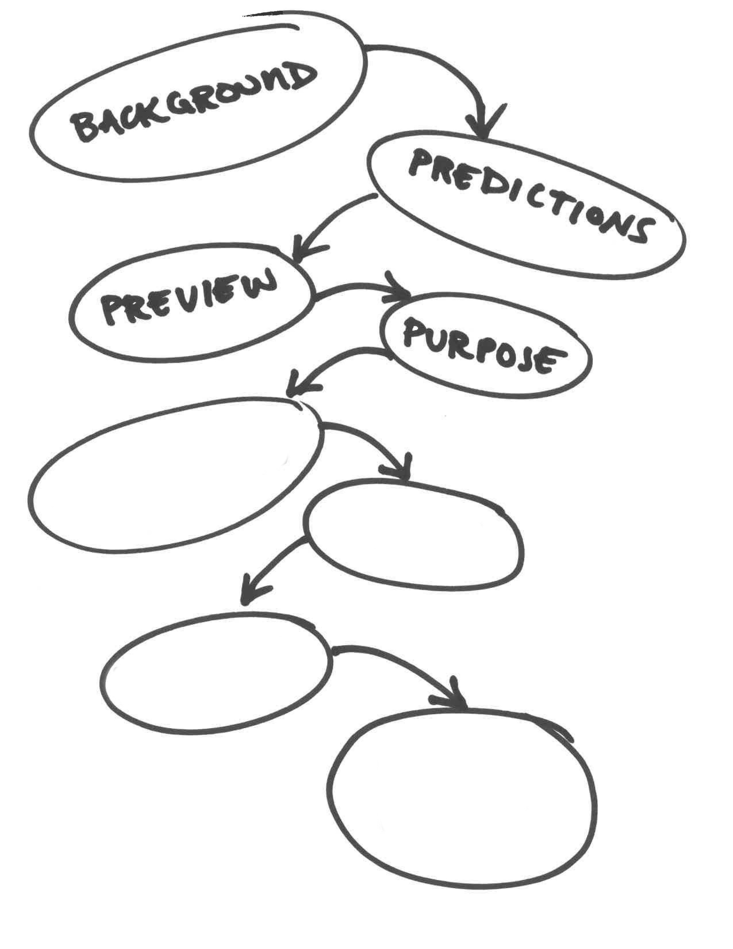
TDA Habits
Form groups of four
Brainstorm habits students
will need to master to
support TDA
Create a flow chart that displays the sequence of actions necessary for students to build habits to support TDA
Learning Guide p. 8

Slide 18
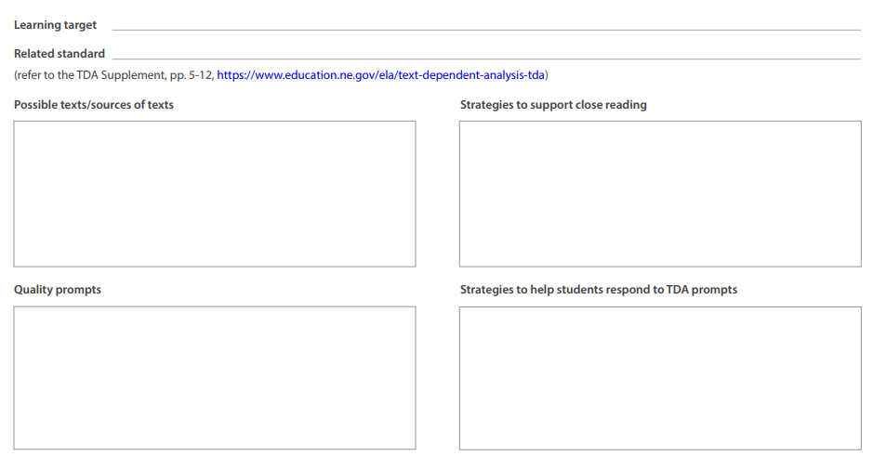
Reflect and Plan
Learning Guide p. 29

Slide 19

Strategies

Slide 20
What are the connections?
Nebraska Content Area Standards
Ongoing Instruction
Achievement
Level
Descriptors
Text-Dependent Analysis

Slide 21
Poll: Achievement Level Descriptors
How well would you rate your understanding of Achievement Level Descriptors?
1
Expert
Understand well
Understand somewhat
Unfamiliar
2
3
4

Slide 22
Achievement Level Descriptors (ALDs)
ALDs define the likely knowledge, skills, and abilities of students in each achievement level and are commonly found on state education department websites, in score reports, and in test interpretation guides
When ALDs are used to interpret an NSCAS scale score, they represent what a student is likely able to do based on the student’s achievement level categorization

Slide 23
Use of Achievement Level Descriptors
With the state assessment
In the classroom
Support of writing items
Help set cut scores
Help interpret what students in different achievement levels
can likely do
Use as a framework for analyzing student work
Support item writing
Use in standard setting
Use in test score interpretations
Connect to student thinking

Slide 24
Sample ELA ALD
Standard | Developing | On Track | College and Career Ready
Analyze and explain the relationships between elements of literary text (e.g., character development, setting, plot, conflict, point of view, inferred and recurring themes). | Identify and explain relationships between basic elements of literary text (e.g., character development, setting, plot, conflict, point of view). | Analyze and explain the relationships between elements of literary text (e.g., character development, setting, plot, conflict, point of view, inferred and recurring themes) and cite specific evidence from the text to explain those relationships. | Analyze and explain subtle relationships between elements of literary text (e.g., character development, setting, plot, conflict, point of view, inferred and recurring themes) and cite specific evidence from the text to demonstrate those relationships.

Slide 25
Characteristics of Quality Prompts
Work with your table group
Consider:
  ͏What makes a quality prompt?
Take one minute to think independently; consider how this question applies to your content area
Share out, round-robin style, at your table; use as many rounds as necessary

Slide 26
Thinking About the Questions We Ask
Form groups of three
Consider:
  How does the approach to writing or responding to TDA prompts differ by content area?
Consider how this question applies to your
content area
Each person shares their thoughts

Slide 27
Questions from Content
Connecting with . . .
Social Studies
Science
English Language Arts
What did the author mean by “_____” [phrase or sentence from text]?
Why did the author choose to use “_____” [word or phrase from text] to describe “_____” [specific noun from text]?
When the author writes “_____” [phrase or sentence from text], what does that tell you about the author’s opinion of or position on _____ [historic event, movement, figure]?
Why did the author choose to describe “_____” [person, place, thing] by writing “_____” [phrase or word from text]?
When the author claims “_____” [scientific principle, phrase, statistic], what evidence in the text supports this claim?
What role does “_____” [variable from scientific method] play in “_____” [sentence from passage]?
Notes:
Animated slide

Slide 28
DOK and TDA Questions
TDA Equivalent | DOK 3 | DOK 4
Author’s craft (character development) | How does <character’s name> change throughout the text? What causes <character’s name> to change? | How does <character’s name>’s development throughout the text impact the other characters in the story?
Author’s purpose | Why did the author write this text? (This assumes purpose is not directly stated in the text.) | Evaluate the author’s success in achieving his or her purpose.
Text structure | How does the author organize the text, and why did he or she most likely choose that structure? | Analyze how the text structure supports or detracts from the power of the author’s message/text.

Slide 29


AUTHORS
IMPLY
READERS
INFER

Slide 30
What are you already doing?
Form a group of four
Create a three-column chart with the headings
Text Complexity, Close Reading, Analytical Writing
Discuss and chart practices you use
Post your group’s work on the wall
Choose a group member to be the “docent”
Circulate through the gallery as a group

Slide 31
Strategies: Text Complexity
Pre-read the text
“What is complex about this text?”
“What is the focus question for this text?”
  Vocabulary
  Complex sentences
  Identify places to stop, ask questions, and have students summarize
Notes:
Animated slide

Slide 32
Strategies: Close Reading
Pre
During
After
Background information
Text context
Preview/
overview
Predictions
Purpose
Annotation
Tools
Multiple reads
Organizing thinking
Group discussion, debate
Evidence analysis
Composing
a response

Slide 33
Strategies: Analytical Writing
Practice low-stakes writing about complex text daily
Build opportunities for students to develop, organize, revise, and publish
Understand task, audience, and purpose
Evaluate and select credible sources

Slide 34

Analytical Writing
Show relationships between pieces of information
Make claims supported with text evidence
Compare and contrast
Assess or evaluate

Slide 35
Existing Practices and Resources
What are you already doing/using?
Add to the TDA Resources and Strategies table in Google Docs™
Learning Guide p. 10

Slide 36
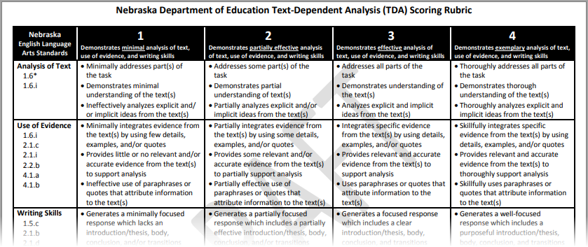
Evaluating vs. Describing Performance
Rubrics

Slide 37
Poll: Rubric Use
Do you use the Nebraska TDA Scoring Rubric when scoring student work?
1
Yes
Yes, with some modifications
I created something different
2
3

Slide 38

Criteria for
Quality Rubrics
Observable
Appropriate
Definable
Distinct
Complete
Continuum-friendly

Slide 39
A Draft Rubric
Part 1: Review helpful resources
Return to your group from Our Students’ Work
Review your group’s chart from earlier
Consider the resources you’ve consulted in using/creating a rubric (list in Learning Guide)
Briefly discuss what makes a quality response
Learning Guide p. 11

Slide 40
A Draft Rubric, continued
Part 2: Consider an eighth grade rubric
Reflect, modify, or create
Download template
Input your rubric for scoring TDA responses
Save your work as you go
Learning Guide p. 11

Slide 41
Peer Feedback on Draft Rubric
Part 3: Provide feedback
Remain in your current group
Review another group’s rubric
Using the Comment feature, provide feedback
  Warm feedback highlights the strength of the content and what’s effective
  Cool feedback poses ideas to prompt the
  presenter to think about the content from a
  different perspective
Learning Guide p. 12

Slide 42
Key Takeaways
What is one key takeaway you have after creating/modifying this rubric?
What is one potential challenge to implementing
this rubric?
Learning Guide p. 12

Slide 43
Learning Centers
Round 1
LEARNING CENTER 1
Digging into Close Reading
LEARNING CENTER 2
Analytical Writing
Learning Guide p. 13

Slide 44
Learning Centers, continued
Round 2
LEARNING CENTER 3
Protocols for Looking at Student Work
LEARNING CENTER 4
Practice Writing Prompts
LEARNING CENTER 5
Explore Text Complexity
Learning Guide p. 13

Slide 45
One Thing to Remember
What’s one thing you want to remember about your learning center?
Find a partner
Share information; leave with your partner’s thoughts
After two or three exchanges, return to your
table group and share

Slide 46

Implications

Slide 47

Educator Spotlight

Slide 48
Classroom Implications
Supporting and remediating
Individually respond to one question in your Learning Guide
Discuss your response with equally interested colleagues
Summarize your group’s discussion
Share out with the whole group
Learning Guide p. 26

Slide 49
Just Part of Instruction
Part 1: Identify quality texts in curriculum
Meet in your ESU groups
Sort through the texts you brought to determine which are appropriate for close reading
Generate a list of potential quality texts
Choose one you would want to use in the
near future
Learning Guide p. 27

Slide 50
Just Part of Instruction, continued
Part 2: Draft a quality prompt
Find a partner in your ESU group
Partners choose a text from either:
  ͏TDA What and Why of TDA Supplement
  ͏The curriculum texts identified earlier
Draft a TDA prompt for the chosen text
Review another partnership’s prompt and provide feedback
Learning Guide p. 27

Slide 51

Reflection and Planning

Slide 52
Planning and Instructional Implications
Consider the following questions:
  Where will close reading practice and TDA response skills fit into your instruction?
  How do you need to shift your planning to address aspects of quality text?

Slide 53
Planning and Instructional Implications
Time
Multiple reads of text
Multiday lessons
Resources
Classroom routines and procedures
Classroom culture

Slide 54
What are you already doing?
Responsive Lesson Planning
Plan
Adapt
Build

Slide 55
Responsive Lesson Planning
Regroup with your ESU
Recall the text you chose earlier while sorting
quality texts
Use this text to start your Responsive Lesson Plan
Draw on your ESU group’s expertise while planning

Slide 56
Key Ideas
Quality text + quality prompt = deeper understanding of content
Rubrics help align learning intentions and quality
of work
Text-dependent analysis and analytical writing
are part of regular instruction

Slide 57
Thinking Ahead: Day 3
NWEA
Participants
Reviews and returns rubric
Email your draft rubric
Use rubric to score a few samples from your H-A-L piles of student work
Bring scored student samples to Day 3
Learning Guide p. 31

Slide 58
Exit Ticket
DELTA
What will you change as a result of your learning today?
PLUS
What worked for you this session?
NEEDS
What do you need now?
WONDER
What are you wondering about now?

Slide 59
https://NWEA.us/tda2

Slide 60
© 2019 Nebraska Department of Education. No part of this publication may be reproduced or distributed in any form or by any means, or stored in a database or retrieval system, without the prior written permission of the publisher.
NWEA is a registered trademark of NWEA in the US and in other countries. The names of other companies and their products mentioned are the trademarks of their respective owners.
We are providing links to the third-party website(s) contained in this material only as a convenience, and the inclusion of links to the linked site does not imply any endorsement, approval, investigation, verification, or monitoring by us of any content or information contained within or accessible from the linked site. NWEA does not control the accuracy, completeness, timeliness, or appropriateness of the content or information on the linked site. If you choose to visit the linked site, you will be subject to its terms of use and privacy policies, over which NWEA has no control. In no event will NWEA be responsible for any information or content within the linked site or your use of the linked site. By continuing to the linked site you agree to the foregoing.
February 2019 Ӏ NETDA_PL20768

Slide 61

Break

Slide 62

Break

Slide 63

Lunch

Slide 64

Lunch

Slide 65
What are you thinking now?
Find a partner at your table
Share your thinking
Find a pair from another table
Share your thinking

Slide 66
Break
Ask someone from another table to share:
Most important concept shared so far
Best practice he or she currently uses related
to the topic
Most useful thing learned so far

Slide 67
Break
Before break, think of a question about what you’ve learned so far (and capture your answer)
After break, ask one or two people to answer your question (turn in questions at end to facilitator)

Slide 68
Break
Graffiti wall
Please add comments/questions you have so far about today’s topic to the Graffiti Wall. Use the sticky notes on the tables.

Slide 69
Sample Prompts
Cohort #2: Lincoln
Prompt 1: In the text “The Ancient Singer,” it is mentioned to the main character, “. . . the marimba is an old friend that will repay your loyalty.” Analyze how the main character displays loyalty to the marimba throughout the story and how he is able to recognize how that loyalty pays off. Write a well-constructed response using evidence from the text.
Prompt 2: In the story “A Drama,” Mario is encouraged to join his school’s drama club. Analyze an external conflict for Mario and an internal conflict that challenges him. Using evidence from the text, support your response in a well-developed manner.
Prompt 3: The passage “A Drama” is written in the first-person point of view. Analyze how this point of view helps the reader to understand how Mario develops throughout the story. Use evidence from the text to support your answer.
Notes:
Animated slide

Slide 70
Sample Prompts
Cohort #3: Wakefield
Prompt 1: In the passage “Keeping Time,” the author states how standardized time was created by the railroads. Analyze how standard time made railroad travel safer, using evidence from the text.
Prompt 2: In the passage “A Drama,” Mrs. Lahti tries to influence Mario’s decision. In what direction did she try to guide him? Cite text evidence to support your answer.
Prompt 3: In the late 1800s, the U.S. Railroad System established a standardized time system to help reduce observed problems. Using evidence from the text “Keeping Time,” write a well-organized response discussing the effectiveness of the standardized time system in present-day society.
Notes:
Animated slide

Slide 71
Sample Prompts
Cohort #4: Scottsbluff
Prompt 1: Explain how Ramiro’s change in teaching strategies through the course of “Getting it Right” exemplifies a cause-and-effect relationship. Provide textual evidence to support your answer.
Prompt 2: Define an “odyssey” using context clues from the story, “Angela’s Odyssey.” Provide evidence from the text to support your definition.
Prompt 3: Beehive fences have been successful
in improving relationships between farmers and elephants. Using evidence from the article, describe beehive fences and how they have evolved. What has been the impact of their development?
Notes:
Animated slide

Slide 72
Sample Prompts
Cohort #5: Kearney
Prompt 1: The passage “Invasive Species” is organized using a problem/solution format. Identify one problem and its solution. Use evidence from the text to support your response.
Prompt 2: Imagery is visually descriptive or figurative language designed to help paint a picture in the mind of a reader. In “The Ancient Singer,” how does the author use imagery to show Dawson’s transformation toward the marimba? Use information and evidence from the text to support your answer.
Prompt 3: The narrator of “With Captain Cook”
not only tells the story, but he also provides perspective. How does the author use the
narrator to communicate a sense of wonder
about the natural world? Write a well-organized response using evidence from the text to support your answer.
Notes:
Animated slide

