Slide 1
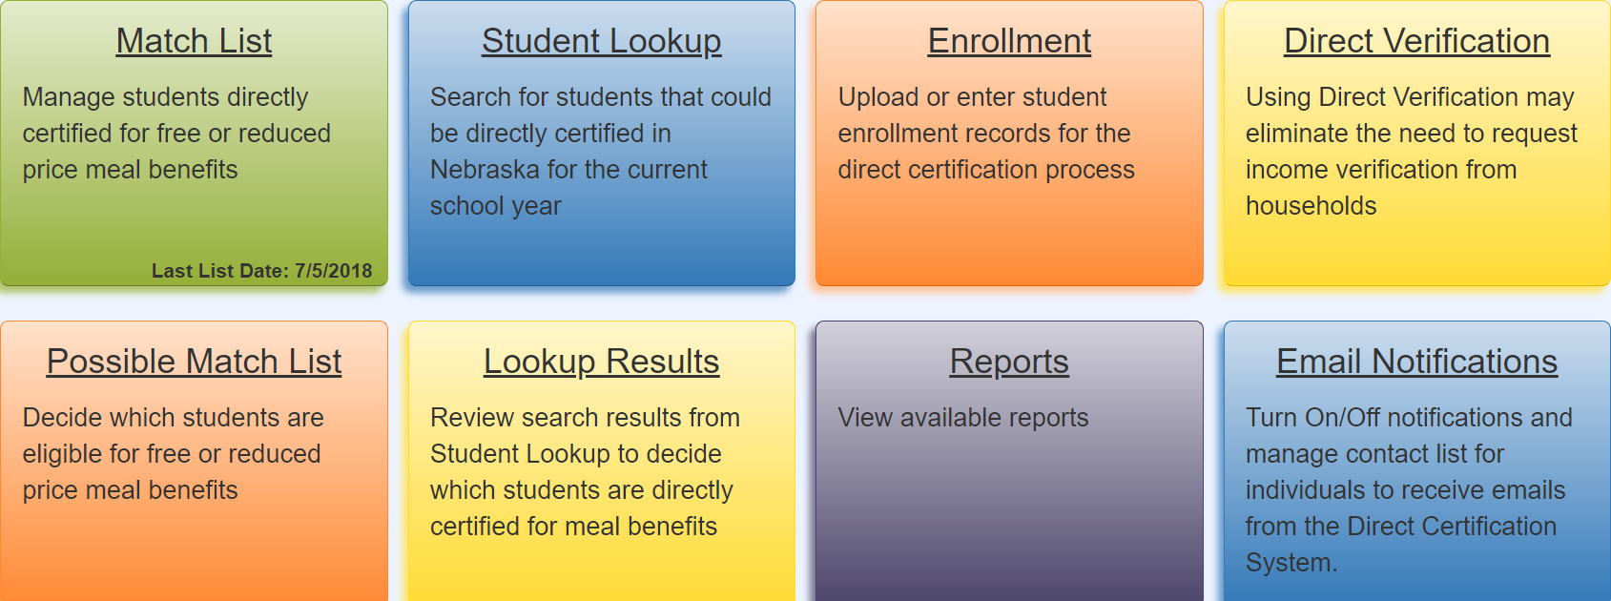
Direct Certification Webinar
Presented by Michelle Stephens
December 18, 2018
Nebraska Department of Education – Office of Nutrition Services
Notes:
Welcome to our Webinar on Direct Certification this afternoon. I am Michelle Stephens a Program Specialist at the Nebraska Department of Education Nutrition Services Office. I am joined here today with several of my Co-workers. All the participants today are muted and we would ask that if you have a question instead of raising your hand please type your question into the chat box. We will monitor any questions as they come in and do our best to answer any questions today or post the questions and answers to our website. The Presentation will be recorded and posted to our website after the holidays.
The Nebraska Department of Education – Nutrition Services Office received an improvement Grant for our Direct Certification System. This presentation, is designed for school lunch staff that work directly with this System. This would be the staff at the school that are responsible for ensuring students are receiving free and reduced benefits for the school lunch program.

Slide 2
Overview
CNP System – Login & Passwords
Enrollment
Match List – Qualifying Programs
Email Notification
User Security – (User Access Rights)
Possible Matches
Student Lookup
Reports
Direct Verification
Notes:
The grant allowed us to develop a new look to the direct certification system and hopefully make it easier for you to use. I’ll go over Login requirements and each of the modules in the system.
How your student enrollments, are collected to make a direct certification match, how to setup E-mail Notifications, Give Security Rights to the person responsible for managing benefits, Reviewing your Possible Match List. And how to use the Individual Student Lookup.
New to the system are reports, I’ll show you how these are beneficial.
The Direct Verification can be used to verify applications for the verification process required by November 15.

Slide 3
Log onto the CNP System
Notes:
The first step to access the direct certification system requires that you Log On to the CNP system.

Slide 4
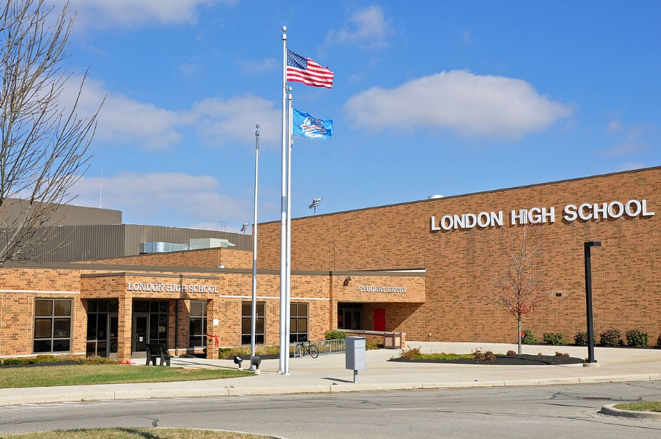
Child Nutrition System (CNP) – User IDs
School Food Authority (SFA)
Authorized Representative (AR)
Notes:
Every Authorized Representative (AR) of the School Food Authority (SFA) is given a User Name and Password to access the CNP system.
The Authorized Representative is assigned as the Administrator and has the rights to assign other users within the SFA. A best practice is for each user to have their own User ID and Password. User Names and Passwords should not be shared, to ensure accountability within the system.
For example, if the school bookkeeper is responsible for submitting the claim for reimbursement that person can be given their own User Name and Password to access the claims part of the CNP system.
If the secretary is responsible for the Match List they could be given their own User Name and Password to access just the DC System.

Slide 5
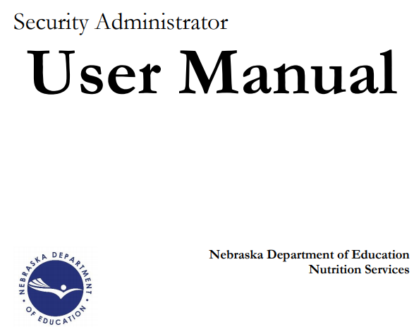
Security Rights – Available Website
Notes:
Written Instructions are available in the CNP system with step by step instructions on how to assign Security Rights

Slide 6
Download Forms
CNP User Manual (Security Admin)
Notes:
This user manual can be viewed by clicking on Applications from the dark blue menu bar and then click on Download Forms
There you will find the CNP User Manual (Security Administration)

Slide 7
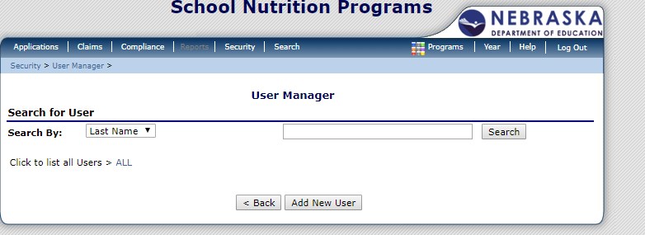
Assign User Access Rights
Notes:
Since only the Authorized Representative can assign new Users you must be logged in as the Administrator to setup new users.
From the dark blue menu bar select Security, and then click on User Manager.
When the User Manager screen appears select “Add New User”

Slide 8
User Profile
Notes:
This will display the User Profile. Here you will add the information about the new user. Complete the User’s Information, Login Information, and Security Base section where you select the Groups you want the user to have access to.
How the profile is completed grants the user access to specific Security Groups within the system.

Slide 9
User’s Assigned Groups
Notes:
After the User’s Profile is completed. The next step is the User’s Assigned Group.

Slide 10
User Assigned Group – Direct Cert
Notes:
This is where you manage access to different parts of the CNP System.
If the person is to have access to the Direct Certification System make sure the SNP Direct Cert/Ver is selected. If this is not selected they will get an Unauthorized message if they try to access the system.
So those are the steps for assigning users in the CNP system. There are a few more steps inside the Direct Certification System I’ll explain later in my presentation.

Slide 11
Access Direct Certification System
Notes:
Access the New Direct System from the Dark Blue menu bar Click on Applications and then select Direct Certification / Direct Verification

Slide 12
Notes:
The next screen displays with a description of these two processes.
Again click on Direct Certification / Direct Verification

Slide 13
Direct Certification System
Notes:
The new look of the DC System allows you to Navigate by clicking on the colored tiles or by Navigating from the dark blue menu bar at the top and selecting from the Drop Down Lists
The Home button will always bring you back to this screen which displays the Colored Tiles.

Slide 14
Enrollment Data
Notes:
In order, for the students enrolled in your school to be matched with direct certification database we need to have enrollment data. USDA requires School Food Authorities to upload student enrollment records 3 times a year; August, October, and February.
We obtain enrollment data from Adviser for Public Schools and Unique ID for Non Public schools.
It is not necessary to upload into both Advisor and Direct Certification System.

Slide 15
Enrollment
Notes:
The first tile I want to discuss is Enrollment.

Slide 16
Enrollment – Upload File
Upload .csv, .xls, .xlsx, or .txt files
Notes:
There are two ways Enrollment data can be submitted into the DC System. You can Upload a Student Information File or you can Enter Student Information individually from the enrollment screen.
I want to clarify that Student Enrollment Records are a list of the schools entire student body or the school roster, not just students that are eligible for free or reduced benefits.
If you are going to upload a file you need to follow the template layout. Which is available by clicking on “Here” to open the Excel File.

Slide 17
Enrollment – Data Layout
Upload .csv, .xls, .xlsx, or .txt files
then Review
Submitted Student Enrollment Records
Student Enrollment Data Layout
School Building Number: | 3 Digit Number, Ex. 001
Local Student ID: | Numbers or Characters – Not Required
NDE Student ID: | 10 Digit Number
Student Last Name: | Characters
Student First Name: | Characters
Student Gender: | 1 Character (M/F)
Student Birth Date: | MM/DD/YYYY or M/D/YY
Note:
Download an Excel template to create an upload file
Data can be uploaded by nonpublic and public schools
Note: Errors are highlighted in orange
Note:
Notes:
The template is a Micro Soft Excel file. The Worksheet is protected and formatted so that you can only enter into the columns listed.
These are the data fields that are used to match your enrollment with the direct certification database.
The School Building Number is the 3 Digit Number assigned by the NDE data center.
All the fields are required except the Local Student ID.
The file name will be your 6 Digit County District number followed with the letter A for the first upload and letter B if there are additional uploads.

Slide 18
Enrollment – Enter by Student
Notes:
Or you can enter Student Enrollment individually if you only have a few students to enter.
This could be helpful when you have new students transfer into your school during the school year or if you don’t have many students.
Matches are made nightly so any new matches will appear on your Match List the following day

Slide 19
Enrollment - Help
Notes:
I want to point out that there is on line help on each of the tiles simply click on “Show Help”.

Slide 20
Match List Date
Notes:
The next tile I want to go over is the Match List .
This tile displays the “Last List Date” a match was determined for one of your students.
An Email notification is sent to the Authorized Representative and Claim contact listed on the program application.
I’ll explain how to edit who gets these notifications later.

Slide 21
Navigating the Match List
1. Select the List Date
2. Number Student Entries Displayed
3. Sort the List by Last Name by clicking on header
4. Print the List
Notes:
The Match List displays the students who are eligible for free or reduced benefits as determined by the “Qualify” column. You can change what is displayed on this screen by
Selecting the List Date range or Click on Search All Dates.
Selecting how many student names to display from 10, 25, or 50 by clicking on the drop down arrow.
Sort the List by Last Name, by clicking on the Last Name Header and
You can Print a copy of the list by clicking on Print List.
You can also choose to “Export the List” to a CSV Comma separated file or a Microsoft Excel file XLS to be uploaded into your Point of Service Software.

Slide 22
Match List – Table Headers
List Date: Date benefits begin
Qualify: How benefits were eligible
Sort Column headers by clicking
Action: Accept or Transfer
Notes:
Lets look at the table headers in more detail.
The “List Date” displays the date a record was added to the Match List or when the qualifying program was updated.
This is also the date when the benefits begin for the household.
The “Qualify” column is the Qualifying Program for benefits. The programs are abbreviated but when you hover over the abbreviation with your mouse the full name appears.
So in my example SNAP stands for Supplemental Nutrition Assistance Program.
Each of the “Columns” can be sorted by clicking on the header. This is helpful for sorting your list in Alphabetical Order by Last Name or by Qualifying Program.
Action is the last column listed, however it is optional, I will explain how it can be used after showing you how to view the Qualifying Programs.

Slide 23
Maintenance – Qualifying Programs
Notes:
A list of the Qualifying Programs can be viewed by clicking on “Maintenance” from the dark blue menu bar and select “Qualifying Programs”.
Here is the full description of the qualifying programs and the program priority used for matching. For example SNAP or Supplemental Nutrition Assistance Program trumps all other qualifying programs. The DC System displays the highest qualifier on your Match List.

Slide 24
Action Column - Optional
Notes:
I want to discuss the options in the Action column. These actions allow you to edit the Match List
I say this is optional because once the eligibility of your students on the Match List have been entered into your Point of Service Software and the households have been notified of their benefits, it is not required to edit the Match List.
However, some schools like to edit the list prior to downloading for use.

Slide 25
Action Options
Accept confirms that a student is a match.
Transfer of a student removes them from the list when a student leaves the district or move between schools however; the student remains directly certified to receive free or reduced price meals. Note: It does not transfer the student to another district.
Undo a record if the record is a possible match and they matched the record by mistake.
Remove a student with a Medicaid – Reduced (MRED) qualifier if they approve an application for free meals from the household.
Notes:
Here are the different actions available if you choose to edit the Match List
Accept just confirms the match is your student and you can actually accept them all at once.
Transfer can be used to change the name of the school building or remove the student if the students leaves your school.
Remove only appears if the qualifying program is Medicaid Reduced. The reason for this qualifier to have a remove options is, if the household submits an application and the income on the application would make the household eligible for free benefits, you may remove the student from your Match List so free benefits can be assigned.
These actions are tracked in the system and I will show you how to review them under “Reports” later in my presentation.

Slide 26
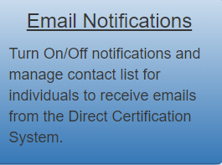
Email Notification
Notes:
As I mentioned we are conducting nightly matches and if there is an update to your Match List an Email notification is automatically sent to the authorized representative and the claim contact from the Program Application.
You can change who gets the Email notification regarding new matches.

Slide 27
E-Mail Notifications
Notes:
Click on Email Notification and select from the drop down list
Add New Contacts or
Manage existing Contacts and
Turn on/Off Notifications
If a person who is not on the Program Application is responsible for the Match List you can have the system send the Email notification directly to that person instead of having to forward it to them.

Slide 28
Maintenance – User Security
Notes:
Under Maintenance
You will select User Security to give user rights to the Direct Certification System as long as the user is set up within the CNP System.

Slide 29
Security Groups
Notes:
The Security screen will display a drop down list of “District Users”. Select the user who needs access to the DC system. If no names appear in the drop down list, either all users in the system have administrator rights or the User IDs are not set up in the CNP System. Please refer to previous slides to set up a user within CNP.
User rights can be assigned to “view only” or “modify”.
The system requires that at least one of these 3 individuals receives email notifications: Authorized Representative, Food Service Director, or the Claim Contact.

Slide 30
Possible Match List
Notes:
In order to improve the number of students directly certified we are also matching records that are similar but not a 100% match. We call this the Possible Match List.
If you have students on the “Possible Match” list we would like you to review them. This can help increase the number of students directly certified therefore eliminating the need for household applications and possibly reducing the number of households selected for verification.
It is important to understand that you are the determining official and need to review this information carefully. On these tables you will compare your student’s information with a record from direct certification database that will be displayed on the line called possible match.

Slide 31
Possible Match List
Check ‘Match’ if the student is the individual in the Possible Match row.
Check ‘No Match’ if the student is not the individual in the Possible Match row.
Note: Yellow highlights help identify records.
Note: Orange highlights help identify differences.
Notes:
To Review move across the record in the table and compare the fields about the ‘Student’ and ‘Possible Match’, such as last name, first name, date of birth, gender, city.
Each record is separated by a black horizontal line and as you move from record to record it will become highlighted in yellow to make it easier for you to see the records you are comparing.
The fields highlighted in Orange, indicate differences. Carefully compare these fields and determine if the ‘Student’ and ‘Possible Match’ are the same person.
If they are you will select Match and the student will be placed on your Match List. If No Match is checked they will be removed from this table and not placed on the Match List.
If you are unsure, leave the checkboxes blank. These students can be entered into the Student Lookup with more information to help you make a decision. We’ll discuss the Student Look module next.
At the bottom of this table are two action buttons, which save your results.
Submit and Go to Match List – saves your matches and takes you to the list.
Submit and Continue saves the work you have completed and allows you to continue.

Slide 32
Possible Match - Undo
Match List
When Possible Matches are saved the Match List shows “Undo” in the Action Column
Notes:
When Possible Matches are added to the Match List you will see an “Undo” in the Action column.
If you determine the match was made in error you can undo the match.

Slide 33
Student Lookup
Notes:
The Student Lookup tile allows you to search for students that could be directly certified. As I mentioned it could be used to confirm a student that is on the Possible Match List by adding more information about the student or to look up newly enrolled students.
If you learn the new student was directly certified at their previous school you can look up the student and have them added to your Match List.

Slide 34
Student Lookup –Confidentiality Agreement
Notes:
As you click on the Student Lookup tile the first thing you must do is Agree to the Confidentiality Agreement in order to use this function.
The purpose is to identify students that are enrolled in your school that may be eligible and you have a legitimate educational interest in accessing this information.

Slide 35
Student Lookup – NDE ID (Preferred)
Notes:
There are 2 different ways to search for student.
The preferred way is by entering the NDE Student ID.
If there is a match it will have a 100% score this way, and you just need to accept the match.

Slide 36
Student Lookup – by Student Information
Notes:
The second way is to search by Student Information
The fields that are required are
Last Name,
First Name,
Gender and
Date of Birth
Additional fields for Address, City, or Parent/Guardian may give you a better search, or would be Fields, you could use if you were trying to confirm a student from the Possible Match List and needed more information.
If there are multiple children in the household you can click on “Add to the Search Queue” and the names will appear on the table as you go. After all household students are added then you can submit the search to the Queue.

Slide 37
Look up Results
Notes:
The “Lookup Results” display in a few minutes. If you stay on this screen you can click the Refresh button to see the results or if you leave the system, you’ll use the Lookup Results tile to see the results.

Slide 38
Lookup Results
Notes:
The Lookup Results requires you to review the match like you do in the Possible Match table.

Slide 39
Lookup Results - Review
100% Doe Jane Marie 10 09 2009 F 1234567891
Doe Jane Marie 10 08 2009 F
Notes:
The Results Table is similar to the Possible Match table but slightly different in how you review the data. Here you have the choice to Review or Remove.

Slide 40
Review Lookup Results
Notes:
The review screen for Student Lookup displays differently than the Possible Match table.
Here the data is displayed side by side for you to review.
Review the information carefully and determine if the student is a match.

Slide 41
Add Match Results to Match List
Enter NDE Student ID
Select a School
Add to Match List
Notes:
If the student is a match you will need to enter the student’s NDE Student ID and the school in order to update the Match List.
If the ID is correct the student will be added to your Match List and the “Action” column in the Match List will contain the Undo or Transfer if you determine the match was made in error.

Slide 42
Lookup Results – Confirming Match
Notes:
The final step will be to double check your accuracy and determine if the data is a match before the student is added to your Match List.

Slide 43
Direct Verification
Notes:
The Verification Process is completed annually by Nov 15.
Direct Verification can be used to assist the verification process before sending letters to the households.
After you have selected your 3% sample of applications you have the option to use Direct Verification to see if there is a match.
To access Direct Verification click on the tile or select from the navigation bar.
The database used for Direct Verification uses additional data including Nebraska Medicaid SCHIP data and 133% of the poverty level for free eligibility.

Slide 44
Direct Verification
Note: Enter Data from Oct 1 to Nov 15
Upload .csv, .xls, .xlsx, or .txt files
THEN
Review the Verification Results
Enter an individual on an application THEN Review and Click ‘Submit Application’
Enter multiple individuals by clicking ‘Add to Application’
OR
THEN
Review and Click ‘Submit Application’
Notes:
You can upload application information or you can enter applications, one at a time.
The majority of schools in Nebraska are only required to verify a few applications so entering them in one at a time may be the easiest method for you.
For larger SFAs a file should be uploaded.

Slide 45
Direct Verification – Upload Template
Upload .csv, .xls, .xlsx, or .txt files
THEN
Review Verification Results
Direct Verification Data Layout
Application Number: | Numbers or characters created by public or nonpublic school
Student First Name: | characters
Student Last Name: | characters
Student Gender: | character (1)
Student Birth Date: | (MM/DD/YYYY) OR (M/D/YY)
Note: Download an Excel template to create an upload file
Note: File can be uploaded from Oct 1 to Nov 15
Notes:
If you plan to upload a file you will need to follow the template layout

Slide 46
Direct Verification Results
Click ‘Print List’ to print results of application(s)
Note: Review the
‘Program’ column to verified individuals on applications
Notes:
If the results match the household eligibility on the application, verification is complete. You are not required to contact the household. Just print the List for documentation that direct verification was completed.
However, if there is not a match you follow up with the household using Attachment F (We Must Check Your Application) and continue by having the household submit documentation.

Slide 47
Reports
Notes:
The final area to review are Reports

Slide 48
Reports
Click the link for the appropriate report and choose the school year, school building, and certain actions associated to the screen
Notes:
The Reports provide information regarding the Action that has taken within each of the Direct Certification System functions
For example the “Match List Report” shows students you have Transferred or Removed from your Match List.
The “Possible Match List Report” shows if students were Accepted or Matched and who the user was and the date match was made.
The “Lookup Results Report” also shows the details of the Actions that were taken for each student.
The “Full Roster Report” shows student records uploaded into UniqID for non public schools, DC upload, or NSSRS/Advisor for public schools.
“Enrollment Report” shows students uploaded into the Enrollment Screen..

Slide 49
Need Help?
Uniq-ID or Adviser - NDE Help Desk
Call toll free at 888-285-0556 or email: ADVISERHelp@NebraskaCloud.org
Nebraska Department of Education - Portal
https://portal.education.ne.gov/site/DesktopDefault.aspx
Office of Nutrition Services
Call 800-731-2233 or Email: nde.nsweb@nebraska.gov
CNP System link
https://nutrition.education.ne.gov/Splash.aspx
Notes:
Here you some resources if you need some assistance.

