Slide 1

Nebraska Career Education
STS Fall Workshops
2018
Notes:
Ask schools to sit together

Slide 2
2018 STS Workshop Agenda
NCE and STS Updates
New Perkins Legislation
NEW Course Standards and Programs of Study
Career Readiness Standards
Workplace Experiences
Non-Traditional Student Recruitment
SkillsUSA Update
Group Share
Industry Tour
Notes:
Tony
Provide instructions for lunch from 11:30

Slide 3
Partnerships for Innovation
Retha Dunn – Executive Director
PFI is the lunch provider

Slide 4
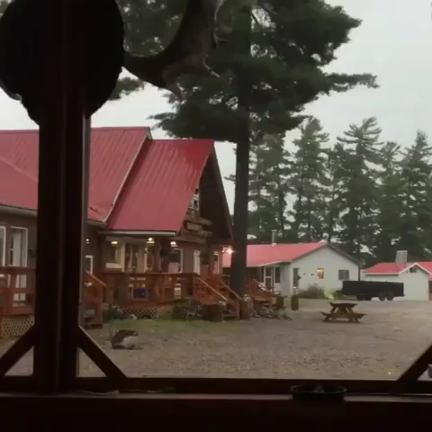

Slide 5
Safety Instructions
Restrooms
Fire
Tornado
CPR
Emergency Caller
Active Shooter
Please quiet cell phones

Slide 6
Whose Here?
Introduce yourself
Name
School
What you teach
How long you have been teaching
Proud moment in teaching

Slide 7
Bookmark These Websites!
https://www.education.ne.gov/STS
http://www.skillsusanebraska.org
https://www.education.ne.gov/NCE

Slide 8


Slide 9
Safety Training
THE most important thing we teach!
http://www.education.ne.gov/sts/I_Safety_Law.html
http://www.careersafeonline.com/

Slide 10
STS Teacher Education Contacts
UNL – Eric Knoll eknoll2@unl.edu
Office: (402) 472-2470
Mobile: (402) 310-2109
WSC – Greg Vander Weil grvande1@wsc.edu
Office: (402) 375-7283

Slide 11
New Perkins Legislation
Level funded
We will be working to develop a new state plan
Stay tuned

Slide 12
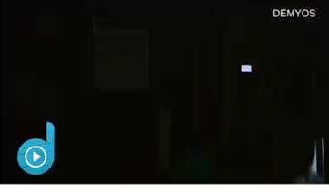
Let’s Get Organized

Slide 13
New STS Standards
http://cestandards.education.ne.gov/Subject_Link.aspx?Sub=Sk
OR https://www.dropbox.com/sh/84q6f4b4f1x9zh1/AABKh1tvSKbRBevkp8aNWuwUa?dl=0

Slide 14
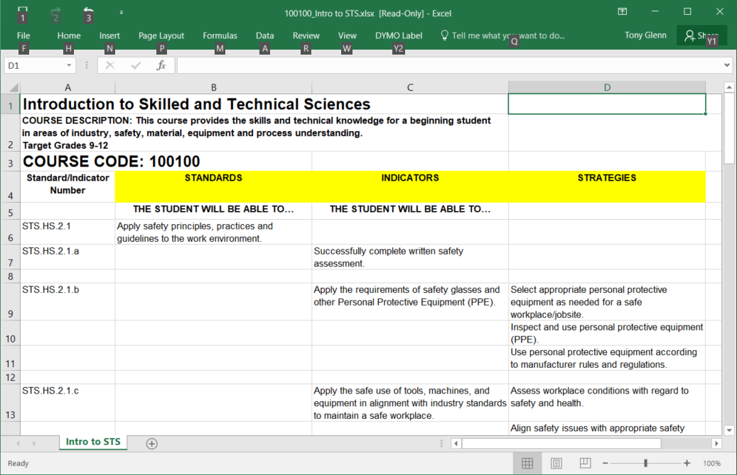
New Standards Terminology

Slide 15
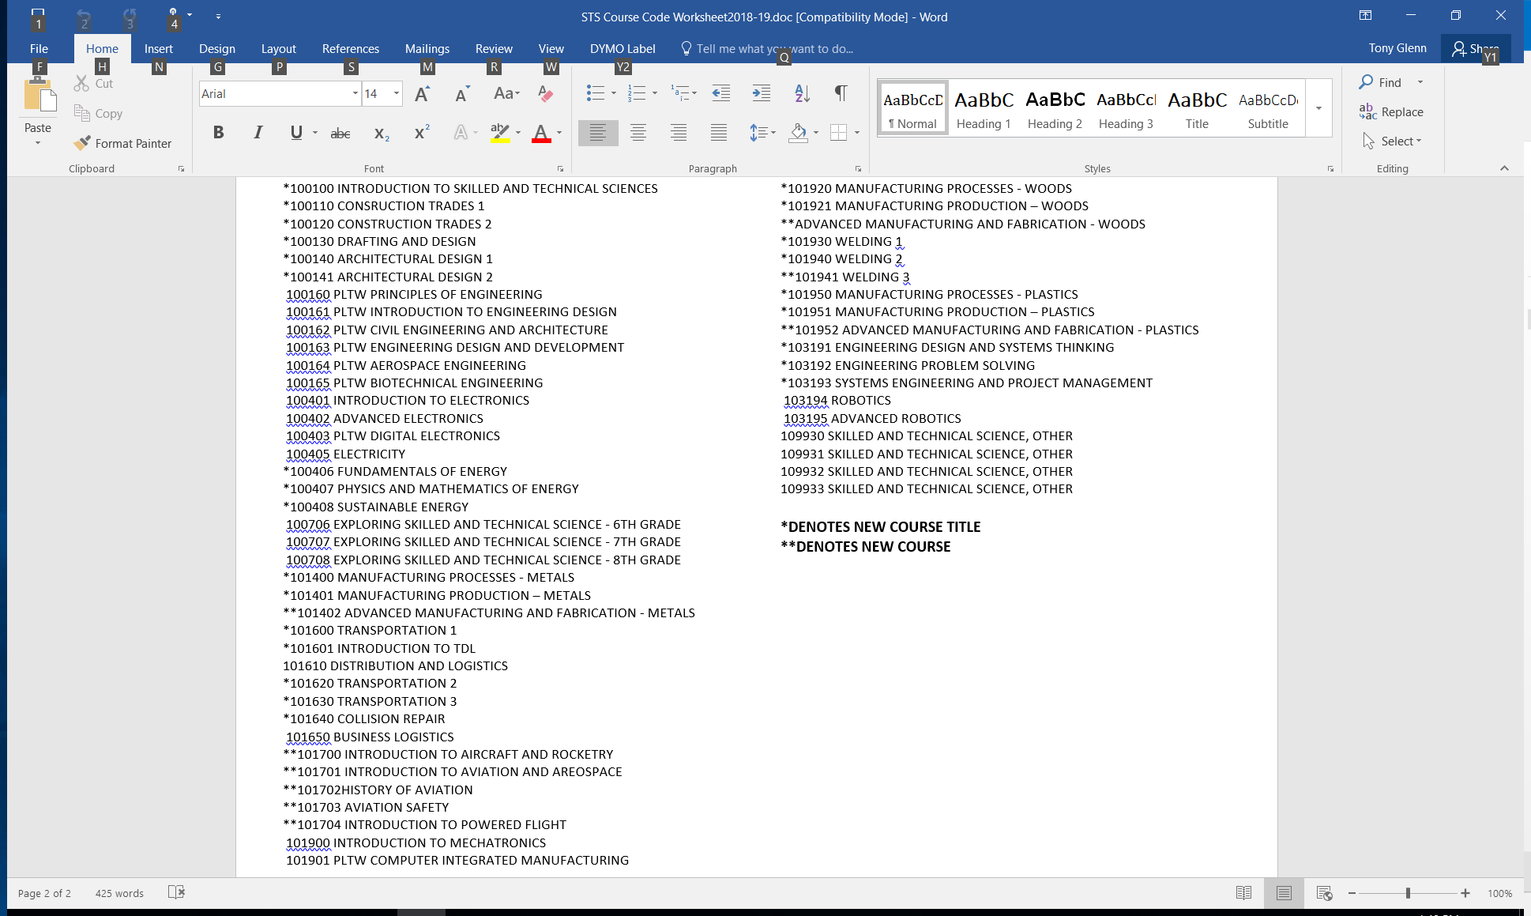
New Courses and Titles

Slide 16
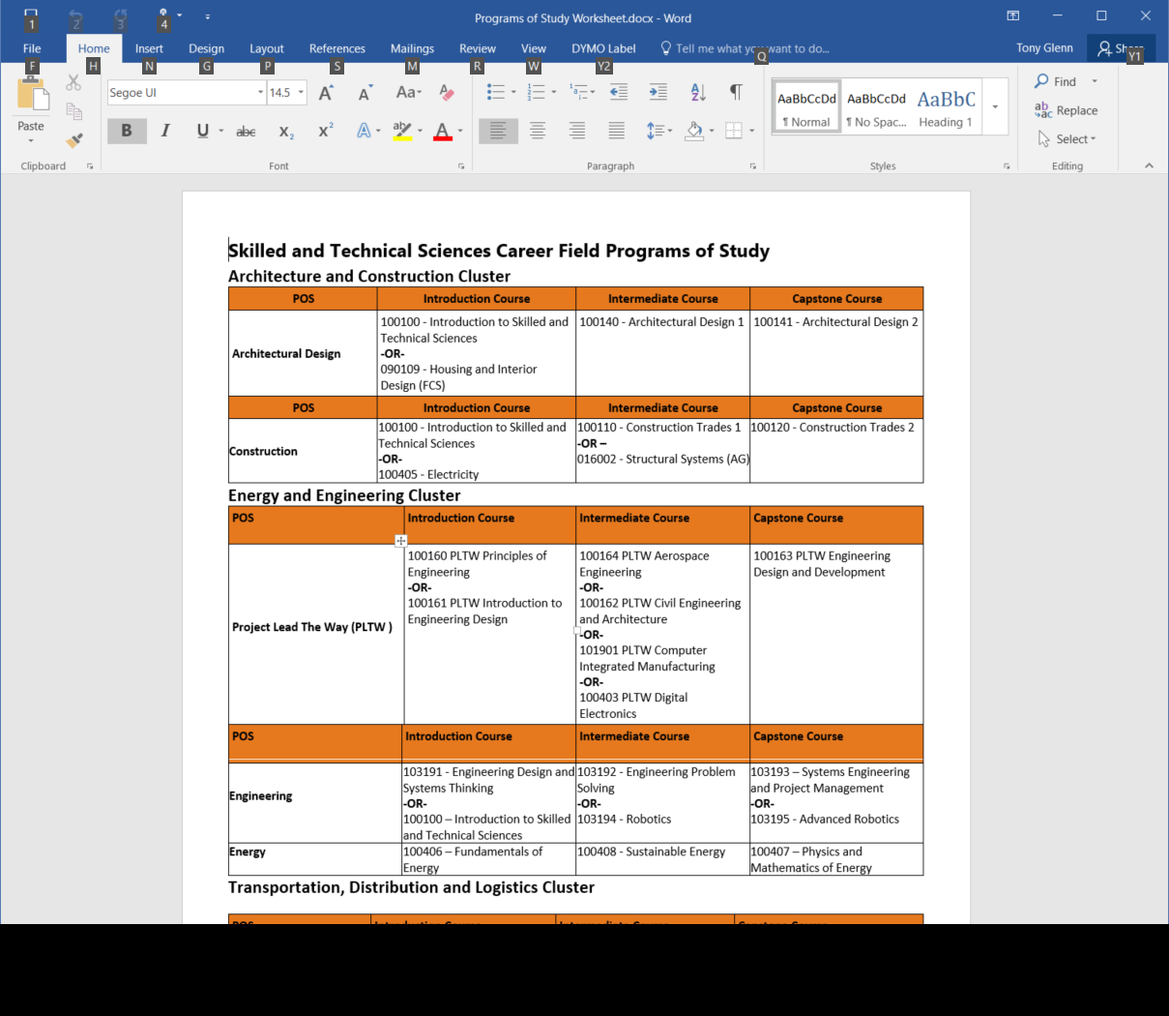
New Programs of Study

Slide 17
Crosswalk to Core
How many used this with the old standards?

Slide 18
Career Readiness Standards
We will emphasize more in the 2020 standards revision
https://www.education.ne.gov/nce/career-readiness-toolkit/
Standards Indicators Handouts

Slide 19
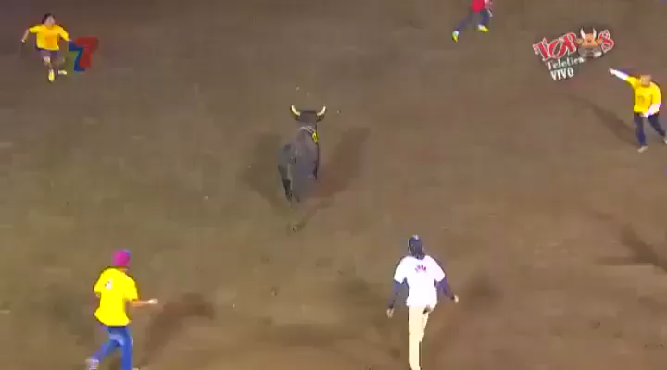
Let’s Take A Break

Slide 20
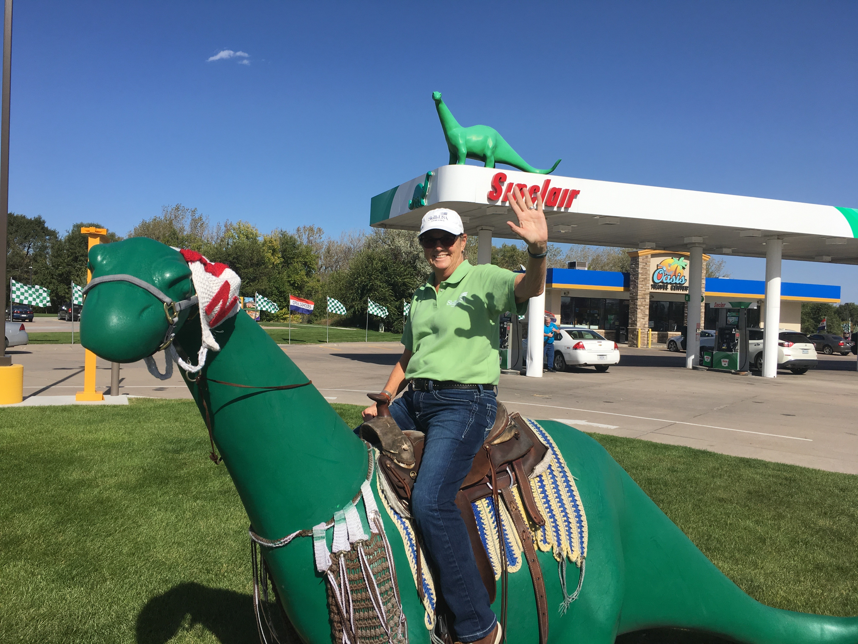
Gender Non-Traditional Recruitment in STS
Please Welcome Charmain Satree
Email: satreec@gmail.com
Cell phone: (402)432-4512

Slide 21
Recruitment Resource
www.careergirls.org
http://stemforall2017.videohall.com/presentations/978

Slide 22
H3 Website
DO NOT USE right now
https://neworks.nebraska.gov/gsipub/index.asp?docid=1165
This will be revamped later this fall

Slide 23
Let’s Get Elementary Students Involved!
Kids start figuring out what they are generally good at by 4th grade
SkillsUSA Jump Into STEM program
Have them tour your shops
Have student demos for them
Let them try a small, simple project
How many are doing this?

Slide 24
Initiatives
reVISION
Industry tours – they want your students to see what is going on
NASTSE
Workplace Experiences

Slide 25



Workplace Experiences

Slide 26
Workplace Experiences
http://www.nebraskaworkplaceexperiences.com/

Slide 27
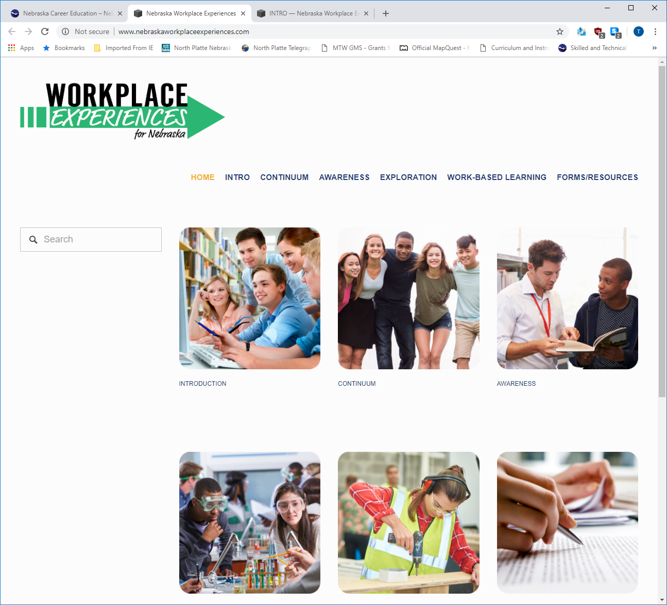
Workplace Experiences

Slide 28
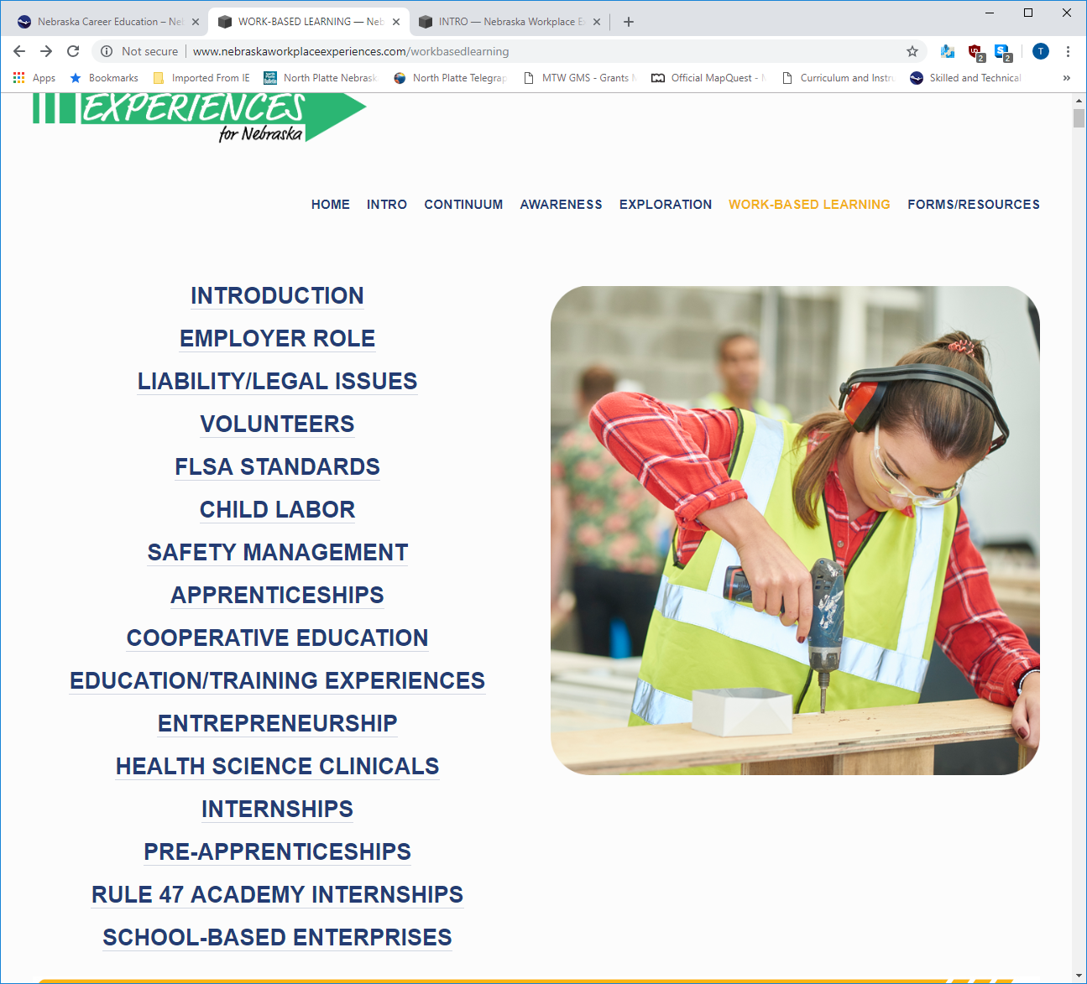
Workplace Experiences

Slide 29



Slide 30

Our mission is NATIONAL —
and there’s SO MUCH MORE to do
4 million students enter public high school every year
3.2 million graduate
2.2 million go to 2-or-4-year colleges
Half will graduate
or earn a credential
SkillsUSA gives EVERY STUDENT the chance to build their path to success.
Notes:
[SkillsUSA reaches ALL the talent—not just the little subset—broadening the pool—the blue AND the red]
You’ve seen what we can do for you, and what we do for students,
But our mission is national—and there’s so much more for us to do.
Let’s take a look at how our “pipeline” of talent is working for an average class of freshmen entering high school in a given year.
3.2M will graduate from public schools
(National Center for Education Statistics
http://nces.ed.gov/programs/digest/d15/tables/dt15_219.10.asp)
800,000 missing because they dropped out
(National Center for Education Statistics, http://nces.ed.gov/programs/digest/d15/tables/dt15_203.10.asp)
2.2M/68.4% will go to college at either 2- or 4-year institutions
(National Center for Education Statistics, http://nces.ed.gov/programs/digest/d15/tables/dt15_302.30.asp?current=yes)
How many will graduate with a 4-year degree or a credential?
We don’t have complete numbers, but it’s likely about half.
60% of the 4-year students will graduate, and 38% of the 2-year students will receive a credential
(National Center for Education Statistics, https://nces.ed.gov/fastfacts/display.asp?id=40)
(Community College Research Center at Columbia University, http://ccrc.tc.columbia.edu/Community-College-FAQs.html)
836,000-1.3M
That’s why we need to get to the next level.

Slide 31

SkillsUSA is a
professional LEADERSHIP ORGANIZATION
BUILT FOR
LED BY
STUDENTS
STUDENTS
THAT PREPARES STUDENTS TO
THRIVE IN SKILLED CAREERS.
CAREERS OF GREATEST
EVERYTHING THEY NEED
OPPORTUNITY
TO
SUCCEED
Notes:
SkillsUSA is a professional leadership organization that prepares students to thrive in skilled careers.
When we say PLO, we mean that it is built for students and led by students
Every chapter elects its own students to serve as president, treasurer, and work on committees and serve through community service
Focused on skilled careers—everything from healthcare to HVAC, construction to cosmetology
A chance to connect students with the careers of greatest opportunity
And give them everything they need to succeed

Slide 32


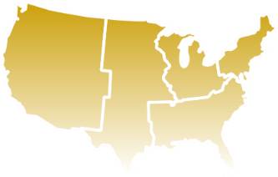


HOW SkillsUSA WORKS: FACTS
395,000
4,000
52
MEMBERS
SCHOOLS & COLLEGES
STATES & Territories
130
600+
OCCUPATIONAL PROGRAMS
NATIONAL PARTNERS
Notes:
Now let’s get into how SkillsUSA works—beginning with some basic facts
Organization with 395,000 members including students, educators and alumni--One of the nation’s largest individual membership associations
We have chapters in 4,000 schools and colleges, mostly at the high school level but also MS and college—in all 50 states plus 1 territory
80% CTE schools have SkillsUSA chapters—that means that the places where communities have made significant investments in CTE—they’re relying on SkillsUSA
We offer 130 different occupational programs and 70 plus career pathways
600 businesses, trade associations and labor unions—at the NATIONAL level; thousands more at the state level

Slide 33

SkillsUSA is a unique opportunity to
STRENGTHEN THE FUTURE
OF YOUR PROGRAM
and
OPEN UP GREAT FUTURES
FOR AMERICA’S CTE STUDENTS
Notes:
Start with our core proposition—if you only remember one thing:
SkillsUSA is a unique opportunity to both strengthen the future of your program and open up great futures for America’s CTE students
A unique solution to two problems
Going to try to prove this to you over the course of the presentation

Slide 34

WHY OUR MISSION MATTERS TODAY
BUSINESSES NEED
STUDENTS NEED
SKILLED TALENT
Employability skills
Skilled trade
workers:
executives:
#1
89%
hardest jobs to fill
of all first-time
hires who lose their job do so
because of a lack of employability skills
Notes:
Let’s begin with why our mission matters today
The simples way to look at it is:
Businesses need skilled talent, while students need a better path to career success
[From the Talent Shortage Survey Results. 2011, by ManpowerGroup]
In the U.S., skilled trades workers are No. 1 among the Top Ten hardest jobs to fill. Technicians rank 4th, behind sales reps and nurses.
[From “The Boiling Point: The Skills Gap in U.S. Manufacturing,” 2011, by Deloitte Development LLC on behalf of The Manufacturing Institute. Based on surveys of a nationally representative sample of 1,123 U.S. manufacturing executives in July and August of 2011]
68% of the respondents identified a high skilled, flexible workforce as most important to meeting his or her company’s business success during the next 3-5 years.
Meanwhile, 17 percent of U.S. students are failing to graduate high school and
Among HS dropouts, 81 percent say they wanted more “real-world” learning opportunities—
That’s from TIME Magazine survey for a cover story in 2006
That’s why we need to get to the next level.

Slide 35
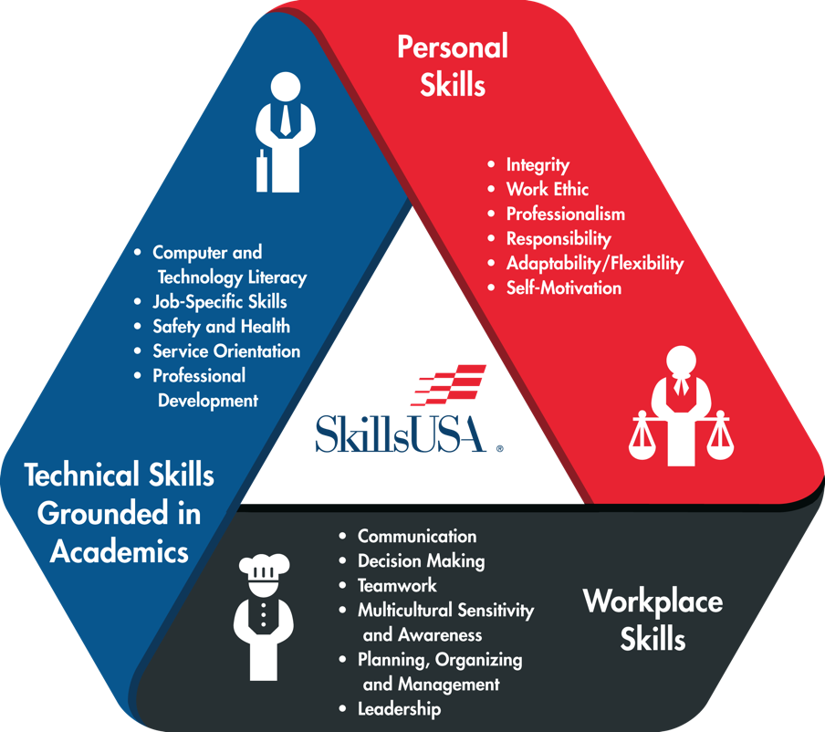
HOW SkillsUSA WORKS:
THE FRAMEWORK IS THE KEY
The SkillsUSA Framework actualizes how students fulfill the mission of the organization “to empower members to become world-class workers, leaders and responsible American citizens.”
Personal
Skills
Technical
Skills
Workplace
Skills
Notes:
The framework is the key – quantifies and measures the SkillsUSA mission
Three components:
Technical skills grounded in academics—
Defined in partnership with industry
Every year, industry partners make sure it’s up to date and connected to needs
When partners in building trades told us we needed to incorporate steel framing—
The very next year, if you went to our national competition, you’d see students competing in a design that required both wood and steel framing
Workplace skills—Communication, Decision-making, Teamwork, Leadership--
The skills you need in ANY career these days
Personal skills—The hardest to define and the easiest to overlook, but the most important to long-term success
Integrity, Work Ethic, Professionalism, Responsibility, Motivation
Employing the Framework creates a culture of work

Slide 36
HOW SkillsUSA WORKS:
ONE STUDENT’S PATH
Health Sciences
Hands-on
Skill Practice
Career
Refrigeration and AC
Teacher:
First Job Supervisor
Leadership Opportunities
College
Mechanical Design CAD
Kyle
Welding
SkillsUSA Industry-Based Standards
Career Essentials Program
Apprenticeship
Automotive Service Technology
Plumbing
Local, State & National Competitions
Military
Bricklaying
Notes:
[best way to understand how it works in practice is to look at one student’s path]
[could be customized]
Kyle finds out about SkillsUSA from a friend/event at their school
Signs up in 10th grade
Chooses a program--school offers 40--he chooses Automotive Service Technology
Every day, he has his core academic classes--math, science, civics, etc
But he also has his Automotive Services program, where he spends time in a fully-equipped, professional-caliber auto service lab
His teacher is an experienced, working technician-who interacts with Kyle as a supervisor would
The curriculum he teaches—influenced by standards from SkillsUSA
And they do real jobs for real clients
He gains leadership opportunities that he otherwise wouldn’t have thought were for him—being treasurer of his SkillsUSA chapter, or even president
And he gets the chance to compete at the local, state, maybe even national levels—in the skills that he’s built
And when he gets to graduation, he has a wide range of options—career, college, apprenticeship, military—
And all of that begins with his participation in SkillsUSA

Slide 37
HOW SkillsUSA WORKS:
Who Does What?
Campus:
Instructors:
Industry Partners:
Employ instructors that serve as advisors
Provide facilities
Determine
program offerings
Teach and
mentor students
Define curriculum
Draw on SkillsUSA standards and resources
Employ SkillsUSA students
Provide classroom experiences, work-based learning and community service opportunities
Serve on advisory committees, state/national boards
Develop technical standards
Provided critical input SkillsUSA Career Essentials curriculum
Manage/judge local, state and national competitions
Notes:
Advisors:
School employs instructors that serve as advisors
Seasoned professionals averaging 15-25 years experience in their field
Supported by the materials, content and standards that SkillsUSA provides, including training/development opportunities and events for the advisors themselves
Advisors are truly dedicated to students, serving as role models and demonstrating pride and dignity in their careers
From the local level to the national level, students have the opportunity to:
Participate in competitions in their occupational skill area as well as in leadership
Local/state winners can advance to National Leadership and Skills Conference & Competition
National champions may also take part in WorldSkills
Take on leadership roles in their local chapters, their state, or in the national organization
These roles include materials and rigorous leadership training to support students in their growth and development
Build their employability skills. SkillsUSA provides:
SkillsUSA Framework
Career Essentials

Slide 38

HOW SkillsUSA WORKS: THE RESULTS
GRADUATION RATES
FROM ALUMNI
FROM ADVISORS
High School
53%
Stayed in same field
76%
Made me
more effective
74%
“Very Significant” impact on success
73%
Improved students’ academics
PostSecondary
65%
Soft skills
“most important”
88%
Local businesses influenced curriculum
83%
Helped with promotions & raises
76%
Prefer to buy from SkillsUSA partners
Notes:
That’s our model—and the model works.
We see the results in so many different ways:
Graduation rates
Based on 2013 survey of 1,200 SkillsUSA advisors regarding their students over the past 5 years
From e-mail survey of SkillsUSA Alumni in September 2013:
77% said they immediately pursued full-time employment or postsecondary education in the same field—or a directly related field—that they studied while a SkillsUSA student.
74% said that SkillsUSA had a “very significant positive impact” on their professional successes.
65% said that Leadership, Teamwork and other Employability skills learned while a SkillsUSA member had been their most important takeaway from their SkillsUSA experience.
83% said that their SkillsUSA experience helped them achieve promotions and pay increases during their career.
From an e-mail survey of SkillsUSA instructors conducted in the fall of 2012:
77% said that engagement with SkillsUSA made them [the instructor] a more effective teacher
74% said that SkillsUSA involvement improved the academic performance of their students
88% of SkillsUSA advisors say that their local advisory committee of business partners influences their curriculum
76% of SkillsUSA instructors indicated that they prefer to buy from SkillsUSA partners when purchasing supplies and equipment for their programs.

Slide 39


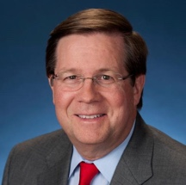
HOW SkillsUSA WORKS:
THE WORD FROM EMPLOYERS
“The thing about SkillsUSA that’s so cool and the reason that my foundation has supported it for years is that it is deliberately focused on celebrating a skill. Three million jobs right now exist in the trades and transportation and commerce. The skills gap is real. Training kids and getting them excited to do the jobs that exist ought to be job one. SkillsUSA does that in a big way.”
“For over a decade, Lowe’s has partnered with SkillsUSA to help students gain the valuable professional, workplace and technical skills needed to succeed. Our partnership is helping develop world-class leaders of tomorrow and ensuring our country has a talented, skilled workforce for years to come.”
“SkillsUSA students are in demand and they are better equipped than anyone out there. This organization improves lives and is indeed creating a better world.”
Jim Lentz
CEO
Toyota North America
Troy J. Dally
Senior Vice President, General Merchandising Manager, Seasonal and Services, Lowe’s Companies, Inc.
Mike Rowe
mikeroweWORKS Foundation
Notes:
Let’s not forget the perspective of the employers
[We can show you quotes like this all day]
“For over a decade, Lowe’s has partnered with SkillsUSA to help students gain the valuable professional, workplace and technical skills needed to succeed. Our partnership is helping develop world-class leaders of tomorrow and ensuring our country has a talented, skilled workforce for years to come.”
Troy J. Dally, Senior Vice President, General Merchandising Manager, Seasonal and Services, Lowe’s Companies, Inc.
“SkillsUSA students are in demand and they are better equipped than anyone out there. This organization improves lives and is indeed creating a better world.”
Jim Lentz, president, Toyota Motor Sales
“The thing about SkillsUSA that’s so cool and the reason that my foundation has supported it for years is that it is deliberately focused on celebrating a skill. Three million jobs right now exist in the trades and transportation and commerce. The skills gap is real. Training kids and getting them excited to do the jobs that exist ought to be job one. SkillsUSA does that in a big way. It’s about excellence and competition and being good at what you do, and eventually through all of that —learning who you are. SkillsUSA is working.”
Mike Rowe, mikeroweWORKS Foundation

Slide 40


WHAT SkillsUSA MEANS FOR YOU:
You are the source for the best-educated
students for industry
It’s not just more people to hire—
it’s the people industry wants to hire first.
Even their first industry job
is their second industry job
They’ve got the skills to be leaders
within industry
Notes:
We see this in three ways:
It’s not just more people to hire—it’s the people you’ll want to hire first.
We don’t just want to add to your stack of resumes—we want to add people who go to the top of that stack
Quality > Quantity
Even their first industry job is their second industry job
You won’t be their first job, first work site, first manager, first team
How great to hire someone who’s already had a great manager—someone who was an instructor at heart
Their first industry job was in high school
They’ve got the skills to be leaders within your business
Start day one as effective employees
AND have the skills to grow a whole career of leadership within your business
And finally, they reflect the diversity of your community and our country.

Slide 41


Notes:
You’ve seen what we can do for you, and what we do for students,
We’re here to talk to you because we’re not done

Slide 42


Slide 43
Thanks for listening!!
Any Questions??

Slide 44
Idea Sharing
Here’s your chance to share a project or successful idea that helps your program

Slide 45
STS Contacts
Tony Glenn
Tony.glenn@nebraska.gov
402-471-4819
Greg Stahr
Greg.stahr@nebraska.gov
402.471.0898
Resources from this presentation can be found at www.education.ne.gov/STS

Slide 46

Let’s Be Careful Out There!

Slide 47

Notes:
End no later than 2 p.m.

