Slide 2
Assessment Team
Valorie.Foy@nebraska.gov
Jeremy.Heneger@nebraska.gov
Rhonda.True@nebraksa.gov
Terry.Ough@nebraska.gov
Iris.Owens@nebraska.gov
Margaret.Sis@nebraska.gov

Slide 3
Nebraska Student-Centered Assessment System
NSCAS

Slide 4
Nebraska Student Centered Assessment System

Slide 5
 | Transitions
2017-2018 | Students participated in between 300,000 and 400,000 state summative assessments
2009-2010 | First year of NeSA-Reading- Nebraska students had taken summative tests in same engine for eight years up to 2018
2016-2017 | Transitioned ELA to CCR Transitioned high school to ACT
2017-2018 | Transitioned mathematics to CCR Transitioned ELA, mathematics, and Science to NSCAS System (NWEA)
2020-2021 | Science transition to CCR

Slide 6
Hot Text (ELA)

Slide 7
Hot Text
2018-One 3rd Grade Operational Hot Text Item
2018- Two 4th Grade Operational Hot Text Item
Were included in scoring because there was not a significant difference in how they operated and the results. Third and fourth grade did not have lower scores due to hot text items.
Hot text is being redesigned for 2018-2019- selectable text will be shadowed.
Every grade Item Sampler will include all Technology Enhanced (TE) item types included at that grade. Not designed for content checks.

Slide 8
NSCAS Technology

Slide 9
Technology for 2018-2019
NSCAS ACT
Almost identical requirements from last year.
NSCAS General
Elimination of older operating systems and browsers. No longer supporting iPad Minis
NSCAS Alternate
Elimination of older operating systems and browsers. No longer supporting Android and Linux systems.
*Headings are links to additional information.
Notes:
No Linux of Android Support for Alternate

Slide 10
Professional Learning

Slide 11
October NSCAS Fall Workshops
ACT-WebExes in October
NSCAS- Grades 3-8- October 9-12, 2018

Slide 12
Certified Facilitators District CFs and ESU CFs 70 CFs in 2018-2019
Selections for CFs to receive Training
Assessment Program Alignment
Data Conversations
Interpreting NSCAS Summative Reports
Developing Learning Targets
Questioning for Learning
Student-Directed Learning
Goal-Focused Planning

Slide 13
Professional Learning Text-Dependent Analysis
TDA will not be on ELA assessment. However,
TDA Skills are included in many standards
Analyzing text and responding to it are essential skills for students
Supporting with evidence
TDA is applicable across content areas
Consideration of including a science TDA on the summative science assessment.
ACT writing includes reading and analyzing text and responding

Slide 14
Professional Learning Text-Dependent Analysis
Open to Certified Facilitators (or other ESU representative)
One Eighth Grade Teacher or Curriculum Leader Per District
Requirement--Experience in TDA—not a beginners’ workshop
Multi-year Professional Learning plan is being developed

Slide 15
Professional Learning Text-Dependent Analysis (One Eighth Grade Teacher Per District and ESU Representatives)
What and Why of Text-Dependent Analysis
Preparing Students for TDA
Developing Responsive TDA Lesson Plans

Slide 16
TDA Workshops for Districts and ESUs
La-Vista ESU 3
Lincoln Cornhusker
Wakefield ESU 1
Scottsbluff ESU 13
Kearney ESU 10
Lincoln Cornhusker

Slide 17
TDA Workshops
Registrations TDA Workshops for Districts and ESUs DAC and ESU Email on August 7. Deadline September 30, 2018

Slide 18
NDE Assessment Website
List of Certified Facilitators

Slide 19
Test Duration

Slide 20
Test Duration – Spring 2018 Data--All Students-Cumulative
content | grade | N_total | 70 min or less | 80 min or less | 90 min or less | 100 min or less | 110 min or less | 120 min or less
 |  |  | % | % | % | % | % | %
ELA | 3 | 23875 | 39.0 | 52.1 | 64.1 | 73.5 | 80.7 | 86.1
ELA | 4 | 23872 | 33.9 | 47.3 | 59.8 | 70.5 | 79.0 | 85.1
ELA | 5 | 22290 | 30.6 | 44.2 | 57.0 | 68.1 | 76.8 | 83.4
ELA | 6 | 23322 | 31.8 | 45.9 | 59.0 | 70.3 | 79.1 | 85.5
ELA | 7 | 22964 | 44.6 | 60.1 | 72.4 | 81.4 | 87.8 | 92.1
ELA | 8 | 23252 | 40.7 | 56.4 | 69.8 | 79.5 | 86.5 | 91.3
MA | 3 | 23858 | 73.4 | 82.3 | 88.3 | 92.0 | 94.5 | 96.0
MA | 4 | 23826 | 62.9 | 74.7 | 83.0 | 88.9 | 92.6 | 95.0
MA | 5 | 22249 | 67.1 | 78.2 | 85.6 | 90.4 | 93.7 | 95.8
MA | 6 | 23277 | 47.4 | 62.4 | 73.8 | 82.2 | 88.3 | 92.2
MA | 7 | 22893 | 60.5 | 73.9 | 83.2 | 89.1 | 93.0 | 95.5
MA | 8 | 23177 | 65.4 | 78.1 | 86.1 | 91.3 | 94.5 | 96.4
SC | 5 | 22251 | 94.8 | 96.9 | 98.2 | 99.0 | 99.4 | 99.6
SC | 8 | 23190 | 95.7 | 97.6 | 98.6 | 99.2 | 99.4 | 99.7

Slide 21
Test Duration – Spring 2018 Data--Students with Disabilities-Cumulative
content | gr | N_ total | 70 min or less | 80 min or less | 90 min or less | 100 min or less | 110 min or less | 120 min or less
 |  |  | % | % | % | % | % | %
ELA | 3 | 3699 | 42.8 | 54.7 | 64.6 | 72.5 | 78.7 | 84.1
ELA | 4 | 3752 | 36.9 | 47.7 | 58.3 | 67.7 | 75.1 | 81.1
ELA | 5 | 3434 | 33.7 | 45.0 | 55.1 | 64.9 | 72.2 | 78.5
ELA | 6 | 3506 | 37.2 | 47.6 | 58.0 | 67.5 | 76.0 | 81.6
ELA | 7 | 3315 | 47.2 | 59.1 | 69.4 | 77.3 | 83.3 | 88.0
ELA | 8 | 3144 | 46.6 | 57.8 | 69.1 | 76.7 | 82.9 | 88.2
MA | 3 | 3701 | 73.5 | 82.2 | 87.7 | 91.9 | 94.2 | 95.7
MA | 4 | 3752 | 61.3 | 72.8 | 80.8 | 86.6 | 90.7 | 93.7
MA | 5 | 3433 | 62.4 | 74.0 | 82.4 | 87.7 | 91.4 | 94.2
MA | 6 | 3502 | 53.8 | 65.9 | 75.8 | 82.6 | 87.7 | 91.2
MA | 7 | 3307 | 64.6 | 75.1 | 82.8 | 88.2 | 91.9 | 94.3
MA | 8 | 3133 | 64.5 | 75.5 | 83.0 | 88.7 | 92.3 | 94.6
SC | 5 | 3439 | 91.3 | 94.8 | 96.9 | 98.2 | 99.0 | 99.3
SC | 8 | 3134 | 90.3 | 94.2 | 96.8 | 97.8 | 98.4 | 99.2

Slide 22
Test Duration – Spring 2018 Data--EL Students-Cumulative
content | gr | N total | 70 min or less | 80 min or less | 90 min or less | 100 min or less | 110 min or less | 120 min or less
 |  |  | % | % | % | % | % | %
ELA | 3 | 3705 | 34.2 | 46.0 | 58.0 | 68.2 | 76.2 | 81.8
ELA | 4 | 3728 | 27.8 | 39.3 | 51.1 | 61.9 | 71.2 | 79.0
ELA | 5 | 3183 | 21.7 | 32.3 | 43.4 | 54.4 | 64.4 | 73.1
ELA | 6 | 3695 | 18.7 | 28.9 | 40.8 | 52.4 | 63.3 | 71.8
ELA | 7 | 3446 | 27.9 | 40.4 | 53.0 | 63.8 | 74.0 | 82.0
ELA | 8 | 3438 | 25.0 | 36.4 | 48.3 | 59.4 | 70.1 | 78.6
MA | 3 | 3692 | 65.0 | 75.6 | 83.6 | 88.2 | 91.0 | 93.3
MA | 4 | 3702 | 49.6 | 63.5 | 73.8 | 81.5 | 87.5 | 91.7
MA | 5 | 3158 | 51.8 | 65.4 | 75.2 | 83.0 | 88.6 | 92.4
MA | 6 | 3669 | 30.8 | 45.2 | 57.3 | 68.4 | 77.2 | 83.7
MA | 7 | 3403 | 43.1 | 57.3 | 69.5 | 78.4 | 85.6 | 90.0
MA | 8 | 3397 | 42.5 | 56.4 | 68.0 | 78.4 | 85.4 | 90.3
SC | 5 | 3157 | 89.0 | 93.7 | 96.5 | 98.3 | 99.0 | 99.4
SC | 8 | 3397 | 86.6 | 92.3 | 95.1 | 97.1 | 97.9 | 98.9

Slide 23
Time Testing
Students spent more time per item- in general.
Students could not move forward until answered the question-adaptive test.
MAP operates the same.
Awareness around adaptive testing- video

Slide 24
Lessons Learned

Slide 25
Lessons Learned
Students are taking their time with items.
At least 24 students took over six hours in 2018 on ELA.
Item statistics have shown some isolated incidents of students taking an hour on a single item (not reading the passage).

Slide 26
Lessons Learned
Test-taking skills should include productive use of time.
It seems it is not best practice- not timed- “Take ALL the time you want.”
ACT is timed

Slide 27
Lessons Learned
NSCAS Test Observations

Slide 28
Lesson Learned-Observations
Observed many rooms in which clear time “limits” were established, but students understood that if they needed more time, they could be given it.
On ELA let students know they should reread the passage if they did not finish all the questions.
Sample- Fifth Graders-”We have a 45-minute session today. You will be reading ELA passages, and you need to read the passage and then answer the questions together. You will probably not finish today, but we have another session tomorrow. I’ll start to warn you when end of time is approaching, but the end-time is also on the board (9:45), monitor whether you should start a new passage.
Then read scripted directions

Slide 29
Lessons Learned-Reminders
Individuals can be tested separately if best practice.
Tests sessions would be better if divided. Two sessions
Flexible scheduling
Proctors can help students with the technology on TE items.
Nothing will prepare students as well as doing the item sampler on the device on which they will be tested (former practice tests).
NDE has opened discussion of a time limit of three hours per test for 2018-2019
Outer limits correlation between time and scores-available this fall

Slide 30
Common Goals
Healthy testing atmosphere
Common Sense
Focus on balanced assessment

Slide 31
Information from a Balanced Assessment System

Slide 32
Summative Assessment
Adaptive Assessment
Grade 4
Interim Assessment
MAP Growth
Grade 5
Grade 3

Slide 33
Interim Assessment
NWEA MAP
Personalized Learning Goals

Slide 34
Personalized Learning Goals
MA 5.2.2.a
Evaluates linear expressions at given values with variables involving positive rational numbers
Determines whether a linear equation or inequality is true for a given value of the variable
MA 6.2.2.b
Matched to Standards

Slide 35
State Standards
Fifth Grade Mathematics Table of Specifications
MA 5.2.2.a
MA 6.2.2.b
Sixth Grade Mathematics Table of Specifications

Slide 36
Fifth Grade Mathematics Table of Specifications
Fifth Grade NSCAS Summative
Sixth Grade NSCAS Summative
Sixth Grade Mathematics Table of Specifications

Slide 37
Interim
Summative Assessments
Learning Goals
Curriculum Instruction
Formative Assessment
Reteaching
Nebraska
Summative Assessments
Tables of Specifications
Standards

Slide 38
Write Items
Review Items
Participate in standard setting
Instruct
Assess
Nebraska Educators

Slide 39
NSCAS-
“College and Career Ready”
NeSA-
“Barely Proficient”

Slide 40
Adaptive Testing--Goals
As test becomes more adaptive, information from summative will become more refined.
Meeting goals in growth does not necessarily indicate student will be proficient on NSCAS.
MAP prediction of NSCAS is being updated to be CCR-winter reports
As the scales for adaptive are stabilized, pre-equating can be accurately set so test results are more timely.
Goal 1: Deliver to schools/districts at the end of test.
Goal 2: Deliver to students at end of test.

Slide 41
This Summer
Hundreds of items written and reviewed
Bias and Item Review
Achievement Level Descriptors for ELA and Mathematics-will be on Assessment website this fall.
Standard Setting- July 26-28 Mathematics and ELA check.

Slide 42
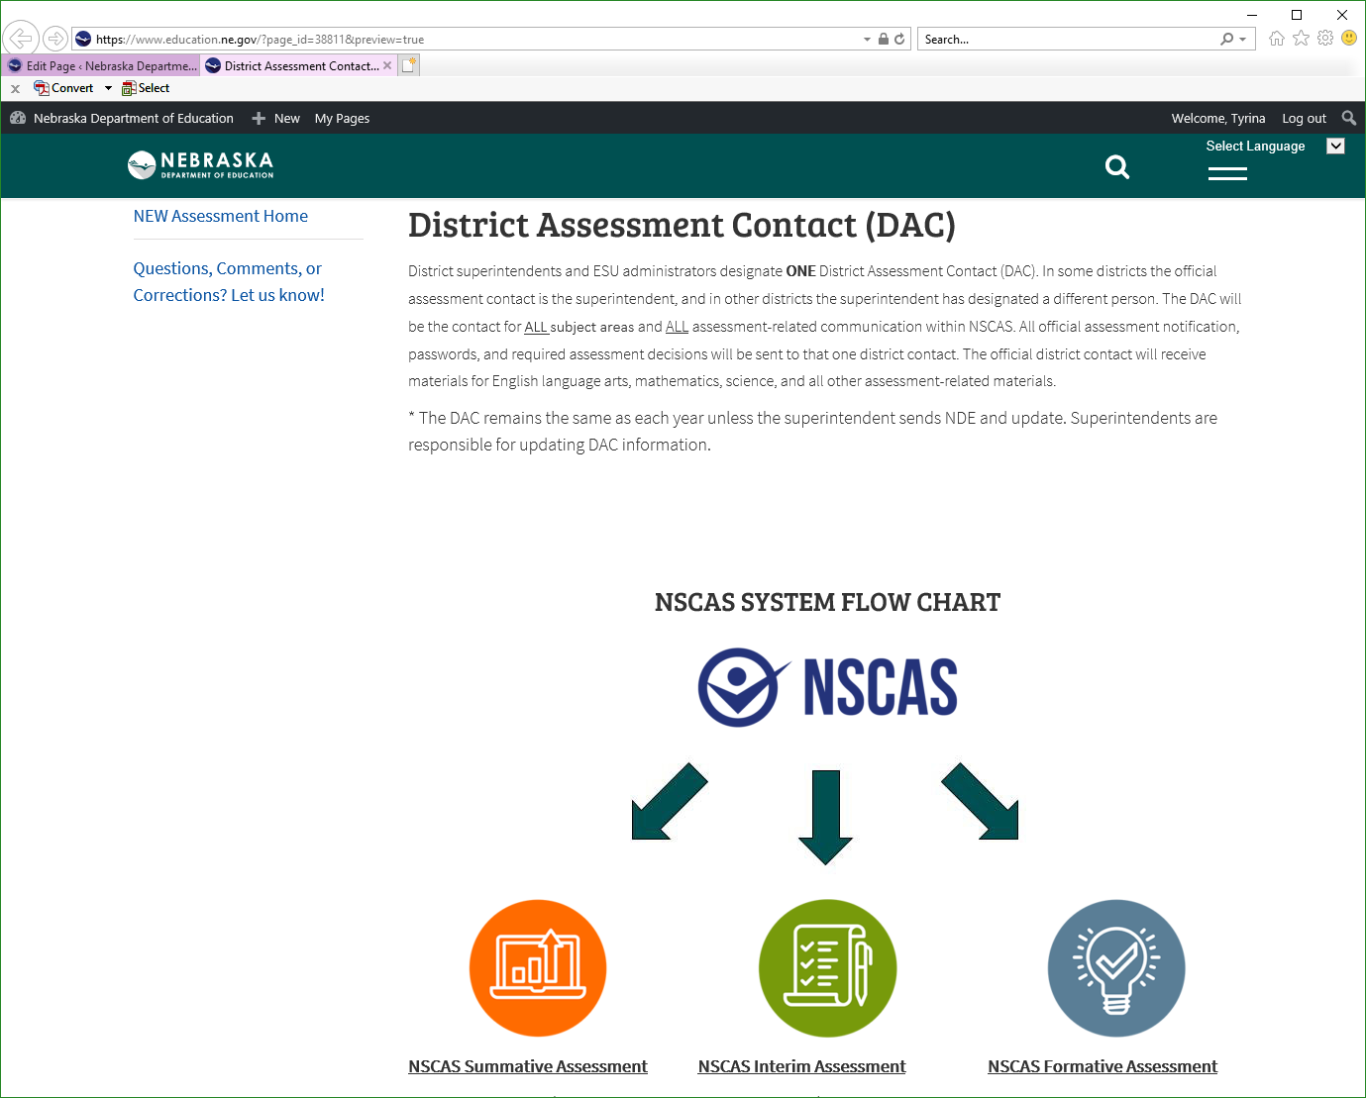
Redesigning Assessment Website

Slide 43
Definitions of ACT Achievement Levels
ACT Benchmark
Students that meet or exceed the ACT College Readiness Benchmark are equipped to enroll (without remediation) and succeed in a credit-bearing first-year course at a two-year or four-year institution, trade school, or technical school. Students have at least a 50% chance of getting a B or better and a 75% chance of getting C or better in a first-year related content course.
On Track
On Track students are approaching the ACT College Readiness Benchmark and are likely to be able to access credit-bearing first-year related content course at some Nebraska postsecondary institutions without remediation.
Developing
Students in the Developing Level are likely to need developmental courses before being able to access credit-bearing first-year courses in the majority Nebraska postsecondary institutions.

Slide 44
Definitions of NSCAS Levels
College and Career Ready Benchmark
Learners who meet the college and Career ready benchmark demonstrate advanced proficiency in the knowledge and skills necessary at this grade level, as specified in the assessed Nebraska College- and Career-Ready Standards. These results provide evidence that the student will likely be ready for academic success at the next grade level.
On Track
Learners who are on track demonstrate proficiency in the knowledge and skills necessary at this grade level, as specified in the assessed Nebraska College- and Career-Ready Standards. These results provide evidence that the student will likely be ready for academic success at the next grade level.
Developing
Learners who are developing do not yet demonstrate proficiency in the knowledge and skills necessary at this grade level, as specified in the assessed Nebraska College- and Career-Ready Standards. These results provide evidence that the student may need additional support for academic success at the next grade level.

Slide 45
WE ALL ARE:
Engaged in the right work.
Engaged together.
Recognize the wisdom of balanced assessment.
Engaged in maximizing the positive effects of a balanced assessment system.

Slide 46
Notes:
Thanks so much for joining us!
I’m excited to tell you about our state’s new system for assessing and supporting student learning.

Slide 47
District Assessment Contact Changes
Superintendents must submit forms
Assessment Office has a table and we have forms available today.
Also, update Nebraska Technology Assessment Contact (NTAC) and/or principals so that we can provide security documents later this year.

Slide 48
DAC and Principal Changes

