Slide 1
Workforce Innovation and Opportunity Act – WIOA Adult Education and family literacy act - Aefla grant Funding RFP Program year 2019 July 1, 2018 – June 30, 2019
Nebraska Adult Education

Slide 2
Welcome
Today’s Pre-Bidder’s Conference
In Person – Please Silence Phones
Conference Call – Please mute call
Questions will be answered throughout the conference and again at the end.
All questions and answers will be posted to the FAQ tab on the website.

Slide 3
Introductions
State Office Staff
Attendees Role Call

Slide 4
Objectives
Define WIOA and AEFLA
Explain Application Components
Clarify Requirements
Define Budgets and Program Requirements
Provide guidance on supporting information and documentation

Slide 5
2018 Timeline
February 16 – Pre-Bidder’s Conference
February 21 – RFP Release & Info Packet
April 5 – Application Due Date
April ~ May – Review & Determination
June 2018 – Announcement of Awards
July 1 – PY19 Start Date

Slide 6
WIOA Workforce Innovation and Opportunity Act
Signed into law on July 22, 2014
First legislative reform in 15 years
Goal to improve job and career options
Utilize an integrated workforce system
Focuses on collaboration among WIOA partners
Identified Core Partners

Slide 7
WIOA Workforce Innovation and Opportunity Act
Title I – Adult, Dislocated Worker and Youth (DOL)
Title II – Adult Education (DE)
Title III – Wagner-Peyser Employment services (DOL)
Title IV – Vocational Rehabilitation (DE)

Slide 8
AEFLA Adult Education and Family Literacy Act
Title II of WIOA
Principal source of funding for Adult Ed
Office of Career Technical and Adult Ed
Division of Adult Education and Literacy
Statutory requirement to States to allocate not less than 82.5% of allotments to local providers through a competitive grant process.

Slide 9
AEFLA Adult Education and Family Literacy Act
Purpose (34 CFR §463.1) of AEFLA is to create a partnership among the Federal Government, States and localities to provide, on a voluntary basis, adult education and literacy activities in order to:
Assist adults in becoming literate and obtain the knowledge and skills for employment and economic self-sufficiency
Assist adults participating in the educational development of children and
Obtain education and skills that lead to sustainable improvements in economic opportunities for their family.

Slide 10
AEFLA Adult Education and Family Literacy Act
Assist adults in attaining a secondary school diploma or its recognized equivalent and in the transition to postsecondary education and training, through career pathways
Assist immigrants and other individuals who are English language learners to improve reading, writing, speaking and comprehension skills in English as well as mathematics skills
Assist adults in acquiring and understanding of the American system of Government.

Slide 11
Grant Process
34 CFR 463.20
Process must include:
Competitive multi-year grants
Direct and equitable access to apply
Same application process for all applicants
Funds must be used to serve eligible individuals

Slide 12
Eligible Applicants
34 CFR §463.23
An organization that has demonstrated effectiveness in providing adult education and literacy activities is eligible to apply for a grant.
These organizations may include:
A local educational agency
A community-based or faith-based organization

Slide 13
Eligible Applicants
A volunteer literacy organization
An institution of higher education
A public or private nonprofit agency
A library
A public housing authority
A nonprofit institution that is not described above and has the ability to provide adult education and literacy activities to eligible individuals

Slide 14
Eligible Applicants
A consortium or coalition of agencies, organizations, institutions, libraries or authorities described in any of the above
A partnership between an employer and an entity described above

Slide 15
Demonstrated Effectiveness
34 CFR §463.24
An eligible provider must demonstrate past effectiveness by providing performance data
Two ways for an eligible provider may meet the requirements

Slide 16
Demonstrated Effectiveness
An eligible provider that has been funded under Title II of the Act must provide performance data required under WIOA Section 116 to demonstrate past effectiveness.

Slide 17
Demonstrated Effectiveness
An eligible provider that has not been previously funded under Title II of the Act must provide performance data to demonstrate its past effectiveness in serving basic skills deficient eligible individuals, including evidence of its success in achieving outcomes listed in §463.24

Slide 18
Demonstrated Effectiveness
§463.24
Provide performance data on its record of improving the skills of eligible individuals, particularly eligible individuals who have low levels of literacy.
In the content domains of reading, writing, mathematics, English language acquisition and other subject areas

Slide 19
Demonstrated Effectiveness
Must also provide information regarding its outcomes for participants related to:
Employment
Attainment of Secondary School Diploma
Transition to postsecondary education and training

Slide 20
Required Activities
34 CFR §463.30
Adult Education
Literacy
English Language Acquisition
Workforce Preparation Activities

Slide 21
Optional Activities
34 CFR §463.30
Integrated English Literacy and Civics Education
Workplace Adult Education and Literacy
Family Literacy
Integrated Education and Training

Slide 22
Eligible Individuals
WIOA Section 203
An eligible individual means an individual
Who has attained 16 years of age
Who is not enrolled or required to be enrolled in secondary school under State Law
Who is basic skills deficient
Who does not have a secondary school diploma or recognized equivalent and has not achieved an equivalent level of education
Is an English language learner

Slide 23
Nebraska Mandatory Attendance
Statute 79-201
https://nebraskalegislature.gov/laws/statutes.php?statute=79-201

Slide 24
Nebraska Withdrawal from Mandatory Attendance
Statute 79-202
https://nebraskalegislature.gov/laws/statutes.php?statute=79-202
Allowable Reasons:
Financial Hardship
Illness

Slide 25
Available Funding
Program Year 2019
July 1, 2018 ~ June 30, 2019
Section 231 – General Adult Education
Section 225 – Corrections Education
Section 243 – Integrated English Literacy and Civics Education
Overall approximately $2M is expected

Slide 26
Available Funding
For Program Year 2020 and 2021 Continuation of Service grant applications will be submitted by grantees to continue service for a period of 3 program years.
At the end of the third program year cycle, Nebraska Adult Education intends to host another RFP for AEFLA funding.

Slide 27
Available Funding
Section 231 – General Adult Education
Estimated $1.6M
Adult Education & Literacy activities
Adult education
Literacy
Workplace education and literacy activities
Family literacy activities
Integrated English literacy and civics education

Slide 28
Available Funding
Workforce preparation activities
Integrated education and training activities

Slide 29
Available Funding
Section 225 – Corrections Education
Estimated $182,000
Corrections Education Activities
Adult education and literacy activities
Special education
Secondary school credit
Integrated education and training
Career pathways

Slide 30
Available Funding
Concurrent enrollment
Peer tutoring
Transition to re-entry initiatives and other post-release services with the goal of reducing recidivism

Slide 31
Available Funding
Section 243 – IELCE
Estimated $272,000
IELCE Activities
Instruction in literacy and English language acquisition
Instruction on the rights and responsibilities of citizenship and civic participation
Workforce training

Slide 32
Availability of Grant Awards
Amount of Federal Grant Award to SEA
Amount of available funding to each service area
Amount of proposed budget requests for each service area
Scoring and recommendations from local workforce areas §463.21

Slide 33
Availability of Grant Awards
Scores and recommendations from compliance review committee
Alignment of proposed activities with need for service in identified service area
Evaluation of cost of service
Cost per student analysis

Slide 34
Payment of Grant Funds
Funds are allocated on a reimbursement basis
Grantees must submit quarterly claims for reimbursement

Slide 35
Match Requirement
All applicants must provide at least a 35% match of their federal grant award in non-federal expenditures for adult education and literacy activities.

Slide 36
Considerations for Funding
34 CFR §463.22
Each eligible provider seeking a grant must submit an application to the eligible agency containing the information and assurances that include:
How funds will be spent consistent with requirements of Title II
Cooperative arrangements with other agencies, institutions or organizations

Slide 37
Considerations for Funding
How program will provide services in alignment with local plan - §463.21 Review of AEFLA grants by local areas for consistency and alignment with local plan.
How program will meet State adjusted levels of performance for the primary indicators of performance.
How program will fulfill one-stop partner responsibilities

Slide 38
Considerations for Funding
How program will provide services in a manner that meets needs of eligible individuals
Responses addressing the 13 Considerations in 34 CFR §463.20

Slide 39
Service Areas
Six distinct service areas in Nebraska
Central Service Area
Metro Omaha Service Area
Northeast Service Area
Southeast Service Area
West Central Service Area
Western Service Area

Slide 40
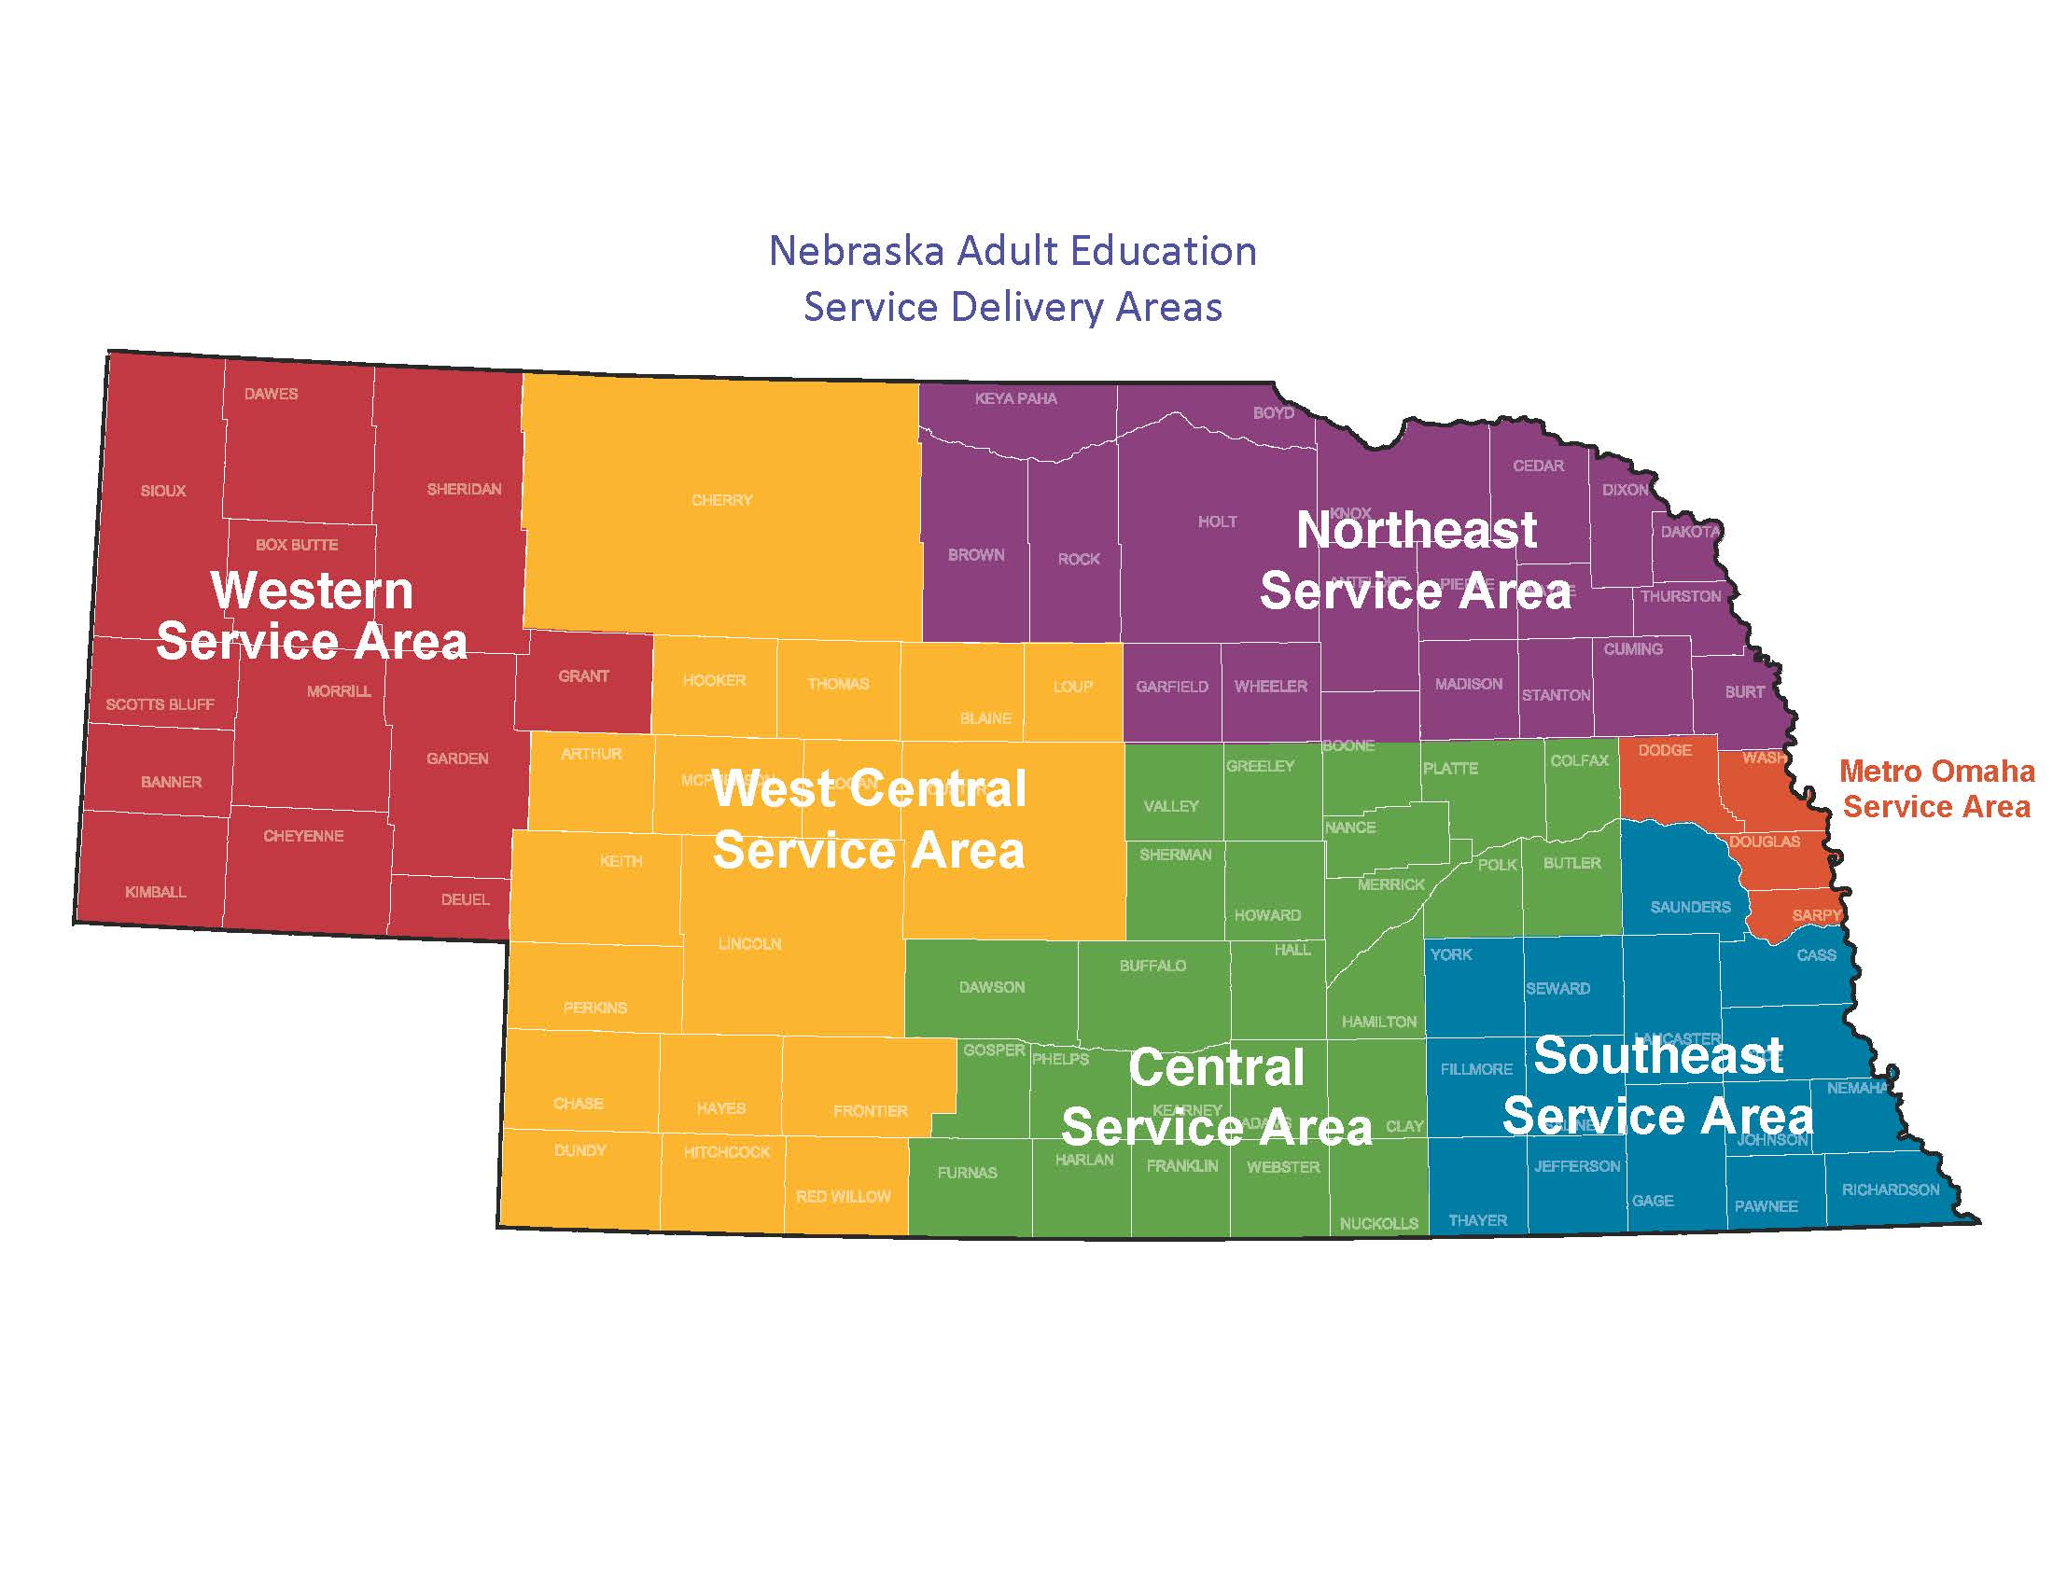
Service Areas

Slide 41
Service Areas
Funding for each service area will depend on:
Federal Grant Award
Amount of available funding for each service area
Amount of requests for each service area
Scoring and recommendations from local workforce area
Scoring from compliance review committee

Slide 42
Service Areas
Alignment of proposed activities with need for service in identified service area
Evaluation of cost of service
Cost per student analysis

Slide 43
Distance Education
Purpose of Distance Education in Nebraska is to provide learning opportunities to a larger population of students across the State.
Policies outlined in Distance Education policy
Approved DE curriculum

Slide 44
Corrections Education
Section 225 Optional Grant Award
No more than 20% allocated to Corrections Education
Must complete Section 231 questions to apply for Section 225
Section 225(c) of WIOA, priority to serving individuals who will be released within 5 years of participation in program

Slide 45
IELCE
Section 243 Optional Grant Award
Amount based on allotment
Must complete Section 231 questions to apply for Section 243
Include instruction in literacy and English language acquisition and instruction on the rights and responsibilities of citizenship

Slide 46
Program Organization
Applicants must include the following positions to operate a funded Adult Education program in Nebraska:
Program Director
Program Coordinator(s)
Adult Education Instructor(s)
Additional Staff

Slide 47
Proposed Budgets
WIOA Section 233(a)(1)(2)
Not less than 95% shall be expended for carrying out adult education and literacy activities
Remaining amount, not to exceed 5% shall be used for administration of grant

Slide 48
Supplement not Supplant
WIOA Section 241(a)
Funds made available for adult education and literacy activities under this Title shall supplement and not supplant other State or local public funds expended for adult education and literacy activities

Slide 49
Program Income
SEA reserves authority to allow local program income
Not authorized through Nebraska Adult Education
Align service with WIOA partners

Slide 50
General Education Provisions Act
GEPA
All applicants for new awards must include information in their applications to address this new provision in order to receive funding under this program.
Steps the applicant proposes to ensure equitable access to and participation in, its Federally-assisted program for students, teachers and other program beneficiaries with special needs.

Slide 51
Assurances and Certifications
Each applicant must comply with assurances and certifications included in grant proposal
Include agency signatures

Slide 52
Instructions
All questions are italicized to aid in identification
Do not enter your responses in italics
All questions require a response
All text box fields require a response
Review format and submission requirements

Slide 53
RFP Timeline
Available to applicants on February 21
Must request application in writing
Information packet and all additional information and links will be posted on the Nebraska Adult Education website at: https://www.education.ne.gov/ADED/
Deadline: April 5, 2018 5:00 pm CST regardless of postmark date

Slide 54
RFP Timeline
Intent to Apply may be submitted in writing until February 21, 2018 to: tate.lauer@nebraska.gov
Beginning February 21, 2018 through March 7, 2018 applicants may request the AEFLA RFP Application during this application period by requesting in writing to: tate.lauer@nebraska.gov

Slide 55
RFP Timeline
After March 7, the application will no longer be available
DEADLINE: April 5, 2018 5:00 PM CST regardless of postmark date
Late applications will not be accepted
Deadline extensions will not be granted for this RFP process

Slide 56
Inquires and FAQ
Inquiries from eligible applicants in need of clarification on content requirements contained in the grant and general questions may contact the State Director in writing at: tate.lauer@nebraska.gov
Inquires will be accepted until March 7.
FAQ from the bidder’s conference and inquiries will be posted and updated on the website at: https://www.education.ne.gov/ADED/

Slide 57
Thank you!
On behalf of the Nebraska Department of Education and Nebraska Adult Education:
Welcome to Adult Education!

